Slide 1


Wood Bridge Design
Based on the
Ontario Wood Highway Bridge Reference Guide
Canadian
Wood
Council
Conseil
canadien
du bois
Notes:
Prepared January 2020

Slide 2
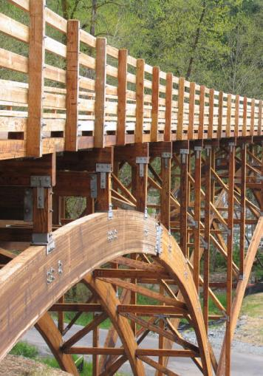
OVERVIEW OF TOPICS
Reference Materials
Wood Materials
Bridge Systems and Sample Bridges
Durability Considerations
Design Example
Notes:
We will be covering the following topics for our discussion on Wood Bridge Design
Required and recommended reference materials
Different wood materials available
Different bridge systems and an overview of some existing wood bridges
Durability considerations for wood bridges
A design example of a glulam deck on glulam girder beams with connection design
Photo: Lower Burnett Road Bridge, Washington
(Photograph courtesy of Western Wood Structures Inc. Tualatin, Oregon)

Slide 3
Reference Materials
Wood Highway Bridges (CWC)
Canadian Highway Bridge Design Code 2014 (Code canadien sur le calcul des ponts routiers)
CAN/CSA 086
Ontario Wood Bridge Reference Guide
Notes:
Required and recommended reference materials but not limited to

Slide 4

Reference Materials
1992 – Wood Highway Bridges (CWC)
Notes:
A handy reference regarding wood materials, wood bridge systems, and loading in Canada

Slide 5

Reference Materials
2014 – Canadian Highway Bridge Design Code
2014 - Code canadien sur le calcul des ponts routiers
Notes:
The design example presented in these slides was designed per the 2014 edition “CSA S6-14”, but the 2019 version “CSA S6-19” is now available.

Slide 6
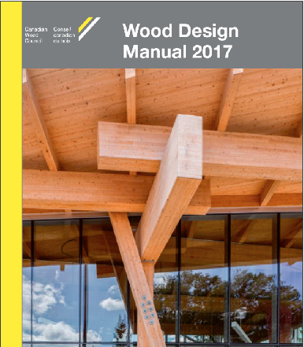
Reference Materials
2014 – CAN/CSA O86-14
Notes:
Connection design in wood : CHBDC references CAN/CSA O86 for design

Slide 7




Reference Materials
Notes:
Released in 2018. Paid for by the Ontario Ministry of Natural Resources and Forestry.
Promote the use of wood HIGHWAY bridges.
Get people thinking about wood again.
Contains two different bridge system design examples
Cover image: Mistissini Bridge over Uupaachikus Pass, Quebec (Photograph courtesy of Stephane Groleau)

Slide 8
OVERVIEW OF TOPICS
Reference Materials
Wood Materials
Bridge Systems and Sample Bridges
Durability Considerations
Design Example
Notes:
There are many options for wood materials that can be used to construct wood bridges.
Lower Burnett Road Bridge, Washington
(Photograph courtesy of Western Wood Structures Inc. Tualatin, Oregon)

Slide 9
Wood Materials
Wood Materials
Solid Sawn
Glued-laminated timber (glulam)
Laminated veneer lumber (LVL)
Parallel Strand Lumber (PSL)
Composites
Notes:
Solid sawn members can be either dimensional lumber (sizes ranging from 38 mm x 89 mm to 89 mm x 286 mm) used for deck laminations, or heavy timbers (ranging from 140 mm x 140 mm to 191 mm x 191 mm) for girders or floors beams.
Glulam is typically made of dimensional lumber (38 mm thick) and glued together to form deep members that are more economical than using a large solid sawn lumber. Glulam is commonly used for stringers or girders, but can also be placed on its side to make a glulam deck or concrete-glulam composite deck. Glulam can also be curved and for standard glulam laminations they can be curved to a radius as small as 8.4 m
LVL is manufactured from veneers all oriented in one direction. LVL is commonly produced in 44 mm thick panels and cut into beams. LVL is approved for dry use only (i.e. for outdoor conditions it cannot be exposed and must be adequately protected). In wood bridge applications, LVL has been used for stressed T- or box-sections but must be carefully protected from moisture.
Parallel strand lumber is a structural composite lumber (SCL) developed in Canada. PSL is made from the same veneers as LVL, but the veneers are sliced into thin long strands (approximately 3 mm x 12 mm x 1000 mm long) prior to pressing. The strands are pressed together with a resin. PSL can be preservative treated but is normally covered by a protective wearing surface. PSL has been built into in T- or box-sections for bridges.
The most common composite material used for wood bridges is a concrete-wood laminated deck. The two materials are mechanically bonded to act as one member.

Slide 10
OVERVIEW OF TOPICS
Reference Materials
Wood Materials
Bridge Systems and Sample Bridges
Durability Considerations
Design Example
Notes:
A quick overview of different bridge systems and some existing wood bridges
For more detail refer to the Ontario Wood Bridge Reference Guide
Lower Burnett Road Bridge, Washington
(Photograph courtesy of Western Wood Structures Inc. Tualatin, Oregon)

Slide 11
Bridge Systems and Sample Bridges
Bridge Systems and Sample Bridges
Decks
Superstructures
Substructures
Notes:
The following slides focus on the various bridge systems used in wood bridges that pertain to decks, super structures and sub-structures.

Slide 12
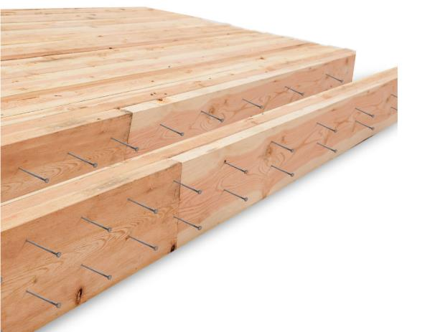
Bridge Systems and Sample Bridges
1992 – Wood Highway Bridges (CWC)
Notes:
Nail laminated deck
Longitudinal and transverse nail-laminated decks

Slide 13
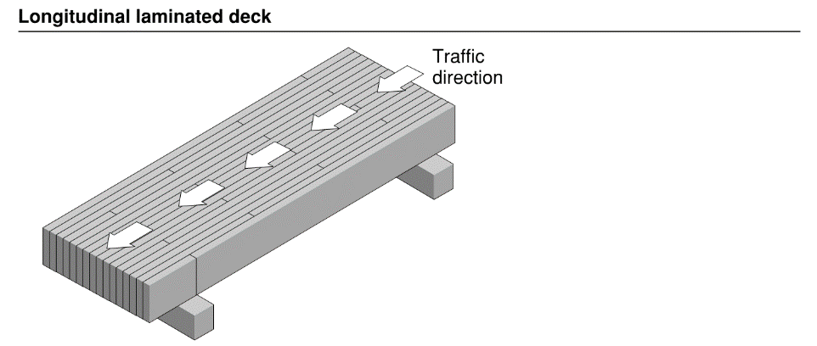
Bridge Systems and Sample Bridges
1992 – Wood Highway Bridges (CWC)
Notes:
Longitudinal nail-laminated decks span along the length of the bridge, in the direction of traffic flow and between supports.
Longitudinal nail-laminated (LNL) decks are built from dimensional lumber laid side-by-side and nailed together to form a wood deck (or slab). Wood laminations span in the same direction as the flow of traffic. Lumber used for the deck ranges from 38 to 89 mm in thickness by 89 to 286 mm in depth.
- The use of longitudinal nail-laminated decks in Canada is limited due to the common occurrence of deck delamination. Deck delamination can occur in LNL decks from some planks receiving more load than adjacent planks directly under wheel loads. These planks will deflect more under the higher concentrated load, causing the nails to bear more heavily and partially withdraw, effectively loosening the deck and delaminating the planks.

Slide 14
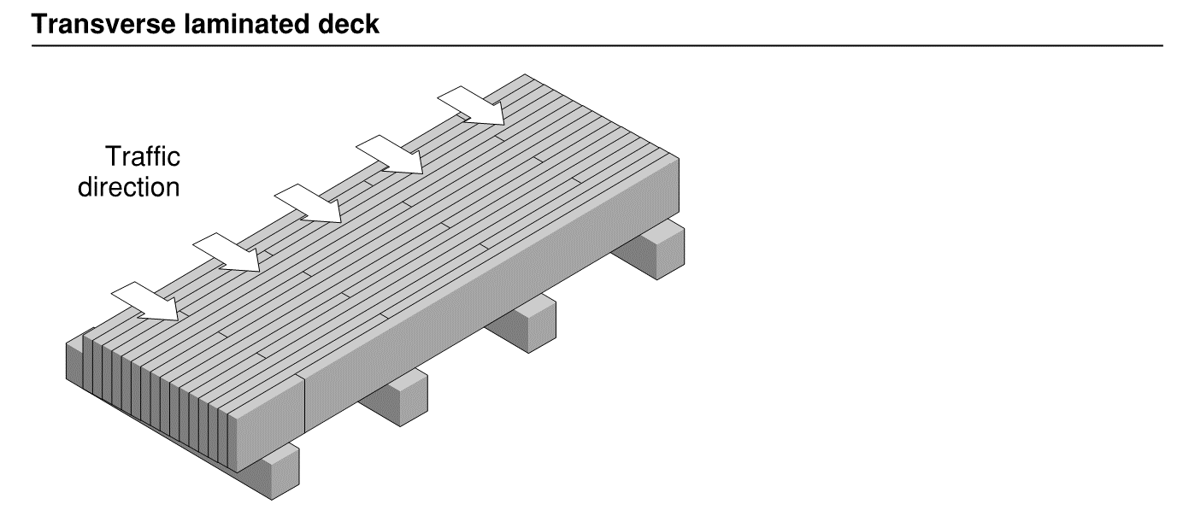
Bridge Systems and Sample Bridges
1992 – Wood Highway Bridges (CWC)
Notes:
- Transverse nail-laminated (TNL) decks are similar to longitudinal nail-laminated (LNL) decks but span across the width of the bridge. TNL decks are also built from dimensional lumber laid side-by-side and nailed together to form the wood deck (or slab). Wood laminations span perpendicular to the flow of traffic. TNL decks are more common than LNL decks since they are less susceptible to delamination. Unlike an LNL deck, the TNL deck requires support from girders or stringers.

Slide 15
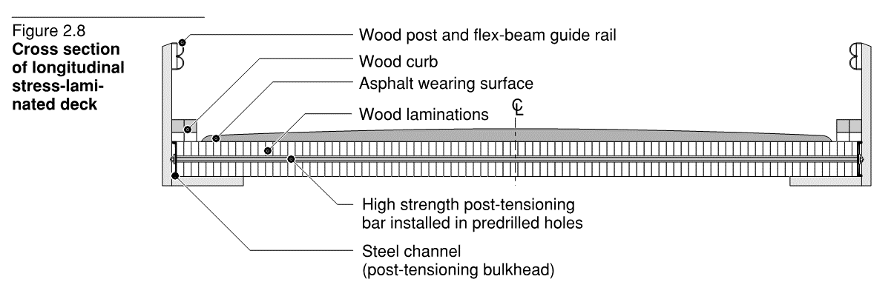
Bridge Systems and Sample Bridges
1992 – Wood Highway Bridges (CWC)
Notes:
Longitudinal stress-laminated (LSL) Decks
Longitudinal stress-laminated decks are built from dimensional lumber laid side-by-side and nailed together to form a wood deck. In addition to the nailing, post-tensioned steel bars are installed through the deck. The post-tensioning helps to reduces plank delamination and improves load sharing. Holes are pre-drilled through the wood planks and pressure treated after drilling for improved durability. LSL decks are more common than TSL decks (see next slide for TSL decks)

Slide 16
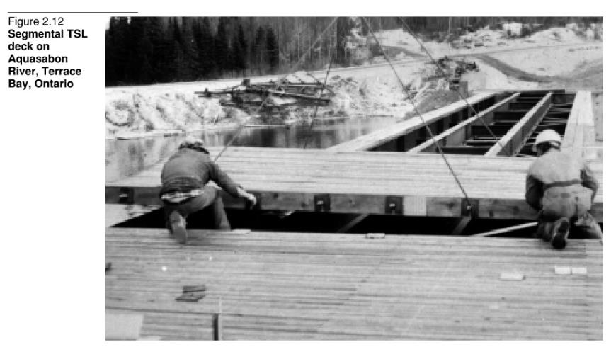
Bridge Systems and Sample Bridges
1992 – Wood Highway Bridges (CWC)
Notes:
Transverse stress-laminated (TSL) decks
- Transverse stress-laminated decks are built from dimensional lumber laid side-by-side and nailed together to form a wood deck. In addition to the nailing, post-tensioned steel bars are installed through the deck. Very few wood bridge decks use TSL decks. TSL is like the LSL deck, but the post-tensioning bars are positioned in the same direction as the flow of traffic. This is problematic as it means the anchorage point is located under the road (higher chances of contact with salt and water) and it is also difficult to access for re-tightening and maintenance of the bars.

Slide 17
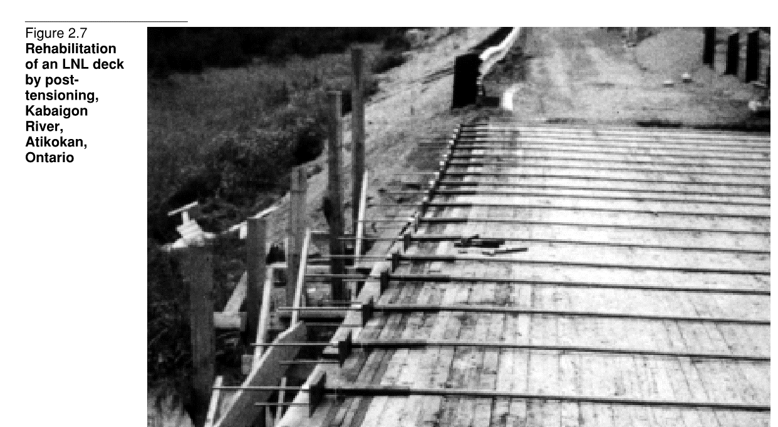
Bridge Systems and Sample Bridges
1992 – Wood Highway Bridges (CWC)
Notes:
Post-tensioning is a means to reduce nail delamination

Slide 18
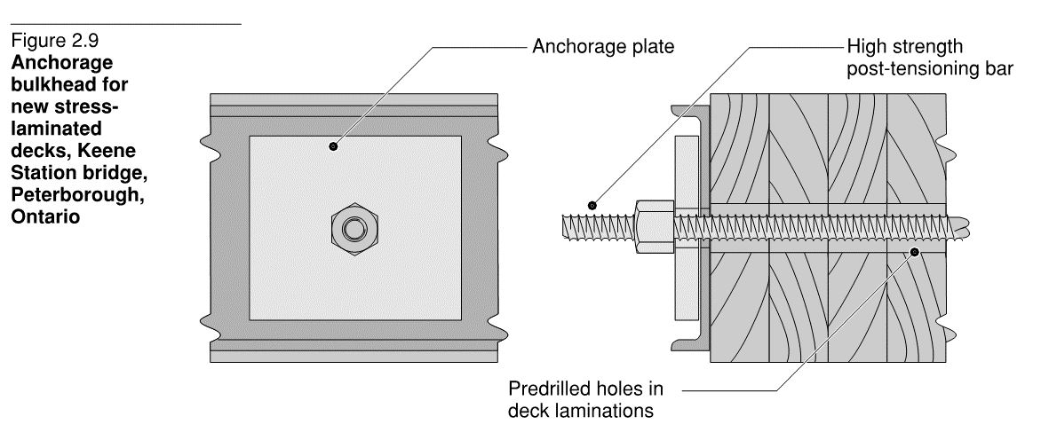
Bridge Systems and Sample Bridges
1992 – Wood Highway Bridges (CWC)
Notes:
Anchorage for stress laminated decks. CSA S6 provides a schedule for re-stressing the rods.

Slide 19
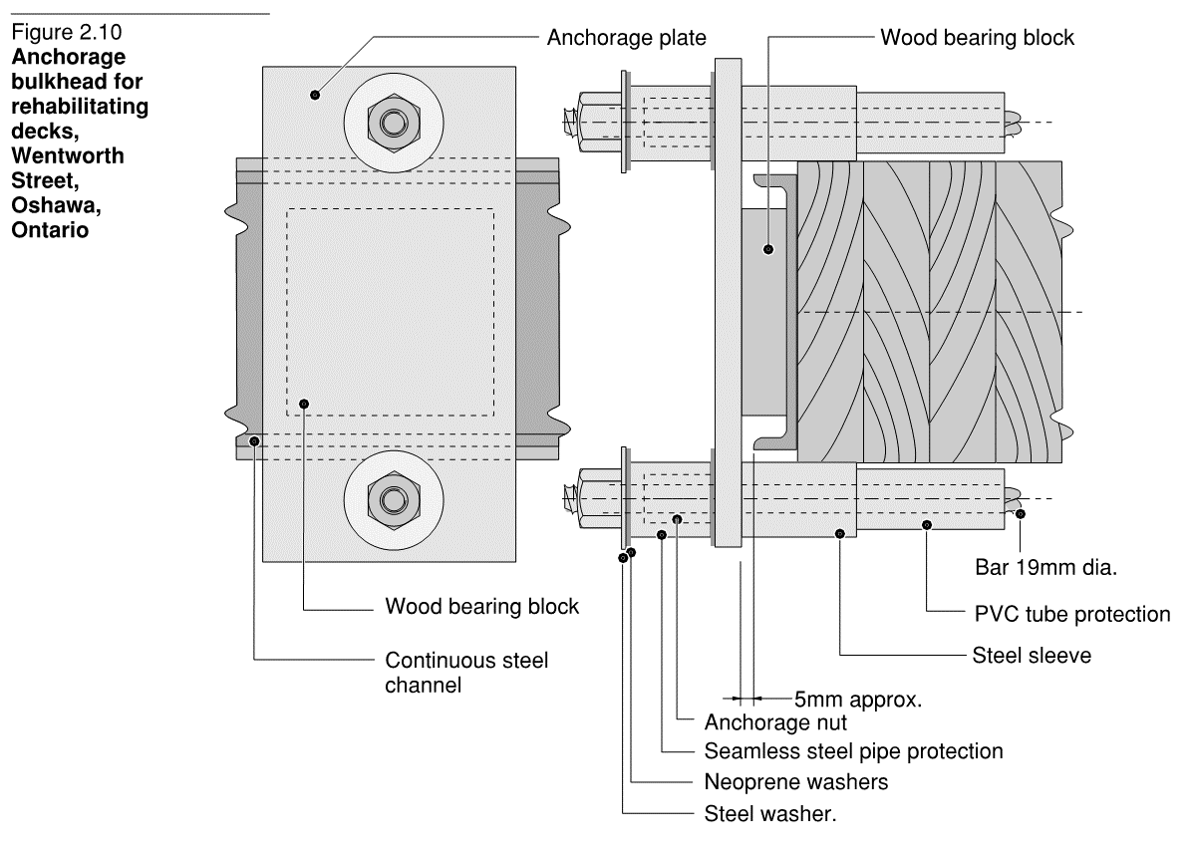
Bridge Systems and Sample Bridges
1992 – Wood Highway Bridges (CWC)
Notes:
- Anchorage detail for stressed laminated decks with bars above and below the deck. The top bar becomes embedded in the wearing surface.

Slide 20
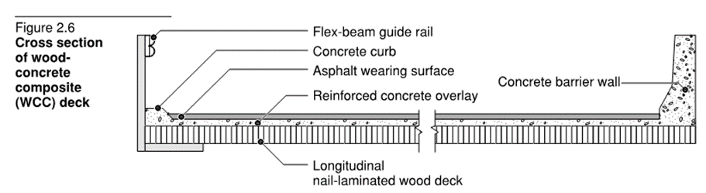
Bridge Systems and Sample Bridges
1992 – Wood Highway Bridges (CWC)
Notes:
Wood-concrete composite deck
- Wood-concrete composite decks are built from dimensional lumber laid side-by-side and nailed together to form a wood deck. The laminations can be either longitudinal or stress-laminated. The concrete is mechanically interlocked with the laminated wood deck using keyways to create a composite slab. The concrete provides a buffer between the vehicle wheels and wood planks, and provides better load distribution to the wood planks (significantly reducing the likelihood of plank delamination). While the wood laminations are not affected by road salts, the concrete portion is susceptible to salts and must be designed and protected appropriately. Detailing between the concrete and wood is also required to ensure that water does not get trapped between the two material interfaces.

Slide 21
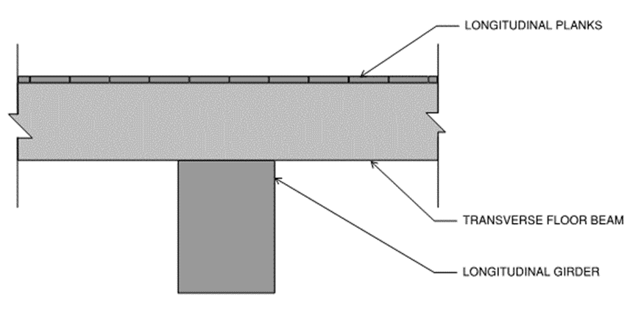
Bridge Systems and Sample Bridges
2017 – Ontario Wood Bridge Reference Guide
Notes:
Floor beam decks
- The most common form of construction for floor beam decks are solid sawn timbers. The system consists of a plank surface on heavy timbers oriented transversely and supported on longitudinal wood or steel girders. The decks are most commonly found on bridges in park and forest roads and municipal roads. Floor beam bridges can support heavy loads, but the planks may need replacing every few years. Typical floor beams are 184 x 184 mm or 200 x 250 mm (depending on girder spacing). Typical plank sizes are 64 x 184 mm and up to 100 x 250 mm.

Slide 22
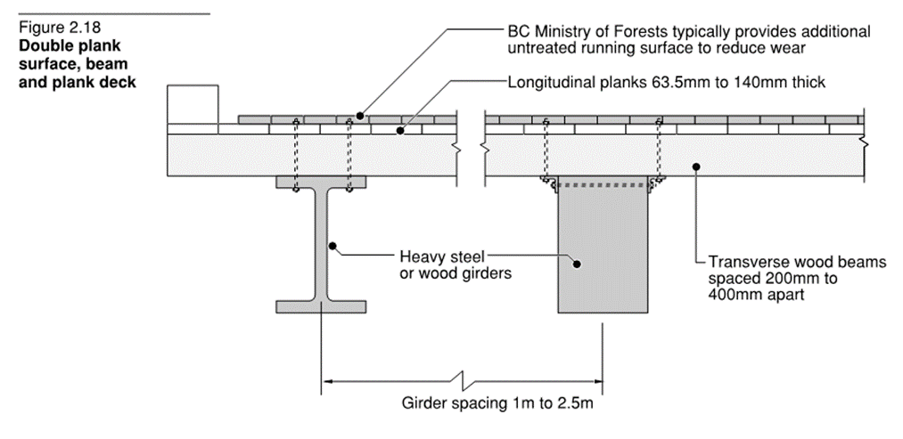
Bridge Systems and Sample Bridges
1992 – Wood Highway Bridges (CWC)
Notes:
Two-layer plank decks
- The most common form of construction of two-layer plank decks are solid sawn timbers. This system consists of two alternating layers of planks supported on floor beams. The two layers help to provide a more dimensionally stable deck and better load distribution

Slide 23
Bridge Systems and Sample Bridges
Bridge Systems and Sample Bridges
Decks
Superstructures
Substructures
Notes:
- On to the various superstructures in wood structures. These support the different decks mentioned earlier

Slide 24
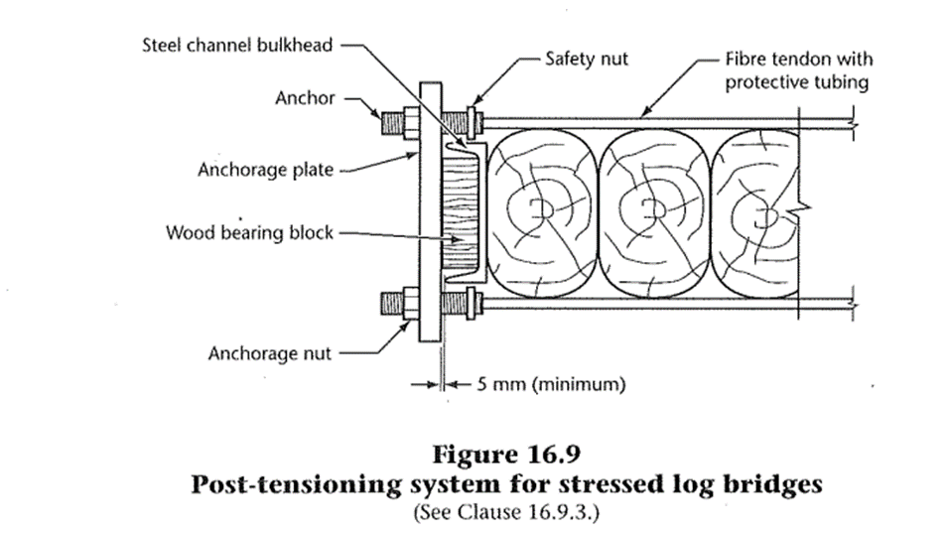
Bridge Systems and Sample Bridges
CAN/CSA S6-14 – CANDIAN HIGHWAY Bridge Design Code (CHBDC)
Notes:
Log beam and stressed log beam
Log beams – one of the oldest methods of forming a bridge span
modern log beam bridges are constructed by placing round logs alternating from base to top (i.e. if the base of the log is wider than the top, to keep a uniform width the base and tops are alternated) and binding them together with steel cables.
Stressed log bridges – became a solution for using discarded wood poles (can also be used for new poles)
The round logs are cut along two parallel faces to create a flat surface. They are pressed together against their flat faces and then are “tied” together with a post-tensioning system
- The post-tensioning is similar to stress laminated decks, but with fundamental differences. Stress laminated decks use nails to connect the laminations together, but this cannot be accomplished with stressed log bridges due to the large size of the logs. And logs have a higher likelihood of experiencing more prestress loss as the wood shrinks.
- A method to reduce the amount of prestress loss is to use a more flexible material than traditional prestressing steel. A solution is to use Aramid fibre which has a tensile capacity of about 1.25 times of prestressing steel yet only 40% of the modulus of elasticity of steel

Slide 25
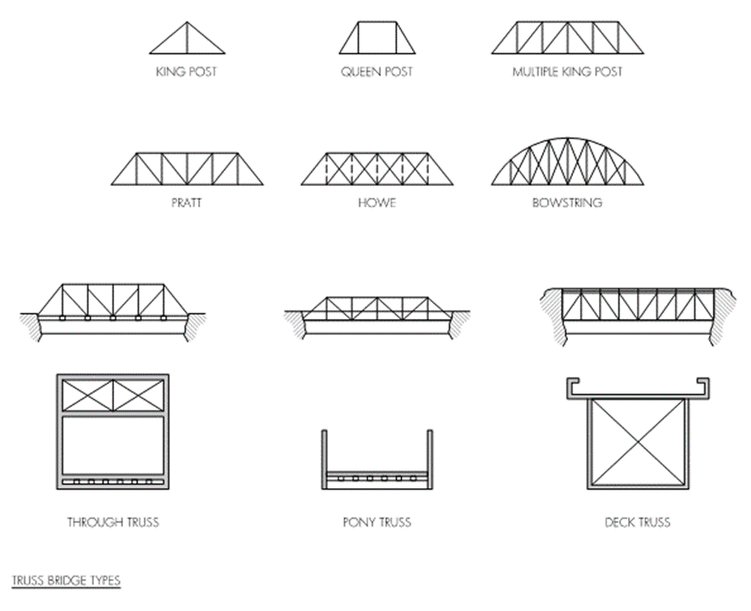
Bridge Systems and Sample Bridges
2017 – Ontario Wood Bridge Reference Guide
Notes:
Timber trusses, can achieve longer clear spans for timber bridges. Trusses can support the bridge deck at various elevations (e.g. top chord or through truss, bottom chord or deck truss, or somewhere in between – pony truss). Truss members using either glulam timber or solid sawn timbers can be built in a wide variety of styles

Slide 26
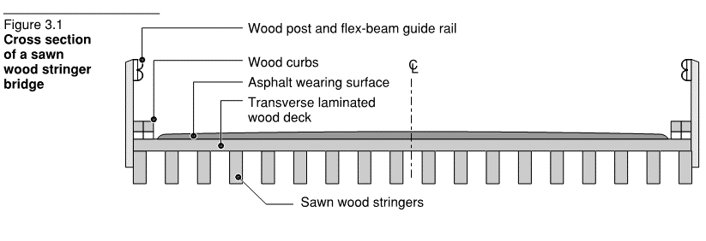
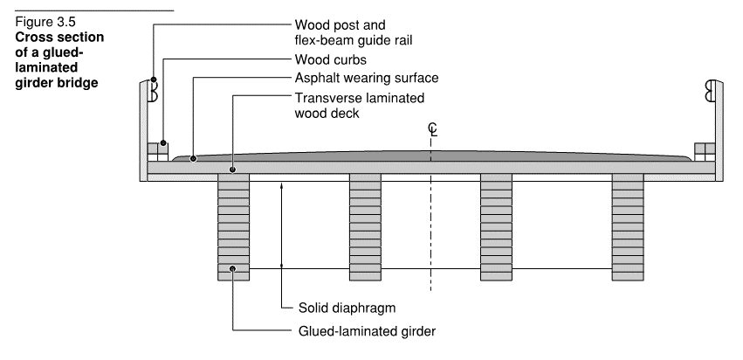
Bridge Systems and Sample Bridges
1992 – Wood Highway Bridges (CWC)
Notes:
Multi-beam Solid Sawn Stringer and Glulam Girders
Solid sawn timber stringers are available in up to 12 m lengths and are therefore typically used for simply-supported spans. Stringer spacing can reach up to 750 mm. The span of solid sawn timbers is limited by the availability of large timbers and capacity since allowable design stresses are reduced for large dimensional solid sawn timbers. Larger solid sawn members will also require adequate drying prior to installation.
Glulam timber girders offer a variety of much larger member sizes and are commonly used for spans between 10 m and 25 m (50 m spans have been reached). With proper treatment, glulam girders can provide a service life of over 50 years. During manufacturing, cambers can also be incorporated to help counter deflections from service loads and creep effects. Glulam girder spacing can reach up to 1.8 m

Slide 27
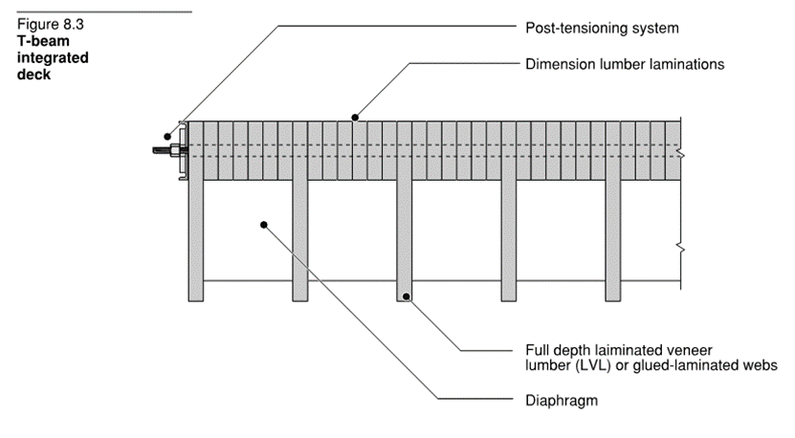
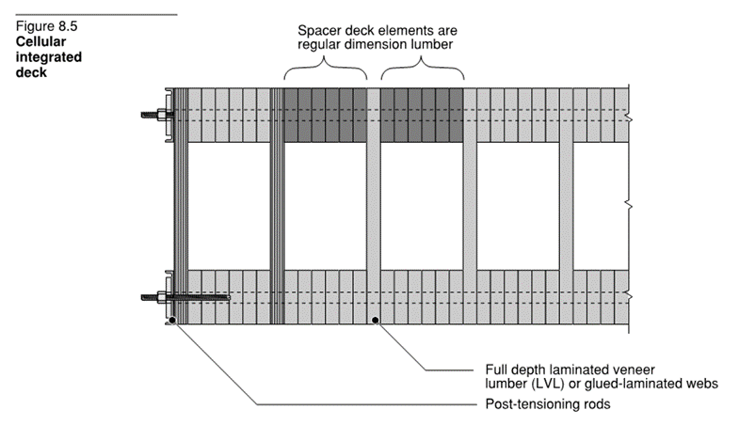
Bridge Systems and Sample Bridges
1992 – Wood Highway Bridges (CWC)
Notes:
Stressed T-and Box Sections
A stressed T-beam deck consists of a longitudinally stress laminated deck with a deep LVL laminates or glulam timber members spaced every six to eight deck lamination
A stressed box-section consists of an upper and lower longitudinally stress laminated deck with a deep LVL lamination or glulam member spaced every six to eight laminations, connecting the two decks
CAUTION – LVL is only approved for dry conditions

Slide 28
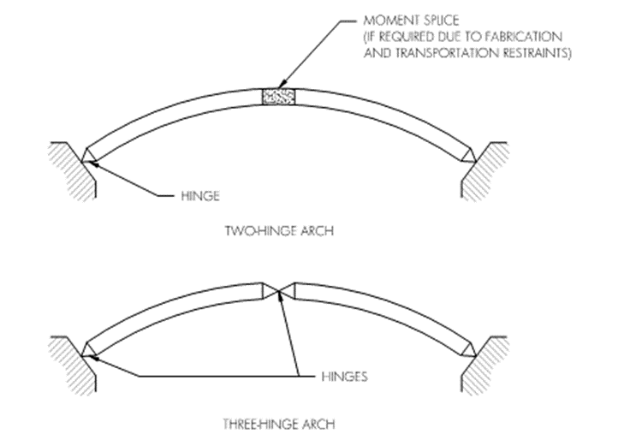
Bridge Systems and Sample Bridges
2017 – Ontario Wood Bridge Reference Guide
Notes:
Glulam arches can be used to achieve larger clear spans. Arches can support the bridge deck from below or by suspension using rods and transverse girders below the deck. The arch can either be two- or three-hinged.

Slide 29
Bridge Systems and Sample Bridges
Bridge Systems and Sample Bridges
Decks
Superstructures
Substructures
Notes:
-And finally the substructures

Slide 30
Bridge Systems and Sample Bridges
Bridge Systems and Sample Bridges
Abutments
  Most commonly made of concrete
  Timber can be used (must be pressure treated)
Bents
  For intermediate support between abutments
  Timber piles or frames
Notes:
One type of timber abutment is a pressure treated solid sawn or pressure treated glulam timber spread footing that is placed on the embankment. This can only be used in situations where the foundation is of high quality (low settlement, little erosion and scour)
Alternatively, post abutments, built from a series of posts (wood or other materials), support the superstructure and are connected to a spread footing and provide a backwall and wingwall for retaining the embankment.
Lastly, if soil conditions cannot support post abutments, then timber piles can be used.
Bents
For relatively short bents, timber piles can be used for the bent structure (the height is generally governed by the available length of the timber). Timber piles penetrate the soil.
For heights beyond those that can be achieved with timber piles, timber frames can be built. Frames can also incorporate braces to provide lateral stability. Timber frames can be supported on either footings or piles.

Slide 31
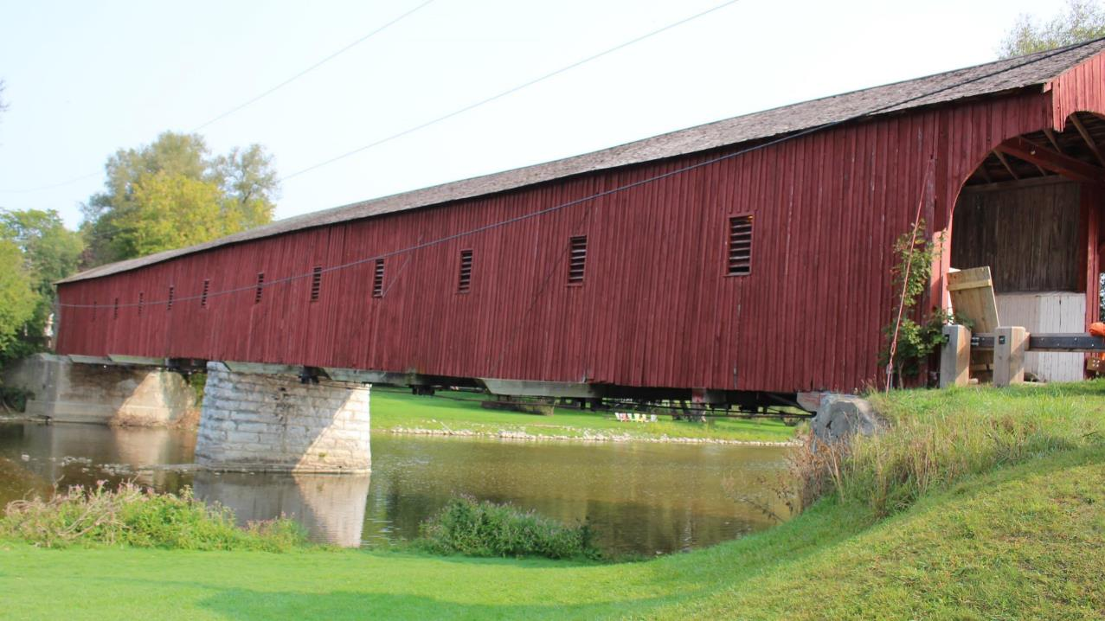
1880 West Montrose Bridge, Ontario
62 m total, hybrid Howe truss
Photograph: David Moses
Notes:
30 examples of bridges

Slide 32
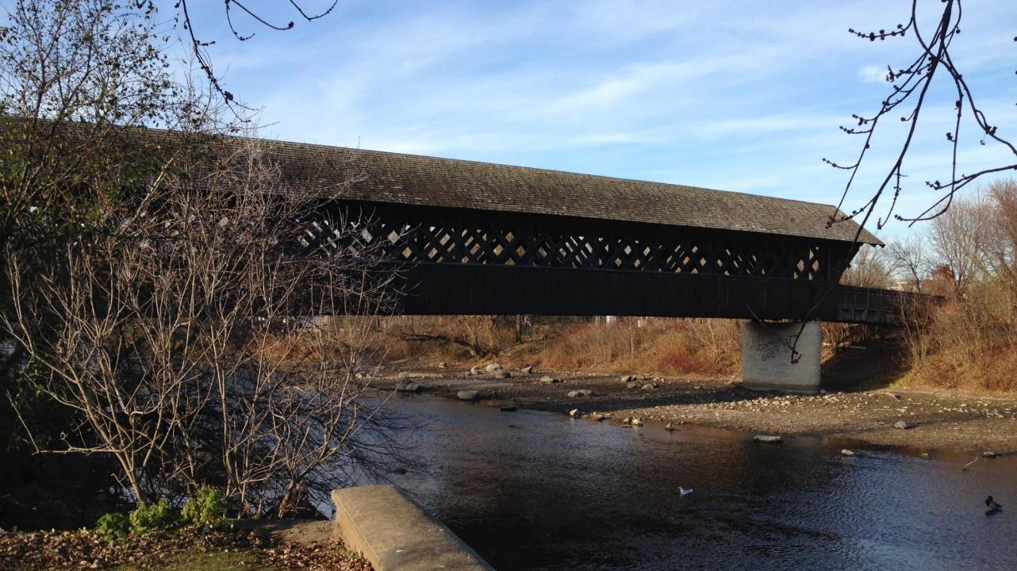
1992 Gordon Street Pedestrian Bridge, Guelph, Ontario
40 m, lattice trusses
Photograph: Eva Chau

Slide 33
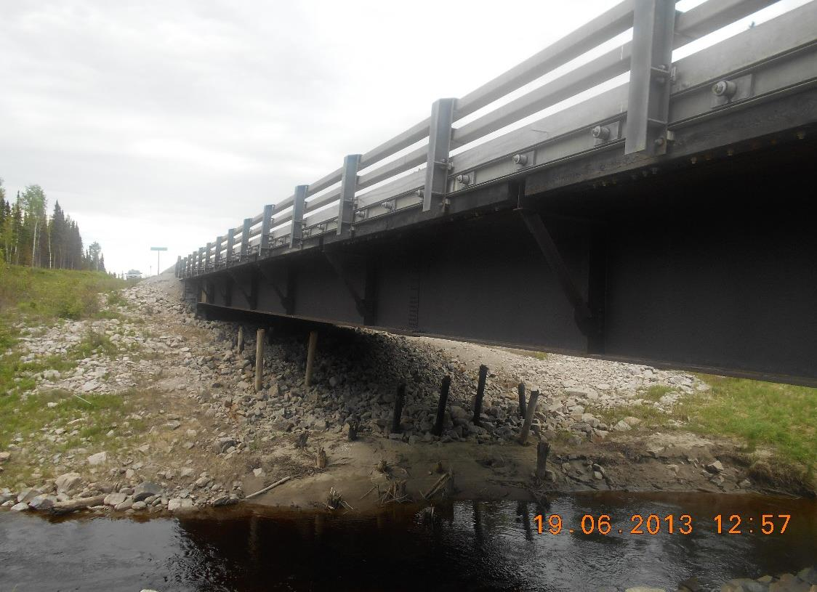
1993 North Pagwachuan River Bridge, Ontario
50 m steel girders, stress-lam.
Photograph courtesy of MTO
Notes:
The North Pagwachuan River Bridge is a single span bridge constructed in 1993 on Highway 17 in Northern Ontario (about 400 km from Thunder Bay). It is a longitudinally laminated timber deck (38 mm x 286 mm D.Fir) with transverse post tensioning. The deck is supported on steel girders, spanning approximately 50 m. This bridge was a prototype of a composite wood-steel bridge (Krisciunas). Concrete and steel bridge options would have been difficult to implement due to the remote location. All the wood was prefabricated and treated before arriving on site. The substructure is steel piles with timber lagging, due to poor soils and the need for an alternative to concrete (Krisciunas).

Slide 34
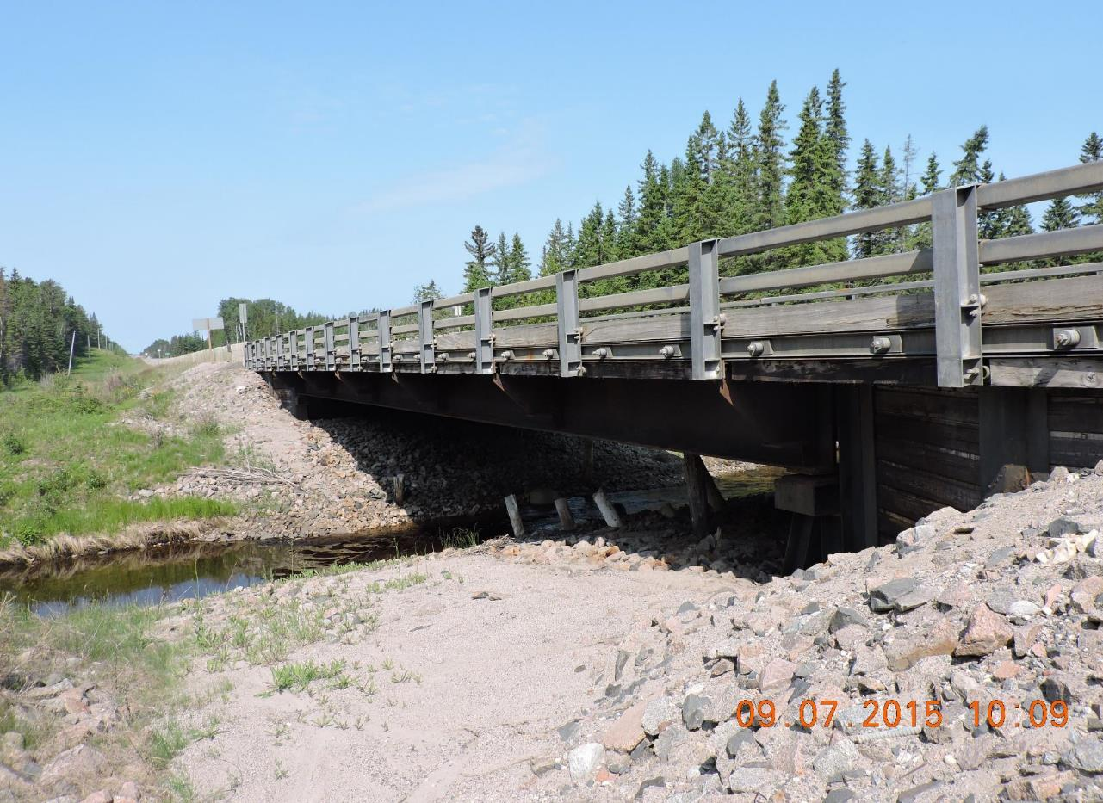
1994 Hoiles Creek Bridge, Ontario
30 m, steel girders, stress-lam.
Photograph courtesy of MTO
Notes:
The Hoiles Creek Bridge is a single span bridge constructed in 1994 on Highway 11 in Ontario. The deck is comprised of longitudinally laminated timbers with transverse post-tensioning. The deck is supported on steel girders. The system used is similar to the North Pagwachuan Bridge (described above). The bridge spans approximately 30 m.

Slide 35
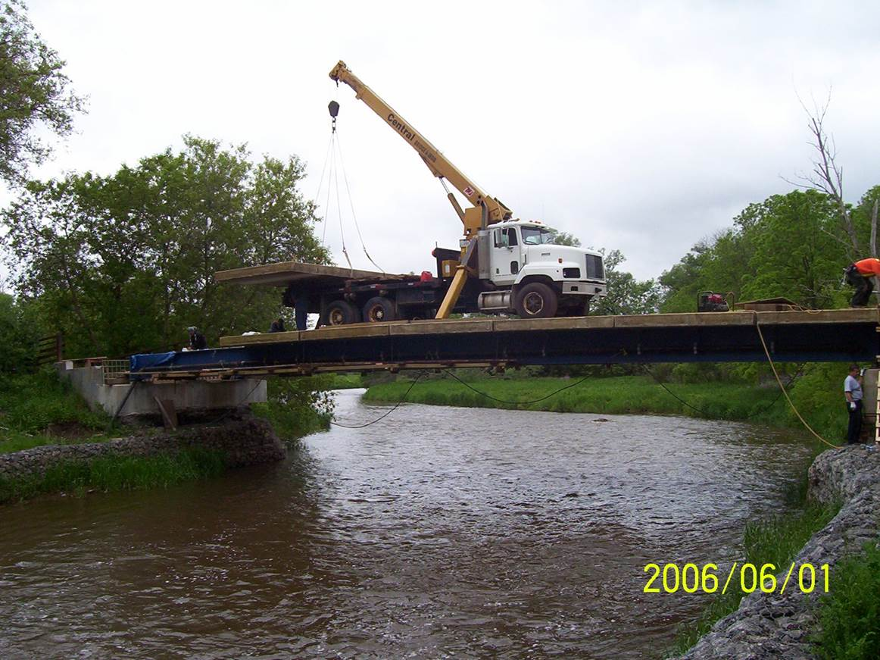
2006 Fibreglass Reinforced Wood Deck, Ontario
Photograph courtesy of Guardian Bridge Rapid Construction Inc.
Notes:
Timber bridge in Canada that used the Guardian Bridge technology. Guardian Bridge prefabricates a bridge that is externally reinforced with a fibreglass composite to improve durability, strength and erection time compared to similar style bridges and structural members. This technology can also be used for non-timber bridges with similar benefits. Although, typically used for retrofits or repairs for deteriorating bridges, this can be applied for new bridges as well.

Slide 36
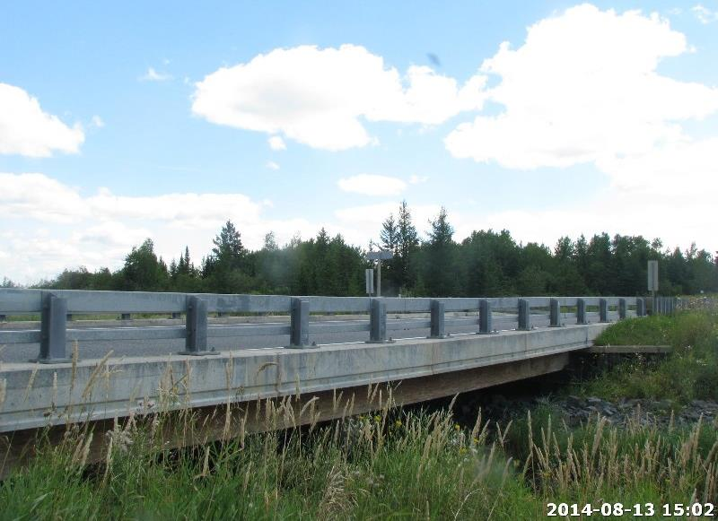
2008 Mather Creek Bridge, Ontario
23 m, PSL slab composite precast concrete deck
Photograph courtesy of MTO
Notes:
Mather Creek Bridge was constructed in 2008 along highway 71 in Ontario. The deck is a longitudinally laminated parallel strand lumber (PSL) slab with a composite precast concrete deck. The deck is supported on steel pile abutments. It spans approximately 23 m.

Slide 37
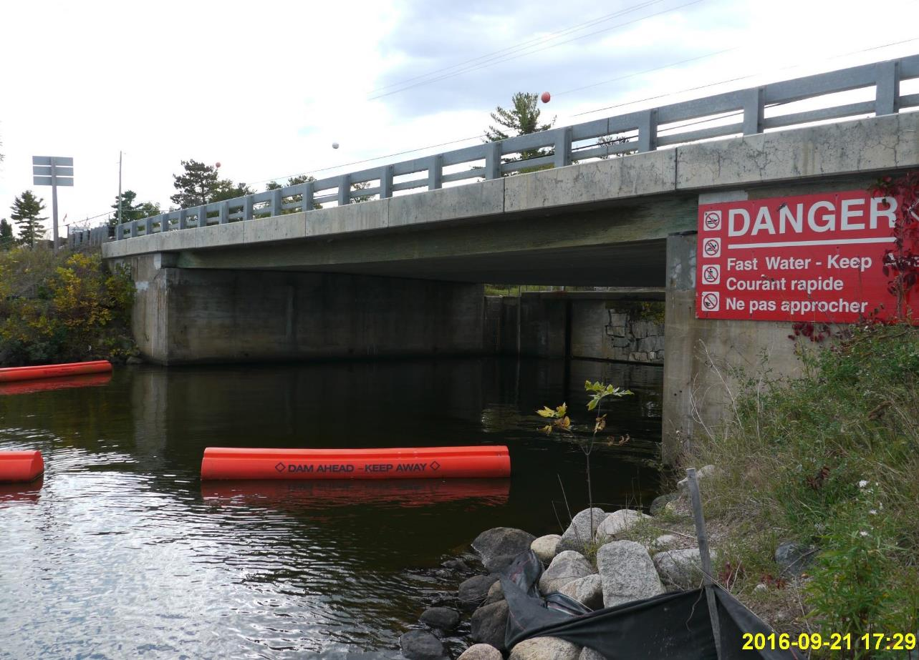
2009 Nestor Falls Bridge, Ontario
16 m, PSL with composite precast concrete deck
Photograph courtesy of MTO
Notes:
Nestor Falls Bridge was constructed in 2009 near Kenora, Ontario. The deck is a longitudinally laminated PSL slab with a composite precast concrete deck. The bridge is a single span of approximately 15.7 m.

Slide 38
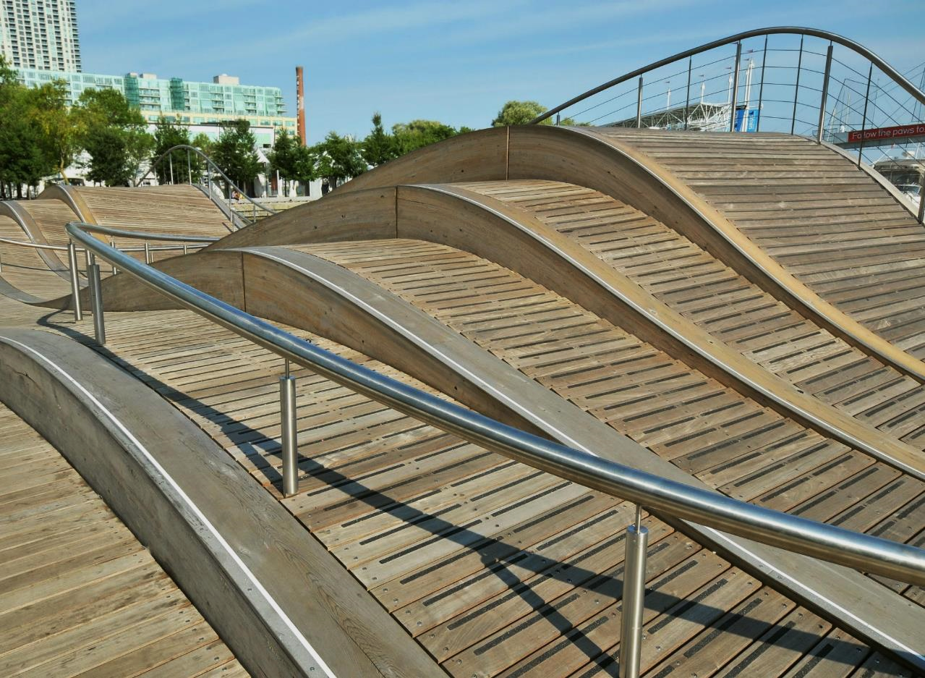
2009 Waterfront Wave Decks, Toronto, Ontario
Photograph courtesy of Ontario WoodWORKS!

Slide 39
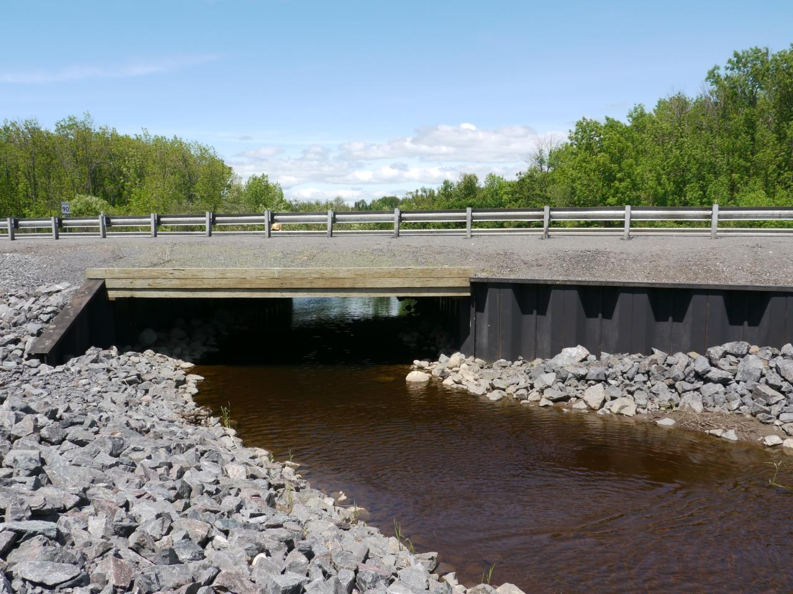
2012 Pennock Creek Culvert, Ontario
8 m, laminated PSL on steel sheet pile abutments
Photograph courtesy of MTO
Notes:
Pennock Creek Culvert was constructed in 2012 along highway 17 in Ontario. The deck is a laminated PSL deck supported on steel sheet pile abutments. The bridge is a single span, spanning approximately 8 m.

Slide 40
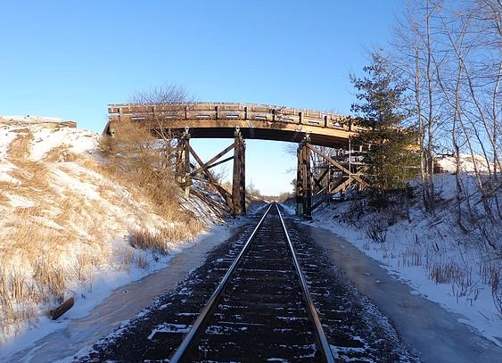
2013 Providence Road Bridge, Ontario
Glulam deck on glulam girders
Photograph courtesy of Timber Restoration Systems
Notes:
The Providence Road Bridge was replaced in 2013 due to deterioration and decay. It is a five-span vehicle overpass in Oshawa, Ontario. The original bridge was a transverse timber deck supported on 15 timber stringers (per span) that were supported on timber caps. The replacement bridge consists of a transverse glulam deck supported on curved glulam girders. The timber guard was also crash-tested. All of the timber components of the bridge were prefabricated and pressure treated and site installed.

Slide 41
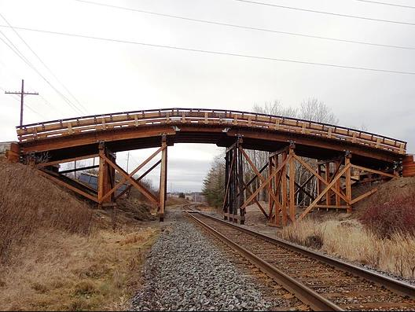
2013 Dickinson Road Bridge, Ontario
Glulam deck on glulam girders
Photograph courtesy of Timber Restoration Systems
Notes:
The Dickinson Road Bridge was replaced in 2013/2014 due to safety concerns in Port Hope, Ontario. It is a five-span vehicle overpass bridge supported on two abutments and six pile bents. The replaced bridge consists of a transverse glulam deck supported on curved glulam girders. Timber guards were crash-tested. All the timber components were prefabricated and pressure treated, then installed on site.

Slide 42
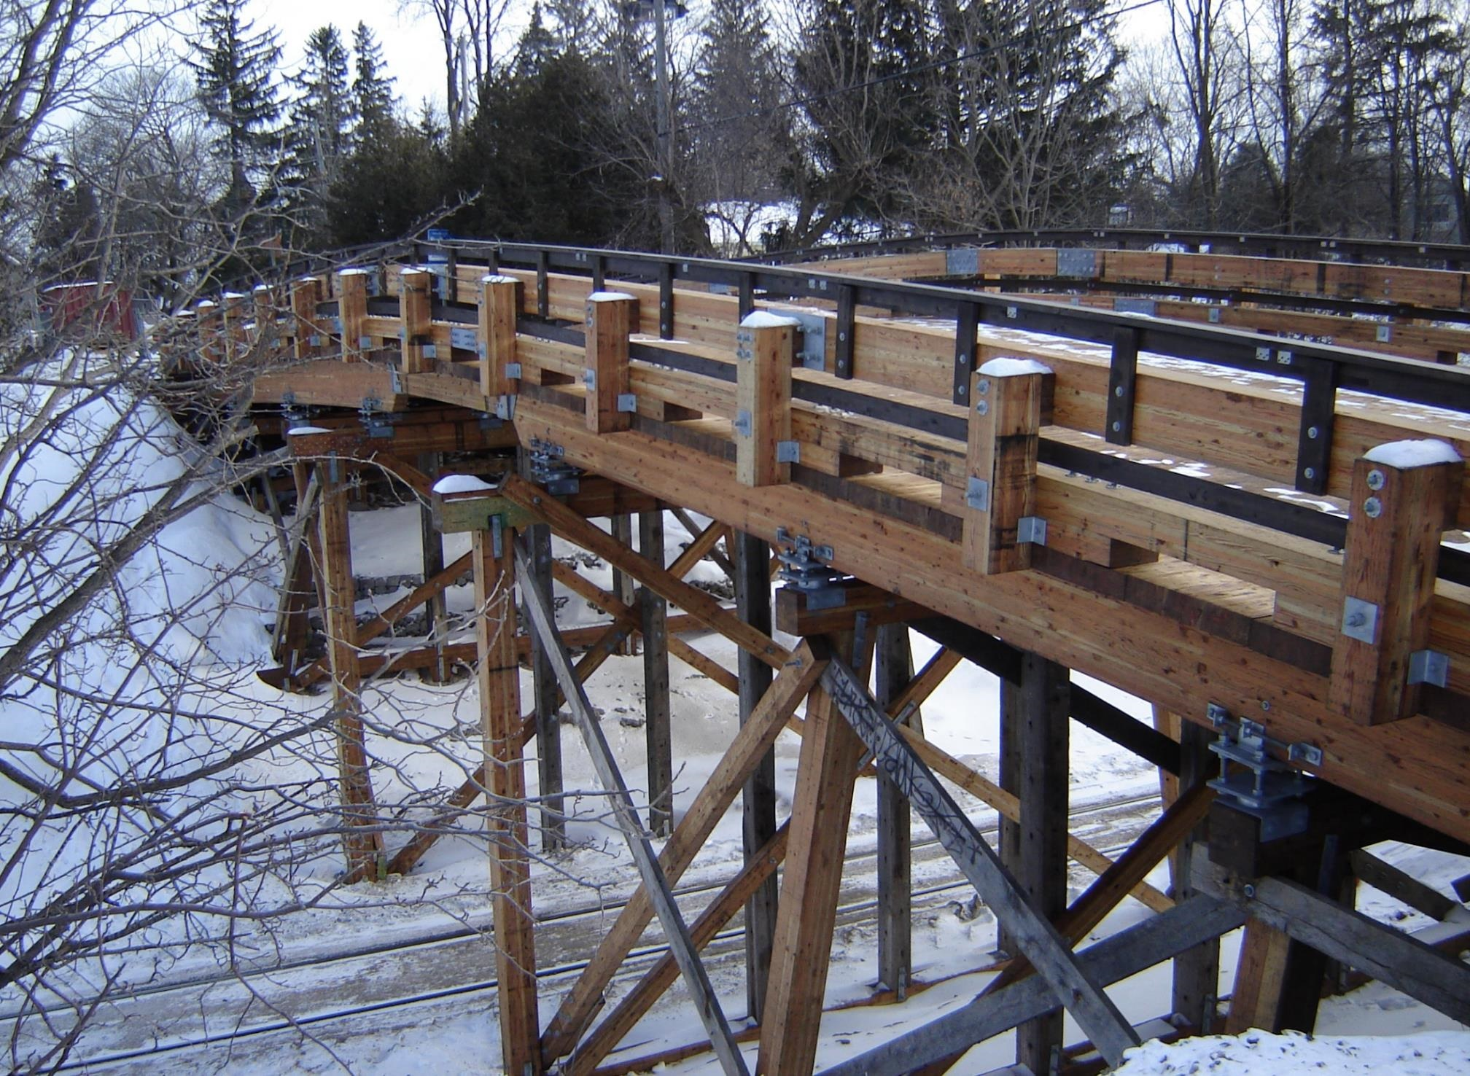
1912/2013 Snake Road Bridge, Ontario
Glulam deck on glulam girders
Photograph courtesy of Timber Restoration Systems
Notes:
The Snake Road Bridge was originally constructed in 1912 and was retrofitted and replaced in 2013/2014 due to inadequate support of the bridge (no frost protection that lead to decay of some on the sub piles). The bridge is a seven-span vehicle overpass between Hamilton and Burlington, Ontario. The replaced bridge is comprised of a transverse glulam deck supported on curved glulam girders. The timber guard rails were crash-tested. All wood components were prefabricated and pressure treated and then assembled on site.

Slide 43
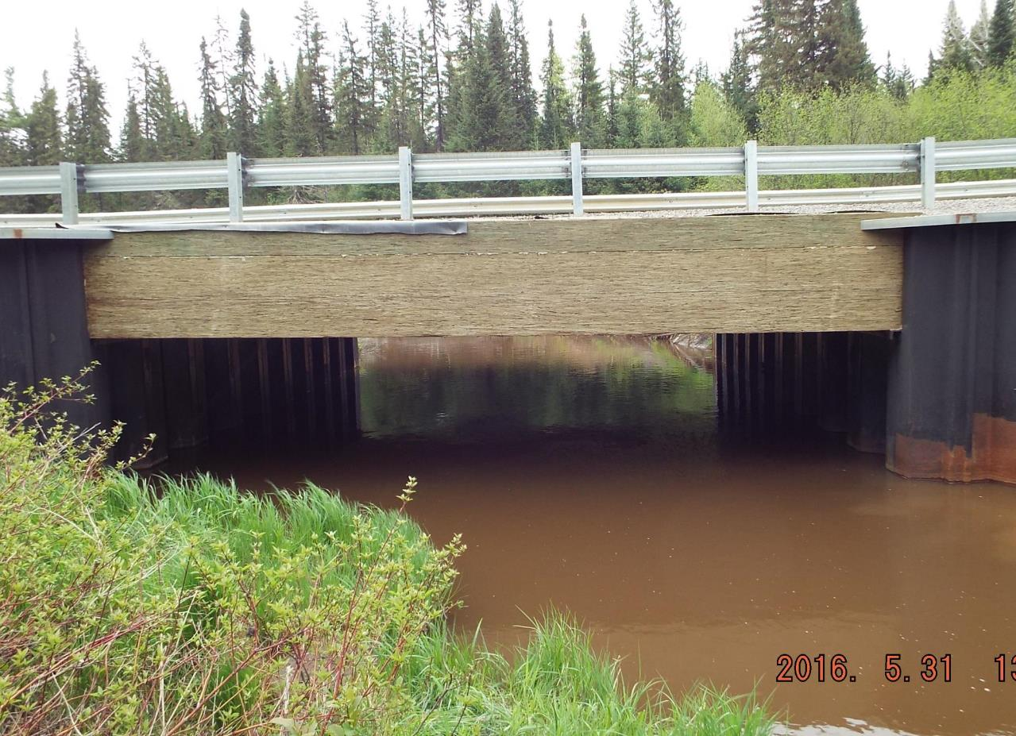
2014 Silver Falls Creek Bridge, Ontario
8 m, PSL slab on steel sheet piles
Photograph courtesy of MTO
Notes:
Silver Falls Creek Bridge was reconstructed in 2014/2015 in Ontario. The deck is a longitudinally laminated PSL slab that is supported by steel sheet pile abutments. The bridge is a single span, spanning approximately 8 m.

Slide 44

Mistissini Bridge over Uupaachikus Pass, Quebec
160 m (37-43 m spans)
Glulam deck on glulam girders
Photograph courtesy of Stephane Groleau
Notes:
The Mistissini Bridge is in Mistissini, Quebec. Due to the remote location of the project (about 600 km north-east of Quebec City) there was lenience to use local materials. Using glulam over a steel-concrete or steel-wood was found to be slightly less expensive, however, the “local” supplier provided wood from a sustainable forest. During the assessment of the design options, CO₂ emissions was one area of consideration. The designers found that the CO₂ emission from the proposed glulam bridge would be -497 tons, meaning these are avoided emissions. The steel-concrete bridge solution would result in net emissions of +969 tons of CO₂. The bridge spans 160 m with intermediate supports at 37 – 43 m. The glulam girders are spliced at connections to the glulam arches. The bridge is constructed with glulam panels 184 mm deep x 921 mm wide. The girders and arches are supported by concrete piers

Slide 45
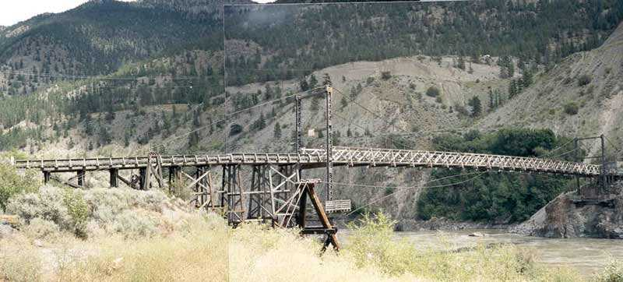
1946 Lillooet Bridge, Lillooet, BC
103 m, Steel truss retrofit, pedestrian only now
Photograph courtesy of BC Department of Highway Bridge Design
Notes:
The Lillooet suspension bridge was built in 1946 in British Columbia. It has since been transferred and serves as a pedestrian only bridge with a steel truss retrofit. The bridge consisted of a timber deck supported on timber singers. The suspension span was approximately 103 m and the timber bents supported up to 46 m on one end.

Slide 46
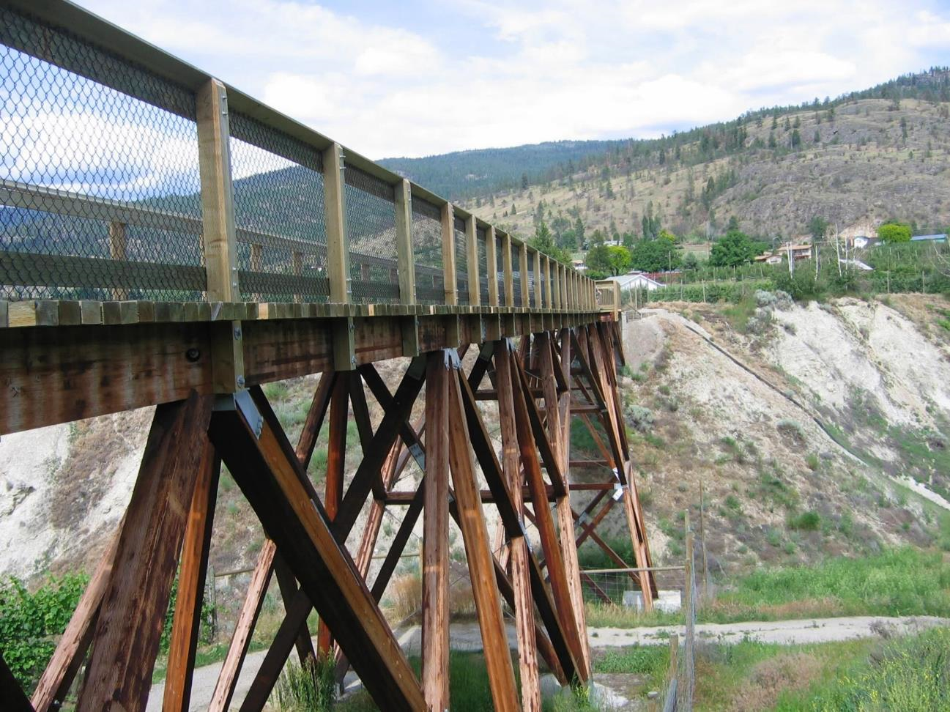
2003 McCulloch Trestle , Penticton, BC
Photograph: David Moses

Slide 47
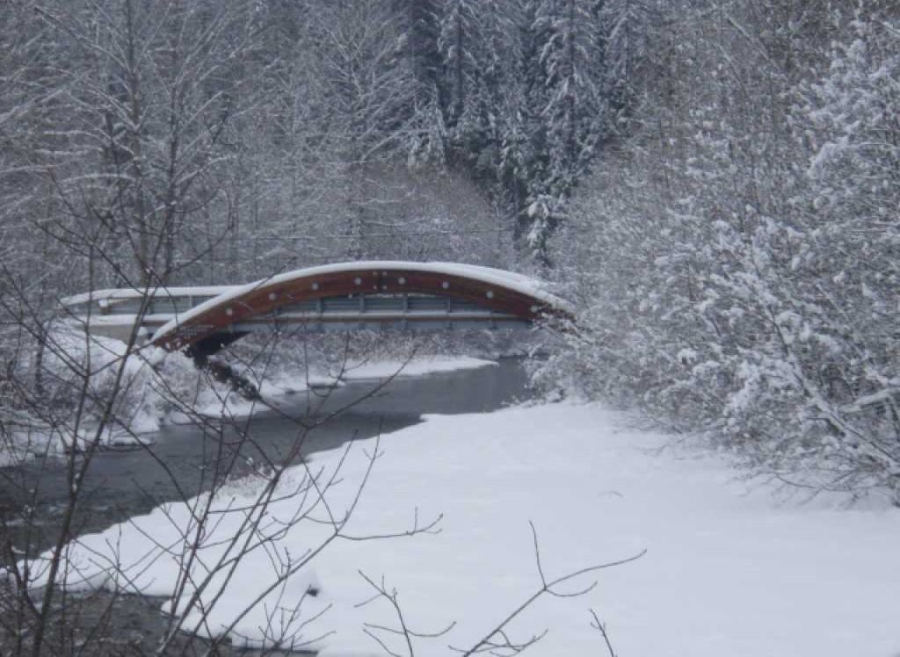
2010 Carney Mill Road Bridge, British Columbia
21 m, 3-pinned arch glulam, laminated deck on steel girders
Photograph courtesy of BC Department of Highway Bridge Design
Notes:
The Carny Mill Road Bridge was constructed in 2010 in British Columbia. It is a 3-pin glulam arch bridge and spans about 21.4 m. The deck is longitudinally laminated timber, supported on steel floor beams. The glulam components were treated with pentachlorophenol (Farden, 2010).

Slide 48
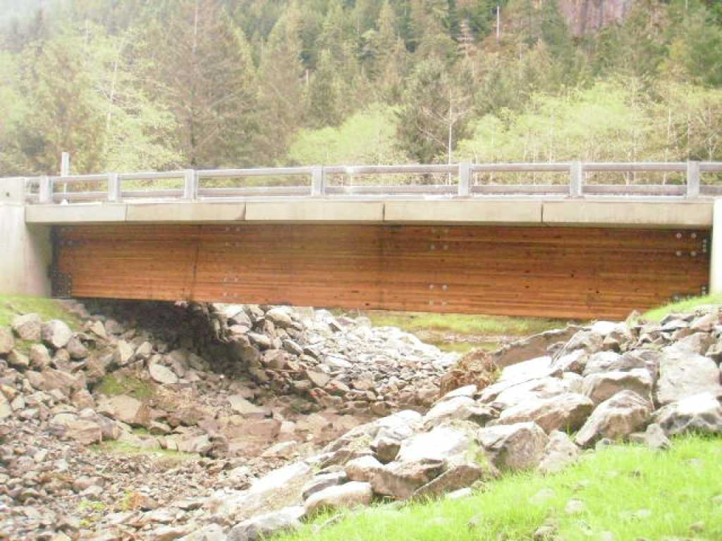
2010 Answer Creek Bridge, BC
Concrete deck on glulam girders (non-composite)
Photograph courtesy of BC Department of Highway Bridge Design
Notes:
The Answer Creek Bridge is on Vancouver Island, British Columbia. It is a non-composite concrete deck supported on glulam girders that were treated with pentachlorophenol (Farnden, 2010).

Slide 49
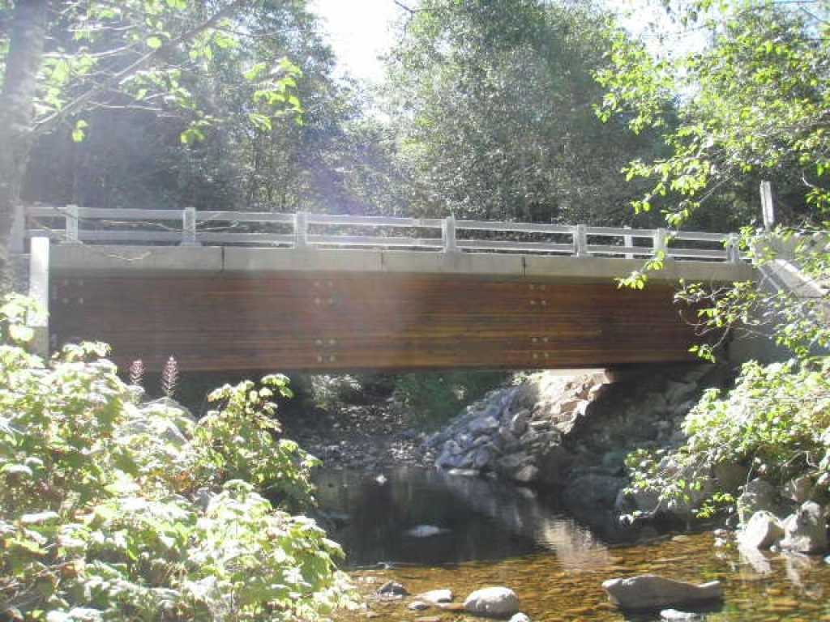
2010 Large Creek Bridge, BC
Concrete deck on glulam girders (non-composite)
Photograph courtesy of BC Department of Highway Bridge Design
Notes:
The Large Creek Bridge is on Vancouver Island, British Columbia, and is almost identical to the Answer Creek Bridge (described above). It is a non-composite concrete deck supported on glulam girders pressure treated with pentachlorophenol (Farnden, 2010).

Slide 50
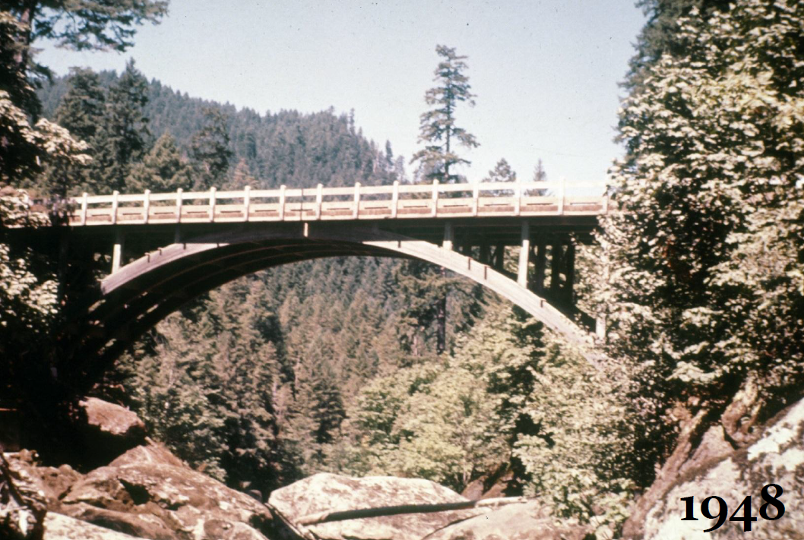
1948 – Loon Lake, Oregon (glulam)
Photograph courtesy of Mike Ritter
Notes:
Built 1947, Replaced 1967
100-foot glued-laminated timber deck arch with 114-feet of timber trestle approach spans.
Length of largest span: 100.0 ft.
Total length: 219.0 ft.
Deck width: 20.0 ft.

Slide 51
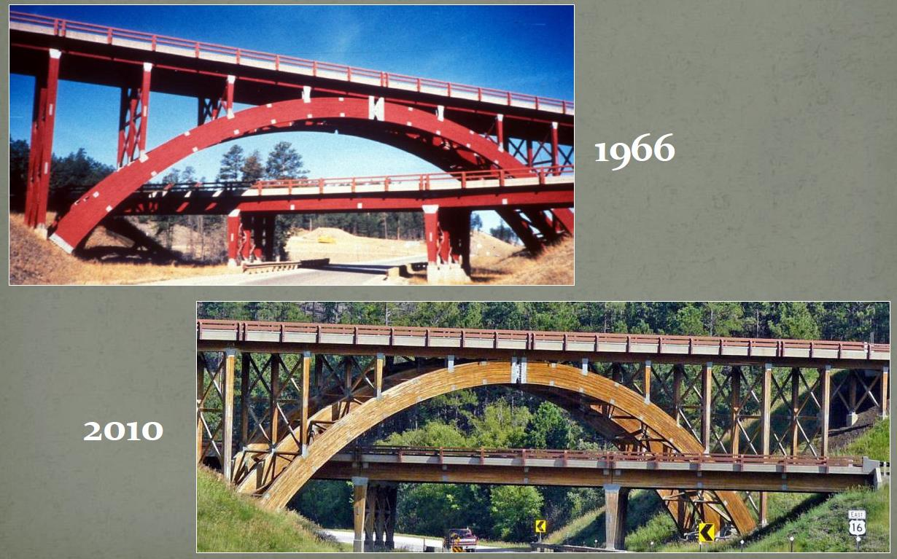
Keystone Wye Interchange, South Dakota (glulam)
Photograph courtesy of Mike Ritter
Notes:
two unique structural glued laminated timber bridges
three 20-meter (66 ft) wooden, single-hinged arches

Slide 52
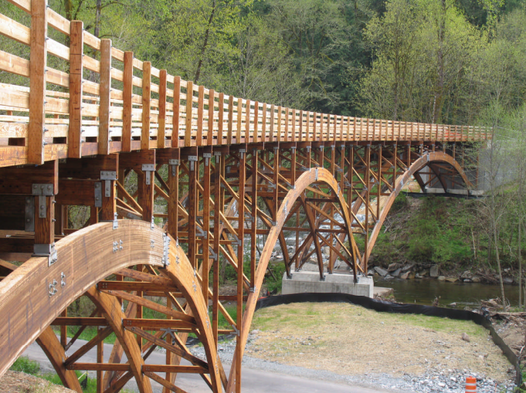
Lower Burnett Road Bridge, Washington
Glulam deck
Photograph courtesy of Western Wood Structures Inc. Tualatin, Oregon
Notes:
The Lower Burnett Road Bridge is a vehicle and pedestrian bridge in Buckley, Washington. This bridge is a curved glulam three arch bridge with a 198 m horizontal curve. The deck is a longitudinal glulam deck supported on timber bents that are supported by the main arches. The use of arches was chosen to reduce the number of piers to meet the AASHTO aesthetic guidelines and limit the exposure to scouring potential from the overflow of the South Prairie Creek. One challenging aspect was the 28 unique bents due to the horizontal curve which was overcome with the aid of prefabrication (Gilham, 2013).

Slide 53
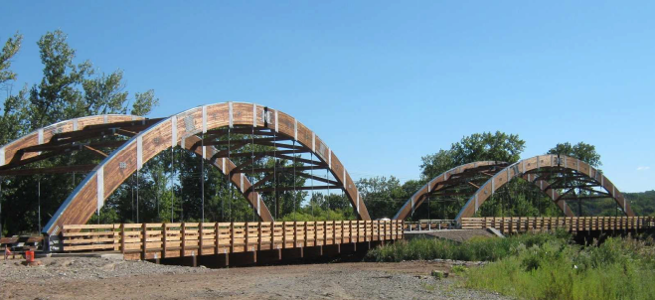
Overpeck Park Bridges, New Jersey
2 x 42 m spans, glulam deck with glulam arches
Photograph courtesy of Western Wood Structures Inc. Tualatin, Oregon
Notes:
The Overpeck Park Bridge in Bergen County, New Jersey is a vehicular bridge designed for AASHTO HS20 with a 25 percent overload (400 kN or 90,000 lb vehicle). The bridge consists of two identical three-pin glulam arches, each spanning approximately 42 m. The deck is a 223 mm thick longitudinal glulam supported on transverse and diagonal glulam braces. The braces are also used for lateral support of the arches. The arches are 362 mm x 1524 mm deep with a peak height of 9.6 m. Due to the size of the arches, the arches were designed with moment splices so reduce the arch segment sizes small enough to fit in a pressure-treating cylinder. (Gilham, 2013).

Slide 54
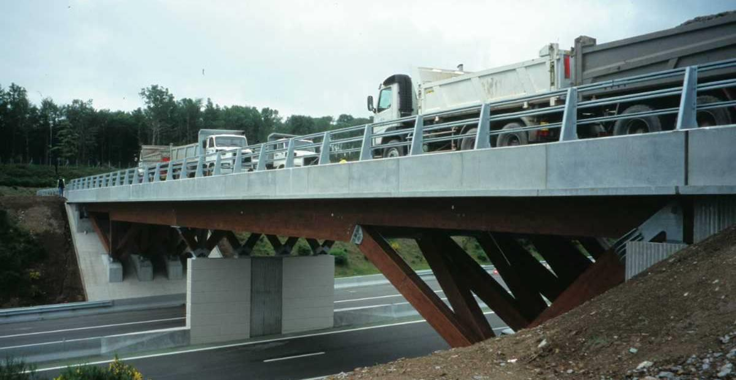
2001 Highway bridge on A89, France
Photograph courtesy of Arboresence SARL

Slide 55
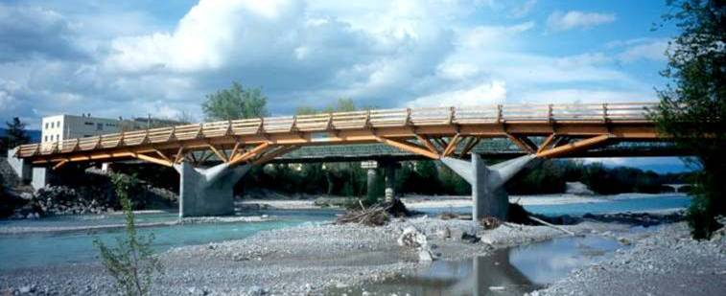
2001 Road bridge over the Crest River, France
Photograph courtesy of Arboresence SARL

Slide 56
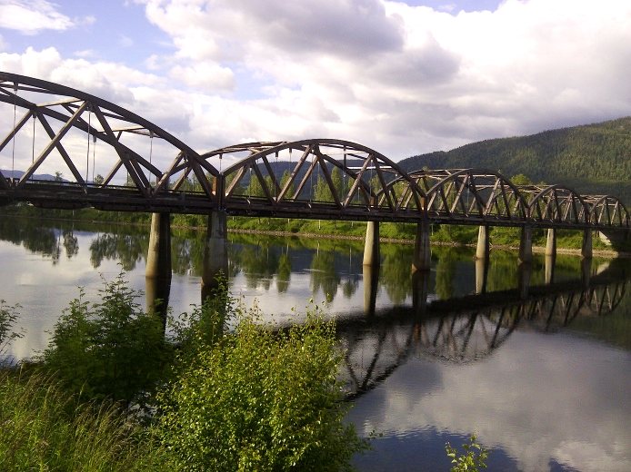
1996 Evenstad Bridge, Norway
5 x 36 m, glulam truss, stress-lam. glulam deck
Photograph courtesy of FPInnovations
Notes:
A Norwegian vehicular bridge constructed in 1996. It is an equal five span bridge with a total length of 180 m. Each span has a glulam arch truss and stress-laminated glulam deck supported on transverse steel beams. Both the deck and glulam arches were dual-treated with copper-based preservatives and then treated with creosote. The top and bottom chords, and diagonals of the glulam truss are covered in copper flashings.

Slide 57
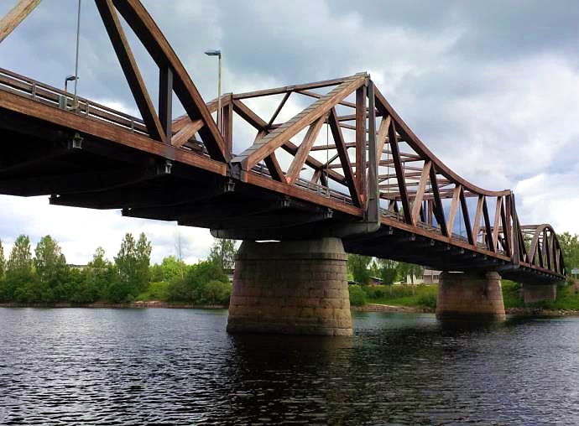
2003 Filsa Bridge, Norway
70 m max, glulam truss, stress-lam. glulam deck
Photograph courtesy of FPInnovations
Notes:
A Norwegian vehicular bridge constructed in 2003. It is a three-span bridge with the largest span being 70 m. The bridge is an arched glulam truss girder with a glulam stress laminated deck support on transverse steel beams. Both the glulam truss and deck were dual-treated with CCA and then creosote. In addition to treatment, the top and bottom chords are covered in a copper flashing.

Slide 58
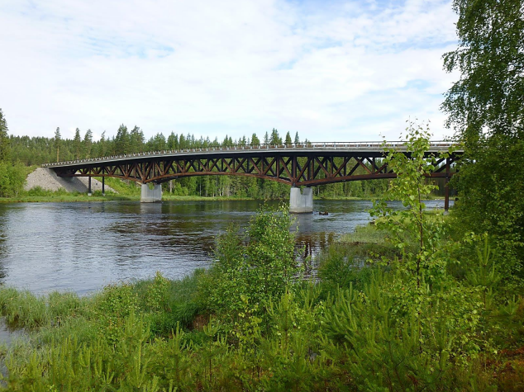
2005 Kjollsaeter Bridge, Norway
145 m (45 m max), 100 tons (>800 kN), glulam truss, conc deck
Photograph courtesy of FPInnovations
Notes:
A Norwegian military traffic bridge constructed in 2005/2006. The bridge has a maximum span of 45 m and a total length of 145 m. The bridge is designed for military vehicles of 100 tons (and is quite possibly one of the heaviest loaded timber bridges in the world). The bridge is a glulam truss girder supporting a reinforced concrete deck. All timber elements of the truss are dual-treated with a copper-based preservative and then treated with creosote.

Slide 59
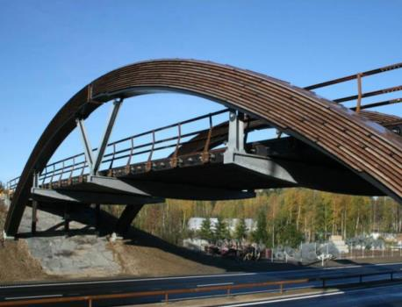
2007 Skogsrud Bridge, Norway
37 m, glulam arch with stress-lam. glulam deck
Photograph courtesy of FPInnovations
Notes:
A Norwegian vehicular bridge constructed in 2007 with a 37 m span and 49 m length. It is a three-pin glulam arch with stress laminated glulam deck, supported on transverse steel beams. The glulam arches are treated with a copper-based treatment and then coated in oil-based paint, the deck is treated with copper-based treatment and then impregnated with creosote. In addition to the wood treatments, the arches have metal flashings to protect against water infiltration.

Slide 60
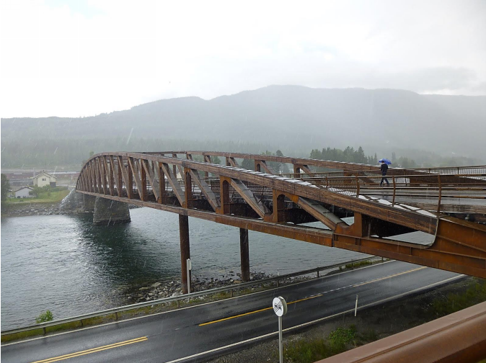
2012 Tretten Bridge, Norway
70 m longest span, glulam truss, stress-lam. glulam deck
Photograph courtesy of FPInnovations
Notes:
A Norwegian vehicular bridge constructed in 2012. It is a three-span bridge with the largest span of 70.2 m and total length of 148 m. The bridge is a glulam truss girder with a stress laminated glulam deck, supported on transverse steel beams. Both the girder truss and the deck are dual-treated with copper-based preservatives and then impregnated with creosote. In addition to the treatment, the top and bottom chords of the truss have a copper flashing to protect against water infiltration. The bridge is a replacement of an original steel bridge. The new glulam bridge was a lighter alternative, allowed reuse of the substructure and was delivered quickly to site.

Slide 61
OVERVIEW OF TOPICS
Reference Materials
Wood Materials
Bridge Systems and Sample Bridges
Durability Considerations
Design Example
Notes:
Lower Burnett Road Bridge, Washington
(Photograph courtesy of Western Wood Structures Inc. Tualatin, Oregon)
Moisture from rain and snow is one source of increased moisture content in timber components. Tree leaves and branches can also trap moisture against the timbers, which can lead to decay. Similarly, birds and other animals can leave droppings which can work in a similar way to trap moisture and promote decay.

Slide 62
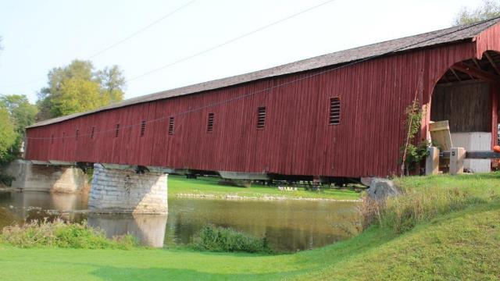
Durability Considerations
Durability Considerations
Protection by design
Preservative treatment
Replaceable elements
Notes:
-3 main areas of consideration to enhance the durability of wood bridges
-protection by design
-preservative treatment
-replaceable elements

Slide 63



Durability Considerations
Durability
Protection by design:
With a roof
Under a deck
Attention to snow accumulation
Notes:
Coverage provided by a roof or cantilevered deck
Pay attention to where snow will accumulate

Slide 64




Durability Considerations
Durability
Limit contact to water, allow drying, drainage
Orient connectors vertically to allow drainage
Do not expose end grain to water
Raise bases
Use metal flashings (correctly)
Notes:
More protection through design. It is all in the details

Slide 65
Durability Considerations
Durability
Detailing for durability is also very important
Position bearings on high pedestals above bearing seat
Detail to allow for air flow around members
Detail connections to minimize the potential for trapped moisture
Use metal flashings to protect critical components
All steel hot-dipped galvanized or stainless
Notes:
More on protection by design. It is all in the details!

Slide 66
Durability Considerations
Durability
Moisture content 26%-28% starts decay
Glulam manufactured to ≤15% moisture content
Moisture content for wood bridges in service measured between 15%-19%
Glulam members must be preservative treated
Oil-borne preservatives preferred over water-borne preservatives
Incising necessary to increase depth of penetration
All fabrication to be completed before treatment
Excess preservative to be avoided to prevent leaching and interaction with waterproofing/paving
Notes:
Preservative treatments shall be used for all wood elements used in bridge design for improved durability

Slide 67
OVERVIEW OF TOPICS
Reference Materials
Wood Materials
Bridge Systems and Sample Bridges
Durability Considerations
Design Example
Notes:
The design example is taken from the Ontario Wood Bridge Reference Guide
Photo: Lower Burnett Road Bridge, Washington
(Photograph courtesy of Western Wood Structures Inc. Tualatin, Oregon)

Slide 68
Design Example
Design Example
Design Considerations
Proposed Concept
Material Properties
Loading
Glulam Deck Panels
Glulam Girder Beams
Notes:
The following areas will be covered in the design example
- Design considerations
Proposed concept
Material properties
Loading
Glulam deck panels
Glulam girder beams
Stiffener beams
Glulam diaphragms
Connection design

Slide 69
Design Example
Design Example
Stiffener Beams
Glued-laminated timber diaphragms
Connection Design

Slide 70
Design Example
Design Considerations
Design Considerations
CHBDC
MTO Ontario Provincial Standard Specification (OPSS)
Ontario Hertiage Bridge Guidelines (OHBG)
Prefabrication
Prestressing
Service Life and Durability
Notes:
CAN/CSA S6 Canadian Highway Bridge Design Code (CHBDC) outlines the criteria for all bridges designed in Canada. CAN/CSA S6 is a code based on limit states design
The MTO Ontario Provincial Standard Specification (OPSS) is an 8-volume set of standards for roads and public works in Ontario. Design and construction of bridges in Ontario must meet the requirements of the OPSS and references CAN/CSA S6. Specifications related to materials and construction are listed in “Volume 1 – Municipal and Provincial Common General and Construction Specifications” in Section 907 “Construction Specification for Structural Wood Systems.”
The Ontario Heritage Bridge Guidelines (OHBG) provide direction for heritage road bridges owned by the province. OHBG does not govern over CHBDC however, Article 1.4.2.8 of the CHBDC states that the appearance of the finished structure must be considered with its surroundings. The OHBG also requires an environmental assessment be complete before any work is done on a heritage bridge.

Slide 71
Design Example
Design Considerations
CHBDC Relevant Sections
CAN/CSA S6 – Section 3 – Loads
  Dynamic load allowance 30% reduction for wood decks
  Shrinkage and swelling
CAN/CSA S6 – Section 5 – Methods of Analysis
  5.5.8 Transverse wood deck
  5.6 Simplified methods for longitudinal load effects
  5.7 Analysis of decks
Notes:
Highlights of CSA S6 sections most relevant to wood bridges (other sections are also relevant and must be considered where applicable)
Section 3 – Dynamic load allowance/shrinkage and swelling
Section 5 – Most clauses relate to simplified methods of analysis for longitudinal load effects e.g. 5.5.8 Transverse Wood Deck and 5.6 Simplified method of analysis for longitudinal load effects, 5.7 Analysis of decks

Slide 72
Design Example
Design Considerations
CHBDC Relevant Sections
CAN/CSA S6 – Section 9 – Wood Structures
  Clause 9.4 Limit States Design
  Clause 9.5 General Design
  Clause 9.6 Flexure
  Clause 9.7 Shear
  Clause 9.11 Solid Wood
  Clause 9.12 Glulam Timber
  Clause 9.15 Connections
  Clause 9.17 Durability
  Clause 9.21 Nail-laminated wood decks
Notes:
Clause 9.4 - No explicit Fatigue Limit State (FLS) requirements are given for wood. Only SLS and ULS provided for wood.
Clause 9.5 – Load-duration factor now matches CSA O86, Wet service condition factor now matches CSA O86 (doesn’t include fracture shear), treatment factor now matches CSA O86
Clause 9.6 – Slight difference between CSA O86/CSA S6 for glulam bending resistance
Clause 9.7 - Designers should be aware that the formulas for shear in Clause 9.7 of CAN/CSA S6 are provided in a different format than in CSA O86 Engineering Design in Wood.
Clause 9.11 - Specified strengths and moduli of elasticity for all recognized species groups and grades of solid wood are provided Note that values for fb and fc in Hem-Fir for beam and stringer grades are higher than values in CSA O86
Clause 9.12 - Designers should note that unlike solid sawn wood, and unlike CSA O86, no design values are provided for Hem-Fir species of glulam timber. Fv values do not match to CSA O86 nor do Spruce-Lodgepole Pine-Jack Pine 14t-E tension fc values
Clause 9.15 – (previously titled “Fastenings”) Designers should be aware that certain connections in wood are not permitted. Rivets, truss plates not allowed.
Clause 9.17 – Protection by design, preservative treatment, replaceable elements
Clause 9.21 - Clause 9.21.3 limits the use of nail-laminated decks to only those cases where a composite wood-concrete deck is used

Slide 73
Design Example
Design Considerations
CHBDC Relevant Sections
CAN/CSA S6 – Section 9 – Wood Structures
  Clause 9.22 Wood-concrete composite decks
  Clause 9.23 Stress-laminated wood decks
  Clause 9.24 Glued-laminated decks
Notes:
Clause 9.22 – nail-laminated wood decks longitudinally laminated acting compositely with a reinforced concrete overlay (not covered in this design example)
Clause 9.23 – design requirements for stress-laminated wood decks (not covered in this design example, but design example provided in the Ontario Wood Bridge Reference Guide)
Clause 9.24 – Glued-laminated decks NEW to CAN/CSA S6-19 – covered in the design example

Slide 74
Design Example
Design Considerations
CHBDC Relevant Sections
CAN/CSA S6 – Section 10 – Steel Structures
CAN/CSA S6 – Section 14 – Evaluation
CAN/CSA S6 – Section 15 – Rehabilitation and Repair
CAN/CSA S6 – Section 16 – Fibre-Reinforced Structures
CAN/CSA S6 – Section 17 – Aluminum Structures
Notes:
Section 10 – No requirements specific to timber bridges. Clause 10.10.1.3 notes that wood decks are not considered to provide lateral support to steel girders “unless the design and fastenings are designed for this purpose
Section 14 – Section 14 specifies requirements for the evaluation of existing wood bridges to assess the capacity for carrying a specified load.
Section 15 – For all types of bridge materials. Clause 15.8.1.2 notes that wood members may be strengthened with fibre-reinforced polymer in accordance with Section 16.
Section 16 – Stress-laminated wood decks may be fibre reinforced.
Section 17 – This section has no requirements that are specific to timber bridges. Clause 17.6.1(a) specifies that corrosion protection is required between aluminum and wood components.

Slide 75
Design Example
Proposed Concept
Design Example
Design Considerations
Proposed Concept
Material Properties
Loading
Glulam Deck Panels
Glulam Girder Beams
Notes:
Proposed concept comes from the first design example in the Ontario Wood Bridge Reference Guide and is described in the following slides.

Slide 76

Design Example
Proposed Concept
DESIGN EXAMPLE OVERVIEW
(Photograph courtesy of Laminated Concepts Inc.)
Glued-laminated timber (glulam) deck panels supported by glued-laminated timber girders
Notes:
Glulam timber deck panels supported by glulam girders.

Slide 77
Design Example
Proposed Concept
DESIGN EXAMPLE OVERVIEW
Design Codes:
  CAN/CSA-S6-19 Canadian Highway Bridge Design Code (CHBDC)
  CAN/CSA-O86-14 Engineering Design in Wood (O86)
  Other relevant technical literature
Superstructure design only
Notes:
Design in accordance with: Canadian Highway Bridge Design Code, the O86 Engineering Design in Wood Code
Example is for the superstructure design only. Many substructure types would be compatible with this bridge.
Example based on CAN/CSA-S6 2014 edition but considered the changes that were coming to the 2019 edition

Slide 78
DESIGN EXAMPLE OVERVIEW
Design Example
Proposed Concept
Glulam railing
Wearing surface
Glulam deck panel
Glulam girder
(Image courtesy of James Wacker)
Transverse glulam deck panels on glulam girders
Popular system in US, but rarely built in Canada
2019 CHBDC now addresses glulam deck panels
Notes:
This structural system using glulam deck panels has been popular in the United States for the past 40 years, but has rarely been built in Canada, likely because the Canadian Highway Bridge Design Code has not addressed glulam deck panels until the 2019 edition

Slide 79
THE PROPOSED CONCEPT
Design Example
Proposed Concept
Transverse glulam deck panels on glulam girders
18 m single span vehicular bridge
Notes:
18 m single span vehicular bridge crossing a creek. Span and design were chosen because many smaller span bridges in service fit into this category and are excellent candidates for using wood.

Slide 80
THE PROPOSED CONCEPT
Design Example
Proposed Concept
Geometric cross-section valid for undivided arterial road with 110 km/h speed limit (i.e. Trans-Canada Highway)
Shoulder width maintained across bridge
Notes:
- The highway geometric cross-section chosen for the design example is valid for an undivided arterial road with speed limit of 110 km/h. This describes the Trans-Canada Highway in many parts of the country.
- Wide shoulder widths have been included along the bridge to demonstrate that proceeding with a wood bridge does not have to compromise highway geometry.

Slide 81
THE PROPOSED CONCEPT
Design Example
Proposed Concept
Notes:
The bridge is assumed to have an asphalt wearing surface with 2% crossfall for drainage
Glulam barriers are designed to satisfy TL-4 crash-testing requirements

Slide 82
THE PROPOSED CONCEPT
Design Example
Proposed Concept
Notes:
Traverse glulam deck panels span across 12 glulam girders
Glulam stiffeners beams, running parallel to the girders, are used to limit differential deflections between adjacent deck panels by acting like an “external dowel”

Slide 83
GLULAM DECK PANELS
Design Example
Proposed Concept
Deck panels are essentially glulam beams turned on their sides
Interior panels typically ~1200 mm wide
Vary end panel widths to suit bridge length
Notes:
Glulam deck panels are similar to glulam beams turned on their sides, except that all the laminations in glulam deck panels have the same strength and stiffness (glulam beams use higher grade material in the outer lamination groups)
Interior deck panels are typically chosen to be about 1200 mm (or say 4 feet) in width
The width of the deck panel at each end of the bridge is chosen to suit the actual bridge length

Slide 84
GLULAM DECK PANELS
Design Example
Proposed Concept
Gap between adjacent panels necessary to accommodate swelling of panels in service
    Glulam manufactured to ≤15% moisture content
    Moisture content for wood bridges in service measured between 15%-19%
Proposed joint detail similar to expansion detail at ends of approaches slabs for steel and concrete bridges
Notes:
The in-service moisture content of glulam deck panels is expected to be 15-19%, which exceeds the maximum 15% moisture content that glulam members are fabricated to
The result is that the deck panels will swell in service, hence a small gap is provided between adjacent panels
One joint detail as shown in the example, is similar to the detail used at the end of approach slabs for steel and concrete bridges

Slide 85

GLULAM DECK PANELS
Design Example
Proposed Concept
(Photograph courtesy of Laminated Concepts Inc.)
Notes:
The deck panels are fastened to the girders using a cast aluminum alloy deck bracket

Slide 86
GLULAM DECK PANELS
Design Example
Proposed Concept
Notes:
- Each deck bracket is connected with a vertical thru-bolt from the deck panels.
- The bottom leg of each deck bracket is seated in a shallow slot that is routed into the side face of a glulam girder

Slide 87
GLULAM STIFFENER BEAMS
Design Example
Proposed Concept
Stiffener beams behave like external dowels
Limit relative deflections between adjacent deck panels
Slot holes in continuous stiffener beams to prevent development of restraint forces
Notes:
The glulam stiffener beams connect adjacent deck panels to limiting relative deflections between deck panels
Stiffener beams are thru-bolted to the underside of the deck panels
If a stiffener beam is continuous across more than one deck panel joint, then the bolt holes should be slotted to accommodate relative movements between the deck panels and the stiffener beam due to changes in moisture content in the perpendicular-to-grain direction

Slide 88
GLULAM GIRDERS
Design Example
Proposed Concept
Notes:
- The glulam girders are the primary vertical load-carrying system
- They are assumed to act non-compositely with the deck panels

Slide 89
GLULAM DIAPHRAGMS
Design Example
Proposed Concept
Brace girders against lateral-torsional buckling
Share lateral loads amongst girders
Notes:
Glulam diaphragms are positioned at discrete intervals to brace the girders against lateral-torsional buckling and to share lateral loads amongst the girders
The diaphragms are detailed to be as deep as possible
A gap of 25 mm is left between the diaphragms and stiffener beams to allow for air circulation (to allow the wood to stay dry)
The diaphragms are thru-bolted to the girders using threaded tie rods
Diaphragm glulam members are offset from one another by 300 mm in adjacent girder bays to avoid interference with the thru-bolt connections

Slide 90
BEARING ASSEMBLIES
Design Example
Proposed Concept
Transmit vertical loads to substructure and allow rotation of girders
Restrain longitudinal and transverse movements as necessary
Elevate girders above bearing seat
Notes:
The girders are supported by elastomeric bearing pads
The bearings transmit vertical loads to substructure and allow for rotation and translation of the girders
Steel angles and anchor bolts are used as side plates to restrain girder translations, as necessary
The bearing assemblies are positioned on concrete pedestals that raise the girders above the bearing seat. This helps to keep the girders dry and away from organic matter that could result in decay.

Slide 91
Design Example
Material Properties
Design Example
Design Considerations
Proposed Concept
Material Properties
Loading
Glulam Deck Panels
Glulam Girder Beams
Notes:
- An overview of the material properties for the wood elements

Slide 92
MATERIALS
Design Example
Material Properties
Spruce-Lodgepole Pine-Jack Pine glulam properties assumed for girders, diaphragms, and stiffener beams
20f-E glulam stress grade
2019 CHBDC will features these properties (not previously included)
f_{b} | = | 25.6 | MPa | bending moment (positive)
f_{b} | = | 19.2 | MPa | bending moment (negative)
f_{v} | = | 1.3 | MPa | longitudinal shear*
f_{c} | = | 25.2 | MPa | compression parallel to grain
f_{cb} | = | 25.2 | MPa | compression parallel to grain combined with bending
f_{cp} | = | 5.8 | MPa | compression perpendicular to grain
f_{tn} | = | 17.0 | MPa | tension at net section
f_{tg} | = | 12.7 | MPa | tension at gross section
f_{tp} | = | 0.51 | MPa | tension perpendicular to grain
E₅₀ | = | 10300 | MPa | 50th percentile modulus of elasticity
E₀₅ | = | 8960 | MPa | 5th percentile modulus of elasticity
* Longitudinal shear updated to match CSA S6-19
Notes:
Spruce-Lodgepole Pine-and Jack Pine glulam properties were assumed for the girders, diaphragms, and stiffener beams
A 20f-E glulam stress grade was assumed
Upcoming 2019 CHBDC anticipated properties were used in the design example
Original design example fv =1.75 MPa, this slide deck updated to match CSA S6-19 fv = 1.3 MPa

Slide 93
MATERIALS
Design Example
Material Properties
Service condition
  Wet service assumed for deck panels
  Semi-wet service assumed for girders, diaphragms, and stiffener beams
  Connections (always) designed for wet service
  2019 CHBDC now provides designers the opportunity to directly apply service condition factor instead of embedding it in the material properties
Treatment factor taken as unity
  Incising not considered to reduce strength unless laminations are thin
Notes:
Wet service condition was assumed for the deck panels
Semi-wet service condition was assumed for the girders, diaphragms, and stiffener beams
Connections were designed for wet service
The 2019 edition of the bridge code now requires designers to apply the service condition factor (previous editions embedded the service condition factor in the material properties)
The treatment factor was taken as unity for incised treatment because incising is not considered to reduce the strength of glulam laminations that are less than 38 mm in thickness

Slide 94
MATERIALS
Design Example
Material Properties
Deck panels designed as built-up system of No. 2 grade sawn lumber
S-P-F No. 2 grade structural joist and plank properties assumed per CHBDC Table 9.16
Better material properties could be obtained by specifying glulam layup
American glulam industry has numerous stress grades created specifically for glulam deck panels
f_{b} | = | 8.4 | MPa | bending moment
f_{v} | = | 1.2 | MPa | longitudinal shear*
f_{c} | = | 6.7 | MPa | compression parallel to grain
f_{cp} | = | 3.0 | MPa | compression perpendicular to grain
f_{t} | = | 3.9 | MPa | tension at net section
E₅₀ | = | 8500 | MPa | 50th percentile modulus of elasticity
E₀₅ | = | 5800 | MPa | 5th percentile modulus of elasticity
* Longitudinal shear updated to match CSA S6-19
Notes:
SPF No. 2 grade structural joist and plank properties were assumed for the glulam deck panels, as these panels were designed as a built-up system of No. 2 grade sawn lumber
Better material properties could be obtained by specifying the layup of laminations. For instance, the American glulam industry has stress grades created specifically for glulam deck panels.
Longitudinal shear updated in these slides to match CSA S6-19 original design fv=1.1 Mpa
Values shown have been multiplied with Ks (Table 9.2) and Kt (Table 9.6). Wet-service and incised pressure treatment has been assumed

Slide 95

MATERIALS
Design Example
Material Properties
Wood is orthotropic (i.e. distinct material properties in three orthogonal directions – longitudinal, radial, and tangential)
Obtain additional material properties (as necessary) for 3D computer structural analysis from the “Wood Handbook – Wood As An Engineering Material”
Elastic moduli, shear moduli, and Poisson’s ratios necessary for computer structural analysis
Tangential
Radial
Longitudinal
Notes:
Wood is orthotropic, i.e. material properties are different in three orthogonal directions: longitudinal, radial, and tangential
Elastic moduli, shear moduli, and poisson’s ratios are necessary with respect to those three directions for computer structural analysis that uses orthotropic material properties
These properties are not provided in the bridge code but can be approximated from the “Wood Handbook”, published by the United States Forest Products Lab. Free download from their website.

Slide 96
Design Example
Loading
Design Example
Design Considerations
Proposed Concept
Material Properties
Loading
Glulam Deck Panels
Stiffener beams
Notes:
Overview of loading assumptions

Slide 97
LOADS & IMPOSED DEFORMATIONS
Design Example
Loading
Self-Weight (γ_{wood} = 6.0 kN/m³)
Component | Width |  | Depth |  | Cross-Sectional Area |  | Linear Weight
deck panel ‘A’ | 1444 | mm | 215 | mm | 0.310 | m² | 1.86 | kN/m
deck panel ‘B’ | 1178 | mm | 215 | mm | 0.253 | m² | 1.52 | kN/m
stiffener beam | 215 | mm | 114 | mm | 0.025 | m² | 0.15 | kN/m
girder | 215 | mm | 1634 | mm | 0.351 | m² | 2.11 | kN/m
diaphragm | 130 | mm | 1406 | mm | 0.183 | m² | 1.10 | kN/m
Notes:
The self-weight for the glulam members was taken as 6 6 kN/m³ for SPF glulam (depends on species)
From this, the line loads for each component are:
1.86 kN/m in deck panel ‘A’
1.52 kN/m in deck panel ‘B’
0.15 kN/m for the stiffener beams
2.11 kN/m for the glulam girder beams
1.10 kN/m for the glulam diaphragms

Slide 98

LOADS & IMPOSED DEFORMATIONS
Design Example
Loading
Self-Weight (γ_{wood} = 6.0 kN/m³)
Superimposed Dead Load
  Wearing surface (γ_{asphalt} = 23.5 kN/m³)
    Asphalt varies from 185 mm at the crown to 50 mm thickness at the face of the timber railings (2% crossfall).
    With girder spacing at 1150 mm. The average thickness for either the two interior girders nearest the crown is
    $$t_{ws,int}=\frac{\left(185 mm−1150 mm ×0.02\right)+185 mm}{2}=\frac{162 mm+185 mm}{2}=174 mm$$
    The deck panel overhang is 730 mm and the timber railing curbs are 305 mm wide, thus the average asphalt thickness for either of the two exterior girders is
    $$t_{ws,ext}=\frac{\left(50 mm+\left[730 mm−305 mm+0.5×1150 mm\right] ×0.02\right)+50 mm}{2}×\frac{\left(730 mm+0.5×1150 mm−305 mm\right)}{730 mm+0.5×1150 mm}=\frac{70 mm+50 mm}{2}×0.77=46 mm$$
Notes:
The weight of the asphalt wearing surface is a superimposed dead load
Two asphalt thicknesses are used to design the interior and exterior girders.
Deck panels are designed by applying the actual thickness of asphalt as trapezoidal distributed load.

Slide 99
LOADS & IMPOSED DEFORMATIONS
Design Example
Loading
Self-Weight (γ_{wood} = 6.0 kN/m³)
Superimposed Dead Load
  Wearing surface (γ_{asphalt} = 23.5 kN/m³)
  Barriers (ω_{barrier} = 1.3 kN/m)
Notes:
The weight of the glulam barriers is a superimposed dead load
- The bridge barrier is a crash-tested TL-4 timber railing. This barrier has an unfactored linear weight of 1.3 kN/m. The frontal area for horizontal wind on the barrier is 0.635 m²/m. The centroid of the frontal area is 594 mm above the mid-depth of the glued-laminated deck. The frontal area of the barriers that overlaps with the horizontal projection of the deck has been neglected from these calculations. This frontal area is considered to belong to the deck. Calculations concerning the barrier weight and frontal area are not included in this design example.

Slide 100
LOADS & IMPOSED DEFORMATIONS
Design Example
Loading
Self-Weight (γ_{wood} = 6.0 kN/m³)
Superimposed Dead Load
  Wearing surface (γ_{asphalt} = 23.5 kN/m³)
  Barriers (ω_{barrier} = 1.3 kN/m)
Live Load
  Vertical CL-625-ONT loading
  Braking forces
Notes:
The design live load is CL-625-ONT loading, as defined in the bridge code
Both the truck load and lane load were considered, as were braking forces

Slide 101
Vertical CL-625-ONT Loading
Design Example
Loading
Figure 3.2.10 – CHBDC vertical live load (Source: Clause A3.4.1, Figure A3.4.1 CL-625-ONT Truck; Clause A3.4.1, Figure A3.4.2 CL-625-ONT Lane Load; Clause 3.8.3.2., Figure 3.2 CL-W Truck – Canadian Highway Bridge Design Code. © 2017 Canadian Standards Association)
Notes:
Per clause 3.8 of the CHBDC, the design of the bridge considers the vertical live load effects caused by each of the CL-625-ONT truck and the CL-625-ONT lane load. The CL-625-ONT truck is a five-axle truck of 18 m length, with a total weight of 625 kN. The CL-625-ONT lane load is a uniformly distributed load of 9 kN/m superimposed with 80% of the CL-625-ONT truck load.

Slide 102
DYNAMIC LOAD ALLOWANCE
Design Example
Loading
Dynamic Load Allowance
  Accounts for interaction between vehicles and structure
  Precludes dynamic analysis
  Allows designer to convert dynamic load effects to an equivalent static load
  Dependent on number of axles
  30% reduction for wood components!!!
    e.g. DLA for four axles = 1 + 0.25 x 70% = 1.175 (versus 1.25)
0.40
0.30
0.25
Notes:
Vertical live load effects were amplified by a dynamic load allowance to consider the effects of dynamic interaction between the design vehicle and the structure
A 30% reduction in dynamic load allowance is permitted for wood components due to the inherent damping characteristics of wood
Note that there is an error in the dynamic load allowance values reported on pages 100 and 160 of the design guide. The values on this slide are correct. Please update your guide accordingly.

Slide 103
BRAKING FORCE
Design Example
Loading
Apply 15% of wheel load laterally as braking force
Ignore CHBDC braking force component caused by lane load UDL
  Represents smaller vehicles braking elsewhere on structure
  Deck panels are narrow, so can be ignored
Multi-lane reduction factors not necessary
  Already built into formula
More research is necessary to validate this approach
Notes:
The braking force acting on a glulam deck panel was taken as 15% of a design truck vertical wheel load
A detailed description on the derivation of this percentage is provided in the text of the design example
The lane load UDL component of the braking force was ignored. This component represents smaller vehicles braking elsewhere on the structure
The application of multi-lane reduction factors is not necessary because they are already built into the derivation of the braking force
More research is necessary to validate the approach presented here, but we believe this approach to be a good approach in the interim

Slide 104

BRAKING FORCE
Design Example
Loading
The braking force is calculated as the sum of 180 kN plus 10% of the uniformly distributed portion of the lane for one design lane.
  Bridge span = 18.000 m
  Girders overhang the centre line of abutment bearings = 0.272 m
  Total deck length = 18.544
  Braking force is thus:
  $$F_{br}=180 kN+0.10×9\frac{kN}{m}×18.544 m=197 kN$$
The heaviest wheel load of the CL-625-ONT truck occurs at Axle 4 = 87.5 kN
  Max discrete wheel braking load is therefore:
  $$F_{br}=87.5 kN×\frac{180 kN}{2×625 kN}=87.5 kN×0.144=12.6 kN$$
Notes:
For a bridge with a continuous concrete deck slab, the braking force would normally be distributed along the entire bridge length, as the concrete slab acts as a large in-plane diaphragm. This application would be incorrect for the bridge in this design example because the deck panels do not abut, and therefore cannot share longitudinal loads. As a result, a single deck panel must resist all the braking forces applied to it (see previous slide notes).
Per commentary clause C3.8.6 of the CHBDC, the 180 kN portion of the lane load is intended to represent heavy braking by a design vehicle, while the 10% of the lane load UDL is intended to capture lighter traction forces due to other traffic on the bridge. The 180 kN represents approximately 25% of the gross vehicle weight of two design trucks braking in two lanes simultaneously. This force has been modified to account for the lesser probability of simultaneous braking of design vehicles in multiple lanes. The force has also been modified to account for the difference in live load factors between the CHBDC and former Ontario Highway Bridge Design Code, the latter having originally developed the braking load formula (CSA 2014b). In light of this information, the braking force due to a wheel load is determined by multiplying the weight of a given wheel load by the ratio of 180 kN and twice the weight of a CL-625-ONT truck.
Using this approach, the maximum discrete wheel braking load represents 14.4% of the gross wheel load. The deck panels are narrow enough that only a single axle would be effectively acting on any given panel at a time. The lane load component of the braking force can be ignored for the example bridge, as the 18 m bridge span length is only long enough to fit a single CL-625-ONT truck, without room for other traffic.
Thus, the design of the deck panels for braking considers the effect of 14.4% of the gross weight of axle 4 of the CL-625-ONT for a design truck in two lanes. The use of modification factors for multi-lane loading is not necessary, as these factors are already built into the braking force equation (CSA 2014b).

Slide 105
LOADS & IMPOSED DEFORMATIONS
Design Example
Loading
Self-Weight (γ_{wood} = 6.0 kN/m³)
Superimposed Dead Load
  Wearing surface (γ_{asphalt} = 23.5 kN/m³)
  Barriers (ω_{barrier} = 1.3 kN/m)
Live Load
  Vertical CL-625-ONT loading
  Braking forces
Wind Loads
  Vertical wind on structure
  Horizontal wind on structure
  Horizontal wind on live load
Notes:
Wind loads were applied, including vertical and horizontal wind acting on the structure, as well as horizontal wind acting on live load

Slide 106
Vertical Wind Load
Design Example
Loading
q₅₀ | = | 465 | Pa | Hourly mean reference wind pressure for a 50-year return period
C_{e} | = | 1.0 |  | wind exposure coefficient
C_{g} | = | 2.0 |  | wind gust effect coefficient
C_{v} | = | 1.0 |  | vertical wind load coefficient
F_{v} | = | 930 | Pa | vertical wind load per unit exposed plan area
Considered to act both upwards and downwards
Two applications considered for both upward and downward wind
  Uniform load acting over the entire bridge plan area
  Eccentric wind load with the centroid acting at the windward quarter-point
Notes:
The eccentric wind load results in a wind pressure that varies linearly across the deck width. From geometry, the magnitude of the wind pressures at the windward and leeward sides of the deck for downward acting vertical wind, are ${2.5×F}_{v}$ and ${−0.5×F}_{v}$, respectively. For downward acting vertical wind, those magnitudes become ${−2.5×F}_{v}$ and ${0.5×F}_{v}$, respectively, at the windward and leeward sides of the deck.

Slide 107

Horizontal Wind Load
Design Example
Loading
q₅₀ | = | 465 | Pa | Hourly mean reference wind pressure for a 50-year return period
C_{e} | = | 1.0 |  | wind exposure coefficient
C_{g} | = | 2.0 |  | wind gust effect coefficient
C_{h} | = | 2.0 |  | horizontal wind load coefficient
F_{v} | = | 1860 | Pa | horizontal wind load per unit exposed plan area
Resulting unfactored uniformly distributed load due wind acting on the railing:
$$P_{h,railing}=\frac{0.635{ m}^{2}}{m}×1.860 kPa=1.12 kN/m$$
Notes:
The horizontal wind load acts on the exposed frontal area of the structure, including the railings, deck panels, and girders. The exposed frontal area of the railings is the total area of railings above the top of the deck panels. Recall that this frontal area is equal to 0.635 m² per metre.
The bridge width is large enough such that the shielding factors in clause C3.10.2.2 of the CHBDC commentary do not apply for horizontal wind acting on the railings. Thus, horizontal wind load is considered to act on the exposed frontal area of each timber railing.

Slide 108

Horizontal Wind Load
Design Example
Loading
The unfactored uniformly distributed load due to wind acting on the deck is
$$P_{h,deck}=0.215 m×1.860 kPa=0.40 kN/m$$
The resulting unfactored uniformly distributed load due to wind acting on an exterior girder is
$$P_{h,girder}=1.634 m×1.860 kPa=3.04 kN/m$$
Notes:
The exposed frontal area of the deck is the product of its width and thickness.
As noted in clause C3.10.2.2 of the CHBDC commentary, most highway bridges, including slab-on-girder bridges, behave aerodynamically as single bodies. Consequently, it is only necessary to apply horizontal wind load to the exposed frontal area of the windward exterior girder.

Slide 109

Horizontal Wind Load on Live Load
Design Example
Loading
q₅₀ | = | 465 | Pa | Hourly mean reference wind pressure for a 50-year return period
C_{e} | = | 1.0 |  | wind exposure coefficient
C_{g} | = | 2.0 |  | wind gust effect coefficient
C_{h} | = | 1.2 |  | horizontal wind load coefficient
F_{v} | = | 1116 | Pa | horizontal wind load per unit exposed plan area
Total exposed area for wind on live load (excluding exposed frontal area of a timber railing) is:
$$A_{fr,LL}=3.0 m ×1.0 m+0.050 m−0.635 m^{2}=2.415{ m}^{2}/m$$
Unfactored uniformly distributed load to wind on live load is:
$P_{h,LL}=\frac{2.415{ m}^{2}}{m}×1.116 kPa=2.70 kN/m$
Notes:
The horizontal wind load acting on live load is assumed to act uniformly over a height of 3.0 m above the roadway surface along the length of the structure. The frontal area within that envelope that has already been considered in the calculation of the horizontal wind load acting on the superstructure (i.e. the timber railings) is neglected from the horizontal wind load acting on live load calculation.

Slide 110
LOADS & IMPOSED DEFORMATIONS
Design Example
Loading
Self-Weight (γ_{wood} = 6.0 kN/m³)
Superimposed Dead Load
  Wearing surface (γ_{asphalt} = 23.5 kN/m³)
  Barriers (ω_{barrier} = 1.3 kN/m)
Live Load
  Vertical CL-625-ONT loading
  Braking forces
Wind Loads
  Vertical wind on structure
  Horizontal wind on structure
  Horizontal wind on live load
Imposed Deformations
  Thermal Effects
  Shrinkage/Swelling due to changes in moisture content
Notes:
- Imposed deformations caused by thermal effects and shrinkage and swelling due to changes in wood moisture content are modelled

Slide 111
LOAD COMBINATIONS
Design Example
Loading
(Image courtesy of CSA Group)
Notes:
- The load combinations from Table 3.1 of the bridge code apply – details on next slide

Slide 112
LOAD COMBINATIONS
Design Example
Loading
SLS 1
  Deflections
SLS 2
  Vibrations
ULS 1
  Worst case vertical loads
ULS 3 & 4
  Lateral loads and uplift due to wind
FLS 1
  Check metal connectors
  No need to check wood components for fatigue
Check other load combinations as necessary
  Earthquakes (ULS 5), stream/ice pressure (ULS 6), etc.
Notes:
The SLS 1 and 2 combinations are used to design for deflections and vibrations, respectively
The ULS 1 combination provides the worst case vertical loading
The ULS 3 & 4 combinations provide the worst case lateral loading and uplift forces due to wind
It is not necessary to check the wood components for fatigue, but all metal connections should be evaluated using the FLS 1 combination
Other load combinations can be checked on a case-by-case basis, including ULS 5 for earthquakes, and ULS 6 for stream and ice pressures. As a general rule, try to avoid stream and ice pressures by positioning the bridge superstructure above the anticipated high-water level.

Slide 113
Design Example
Glulam Deck Panels
Design Example
Design Considerations
Proposed Concept
Material Properties
Loading
Glulam Deck Panels
Glulam Girder Beams
Notes:
-Analysis and design of glulam deck panels

Slide 114


STRUCTURAL ANALYSIS – DECK PANELS
Design Example
Glulam Deck Panels
Uniform loads (i.e. self-weight, SDL, & wind) are easy to address
Entire deck panel width not effective in resisting discrete wheel loads
Original research by McCutcheon & Tuomi at US FPL in 1970’s yielded design equations for live load shear and moment per metre deck width
(Left image from “Procedure for Design of Glued-Laminated Orthotropic Bridge Decks”, 1973)
(Above image from “Simplified Design Procedure for Glued-Laminated Bridge Decks”, 1974)
Notes:
Structural analysis of the deck panels
Uniform loads are assumed to be resisted by the full width of a deck panel
Discrete wheel loads pose a challenge because the entire deck panel width is not effective in resisting them
Research on glulam deck panels was conducted during the 1970’s at the United States Forest Product Lab by McCutcheon & Tuomi. They addressed the effect of discrete wheel loads by deriving design equations that yielded the live load shear and moment per metre deck width for a given wheel load

Slide 115

STRUCTURAL ANALYSIS – DECK PANELS
Design Example
Glulam Deck Panels
MTO research in 1970’s focused on the development of “stress-laminated timber decks”
No research on glulam deck panels
Notes:
The Ontario Ministry of Transportation (the MTO) did not research glulam deck panels in the 1970’s
MTO focused on the development of stress-laminated timber decks
As an aside, the other wood bridge design example in the new reference guide includes a stress-laminated deck design

Slide 116

STRUCTURAL ANALYSIS – DECK PANELS
Design Example
Glulam Deck Panels
MTO research by Bakht in late 1980’s validated 1970’s research, but found it unconservative for wheels placed near deck panel edges
(Image from “Load Distribution in Laminated Timber Decks” by Baidar Bakht, 1988)
Notes:
The MTO researched glulam deck panels in the late 1980’s
Research by Baidar Bakht validated the 1970’s research by the Americans, but found it unconservative for wheels placed near deck panel edges

Slide 117
STRUCTURAL ANALYSIS – DECK PANELS
Design Example
Glulam Deck Panels
Bakht developed design curves to address his findings
Bakht’s curves have been developed into the equations presented in CHBDC clause 5.7.3.2
Effective Width = 0.30 m + 0.14 x girder spacing (no edge stiffening)
CHBDC equations equally applicable to glulam decks as they are stress-laminated decks
Notes:
Bakht developed design curves to address the MTO findings
The curves provide the width of deck panel that is effective in resisting a discrete wheel load
The design curves were subsequently developed into the design equations in Clause 5.7.3.2 of the bridge code
This clause is noted as applicable for stress-laminated timber decks, but it is actually also applicable for glulam decks
CSA S6 2019 should modify the wording of that clause to make reference to glulam deck panels
The equation for “no edge stiffening” should be used to determine the deck panel width that is effective in resisting discrete wheel loads

Slide 118
STRUCTURAL ANALYSIS – DECK PANELS
Design Example
Glulam Deck Panels
AASHTO LFRD Bridge Design Specifications (AASHTO) introduced equations in 1994 for same purpose
Bakht’s and AASHTO’s equations yield significantly different results
Why the big difference?
AASHTO’s equations based on findings of Sexsmith et al. (1979)
Notes:
Bakht’s findings on glulam deck panels were published in 1988
The AASHTO LFRD Bridge Design Specifications, the American bridge code, introduced equations for the same purpose in 1994
Those equations yielded significantly different results, with the American equations suggesting effective deck widths that were two to three times those of Bakht’s findings
It appears the American equations were based on the research of Sexsmith and others

Slide 119


STRUCTURAL ANALYSIS – DECK PANELS
Design Example
Glulam Deck Panels
Sexsmith et al. found that wood softens slightly before failure, resulting in load sharing for systems of adjacent members (i.e. plastic redistribution)
CHBDC & O86 load-sharing factor accounts for Sexsmith’s findings
AASHTO does not have a load-sharing factor
Single Lamination
Laminated Deck
(Images from “Load Sharing in Vertically Laminated Post-Tensioned Bridge Decking” by Sexsmith et al., 1979)
Notes:
Sexsmith and others conducted bending tests on laminated decks in the late 1970’s
They found that the most loaded laminations soften slightly before failure, tending to engage adjacent laminations that are not directly supporting the applied load
This behavior results in a plastic redistribution of forces
As it turns out, the load-sharing factor in the resistance equations contained within the Canadian design code account for this plasticity
The AASHTO bridge code does not have a similar load-sharing factor

Slide 120
STRUCTURAL ANALYSIS – DECK PANELS
Design Example
Glulam Deck Panels
AASHTO accounts for plasticity in analysis (i.e. demand)
Canadian codes account for plasticity in resistance equations
Potentially unconservative to use AASHTO effective deck panel width equations with CHBDC & O86 resistances
Use Bakht’s CHBDC analysis equations with CHBDC resistances
Notes:
The result: the AASHTO code implicitly accounts for plasticity in analysis; that is, on the demand side of the equation; while the Canadian codes account for this plasticity in the resistance equations
It would thus seem unconservative to use the AASHTO analysis equations with the Canadian resistance equations because the benefit due to plasticity would be double-counted
Therefore, we recommend using both the analysis and resistance equations from the Canadian Highway Bridge Design Code

Slide 121
STRUCTURAL ANALYSIS – DECK PANELS
Deck panels analyzed as continuous beams on rigid vertical supports
Apply permanent loads and wind as distributed loads
Apply wheel loads as short UDLs (less conservative than point loads)
Move wheel loads along deck panels while respecting truck envelopes and design lane widths
Don’t forget to check for uplift (wood is light!)
Frame element representing deck panel
Rigid vertical support representing girder
Notes:
The deck panels can be analyzed separately from the girders
They can be idealized as continuous beams, with the girders acting as rigid vertical supports
Permanent loads and wind loads should be applied as distributed loads
Wheel loads should be applied as short uniformly distributed loads, which is a less conservative approach than applying them as point loads
The wheel loads should be moved along the deck width to determine the worst case positioning
The design truck envelope and the design lane widths must be respected during this process
And don’t forget to check for uplift!

Slide 122
MEMBER DESIGN – GLULAM DECK PANELS
Limit states for design:
  SLS 1
    Live load deflection without DLA < span/400
      CHBDC clause 9.4.2
    Differential deflections < 1.3 mm (0.05 in)
      Limits chance of asphalt cracking
      Good practice, but not a code check
  ULS
    Bending strength
      CHBDC clause 9.6.1
    Design for shear not necessary per CHBDC clause 9.7.5
Notes:
For the deck panels, deflection due to live load without dynamic load allowance should be limited to L/400 using the SLS 1 load combination
Differential deflections should be limited to 1.3 mm (0.05 inches) to limit the chance of telegraphing cracks into the asphalt
Bending should be checked at ULS, but it is not necessary to check shear

Slide 123

MEMBER DESIGN – GLULAM DECK PANELS
Effective strip width of a deck panel:
$$b_{eff}=0.30+0.14S=0.30+0.14×1.150 m=0.461 m$$
Unfactored self weight:
$$ω_{deck}=0.215 m ×0.461 m×6\frac{kN}{m^{3}}=0.59 kN/m$$
Min and max ULS load factors for the deck are 0.90 and 1.20
Unfactored trapezoidal superimposed dead load from wearing surface
$$ω_{ws,min}=0.050 m ×0.461 m×23.5\frac{kN}{m^{3}}=0.55\frac{kN}{m}$$
$$ω_{ws,min}=0.185 m ×0.461 m×23.5\frac{kN}{m^{3}}=2.00 kN/m$$
The mini and maximum ULS load factors for the wearing surface are 0.65 and 1.50, respectively.
Notes:
The deck has a depth of 215 mm and a unit weight of 6 kN/m³
The asphalt wearing surface has a unit weight of 23.5 kN/m. The minimum and maximum asphalt thicknesses are 50 mm and 185 mm, respectively
This trapezoidal distributed load is applied to the continuous deck design strip within the limits of the wearing surface. The minimum and maximum ULS load factors for the wearing surface are 0.65 and 1.50, respectively.

Slide 124

MEMBER DESIGN – GLULAM DECK PANELS
Railing unfactored point load:
$$P_{railing}=1.30\frac{kN}{m}×0.461 m=0.60 kN$$
Min and max ULS load factors for the timber railings are 0.90 and 1.20
Unfactored uniformly distributed wind load:
$$ω_{wind,uniform}=930 Pa×\frac{kPa}{1000 Pa}×0.461 m=0.43\frac{kN}{m}$$
Eccentric wind load pressures acting in a trapezoidal distribution are:
$${±2.5×F}_{v}=±2.5×930 Pa×\frac{kPa}{1000 Pa}×0.461 m=±1.08\frac{kN}{m}$$
$${±0.5×F}_{v}=±0.5×930 Pa×\frac{kPa}{1000 Pa}×0.461 m=±0.22\frac{kN}{m}$$
Notes:
The weight of the timber railings is applied as a concentrated load at the free end of each deck cantilever.
As previously stated, eccentric wind load must be considered, with the resultant of the wind load acting along the windward quarter-point. By geometry, the magnitude of the wind pressures at the windward and leeward sides of the deck for downward acting vertical wind, are ${2.5×F}_{v}$ and ${−0.5×F}_{v}$, respectively. For downward acting vertical wind, those magnitudes become ${−2.5×F}_{v}$ and ${0.5×F}_{v}$, respectively, at the windward and leeward sides of the deck.
The vertical wind load is considered to act upward and downward. It is only applicable for the ULS 3 and ULS 4 load combinations. The ULS load factors for those combinations are 0.45 and 1.40, respectively.

Slide 125
MEMBER DESIGN – GLULAM DECK PANELS
Live load applied to deck design strip for the heaviest transverse line of wheels (axle 4)
Wheel loads positioned transversely within the design lanes for worst load effect
Both two and three lanes are considered
Two lane configuration
  Each single load lane
  Both loaded lanes
Multi-lane reduction factors
  1.0 for one loaded lane
  0.9 for two loaded lanes
  0.8 for 3 loaded lanes
Analysis completed using computer structural analysis software
Notes:
The analysis is made less conservative by idealizing the wheels as discrete uniformly distributed loads instead of concentrated loads.

Slide 126
MEMBER DESIGN – GLULAM DECK PANELS
Wheel loads amplified by the dynamic load allowance of 0.4. This values is reduced by 30% for dynamic qualities of wood bridges per CHBDC clause 3.8.4.5.4.
Dynamic load allowance is:
  1 + 0.40 x 0.70 = 1.28
All described load effects are applied to a continuous beam of 461 mm width that spans the full 14110 mm deck width
  Girders assumed to act as rigid vertical supports
Notes:
- Wheel loads amplified by the dynamic load allowance of 0.4. This values is reduced by 30% for dynamic qualities of wood bridges per CHBDC clause 3.8.4.5.4.
- This results in a dynamic load allowance of 1.28

Slide 127

FLEXURAL DESIGN – GLULAM DECK PANELS
Summary of factored bending moments on the deck design strip
The flexural resistance of the deck, $M_{r,deck}$, is calculated as for a sawn wood member, per CHBDC clause 9.6.1. The resistance is equal to
$$M_{r,deck}=φF_{b}S{K_{L}K}_{Zb}$$
Where $F_{b}=f_{b}{K_{D}K}_{Sb}{K_{T}K}_{m}$
The material resistance factor, $∅$, is determined from CHBDC Table 9.1 to be equal to 0.9 for sawn wood in flexure.
Span | SLS 1 | ULS 1 | ULS 2 | ULS 3 | ULS 4 | ULS 4 (Uplift)
interior | 18 | 34 | 32 | 28 | 1 | 1 | kNm
cantilever | -16 | -30 | -28 | -25 | -1 | -1 | kNm
Notes:
- $M_{r,deck}$ updated per CSA S6-19

Slide 128

FLEXURAL DESIGN – GLULAM DECK PANELS
$$M_{r,deck}=φF_{b}S{K_{L}K}_{Zb}$$
Where $F_{b}=f_{b}{K_{D}K}_{Sb}{K_{T}K}_{m}$
$K_{D}$ per CHBDC clause 9.5.3 = 1.0
$K_{sb}$ per CHBDC Table 9.2 = 0.84
$K_{T}$ per CHBDC Table 9.6 = 0.85
$K_{m}$ per CHBDC clause 9.5.6 = 1.36
$f_{b}$ per CHBDC Table 9.16 = 11.8 MPa
$$F_{b}=11.8 MPa x 1.0 x 0.84 x 0.85 x 1.36=11.5 MPa$$
Notes:
The load-sharing factor, $k_{m}$, is determined using CHBDC clause 9.5.6. With $D_{e}$=0.4 m and the deck laminations width = 0.038 m, resulting in $n=0.400 m÷0.038 m=10.5$ laminations being effective in sharing load. Using the value of $n=10.5$ laminations, the load-sharing factor is linearly interpolated from CHBDC Table 9.2 to be equal to 1.36.
$k_{sb}$ previously from Table 9.2 linearly interpolated for 215 deep
Design example in Ontario Wood Bridge Reference Guide follows CSA S6-14 values have been updated to CSA S6-19

Slide 129

FLEXURAL DESIGN – GLULAM DECK PANELS
$$M_{r,deck}=φF_{b}S{K_{L}K}_{Zb}$$
$K_{L}$ per CHBDC clause 9.6.3 = 1.0
$K_{Zb}$ per CHBDC Table 9.7 = 1.14
$S=\frac{bd^{2}}{6}=\frac{461 mm×{\left(215 mm\right)}^{2}}{6}=3552×{10}^{3}{ mm}^{3}$
$M_{r,deck}=0.9 x 11.5 MPa x 3552×{10}^{3}{ mm}^{3}x 1.0 x 1.14=41 MPa$
$$M_{f,deck}=34\frac{kNm}{m}<M_{r,deck}=41\frac{kNm}{m}$$
Notes:
Kzb linearly interpolated
Design example in Ontario Wood Bridge Reference Guide follows CSA S6-14 values have been updated to CSA S6-19

Slide 130

LIVE LOAD DEFLECTIONS – GLULAM DECK PANELS
Live load under SLS 1 load combination limited to a maximum of 1/400th the span per CHBDC clause 9.4.2
Limiting values are:
$$∆_{max,ext} =\frac{L_{ext}}{400}=\frac{730}{400}=1.8 mm$$
$$∆_{max,int} =\frac{L_{int}}{400}=\frac{1150}{400}=2.9 mm$$
The SLS 1 live load deflections are:
$${∆_{SLS,ext} =1.3 mm<∆}_{max,ext} =1.8 mm$$
$${∆_{SLS,int} =1.1 mm<∆}_{max,int} =2.9 mm$$
Notes:
-Therefore, SLS deflections are within the permissible limit prescribed the CHBDC.
-Differential live load deflection of the deck panels is considered in accordance with clause 9.4.2 of the CHBDC. An additional maximum deflection criterion of 0.05 in (1.27 mm) is imposed based on the findings of limiting the potential for asphalt pavement cracking (Eriksson et al. 2003).

Slide 131
Design Example
Glulam Girder Beams
Design Example
Design Considerations
Proposed Concept
Material Properties
Loading
Glulam Deck Panels
Glulam Girder Beams
Notes:
-Super structure design – glulam girder beams.
Design conducted for both exterior and interior girders

Slide 132
STRUCTURAL ANALYSIS - GIRDERS
Design Example
Glulam Girder Beams
Girders can be analyzed by CHBDC simplified method or by computer structural analysis
Both simplified method and computer structural analysis used in design example for comparison purposes
Simplified method generally more conservative
  Useful for preliminary design
  Computer structural analysis preferred for detailed design
Notes:
The girders can be analyzed using the simplified method from the CHBDC or by computer structural analysis
Both methods were used in the design example for comparison purposes
In general, the simplified method produces more conservative results
Nonetheless, it can be a useful tool for preliminary design before you build an analysis model

Slide 133

STRUCTURAL ANALYSIS
Design Example
Glulam Girder Beams
Computer structural analysis was performed using CSi Bridge
Girders, stiffener beams, and deck panels modeled as frame elements
Diaphragms modeled as shell elements
Connections and bearings modeled as link elements
Cross-Section View
Notes:
The computer structural analysis for the design example was CSiBridge software
The girders, stiffener beams, and deck panels were modeled as frame elements
The diaphragms were modeled as shell elements
The connections and bearings were modeled using link elements
An extruded cross-sectional view of the model is shown on the slide

Slide 134

STRUCTURAL ANALYSIS
Design Example
Glulam Girder Beams
Plan View
Notes:
Plan view of the model
The blue frame elements running left to right are the girders and deck stiffener beams
The blue frame elements running up and down are deck panels
The red elements are the shells representing the staggered diaphragms

Slide 135

STRUCTURAL ANALYSIS
Design Example
Glulam Girder Beams
Isometric View
Notes:
Isometric view of the model
The green link elements represent the connections

Slide 136

STRUCTURAL ANALYSIS
Design Example
Glulam Girder Beams
Self-Weight Deflection
Notes:
- The deflected shape under self-weight

Slide 137

SIMPLIFIED METHOD- GIRDERS
Design Example
Glulam Girder Beams
The interior and exterior girders have a depth of 1634 mm, a width of 215 mm, and a unit weight of 6 kN/m3, resulting in unfactored linear weights of
$$ω_{girder,int}=ω_{girder,ext}=1.634 m ×0.215 m×6\frac{kN}{m^{3}}=2.11\frac{kN}{m}$$
The minimum and maximum ULS load factors for the girders are 0.90 and 1.20, respectively.
The asphalt wearing surface has a unit weight of 23.5 kN/m. An interior girder near the bridge centreline has an average asphalt thickness of 174 mm and a tributary asphalt width of 1150 mm. An exterior girder has an average asphalt thickness of 46 mm and a tributary asphalt width of 1000 mm. This geometry results in unfactored linear weights of
$$ω_{ws,int}=0.174 m ×1.150 m×23.5\frac{kN}{m^{3}}=4.70 kN/m$$
$$ω_{ws,ext}=0.046 m ×1.000 m×23.5\frac{kN}{m^{3}}=1.08 kN/m$$
The minimum and maximum ULS load factors for the asphalt wearing surface are 0.65 and 1.50, respectively.
  Exterior girder bending moments similar for both methods
  Interior girder bending moments overestimated by simplified method
  Shear forces and live load deflections overestimated by simplified method
Notes:
Analyze interior and exterior girders

Slide 138

SIMPLIFIED METHOD- GIRDERS
Design Example
Glulam Girder Beams
The weight of the timber railings is assumed to be carried exclusively by the exterior girders. Each railing has an unfactored linear weight of
$$ω_{railing}=1.40\frac{kN}{m}$$
The minimum and maximum ULS load factors for the timber railings are 0.90 and 1.20, respectively.
The vertical wind pressure is 930 Pa. The resulting unfactored uniformly distributed loads acting on the interior and exterior girders, respectively, are
$$ω_{wind,int}=930 Pa×\frac{kPa}{1000 Pa}×1.150 m=1.07\frac{kN}{m}$$
$$ω_{wind,ext}=930 Pa×\frac{kPa}{1000 Pa}×1.305 m=1.21\frac{kN}{m}$$
  Exterior girder bending moments similar for both methods
  Interior girder bending moments overestimated by simplified method
  Shear forces and live load deflections overestimated by simplified method
Notes:
The vertical wind load is considered to act upward and downward. It is only applicable for ULS 3 and ULS 4 load combinations. The ULS load factors for those combinations are 0.45 and 1.40, respectively.
The distribution of discrete live loads acting across the width of the bridge must be considered. The simplified method of analysis for longitudinal load effects, per CHBDC clause 5.6, is an appropriate means of determining the percentage of live load carried by a single girder. Clause 5.6.7, which specifically addresses transverse live load distribution in sawn wood stringer bridges with transverse laminated wood decks, is used for this purpose in this design example. The glued-laminated timber girders are considered analogous to sawn wood stringers, given that they both have similar flexural and torsional stiffnesses. The resulting live load effects are added to the effects caused by self-weight, wearing surface, barriers, and wind load to produce the total load effects.

Slide 139
SIMPLIFIED METHOD- GIRDERS
Design Example
Glulam Girder Beams
The use of the CHBDC simplified method of analysis relied upon satisfying the follow criteria from clause 5.6.2.
Therefore, is is acceptable to use the simplified method for analysis of the girders
  Exterior girder bending moments similar for both methods
  Interior girder bending moments overestimated by simplified method
  Shear forces and live load deflections overestimated by simplified method
Clause | Criteria | Criteria Satisfied?
(a) | the width of the bridge is constant | Yes
(b) | the deck is continuous along the entire bridge width | Yes
(c) | The span between centreline of supports or bearing units is constant throughout the width of the bridge | Yes
(d) | the support conditions are closely equivalent to line support in all cases | Yes
(f) | diaphragms and bracing systems comply with the applicable requirements of Sections 8 to 10 and 17 | Yes
Notes:
(a). The deck is continuous along the entire bridge width, satisfying the clause
(b). The span is constant length and the girders are spaced closely enough to approximate a line support, satisfying clauses
(c) and (d). Finally, there are diaphragms at each support, per clause 9.20.2, satisfying clause
(f). Note that the diaphragms that are offset 600 mm from the centreline of abutment bearings may be considered as abutment diaphragms in assessing whether there are diaphragms at the supports. Previous designs have had success with the diaphragms offset up to 900 mm from the centreline of abutment bearings (Wacker, J.P. & Smith, M.S. 2001).
(e), (g), (h), (i), (j), and (k) are not applicable to wood bridges, and have thus been excluded from the above table. Therefore, it is acceptable to use the simplified method for analysis of the girders.

Slide 140

SIMPLIFIED METHOD- GIRDERS
Design Example
Glulam Girder Beams
From Table 3.5 of the CHBDC both 2 and 3 lane design lanes are to be considered for the travelled width of 13.500 m.
The longitudinal bending moment per girder due to CL-625-ONT live loading, $M_{L}$, is calculated as
$$M_{L}=F_{T}F_{S}M_{T}$$
where $F_{T}$ is the truck fraction carried per girder, $F_{S}$ is the skew factor, and $M_{T}$ is the longitudinal bending moment generated by the passage of the CL-625-ONT live loading along a single design lane.
Similarly, the longitudinal shear force per girder due to CL-625-ONT live loading, $V_{L}$, is calculated as
$$V_{L}=F_{T}F_{S}V_{T}$$
where $V_{T}$ is the longitudinal shear force generated by the passage of the CL-625-ONT live loading along a single design lane.
  Exterior girder bending moments similar for both methods
  Interior girder bending moments overestimated by simplified method
  Shear forces and live load deflections overestimated by simplified method
Notes:
The bridge girders are designed for flexure and shear at the ultimate limit state, in accordance with CHBDC clauses 9.6 and 9.7, respectively. They are designed for deflection and vibrations at the serviceability limit state in accordance with clauses 9.4.2 and 3.4.4, respectively.

Slide 141

SIMPLIFIED METHOD- GIRDERS
Design Example
Glulam Girder Beams
The skew factor, $F_{S}$, is taken as 1.0, per CHBDC clause 5.6.4.5 because the bridge is not skewed.
The truck fraction, $F_{T}$, is calculated as
$$F_{T}=\frac{S}{D_{T}γ_{c}\left(1+μλ\right)}≥1.05\frac{nR_{L}}{N} for ULS \& SLS$$
$$F_{T}=\frac{S}{D_{T}γ_{c}\left(1+μλ+γ_{e}\right)}≥1.05\frac{1}{N} for FLS$$
The girder spacing, $S$, is equal to 1.150 m. The number of girders, $N$ =12.
$$V_{L}=F_{T}F_{S}V_{T}$$
where $V_{T}$ is the longitudinal shear force generated by the passage of the CL-625-ONT live loading along a single design lane.
$$F_{T,v,ext}=F_{T,v,int}=0.426$$
  Exterior girder bending moments similar for both methods
  Interior girder bending moments overestimated by simplified method
  Shear forces and live load deflections overestimated by simplified method
Notes:
The truck load distribution width, $D_{T}$, is taken from Table 5.11 of the CHBDC for sawn wood stringer bridges with transverse laminated wood decks. The value is a function of the number of design lanes, $n$, and the span length for the equivalent beam method, $L_{e}$. The latter value is equal to the span length between inflection points under the governing load case. Given that the bridge is simply-supported, value of $L_{e}$ is merely equal to the span length of 18 m. CHBDC Figure 5.1(a) may be used to determine the value of $L_{e}$ for multi-span bridges.
Refer to CHBDC and Ontario Wood Bridge Reference Guide for truck fraction calculations

Slide 142

SIMPLIFIED METHOD- GIRDERS
Design Example
Glulam Girder Beams
Recall that the truck fraction for bending moment at FLS can be used to approximate the SLS live load deflection in a girder.
$$F_{T,m,int,FLS}=0.320$$
$$F_{T,m,ext,FLS}=0.282$$
  Exterior girder bending moments similar for both methods
  Interior girder bending moments overestimated by simplified method
  Shear forces and live load deflections overestimated by simplified method

Slide 143
SIMPLIFIED METHOD- GIRDERS
Design Example
Glulam Girder Beams
The longitudinal bending moment, shear force, and deflection, generated by the passage of the CL-625-ONT live loading along a single design lane is most easily determined using the moving load analysis function of a structural analysis program. The maximum bending moment, shear, and deflections are :
Live Load Effect | Truck Load | Lane Load | Truck Axles on Bridge
bending moment | 1505 kNm | 1568 kNm | 1 to 4
shear force | 394 kN | 397 kN | 2 to 5
deflection | 72 mm | 76 mm | 1 to 4
Notes:
Results from computer model (can be computed by hand, but a very rigorous task)

Slide 144

SIMPLIFIED METHOD- GIRDERS
Design Example
Glulam Girder Beams
The dynamic load allowance taken as 0.25 because four axles cause the critical load effects. The dynamic load allowance is reduced by 30% to account for the dynamic qualities of wood bridges, per CHBDC clause 3.8.4.5.4. The resulting $M_{T}$, $V_{T}$, and $Δ_{T}$ are:
$$M_{T}=1505 kNm×\left(1+0.25×0.70\right)=1505 kNm×1.175=1769 kNm$$
$$V_{T}=394 kN×\left(1+0.25×0.70\right)=394 kN×1.175=463 kN$$
$$∆_{T}=72 mm×\left(1+0.25×0.70\right)=72 mm×1.175=85 mm$$
Notes:
The load effects due to the lane load are greater than those due to the truck load; however, it is ultimately the truck load that will govern in this design example because the truck load is subject to amplification by the dynamic load allowance, while the lane load is not subject to this amplification.
The dynamic load allowance taken as 0.25 because four axles cause the critical load effects.
The dynamic load allowance is reduced by 30% to account for the dynamic qualities of wood bridges, per CHBDC clause 3.8.4.5.4. The resulting $M_{T}$, $V_{T}$, and $Δ_{T}$ are shown.

Slide 145

SIMPLIFIED METHOD- GIRDERS
Design Example
Glulam Girder Beams
The resulting maximum bending moment of interior and exterior girders due to CL-625-ONT live loading, $M_{L,int}$ and $M_{L,ext}$, respectively, are:
$$M_{L,int}=0.340×1.0×1769 kNm=602 kNm$$
$$M_{L,ext}=0.363×1.0×1769 kNm=642 kNm$$
The resulting maximum shear force of interior and exterior girders due to CL-625-ONT live loading, $V_{L,int}$ and $V_{L,ext}$, respectively, are:
$$V_{L,int}=0.426×1.0×463 kN=198 kN$$
$$V_{L,ext}=0.426×1.0×463 kN=198 kN$$
Notes:
Bending and shear forces for interior and exterior girders due to CL-625-ONT are shown.

Slide 146

SIMPLIFIED METHOD- GIRDERS
Design Example
Glulam Girder Beams
The maximum live load deflection at interior and exterior girders due to CL-625-ONT live loading, $∆_{L,int}$ and $∆_{L,ext}$, respectively, are:
$$∆_{L,int}=0.320×1.0×72 mm=23 mm$$
$$∆_{L,ext}=0.282×1.0×72 mm=21 mm$$
Notes:
Maximum live load deflections of girders are shown.

Slide 147
STRUCTURAL ANALYSIS - GIRDERS
Design Example
Glulam Girder Beams
  Comparison of simplified method and computer structural analysis results:
  Exterior girder bending moments similar for both methods
  Interior girder bending moments overestimated by simplified method
  Shear forces and live load deflections overestimated by simplified method
Notes:
A comparison of the simplified method of analysis to computer structural analysis produces a few noteworthy observations, see following slides

Slide 148
STRUCTURAL ANALYSIS - GIRDERS
Design Example
Glulam Girder Beams
  Comparison of simplified method and computer structural analysis results:
  Exterior girder bending moments similar for both analysis methods
  Interior girder bending moments overestimated by simplified method
  Shear forces and live load deflections overestimated by simplified method
Notes:
- First, the exterior girder bending moments were similar for both analysis methods

Slide 149
STRUCTURAL ANALYSIS - GIRDERS
Design Example
Glulam Girder Beams
  Comparison of simplified method and computer structural analysis results:
  Interior girder bending moments overestimated by simplified method
  Interior girder bending moments overestimated by simplified method
  Shear forces and live load deflections overestimated by simplified method
Notes:
Second, the interior girder bending moments were overestimated by the simplified method

Slide 150
STRUCTURAL ANALYSIS - GIRDERS
Design Example
Glulam Girder Beams
  Comparison of simplified method and computer structural analysis results:
  Shear forces and live load deflections overestimated by simplified method
  Computer structural analysis preferred for detailed design
Notes:
- Third, the shear forces and live load deflections were overestimated by the simplified method for both interior and exterior girders
Ultimately, computer structural analysis is preferred for detailed design as it tends to yield more favourable results

Slide 151
SHEAR LOAD
Design Example
Glulam Girder Beams
Shear failures in glulam follow a horizontal slip plane
Shear resistance is a function of member volume and loading pattern (aka “shear load”)
CHBDC requires that factored shear resistance exceed the “shear load”
All loads must be applied simultaneously (i.e. no superposition)
Critical live load position for maximum shear load is generally not the same as for maximum vertical shear
Notes:
Shear failures in glulam members follow a horizontal slip plane
The shear resistance is a function of both member volume and the loading pattern
This loading pattern is referred to as the “shear load”
The bridge code requires that the factored shear resistance of a glulam beam exceed the factored shear load that is described by the equation on the slide
Note that this equation includes an integral, something that is not part of everyday hand calculations for structural engineers.
But don’t worry, simplified procedure on following slide
When calculating the shear load, all loads must be applied simultaneously; that is, superposition is not permitted
The critical live load position that results in the maximum shear load is generally not the same that results in the maximum vertical shear

Slide 152
SHEAR LOAD
Design Example
Glulam Girder Beams
Shear load calculation best performed on isolated girder as follows:
  Apply permanent loads at discrete locations, say 10th-points
  Determine the truck fraction for the girder (i.e. the percentage of one lane of CL-625 loading carried by that girder)
  Use multi-step live load analysis to move live load along girder at one metre increments
  Calculate the shear load for each live load increment
  The shear load for design is the maximum shear load
Benefit to applying only point loads is the shear load integral reduces to a summation of a step-wise shear force diagram
Notes:
The shear load is best determined by applying the following process to an isolated girder:
Firstly, apply the permanent loads at the discrete locations. The span 10th-points should suffice
Determine the truck fraction for the girder; that is, the percentage of one lane of design truck loading carried by that girder. You can determine that percentage using the simplified method of analysis or from your computer structural analysis model
Use multi-step live load analysis to move the calculated live load along the girder at one metre increments
Calculate the resulting shear load for each live load increment
The shear load for design is the maximum shear load determined by that process
The benefit to applying only point loads is that the shear load integral reduces to the summation of a step-wise shear force diagram

Slide 153
SHEAR LOAD
Design Example
Glulam Girder Beams
The calculated shear loads were determined to be as follows:
Although cumbersome, calculating the factored shear load provides substantial design economy relative to using the factored vertical shear
Notes:
Although cumbersome, calculating the factored shear load provides substantial design economy relative to designing for the factored vertical shear force
For this particular design example, more than 50% savings in factored shear demand was realized by calculating the shear load
Glulam bridge girders are more often governed by shear than moment, so the shear load calculation is typically a worthwhile effort

Slide 154
MEMBER DESIGN – GLULAM GIRDERS
Design Example
Glulam Girder Beams
Lateral stability factor accounts for lateral-torsional buckling
  Unbraced length taken as centre-to-centre spacing of diaphragms
Load sharing factor taken as unity
  Some designers treat as sawn timber stringer for this calculation
    Likely unconservative benefit because sawn timbers have more defects than glulam, and thus more to gain from presence of multiple members in a system
Reduction of section modulus due to butt joints not necessary
  Individual laminations are finger-jointed and glued together to form continuous lamination
Notes:
In calculating the lateral stability factor for lateral torsional buckling, the unbraced length should be taken as the centre-to-centre spacing of the diaphragms
The load sharing factor should be taken as unity for the girders
Some designers have historically treated the girders as sawn timber stringers for this calculation, which results in a load sharing factor in excess of unity
This assumption is likely unconservative because sawn timbers have more defects than glulam, and thus more to gain from presence of multiple members in a system
A reduction in section modulus due to butt joints in the laminations is unnecessary because the individual laminations are finger-jointed and glued together to form a continuous lamination

Slide 155

FLEXURAL DESIGN – GLULAM GIRDERS
Design Example
Glulam Girder Beams
The flexural resistance of a glued-laminated girder, $M_{r,girder}$, per CHBDC clause 9.6.1, is the lesser of:
$M_{r,girder}=φk_{d}k_{ls}k_{m}f_{bu}S$ and $M_{r,girder}=φk_{d}{k_{m}k}_{sb}f_{bu}S$
$∅$ = 0.9
$K_{d}=1.0$.
Notes:
The variables in these two equations have the same definitions as those used to calculate the flexural resistance of the glued-laminated deck. The following calculations demonstrate the flexural resistance of a 265 mm x 1 634 mm exterior girder.
Flexural resistance is based on CSA S6-14, make sure to use the most current version of CSA S6

Slide 156

FLEXURAL DESIGN – GLULAM GIRDERS
Design Example
Glulam Girder Beams
$k_{ls}$, requires explicit calculation because the depth-to-width ratio of the girders exceeds 1.0. The slenderness factor is:
$$C_{s}=\sqrt{\frac{L_{u}d}{b^{2}}}=\sqrt{\frac{6000 mm×1634 mm}{{\left(265 mm\right)}^{2}}}=11.82>10$$
The slenderness factor is greater than ten, so the lateral stability factor must be calculated as a function of both the slenderness ratio, $C_{s}$, and the intermediate slenderness ratio, $C_{k}$, where:
$$C_{k}=\sqrt{\frac{E_{05}}{f_{bu}}}=\sqrt{\frac{8512}{23.0}}=19.24$$
Notes:
- The lateral stability factor, $k_{ls}$, requires explicit calculation because the depth-to-width ratio of the girders exceeds 1.0. It is calculated as a function of the slenderness factor, $C_{s}$, which is in turn a function of the laterally unsupported length, $L_{u}$. The latter is equal to the diaphragm spacing, as the diaphragms are designed to be the points of lateral support against lateral-torsional buckling for the purpose of calculating the lateral stability factor.
- Flexural resistance is based on CSA S6-14, make sure to use the most current version of CSA S6

Slide 157

FLEXURAL DESIGN – GLULAM GIRDERS
Design Example
Glulam Girder Beams
Accordingly, the lateral stability factor is determined from CHBDC Table 9.5:
$$k_{ls}=1−0.3{\left(\frac{C_{s}}{C_{k}}\right)}^{4}=1−0.3{\left(\frac{11.82}{19.24}\right)}^{4}=0.96$$
The load-sharing factor, $k_{m}$, is equal to 1.0, per CHBDC clause 9.5.6, because glued-laminated timber girders are not covered in CHBDC Table 9.3.
Notes:
Some designers have been known to treat glued-laminated timber girders as sawn wood stringers for calculating the load-sharing factor. It is possible that this approach is somewhat unconservative. Recall that the load-sharing factor accounts for the reduced probability of material defects within adjacent members of given cross-section. Since glued-laminated timber inherently contains less defects than sawn wood, it is logical that the load-sharing benefit in glued-laminated timber members is less than that in sawn wood members. Research is underway currently to investigate this possibility.
Flexural resistance is based on CSA S6-14, make sure to use the most current version of CSA S6

Slide 158

FLEXURAL DESIGN – GLULAM GIRDERS
Design Example
Glulam Girder Beams
The size-effect factor for glued-laminated timber, $k_{sb}$, is determined from CHBDC clause 9.6.2:
$$k_{sb}={\left(\frac{130}{b}\right)}^{\frac{1}{10}}{\left(\frac{610}{d}\right)}^{\frac{1}{10}}{\left(\frac{9100}{L}\right)}^{\frac{1}{10}}≤1.3$$
$$k_{sb}={\left(\frac{130}{265}\right)}^{\frac{1}{10}}{\left(\frac{610}{1634}\right)}^{\frac{1}{10}}{\left(\frac{9100}{18000}\right)}^{\frac{1}{10}}=0.79≤1.3$$
$${∴k}_{sb}=0.79$$
The section modulus of the girder is
$$S=\frac{bd^{2}}{6}=\frac{265 mm×{\left(1634 mm\right)}^{2}}{6}=117923×{10}^{3}{ mm}^{3}$$
Notes:
- Flexural resistance is based on CSA S6-14, make sure to use the most current version of CSA S6

Slide 159

FLEXURAL DESIGN – GLULAM GIRDERS
Design Example
Glulam Girder Beams
The resulting factored flexural resistance of an exterior girder is equal to the lesser of
$$M_{r,girder,ext}=φk_{d}k_{ls}k_{m}f_{bu}S$$
$$M_{r,girder,ext}=0.9×1.0×0.96×1.0×23.0 MPa×117923×{10}^{3}{ mm}^{3}=2344 kNm$$
and
$$M_{r,girder,ext}=φk_{d}k_{m}k_{sb}f_{bu}S$$
$$M_{r,girder,ext}=0.9×1.0×1.0×0.79×23.0 MPa×117923×{10}^{3}{ mm}^{3}=1928 kNm$$
$${∴M}_{r,girder,ext}=1928 kNm$$
Notes:
-Flexural resistance is based on CSA S6-14, make sure to use the most current version of CSA S6

Slide 160

FLEXURAL DESIGN – GLULAM GIRDERS
Design Example
Glulam Girder Beams
Similar calculations for the interior girders yields $M_{r,girder,int}=1592 kNm$
The factored flexural demand was calculated to be equal to
$$M_{f,girder,ext}=1474 kNm<M_{r,girder,ext}=1928 kNm$$
$$M_{f,girder,int}=1308 kNm<M_{r,girder,int}=1592 kNm$$
Therefore, the girders have sufficient flexural capacity.

Slide 161

SHEAR DESIGN – GLULAM GIRDERS
Design Example
Glulam Girder Beams
The shear resistance of a girder, $V_{r,girder}$, per CHBDC clause 9.6.1:
$$V_{r,girder}=φk_{d}k_{m}k_{sv}f_{vu}A/1.5$$
Shear resistance of 265 mm x 1 634 mm exterior girder.
$∅=0.9$
$K_{d}=1.0$ and
$K_{m}=1.0$
The size-effect factor for glued-laminated timber in shear is determined using CHBDC clause 9.7.2:
$$k_{sv}=V^{−0.18}={\left(0.265 m×1.634 m×18.000 m\right)}^{−0.18}=0.69$$
Notes:
- Shear resistance is based on CSA S6-14, make sure to use the most current version of CSA S6

Slide 162

SHEAR DESIGN – GLULAM GIRDERS
Design Example
Glulam Girder Beams
$A=bd=265 mm×1634 mm=433010 {mm}^{2}$
The resulting factored shear resistance is:
$$V_{r,girder,ext}=\frac{φk_{d}k_{m}k_{sv}f_{vu}A}{1.5}=\frac{0.9×1.0×1.0×0.69×1.18 MPa×433010 {mm}^{2}}{1.5}=211 kN$$
Similar for the interior girders:
$$V_{r,girder,int}=178 kN$$
The factored shear load is:
$$V_{f,girder,ext}=168 kNm<V_{r,girder,ext}=211 kN$$
$$V_{f,girder,int}=168 kNm<V_{r,girder,int}=178 kN$$
Therefore, the girders have sufficient shear capacity.
Notes:
Like the section modulus, the cross-sectional area of a glued-laminated timber member does not need to be reduced in stiffness because there are no butt joints.
- Shear resistance is based on CSA S6-14, make sure to use the most current version of CSA S6

Slide 163
MEMBER DESIGN – GLULAM GIRDERS
Design Example
Glulam Girder Beams
Limit states for design:
  SLS 1
    Live load deflection without DLA < span/400
      CHBDC clause 9.4.2
      Deflection limit = 18000 mm/400 = 45 mm
      Exterior girder deflection = 12.7 mm < 45 mm
      Interior girder deflection = 13.3 mm < 45 mm
      Therefore, superstructure deflections under live load have been addressed
  SLS 2
    Vibration check
      CHBDC clause 3.4.4
Notes:
For the glulam girders, deflection due to live load without dynamic load allowance should be limited to L/400 using the SLS 1 load combination
The SLS 2 vibration check should be performed using CHBDC clause 3.4.4

Slide 164
MEMBER DESIGN – GLULAM GIRDERS
Design Example
Glulam Girder Beams
Camber girders for 1/600th the span + twice the unfactored permanent load deflection
  CHBDC clause 9.12.4
  Accounts for long-term creep deflection
Notes:
It is important to camber the girders for 1/600th the span length plus twice the unfactored permanent load deflection
This camber accounts for long-term creep deflection and prevents the bridge from permanently sagging

Slide 165
Design Example
Stiffener Beams
Design Example
Stiffener Beams
Glued-laminated timber diaphragms
Connection Design
Notes:
- Analysis and Design of stiffener beams

Slide 166
Design Example Stiffener Beams
STRUCTURAL ANALYSIS – STIFFENER BEAMS
Deck panels span predominantly one-way between girders
There does exist some two-way action under wheel loads
Stiffener beams transfer the secondary moment and shear caused by two-way action between adjacent deck panels
Secondary moment and shear can be found using the “Simplified Design Procedure for Glued-Laminated Bridge Decks” document by McCutcheon & Tuomi (1974)
deck panel
joint
deck panel
stiffener beam across joint
(Photograph courtesy of Mike Ritter)
Notes:
The deck panels span predominantly as one-way panels between the girders
There does, however, exist some two-way action under wheel loading
The deck stiffener beams, which run perpendicular to the deck panels, serve to transfer this two-way action between adjacent deck panels, ultimately tending to reduce relative deflections between panels
The moments and shears transferred by the stiffener beams can be determined using the “Simplified Design Procedure for Glued-Laminated Bridge Decks” publication by McCutcheon & Tuomi

Slide 167

Design Example Stiffener Beams
STRUCTURAL ANALYSIS – STIFFENER BEAMS
The factored moment, $M_{f,stiffener}$, and the factored shear, $V_{f,stiffener}$, that are to be transmitted by the stiffener beam are:
$$M_{f,stiffener}=4.8 kNm$$
$$V_{f,stiffener}=51.7 kN$$
The maximum fastener axial force, $T_{f}$, is:
$$T_{f}=55 kN$$
The shear load in the stiffener beam is:
$$V_{f}=33 kN$$
deck panel
joint
deck panel
stiffener beam across joint
Notes:
This factored moment and factored shear are used to determine the forces in the stiffener beams fasteners using the work of Witmer et al. (2002).
The shear force diagram of a stiffener beam can be determined using the calculated fastener forces.

Slide 168

Design Example Stiffener Beams
MEMBER DESIGN– STIFFENER BEAMS
The factored moment resistance, and factored shear resistance of a stiffener beam are:
$$M_{r,stiffener}=9.6 kNm>M_{f,stiffener}=4.8 kNm$$
$$V_{r,stiffener}=51 kN>V_{f}=33 kN$$
Therefore, the stiffener beams have adequate capacity.
deck panel
joint
deck panel
stiffener beam across joint
Notes:
The longitudinal glued-laminated timber stiffener beams are designed for flexure and shear using the same procedure as for the girders. The stiffener beams may be idealized as discrete length beams to calculate the size effect factors in flexure and shear. The length may be taken as the largest distance between the fasteners required to transmit the longitudinal bending moment and shear force from one deck to another.
It is imperative that the fastener holes in the stiffener beams be slotted in the longitudinal direction if a continuous stiffener beam is specified. Failure to slot these holes will lead to the development of large restraint forces due to shrinking and swelling of the decks panels perpendicular to grain. These forces could lead to failure of the stiffener beams and/or deck panels.

Slide 169
Design Example Glulam Timber Diaphragm
Design Example
Stiffener Beams
Glued-laminated timber diaphragms
Connection Design
Notes:
- Analysis and design of glulam diaphragms

Slide 170
Design Example Stiffener Beams
STRUCTURAL ANALYSIS – GLULAM DIAPHRAGMS
Glulam timber diaphragms brace the girders against lateral-torsional buckling
Maintain the relative spacing of the girders
Transmit lateral load between girders
  at midspan for spans < 12 m and
  Third-points for spans >= 12 m
Abutment diaphragms in the design are offset 600 mm forward from the bearings to not interfere with the bearing assemblies
Diaphragms should be as deep as possible (per CHBDC clause 9.20.2)
  Design example detailed to provide a 25 mm gap between diaphragms and stiffener beams for air circulation
Tie roads are located a 222 mm from the underside of the girder
stiffener beam across joint
Notes:
CHBDC commentary clause C9.20.2 states that abutment diaphragms remain effective when offset up to one girder depth from the bearings.
Ritter (1992) advises leaving a gap of 50 mm to 125 mm between the top of the diaphragms and underside of the deck, to allow for air circulation and to preclude interference with deck attachment hardware.
Ritter (1992) also advises locating the tie rods outside of the outer tension zone of the girders, which is usually considered to be the outer ten percent of the girder depth.
The tie rods in this design example are located at 222 mm from the underside of the girder, which is outside the $1634 mm÷10=163 mm$ deep outer tension zone. It is sometimes convenient to position the tie rods at the interface between adjacent laminations. In doing so, the tie rod holes can be routed into the outside faces of these laminations before they are glued together. The tie rods have been positioned 133 mm from the top and bottom faces of the diaphragms for this design example, which is exactly equal to 3.5 laminations.

Slide 171

Design Example Stiffener Beams
STRUCTURAL ANALYSIS – GLULAM DIAPHRAGMS
Assuming a linear-elastic stress distribution, the lever between the resultant tensile and compression forces is
$$e=2×\left(\frac{1.634 m}{2}×\frac{2}{3}\right)=1.090 m$$
The total compression force within the compression zone of the girder is
$$C_{f}=\frac{M_{f}}{e}=\frac{1474 kNm}{1.090 m}=1353 kN$$
The lateral brace force to be resisted by the diaphragm, in either tension or compression, is
$$F_{brace}=± 0.02×C_{f}=± 0.02×1353 kN=± 27 kN$$
The maximum factored force experienced by a tie rod due to external loads is 46 kN in tension. The maximum factored tie rod force, considering both forces arising from external loads and bracing of the girders is
$$T_{f}=46 kN+27 kN=73 kN$$
Notes:
The primary purpose of the diaphragms is to brace the girders against lateral-torsional buckling. Analogous to steel design, 2% of the total compression force acting within the compression zone of a girder at maximum factored bending moment is taken as the brace force. The maximum factored moment in a girder is 1474 kNm
Brace forces acting in compression are transmitted to the diaphragms through direct bearing between the side faces of the girders and the end faces of the diaphragms. Brace forces acting in tension are transmitted to the diaphragms by the tie rods.
The diaphragms also experience forces arising from external loads acting on the bridge. The tie rods were modelled directly in the computer structural analysis model to capture these forces. The maximum factored force experienced by a tie rod due to external loads is 46 kN in tension.

Slide 172

Design Example Stiffener Beams
STRUCTURAL ANALYSIS – GLULAM DIAPHRAGMS
From the computer structure analysis model, the maximum axial stress in a diaphragm is 0.83 MPa. Using the tie rod spacing of 1140 mm, the additional factored axial stress in the diaphragm due to bracing the girders at ULS is
$$\frac{27 kN}{130 mm×1406 mm}×\frac{1000 N}{kN}+\frac{27 kN×1.140 m}{130×{1406}^{2}÷6}×\frac{1000 N}{kN}×\frac{1000 mm}{m}=0.15 MPa+0.72 MPa=0.87 MPa$$
Therefore, the total factored axial stress in the diaphragms is
$$σ_{f,diaphragm}=0.83 MPa+0.87 MPa=1.70 MPa$$
Notes:
The diaphragms in this design example are 130 mm wide, 1406 mm deep, and 885 mm to 935 mm long, depending on which girders they are positioned between.

Slide 173

Design Example Stiffener Beams
MEMBER DESIGN– GLULAM DIAPHRAGMS
Similar to the flexural resistance for girder design, the flexural resistance of the diaphragms is taken as the lesser of
${σ_{r,diaphragm}=M}_{r,diaphragm}÷S=φk_{d}k_{ls}k_{m}f_{bu}$ and
$${σ_{r,diaphragm}=M}_{r,diaphragm}÷S=φk_{d}{k_{m}k}_{sb}f_{bu}$$
Where:
$∅=0.9$
$k_{d}=1.0$
$k_{m}=1.0$
$\frac{d}{b}=\frac{1406 mm}{130 mm}=10.82<10$
Notes:
Flexural resistance is based on CSA S6-14, make sure to use the most current version of CSA S6

Slide 174

Design Example Stiffener Beams
MEMBER DESIGN– GLULAM DIAPHRAGMS
$$C_{s}=\sqrt{\frac{L_{u}d}{b^{2}}}=\sqrt{\frac{6000 mm×1634 mm}{{\left(265 mm\right)}^{2}}}=11.82>10 and <C_{k}$$
$$C_{k}=\sqrt{\frac{E_{05}}{f_{bu}}}=\sqrt{\frac{8512}{23.0}}=19.24$$
$${∴k}_{ls}=1−0.3{\left(\frac{C_{s}}{C_{k}}\right)}^{4}=1−0.3{\left(\frac{10.82}{19.24}\right)}^{4}=0.97$$
$$k_{sb}={\left(\frac{130}{130}\right)}^{\frac{1}{10}}{\left(\frac{610}{1406}\right)}^{\frac{1}{10}}{\left(\frac{9100}{935}\right)}^{\frac{1}{10}}=1.15≤1.3$$
$${∴k}_{sb}=1.15$$
Notes:
Flexural resistance is based on CSA S6-14, make sure to use the most current version of CSA S6

Slide 175

Design Example Stiffener Beams
MEMBER DESIGN– GLULAM DIAPHRAGMS
$$M_{r,girder,ext}÷S=φk_{d}k_{ls}k_{m}f_{bu}$$
$$σ_{r,diaphragm}=0.9×1.0×0.97×1.0×23.0 MPa=20.1 MPa$$
and
$$M_{r,girder}÷S=φk_{d}k_{m}k_{sb}f_{bu}$$
$$σ_{r,diaphragm}=0.9×1.0×1.0×1.15×23.0 MPa=23.8 MPa$$
$$∴σ_{r,diaphragm}=20.1 MPa>σ_{f,diaphragm}=1.70 MPa$$
Therefore, the diaphragms have sufficient capacity.
Notes:
Flexural resistance is based on CSA S6-14, make sure to use the most current version of CSA S6

Slide 176
Design Example Connection Design
Design Example
Stiffener Beams
Glued-laminated timber diaphragms
Connection Design
Notes:
- Connection design Per CSA O86-01. Designers make sure to use the latest version of CSA O86

Slide 177
Design Example Connection Design
CONNECTION DESIGN
4 Major connections for this bridge design
  Deck to Girder connection
  Deck to Stiffener beam connection
  Diaphragm connection
  Girder bearing connection
Notes:
Four major connections for this bridge are:
Deck to girder connection
Deck to stiffener beam connection
Diaphragm connection
Girder bearing connection

Slide 178
Design Example Connection Design
CONNECTION DESIGN – DECK-TO-GIRDER
(Photograph courtesy of Laminated Concepts Inc.)
Notes:
The deck panels are fastened to the girders using a cast aluminum alloy deck bracket

Slide 179
Design Example Connection Design
CONNECTION DESIGN – DECK-TO-GIRDER
Notes:
- Each deck bracket is connected with a vertical thru-bolt from the deck panels.
- The bottom leg of each deck bracket is seated in a shallow slot that is routed into the side face of a glulam girder

Slide 180
Design Example Connection Design
CONNECTION DESIGN – DECK-TO-GIRDER
Downward forces are resisted by direct bearing between deck panels and tops of girders
Upward forces are resisted by tension in the through-bolts and direct bearing of aluminum deck clips
Transverse forces resisted by shear in the through bolts and direct bearing of the aluminum deck clips
Longitudinal loads are resisted by shear in the lag screws

Slide 181

Design Example Connection Design
CONNECTION DESIGN – DECK-TO-GIRDER
Only longitudinal force is the braking force
Recall $F_{br}=87.5 kN×\frac{180 kN}{2×625 kN}=87.5 kN×0.144=12.6 kN$
Multiply by 1.7 for ULS 1 = $12.6 kNx1.7=21.4 kN$
See next slide
Notes:
The effect of friction between the deck panels and girders is ignored in this design example. However, it is interesting to note that friction between the deck panels and the girders is sufficient on its own to resist the longitudinal forces. The only longitudinal force acting on the deck panels is the braking force. This consists of 14.4% of the unfactored vertical load acting on the panels. With a 1.7 times ULS 1 load factor for braking, this corresponds to approximately 25% of the vertical load acting on the panels. The coefficient of static friction for smooth, dry wood acting on smooth, dry wood is approximately 0.30 to 0.50 (FPL 2010). The friction between the deck panels and girders would therefore be able resist at least 30% of the vertical load acting as a longitudinal force. Furthermore, the through-bolts and aluminum deck clips would offer additional normal force due to clamping action, thereby increasing the frictional resistance of longitudinal loads.

Slide 182

Design Example Connection Design
CONNECTION DESIGN – DECK-TO-GIRDER
Fx (main perp, side parallel) Qr3
Use 8-19Ø Lag screws @150 OC
SPF
$P_{r}=7.63 x 7.0 x 0.67=24.8kN$
$Q_{r}=6.21 x 7.0 x 0.67=29.1kN>F_{x}=21.4 kN \left(74\%\right)$ [note typo p.130]
$A_{m}=1200 x 215=258,00mm^{2}$
$A_{s}=1558 x 215=334,970mm^{2}$
$\frac{A_{m}}{A_{s}}=0.77$
$n_{Fe}=\frac{1}{2}\left(6.8+7.28\right)=7.0$
Note: this ignores friction between deck and girder
Notes:
Refer to the latest version of CSA O86 for lag screw design

Slide 183

Design Example Connection Design
CONNECTION DESIGN – DECK-TO-GIRDER
Uplift on lag screws deck-to-girder connection
From analysis, deck uplift is Fz=34 kN per glulam deck plank over each girder
  Use 19Ø Lag screws with 150 mm embedment down into the girder
  Lag screw length = 215 +150 = 365 mm
$P_{rw}^{′}=84 x 141 x 5 lags x \left(1.0x0.67x1.0x1.0\right) x {10}^{−3}=39.6kN>34kN (F_{z} 86\%)$
$L_{t}=152−11.1=141mm$

Slide 184

Design Example Connection Design
CONNECTION DESIGN – DECK-TO-GIRDER
Assume aluminum clips @ 600 OC (2 per panel per girder)
4-19Ø rods A307
$$T_{r}=4 x 59.3=237kN>F_{z}^{UP}=34kN (15\%)$$
75Ø Washers
$$Q_{r}=0.8 x 5.8 x \left(0.67\right) x \left(4 x 4200\right) x {10}^{−3}=52kN>F_{z}^{UP}=34kN (65\%)$$
Clip in bolted slot
$$Q_{r}=0.8 x 5.8 x \left(0.67\right) x \left(4 x 25 x 125\right) x {10}^{−3}=39kN>F_{z}^{UP}=34kN (88\%)$$
Slot Shear
$$V_{r}=0.8 x 1.75 x 0.67 x 0.87 x 100 x 125 x 4 x {10}^{−3}=40.6kN>F_{z}^{UP}=34kN (84\%)$$
Notes:
Fzup =34 kN is from the computer model
Rod design to resist upward forces
Washer size for rod bearing on wood to resist upward forces
Clip bearing to wood to resist upward forces
Shear resistance in the slot for upward forces

Slide 185

Design Example Connection Design
CONNECTION DESIGN – DECK-TO-GIRDER
Clips – single shear plate/wood
$P_{r}=13.4 x 0.67={9.0kN}/{bolt}x 4=35.9kN>F_{z}^{UP}=34kN (95\%)$
Note: check aluminum clip for bending & bolt bearing
F_{x}^{Down}
$$F_{z}^{DOWN}=8kN$$
$$Q_{r}=φF_{cp}A_{b}K_{B}K_{Z_{cp}}$$
$$Q_{r}=0.8 x 5.8 x \left(1.0 x 0.67 x 1.0\right)x\left(215 x 1200\right)x1.0x1.0x{10}^{−3}=732kN>T_{f}=8 kN (1\%)$$
Notes:
Clip bearing on wood to resist download force
Reactions Fx and Fz are from the computer model

Slide 186

Design Example Connection Design
CONNECTION DESIGN – DECK-TO-GIRDER
Where,
$φ=0.8$
$F_{cp}=f_{cp }\left(K_{D}K_{S_{cp}}K_{T}\right)$
$f_{cp}=5.8MPa$
$K_{D}=1.0$
$K_{s_{cp}}=0.67 (Wet service condition at connection)$
$K_{T}=1.0$
$K_{B}=1.0$
$K_{z_{cp}}=1.0$
Notes:
Respective factors used in deck-to-girder connection design.
Based on CSA O86-01, use most recent version of CSA O86

Slide 187
Design Example Connection Design
CONNECTION DESIGN – DECK-TO-STIFFENER
The deck-to-stiffener beam connection is based on the work of Witmer et al. The design is as follows:
Stiffener beam bolt forces determined per “Reinforcing Transverse Glued-laminated Deck Panels with Through-bolted Glued-laminated Stiffener Beams” ASCE Journal of Bridge Engineering paper
Stiffener beam moments and shears determined per “Simplified Design Procedure for Glued-Laminated Bridge Decks” by McCatcheon and Taomi
Strength design per the CHBDC
Notes:
- The deck-to-stiffener beam connection is based on the work of Witmer et al. The design is as follows:
- Stiffener beam bolt forces determined per “Reinforcing Transverse Glued-laminated Deck Panels with Through-bolted Glued-laminated Stiffener Beams” ASCE Journal of Bridge Engineering paper
- Stiffener beam moments and shears determined per “Simplified Design Procedure for Glued-Laminated Bridge Decks” by McCatcheon and Taomi
- Strength design per the CHBDC

Slide 188

Design Example Connection Design
CONNECTION DESIGN – DECK-TO-STIFFENER
1) Longitudinal Moment and Shear to be transferred by Stiffener Beams
$$P=87.5kN=19646lb (Axle 4 wheel load)$$
$$s=1150mm=45.3in (girder spacing)$$
$$R_{y}=\frac{6Ps}{1000}=5337lb=23.8kN \left(Live load longitudinal shear to be transferred\right)$$
$$M_{y}=\frac{Ps}{1600}\left(s−10\right)=19611lb.in$$
$$=2.2kNm \left(Live load longitudinal moment to be transfered\right)$$
Notes:
Determine the longitudinal shear and moment in the stiffener beam to design the stiffener beam and its bolts

Slide 189

Design Example Connection Design
CONNECTION DESIGN – DECK-TO-STIFFENER
2) Stiffener Beam Forces
αLL=1.7 ULS Live load factor
Mf=αLLMy=3.8kNm ULS Moment
Vf=αLLRy=40.4kN ULS Shear
d=0.317m
c=0.152m
e=0.152m
f=0.317m
Notes:
Determine the bolt forces
Determine spacing between bolts
Load path required to transfer verticals from adjacent glulam deck panels results in shearing and bending of the stiffener beam. The through bolts in the stiffener beam must resist the these forces in axial tension.

Slide 190


Design Example Connection Design
CONNECTION DESIGN – DECK-TO-STIFFENER
3) Shear in Stiffener beam
Assume that the continuous stiffener beam can be idealized as several discrete beams of length:
$d+c+e+f=0.938m$
Notes:
Determine the shear in the stiffener beam and calculate the resulting axial forces in the bolts
Assume the continuous stiffener beam can be idealized as several discrete beams of length d+c+e+f
Use this shear force to design the stiffener beam (next slide)

Slide 191

Design Example Connection Design
CONNECTION DESIGN – DECK-TO-STIFFENER
3) Shear in Stiffener Beam
$$V_{f}=0.82 {\left[\frac{1}{0.938m}x\left\{{\left|31.3\right|}^{5}x0.317+{\left|−40.4\right|}^{5}x0.304+{\left|7.5kN\right|}^{5}x0.317\right\}\right]}^{0.2}=28kN$$
$$V_{r}=φk_{d}k_{m}k_{sv}f_{vu}A/1.5$$
$$V_{r}=51.3kN >V_{f}=28kN∴OK$$
Where,
$φ=0.90$
$k_{d}=1.0$
$k_{m}=1.0$
$k_{sv}=V^{−0.18}={\left(0.215x0.114x0.938\right)}^{−0.18}=1.97$
$f_{vu}=1.18 MPa$
$A=215x114=24510mm^{2}$
Notes:
Shear resistance in stiffener beam based on CSA S6-14. (note CSA S6-19 has slightly different version of this equation, but result is the same)

Slide 192


Design Example Connection Design
CONNECTION DESIGN – DIAPHRAGM-TO-GIRDER
The diaphragm-to-girder connection consists of a pair of threaded rods through-bolted through a routed slot along the length of the diaphragms and through the side faces of adjacent girders.
Rods
$$T_{f}=73kN$$
Use 22Ø A307 rod with threaded ends
$$T_{r}=80.7kN>T_{f}=73kN OK \left(91\%\right)$$
Washer: 170x170x12.7
$$Q_{r}=φF_{cp}A_{b}K_{B}K_{Z_{cp}}$$
$$Q_{r}=0.8x5.8x\left(1.0x0.67x1.0\right)x\left(170x170\right)x1.0x1.0x{10}^{−3}$$
$$=90kN>T_{f}=73kN OK \left(82\%\right)$$
Notes:
Recall the maximum tension force in the tie rods is the sum of 46 kN (from external loads) and 27 kN (lateral brace force) = 73 kN
Connection design similar to the Deck to girder beam design
Design done using CSA O86-01 – designer to use most recent CSA O86

Slide 193

Design Example Connection Design
CONNECTION DESIGN – DIAPHRAGM-TO-GIRDER
Where,
$φ=0.8$
$F_{cp}=f_{cp }\left(K_{D}K_{S_{cp}}K_{T}\right)$
$f_{cp}=5.8MPa$
$K_{D}=1.0$
$K_{s_{cp}}=0.67 (Wet service condition at connection)$
$K_{T}=1.0$
$K_{B}=1.0$
$K_{z_{cp}}=1.15 (RATIO=\frac{215}{38}=5.65>2)$
NOTE: Washer plate thickness shall be checked.
Notes:
Respective factors used in diaphragm to girder connection design.
Based on CSA O86-01, use most recent version of CSA O86
Note that the washer plate thickness shall also be checked (not shown)

Slide 194


Design Example Connection Design
CONNECTION DESIGN – GIRDER-TO-BEARING
Notes:
Concept of the girder to bearing connection

Slide 195

Design Example Connection Design
CONNECTION DESIGN – GIRDER-TO-BEARING
Bearing on side of girder
$$Q_{r}=φF_{cp}A_{b}K_{B}K_{Z_{cp}}$$
$$Q_{r}=0.8x5.8x\left(1.0x0.67x1.0\right)x\left(130x200\right)x1.0x1.0x{10}^{−3}=81kN>T_{f}=73kN OK \left(90\%\right)$$
Where,
$φ=0.8$
$F_{cp}=f_{cp }\left(K_{D}K_{S_{cp}}K_{T}\right)$
$f_{cp}=5.8MPa$
$K_{D}=K_{T}=K_{B}=K_{z_{cp}}=1.0$
$K_{s_{cp}}=0.67 (Wet service condition at connection)$
Notes:
Tf = 73 kN comes from computer model analysis

Slide 196

Design Example Connection Design
CONNECTION DESIGN – GIRDER-TO-BEARING
Bearing (Clause 6.5.9.2 O86-01)
$$Q_{r}=φF_{cp}A_{b}K_{B}K_{Z_{cp}}$$
$$Q_{r}=0.8x5.8x\left(1.0x0.67x1.0\right)x\left(215x500\right)x1.0x1.15x{10}^{−3}=385kN ≥F=371kN$$
Where,
$φ=0.8$
$F_{cp}=f_{cp }\left(K_{D}K_{S_{cp}}K_{T}\right)$
$f_{cp}=5.8MPa$
$K_{D}=K_{T}=K_{B}=1.0$
$K_{s_{cp}}=0.67 (Wet service condition at connection)$
$K_{z_{cp}}=1.15 (ratio=\frac{215}{38}=5.65>2)$
Notes:
Based on CSA O86-01, use most recent version of CSA O86

Slide 197

Design Example Connection Design
CONNECTION DESIGN – GIRDER-TO-BEARING
Bolts in Glued-laminated Timber (Clause 10 O86-01)
$P_{f}=87kN$
$Q_{f}=9kN$
$N_{f}^{3.4°}=\sqrt{{87}^{2}+9^{2}}=87.5kN$
$K_{SF}=0.67 \left(Wet service\right)$
$K_{SV}=0.87$
$K_{st}=0.75$
$θ=\operatorname{atan}\left(\frac{9}{87}\right)=5.9°$
Notes:
Design of bolts in glued-laminated timber
Based on CSA O86-01, use most recent version of CSA O86

Slide 198

Design Example Connection Design
CONNECTION DESIGN – GIRDER-TO-BEARING
Bolts in Glued-laminated Timber (Clause 10 O86-01)
S-W-S (STEEL SIDE PLATES)
TRY 2 ROWS OF 2 BOLTS, 19Ø, A307:
$P_{r}=104kN>F_{x}=87kN \left(Brittle resistance\right) OK$
$Q_{RS}=17kN>F_{z}^{UP}=9kN \left(Splitting resistance\right) OK$
$N_{r}=114kN>N_{f}^{5.9°}=87.5kN \left(Yeilding resistance\right) OK$
$N_{r}=103kN>N_{f}=87.5kN \left(Brittle resistance\right) OK$
Notes:
Double shear with wood main member

Slide 199

Design Example Connection Design
CONNECTION DESIGN – GIRDER-TO-BEARING
Anchor bolts (Clause 10 O86-01)
Use 4-13 Ø galvanized anchor bolts using epoxy system per manufacturer’s requirements.
$T_{r}={33kN}/{Bolt}x0.9x0.78x4 Bolts=93kN >F_{z}^{UP}=9kN$
$V_{r}={83kN}/{Bolt}x0.9x0.42x4 Bolts=125kN >F_{x}=87kN$
Unity check:
${\left(\frac{9}{93}\right)}^{\frac{5}{3}}+ {\left(\frac{87}{125}\right)}^{\frac{5}{3}}=0.57<1.0 OK$
Notes:
Tr and Vr reduction values per manufacturer’s specifications
Unity check ratios per manufacturer’s specifications

Slide 200

Design Example Connection Design
CONNECTION DESIGN – GIRDER-TO-BEARING
Anchor bolts (Clause 10 O86-01)
Eccentricity of F_{X} on anchors:
$M_{f}=87x0.14m=12.2kN.m$
$T_{f}=C_{f}=\frac{M_{f}}{e}=\frac{12.2}{0.204}=60kN÷2 BOLTS=30kN/BOLT$
$T_{r}=\frac{93}{4}={23.3kN}/{BOLT}$
∴ Use larger bolt: Try 19 Ø
$T_{r}=55x0.91x0.88={44kN}/{BOLT }>T_{f}=\frac{9}{4BOLTS}+30=32kN/BOLT$
$V_{r}=107x0.91x0.56={54.5kN}/{BOLT }>V_{f}=\frac{87}{4BOLTS}=22kN/BOLT$
Unity Check:
${\left(\frac{32}{44}\right)}^{\frac{5}{3}}+ {\left(\frac{22}{54.5}\right)}^{\frac{5}{3}}=0.81<1.0 OK$
Notes:
Tr and Vr reduction values per manufacturer’s specifications
Unity check ratios per manufacturer’s specifications

Slide 201

Design Example Connection Design
CONNECTION DESIGN – GIRDER-TO-BEARING
Anchor bolts (Clause 10 O86-01)
Anchor bolt strength
$T_{r}=66kN>T_{f}=32kN$
$V_{r}=34kN>V_{f}=22kN$
∴ Use 4-19 Ø galvanized anchor bolt with 170 MIN. Embed
Note: Check bearing plate thickness for gravity and uplift forces
Notes:
Anchor bolt design is adequate
Check bearing plate thickness for gravity and uplift forces (not shown)

Slide 202

Design Example Connection Design
CONNECTION DESIGN – GIRDER-TO-BEARING
Upper clips (Clause 10 O86-01)
Estimate side force:
$M_{f}=1308kN.m$
$T_{f}=C_{f}=\frac{1380}{1.55}=886kN (AT MID−SPAN)$
say 2% is torsional components for restraint:
$$C_{f}^{b}=0.02x886=17.7kN$$
assume 200x100 bearing area on steel angle (6.5.9.2 O86-01):
$$Q_{r}=φF_{cp}A_{b}K_{B}K_{Z_{cp}}$$
$$Q_{r}=0.8x5.8x\left(1x0.67x1.0\right)x\left(200x100\right)x1.0x1.0x{10}^{−3}=62kN>17.7kN OK$$
Notes:
Based on CSA O86-01, use most recent version of CSA O86

Slide 203

Design Example Connection Design
CONNECTION DESIGN – GIRDER-TO-BEARING
Where,
$φ=0.8$
$F_{cp}=f_{cp }\left(K_{D}K_{S_{cp}}K_{T}\right)$
$f_{cp}=5.8MPa$
$K_{D}=K_{T}=K_{B}=K_{z_{cp}}=1.0$
$K_{s_{cp}}=0.67 (Wet service condition at connection)$
Note: Diaphragms near support will also provide restraint. Additional checks for angles for bending & prying on anchor bolts required.
Notes:
Respective factors used in girder–to-bearing connection design.
Based on CSA O86-01, use most recent version of CSA O86
Note: Diaphragms near support will also provide restraint.
Note: Additional checks for angles for bending & prying on anchor bolts required.

Slide 204

Design Example Connection Design
CONNECTION DESIGN – GIRDER-TO-BEARING
Side plates at bolts (6.5.9.2 O86-01)
Bearing on wood
$Q_{r}=φF_{cp}A_{b}K_{B}K_{Z_{cp}}$
$Q_{r}=0.8x5.8x\left(1.0x0.67x1.0\right)x\left(356x25\right)x1.0x1.0x{10}^{−3}=28kN>F_{y}=12kN$
Where,
$φ=0.8$
$F_{cp}=f_{cp }\left(K_{D}K_{S_{cp}}K_{T}\right)$
$f_{cp}=5.8MPa$
$K_{D}=K_{T}=K_{B}=K_{z_{cp}}=1.0$
$K_{s_{cp}}=0.67 (Wet service condition at connection)$
Note: Check plate bending.
Notes:
Side plate design for bearing on the wood
Note: check the plate for bending (not shown)

Slide 205
FABRICATION & CONSTRUCTION
Glulam members fabricated in controlled environment
Lightweight members are easy to transport to site
Superstructure construction limited to erection of glulam members, fastening of connections, and waterproofing/paving deck
Small cranes or excavators sufficient for erection of glulam members
Minimal on-site construction time
Notes:
Notes on fabrication and construction:
Glulam members are fabricated in a controlled environment, with high quality control
Wood members are light and easy to transport to site
They are light enough that small cranes, or even excavators, are typically sufficient for erection
Construction of the superstructure is limited to installation of the glulam members, fastening the connections, and waterproofing and paving the deck
This process is much quicker than what we would expect for typical slab-on-girder bridges in steel and concrete

Slide 206
NEXT STEPS
Simple spans currently limited to ~20 metres
Girder continuity and/or strengthening with post-tensioning or FRPs should afford increased span possibilities
Design examples indicate topics that require more research
2019 CHBDC will include new clauses to address glulam deck panels
Notes:
Future work:
Simple spans for this system are currently limited to about 20 metres. The design for shear and deflection becomes difficult satisfy beyond that limit
Girder continuity and/or strengthening with post-tensioning or fibre-reinforced polymers should afford increased span possibilities
The design examples indicate some topics that require more research
And finally, the 2019 edition of the Canadian Highway Bridge Design Code will include clauses to address the design of glulam deck panels

