Slide 1
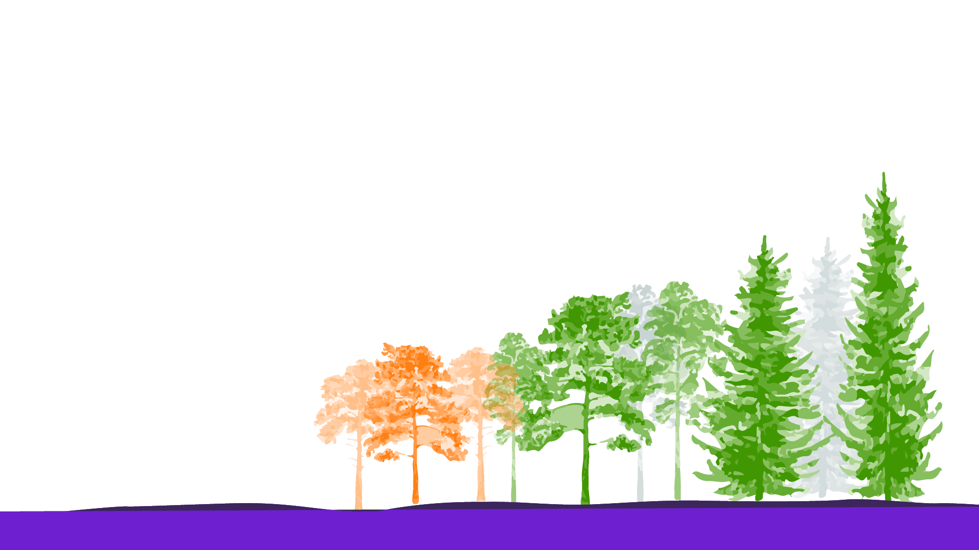

An Overview of Sustainable Forestry in Canada for Architecture and Engineering Students
Prepared by:
The Mass Timber Institute at the University of Toronto’s John H. Daniels Faculty of Architecture, Landscape, and Design for the Canadian Wood Council
Monique Dosanjh
Shan Shukla
Sanjana Patel
Dr. Anne Koven

Slide 2
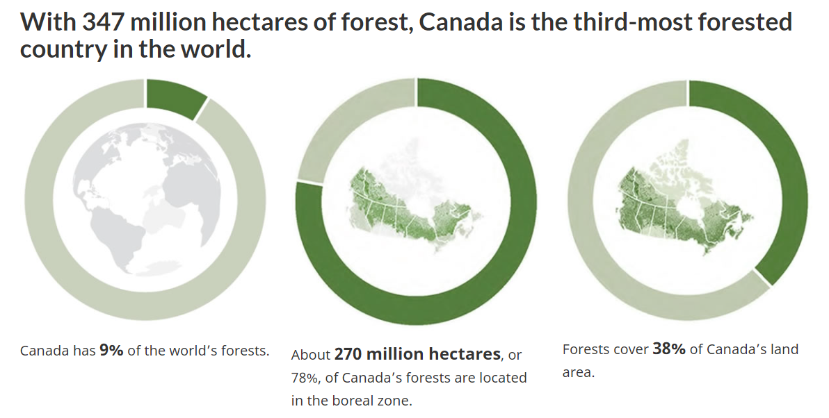

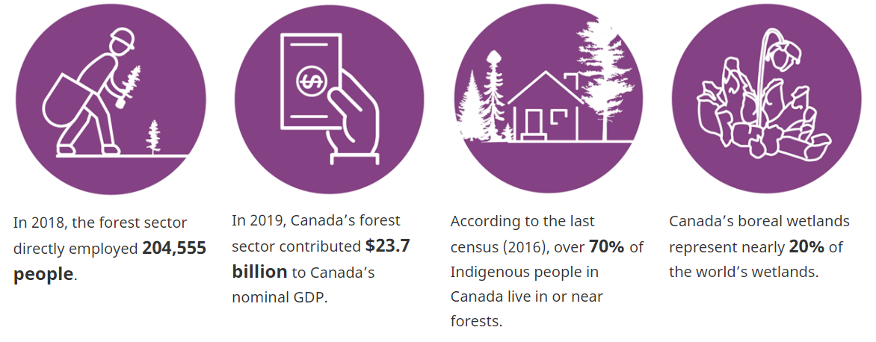
Canada: A Forest Country
With 362 million hectares of forest, Canada is the third-most forested country in the world.
Please note!
Each PPT slide is accompanied by notes and links.
The Learning Module document (PDF) compiles all notes, and links, and includes a Glossary of Terms, sample questions, and CACB learning objectives.
Canada’s forests are important to Canadians, the economy and the environment.
Data Source: Natural Resources Canada, 2020. The State of Canada’s Forests: Annual Report 2020, 8. https://d1ied5g1xfgpx8.cloudfront.net/pdfs/40219.pdf
Notes:
Slide 2: Canada: A Forest Country
Canada’s forests cover 38% of the country (Natural Resources Canada, 2020, p . 17)
Canada has 9% of the world’s forests (Natural Resources Canada, 2020, p. 17)
Canada’s forest cover sits 3rd behind Russia and Brazil
The majority of Canada’s forests (77%) are found in the boreal zone while 37% are found in temperate forests (Natural Resources Canada, 2020, p. 17)
Forest area in Canada is stable; since 1990, less than 0.5% of Canada’s forests have been deforested or afforested (Natural Resources Canada, 2020, p. 20)
Forests are home to the majority of Canada’s Indigenous peoples (over 1.1 million or 70% according to the 2016 census) (Natural Resources Canada, 2020, p. 47)
Canada’s forests provide vast environmental, social, and economic benefits
Benefits are magnified for rural Canada; many rural and remote communities depend on forestry for jobs and income (Natural Resources Canada, 2020, p. 47)
Benefits include ecosystem services such as flood control, enhanced water and air quality, biodiversity, and soil preservation (Natural Resources Canada, 2020, p. 43)
Forests are critical to the Earth’s carbon cycle due to their capacity to sequester large amounts of carbon (Natural Resources Canada, 2020, p. 43)
Forests provide a wide range of wood and other forest products, and social and cultural benefits such as hiking and camping, and hunting and trapping (which are important traditions for many Indigenous communities) (Natural Resources Canada, 2020, p. 43)
Slide 2 References:
Natural Resources Canada. (2020). The State of Canada’s Forests: Annual Report 2020. Natural Resources Canada. https://cfs.nrcan.gc.ca/publications?id=40219

Slide 3
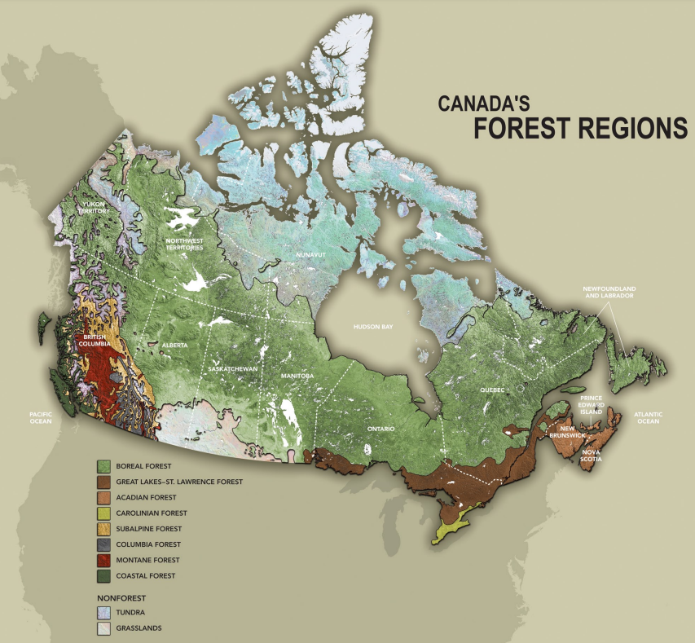
Each PPT slide is accompanied by notes and links. See other resources in the learning module PDF document.
Which Trees are in Canada’s Forests?
There are approximately 180 tree species in Canada’s forests.
35 tree species today are used for forest products.
  None of which are species at risk.
75% of Canada’s forests are in the boreal zone.
Image Credit: Natural Resources Canada. (2021). Forest Maps. Natural Resources Canada. https://www.nrcan.gc.ca/maps-tools-and-publications/maps/forest-maps/16874.
Notes:
Slide 3: Which Trees are in Canada’s Forests?
There are approximately 180 tree species in Canada’s forests (Natural Resources Canada, 2021)
35 tree species are commercially valuable
None of which are species at risk
75% of Canada’s forests are in the boreal zone:
Forest regions (such as the boreal forest) are areas that have similar dominant tree species; the dominant tree species in the boreal forest include black spruce, white spruce, jack pine, balsam fir, and tamarack (Natural Resources Canada, 2022)
The boreal zone circles the Northern Hemisphere and forms a ring around the North Pole; globally, it covers 1.9 billion hectares, which amounts to 14% of the Earth’s land and 33% of Earth’s forested area (Natural Resources Canada, 2020)
Tree Canada is an exceptionally good resource for identifying the common tree species in Canada (Tree Canada, n.d.).
Slide 3 References:
Natural Resources Canada. (2020). 8 facts about Canada’s boreal forest. Natural Resources Canada. https://www.nrcan.gc.ca/our-natural-resources/forests/sustainable-forest-management/boreal-forest/8-facts-about-canadas-boreal forest/17394.
Natural Resources Canada. (2021). Forest Maps. Natural Resources Canada. https://www.nrcan.gc.ca/maps-tools-and-publications/maps/forest-maps/16874.
Natural Resources Canada. (2022). Forest classification. Natural Resources Canada. https://www.nrcan.gc.ca/our-natural-resources/forests/sustainable-forest-management/measuring-and-reporting/forest-classification/13179.
Tree Canada. (n.d.). Trees of Canada – Tree Canada. Trees of Canada. Retrieved May 10, 2022, from https://treecanada.ca/resources/trees-of-canada/

Slide 4
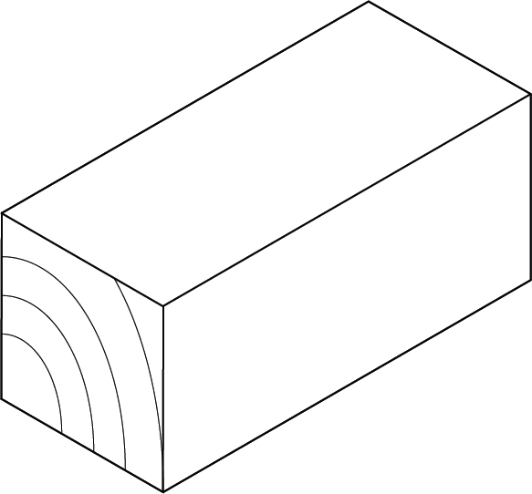
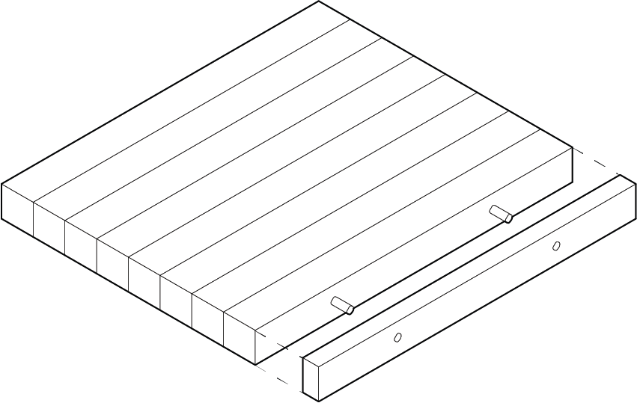
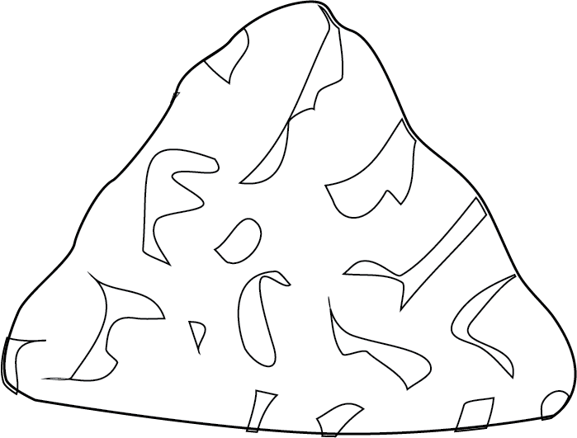

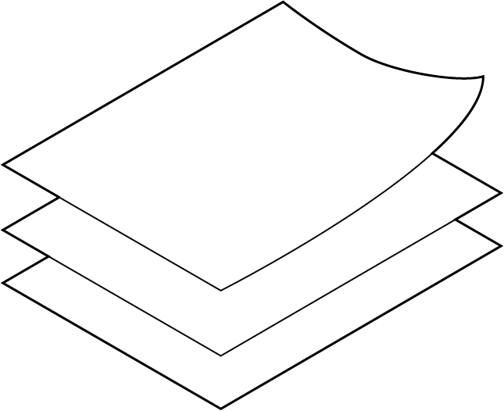
Canada’s Forest Products
Each PPT slide is accompanied by notes and links. See other resources in the learning module PDF document.
Softwood lumber
  #2 GLOBAL PRODUCER (2016) AND #1 EXPORTER (2017)
  Conifer timber sawed into dimensional lumber and other products
  Biggest market is US housing construction
Structural wood panels
  #3 GLOBAL PRODUCER (2016) AND #2 EXPORTER (2017)
  For walls, floors, roofs, and furniture
FOR MASS TIMBER
Wood pulp
  #3 GLOBAL PRODUCER (2016) AND #2 EXPORTER (2017)
  For paper products, food additives, and many other products
Newsprint
  #1 GLOBAL PRODUCER (2016) AND EXPORTER (2017)
  For newspapers and magazines
Printing and writing paper
  #8 GLOBAL PRODUCER (2016) AND EXPORTER (2017)
  For higher quality, heavier paper for printers, envelopes, and forms
Image Credit: Sanjana Patel
Data Source: Natural Resources Canada, 2021. The State of Canada’s Forests: Annual Report 2021, 52. https://www.nrcan.gc.ca/sites/nrcan/files/forest/sof2021/6317_NRCan_SoF_AR_2021_EN_P7B_web_accessible.pdf
Notes:
Slide 4 and 5: Canada’s Forest Products
Canada is a global forest product manufacturing leader and the fourth largest forest product exporter in the world by value as of 2019 (behind China, the United States, and Germany) (Natural Resources Canada, 2020, p. 53).
Of Canada’s total exports, forest products make up 7% with the three largest export destinations being the United States, China, and Japan.
Softwood lumber is timber that is harvested from coniferous trees, which are trees that have cones and needle-like leaves (Natural Resources Canada, 2019).
This lumber is then sawed into a variety of forest products such as dimensional lumber, appearance-grade lumber, and softwood boards.
Dimensional softwood lumber products are mostly used for the framing in residential buildings; therefore, their demand and pricing are closely related to housing construction in the US, which is where 75% of Canada’s softwood lumber goes.
Wood pulp is a wood fibre that has been mechanically or chemically reduced to pulp (Natural Resources Canada, 2019).
Wood pulp is used as an intermediate product that is then used to produce paper products, packaging, and is also used as a food additive and in clothing.
The most common wood pulp product produced in Canada is northern bleached softwood kraft pulp (NBSK), which is used to make printing and writing paper, and tissue.
Newsprint is a pulp product made of thermomechanical pulp (Natural Resources Canada, 2019).
It is used to make newspapers, magazines, and similar products.
The market for newsprint has declined with the rise of digital media and is expected to continue declining.
Printing and writing paper is another pulp product that is higher quality than newsprint and is used for a variety of office papers such as for printers, envelopes, forms, and paper pads (Natural Resources Canada, 2019).
Similar to the market decline for newsprint, the same is expected for printing and writing paper as the world becomes more digital.
Structural wood panels include oriented strand board (OSB) and plywood (Natural Resources Canada, 2019).
OBS is made from strands of wood cut from small logs and is used mostly for load-bearing purposes in residential buildings, wall sheathing, flooring, roofing, and to make furniture.
Plywood is made of several thin layers of wood that are glued together and is mostly used to make walls, floors, roof sheathing since it provides strength, stiffness, and stability.
Slide 4 and 5 References:
Natural Resources Canada. (2019). Forest fact book 2018-2019. Canadian Forest Service. https://cfs.nrcan.gc.ca/publications?id=39505
Natural Resources Canada. (2020). The State of Canada’s Forests: Annual Report 2020. Natural Resources Canada. https://cfs.nrcan.gc.ca/publications?id=40219.

Slide 5
Canada’s Forest Products
Each PPT slide is accompanied by notes and links. See other resources in the learning module PDF document.
Exports of Canadian forest products, 2020
30%
Softwood lumber
$10 billion
4%
Newsprint
$1.3 billion
6%
Printing and writing paper
$2 billion
9%
Structural wood panels
$2.9 billion
20%
Wood pulp
$6.7 billion
31%
Other forest products
$10.4 billion
Image Credit: Sanjana Patel
Data Source: Natural Resources Canada, 2021. The State of Canada’s Forests: Annual Report 2021, 53. https://www.nrcan.gc.ca/sites/nrcan/files/forest/sof2021/6317_NRCan_SoF_AR_2021_EN_P7B_web_accessible.pdf
Notes:
Slide 4 and 5: Canada’s Forest Products
Canada is a global forest product manufacturing leader and the fourth largest forest product exporter in the world by value as of 2019 (behind China, the United States, and Germany) (Natural Resources Canada, 2020, p. 53).
Of Canada’s total exports, forest products make up 7% with the three largest export destinations being the United States, China, and Japan.
Softwood lumber is timber that is harvested from coniferous trees, which are trees that have cones and needle-like leaves (Natural Resources Canada, 2019).
This lumber is then sawed into a variety of forest products such as dimensional lumber, appearance-grade lumber, and softwood boards.
Dimensional softwood lumber products are mostly used for the framing in residential buildings; therefore, their demand and pricing are closely related to housing construction in the US, which is where 75% of Canada’s softwood lumber goes.
Wood pulp is a wood fibre that has been mechanically or chemically reduced to pulp (Natural Resources Canada, 2019).
Wood pulp is used as an intermediate product that is then used to produce paper products, packaging, and is also used as a food additive and in clothing.
The most common wood pulp product produced in Canada is northern bleached softwood kraft pulp (NBSK), which is used to make printing and writing paper, and tissue.
Newsprint is a pulp product made of thermomechanical pulp (Natural Resources Canada, 2019).
It is used to make newspapers, magazines, and similar products.
The market for newsprint has declined with the rise of digital media and is expected to continue declining.
Printing and writing paper is another pulp product that is higher quality than newsprint and is used for a variety of office papers such as for printers, envelopes, forms, and paper pads (Natural Resources Canada, 2019).
Similar to the market decline for newsprint, the same is expected for printing and writing paper as the world becomes more digital.
Structural wood panels include oriented strand board (OSB) and plywood (Natural Resources Canada, 2019).
OBS is made from strands of wood cut from small logs and is used mostly for load-bearing purposes in residential buildings, wall sheathing, flooring, roofing, and to make furniture.
Plywood is made of several thin layers of wood that are glued together and is mostly used to make walls, floors, roof sheathing since it provides strength, stiffness, and stability.
Slide 4 and 5 References:
Natural Resources Canada. (2019). Forest fact book 2018-2019. Canadian Forest Service. https://cfs.nrcan.gc.ca/publications?id=39505
Natural Resources Canada. (2020). The State of Canada’s Forests: Annual Report 2020. Natural Resources Canada. https://cfs.nrcan.gc.ca/publications?id=40219.

Slide 6

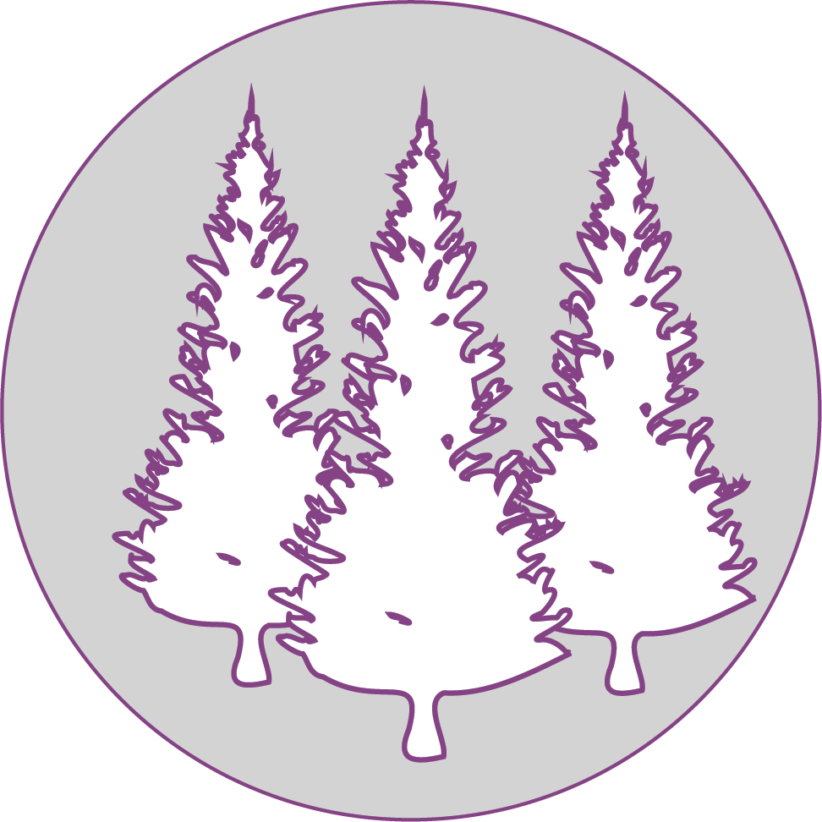
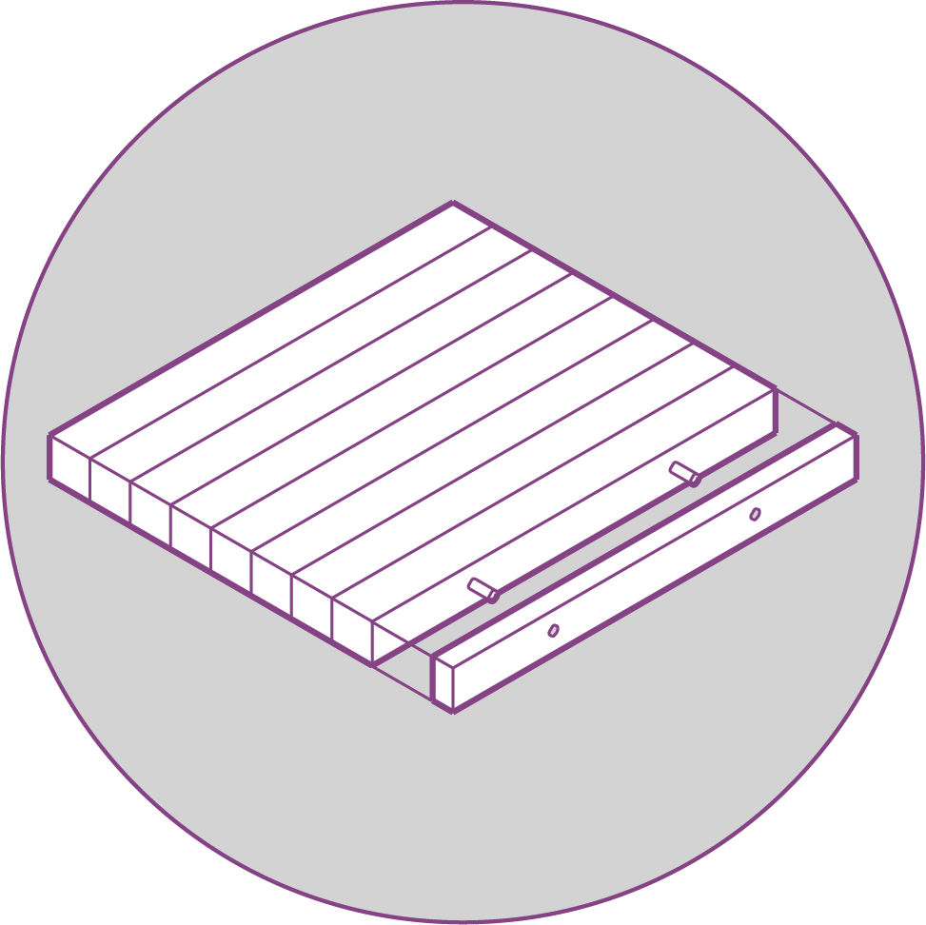
Canada’s Forest Sector is Important for the Economy
Each PPT slide is accompanied by notes and links. See other resources in the learning module PDF document.
184,510 people (2020) are employed by the forest sector in Canada.
  This includes 12,000 Indigenous people (6.5% of Canada’s forestry workforce).
In 2018, the forest sector generated $1.9 billion in revenue for provincial and territorial governments.
In 2020, the forest sector contributed $25.2 billion (1.2%) to Canada’s nominal GDP.
In 2019, Canada’s forest product exports were valued at $33 billion (4th largest in the world behind China, the US, and Germany).
Image Credit: Sanjana Patel
Data Source: Natural Resources Canada, 2021. The State of Canada’s Forests: Annual Report 2021, 51. https://www.nrcan.gc.ca/sites/nrcan/files/forest/sof2021/6317_NRCan_SoF_AR_2021_EN_P7B_web_accessible.pdf
Notes:
Slide 6: Canada’s Forest Sector is Important for the Economy
In 2020, 184,510 people were employed by the forest sector in Canada (Natural Resources Canada, 2021, p. 44).
This includes 12,000 Indigenous people (6.5% of Canada’s forestry workforce) (Natural Resources Canada, 2021, p. 46).
Although the COVID-19 pandemic and issues such as forest fires, pests, and trade disputes are expected to impact demand for forest products for several years. There are many opportunities for the forestry sector to continue to be a major employer for many communities across Canada, particularly remote and rural communities where few other industries operate (Natural Resources Canada, 2021, p. 44).
In 2018, the forest sector generated $1.9 billion in revenue for provincial and territorial governments (Natural Resources Canada, 2020, p. 49).
In 2020, the forest sector contributed $25.2 billion (1.2%) to Canada’s nominal GDP (Natural Resources Canada, 2021, p. 50).
This is a 4% increase from 2019, while the overall economy contracted by 5.6% during this period (Natural Resources Canada, 2021, p. 50).
Canada’s forestry sector’s real GDP declined by 1.6% while the total economy’s real GDP declined by 5.2% (Natural Resources Canada, 2021, p. 50).
The forest sector benefitted from higher lumber and panel prices, but the pandemic caused an overall decline in real terms due to a slowdown in some operations (Natural Resources Canada, 2021, p. 50).
In 2019, Canada’s forest product exports were valued at $33 billion (4th largest in the world behind China, the US, and Germany) (Natural Resources Canada, 2020, p. 49-50).
Canada is a global leader in forest product production and over two thirds of these products are exported.
The United States is Canada’s largest trading partner and accounted for 68% of Canada’s forest product exports in 2019.
Slide 6 References:
Natural Resources Canada. (2020). The State of Canada’s Forests: Annual Report 2020. Natural Resources Canada. https://cfs.nrcan.gc.ca/publications?id=40219.
Natural Resources Canada. (2021). The State of Canada’s Forests: Annual Report 2021. Natural Resources Canada. https://www.nrcan.gc.ca/our-natural-resources/forests/state-canadas-forests-report/16496.

Slide 7
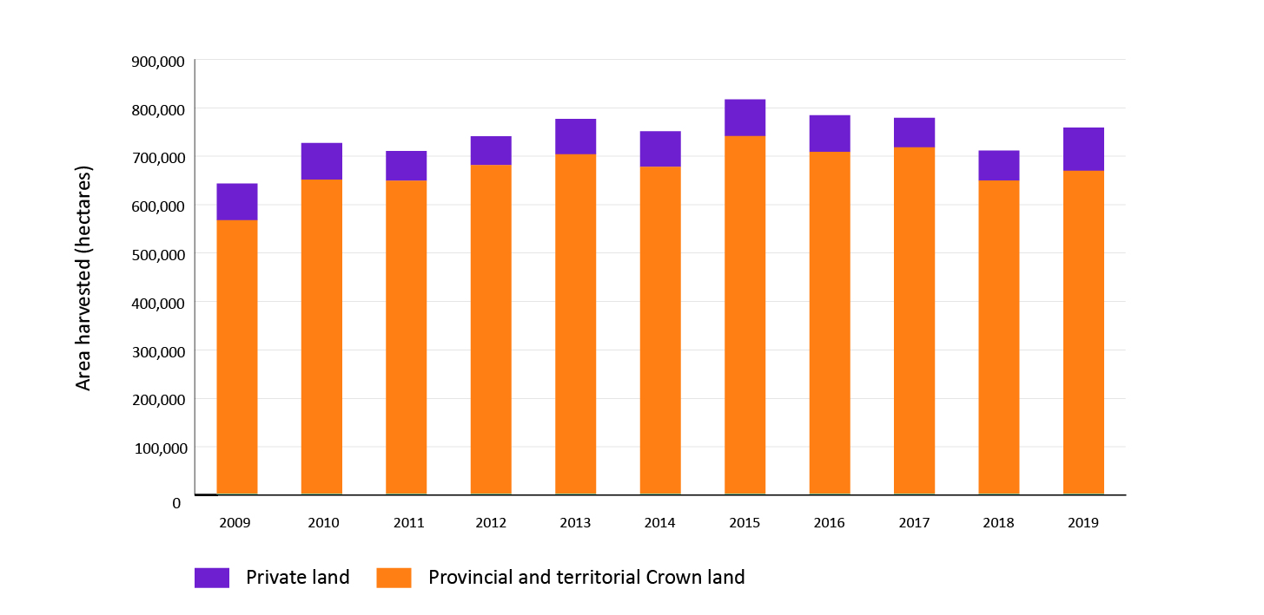
Each PPT slide is accompanied by notes and links. See other resources in the learning module PDF document.
Forest Harvesting
In 2019, approximately 757,000 hectares of forest were harvested - this is less than 0.5% of Canada’s forests annually.
Harvesting of crown forests is regulated to ensure a sustainable supply of timber.
757,000 ha.
Data Source: Natural Resources Canada, 2021. The State of Canada’s Forests: Annual Report 2021, 24. https://www.nrcan.gc.ca/sites/nrcan/files/forest/sof2021/6317_NRCan_SoF_AR_2021_EN_P7B_web_accessible.pdf
Notes:
Slide 7: Forest Harvesting
In 2019, approximately 757,000 hectares of forest were harvested - this is less than 0.5% of Canada’s forests annually (Natural Resources Canada, 2021, p. 29).
The area harvested each year is significantly less than the areas impacted by insects and forest fires each year (Natural Resources Canada, 2021, p. 29).
The area harvested each year depends on multiple factors such as the demand for Canadian forest products, and forest management decisions in response to pests and forest fires (Natural Resources Canada, 2021, p. 29)
Harvesting of crown forests is regulated to ensure a sustainable supply of timber (Natural Resources Canada, 2021, p. 29).
Slide 7 References:
Natural Resources Canada. (2021). The State of Canada’s Forests: Annual Report 2021. Natural Resources Canada. https://www.nrcan.gc.ca/our-natural-resources/forests/state-canadas-forests-report/16496.

Slide 8
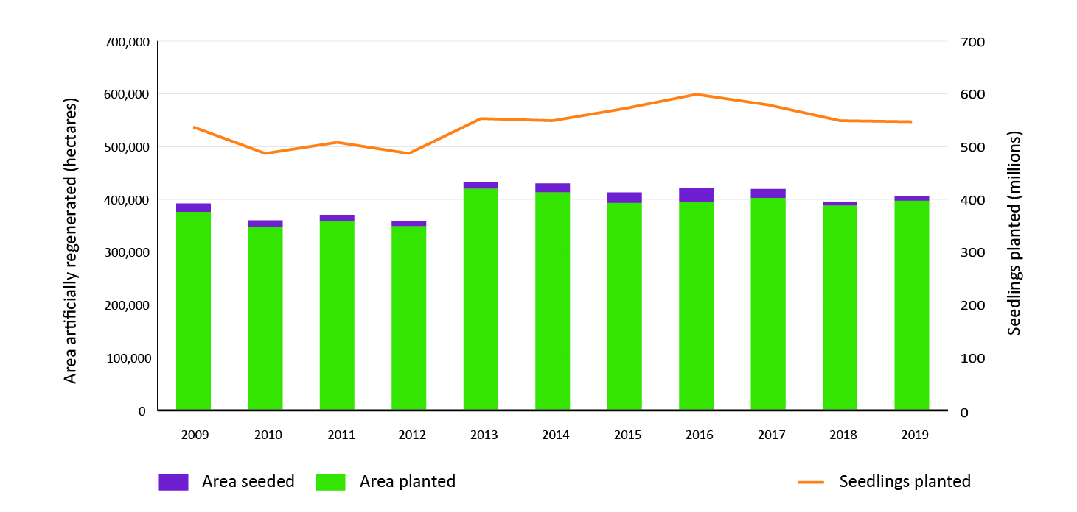
Each PPT slide is accompanied by notes and links. See other resources in the learning module PDF document.
No Forest Harvesting is Allowed Without Regeneration
Regeneration
In 2019, more than:
547 million seedlings were planted on 375,000 hectares of forest land in Canada
8,600 hectares of forest were established by seeding
Data Source: Natural Resources Canada, 2021. The State of Canada’s Forests: Annual Report 2021, 25. https://www.nrcan.gc.ca/sites/nrcan/files/forest/sof2021/6317_NRCan_SoF_AR_2021_EN_P7B_web_accessible.pdf
Notes:
Slide 8: No Forest Harvesting is Allowed Without Regeneration
Regeneration
Forest regeneration is the act of growing back the forest after harvesting and is required on all public lands in Canada (Natural Resources Canada, 2020, p. 25).
The type of forest regeneration method; artificial or natural regeneration, depends on the forest type, silviculture system, and required composition of the new forest (Natural Resources Canada, 2020, p. 25).
Forest regeneration ensures that harvested areas regenerate into forests and continue to provide timber, ecosystem services, and social benefits such as recreation (Natural Resources Canada, 2020, p. 25).
In 2019, approximately 547 million seedlings were planted on 397,000 hectares of provincial forest land in Canada and 8,600 hectares of forest were established by seeding (Natural Resources Canada, 2021, p. 30).
The area regenerated each year is strongly related to the recent area harvested, which is impacted by market factors but is always bound by sustainable forest management laws and regulations (Natural Resources Canada, 2021, p. 30).
Slide 8 References:
Natural Resources Canada. (2020). The State of Canada’s Forests: Annual Report 2020. Natural Resources Canada. https://cfs.nrcan.gc.ca/publications?id=40219.
Natural Resources Canada. (2021). The State of Canada’s Forests: Annual Report 2021. Natural Resources Canada. https://www.nrcan.gc.ca/our-natural-resources/forests/state-canadas-forests-report/16496.

Slide 9
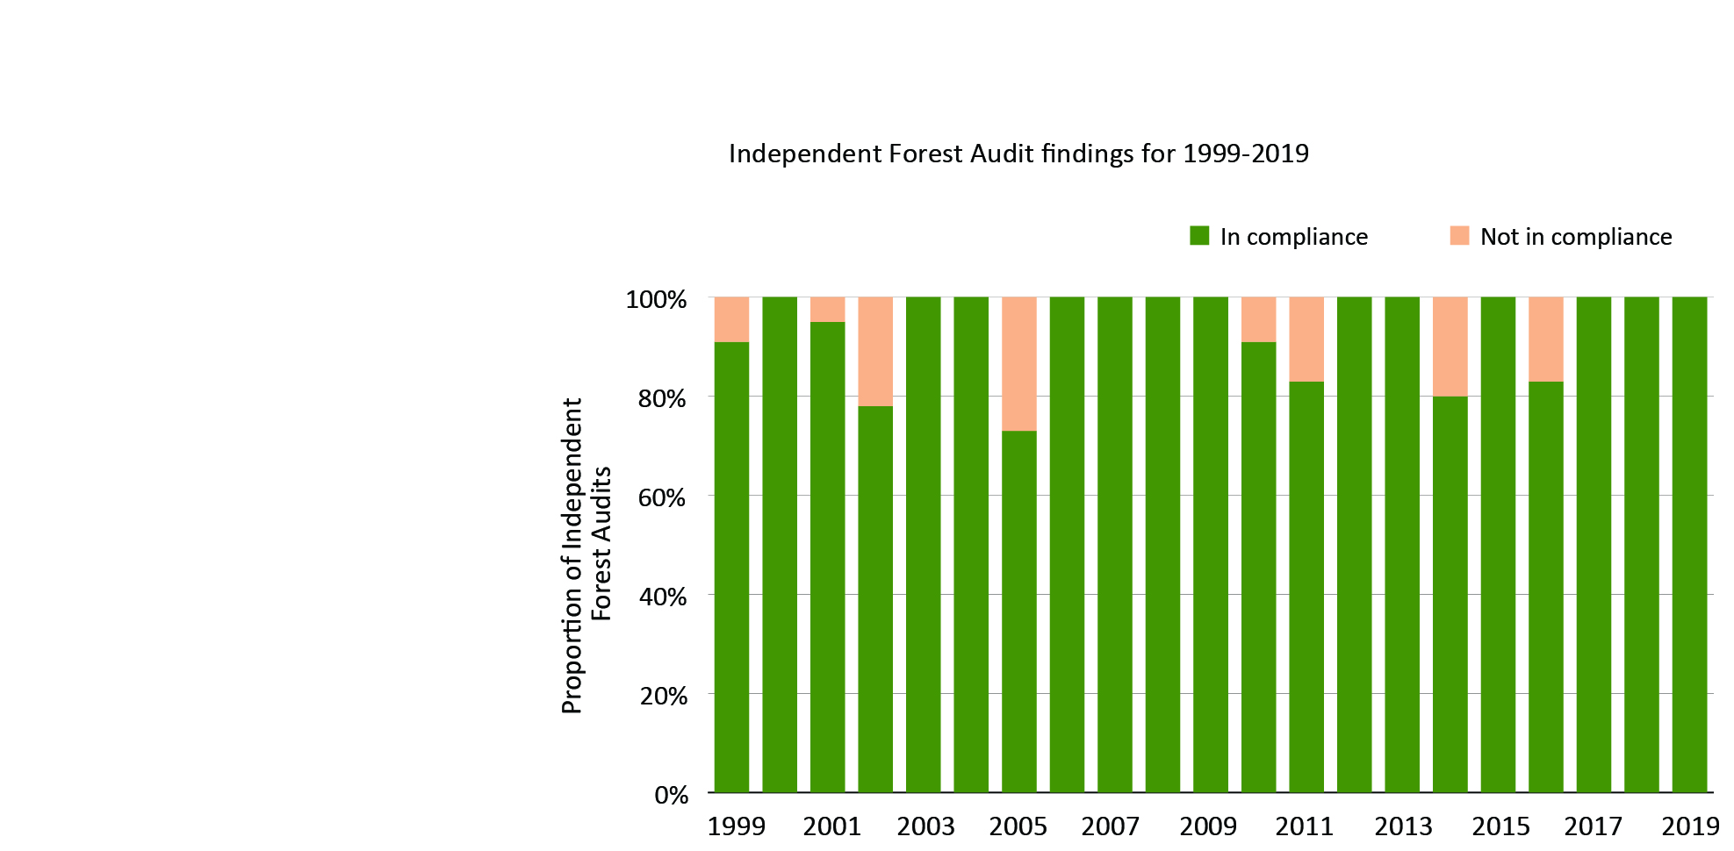
Each PPT slide is accompanied by notes and links. See other resources in the learning module PDF document.
Is Forest Regeneration Successful?
For example, Independent Forest Audits occur every 10-12 years in Ontario.
  They assess sustainable forest management, which includes forest regeneration.
From 1999 to 2013, the average compliance rate was 94%.
It can take 15 or more years for harvested areas to be successfully regenerating, i.e. “established” in Ontario’s definition (see Glossary).
Data Source: Ministry of Northern Development, Mines, Natural Resources and Forestry. (2022). Independent forest audits. Government of Ontario. https://www.ontario.ca/page/independent-forest-audits.
Notes:
Slide 9: Is Forest Regeneration Successful?
Independent forest audits occur every 10-12 years for each forest management unit in Ontario. The auditing period differs by province. (Ministry of Northern Development, Mines, Natural Resources and Forestry, 2022; Ministry of Northern Development, Mines, Natural Resources and Forestry, 2021a)
During these audits, auditors assess sustainable forest management, which includes forest regeneration.
An independent auditor assesses the performance of the sustainable forest license holder and the Ontario Ministry of Northern Development, Mines, Natural Resources and Forestry in meeting their forest management responsibilities.
Action plans are developed after the audits are done to address the findings made by the auditor.
Independent forest audit reports are publicly accessible and can be viewed here: https://www.ontario.ca/page/independent-forest-audits.
Examples of third-party independent auditors in Ontario are KBM Resources Group (https://kbm.ca/ ), Arbex Forest Resource Consultants Ltd. (http://arbex.ca/), and ArborVitae Environmental Services Ltd. (http://www.avesltd.ca/).
From 1999 to 2019, the average compliance rate was 94% (Ministry of Northern Development, Mines, Natural Resources and Forestry, 2021b).
It can take 15 or more years for harvested areas to be established (Ministry of Northern Development, Mines, Natural Resources and Forestry, 2021b).
In Ontario, forest managers conduct surveys to assess forest regeneration; successful regeneration is classified as "established”, which means that the regenerating trees meet standards (species composition, height, and site occupancy) and are healthy and free from competing vegetation (Ministry of Northern Development, Mines, Natural Resources and Forestry, 2021b).
Slide 9 References:
Ministry of Northern Development, Mines, Natural Resources and Forestry. (2021a). Forest monitoring. Government of Ontario. https://www.ontario.ca/page/forest-monitoring.
Ministry of Northern Development, Mines, Natural Resources and Forestry. (2021b). State of Ontario’s Natural Resources - Forest 2021. Government of Ontario. https://www.ontario.ca/page/state-ontarios-natural-resources-forest-2021.

Slide 10
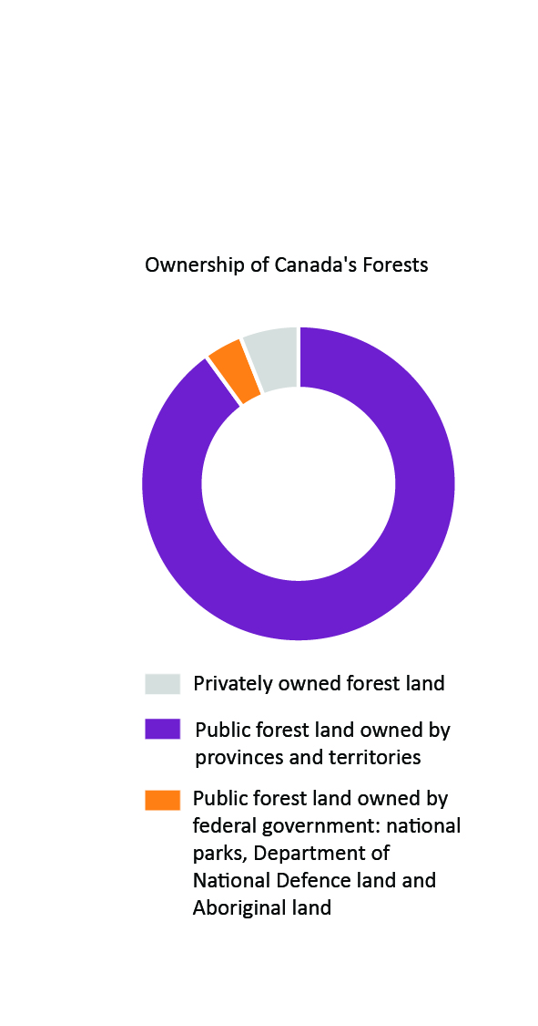
Each PPT slide is accompanied by notes and links. See other resources in the learning module PDF document.
Ownership of Canada’s Forests
90% of Canada’s forests are publicly owned (Crown Lands) and managed for the public by provincial and territorial governments.
4% of Canada’s forests are publicly owned and managed for the public by the federal government.
6% of Canada’s forests are privately owned.
Most harvesting in public forests in Canada is done by private forestry companies.
These companies have an agreement with the provincial or territorial government to supply timber and must comply with laws and regulations.
Data Source: Natural Resources Canada. (2020). Forest land ownership. Natural Resources Canada. https://www.nrcan.gc.ca/our-natural-resources/forests/sustainable-forest-management/forest-land-ownership/17495
Notes:
Slide 10: Ownership of Canada’s Forests
90% of Canada’s forests are publicly owned and managed for the public by provincial and territorial governments (Natural Resources Canada, 2020).
Of the forests owned by the government, provinces and territories are responsible for developing and enforcing laws and regulations, setting up timber supply agreements with forestry companies which outline all responsibilities, monitoring forestry activities to ensure compliance with laws and regulations, and collecting royalties.
4% of Canada’s forests are publicly owned and managed for the public by the federal government (Natural Resources Canada, 2020).
These forests are mostly in national parks, on the Department of National Defence lands, and on reserve lands owned or controlled by Indigenous peoples.
There are many federal departments responsible for managing this land and they include Aboriginal Affairs and Northern Development Canada, Department of National Defence, Natural Resources Canada, and Parks Canada.
Most harvesting in public forests in Canada is done by private forestry companies (Natural Resources Canada, 2020).
These companies have an agreement with the provincial or territorial government to supply timber and must comply with laws and regulations.
6% of Canada’s forests are privately owned (Natural Resources Canada, 2020).
These are mostly large forests owned by forestry companies in New Brunswick, Nova Scotia, Ontario, Quebec, and British Columbia.
This category also includes small family-owned forests.
Although privately-owned forests constitute a very small proportion of Canada’s forests, they contribute substantially to the timber harvested; 10% of all timber harvested in Canada comes from privately owned forests.
Slide 10 References:
Natural Resources Canada. (2020). Forest land ownership. Natural Resources Canada. https://www.nrcan.gc.ca/our-natural-resources/forests/sustainable-forest-management/forest-land-ownership/17495.

Slide 11


Each PPT slide is accompanied by notes and links. See other resources in the learning module PDF document.
Provincial Forest Laws
Provinces and territories were given the power to manage their own forests (90% of Canada’s forests) in the Constitution Act, 1867 (also known as the British North America Act) and this was reaffirmed in Section 92A in the 1982 amendments to the Constitution Act.
Provinces and territories develop and enforce laws, regulations, and policies related to forests, ensuring that:
  Indigenous interests are considered
  Wildlife habitat is protected
  Timber harvesting is regulated
  Forest regeneration occurs
Canada has many laws and regulations ensuring that forestry operations only occur in approved areas where there has been adequate and long-term planning.
Amendments to the Constitution Act were made in 1982 and reaffirmed the power of provinces and territories to manage their own forests.
Image Credit: https://www.justice.gc.ca/eng/csj-sjc/rfc-dlc/ccrf-ccdl/learn-apprend.html
Notes:
Slide 11: Provincial Forest Laws
Section 92A in the 1982 amendments to the Constitution Act, 1867 gives provinces and territories the power to manage their own forests (Natural Resources Canada, 2017).
Provinces and territories develop and enforce laws, regulations, and policies related to forests, which ensure that (Natural Resources Canada, 2020):
Indigenous interests are considered
Wildlife habitat is protected
Timber harvesting is regulated
Forest regeneration occurs
Monitoring and enforcement are crucial and include (Natural Resources Canada, 2020):
Reporting from forestry companies
Audits
Investigations of infractions
Canada has many laws and regulations so that forestry operations only occur in approved areas where there has been adequate and long-term planning (Natural Resources Canada, 2021).
Slide 11 References:
Natural Resources Canada. (2017). Roles and Responsibilities of Governments in Natural Resources. Natural Resources Canada. https://www.nrcan.gc.ca/science-data/science-research/earth-sciences/earth-sciences-resources/earth-sciences-federal-programs/roles-responsibilities-governments-natural-resources/8882.
Natural Resources Canada. (2020). Canada's forest laws. Natural Resources Canada. https://www.nrcan.gc.ca/our-natural-resources/forests/sustainable-forest-management/canadas-forest-laws/17497.
Natural Resources Canada. (2021). Legality and sustainability. Natural Resources Canada. https://www.nrcan.gc.ca/our-natural-resources/forests/sustainable-forest-management/canadas-forest-laws/legality-and-sustainability/13303.

Slide 12

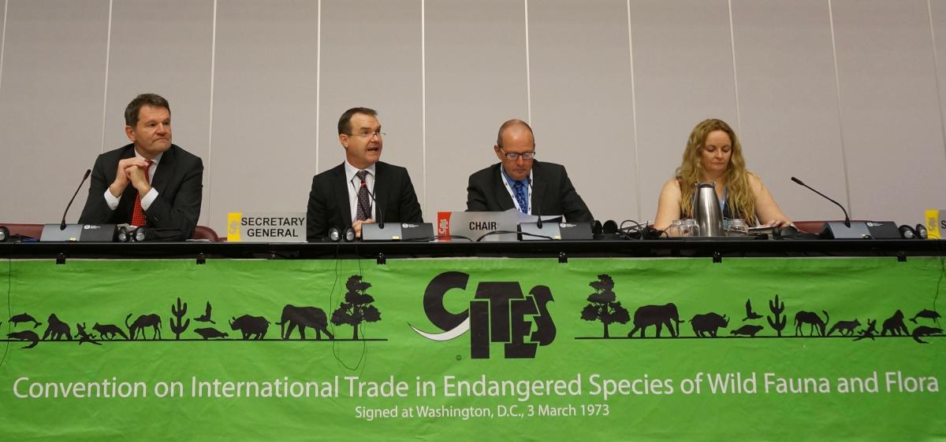
Image (Above) Credit:
https://nationtalk.ca/story/nafa-encourages-canadian-leadership-on-indigenous-rights-in-the-forest-and-welcomes-ainu-representation-to-the-permanent-indigenous-peoples-committee-of-fsc
Federal Forest Laws
The federal government’s power to manage their forest lands (only 4% of Canada’s forests) was reaffirmed in Section 91 in the 1982 amendments to the Constitution Act.
HOWEVER, the federal government has a major influence over Canadian forests because of responsibilities for Indigenous peoples and global agreements.
Federal laws that apply to these forests include the Indian Act, First Nations Land Management Act, National Parks Act, Species at Risk Act, Migratory Birds Convention Act, Plant Protection Act, and Fisheries Act.
International agreements that Canada is a signatory to include the Convention on Biological Diversity and the Convention on International Trade in Endangered Species of Wild Fauna and Flora.
Image (Below) Credit: https://cites.org/eng/news/pr/CITES_Animals_and_Plants_Committee_Meetings_attract_record_turnout_of_the_worlds_scientific_experts_18072017
Canada is a signatory to the Convention on International Trade in Endangered Species of Wild Fauna and Flora.
Notes:
Slide 12: Federal Forest Laws
Section 91 of the Constitution Act, 1867 gives the federal government the power to manage their forest lands (Natural Resources Canada, 2017).
Federal laws that apply to these forests include the Indian Act, First Nations Land Management Act, and National Parks Act (Natural Resources Canada, 2020).
Federal laws and agreements that apply to all forests in Canada include (Natural Resources Canada, 2020):
Laws such as the Species at Risk Act, Fisheries Act, Migratory Birds Convention Act, and Plant Protection Act
International agreements such as the Convention on Biological Diversity and the Convention on International Trade in Endangered Species of Wild Fauna and Flora
Slide 12 References:
Natural Resources Canada. (2017). Roles and Responsibilities of Governments in Natural Resources. Natural Resources Canada. https://www.nrcan.gc.ca/science-data/science-research/earth-sciences/earth-sciences-resources/earth-sciences-federal-programs/roles-responsibilities-governments-natural-resources/8882.
Natural Resources Canada. (2020). Canada's forest laws. Natural Resources Canada. https://www.nrcan.gc.ca/our-natural-resources/forests/sustainable-forest-management/canadas-forest-laws/17497.

Slide 13

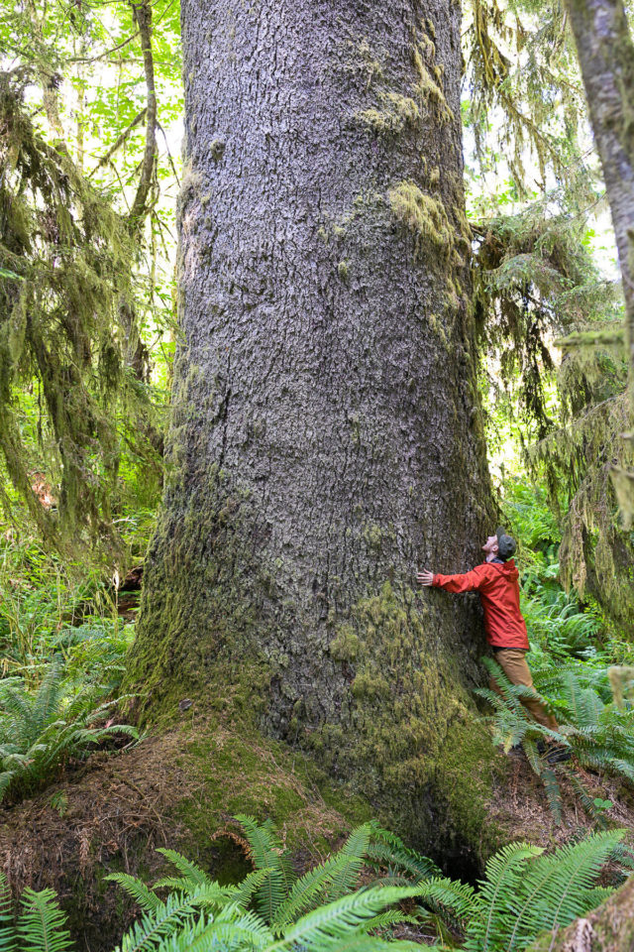
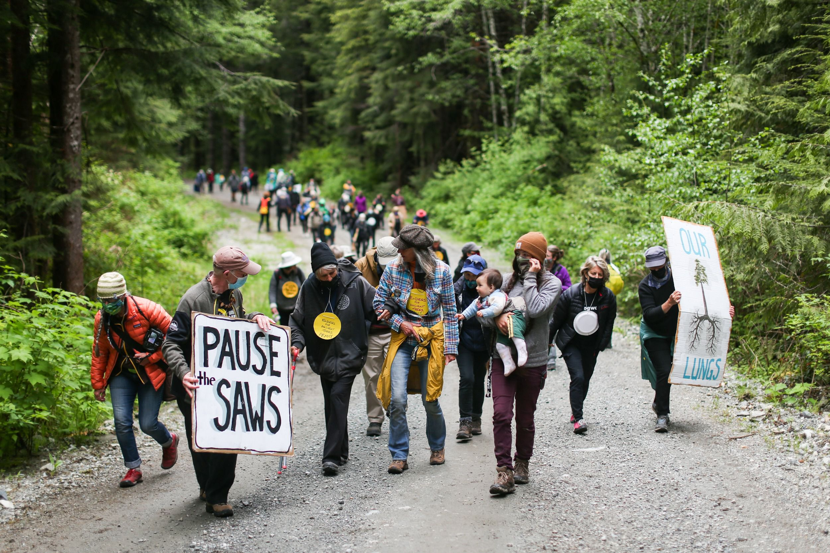
Old-Growth Forests
Society’s views on forests were influenced by environmental ideas and philosophies for decades.
Old-growth forests are a focus of forest management involving:
  Aesthetics
  Cultural importance
  Biodiversity
This has led to political and social tension among the government, industry, Northern and Indigenous communities, and environmental groups.
Fairy Creek Protests, 2021.
Many people and communities find inherent value in old-growth forests.
Image (Left) Credit: Jesse Winter. (May 25, 2021). [Protesters march near the fairy creek watershed after RCMP left] [Photograph]. The Globe and Mail. https://www.theglobeandmail.com/canada/british-columbia/article-loggers-protestors-remain-in-fairy-creek-as-rcmp-depart/
Image (Right) : Sooke News Mirror (https://www.sookenewsmirror.com/news/conservation-groups-discover-ancient-old-growth-forest-near-port-renfrew/ )
Notes:
Slide 13: Old Growth Forests
What is an old-growth forest? While there is no one definition of what an old-growth forest is as they are very complex and diverse, they are generally known to contain old trees that exist in landscapes relatively undisturbed by humans (USDA – Pacific Northwest Research Station, 2003).
Old-growth forests can differ in age, structure, and disturbance history. They generally have a high amount of diversity both horizontally, and vertically (USDA – Pacific Northwest Research Station, 2003).
Old-growth forests are ecologically important because they hold a tremendous amount of biodiversity, especially those in British Columbia (Moffatt, 2021a).
There are many old-growth forests; over 11.1 million ha of old-growth forests in British Columbia. In B.C., some of the interior forests are considered to be old growth if the trees they contain are more than 140 years old. (Government of the Province of British Columbia, n.d.).
The province of British Columbia has committed to a new integrated management approach for old-growth forests, taking into consideration economic, environmental, and Indigenous reconciliation interests. The goal is to complete this contentious process in 2023 (Government of the Province of British Columbia, n.d.).
Despite this new approach to old growth management, activists such as Greenpeace maintain that the old growth forests in B.C. are being cut down at an alarming rate (Moffatt, 2021b).
Indigenous leaders in B.C. have requested that the government put a halt on old growth logging (Moffatt, 2021b).
Fairy Creek in B.C. is an area of contention as activists are blockading access to the last remaining 5000 or so acres of old-growth forest from the logging company Teal Jones (CBC, 2022).
Old growth protection protests have historic roots going back to the Clayoquot protests which took place in the 1980s and earlier. The current protests are still ongoing tensions from these original protests many decades ago. There are mixed feelings from Indigenous communities who feel they have the right to manage these lands as they see fit. In the past few years, over 1100 people have been arrested against the blockade injunction at Fairy Creek (Hayward, 2021).
It is not just B.C. forests that are under threat, the boreal is also under threat from logging (Lewis C., Jordan A., 2021).
Slide 13 References:
CBC. (2022). Court reinstates injunction against Fairy Creek logging protesters | CBC News. CBC . https://www.cbc.ca/news/canada/british-columbia/injunction-reinstated-against-fairy-creek-protesters-1.6328496
Government of the Province of British Columbia. (n.d.). Old Growth Forests. Retrieved April 3, 2022, from https://www2.gov.bc.ca/gov/content/industry/forestry/managing-our-forest-resources/old-growth-forests
Hayward, J. (2021). Second judge to consider stay application in Fairy Creek logging protest case – Victoria News. Victoria News. https://www.vicnews.com/news/second-judge-to-consider-stay-application-of-old-growth-logging-protesters-in-b-c/
Moffatt, S. (2021a). How old-growth forests keep falling on B.C. Premier John Horgan’s watch. Greenpeace Canada. https://www.greenpeace.org/canada/en/story/47756/how-old-growth-forests-keep-falling-on-b-c-premier-john-horgans-watch/
Moffatt, S. (2021b). Saving Fairy Creek and Why Ancient Forests are Worth More Standing - Greenpeace Canada. Greenpeace Canada. https://www.greenpeace.org/canada/en/story/47068/saving-fairy-creek-and-why-ancient-forests-are-worth-more-standing/
R. T., Lewis, C., & Jordan, A. (2021). By a Thousand Cuts: How Powerful Companies’ Wood Sourcing is Degrading Canada’s Boreal Forest. www.suerossi.com
USDA - Pacific Northwest Research Station. (2003). New Findings About Old-Growth

Slide 14
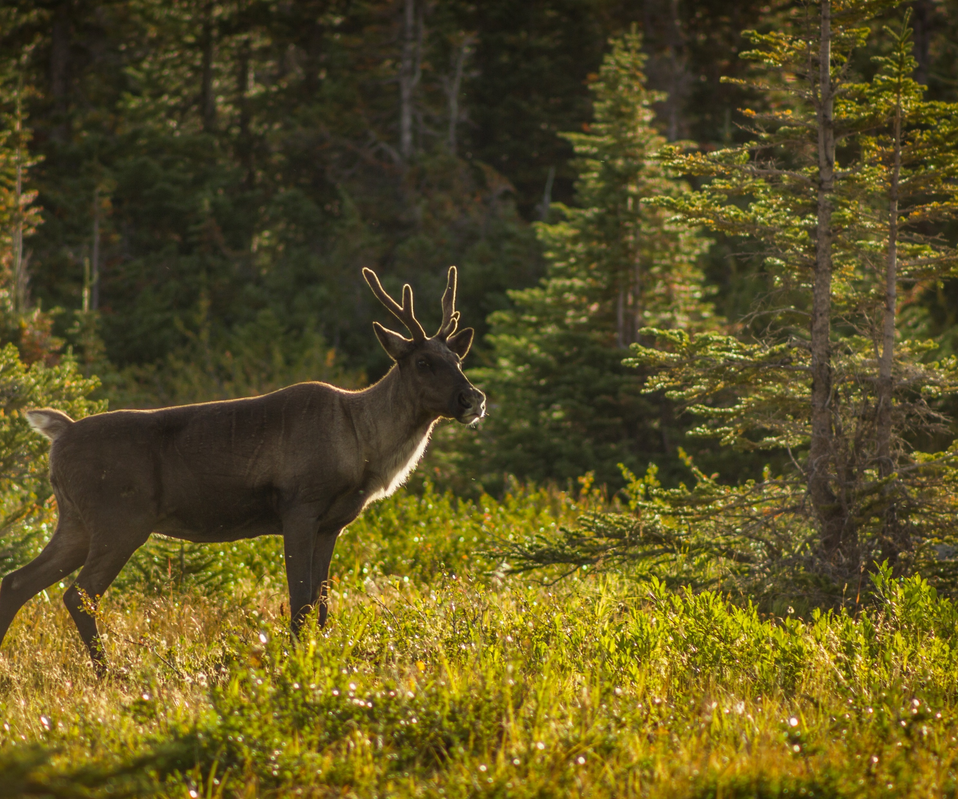
Protecting Biodiversity
Global biodiversity needs protection on two main fronts:
  1. Maximizing the number of species is important as biodiversity loss leads to unforeseen consequences (Cardinale et al., 2012).
  2. Protecting plant and forest biodiversity contributes to climate crisis solutions (Langford et al., 2022).
Forest fragmentation refers to a loss of forest and the division of the remaining forest into smaller blocks (Riitters, 2007).
The government of Canada is currently working towards habitat restoration for woodland caribou (Natural Resources Canada 2021).
Canada is a signatory to the High Ambition Coalition for Nature and People, which is committed to a global goal of protecting at least 30% of the world’s lands and oceans by 2030
One focus in Canadian biodiversity protection is the conservation of woodland caribou and habitat.
Image Credit: Wikimedia Commons.
Cardinale, B. J., Duffy, J. E., Gonzalez, A., Hooper, D. U., Perrings, C., Venail, P., Narwani, A., MacE, G. M., Tilman, D., Wardle, D. A., Kinzig, A. P., Daily, G. C., Loreau, M., Grace, J. B., Larigauderie, A.,
Srivastava, D. S., & Naeem, S. (2012). Biodiversity loss and its impact on humanity. In Nature (Vol. 486, Issue 7401, pp. 59–67). Nature Publishing Group. https://doi.org/10.1038/nature11148
Langsdorf, S., Löschke, S., Möller, V., & Okem, A. (2022). Climate Change 2022 Impacts, Adaptation and Vulnerability Working Group II Contribution to the Sixth Assessment Report of the Intergovernmental Panel on Climate Change. www.ipcc.ch
Natural Resources Canada. (2021). Woodland caribou – boreal population. Government of Canada.
https://www.Natural Resources Canada.gc.ca/our-natural-resources/forests/sustainable-forest-management/conservation-and-protection-canadas-forests/woodland-caribou-boreal-population/13201
Riitters, Kurt H. 2007. Forest Fragmentation. Pages 9-15 In: Forest health monitoring: 2005 national technical report.
General Technical Report SRS-104. Asheville, NC: U.S. Department of Agriculture, Forest Service, Southern Research Station.
Notes:
Slide 14: Protecting Biodiversity
Biodiversity loss is consequential and predicted to worsen in the future (Cardinale et al., 2012).
Protecting plant and forest biodiversity contributes to climate crisis solutions (Langford et al., 2022).
Forest fragmentation refers to a loss of forest and the division of the remaining forest into smaller blocks (Riitters, 2007).
Forest fragmentation occurs when forest habitat is destroyed, leaving smaller isolated patches of forests behind, that are no longer connected as they used to be.
Forest fragmentation is detrimental because it results from habitat destruction, dividing habitat into smaller fragments that are isolated between a matrix of human influences (Haddad et al., 2015).
The same article maintains that scientists generally agree that fragmentation is detrimental to biodiversity. There is however, still uncertainty in terms of the extent of impact varying levels of fragmentation can have on biodiversity.
WCS Canada (President and Senior Scientist, Dr. Justina Ray) works to save wildlife in Canada through science, conservation, action, and inspiration (WCS Canada, n.d.)
The government of Canada has recognized the threat that some forestry practices have on woodland caribou habitat, and is attempting restore their habitat in the boreal forest (Natural Resources Canada, 2021a)
Canada is a signatory to the High Ambition Coalition for Nature and People, which is committed to a global goal of protecting at least 30% of the world’s lands and oceans by 2030 (Environment and Climate Change Canada, 2020; High Ambition Coalition for Nature and People, n.d.)
Canada has almost 24 million hectares of protected forests (mostly in national and provincial parks); this is almost 7% of Canada’s total forest area and does not include many millions of additional hectares that are in remote, inaccessible areas (Natural Resources Canada, 2021b)
Slide 14 References:
Cardinale, B. J., Duffy, J. E., Gonzalez, A., Hooper, D. U., Perrings, C., Venail, P., Narwani, A., MacE, G. M., Tilman, D., Wardle, D. A., Kinzig, A. P., Daily, G. C., Loreau, M., Grace, J. B., Larigauderie, A., Srivastava, D. S., & Naeem, S. (2012). Biodiversity loss and its impact on humanity. In Nature (Vol. 486, Issue 7401, pp. 59–67). Nature Publishing Group. https://doi.org/10.1038/nature11148
Environment and Climate Change Canada. (2020). Canada joins the High Ambition Coalition for Nature and People. Government of Canada. https://www.canada.ca/en/environment-climate-change/news/2020/09/canada-joins-the-high-ambition-coalition-for-nature-and-people.html.
Haddad, N. M., Brudvig, L. A., Clobert, J., Davies, K. F., Gonzalez, A., Holt, R. D., Lovejoy, T. E., Sexton, J. O., Austin, M. P., Collins, C. D., Cook, W. M., Damschen, E. I., Ewers, R. M., Foster, B. L., Jenkins, C. N., King, A. J., Laurance, W. F., Levey, D. J., Margules, C. R., … Townshend, J. R. (2015). Habitat fragmentation and its lasting impact on Earth’s ecosystems. Science Advances, 1(2). https://doi.org/10.1126/sciadv.1500052
High Ambition Coalition for Nature and People. (n.d.). Home. High Ambition Coalition for Nature and People. https://www.hacfornatureandpeople.org/home.
Langsdorf, S., Löschke, S., Möller, V., & Okem, A. (2022). Climate Change 2022 Impacts, Adaptation and Vulnerability Working Group II Contribution to the Sixth Assessment Report of the Intergovernmental Panel on Climate Change. www.ipcc.ch
Natural Resources Canada. (2021a). Woodland caribou – boreal population. Government of Canada. https://www.Natural Resources Canada.gc.ca/our-natural-resources/forests/sustainable-forest-management/conservation-and-protection-canadas-forests/woodland-caribou-boreal-population/13201
Natural Resources Canada. (2021b). Conservation and protection of Canada’s forests. Natural Resources Canada. https://www.nrcan.gc.ca/our-natural-resources/forests/sustainable-forest-management/conservation-and-protection-canadas-forests/17501.
Riitters, Kurt H. 2007. Forest Fragmentation. Pages 9-15 In: Forest health monitoring: 2005 national technical report. General Technical Report SRS-104. Asheville, NC: U.S. Department of Agriculture, Forest Service, Southern Research Station.
WCS Canada. (n.d.). Staff. Retrieved April 4, 2022, from https://www.wcscanada.org/Staff-all/ProjectId/631.aspx

Slide 15
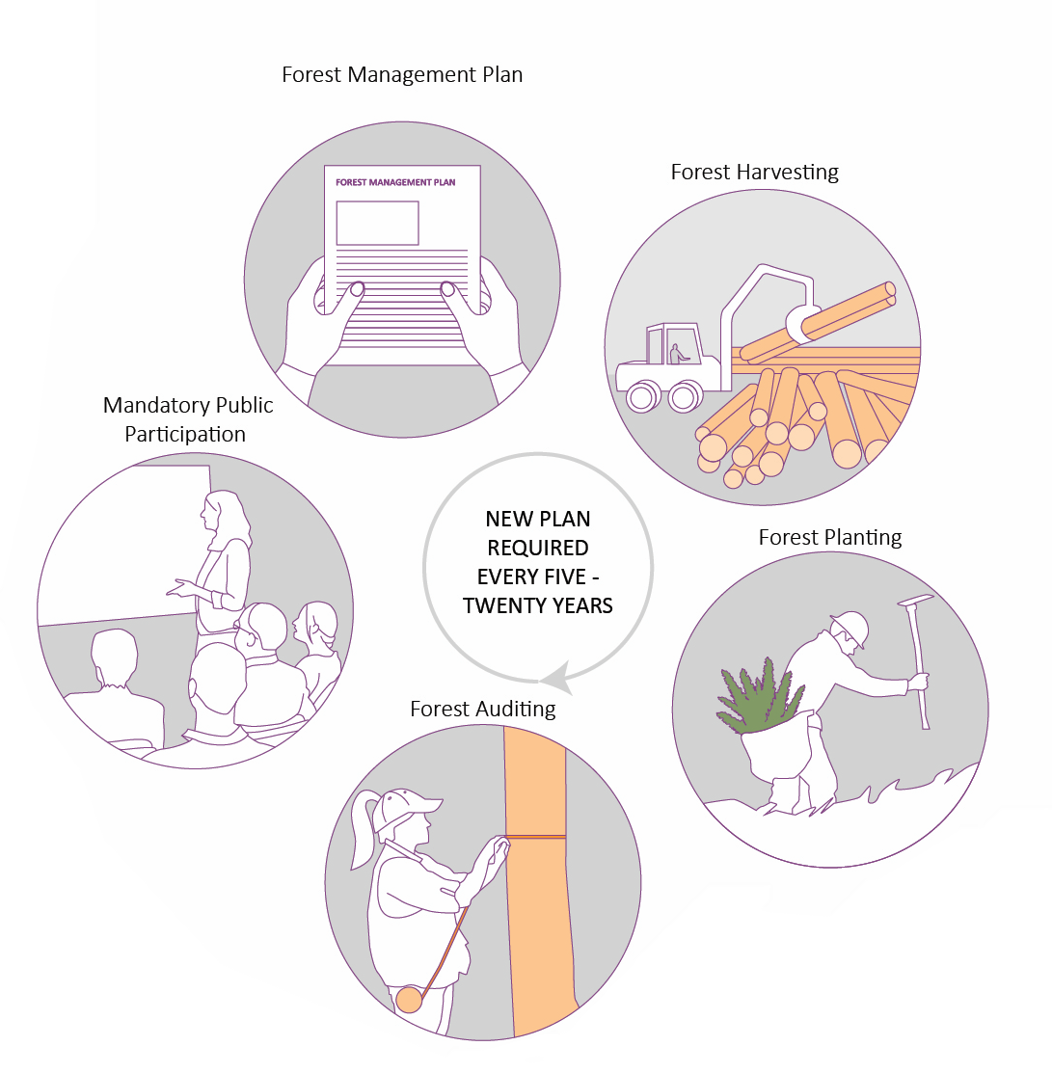
Each PPT slide is accompanied by notes and links. See other resources in the learning module PDF document.
Forest Management Planning is Required by Law in Canada
One of the main tools used to ensure forest sustainability in Canada
There is long-term monitoring of forestry practices to ensure plan adherence
Forest science is the foundation of forest management planning
Image Credit: Sanjana Patel
Notes:
Slide 15: Forest Management Planning is Required by Law in Canada
One of the main tools used to ensure forest sustainability in Canada (Natural Resources Canada, 2020).
Each forestry company is required by law to create a forest management plan, and have it approved by the government before they can begin harvesting.
Forest management planning involves work schedules, 5-20-year approval periods, and is based on long-term plans.
A forest management plan usually covers a period of several years; in Ontario it covers a 10-year period (Ministry of Northern Development, Mines, Natural Resources and Forestry, 2021).
A forest management plan (Natural Resources Canada, 2020):
Provides an assessment of the current state of the forest (inventory), which includes information on the size, number, and species of trees in the forest,
Sets out the management objectives, which must show a commitment to balancing social, environmental, and economic values,
Identifies protected areas with non-timber values such as: wildlife habitat, recreation, tourism,
Describes the harvesting, regeneration, and other activities to be carried out:
Other activities include providing access to timber through the construction of roads and bridges and maintenance to ensure the forest is productive.
To guide activities such as roadbuilding and timber harvesting, more detailed plans are also written along with annual operating plans that detail where and when harvesting and regeneration activities will occur.
There is long-term monitoring of forestry practices to ensure plan adherence (Natural Resources Canada, 2020).
This involves tracking timber that is harvested, ensuring companies meet forest regeneration standards, conducting audits to determine plan adherence and assessing the effectiveness of forest management activities.
Governments also review each forestry company's plans after a certain period of time based on the province.
Forestry companies must submit regular reports on their activities and update their plans in response to changing conditions and objectives; there are penalties such as warnings, fines, and suspension of timber harvesting rights if forestry companies do not comply with forest management plans.
No plans are approved without public participation (Natural Resources Canada, 2020).
Forest management plans include involvement from Indigenous communities, the public, and stakeholders at many stages.
In many provinces, such as Ontario and British Columbia, forest management plans must be made available to the public for review.
Ontario’s forest management plans are available here: https://nrip.mnr.gov.on.ca/s/fmp-online?language=en_US.
Forest science is the foundation of forest management planning (Natural Resources Canada, 2020).
Provincial and territorial governments use the best available science to support forest management planning requirements, practices, and policies.
Research is constantly occurring in Canada’s forests to inform sustainable forest management practices.
The Canadian Forest Service, a science-based policy organization that is part of the federal government, provides science and policy expertise on forestry issues; topics under study include climate change, forest fires, and forest pests and diseases (Canadian Forest Service, 2020).
Slide 15 References:
Canadian Forest Service. (2020). Canadian Forest Service research projects. Government of Canada. https://cfs.nrcan.gc.ca/projects.
Ministry of Northern Development, Mines, Natural Resources and Forestry. (2021). Forest management planning. Government of Ontario. https://www.ontario.ca/page/forest-management-planning.
Natural Resources Canada. (2020). Forest management planning. Natural Resources Canada. https://www.nrcan.gc.ca/our-natural-resources/forests/sustainable-forest-management/forestmanagement-planning/17493

Slide 16
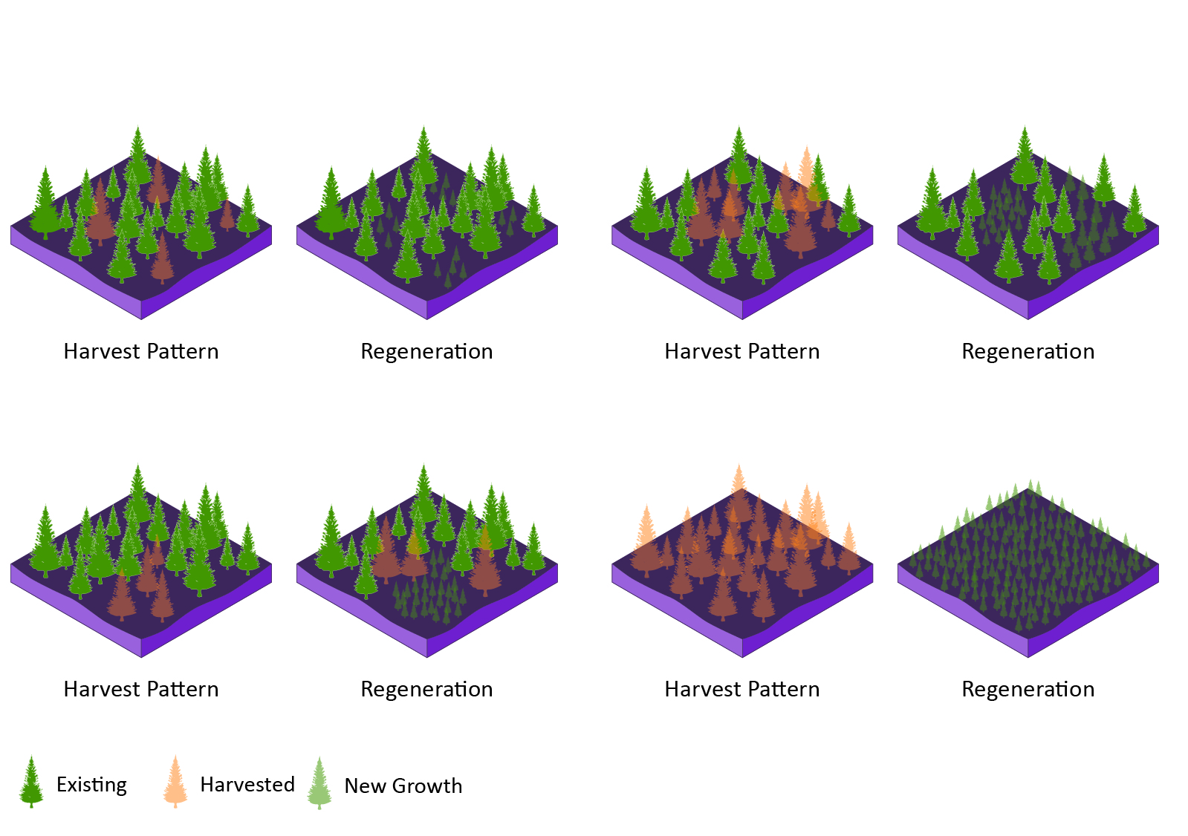
Each PPT slide is accompanied by notes and links. See other resources in the learning module PDF document.
Silvicultural Systems
Silviculture (from the Latin silvi, which means ‘forest’) is the art and science of growing trees.
The silvicultural systems typically used in Canada are:
  Single tree selection
  Group selection
  Shelterwood
  Clear-cut (most controversial)
Silvicultural system selection depends on the condition of the forest stand such as the species’ shade tolerance and moisture needs.
Single Tree Selection
Group Selection
Shelterwood
Clear Cut
Image Credit: Sanjana Patel
Notes:
Slide 16: Silvicultural Systems
Silviculture (from the Latin silvi, which means ‘forest’) is the art and science of growing trees (Ministry of Natural Resources, 2013).
It involves “controlling the establishment, growth, composition, health, and quality of forests and woodlands to meet the diverse needs and values of landowners and society such as wildlife habitat, timber, water resources, restoration, and recreation on a sustainable basis” (U.S. Forest Service, n.d.).
A silvicultural system refers to a planned program of treatments that is designed to achieve specific stand structural objectives (Ministry of Forests, 2003).
Treatments include specific harvesting methods, regeneration techniques, and stand tending methods such as thinning.
The silvicultural systems typically used in Canada are:
Single tree selection, which involves the removal of single trees to create small openings that promote the growth and establishment of shade tolerant tree species such as sugar maple (Ministry of Northern Development, Mines, Natural Resources and Forestry, 2021).
Group selection, which involves the removal of small groups of trees to create openings that promote uneven-aged or multi-cohort stands as the groups of trees are replaced.
Group selection can increase tree species diversity as it promotes the regeneration of shade-intolerant species due to the larger canopy gaps along with the regeneration of shade-tolerant species.
Group selection may also have other ecological benefits such as the creation of wildlife habitat and increased levels of biodiversity.
Shelterwood, which involves the removal of trees in a series of cuts in order to achieve a new stand under the shelter of the remaining trees (Beadle & Sands, 2004).
In this system, the remaining trees provide the seed source for the new trees.
The shelterwood system is suitable for trees that have intermediate shade tolerance (mid-tolerant) (Algonquin Forestry Authority, 2022).
This system mimics natural disturbances such as fire, insect outbreaks, and wind storms; in Ontario, the shelterwood system is used to regenerate white pine (Ministry of Natural Resources, 2013).
White pine has intermediate shade tolerance and is adapted to a fire regime consisting of surface fires every 20-40 years and stand-replacing fires every 150-300 years.
Since Canada does not have a natural fire regime anymore due to fire suppression, the shelterwood system emulates this natural fire regime and allows for the growth and establishment of white pine.
Clearcut, which involves the removal of the entire stand over a short period of time to create an exposed microenvironment for the establishment of a new even-aged stand (Ministry of Northern Development, Mines, Natural Resources and Forestry, 2021).
Regeneration then occurs naturally as seedlings and saplings grow or through the planting of new trees.
Clearcutting is considered by many to be environmentally harmful, but there are circumstances in which this system is the most suitable.
In many natural forests, large levels of tree loss arise from natural disturbance (usually through fire) and are critical for forest regeneration and replacement; clearcutting emulates this kind of natural disturbance and provides opportunities for new trees, particularly those requiring lots of sun, to grow (Ministry of Natural Resources, 2013).
Clearcutting is mainly used in stands with tree species that are adapted to regenerating after large natural disturbances such as fires; these species include jack pine, black spruce, poplar, and white birch (Ministry of Natural Resources, 2013).
Clearcutting also provides wildlife habitat for species that prefer young forests such as moose (Ministry of Natural Resources, 2013).
Silvicultural system selection depends on the condition of the forest stand such as the species’ shade tolerance, natural disturbance regime, moisture needs, and the desired future state of the forest (Ministry of Natural Resources, 2013).
Silvicultural research by Natural Resources Canada and its partners is underway to identify strategies to lower production costs, increase the volume and quality of timber, while ensuring forest sustainability (Natural Resources Canada, 2020).
Data on the area harvested in Canada by silvicultural system is available in the National Forestry Database (Canadian Council of Forest Ministers, 2022).
Slide 16 References:
Algonquin Forestry Authority. (2022). Silvicultural Systems: Even-Aged — Shelterwood. Algonquin Forestry Authority. https://algonquinforestry.on.ca/policy-planning-sustainable-forest-management-policy/silvicultural-systems-even-aged-shelterwood/.
Beadle, C., & Sands, R. (2004). Tree Physiology: Physiology and silviculture. Encyclopedia of Forest Sciences, 1568–1577. https://doi.org/10.1016/b0-12-145160-7/00097-1.
Canadian Council of Forest Ministers. (2022). Harvest | National Forestry Database. National Forestry Database. http://nfdp.ccfm.org/en/data/harvest.php
Ministry of Forests. (2003). Silvicultural Systems Handbook for British Columbia. Government of British Columbia. http://www.for.gov.bc.ca/HFP/Pubssilvsystems.htm.
Ministry of Natural Resources. (2013). Emulating natural disturbances: clearcut silviculture in Ontario. Government of Ontario. https://dr6j45jk9xcmk.cloudfront.net/documents/3123/stdprod-110056.pdf.
Ministry of Northern Development, Mines, Natural Resources and Forestry. (2021). Forest Management Guide to Silviculture in the Great Lakes-St. Lawrence and Boreal Forests of Ontario. Government of Ontario. https://www.ontario.ca/page/forest-management-guide-silviculture-great-lakes-st-lawrence-and-boreal-forests-ontario.
Natural Resources Canada. (2020). Silvicultural research. Natural Resources Canada. https://www.nrcan.gc.ca/our-natural-resources/forests/industry-and-trade/forest-industry-tools-research/silvicultural-research/13341
U.S. Forest Service. (n.d.). Silviculture. U.S. Forest Service. https://www.fs.fed.us/forestmanagement/vegetation-management/silviculture/index.shtml.

Slide 17
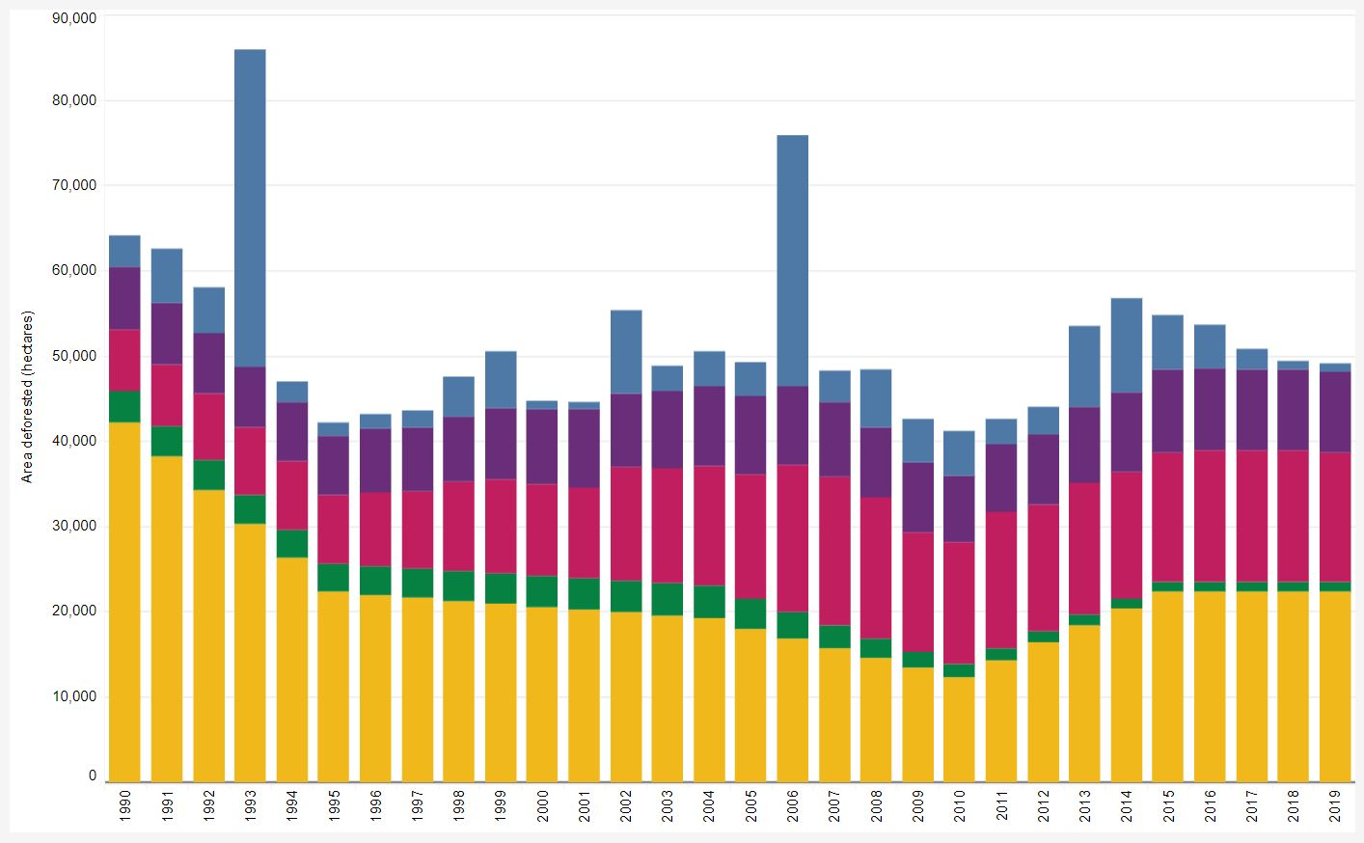
Each PPT slide is accompanied by notes and links. See other resources in the learning module PDF document.
Causes of Deforestation
Estimated area (hectares) of annual deforestation in Canada, by industrial sector, 1990–2019
Hydroelectric
Built-up
Mining, oil and gas
Forestry
Agriculture
Image Credit:
Natural Resources Canada. (2022, March 25). How much forest does Canada have? State of Canada’s Forests Report. https://www.nrcan.gc.ca/our-natural-resources/forests/state-canadas-forests-report/how-much-forest-does-canada-have/17601
Notes:
Slide 17: Causes of Deforestation
Deforestation refers to the permanent removal of forested land to other uses such as agriculture or urban sprawl (Government of Canada, 2020)
Timber harvesting and natural disturbances such as forest fires, which lead to forest cover change, are not considered deforestation since the area is replanted or regenerates naturally, which renews the forest
Canada has a very low deforestation rate at less than 0.5% each year between 1990 to 2018 (Natural Resources Canada, 2020, p. 20)
The large increases in deforestation during the year 1993 and 2006 were caused by the flooding of forests during the development of hydroelectric reservoirs (Natural Resources Canada, 2020, p. 20)
The industries that cause the most deforestation in Canada are the mining, oil, and gas, and agriculture industries (Natural Resources Canada, 2020, p. 20)
Canada has the National Deforestation Monitoring System (NDMS), which is one of the world’s most sophisticated systems to track land use changes from forest to other land uses such as agriculture or urban development (Dyk et al., 2015)
The extent of Canada’s deforestation has been challenged by environmental groups
A notable example is a study done by the Wildlands League; a Canadian not-for-profit charity dedicated to nature conservation
This study argues that deforestation in Canada is higher than reported due to “logging scars,” which refer to the loss of productive forest from clearcutting forests in Ontario (Wildlands League, 2020)
Slide 17 References:
Dyk, A., Leckie, D. G., Tinis, S., & Ortlepp, S. M. (2015). Canada’s National Deforestation Monitoring System: System Description. National Resources Canada. https://cfs.nrcan.gc.ca/publications?id=36042.
Government of Canada. (2020). Deforestation. Government of Canada. https://www.canada.ca/en/services/environment/natural-resources/forests/deforestation.html.
Natural Resources Canada. (2020). The State of Canada’s Forests: Annual Report 2020. Natural Resources Canada. https://cfs.nrcan.gc.ca/publications?id=40219.
Wildlands League. (2020). Logging Scars Report. Logging Scars: Wildlands League. https://loggingscars.ca/report/

Slide 18
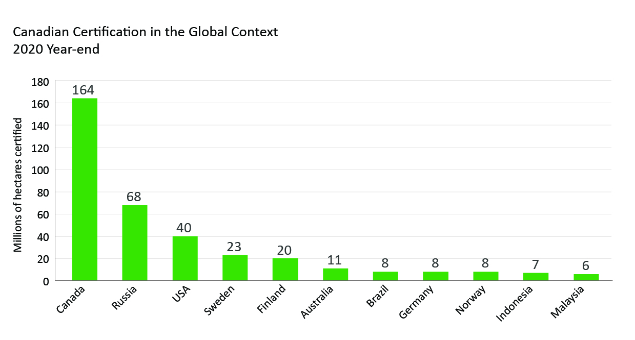
Each PPT slide is accompanied by notes and links. See other resources in the learning module PDF document.
What is Forest Certification?
Forest management certification (which is done by third-party independent auditors) is the public’s source of info to assess the sustainability of forestry operations.
In 2020, more than 75% of Canada’s managed forests were certified.
Some environmental advocates call for improvements to forest certification (Greenpeace International, 2021).
Greenpeace International. (2021). Destruction: Certified. Greenpeace. https://www.greenpeace.org/static/planet4-international-stateless/2021/04/b1e486be-greenpeace-international-report-destruction-certified_finaloptimised.pdf
Image Credit: Forest Products Association of Canada. (2019). Canadian Certification in the Global Context. https://certificationcanada.org/wp-content/uploads/2020/02/CertificationGlobalContext2019.pdf
Notes:
Slide 18: What is Forest Certification?
Forest certification, which is performed by third-party independent auditors, is the public’s source of info to assess the sustainability of forestry operations (Natural Resources Canada, 2021a).
Forest certification is in addition to the laws and regulations surrounding forest management in Canada and provide additional assurance that a forest company is operating sustainably (Natural Resources Canada, 2021a).
Forest certification emerged in the 1990s and was adopted quickly across Canada (Natural Resources Canada, 2021a).
Forest certification allows consumers to consider this in their purchasing decisions and forestry companies can use it to show their commitment to sustainability (Natural Resources Canada, 2021a).
Forest certification can also help improve forestry practices globally as consumer demand for certified wood increases (Natural Resources Canada, 2021a).
Some of the assurances that forest certification provides are sustainable harvesting plans, wildlife habitat protection, soil quality maintenance, and ensuring that no illegal logging is occurring (Forest Products Association of Canada, 2020).
In 2020, more than 75% of Canada’s managed forests were certified (Natural Resources Canada, 2021a).
Globally, this represents 36% of all certified forests; this means that Canada has the largest area of independently certified forests of any nation (Natural Resources Canada, 2021a).
Some environmental advocates call for improvements to forest certification:
Greenpeace, an independent global campaigning network dedicated to environmental protection, published a report called “Destruction: Certified”, which evaluates the effectiveness of numerous certification programs and describes the limitations of forest certification (Greenpeace International, 2021).
A coalition of Canada environmental groups (Ecojustice, Stand.earth, and the Ancient Forest Alliance) have filed an investigation request into the Canadian Standards Association for false sustainable labelling of wood from British Columbia (Baker, 2021).
Slide 18 References:
Baker, R. (2021, July 21). Green coalition challenges certification claims that Canada’s forestry products are sustainable. Canada’s National Observer. https://www.nationalobserver.com/2021/07/21/news/green-coalition-challenges-certification-claims-canadas-forestry-products.
Forest Products Association of Canada. (2020). Forest certification in Canada: The Programs, Similarities & Achievements. FPAC. https://www.fpac.ca/reports/forest-certification-in-canada-the-programs-similarities-achievements.
Greenpeace International. (2021). Destruction: Certified. Greenpeace. https://www.greenpeace.org/static/planet4-international-stateless/2021/04/b1e486be-greenpeace-international-report-destruction-certified_finaloptimised.pdf.
Natural Resources Canada. (2021a). Forest certification in Canada. Natural Resources Canada. https://www.nrcan.gc.ca/our-natural-resources/forests/sustainable-forest-management/forest-certification-canada/17474.

Slide 19

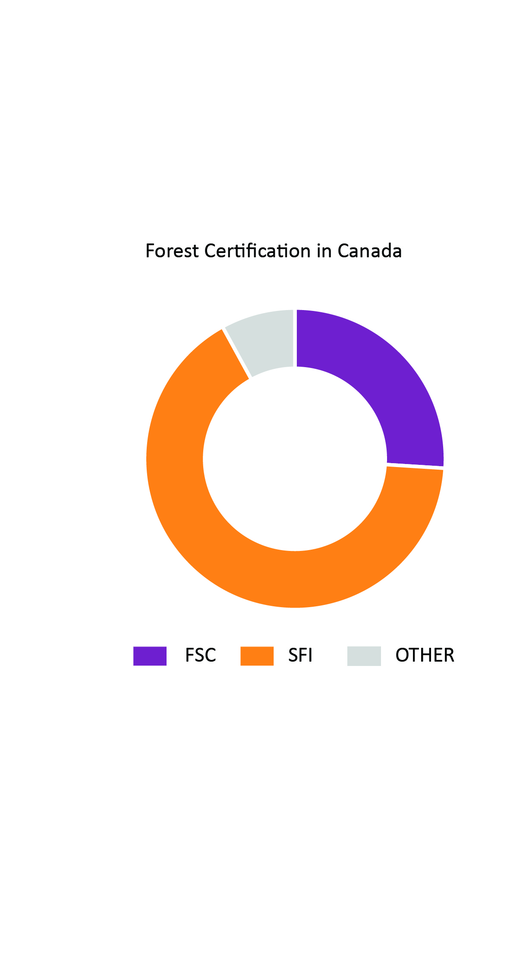

Each PPT slide is accompanied by notes and links. See other resources in the learning module PDF document.
Canada’s Certification Systems
The 2 largest forest certification systems in Canada are:
Forest Stewardship Council (FSC)
    Supported by environmental organizations
Sustainable Forestry Initiative (SFI)
    Developed by the forest industry
The Woodworkers Alliance for Rainforest Protection developed the idea of forest certification in the early 1990s.
8% Other
(13)
19% Other (86)
48% FSC Certified
(220)
26% FSC Certified
(48)
33% SFI Certified
(150)
66% SFI Certified
(121)
Global Forest Certification (millions of ha)
Canadian Forest Certification (millions of ha)
Data Source: Certification Canada, 2021. 2020 Year-end Statistics. https://certificationcanada.org/en/statistics/canadian-statistics/
Notes:
Slide 19: Canada’s Certification Systems
The two largest forest certification systems in Canada are:
Forest Stewardship Council (FSC)
Initially supported by environmental organizations
Sustainable Forestry Initiative (SFI)
Developed by the forest industry
The standards used to evaluate forest operations for sustainability are constantly updated to reflect current knowledge and concerns about sustainable forest management (Forest Products Association of Canada, 2020).
The Woodworkers Alliance for Rainforest Protection, a coalition of woodworkers, wood importers, and ecologists advocating for the end of tropical deforestation and illegal logging, developed the idea of forest certification in the early 1990s (Rotherham, 2016).
After environmental organizations like the World Wildlife Fund (WWF) began advocating for forest certification, the Forest Stewardship Council (FSC) was established (Rotherham, 2016).
Forest managers have adopted FSC certification in response to market pressures; a core group of environmental non-profit organizations have encouraged consumers to only purchase and use FSC-certified products (Rotherham, 2016).
FSC was established in 1993 and is globally popular (Forest Stewardship Council, n.d.).
It is considered the most robust forest certification system by many environmental organizations such as the World Wildlife Fund and Greenpeace, who helped establish it (Rotherham, 2016).
It is also considered the most prescriptive and comprehensive forest certification system in Canada (Forest Stewardship Council, n.d.).
SFI was established in 1993 by the forest industry (American Forest and Paper Association) as a less prescriptive alternative to FSC (Sustainable Forestry Initiative, n.d.).
Currently, SFI is independently managed and has more rigorous standards than when it was established (Sustainable Forestry Initiative, n.d.).
SFI only operates in North America.
FSC International is one of two international forest certification programs; the other is the Programme for the Endorsement of Forest Certification (PEFC).
The common objective of both (FSC and PEFC) is to improve forest management and provide assurance to the public and customers that forest products come from sustainably managed forests and not from illegal operations (Natural Resources Canada, 2021).
Another forest certification system that is used in Canada, but to a much smaller degree, is the Canadian Standards Association (CSA) (Natural Resources Canada, 2021).
It accounts for 7% of certified forests in Canada and its standards are heavily dependent on local conditions (Forest Products Association of Canada, n.d.; Canadian Sustainable Forest Management, n.d.).
The first CSA sustainable forest management standard was published in 1996, with new editions published in 2002, 2008, and 2016.
Although all forest certification programs have similar goals related to sustainable forestry, they differ in their comprehensiveness and prescriptiveness (Gutierrez Garzon et al., 2020).
Slide 19 References:
Canadian Sustainable Forest Management. (n.d.). Forests Certified to CSA: your assurance of Canada’s highest standard. Canadian Standards Association. https://www.csasfmforests.ca/default.htm.
Forest Products Association of Canada. (2020). Forest certification in Canada: The Programs, Similarities & Achievements. FPAC. https://www.fpac.ca/reports/forest-certification-in-canada-the-programs-similarities-achievements.
Forest Products Association of Canada. (n.d.). Canadian Statistics. Certification Canada. https://certificationcanada.org/en/statistics/canadian-statistics/.
Forest Stewardship Council. (n.d.). Home page. Forest Stewardship Council. https://ca.fsc.org/ca-en.
Gutierrez Garzon, A. R., Bettinger, P., Siry, J., Abrams, J., Cieszewski, C., Boston, K., Mei, B., Zengin, H., & Yeşil, A. (2020). A comparative analysis of five forest certification programs. Forests, 11, 863, 1-12. doi:10.3390/f11080863.
Natural Resources Canada. (2021). Forest certification in Canada. Natural Resources Canada. https://www.nrcan.gc.ca/our-natural-resources/forests/sustainable-forest-management/forest-certification-canada/17474.
Rotherham, T. (2016). Forest Management Certification in Canada and around the world. The Forestry Chronicle, 92(02), 142–146. https://doi.org/10.5558/tfc2016-031
Sustainable Forestry Initiative. (n.d.). Home page. Sustainable Forestry Initiative. https://forests.org/.

Slide 20
Natural Disturbance is in the Life Cycle of Forests
Each PPT slide is accompanied by notes and links. See other resources in the learning module PDF document.
4% (740,000)
  Disturbances, such as forest fires, insect outbreaks, and diseases have regenerated forests for thousands of years.
  Sustainable forest management practices attempt to mimic natural disturbances (clearcuts in the disturbance-driven boreal forest).
  Fire, insect outbreaks, and other natural disturbances have a much larger impact on forests than harvesting does.
96%
(17,600,000)
  INSECT AND FIRE HARVEST
Disturbance due to Harvest vs. Insect and Fire (ha), Average from 2009-2019.
Data Source: Natural Resources Canada, 2021. The State of Canada’s Forests: Annual Report 2021, 33. https://www.nrcan.gc.ca/sites/nrcan/files/forest/sof2021/6317_NRCan_SoF_AR_2021_EN_P7B_web_accessible.pdf
Notes:
Slide 20: Natural Disturbance is in the Life Cycle of Forests
Disturbance, such as forest fires, insect outbreaks, and disease have regenerated forests for thousands of years, and are part of the natural forest cycle (Natural Resources Canada, 2022).
Disturbance removes old and unhealthy trees, helps cycle nutrients, and creates dead wood, which becomes food and habitat for plants and animals, and helps new trees to grow (Natural Resources Canada, 2022).
Fire, insect outbreaks, and other natural disturbances have a much larger impact on forests than harvesting does.
In 2020, approximately 19 million hectares were impacted by fire, insects, and disease; this is almost 25 times the area harvested by the forest sector (Forest Products Association of Canada, 2021).
The boreal forest requires natural disturbances such as forest fires, and insect and disease outbreaks (Natural Resources Canada, 2010).
Disturbance often occurs on a larger scale there compared to other forests in Canada such as temperate forests (Natural Resources Canada, 2022).
Large insect outbreaks and diseases help to renew the forest by killing sick and ageing trees; this reduces competition among trees and can help make forests more productive (Natural Resources Canada, 2022).
Fires release valuable nutrients stored in the leaf layer on the forest floor and open the canopy to allow sunlight to enter, which helps new trees grow.
Fire also allows fire-adapted tree species such as jack pine and lodgepole pine to regenerate by opening their cones and releasing their seeds; these tree species have serotinous cones which are covered in resin and require high temperatures to melt them and allow the cones to open and release the seeds (Natural Resources Canada, 2022).
Disturbance gives way to succession, which shapes landscapes by producing a variety of forest types with trees of different ages and species; this contributes to biodiversity (Natural Resources Canada, 2020a, p. 31).
Research is ongoing to better understand how Canada’s forests respond to disturbance and how to use this information to improve forest management practices to maintain healthy forests (Natural Resources Canada, 2020b).
Slide 20 References:
Forest Products Association of Canada. (2021). Fire, Pests & Disease. Forestry for the future. https://www.forestryforthefuture.ca/topics/fire-pest-disease.
Natural Resources Canada. (2010, November 25). Natural Disturbances in Canada's Boreal Forest [Video]. Youtube. https://www.youtube.com/watch?v=bH1yAOhlmnE.
Natural Resources Canada. (2020a). The State of Canada’s Forests: Annual Report 2020. Natural Resources Canada. https://cfs.nrcan.gc.ca/publications?id=40219.
Natural Resources Canada. (2020b). Forest management and natural disturbances research. Natural Resources Canada. https://www.nrcan.gc.ca/our-natural-resources/forests/wildland-fires-insects-disturbances/forest-management-and-natural-disturbances-research/13187.
Natural Resources Canada. (2022). Why forests need fires, insects and diseases. Natural Resources Canada. https://www.nrcan.gc.ca/our-natural-resources/forests/wildland-fires-insects-disturbances/why-forests-need-fires-insects-and-diseases/13081.

Slide 21

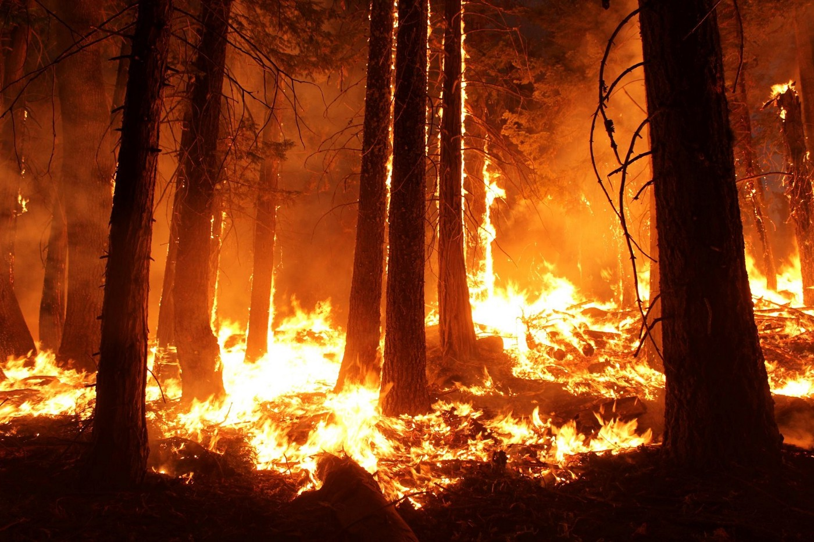
The Climate Crisis is Increasing the Frequency and Intensity of Natural Disturbance
Each PPT slide is accompanied by notes and links. See other resources in the learning module PDF document.
Fires, insect outbreaks, and diseases are becoming more frequent and severe due to climate change.
This puts communities and forests at risk and releases large amounts of CO₂ into the atmosphere.
Forest management practices to help forests adapt to climate change are being explored.
Forest fires are becoming more frequent and severe, putting communities and forests at risk.
Image Credit: Williams, S. B. T. (2018). Wildfire Destruction — A Random Forest Classification of Forest Fires | by Sky B.T. Williams | Towards Data Science. Towards Data Science. https://towardsdatascience.com/wildfire-destruction-a-random-forest-classification-of-forest-fires-e08070230276
Notes:
Slide 21: The Climate Crisis is Increasing the Frequency and Intensity of Natural Disturbance
Fires, insect outbreaks, and disease are becoming more frequent and severe due to climate change (Natural Resources Canada, 2020a).
Studies show that fire activity is increasing in Canada’s forests (Flannigan et al., 2015; Kelly et al., 2013).
This puts communities and forests at risk and releases large amounts of CO₂ into the atmosphere.
Large wildfires such as the one in Fort McMurray, AB in 2016 and Parry Sound, ON in 2018 led to large community evacuations and damage to property (Snowdon, 2017; Roy, 2018).
Forest management practices to help forests adapt to climate change are being explored (Natural Resources Canada, 2020b; Natural Resources Canada, 2021).
For instance, the sector is exploring the use of assisted tree migration, which involves the human-assisted movement of trees to areas that are more climatically suitable (Natural Resources Canada, 2020c).
Slide 21 References:
Flannigan, M. D., Wotton, B. M., Marshall, G. A., de Groot, W. J., Johnston, J., Jurko, N., & Cantin, A. S. (2015). Fuel moisture sensitivity to temperature and precipitation: Climate change implications. Climatic Change, 134(1-2), 59–71. https://doi.org/10.1007/s10584-015-1521-0
Kelly, R., Chipman, M. L., Higuera, P. E., Stefanova, I., Brubaker, L. B., & Hu, F. S. (2013). Recent burning of boreal forests exceeds fire regime limits of the past 10,000 years. Proceedings of the National Academy of Sciences, 110(32), 13055–13060. https://doi.org/10.1073/pnas.1305069110
Natural Resources Canada. (2020a). Impacts. Natural Resources Canada. https://www.nrcan.gc.ca/climate-change-adapting-impacts-and-reducing-emissions/climate-change-impacts-forests/impacts/13095.
Natural Resources Canada. (2020b). Adaptation. Natural Resources Canada. https://www.nrcan.gc.ca/climate-change/impacts-adaptations/climate-change-impacts-forests/adaptation/13099.
Natural Resources Canada. (2020c). Assisted migration. Natural Resources Canada. https://www.nrcan.gc.ca/climate-change-adapting-impacts-and-reducing-emissions/climate-change-impacts-forests/adaptation/assisted-migration/13121.
Natural Resources Canada. (2021). Forest Change adaptation tools. Natural Resources Canada. https://www.nrcan.gc.ca/climate-change-adapting-impacts-and-reducing-emissions/climate-change-impacts-forests/forest-change-adaptation-tools/17770
Roy, G. (2018, August 6). Forest fires like ones in Ontario can take long-term environmental toll, experts say. Global News. https://globalnews.ca/news/4372835/forest-fires-environmental-impact/.
Snowdon, W. (2017, January 17). Fort McMurray wildfire costs to reach almost $9B, new report says. CBC. https://www.cbc.ca/news/canada/edmonton/fort-mcmurray-wildfire-costs-to-reach-almost-9b-new-report-says-1.3939953.

Slide 22
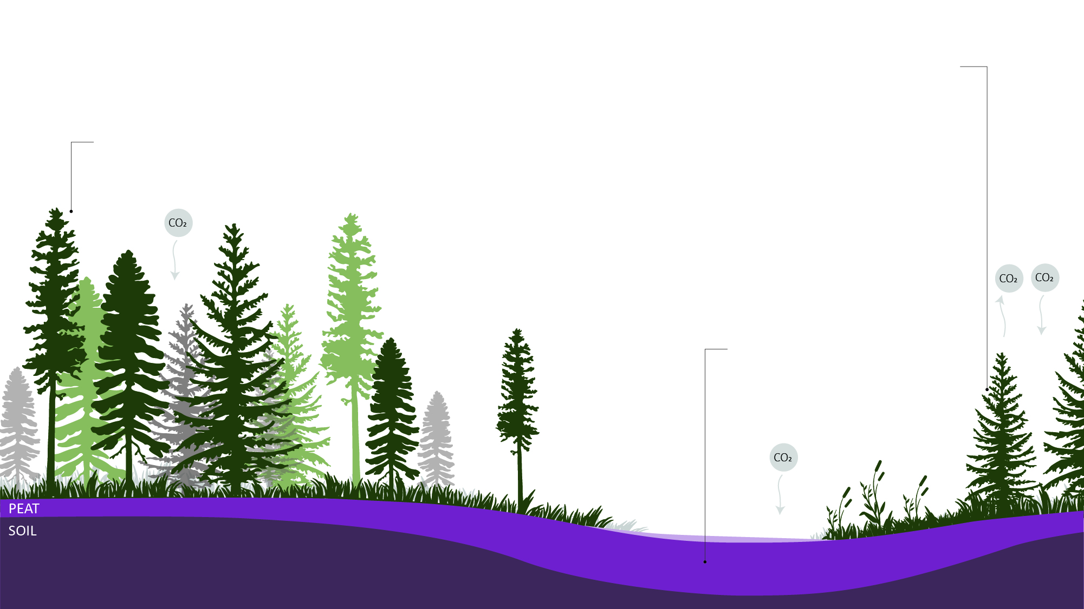
Forests Capture and Store Carbon
Forests were carbon sinks, but are now turning to carbon sources.
Canada monitors greenhouse gas (GHG) emissions under the United Nations Framework Convention on Climate Change.
Forests are essential to absorbing carbon dioxide from the atmosphere.
They have absorbed 25% of carbon emitted by human activities in the last 40 years
Image Credit: Sanjana Patel
Peat in the boreal forests of Canada stores large amounts of carbon.
Notes:
Slide 22: Forests Capture and Store Carbon
Carbon Storage and sequestration of forests:
Forests help maintain the earth’s carbon balance through carbon fluxes. This is the exchange of carbon from tree biomass (leaves, wood) and soils to and from the atmosphere. This is especially important in the current climate crisis as atmospheric carbon dioxide is known as a contributor to global warming cascading to adverse climatic events.
Carbon sequestration is known as the process by which atmospheric carbon dioxide is consumed through photosynthesis by plants, and used to create biomass such as leaves, wood, roots, and soils (United States Department of Agriculture (USDA) Forest Service, n.d.).
Forests have absorbed 25% of the carbon emitted by human activities in the past four decades (Natural Resources Canada, 2022).
A broad overview of forest carbon sequestration is described by Kananaskis (2017). The report states that Canada’s boreal forests and peatlands store large amounts of carbon. The report also maintains that peatland contains a large amount of carbon, however the carbon flux in the peatlands has been historically low as this carbon is in a sense, locked into the ground (Kananaskis, 2017).
The boreal and temperate forests in Canada are some of the world's most important carbon sinks. Scientists are calling on Trudeau to protect these important resources (Labbe, 2022).
The role of soils in carbon storage:
Soil also holds a significant amount of carbon in Canada (Saxifrage, 2022)
Hudson and James Bay lowlands are important carbon storage areas due to their carbon dense peatlands (Martin, 2022).
Slide 22 References:
Kananaskis, A. (2017). Forest Carbon sequestration and avoided emissions. www.ivey.org
Labbe, S. (2022). 90 scientists call on Trudeau to protect forests ahead of climate plan - Victoria Times Colonist. Times Colonist. https://www.timescolonist.com/local-news/logging-threatens-critical-lifeline-to-fend-off-climate-crisis-scientists-warn-trudeau-5192011
Martin, C. (2022). Digging into soil carbon: How the ground under our feet can help fight climate change. World Wildlife Fund. https://wwf.ca/stories/what-is-soil-carbon-climate-change/
Natural Resources Canada. (2022.). Forest carbon. Retrieved March 31, 2022, from https://www.Natural Resources Canada.gc.ca/climate-change-adapting-impacts-and-reducing-emissions/climate-change-impacts-forests/forest-carbon/13085
Saxifrage, B. (n.d.). How B.C.’s forests became a carbon-spewing liability | Canada’s National Observer: News & Analysis. Retrieved March 31, 2022, from https://www.nationalobserver.com/2022/03/04/analysis/how-bcs-forest-became-carbon-spewing-liability
United States Department of Agriculture (USDA) Forest Service. (n.d.). Carbon Sequestration. Retrieved April 3, 2022, from https://www.fs.fed.us/ecosystemservices/carbon.shtml

Slide 23
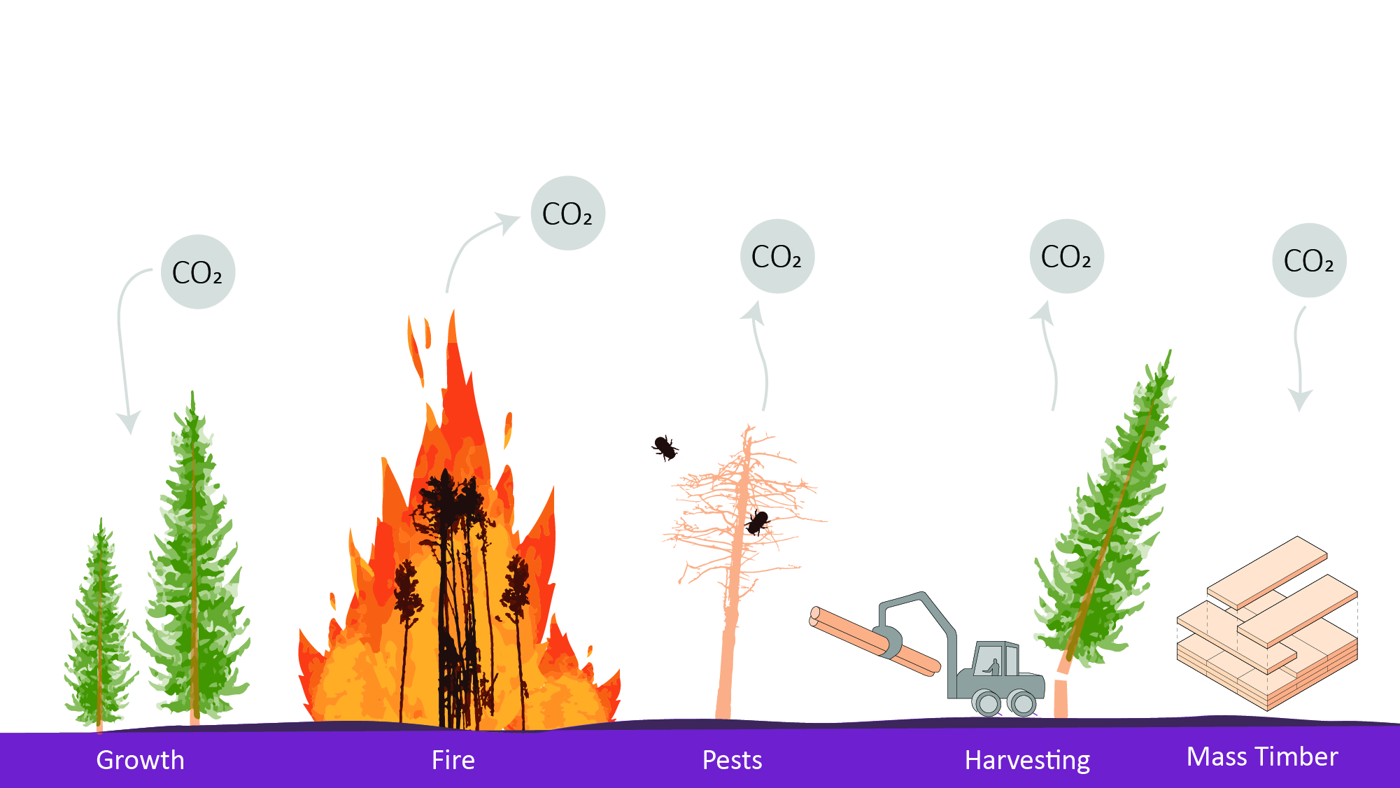
Each PPT slide is accompanied by notes and links. See other resources in the learning module PDF document.
Factors Impacting Forest Carbon Storage
Image Credit: Sanjana Patel
23
Notes:
Slide 23: Factors Impacting Forest Carbon Storage:
Climate change is resulting in more intense and frequent wildfires, droughts and insect infestations (Kananaskis, 2017., Walker et al., 2019)
As a result, some forests in British Columbia that have been carbon sinks in the past, are now transitioning to becoming carbon sources (Saxifrage, 2022).
Canada has an obligation under the United National Framework Convention on Climate Change (https://unfccc.int/) to monitor and report the GHG emissions and changes in the carbon stock of its forests (Natural Resources Canada, 2022d).
Monitoring Carbon fluxes:
The Canadian Forest Service (CFS) uses the National Forest Carbon Monitoring, Accounting and Reporting System (NFCMARS) to monitor carbon.
This reporting occurs annually.
Within this, the Carbon Budget Model of the Canadian Forest Sector (CBM-CFS3) is used.
This model estimates that Canada’s managed forests have been a sink for the past 70 years (Kananaskis, 2017).
One report points out the loopholes behind the carbon accounting present in Canada’s logging industry (Skene et al., 2021).
Background information for this report can be found in the report (Bramley et al., 2021).
Factors impacting carbon storage:
There are many factors impacting the levels of carbon stored in forests including:
Growth, decomposition, disturbances (fire, and insects), harvesting and land-use changes.
There has already been an increase in fire severity and pest infestations such as the Mountain Pine Beetle in British Columbia and Alberta. This leads to forests acting more as carbon sources rather than sinks as high levels of pest infestation causes high tree mortality, and decreases overall forest health.
While it is known that young trees sequester more carbon than old trees, it is relatively well understood that converting old-growth forests (topic covered in slide 13) to young forests does not decrease atmospheric carbon dioxide (Harmon et al., 1990., Kananaskis, 2017).
The potential of carbon sequestration by forests:
Tree planting in understocked areas has the potential to increase carbon sequestration capacity of forests in the United States (Domke et al., 2020). In addition, tree planting in previously forested sites has the greatest potential to mitigate emissions compared to afforestation (Waring et al., 2020).
One study found that natural forests store more carbon than plantation forests, because of an increased complexity and storage of carbon in the soil and forest floor. The same study by Waring et al (2020) also found that the planting location matters as well as the type of species planted, and the fate of the wood that is produced from these forests (Waring et al., 2020).
Carbon capture can be enhanced through forest management. For example: removing dying and diseased trees can enhance carbon uptake by growing trees.
Slide 23 References:
Bramley, M. J., Advisor, S., & Canada, N. (2021). Canada’s Approach to Forest Carbon Quantification and Accounting: Key Concerns.
Harmon, M. E., Ferrell, W. K., & Franklin, J. F. (1990). Effects on Carbon Storage of Conversion of Old-Growth Forests to Young Forests. In New Series (Vol. 9, Issue 4943).
Kananaskis, A. (2017). Forest Carbon sequestration and avoided emissions. www.ivey.org
Natural Resources Canada. (2022d.). Forest carbon. Retrieved March 31, 2022, from https://www.Natural Resources Canada.gc.ca/climate-change-adapting-impacts-and-reducing-emissions/climate-change-impacts-forests/forest-carbon/13085
Saxifrage, B. (n.d.). How B.C.’s forests became a carbon-spewing liability | Canada’s National Observer: News & Analysis. Retrieved March 31, 2022, from https://www.nationalobserver.com/2022/03/04/analysis/how-bcs-forest-became-carbon-spewing-liability
Skene, J., Polanyi, M., Pruess, E., Weingart, T., Ng, J., Walsh, K., Spacher, A., Vinyard, S., Lewis, C., Jordan, A., Barratt-Brown, L., Axelrod, J., Stashwick, S., Boan, J., Connolly, M., Sumner, J., Hesselink, T., & Desmarais, M.-È. (2021). Missing the Forest: How Carbon Loopholes for Logging Hinder Canada’s Climate Leadership. www.suerossi.com
Walker, X. J., Baltzer, J. L., Cumming, S. G., Day, N. J., Ebert, C., Goetz, S., Johnstone, J. F., Potter, S., Rogers, B. M., Schuur, E. A. G., Turetsky, M. R., & Mack, M. C. (2019). Increasing wildfires threaten historic carbon sink of boreal forest soils. Nature, 572(7770), 520–523. https://doi.org/10.1038/s41586-019-1474-y
Waring, B., Neumann, M., Prentice, I. C., Adams, M., Smith, P., & Siegert, M. (2020). Forests and Decarbonization – Roles of Natural and Planted Forests. Frontiers in Forests and Global Change, 3. https://doi.org/10.3389/ffgc.2020.00058

Slide 24

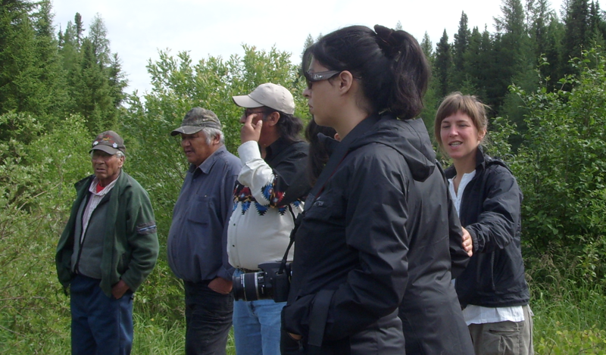
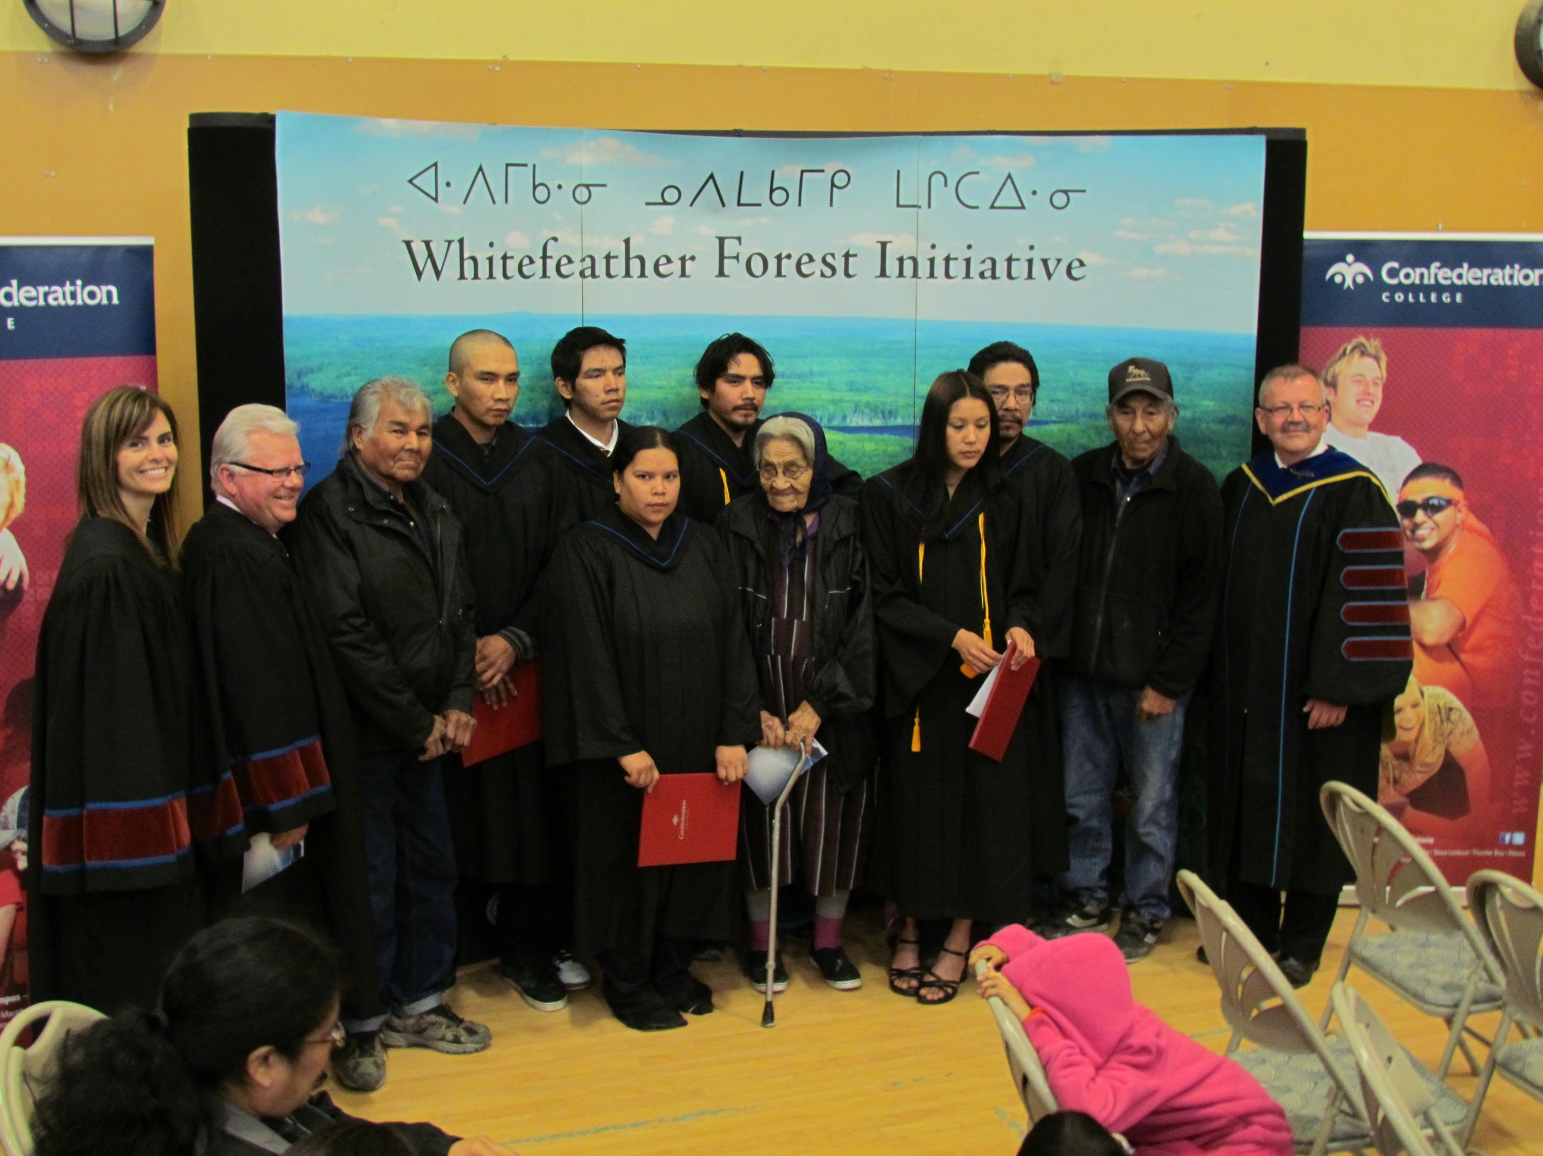
Indigenous Participation in Forestry
Each PPT slide is accompanied by notes and links. See other resources in the learning module PDF document.
Important Indigenous traditional knowledge and experience can improve Canadian forest management.
More than 70% of Indigenous peoples live near forest lands.
Forests are associated with their Aboriginal and Treaty rights.
Collaboration is growing with Indigenous communities:
  Sustainable Forestry Initiative (SFI)
  Natural Resources Canada (NRCan)
  Canadian Council of Forest Ministers (CCFM)
  Ontario Professional Forestry Association (OPFA)
Graduate university student from Quebec and member of the Conseil des Atikamekw learning about light footprint forestry from Pikangikum Elders.
Forestry is one of the largest Indigenous employers in Canada (FPAC).
Forest Ecosystem Management Technicians graduation from Confederation College (convocation held in Pikangikum).
Image Credits: Whitefeather Forest Community Resource Management Authority
Notes:
Slide 24: Indigenous Participation in Forestry:
Overview of Indigenous Participation in Forestry:
There is a long history and progress to be made on the topic of truth and reconciliation with respect to Indigenous communities in Canada especially within the forest industry.
One study found that there was an underrepresentation of diverse groups (including Indigenous communities) in community forest boards, and forest-sector advisory committees (Egunyu et al., 2020).
More information about Indigenous Peoples’ rights in Canada (Henderson & Bell, 2020).
Many groups that have been mentioned previously have recognized the unique ecological knowledge of Indigenous Peoples’. Traditional Ecological Knowledge can be defined as “the culturally and spiritually based way in which Indigenous people relate to their ecosystem” (Natural Resources Canada, 1999).
Parks Canada recognizes the importance of Indigenous knowledge and has engaged in many partnerships with Indigenous communities (Parks Canada, n.d.).
As the first stewards of the forest in Canada, Indigenous communities have extensive knowledge and experience when it comes to forest management. Many industry leaders and conservation authorities recognize the role of Indigenous communities in moving towards a more sustainable future. Organizations like the Forest Stewardship Council (FSC), Sustainable Forestry Initiative (SFI), Natural Resources Canada (NRCAN), Forest Products Association of Canada (FPAC), Canadian Council of Forest Ministers (CCFM), and the Ontario Professional Foresters Association (OPFA), recognize that not only is there a need begin respecting Indigenous communities in forestry in terms of their knowledge and best practices, but also in sharing of the economic benefits that come from forest management (CCFM, 2022; Forest Products Association of Canada, 2021; Forest Stewardship Council, n.d.; Natural Resources Canada, n.d.; Ontario Professional Foresters Association, 2018; Parks Canada, n.d.; Sustainable Forestry Initiative (SFI), n.d.).
More than 70% of Indigenous people live near forests (Canadian Council of Forest Ministers (CCFM), 2022).
The history of Indigenous people is closely tied in with the forest.
It is also important to note that Indigenous peoples are not simply stakeholders of forest management, but they hold important rights in terms of forest land that is stated in the Canadian constitution (National Aboriginal Forest Association, 2020)
Ontario for example has been committed to increasing the inclusion of Indigenous communities in forest management planning. The Forest Management Planning Manual (FMPM) allows First Nation and Metis communities some flexibility in terms of how they can be involved in developing a forest management plan. This is done in consultation with the Ministry of Natural Resources. (Ministry of Natural Resources, 2017)
The Government of Canada provides funding opportunities for Indigenous Communities in Forestry through their Indigenous Forestry Initiative (Natural Resources Canada, 2022).
Indigenous communities in Canada have a sacred relationship with Woodland Caribou (Smith, 2015).
Relevant Indigenous Communities
Some current partnerships that involve Indigenous communities include:
British Columbia Community Forest Association comprises 100 Indigenous communities (British Columbia Community Forest Association, n.d.)
Whitefeather Forest Initiative operating under a forest tenure (Whitefeather Forest Management Corporation, n.d.)
A full list can be found in the NAFA report (National Aboriginal Forest Association, 2020).
As a result of extensive industrial activity occurring in the Grassy Narrows First Nations territory, the community has banned logging in certain areas (Prokopchuk, 2018).
Other Indigenous Resources:
The Government of Canada’s Principles respecting their relationship with Indigenous peoples (Department of Justice Canada, 2018).
Publication describing the Indian Act and Aboriginal Governance in Canada (Coates, 2008).
More information about Traditional Ecological Knowledge and its application towards scientific research (U.S. Fish & Wildlife Service et al., 2011).
More information about Truth and Reconciliation in Canada (Crown-Indigenous Relations and Northern Affairs Canada, 2021).
A book that described the political, cultural, environmental, and economic implications of forest use in Canada among Aboriginal people (Tindall et al, 2013).
Information regarding Aboriginal Forestry issues in Canada (NAFA, n.d.).
Slide 24 References:
Canadian Council of Forest Ministers (CCFM). (2022). Indigenous Peoples and forests. https://www.ccfm.org/canadians-and-communities/indigenous-peoples-and-forests/
Canadian Journal of Forest Research, 50(11), 1152–1159. https://doi.org/10.1139/cjfr-2020-0026
Coates, K. (2008). The Indian Act and the Future of Aboriginal Governance in Canada. http://laws.justice.gc.ca/en/showdoc/cs/I-5/bo-ga:s_5//en#anchorbo-ga:s_5.
Crown-Indigenous Relations and Northern Affairs Canada. (2021). Truth and Reconciliation Commission of Canada. https://www.rcaanc-cirnac.gc.ca/eng/1450124405592/1529106060525
Department of Justice Canada. (2018). Principles respecting the Government of Canada’s relationship with Indigenous peoples. https://www.justice.gc.ca/eng/csj-sjc/principles-principes.html
Egunyu, F., Reed, M. G., Sinclair, A. J., Parkins, J. R., & Robson, J. P. (2020). Public engagement in forest governance in Canada: Whose values are being represented anyway?
Forest Products Association of Canada (FPAC). (2021). Indigenous Partnerships | Forestry For The Future. https://www.forestryforthefuture.ca/topics/indigenous-partnerships
Forest Stewardship Council. (n.d.). Home Page | Forest Stewardship Council. Retrieved July 28, 2022, from https://fsc.org/en
Henderson, Wi. B., & Bell, C. (2020). Rights of Indigenous Peoples in Canada. The Canadian Encyclopedia. https://www.thecanadianencyclopedia.ca/en/article/aboriginal-rights
Ministry of Natural Resources and Forestry. (2017). Forest Management Planning Manual. www.serviceontario.ca/publications
NAFA. (n.d.). The Resource Centre for Aboriginal Forestry Issues in Canada. Retrieved May 9, 2022, from http://nafaforestry.org/forest_home/about.html
National Aboriginal Forest Association. (2020). Fifth Report on Indigenous-Held Forest Tenures in Canada 2020.
Natural Resources Canada. (1999). Traditional Ecological Knowledge within the Government of Canada’s First Nation Forestry Program. https://cfs.Natural Resources Canada.gc.ca/pubwarehouse/pdfs/10458.pdf
Natural Resources Canada. (2022). Indigenous Forestry Initiative. Retrieved April 3, 2022, from https://www.nrcan.gc.ca/science-and-data/funding-partnerships/funding-opportunities/forest-sector-funding-programs/indigenous-forestry-initiative/13125
Ontario Professional Foresters Association. (2018, March). Indigenous Peoples, Lands, and Resources. The Professional Forester - Issue 229, 20–20. www.opfa.ca
Parks Canada. (n.d.). Indigenous leadership in conservation - Science and Conservation. Retrieved April 3, 2022, from https://www.pc.gc.ca/en/nature/science/autochtones-indigenous
Prokopchuk, Ma. (2018). Grassy Narrows declares logging ban in its territory ahead of forest management planning. CBC News. https://www.cbc.ca/news/canada/thunder-bay/grassy-narrows-logging-ban-1.4856870
Smith, P. (2015). A Reflection on First Nations in their Boreal Homelands in Ontario: Between a Rock and a Caribou. Conservation and Society, 13(1), 23–38. https://doi.org/10.4103/0972-4923.161214
Sustainable Forestry Initiative (SFI). (n.d.). Indigenous Relations. Retrieved April 3, 2022, from https://forests.org/indigenous/
Tindall, D. B., Trosper, L. R., & Perreault, P. (2013). Aboriginal Peoples and Forest Lands in Canada (L. R. Trosper, D. B. Tindall, & P. Perreault, Eds.). UBC Press.
U.S. Fish & Wildlife Service, Rinkevich, S., Greenwood, K., & Leonetti, C. (2011). Traditional Ecological Knowledge for Application by Service Scientists. http://www.esa.org/tek/

Slide 25
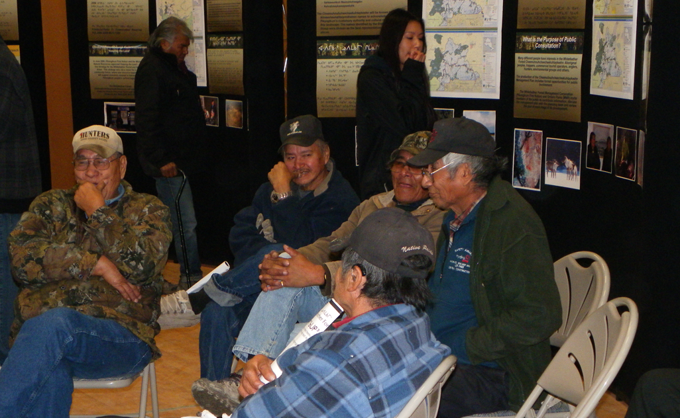
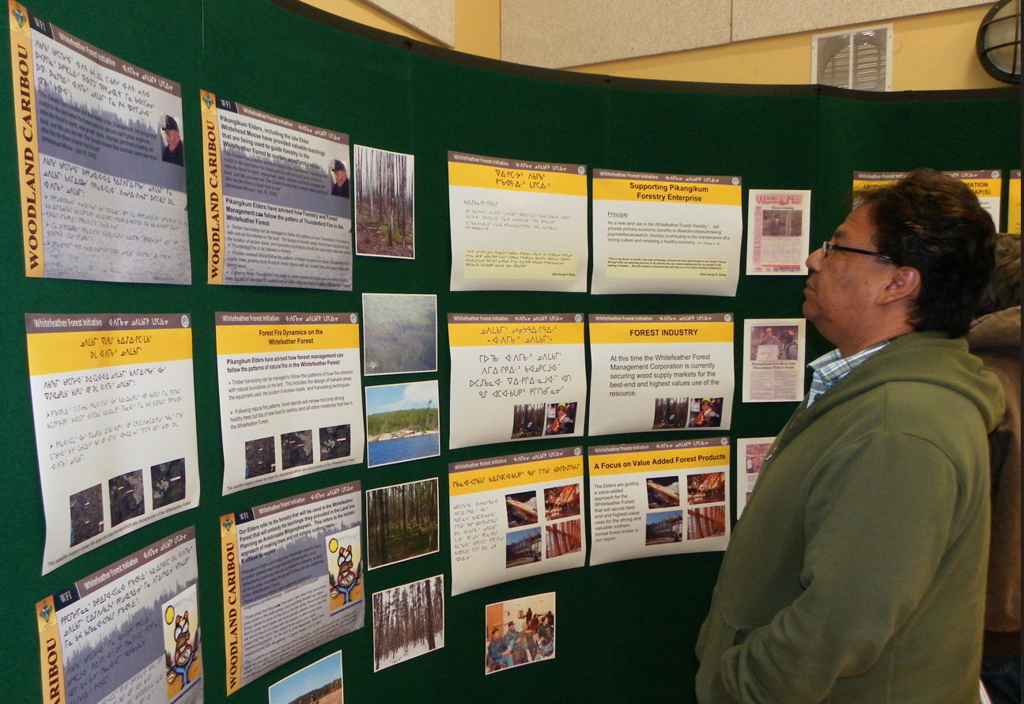
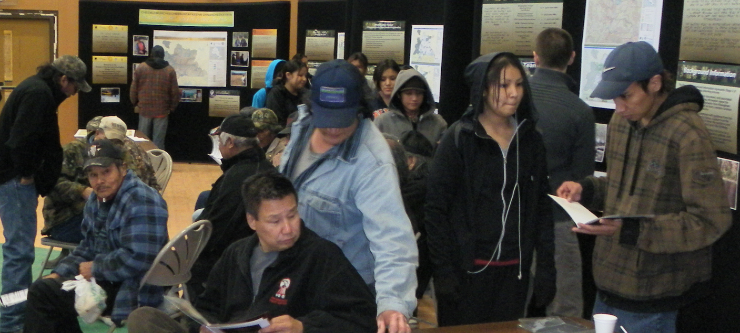
Indigenous Communities and Forests
Canadian courts have established the rights of Indigenous communities to be consulted for forest management activities.
The National Aboriginal Forestry Association (NAFA) is involved in successes and challenges in Indigenous forestry.
There are Indigenous criticisms about their access to practicing forestry according to their cultural beliefs.
A few notable Indigenous communities involved in forestry:
  Whitefeather Forest Initiative from Pikangikum First Nation
  Wabaseemoong Independent Nations
Image Credits: Whitefeather Forest Community Resource Management Authority
Images from the Long-Term Management Direction Open House at Pikangikum for the 2012-22 Forest Management Plan.
Notes:
Slide 25: Indigenous Communities and Forests:
Indigenous communities have been managing Canadian forests and some forests in the United States for generations through dynamics such as cultural burning (Manke, 2022., Schelenz, 2022).
A description of the Indian Act in Canada and the future of Aboriginal governance in Canada can be found in Coates (2008) (Coates, 2008).
Keith Thor Carlson is an ethnohistorian focusing on Indigenous history in Western Canada and Northwestern United States. These resources can be found here (Carlson, n.d.).
The Pikangikum First Nation who steward the Whitefeather Forest land reached an agreement with the Ministry of Natural Resources to create a management plan that reflects their values (MNDMNRF, 2021., Pikangikum First Nation, 2006).
There is sometimes contention between the self-governance rights of Indigenous communities and the objectives of environmental organizations and NGO’s (Bullock et al., 2020).
One example of an Indigenous led forestry company is Wincrief Forestry Products (Wincrief Forest Products, n.d.).
Indigenous Communities have historically been using fire to as a forest management practice (Wheelock, 2022).
Other References:
Links to Aboriginal forestry in Canada (Canadian Forests, 2022).
Centre for Indigenous Environmental Resources (CIER, n.d.).
Indigenous held forest tenures in Canada (National Aboriginal Forest Association, 2020).
Grassy Narrows logging ban (Prokopchuk, 2018).
The British Columbia Community Forest Association provides resources to aid community forestry within Indigenous Communities (British Columbia Community Forest Association, n.d.).
Whitefeather forest management initiative website (Whitefeather Forest management Corporation, n.d.).
Dr. Carlson is the Research Chair in Indigenous Community-Engaged History at the University of Saskatchewan. There are some excerpts of his work included in publications (Carlson, n.d.).
Slide 25 References:
British Columbia Community Forest Association –. (n.d.). Local Forests, Local People, Local Decisions. Retrieved April 3, 2022, from https://bccfa.ca/
Bullock, R., Zurba, M., Reed, M. G., & McCarthy, D. (2020). Strategic Options for More Effective Indigenous Participation in Collaborative Environmental Governance. Journal of Planning Education and Research. https://doi.org/10.1177/0739456X20920913
Canadian Forests. (2022). Aboriginal Forestry in Canada. https://www.canadian-forests.com/aboriginal-forestry.html
Carlson, K. (n.d.). Chapter by Dr. Carlson included in other scholarly works . Retrieved May 9, 2022, from https://artsandscience.usask.ca/keithcarlson/chapters.php
Carlson, K. (n.d.). Keith Thor Carlson Publications. Retrieved April 6, 2022, from https://artsandscience.usask.ca/keithcarlson/chapters.php
CIER. (n.d.). Centre for Indigenous Environmental Resources. Retrieved April 3, 2022, from https://yourcier.org/
Coates, K. (2008). The Indian Act and the Future of Aboriginal Governance in Canada. http://laws.justice.gc.ca/en/showdoc/cs/I-5/bo-ga:s_5//en#anchorbo-ga:s_5.
Manke, K. (2013). How Indigenous burning shaped the Klamath’s forests for a millennia | Berkeley News. Berkeley News. https://news.berkeley.edu/2022/03/14/how-indigenous-burning-shaped-the-klamaths-forests-for-a-millennia/
Ministry of Northern Development, M. N. R. and F. (2021). Sustainable Forest Licence for the Whitefeather Forest. Ontario.Ca. https://www.ontario.ca/page/sustainable-forest-licence-whitefeather-forest
National Aboriginal Forest Association. (2020). Fifth Report on Indigenous-Held Forest Tenures in Canada 2020.
Pikangikum First Nation. (2006). Keeping the Land. www.whitefeatherforest.com
Prokopchuk, Ma. (2018). Grassy Narrows declares logging ban in its territory ahead of forest management planning. CBC News. https://www.cbc.ca/news/canada/thunder-bay/grassy-narrows-logging-ban-1.4856870
Schelenz, R. (2022). How the Indigenous practice of “good fire” can help our forests thrive. Phys.Org. https://phys.org/news/2022-04-indigenous-good-forests.html
Wheelock, J. (2022). How the Indigenous practice of “good fire” can help our forests thrive Once outlawed, cultural burns can save our forests from uncontrollable wildfire. https://www.youtube.com/watch?v=i6kKwsA1B3U]
Whitefeather Forest Management Corporation. (n.d.). Whitefeather Forest Initiative. Retrieved April 3, 2022, from https://www.whitefeatherforest.ca/
Wincrief Forestry Products. (n.d.). Wincrief Forestry Products L.P. Retrieved April 6, 2022, from https://www.facebook.com/Wincrief/

Slide 26
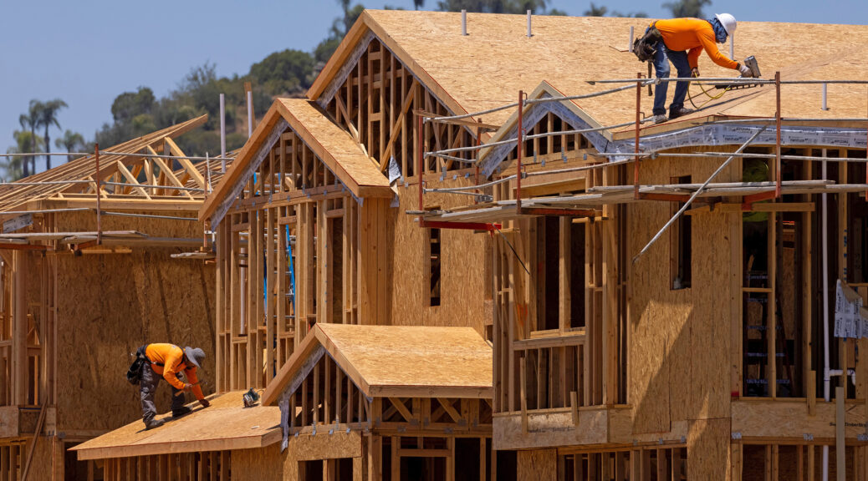
New Directions for Sustainable Forest Products
Each PPT slide is accompanied by notes and links. See other resources in the learning module PDF document.
Benefits of Building with Wood
Renewable and abundant
Low embodied carbon and energy
Visually appealing and enhanced wellbeing
Strong, durable, and resilient
Faster to build and often cost-effective
Biodegradable and recyclable
Construction workers in the process of building a traditional wood framed house
Image Credit: Cavins, S. (2021). Do Lower Lumber Prices Mean Lower Home Prices? - Merit Real Estate. Merti Real Estate, Inc. https://meritrealestate.com/lumber-prices/
Notes:
Slide 26: New Directions for Sustainable Forest Products
Benefits of Building with Wood
Renewable and abundant (Forest Products Laboratory, 2021)
Low embodied carbon and energy (Forest Products Laboratory, 2021):
Decarbonizing the buildings and construction centre is key to reduce emissions and meet climate targets (Global Alliance for Buildings and Construction, International Energy Agency and the United Nations Environment Programme, 2019).
As climate change is increasingly recognized as a significant threat, cities such as Toronto are pursuing ambitious climate strategies (City of Toronto, 2021); this strategy include examining the benefits of using low-carbon construction materials such as wood.
Visually appealing and enhanced wellbeing:
The variety of grain patterns and colours of wood, along with the ability to enhance it using stains, varnishes, and other finishes makes it a visually appealing building material (Forest Products Laboratory, 2021).
Being surrounded by natural elements like wood can provide wellness benefits such as stress reduction (Augustin & Fell, 2015).
Strong, durable, and resilient:
Wood has a high strength to weight ratio and is highly durable (Forest Products Laboratory, 2021).
Faster to build and often cost-effective:
Wood buildings can be prefabricated (components are built off-site in factors and assembled on-site) which can save time and money, but more research and development and support for the prefabrication industry is needed (Forestry Innovation Investment, n.d.; Kuan & Kaustinen, 2016).
Biodegradable and recyclable:
A study on the feasibility of recycling and reusing building materials such as wood from single-family homes in Metro Vancouver explores the opportunities and challenges of doing so (Forrest, 2021).
There is potential for wood to be a highly sustainable building material, but issues related to its reuse and recyclability need to addressed (Kaye, 2012).
FPInnovations is a group that specializes in “the creation of solutions that accelerate the growth of the Canadian forest sector” (FPInnovations, n.d.).
Slide 26 References:
Augustin, S. & Fell, D. (2015). Wood as a Restorative Material in Healthcare Environments. FPInnovations. https://www.glass.org/sites/default/files/2020-09/wood_as_a_restorative_material.pdf.
City of Toronto. (2021). TransformTO Net Zero Strategy: A climate action pathway to 2030 and beyond. https://www.toronto.ca/services-payments/water-environment/environmentally-friendly-city-initiatives/transformto/.
Forest Products Laboratory. (2021). Wood handbook – wood as an engineered material. United States Department of Agriculture Forest Service. https://www.fpl.fs.fed.us/documnts/fplgtr/fplgtr282/fpl_gtr282.pdf.
Forestry Innovation Investment. (n.d.). Prefabricated wood building systems. NaturallyWood. https://www.naturallywood.com/topics/prefabrication/.
Forrest, J. (2021). The feasibility of recycling and reusing building materials found in single-family homes built after 1970 in Metro Vancouver. University of British Columbia. https://sustain.ubc.ca/sites/default/files/2021-010_Feasibility%20of%20recycling%20and%20reusing_Forrest.pdf.
FPInnovations. (n.d.). Home - FPInnovations. Retrieved July 28, 2022, from https://web.fpinnovations.ca/
Global Alliance for Buildings and Construction, International Energy Agency and the United Nations Environment Programme. (2019). 2019 global status report for buildings and construction: Towards a zero-emission, efficient and resilient buildings and construction sector. https://www.worldgbc.org/sites/default/files/2019%20Global%20Status%20Report%20for%20Buildings%20and%20Construction.pdf.
Kaye, L. (2012, July 24). Recycled wood: the truly green key to a sustainable built environment. The Guardian. https://www.theguardian.com/sustainable-business/recycled-wood-green-sustainable-built-environment.
Kuan, S. & Kaustinen, M. (2016). What is holding back the expanded use of prefabricated wood building systems? FP Innovations. https://library.fpinnovations.ca/en/permalink/fpipub5807.

Slide 27
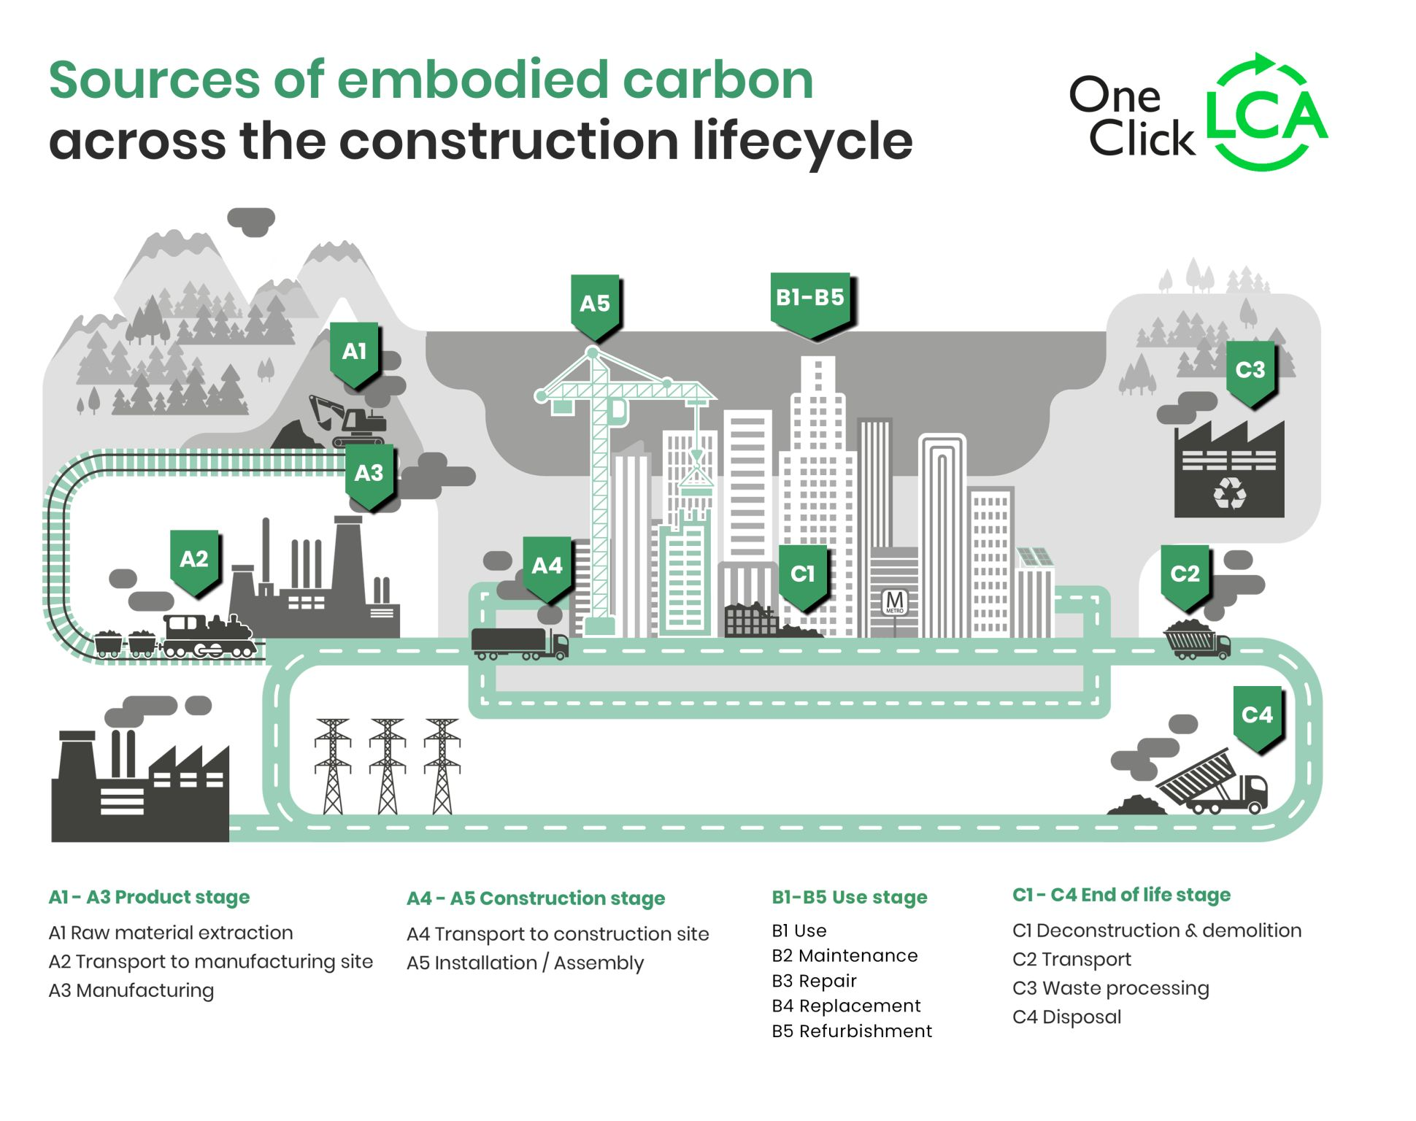
Life-Cycle Assessment (LCA) Comparing Wood, Concrete, and Steel
There is sometimes controversy when comparing the environmental impact of certain materials.
LCA is used to compare the embodied carbon of different processes and materials.
In LCA studies, wood as a building material produces less carbon compared to concrete and steel.
Scientists and practitioners continue to investigate biogenic features or characteristics.
There is still a need for standardized LCA methodology.
Image Credit: World Business Council for Sustainable Development. (2021). Decarbonizing construction Guidance for investors and developers to reduce embodied carbon
Notes:
Slide 27: Life-Cycle Assessment (LCA) Comparing Wood, Concrete, and Steel
Life Cycle Assessment is a method to assess the total energy inputs for a product from creation (cradle) to disposal (grave). (Glover et al., 2002).
One literature and meta-analysis article concluded that by substituting conventional building materials like steel and concrete with mass timber reduced construction phase emissions by 69% on average (Himes & Busby., 2020).
The building sector accounts for a large portion of greenhouse gas emissions globally. In 2008, this figure was 12% in Canada, but this figure does not reflect other processes involved in construction, like transportation and manufacturing. Examining embodied carbon includes all processes involved in creating greenhouse gas emissions when constructing buildings (Toronto & Dulmage., 2018).
The study by Pajchrowski et al., (2014), is a good example of the life cycle assessment of buildings (Pajchrowski et al., 2014).
One report by the International Institute for Sustainable Development published a report outlining some limitations of LCA studies. While they are the best tool that is currently available to assess the environmental impact of certain processes, there should be awareness about its limitations (Stiebert et al., 2019).
Some key findings of this report include:
Regional variability can affect life cycle emissions. Examples of these variabilities include differences among how countries produce steel and concreteFor example, Canada’s steel furnaces use recycled steel and renewable electricity and are therefore considered more efficient than steel mills using coal.
Depending on how wood is sourced, the related GHG emissions can vary.
If construction materials are implemented efficiently, and plan for a long life, GHG impacts based on material choice are negligible. With this, there is no one size fits all approach, and material should be chosen on a case-by-case basis.
Accounting for the embodied carbon of wood is complex as it is a biogenic carbon cycle.
Ryan Zizzo, who is a professional engineer, and an Instructor at the Toronto Metropolitan University (formerly Ryerson University) is a contributor to the field of embodied carbon (Mantle Developments, n.d.)
Another study found that the location of wood suppliers with reference to cross laminated timber manufacturing facilities affect the overall environmental impacts of mass timber (Chen, 2019).
Kelly Alvarez Doran is an Adjunct Professor at the Daniels faculty of Architecture, Landscape, and Design at the University of Toronto. He also leads MASS Design Group’s London studio and is a subject matter expert in sustainability and regenerative design (University of Toronto John H. Daniels Faculty of Architecture, L. and D., n.d.).
Slide 27 References:
Chen, C. X., Pierobon, F., & Ganguly, I. (2019). Life Cycle Assessment (LCA) of Cross-Laminated Timber (CLT) produced in Western Washington: The role of logistics and wood species mix. Sustainability (Switzerland), 11(5). https://doi.org/10.3390/su11051278
Glover, J., White, D. O., & Langrish, T. A. G. (2002). Wood versus Concrete and Steel in House Construction. Journal of Forestry.
Himes, A., & Busby, G. (2020). Wood buildings as a climate solution. Developments in the Built Environment, 4. https://doi.org/10.1016/j.dibe.2020.100030
Stiebert, S., Echeverria, D., Gass, P., & Kitson, L. (2019). Emission Omissions: Carbon accounting gaps in the built environment IISD REPORT. www.iisd.org
Toronto, O., & Dulmage, S. (2018). EMBODIED CARON WHITE PAPER EXECUTIVE SUMMARY.
University of Toronto John H. Daniels Faculty of Architecture, L. and D. (n.d.). Kelly Alvarez Doran. Daniels. Retrieved May 15, 2022, from https://www.daniels.utoronto.ca/people/adjunct-faculty/kelly-alvarez-doran

Slide 28
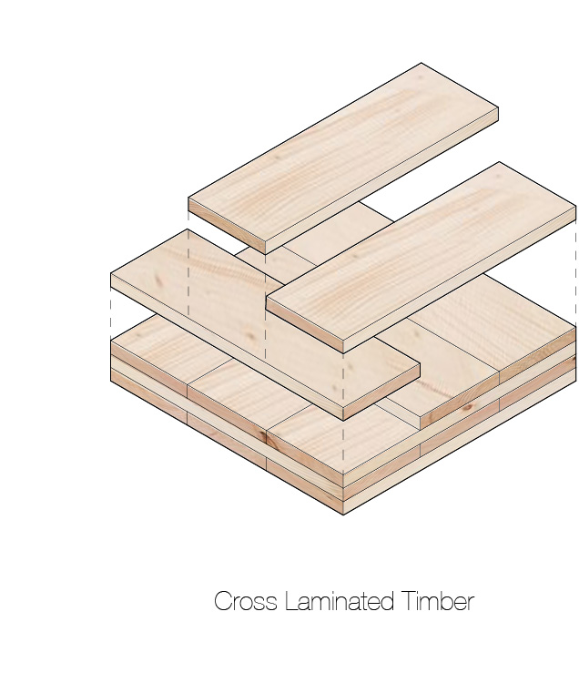
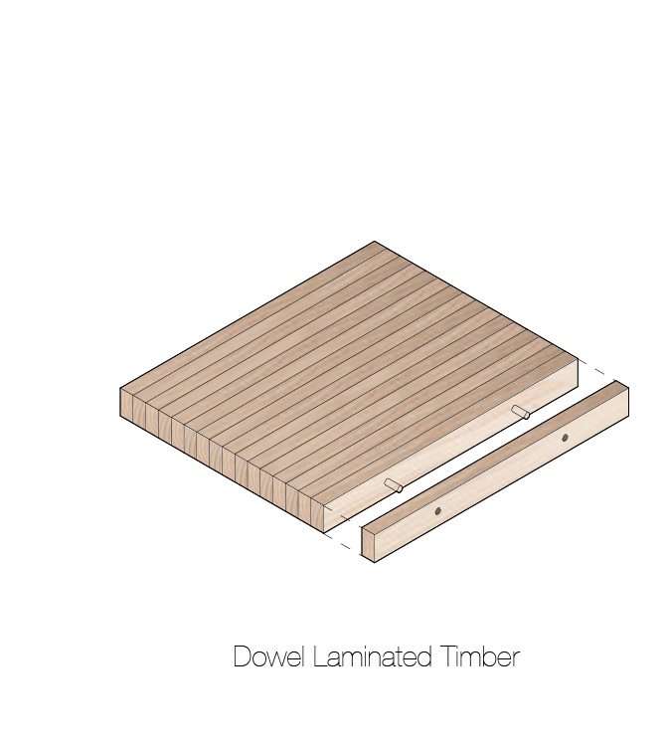
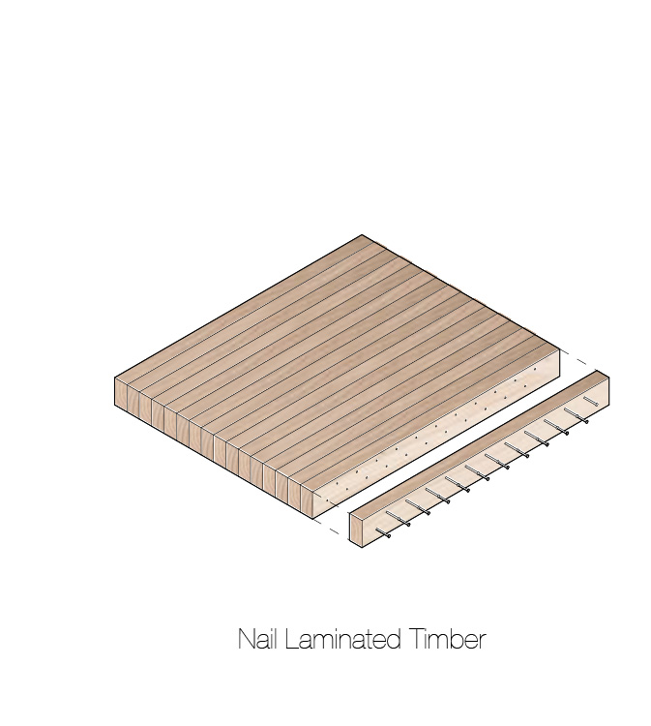
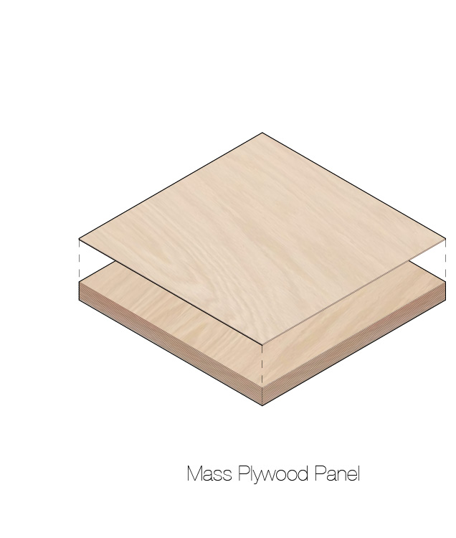
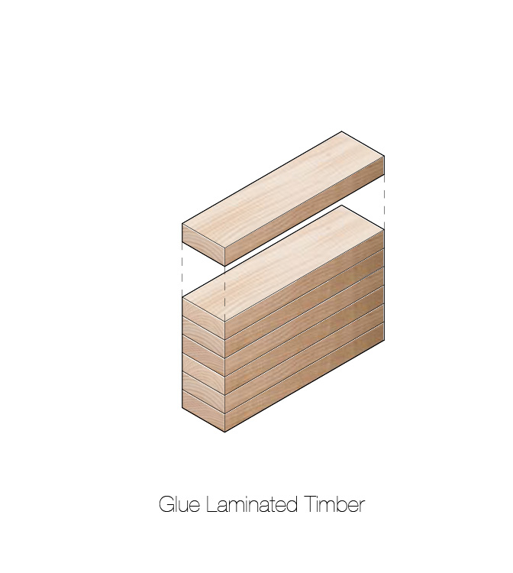
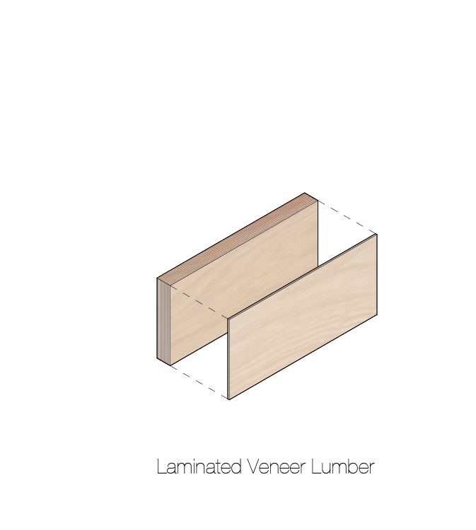
Potential for Mass Timber
Each PPT slide is accompanied by notes and links. See other resources in the learning module PDF document.
Mass timber is an engineered wood structural building material used for large-scale infrastructure (mid-rise to tall buildings and bridges).
Mass timber is a renewable building material with numerous environmental, social, and economic benefits.
Canada could become a global leader in mass timber given its supply of wood from sustainably managed forests.
Image Credit: Sanjana Patel
Notes:
Slide 28: Potential for Mass Timber
Mass timber is an engineered wood structural building material used for mid-rise and large-scale infrastructure (buildings and bridges) (Advanced Research Systems, n.d.; Anderson, Dawson, & Muszynski, 2021; Canadian Wood Council, 2022; Kesik & Martin, 2021; Mass Timber Institute, n.d.a.; Think Wood, 2022).
Mass timber uses multiple solid wood panels that are nailed and glued together to create “massive” pieces such as panels and beams to create this large-scale infrastructure (Natural Resources Canada, 2021, p. 9).
Dr. Ted Kesik (Professor of Building Science) is currently involved in the design of low-carbon buildings (Ted Kesik | Daniels, n.d.).
Mass timber is a renewable building material with numerous environmental, social, and economic benefits (John H. Daniels Faculty of Architecture, Landscape, and Design, 2021).
It is able to store large amounts of carbon (Churkina et al., 2020).
Studies have shown that mass timber is fire resistant, has a high load bearing capacity, and is lightweight (Natural Resources Canada, 2021, p. 8).
Canada could become a global leader in mass timber given its supply of wood from sustainably managed forests (Natural Resources Canada, 2021, p. 19).
The impacts of using mass timber on climate and forests is being examined(Pasternack et al., 2022).
The State of Mass Timber in Canada (2021) identifies mass timber companies (Element5, n.d.; Nordic Structures, 2022; StructureCraft, n.d.; Structurlam Mass Timber Corporation, 2022) and manufacturing facilities (Natural Resources Canada, 2021, p. 18) in Canada.
There are opportunities for collaboration among architects, engineers, researchers, and other skilled professionals in the mass timber sector in Canada (Mass Timber Institute, n.d.b.)
Slide 28 References:
Advanced Research in Timber Systems | Engineering at Alberta. (n.d.). Retrieved July 28, 2022, from https://www.ualberta.ca/engineering/research/groups/timber-systems/index.html
Anderson, R., Dawson, E., & Muszynski, L. (2021). 2021 International Mass Timber Report. Forest Business Network. https://www.masstimberreport.com/.
Canadian Wood Council. (2022). Mass Timber. Canadian Wood Council. https://cwc.ca/en/how-to-build-with-wood/wood-products/mass-timber/.
Churkina, G., Organschi, A., Reyer, C. P., Ruff, A., Vinke, K., Liu, Z., Reck, B. K., Graedel, T. E., & Schellnhuber, H. J. (2020). Buildings as a global carbon sink. Nature Sustainability, 3(4), 269–276. https://doi.org/10.1038/s41893-019-0462-4.
Element5. (n.d.). Element5: Modern Timber Buildings. Element Five. https://elementfive.co/.
Kesik, T., & Martin, R. (2021). Mass Timber Building Science Primer. Mass Timber Institute, University of Toronto, Canada. https://academic.daniels.utoronto.ca/masstimberinstitute/building-science-primer/.
Mass Timber Institute. (n.d.a). All About Mass Timber. University of Toronto John H. Daniels Faculty of Architecture, Landscape, and Design. https://academic.daniels.utoronto.ca/masstimberinstitute/about-mass-timber/.
Mass Timber Institute. (n.d.b). Contacts and Connections. University of Toronto John H. Daniels Faculty of Architecture, Landscape, and Design. https://academic.daniels.utoronto.ca/masstimberinstitute/contacts-connections/.
Natural Resources Canada. (2021). The State of Mass Timber in Canada. Natural Resources Canada. https://cfs.nrcan.gc.ca/publications?id=40364.
Nordic Structures. (2022). Nordic structures, leader in sustainable wood solutions. Nordic. https://www.nordic.ca/en/home.
Pasternack, R., Wishnie, M., Clarke, C., Wang, Y., Belair, E., Marshall, S., Gu, H., Nepal, P., Dolezal, F., Lomax, G., Johnston, C., Felmer, G., Morales-Vera, R., Puettmann, M., & Van den Huevel, R. (2022). What is the impact of mass timber utilization on climate and forests? Sustainability, 14(2), 758. https://doi.org/10.3390/su14020758.
StructureCraft. (n.d.). Structural Engineering + Timber Construction. StructureCraft. https://structurecraft.com/.
Structurlam Mass Timber Corporation. (2022). Opening a world of possibilities through mass timber. Structurlam. https://www.structurlam.com/.
Ted Kesik | Daniels. (n.d.). Retrieved July 29, 2022, from https://www.daniels.utoronto.ca/people/core-faculty/ted-kesik
Think Wood. (2022). Create a mass-timber-piece. Think Wood. https://www.thinkwood.com/mass-timber
Woodworks. (n.d.). Wood-Works – Program of the Canadian Wood Council. Retrieved July 28, 2022, from https://wood-works.ca/

Slide 29
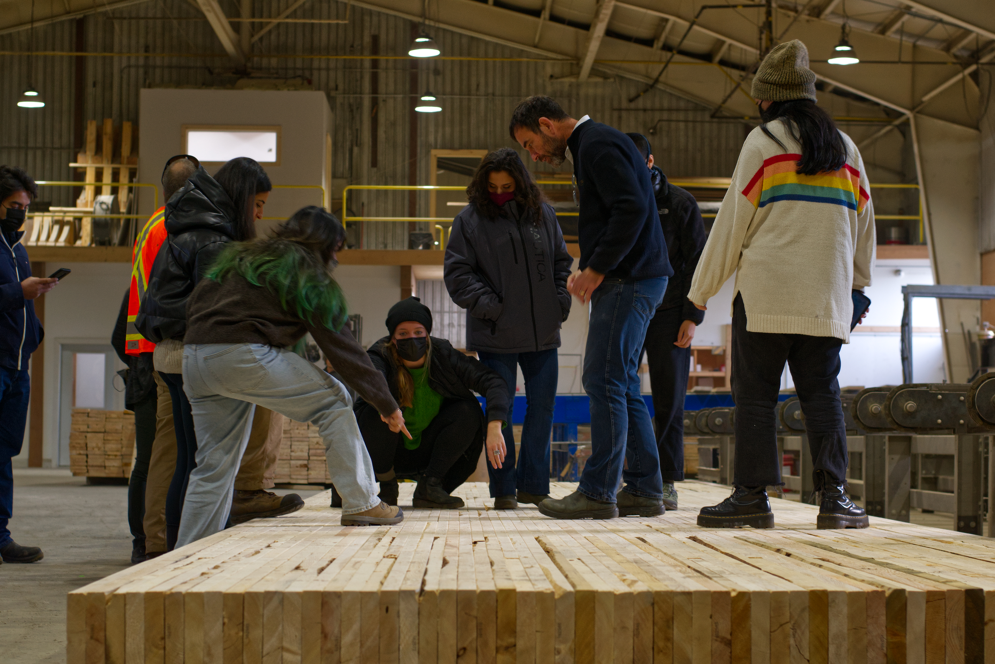
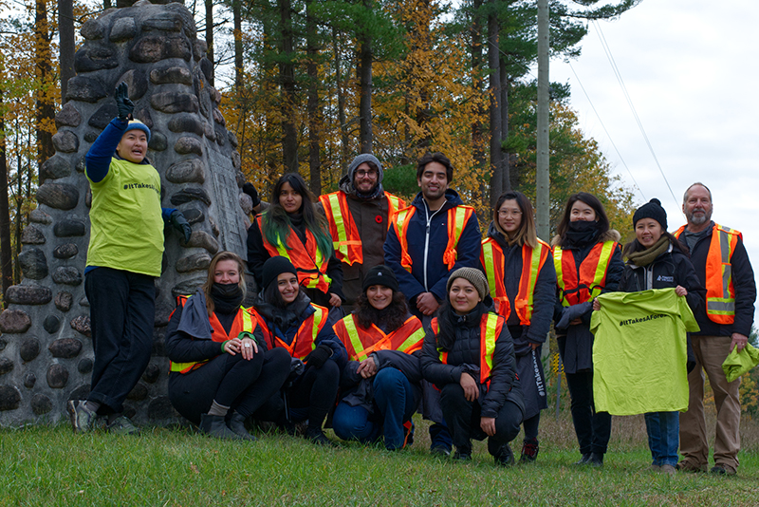
Contact for More Information and Updates
Each PPT slide is accompanied by notes and links. See other resources in the learning module PDF document.
Mass Timber Institute: www.academic.daniels.utoronto.ca/masstimberinstitute
CWC:
www.cwc.ca
Daniels Faculty architecture students visiting Timmerman Timberworks sawmill in New Lowell, ON as part of Ha/f Studio, led by professor Kelly Doran.
Daniels Faculty architecture students learn about sustainable forest management while visiting the Hendrie Tract in Anten Mills as part of Ha/f Studio.
Image Credits: Daniels Ha/f Studio

