Slide 1
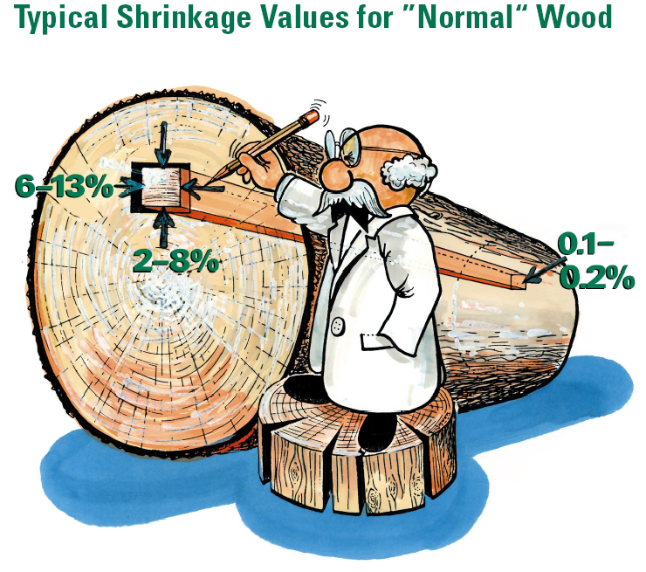
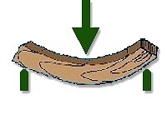
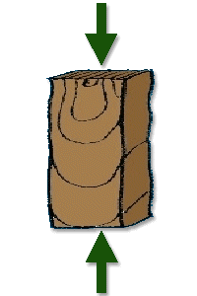
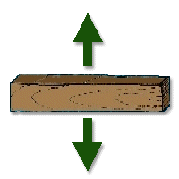
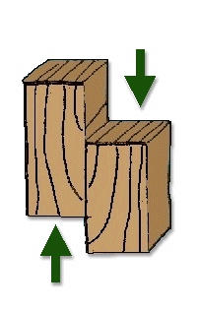
Lecture #1
Physical and Mechanical Properties of Wood
Y. H. Chui
University of Alberta

Slide 2
Part 1– Physical Properties of Wood
Notes:
This lecture series consists of two parts. First part is on physical properties of wood and the second part is on mechanical properties of wood. As with any structural materials, it is important that designers understand the characteristics of the material that he/she specifies. This would minimize mis-use and problem designs.

Slide 3
Wood Density
An important indicator of other wood properties:
  Strength & stiffness
  Thermal conductivity
  Shrinkage/swelling
  Paint adhesion
  Glue adhesion
  Drying
Notes:
Wood density is one of the most important physical properties of wood. Unlike other materials such as steel and concrete, wood formation cannot be controlled. Density of wood is often used to provide an indication of its physical and mechanical properties since it can be measured non-destructively with relative ease. Here is a list of wood properties that have a good correlation with wood density.

Slide 4
Definition of Density
Units:
pounds per cubic foot (lb/ft³)
grams per cubic centimetre (g/cm³)
kilograms per cubic metre (kg/m³)
1 lb/ft³ ≈ 16 kg/m³
ρ: density
m: mass
V: volume of the piece of wood used in its determination
Notes:
This is standard definition of density of a material. Units can be in Metric or Imperial (mainly in USA). Conversion is provide from lb/ft3 to kg/m3.

Slide 5
Wood Density
Oven-dry, air-dry, green and bulk density.
Notes:
Since both wood mass and volume can be influenced by the moisture it contains, when stating density of wood it should also state the basis of the density value. Here are 4 possible definitions. OD is when the piece of wood is completely dry without any moisture. Air-dry density is fro wood at a moisture content of a%. Green density is when the wood is completely saturated with water This is often the case when wood is freshly cut from a tree. Bulk density is defined as completely dry mass over completely saturated volume.

Slide 6
Definition of Specific Gravity (Relative Density)
In general terms, the ratio of the density (relative density) of a substance to that of water at the same temperature.
In wood science,
Specific gravity is always based on mass when oven-dry (OD), but volume can be at any given MC, e.g. green, oven dry or at any moisture content
Notes:
Specific gravity (G) is defined as the ratio of the density of a substance to that of water at the same temperature. When describing wood, specific gravity is usually based on the oven-dry mass of wood and the volume of that same quantity of wood at some specified moisture content such as green, OD and at any MC. The rationale for using OD mass is that it avoids the potential influence of MC on SG. This explains why SG is a better indicator of wood properties than density, because presence of moisture would increase density but not strength. Numerically SG equals to density of wood in g/cc since density of water is 1 g/cc.

Slide 7
Basic Specific Gravity
Uses green volume basis. This is the most common value computed for wood, especially for research purposes.
Notes:
The most common SG is basic SG which is based on oven-dry mass and green volume. In this case, mass is the lowest possible and volume is the highest possible for a piece of wood. Because of these, basic SG has the lowest value among all possible bases for SG of a piece of wood.

Slide 8
Oven-dry Specific Gravity
Based on the oven-dry volume. It has application in computing the thermal diffusivity properties of wood and controlling quality of many wood products.
Notes:
Another common SG is OD basis, which is based on OD mass and OD volume. OD SG is often used to predict thermal diffusivity (conductivity).

Slide 9
Air Dry or Nominal Specific Gravity
Based on air-dry (12% MC) volume. It is used as the basis for determining strength properties of wood.
Notes:
SG based on 12%MC volume (nominal SG) is sometimes used for calculating some strength properties of wood e.g. MOE. This is because in some regions, e.g. Europe, design properties are often based on 12% MC in wood.

Slide 10
Basic SG of some hardwoods
Species | Specific Gravity (12%)
white ash | 0.63
aspen | 0.41
basswood | 0.38
yellow birch | 0.66
hickory | 0.77
sugar maple | 0.66
red oak | 0.65
white oak | 0.72
Notes:
Here are some SG values for selected hardwood species in North America. They range from 0.38 for basswood to 0.77 for hickory. Note that hardwoods do not always have high SG.

Slide 11
Basic SG of some softwoods
Species | Specific Gravity (12%)
eastern white cedar | 0.34
balsam fir | 0.37
eastern hemlock | 0.42
eastern white pine | 0.37
jack pine | 0.45
red pine | 0.46
black spruce | 0.43
red spruce | 0.42
white spruce | 0.37
Notes:
Here is a list of basic SG values for selected softwood species in North America. Note that some hardwoods e.g. basswood has SG lower than some softwoods.

Slide 12
Measurement of Specific Gravity
ASTM D 2395–14 “Standard Test Methods for Specific Gravity of Wood and Wood-Based Materials”
Mass
1 m³
Max. buoyancy 1000 kg
Density of water at 20°C=1000 kg/m³
Notes:
Standardized methods of measuring SG is given in ASTM D2395. The volume of a wood block can be measured using the buoyancy-in-water principles, which state that the buoyancy force in g or kg iis equivalent to the mass of the volume of water displaced by the wood block.

Slide 13

Measurement of dimensions
Direct measurement of dimensions
  For regular shape
Immersion method
  For irregular shape
  Buoyancy weight of a specimen, more accurate
  Dry specimen coated with wax
pointed rod
container
water
weights
wood
(Source: ASTM D 2395–14)
Diagrammatic sketch of apparatus used to measure volume of specimens
Notes:
ASTM allows for direct measurement of dimensions of a wood block using caliper or rules. This direct method works for wood block of regular shape. The so-called immersion method is used when the wood block does not have a regular shape e.g. wood chips. It is a considered a more accurate method than direct measurement, if the moisture uptake into the wood block can be avoid. This can be achieved sometimes by coating the wood block with wax. Two possible procedures for the immersion method. First one is to use a graduated cylinder, where the volume can be read off directly. The second procedure is by measuring the buoyancy force. A possible test setup is shown in the left figure, When a piece of wood is push into a bath of water resting on a balance, the balance reading will change. The change in balance reading is equal to the buoyancy force as defined in the previous slide i.e. mass of the same volume of water displaced by the wood block. Since density of water is 1 g/cc, if the force is X g, then the volume is X cc.

Slide 14
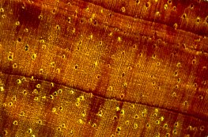
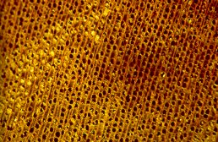
POROSITY / VOID VOLUME
Void spaces in wood include cell lumens, pit openings, pit cavities, and intercellular spaces.
Cocobolo (South America)
Kapur (Southwest Asia)
Notes:
Knowledge of wood specific gravity can help you visualize the nature of a particular wood. What specific gravity reveals about the void volume of wood is especially useful.
Some woods, such as balsa wood, are known as extremely light-weight woods. Other woods have a reputation of being hard, heavy, and very strong; among these woods are ebony and lignum-vitae. While the very light weight and very heavy woods are obviously quite different, they are also remarkably the same, especially with respect to specific gravity.
When a microscopic piece of a wood cell wall is isolated such that all void spaces - lumens, pit openings, pit cavities - are avoided, and the specific gravity of that solid, void-free cell wall material is measured, the specific gravity is just under 1.5. This is the case whether the cell wall material originates in balsa, aspen, cedar, pine, redwood, oak, hickory, ebony, or any other wood species. Thus, the nature of individual woods is almost totally determined by the configuration of areas within wood that are not occupied by wood substance.
The consistent specific gravity of solid wood substance from one wood to another provides a convenient way of visualizing various woods. Since the void-free wood substance has a specific gravity of just under 1.5, this is the absolute maximum specific gravity of any wood. And, since there are no woods that lack cell lumens and pits, the highest specific gravity is less than the 1.5 maximum. With a specific gravity of up to 1.0, Cocobolo wood from South America, is one of the more dense woods in the world. A magnified cross section and tangential section shows how little of the volume of this wood is comprised of cell lumens.
In contrast to cocobolo, consider kapur, a wood of southwest Asia. With a specific gravity of about 0.60 more of the volume of this wood is contained in void spaces between wood substance. This can be readily seen by looking at a magnified cross section.
But just how much of kapur is airspace rather than wood? For that matter, what about woods that are commonly used such as ponderosa pine, Douglas-fir, oak, and hickory?
As already noted, if a wood were to have a dry specific gravity of 1.5 it would consist entirely of wood substance, and would have no air spaces within it. On the other hand, a wood with a dry specific gravity of 0.75 would contain 50% airspace. To put this in context, 0.75 is the specific gravity of pignut hickory, the highest specific gravity of all commonly used woods in the United States. This wood, which is viewed as being incredibly hard and dense, is half airspace or void volume.

Slide 15
Estimation of SG at a given MC
Wood moisture content must be stated when referring to either density or specific gravity
SG_{X} : SG at X% moisture content
SG_{green}: SG at green condition
S_{V}: Volumetric shrinkage from green to X% moisture content
Notes:
Since the literature values provided can be of different basis. To facilitate comparison, it is often necessary to convert one SG value to another. Working from basic principles, this equation can be used to convert green SG to SG at a specific MC X, if the volumetric shrinkage from green to X % MC is known (S_{v}).
Background : SG_{g} = M_{OD} / V_{g}; SG_{X}=M_{OD} / V_{X}; V_{X}=V_{g} (1 – S_{v})

Slide 16
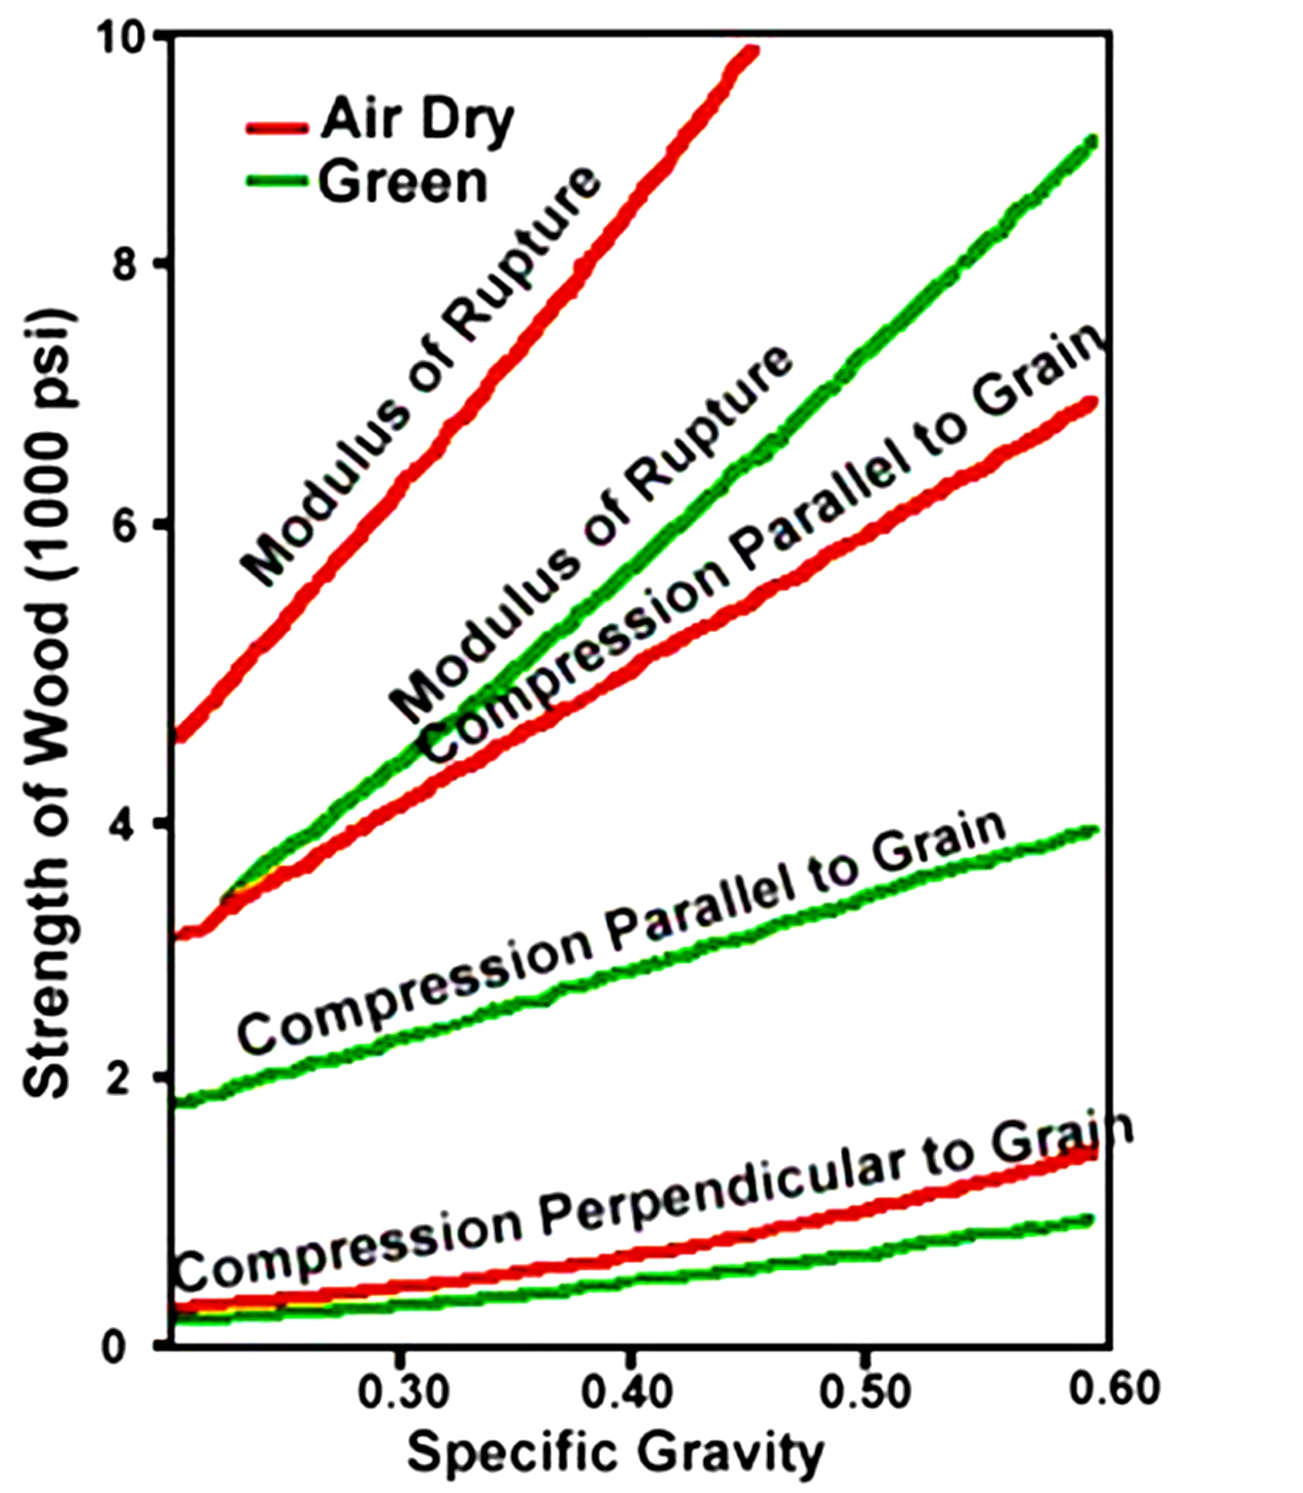
Effect of Specific Gravity on Mechanical Properties
Notes:
Strength In general, the higher the specific gravity or density the higher the strength. This relationship is illustrated in the graph.
This general relationship holds for static bending strength, compression and tension parallel to the grain, compression and tension perpendicular to the grain, hardness, and shear strength. The single exception is impact strength; very high specific gravity woods will occasionally shatter under an impact load, whereas less stiff woods will absorb the load without failing.

Slide 17
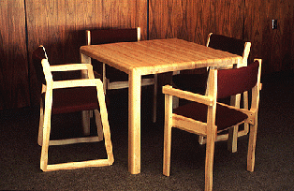
WATER AND WOOD
H₂O
H₂O
Wood is a hygroscopic material
Physical and mechanical properties are greatly influenced by the amount of water present
Notes:
Wood is a hygroscopic material, meaning that it readily absorbs moisture from the air if the right environmental condition occurs. Dry wood will absorb moisture from and wet wood will lose moisture from air. Water molecules constantly move in and out of a piece of wood until an equilibrium condition is reached ie there is no net change in water in wood. Knowing the moisture content in wood is important as many physical and mechanical properties of wood are dependent on the moisture content in the wood.

Slide 18
Moisture Content
Moisture content (MC) is the mass of water contained in the wood, usually expressed as a percentage:
Notes:
MC is defined as the mass of water in wood divided by oven-dry (bone dry) mass of wood. In the lab, the procedure to measure MC in wood is to weigh its mass first (Wi), oven dry the wood and then measure oven-dry mass (Wo).Therefore mathematically it is generally calculated using the second equation.

Slide 19
Measurement of Moisture Content
Oven-dry method
  Oven temperature: 103±2ºC
  Accurate
Electrical resistance method
  Good for field measurement
  Species and temperature dependent
  Only works well between 6% and FSP (i.e. 28%)
  Not very accurate (measurement error 3-5%)
Distillation method
  Measurement of moisture driven off
  Good for wood with high extractive content
  More accurate than oven-dry method
  Delicate apparatus required
Notes:
There are generally 3 traditional methods of measuring moisture content of wood: oven dry, electrical resistance and distillation method. Which method to use depends on the accuracy required, time and resources available. Oven-dry method is commonly used in research studies, as it typically involves measuring the initial mass, putting the wood in an oven and then measure the oven-dry mass at the end. Electrical resistance is usually used by the industry for quick measurement of MC in wood. It is based on relationship between electrical resistance and MC in wood. The next slide provides more details on the electrical meter method. Such relationship is species and temperature dependent, so correction factors are required and generally provided by manufacturers moisture meters. Even with corrections, the measurement errors could be a few percent points. The best range if 6%-28% (fibre saturation point, or FSP). Distillation method is normally used for species that has a high extractive content, as it collects and measures driven off, rather than difference in initial and oven-dry mas. It is most accurate but time-consuming to perform and require specific apparatus.

Slide 20
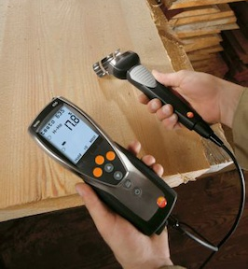
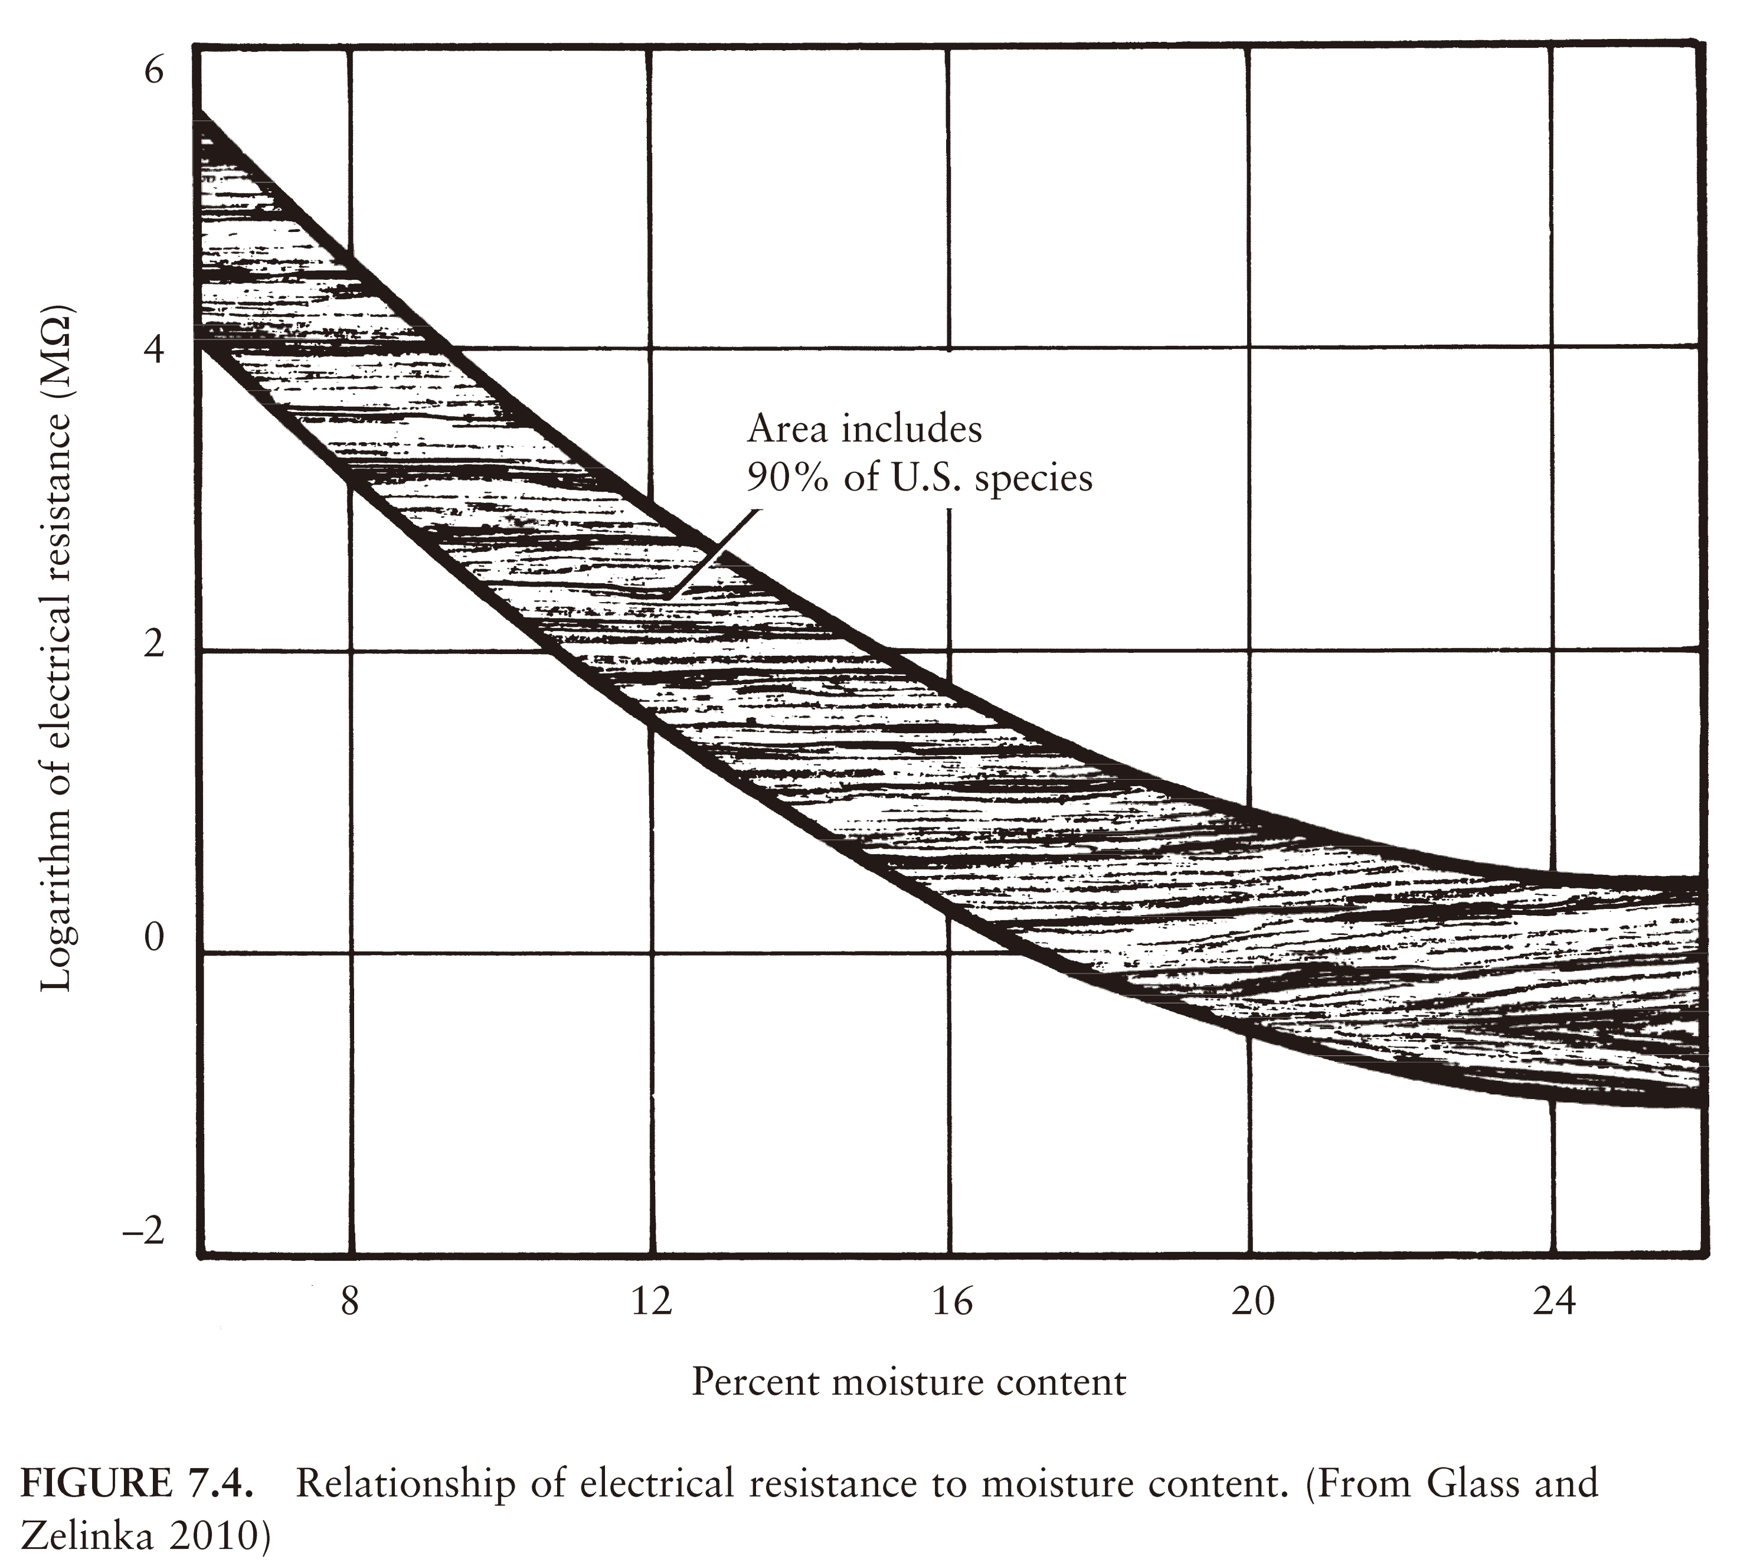
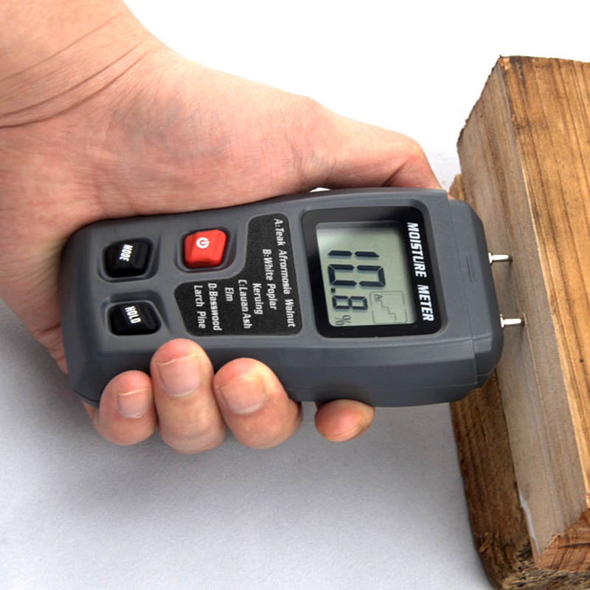
Electrical Resistance Method
(Source: logismarket.de)
Relationship of electrical resistance to moisture content
(Source: Glass and Zelinka 2010)
Notes:
The graph on the left depicts a typical relationship between Log of electrical resistance and percent MC, which illustrates that the relationship has some variation. The pictures in the right show two types of hand-held moisture meters, with two pins. Note that the pins must line up in the direction of the grain for accurate measurement.

Slide 21
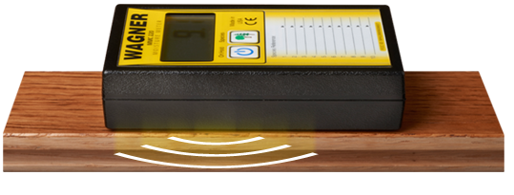
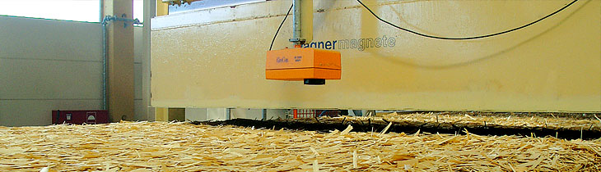
Measurement of Moisture Content
Advanced production line methods
  Infrared/radio frequency/microwave (suitable for high speed production)
  Electrical capacitance
Notes:
Recent advanced techniques include use of electric wave or measurement of electric capacitance principles. These are more expensive devices and are suited for production line implementation as these are non-destructive or non-contact devices.

Slide 22
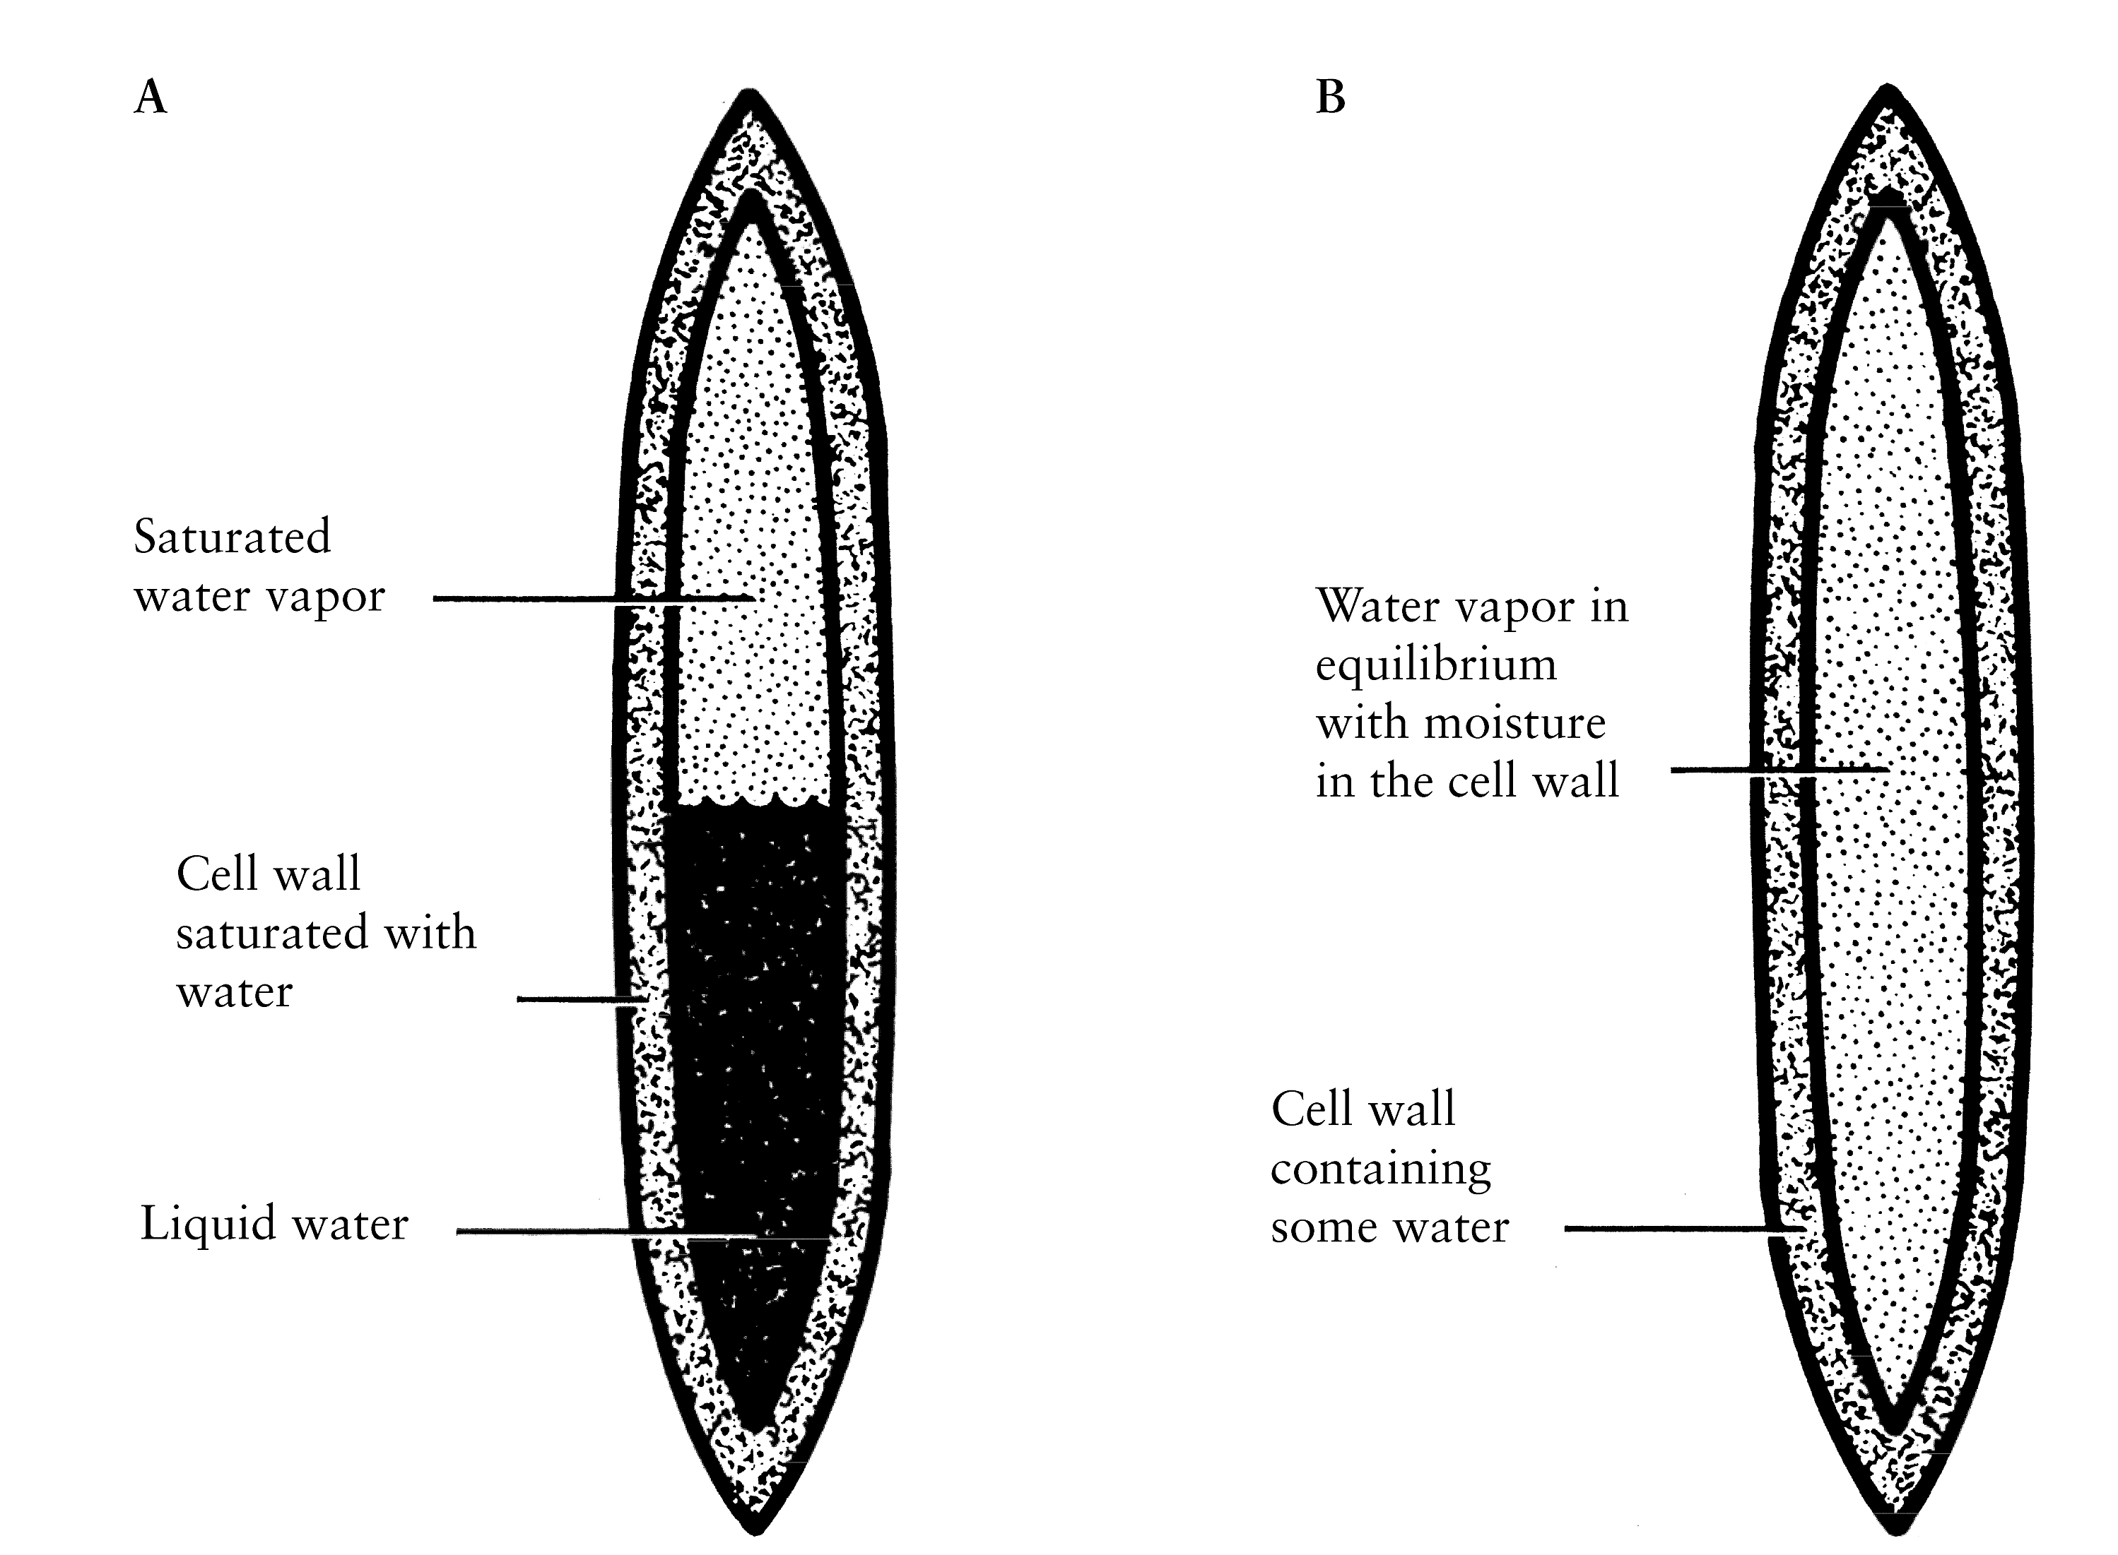
Location of Water in Wood
In voids such as cell lumens
Within cell walls
(Source: Shmulsky & Jones 2011)
Water in a cell of green wood
Water in a cell of dry wood
Notes:
Water molecules in wood cell can be found either inside the cell wall or in the cell cavity known as cell lumen.

Slide 23
Nature of Water in Wood
Free water
  in voids such as lumens, pit openings, pit cavities, and intercellular spaces
  Influence weight only
Bound water
  held by physico-chemical forces (hydrogen bonds) in cell wall
  Influence most physical and mechanical properties
Notes:
Water present in wood cell is in one of two forms: bound water and free water. Free water is no chemically attached to wood molecules and is simply located in cell wall cavity, known as cell lumen. Free water affects mass of wood but not physical and mechanical properties of wood. Bound water is chemically attached to cell wall material. It affects most physical (e.g. shrinkage, swelling and thermal) and mechanical (e.g. strength and stiffness) properties.

Slide 24
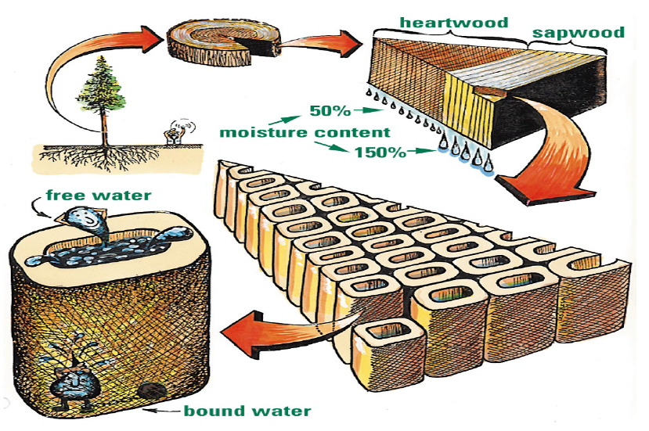
Water in Softwood
Notes:
Living trees contain a large quantity of water, specially in the outer part of the tree, called sapwood. Sapwood cells have lower density and larger cavity, hence the reason for its ability to hold more water than heartwood. In softwood trees, the MC of sapwood can be well over 150% MC and heardwood MC is usually around 50%.

Slide 25
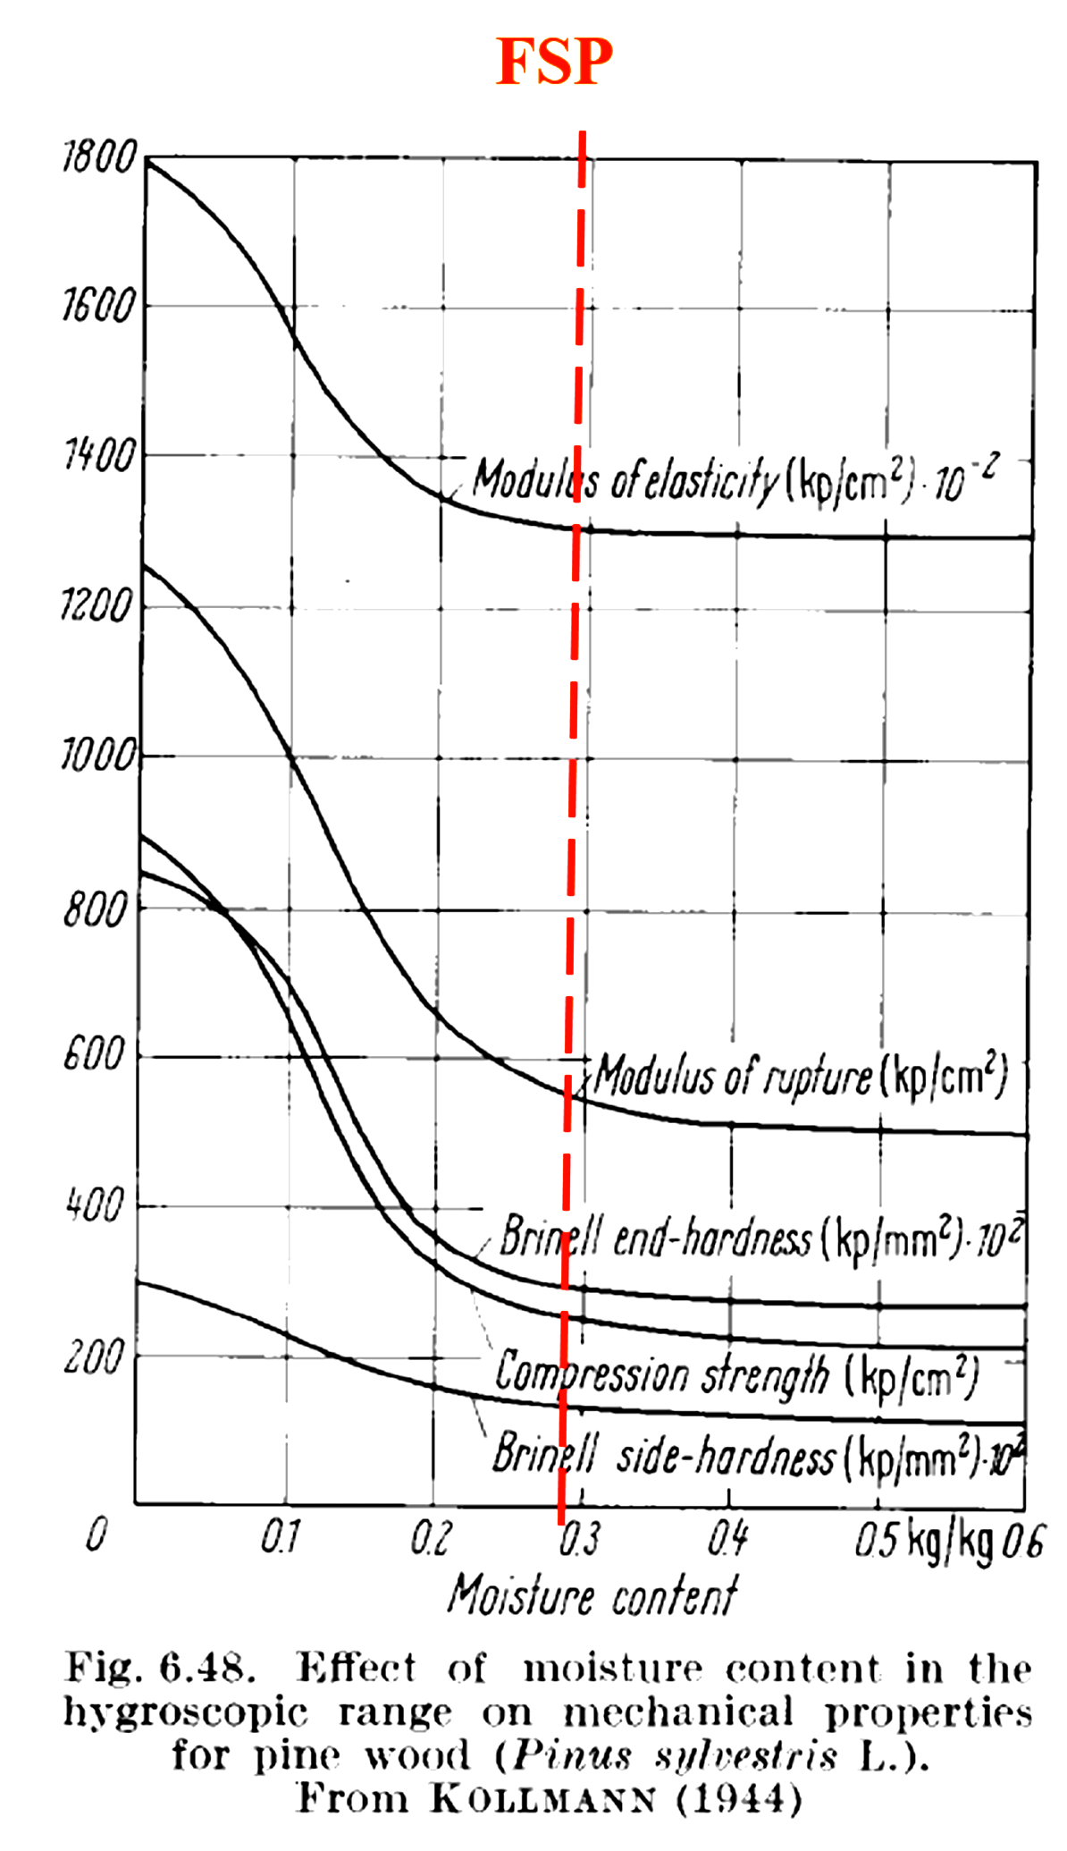
Fibre Saturation Point (FSP)
The point at which all the liquid water in the lumen has been removed but the cell wall is still saturated is called FSP.
This is a critical point since below this most properties of wood are altered by changes in moisture content.
MC at FSP is about 28%, ranging from 25% to 30%
Notes:
The point at which all the liquid water in the lumen has been removed but the cell wall is fully saturated is called fibre saturated point (FSP). For most species FSP is between 25% - 30% and can be assumed to be around 28%. FSP is a critical moisture content point for wood because above FSP there is no change in mechanical properties and shrinkage/swelling due to moisture content change. This is because any additional water will be added as free wall to the cell lumen. Conversely, below FSP additional water enters or departs the cell wall which changes its dimensions and therefore mechanical properties and causes shrinkage or swelling in wood depending on water is added or removed. The graph on the right shows changes in some mechanical properties with MC. As can be seen, the relationship is flat above about 28% MC.

Slide 26
Factors influencing FSP
Extractives such as resin, tannins, and fatty acids
Chemical components
  Cellulose: 40 - 50%
  Hemicellulose: 20 - 30%
  Lignin: 15 - 40%
Temperature
…
Notes:
FSP is affected by a number of factors. Among the factors are extractive contents of wood, proportion of cellulose, lignin and hemicellulose in the wood, and temperature. Since extractive content and proportion of cellulose/lignin/hemicullose are species dependent. This explains why FSP is also species dependent.

Slide 27
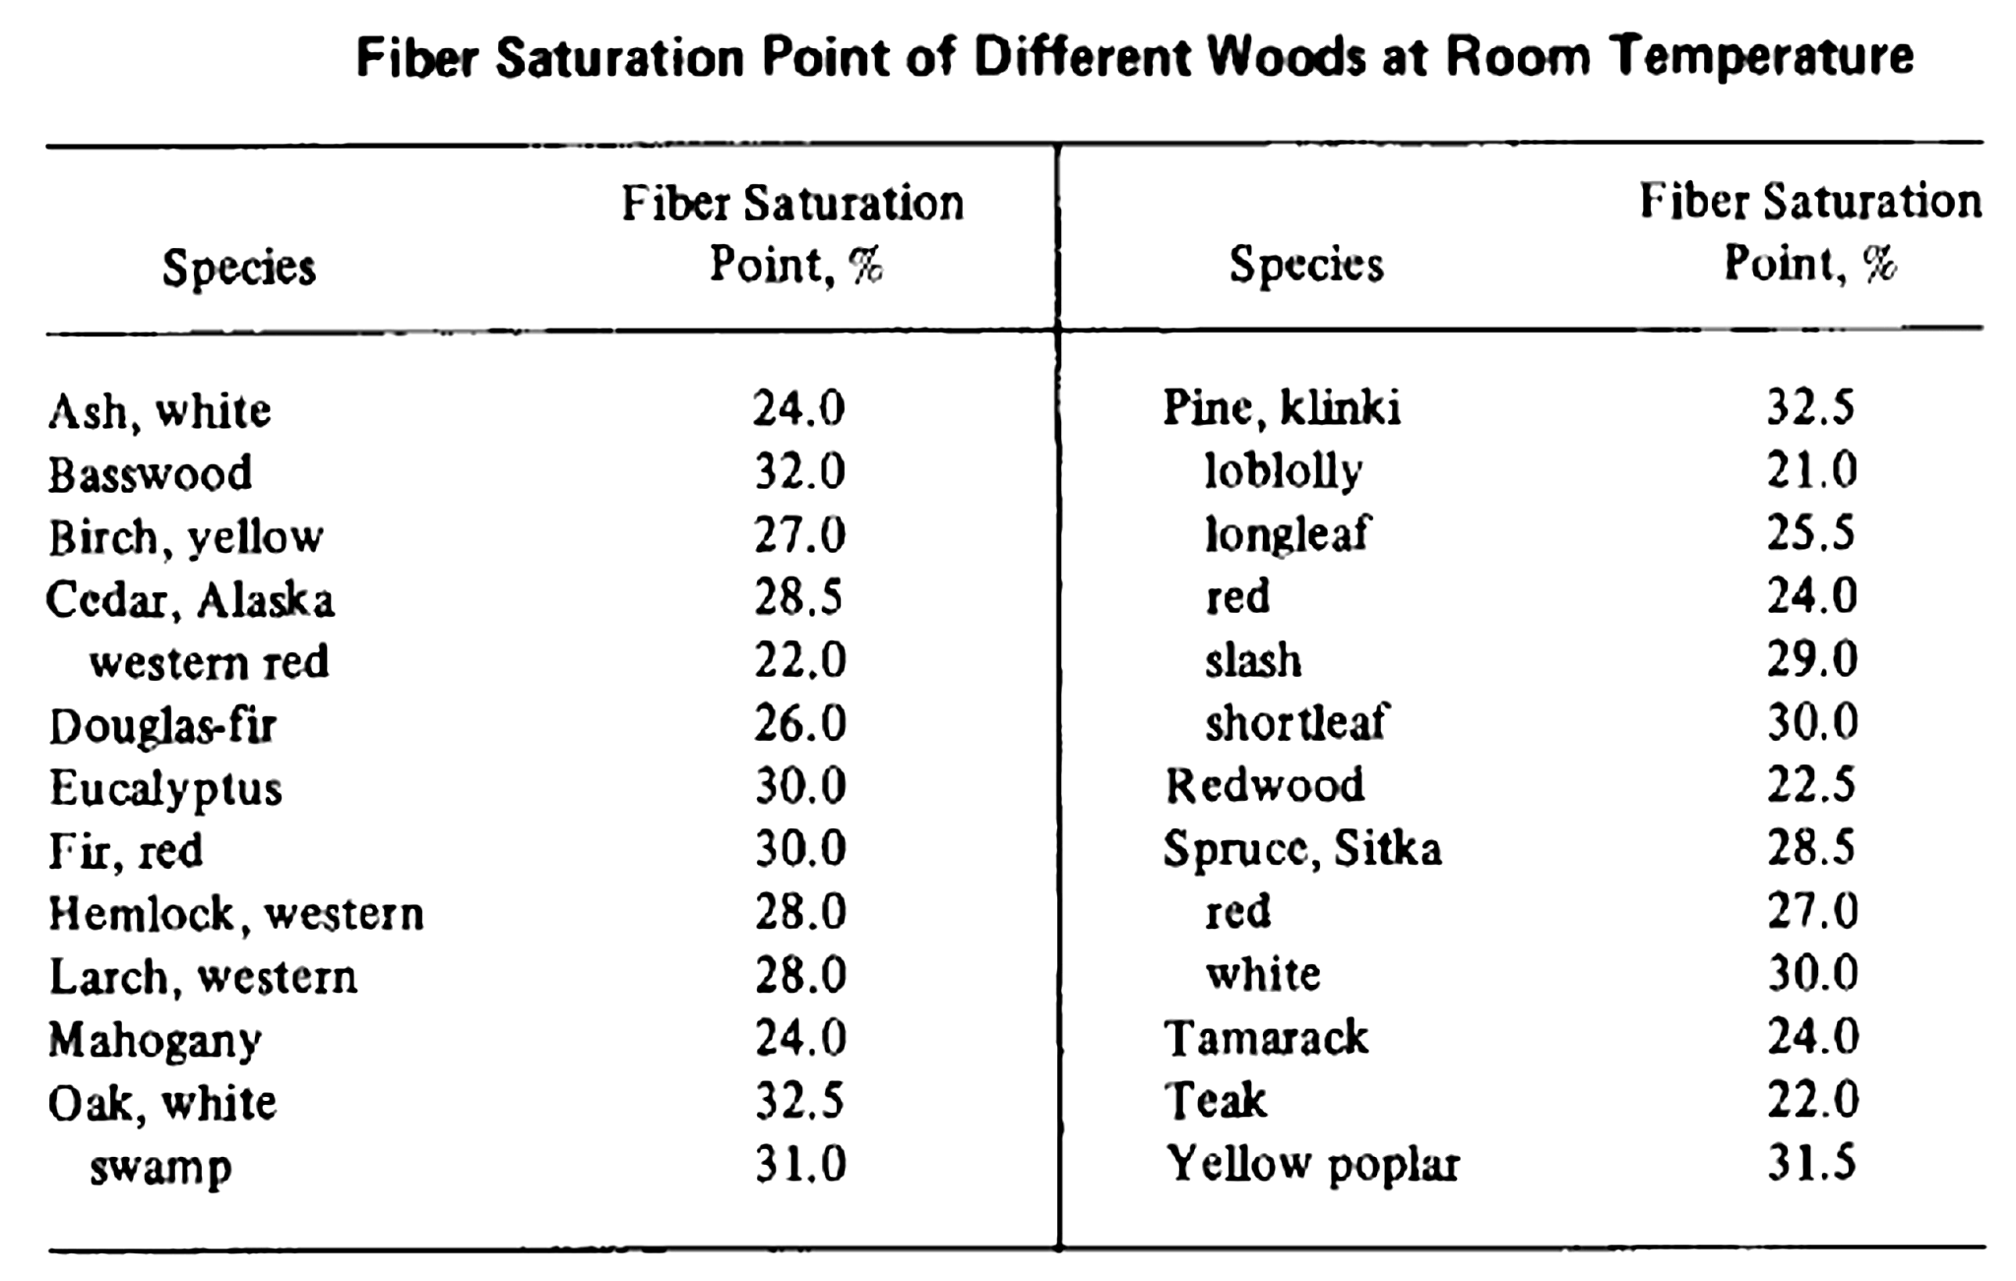
Fibre Saturation Point (FSP)
Notes:
This table shows the FSP for various softwood and hardwood species in North America measured at room temperature.

Slide 28
Equilibrium Moisture Content (EMC)
Wood is a hygroscopic material, which constantly exchanges moisture with its surrounding atmosphere even in an equilibrium system. This depends on the surrounding atmosphere’s moisture carrying capability that is proportional to its temperature and relative humidity.
The MC at which water transfers in and out of wood equal to each other ie there is no net change in MC, is known as equilibrium moisture content (EMC).
EMC is affected by temperature, RH and to a less degree on species.
Notes:
As stated above moisture in wood would eventually be in equilibrium with the environment ie water in and out of wood is balanced. The MC at which equilibrium MC is achieved Is known as equilibrium moisture content (EMC). If is primarily dependent on temperature and relative humidity in the air. Generally as temperature increases EMC increases. Similarly as RH increases EMC also increase. This is because in both cases, the air can hold more moisture as either temperature or RH increasers. EMC is affected by these 3 factors on the left. Species infuence is relatively minor, compared with T and RH.

Slide 29

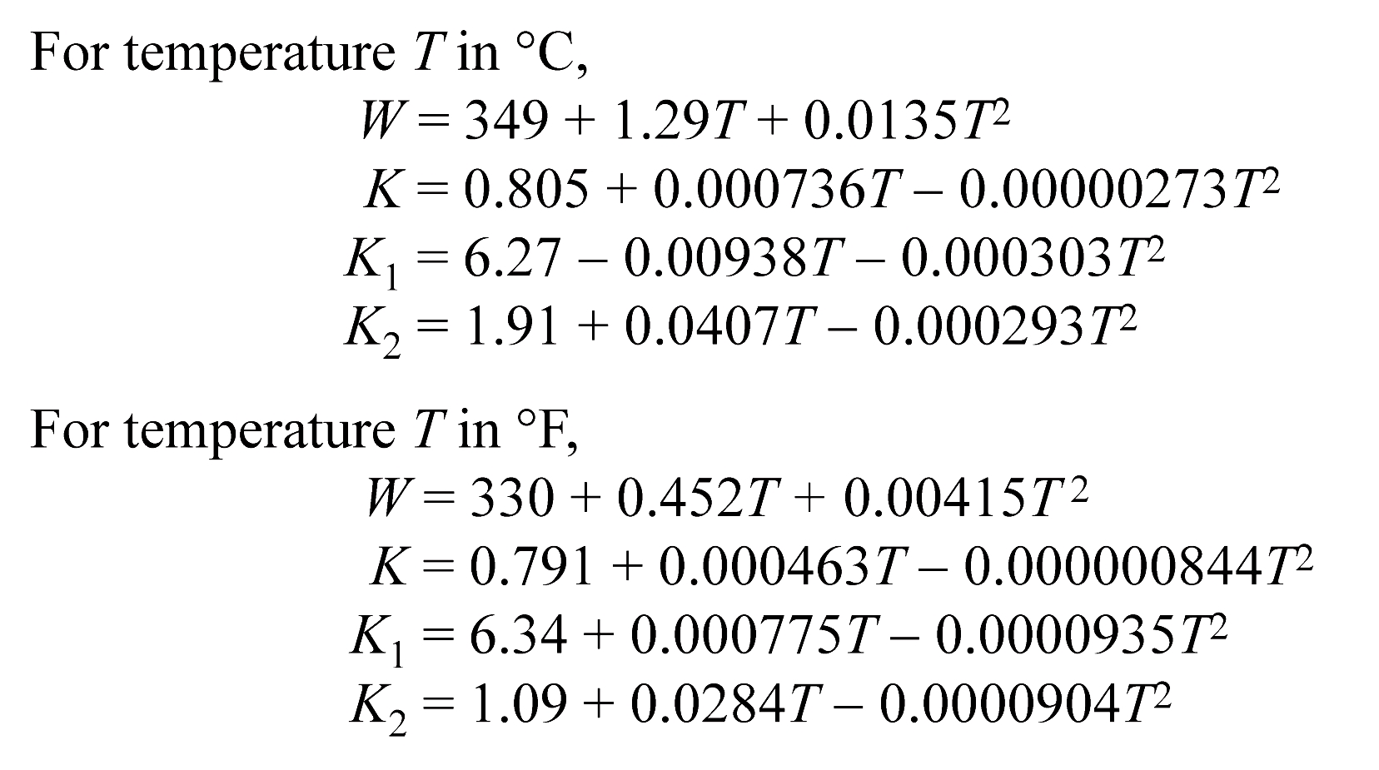
Estimation of EMC for solid wood
EMC (%)
where h is relative humidity (%/100, if 20% RH h=0.2)
Notes:
As an average for a number of species, EMC of solid wood at a specific combination of temperature and RH, EMC can be calculated using this equation. Parameters in Metric (Celsius) or Imperial (Fahrenheit) units are defined separately. Note h is input as a fraction and not as a percent value.

Slide 30
EMC vs RH (Wood)
Notes:
This is a plot showing variation of EMC with temperature and RH. Note that RH is the more dominant parameter.

Slide 31
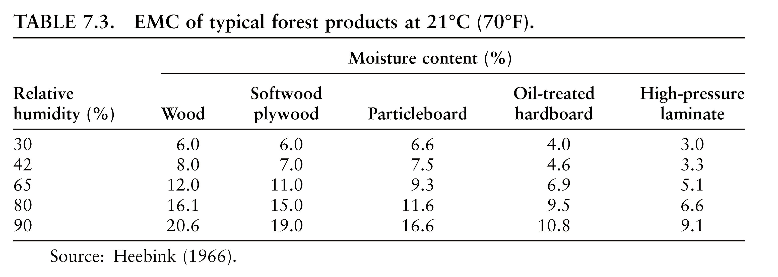
EMC of Forest Products
EMC of wood products is slightly lower than the raw wood from which they are produced
  Application of resins, coatings and sizing materials
  Effect of heat treatment
Notes:
The equation shown before was for solid wood material. For other man-made composite products, which are produced under heat and pressure the EMC is different, This is because these composite products are produced under heat and pressure, which change the ability of the original wood to hold moisture. Generally these composite products’ EMC is lower than solid wood for the same T and RH.

Slide 32
Shrinkage and Swelling
Wood begins to shrink as it dries below the FSP, and continues to shrink until MC = 0.
Wood swells as it absorbs moisture until MC = FSP. No further swelling occurs if MC > FSP.
Notes:
Wood is a material that changes its dimensions when it absorbs moisture (swelling) or desorbs moisture (shrinkage) below FSP. Note above FSP there is no shrinkage or swelling.

Slide 33

Calculation of Shrinkage
In wood science
l₀
l₁
∆l
Generally
Notes:
In wood science, shrinkage is defined as decrease in dimension over original dimension. Change in dimension is usually calculated based on subtracting final dimension from original dimension, as shown in the equation at the bottom.

Slide 34
Calculation of Swelling
In wood science
a₀
∆a
a₁
Generally
Notes:
Swelling is the opposite of shrinkage i.e. increase in dimension over original dimension. Change in dimension is obtained by subtracting the original dimension from the final dimension.

Slide 35
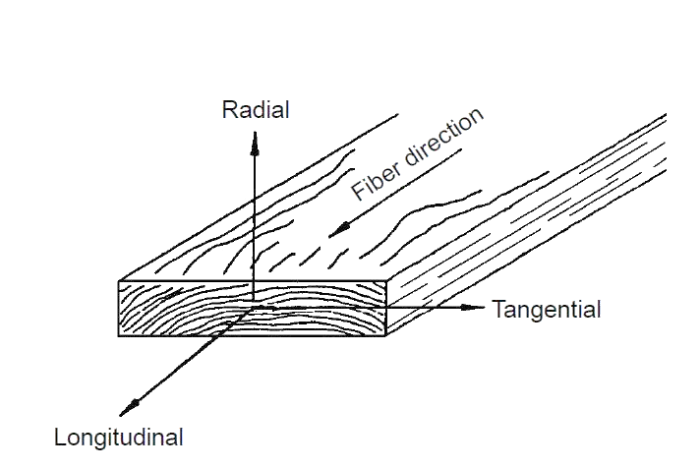
Anisotropy in Wood: direction-dependent. Generally assumed to be orthotropic in R, T and L directions)
Notes:
Shrinkage (and therefore swelling) is different in the three major directions in wood (ie orthotropic properties) The longitudinal direction is along the length of the tree i.e. parallel to the wood grain. Longitudinal shrinkage is negligible and is about 0.1-0.2% from FSP to oven-dry condition (roughly 28% MC to 0% MC). Tangential shrinkage is highest at 6-13% whereas radial shrinkage is roughly half of that at 2-8% depending on species.

Slide 36
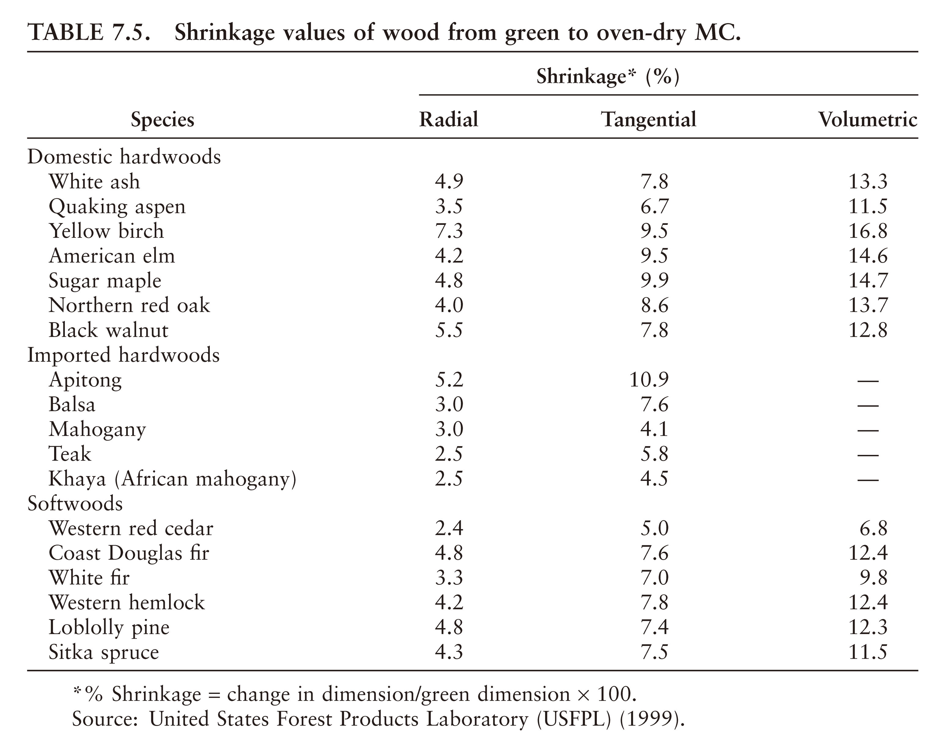
Shrinkage values of wood from green to oven-dry moisture content
Notes:
This table from the Wood Handbook provides Radial, Tangential and Volumetric shrinkage values for different softwood and hardwood species. As a general rule the shrinkage/swelling coefficient (FSP to OD) is dependent on the specific gravity of wood, because a higher SG wood would have more cell wall material to shrink or swell.

Slide 37
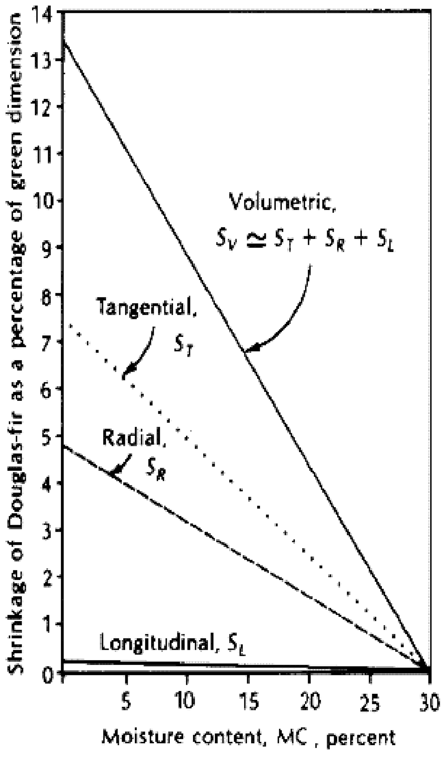
Shrinkage difference in 3 directions
Values of wood from FSP to oven-dry condition
  Longitudinal shrinkage (S_{L}): 0.1-0.2%
    Negligible for most practical purposes
  Radial shrinkage (S_{R}): 2-8%
  Tangential shrinkage (S_{T}) : 6-13%
  Volumetric: S_{V} ≈ S_{R} + S_{T}
Moisture content vs. shrinkage in Douglas-fir
Notes:
Here the shrinkage values of wood in the three major directions from FSP to OD condition are summarized. Generally the volumetric shrinkage is roughly the sum of tangential and radial shrinkage as illustrated in the figure on right.

Slide 38
Estimation of shrinkage at a given MC
S_{MC} is the shrinkage from the green (FSP) condition to the MC of interest;
S_{O} is the total shrinkage from the green to oven-dry condition.
Notes:
Note all published shrinkage coefficients are from FSP to OD. If the interest is to obtain shrinkage when wood dries from FSP to a specific MC, Linear interpolation can be assumed. Therefore the equation is shown here. If FSP for the species in unknown, a value of 28% can be assumed.

Slide 39
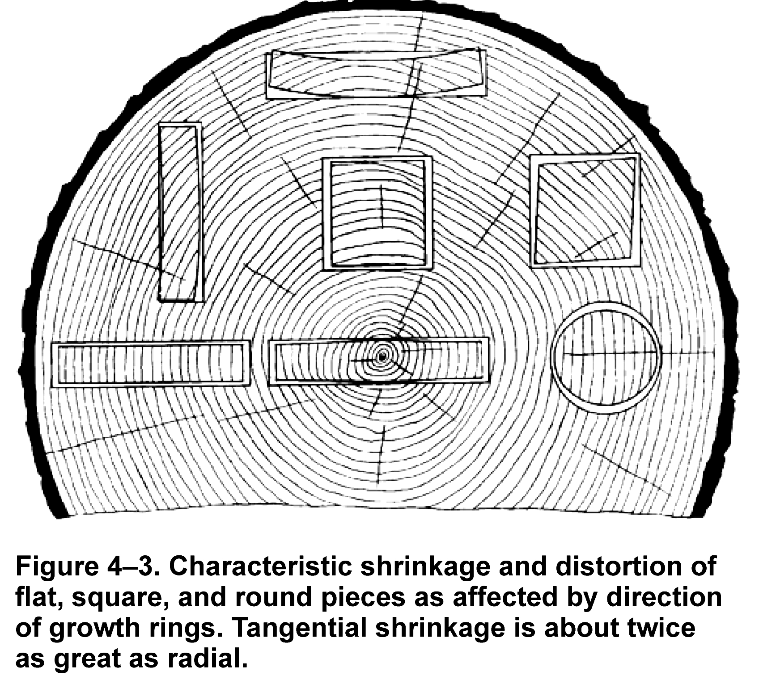
Differential Shrinkage
A. Why does this piece warp this way after drying?
Reflection of anisotropic nature of wood
Causing distortion in boards and lumber
B. Why do the 4 sides of this piece remain square after drying?
(Source: Wood Handbook 2010)
Notes:
Since wood shrinks differently in radial and tangential shrinkage. This differential shrinkage is the main reason for the distortion of lumber and boards. For A the board distorts in the manner as shown because the top edge is dominated by tangential shrinkage, whereas the bottom edge is influenced by both radial and tangential shrinkage due to the growth ring curvature in the cross section. Since radial shrinkage is smaller, therefore the top edge shrink more than bottom edge, causing the piece to distort. For piece B, since the edges of the boards are all parallel to the tangential and radial direction because there is no curvature in the growth ring pattern in the cross section, there is no differential shrinkage for top and bottom edges. Therefore the piece remain undistorted. The distortion patterns for the other pieces in the figure can be explained by the same principle of growth ring pattern relative to the tangential and radial directions.

Slide 40
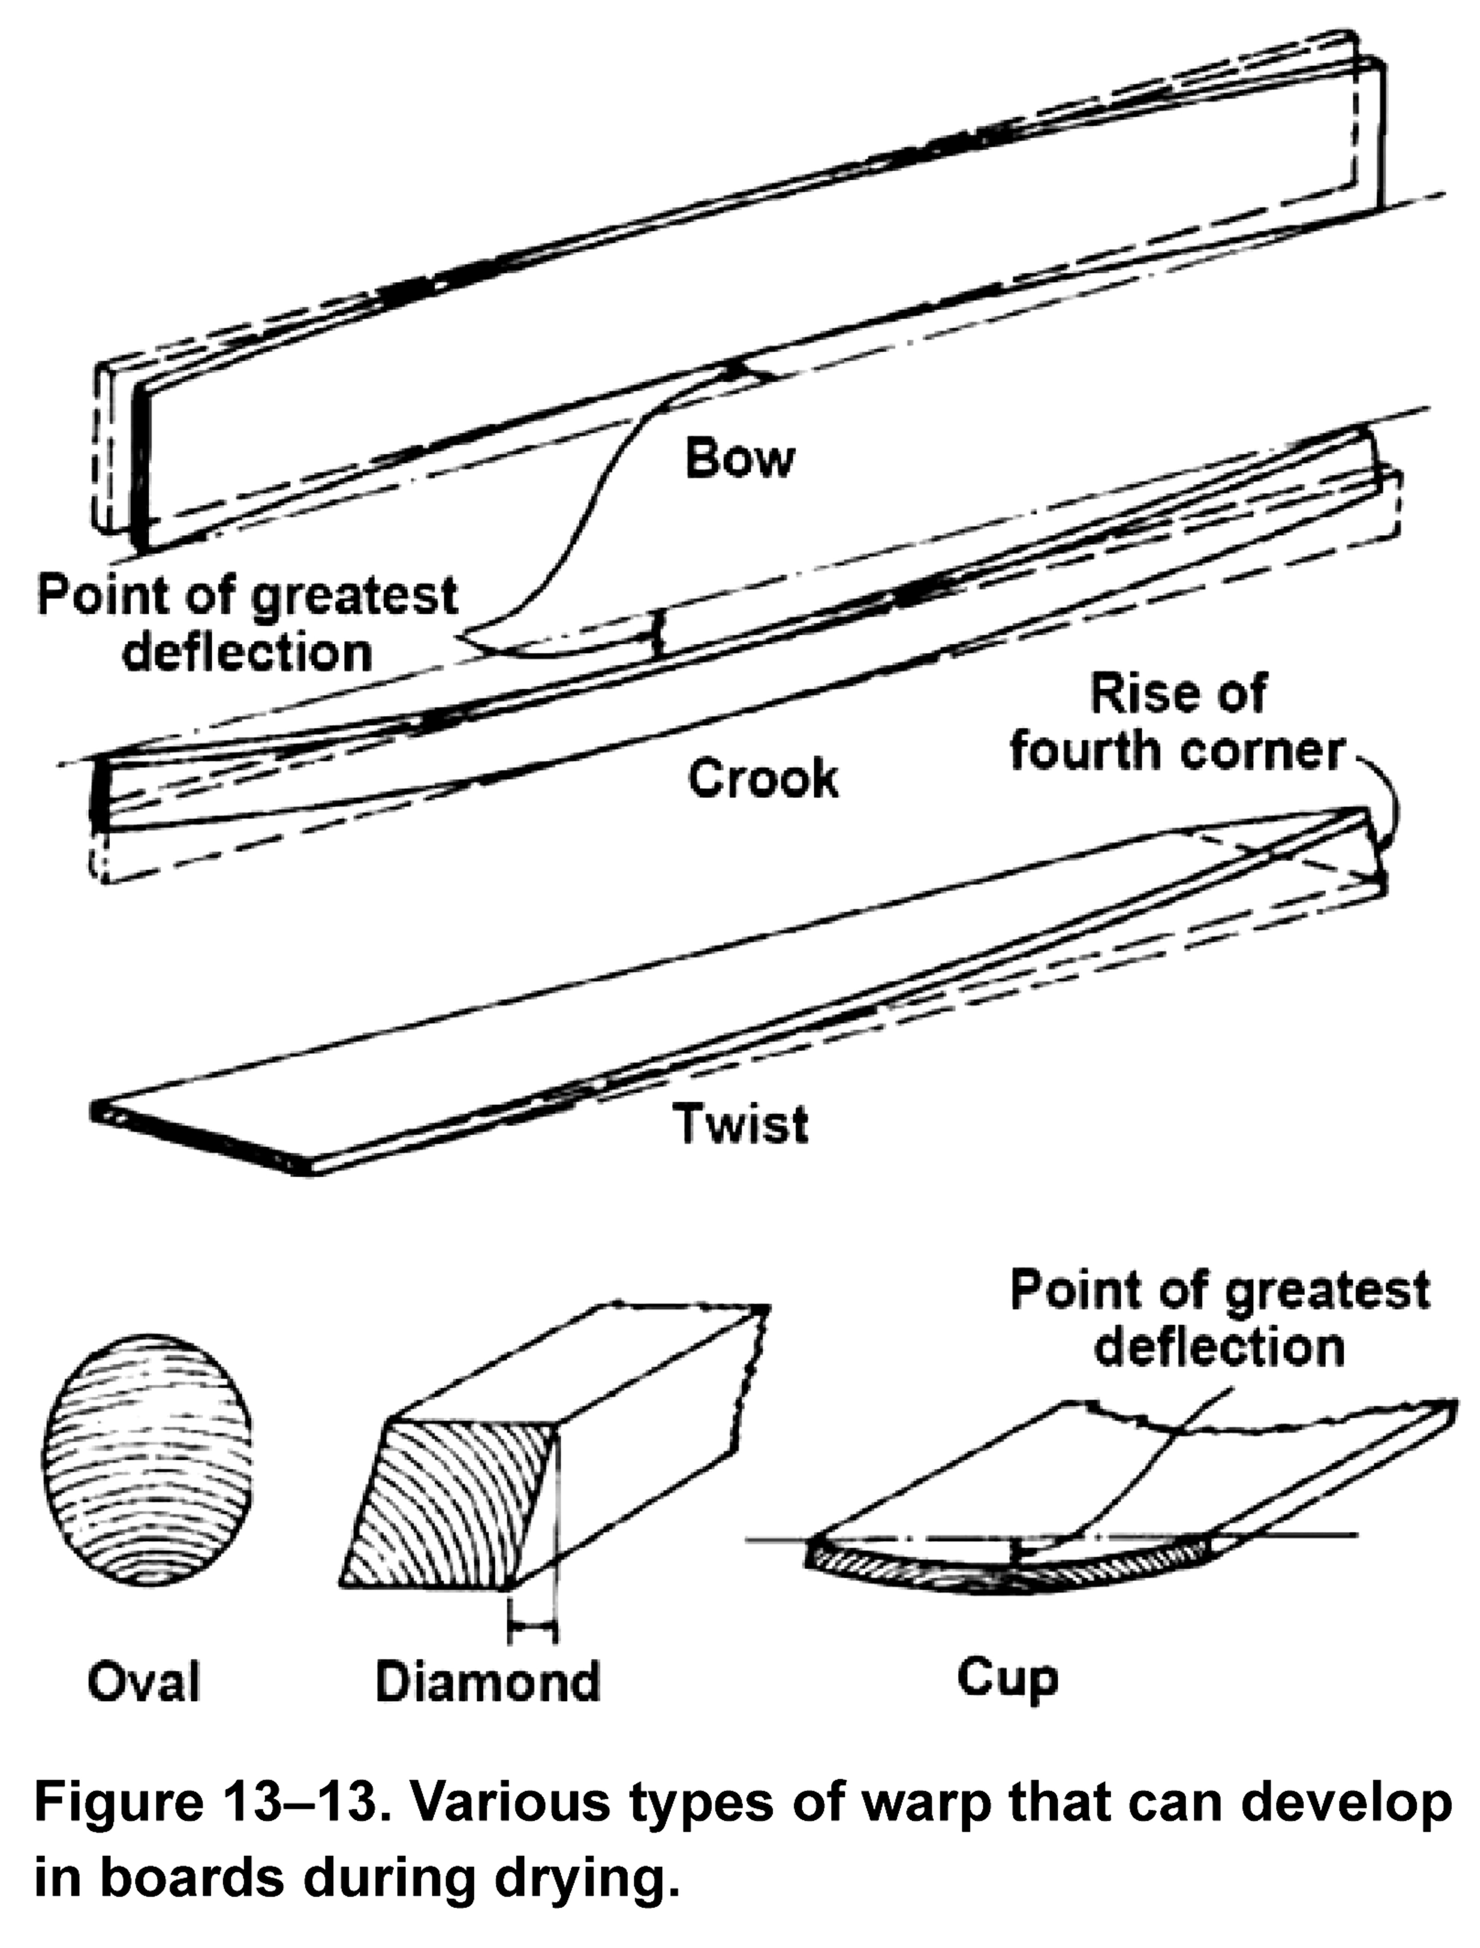
Warp
(Source: Wood Handbook 2010)
Notes:
Shown in this slide are a few types of warping in lumber and timber,

Slide 41
Thermal Conductivity
Thermal conductivity (K) is a measure of the rate of heat flow through a material due to a temperature gradient
K parallel to grain is about 2 – 2.8 time that in perpendicular to grain direction
K in transverse direction (perpendicular to grain) is related to SG and MC
K = SG_{M} (1.39 + C •M) + 0.165, Btu/ (h. ft².°F) per inch
where C = 0.028 for M < 40%
= 0.038 for M ≥ 40%
M = MC in %
SG_{M} = SG based on OD mass and volume at M
Notes:
Thermal conductivity (K) is a measure of the rate of heat flow through a material due to a temperature gradient. The thermal conductivity of wood is influenced by its specific gravity. Intuitively the more cell wall material there is the higher the thermal conductivity or lower the thermal insulation value. Therefore thermal conductivity of wood (K) has a good correlation with its specific gravity. K in the perpendicular to grain direction per inch can be calculated from its specific gravity (SG_M) and moisture content (M) using the equation shown here. Units are Btu per h per ft2 per F degree. Parameter C is dependent on M. Wood conducts heat faster in the longitudinal direction and K is about 2 – 2.8 times that in the perpendicular to grain direction.

Slide 42
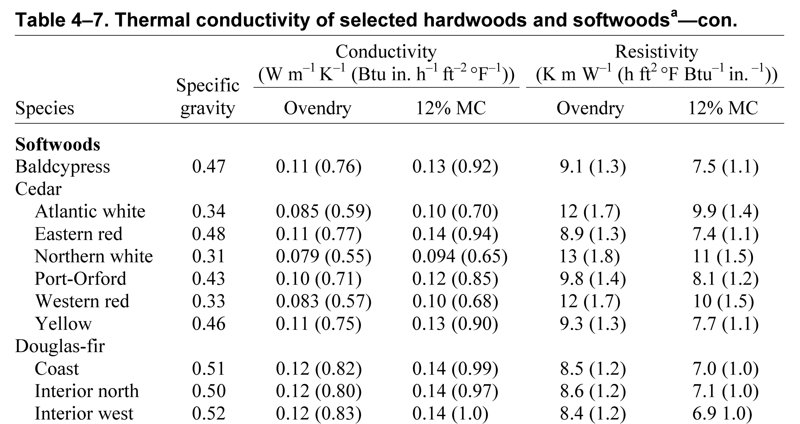
Thermal conductivity of selected species
(Source: Wood Handbook 2010)

Slide 43
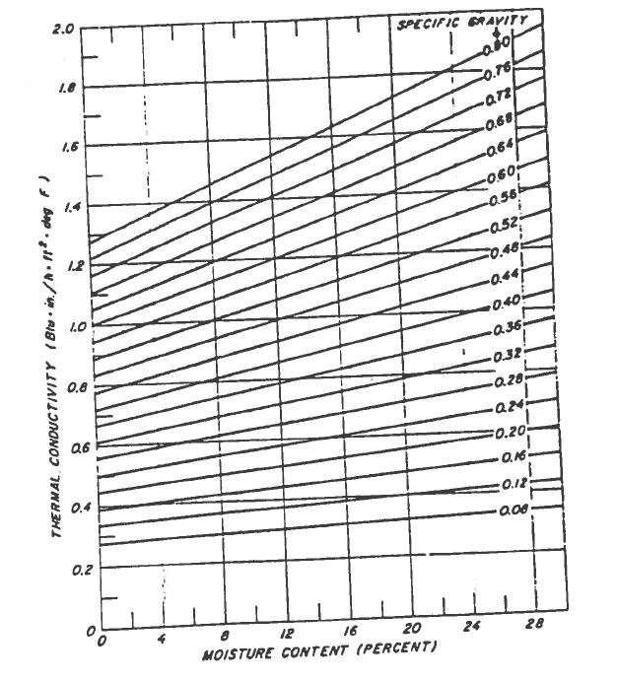
Thermal Conductivity
Metric units for K : Watt / m / Kelvin
Conversion from Imperial to Metric – multiplied by 0.14422
Thermal resistance, R = 1/K per inch
Notes:
Thermal conductivity generally increases with moisture content in the wood as moisture would occupy the air voids in the wood cellular structure. The figure on the right shows the relationship between K and M for different SG. The Metric units for K is W/m/K. To convert from Imperial to Metric multiply by 0.14422. Note that thermal resistance (R ) is the reciprocal of K.

Slide 44

Thermal Expansion
Thermal expansion
    where Δ = change in dimension
    ΔT = change in temperature
    = original dimension
In R and T directions, α is dependent on SG_{OD}
  α_{R} = (18 x SG_{OD} + 5.5) 10⁻⁶ per °F
  α_{T} = (18 x SG_{OD} + 10.2) 10⁻⁶ per °F
α is independent of SG in L direction
  α_{L} = 1.7 – 2.5 x 10⁻⁶ per °F
Notes:
Similar to thermal conductivity, thermal expansion coefficient of wood, α, is also related to SG in the radial and tangential directions as shown in the bottom 2 equations. α is defined as shown in the equation here. Thermal expansion in the L direction is independent of SG and is given by the equation shown here.

Slide 45
Thermal Expansion
To convert from Imperial to Metric units, multiplied by 1.8 i.e. per °C
Thermal expansion of other materials:
  Steel : 3 times
  Concrete : 2 times
Thermal expansion of wood containing moisture is insignificant because it is offset by the shrinkage due to loss of moisture
Notes:
To convert from Imperial to Metric units, multiplied by 1.8 i.e. per °C. Compared with steel and concrete, thermal expansion of wood is lower: steel is 3 times that of wood whereas concrete is 2 time.
Thermal expansion of wood containing moisture is insignificant because it is offset by the shrinkage due to loss of moisture.

Slide 46
Combustion of wood
Ignition temperature of wood is 275°C
Speed of ignition depends on: 1) Size of wood; 2) Rate of heat loss from surface; 3) Rate of supply of heat to surface
Heat of combustion (H) is defined as Btu produced by burning 1 pound of material
  For OD wood, H = 8500 – 9000 Btu
  Heat value is reduced by any presence of moisture in wood
  Btu per pound of wood with moisture
Notes:
Wood burns at about 275 degree C ie wood would burn when this temperature is reached. Flame spread or speed of ignition is dependent on size of wood, rate of heat loos, and rate of supply of heat to the burning surface. When wood burns it gives off heat and it has been a significant energy sources for humans for thousands of years. Heat of combustion of one unit weight of wood e.g. 1 lb is shown to be constant across all species, 8500 – 9000 Btu. In other words when burning 1 lb of OD wood, 8500 to 9000 Btu is produced. When the wood contains moisture, its heat of combustion value decreases and can be calculated from this equation.

Slide 47
Part 2– Mechanical Properties of Wood

Slide 48
Mechanical properties
Behaviour of wood under different types of stress
Methods of measurement for small clear wood
Factors influencing mechanical properties of wood
  Environmental (e.g. moisture, temperature)
  Growth features (e.g. grain, knots, density)
  Long-term loading
Modification factors used in design
Notes:
This lecture series addresses the behaviour of wood under different types of stresses, and measurement of mechanical properties of small clear wood specimens, and how mechanical properties are influenced b various factors, including these…....

Slide 49
What are mechanical properties?
Strength : the ability of a material to resist applied loads or forces without failure.
Resistance to deformation (stiffness): change in dimension of a material when subjected to an applied load.
Notes:
There are two types of mechanical properties. Strength properties govern the load carrying ability with fracture of material. Stiffness properties govern the deformation of a material under load, and it is not related failure of the material.

Slide 50
Comparison of wood with other materials
Material | Density (kg/m³) | MOE (GPa) | Tensile strength (MPa)
Wood | 500 | 12 | 80
Mild steel | 7800 | 200 | 400
Aluminum | 2700 | 70 | 200
Concrete | 2300 | 35 | 3
Notes:
Comparing with steel, concrete and aluminum, density of wood is much lower. MOE is a stiffness property. Most mechanical properties of wood are lower except for tensile strength of concrete.

Slide 51
Ratio of ‘strength’ to density
Material | MOE / density | Tensile strength / density | Compressive strength / density
Wood | 20-30 | 120-170 | 60-90
Mild steel | 26 | 30 | 30
Aluminum | 25 | 180 | 130
Concrete | 15 | 3 | 30
Notes:
Although wood is generally less stiff and weaker, the strength and stiffness to density ratio of wood is comparable with other materials. This is significant because it means ease of handling during construction.

Slide 52
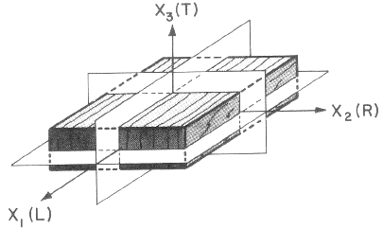
Orthotropic model of a clear wood block
(Source: Wood Handbook 2010)
Notes:
Wood is considered to be an orthotropic material with three principal material property axes. These are longitudinal, tangential and radial. L direction aligns with wood grain. Radial direction is perpendicular to growth ring. Tangential direction by definition is the direction parallel to the growth ring.

Slide 53
Types of loading
Bending
Compression
Tensile
Shear

Slide 54
Mechanical Properties
Orthotropic – properties being directionally dependent
For practical purpose, assume two principal directions:
    Parallel to grain (Longitudinal)
    Perpendicular to grain (Tangential and Radial)
E_{L} : E_{R} : E_{T} ≈ 20 : 1.6 : 1
G_{LR} : G_{LT} : G_{RT} ≈ 10 : 9.4 : 1
E_{L} : G_{LR} ≈ 14 : 1
E – Young’s modulus, G – shear modulus
Notes:
Wood may be described as an orthotropic material; that is, it has unique and independent mechanical properties in the directions of three mutually perpendicular axes: longitudinal, radial, and tangential. The longitudinal axis L is parallel to the fiber (grain); the radial axis R is normal to the growth rings (perpendicular to the grain in the radial direction); and the tangential axis T is perpendicular to the grain but tangent to the growth rings.
Note that the E/G ratio of wood is roughly about 14. In CSA O86 it is generally assumed to be 16.
The modular ratios for E and G are greatest between longitudinal direction the the two transverse direction (R and T). For practical purposes, there is no differentiation between R and T direction as it is not practical to do it in practice. Therefore wood properties are often referred to as parallel (L) and perpendicular (R and T) direction only.

Slide 55
Mechanical Properties
Elastic properties
  Modulus of elasticity (E): resistance to deformation caused by axial stress
  Modulus of rigidity (G): resistance to deformation caused by shear stress
Common strength properties
  Modulus of rupture (MOR): strength of a member in bending (extreme fibre stress in tension or compression)
  Compressive strength: parallel & perpendicular to grain
  Tensile strength: parallel & perpendicular to grain
  Shear strength: parallel to grain and through-thickness (rolling shear)
Strong in parallel-to-grain direction
Weak in perpendicular-to-grain direction
Notes:
This is a list of important mechanical properties of wood, which are presented in design standards.
Rolling shear strength—Shear strength of wood where shearing force is in a longitudinal plane and is acting perpendicular to the grain. Few test values of rolling shear in solid wood have been reported. In limited tests, rolling shear strength averaged 18% to 28% of parallel-to-grain shear values. Rolling shear strength is about the same in the longitudinal–radial and longitudinal–tangential planes.
Wood is strong and stiff when loaded parallel to the grain and weak and flexible when loaded perpendicular to the grain.

Slide 56
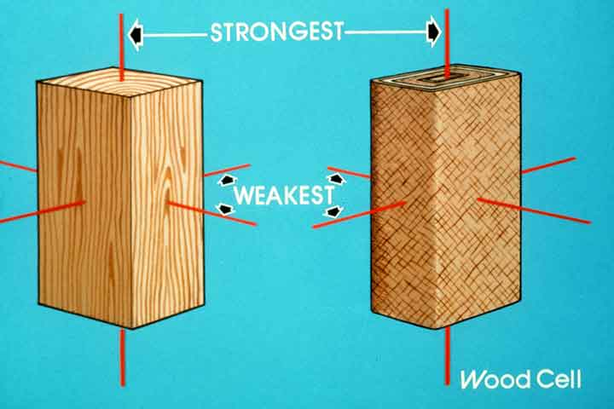
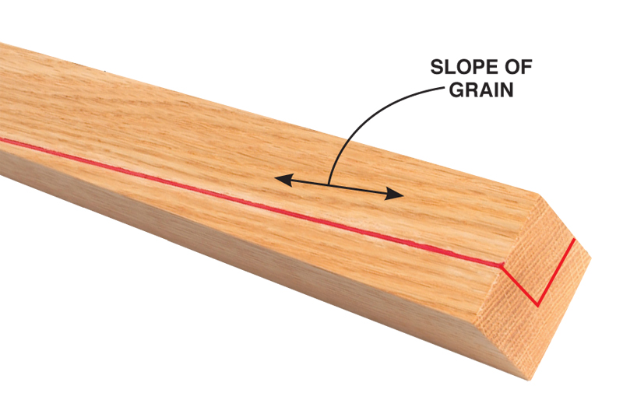
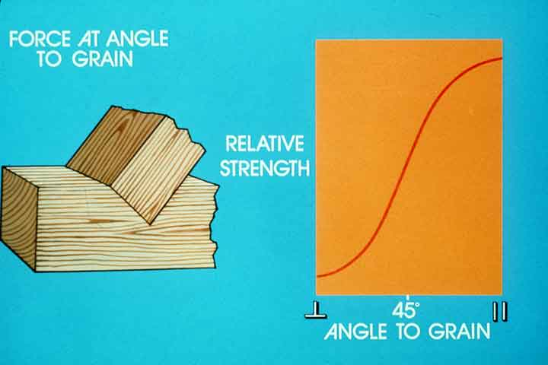
Strength of wood depends on loading direction relative to grain
Parallel-to-grain strength ≈ 20 x perp-to-grain strength
Notes:
Strength of wood is different when loaded parallel and perpendicular to grain. A ratio of 20 to 1 is not uncommon. When load is applied at an angle to the grain, the decrease in strength is exponential in comparison with the parallel to grain strength, as illustrated in the figure at the bottom right.

Slide 57
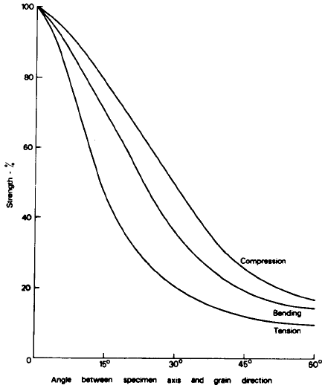
Hankinson’s formula
Strength at angle θ, P_{θ}
where P// and P┴ are strength parallel and perpendicular to grain respectively, n is dependent on property
Property | n | P┴ / P//
Tension | 1.5 - 2.0 | 0.04 - 0.07
Compression | 2.0 - 2.5 | 0.03 - 0.40
MOR | 1.5 - 2.0 | 0.04 - 0.10
MOE | 2.0 | 0.04 - 0.12
Notes:
The relationship between strength property and grain angle can be represented by the famous Hankinson’s formula. The constant n is dependent on the property of interest and is given in this table. Hankinson’s formula is adopted in CSA O86 for calculating strength of wood and connections when loaded at an angle to wood grain.

Slide 58
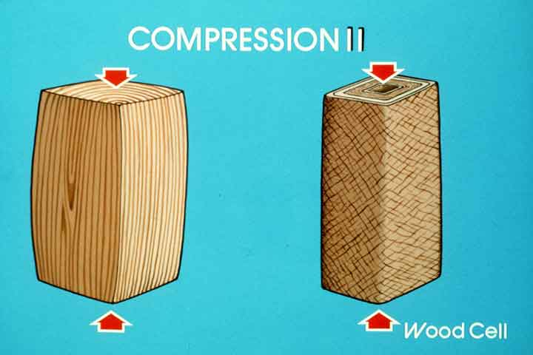
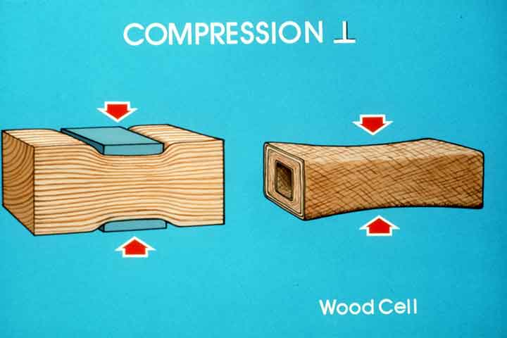
Compression
Perp-to-grain is about 10%-20% that of par-to-grain strength
Load
Par
Perp
Deformation
Notes:
The schematic figure compares load-deformation response when wood is stressed parallel and perpendicular to grain direction. As can be seen, there is some signs of plasticity in the response, more so in the perpendicular to grain curve. Indeed only under compression perpendicular grain loading that wood exhibits some ductile behaviour.

Slide 59
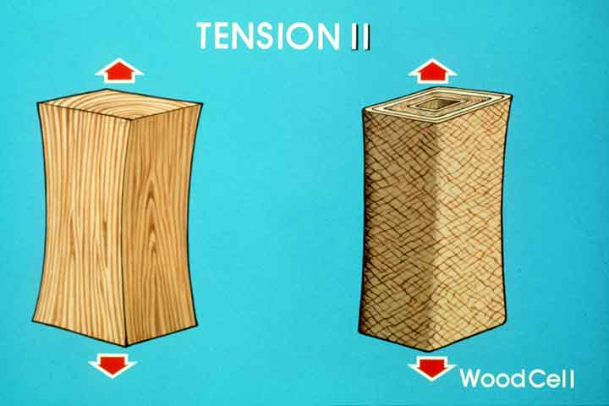
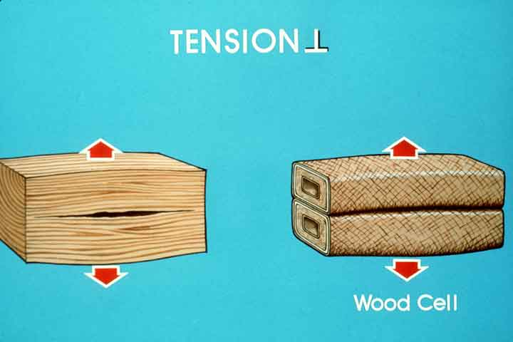
Tension
Perp-to-grain strength is only about 5% that of par-to-grain
Load
Par
Perp
Deformation
Notes:
Under tensile force the behaviour of wood is brittle in both directions with sudden failure when wood reaches its ultimate strength with no plastic region. Perpendicular to grain strength is about 5% that of parallel to grain strength.

Slide 60
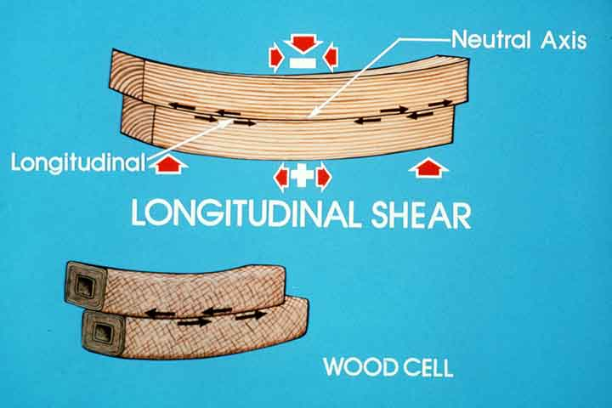
Shear parallel to grain (longitudinal shear)
Not as affected by knot for tension and compression
Property could be enhanced by knots
Initial crack and splitting are weakness
Notes:
Wood fails in shear when there is possibility of crack growth. Therefore potential failure modes are parallel to grain (failure along grain) and rolling shear (failure along growth ring). Shear parallel to grain is less affected by presence of knots and more influenced by slope of grain and presence of initial cracks and checks.

Slide 61
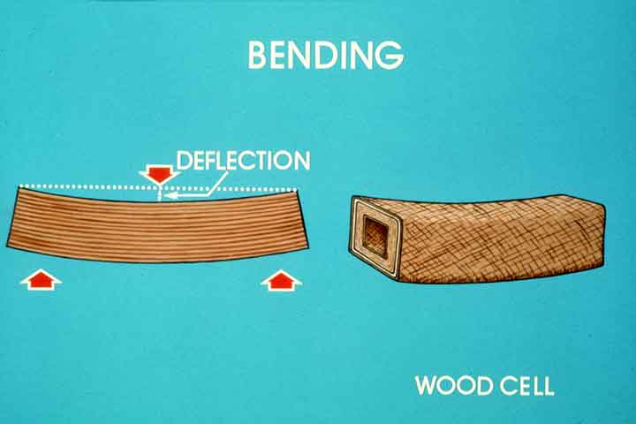
Bending
Potential failure modes:
  Tension
  Compression
  Shear
  Bearing
One of these would govern in practice
Modulus of rupture (MOR) is often used for bending strength
Notes:
In scientific terms, there is no such thing as ‘bending failure’. Under bending, a wooden beam can fail in a number of manners, tension, compression, shear and potentially bearing. Therefore the term modulus of rupture (MOR) is often used for bending strength of wood.

Slide 62
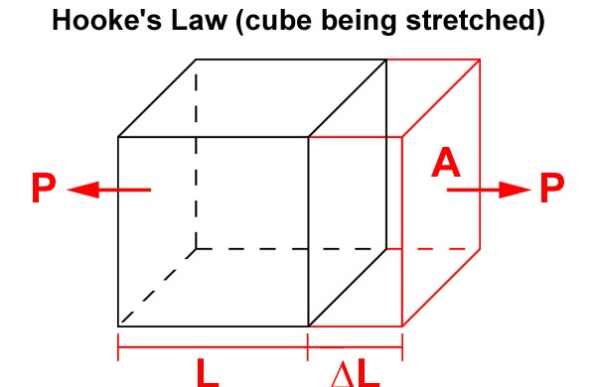
Hooke’s law
Idealized material
Load / Stress
Deformation / Strain
Notes:
Hooke’s law defines the stress-strain relationship for an linear-elastic material. Most materials are not linear elastic but may be true under low stress level.

Slide 63
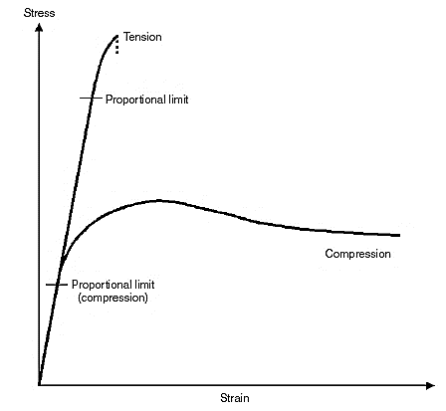
Stress-strain response
Shape of stress-strain differs under different loading
3 key parts: Elastic, plastic and failure
  Linear elasticity
  Brittle and ductile failure
Hooke’s law
  Proportional limit
  Young’s modulus (E) / Modulus of elasticity (MOE)
Stress versus strain curves for wood loaded in tension and compression
Notes:
When wood is stressed in compression or tension, the stress-strain response generally have 3 parts. Initial linear portion can be used to calculate Young’s modulus or modulus of elasticity (MOE). The point where the stress-strain curve deviates from straight line is usually called the proportional limit. Under tension there is generally no or small plastic region. Under compression, especially perpendicular to grain, there is usually some plastic deformation.

Slide 64
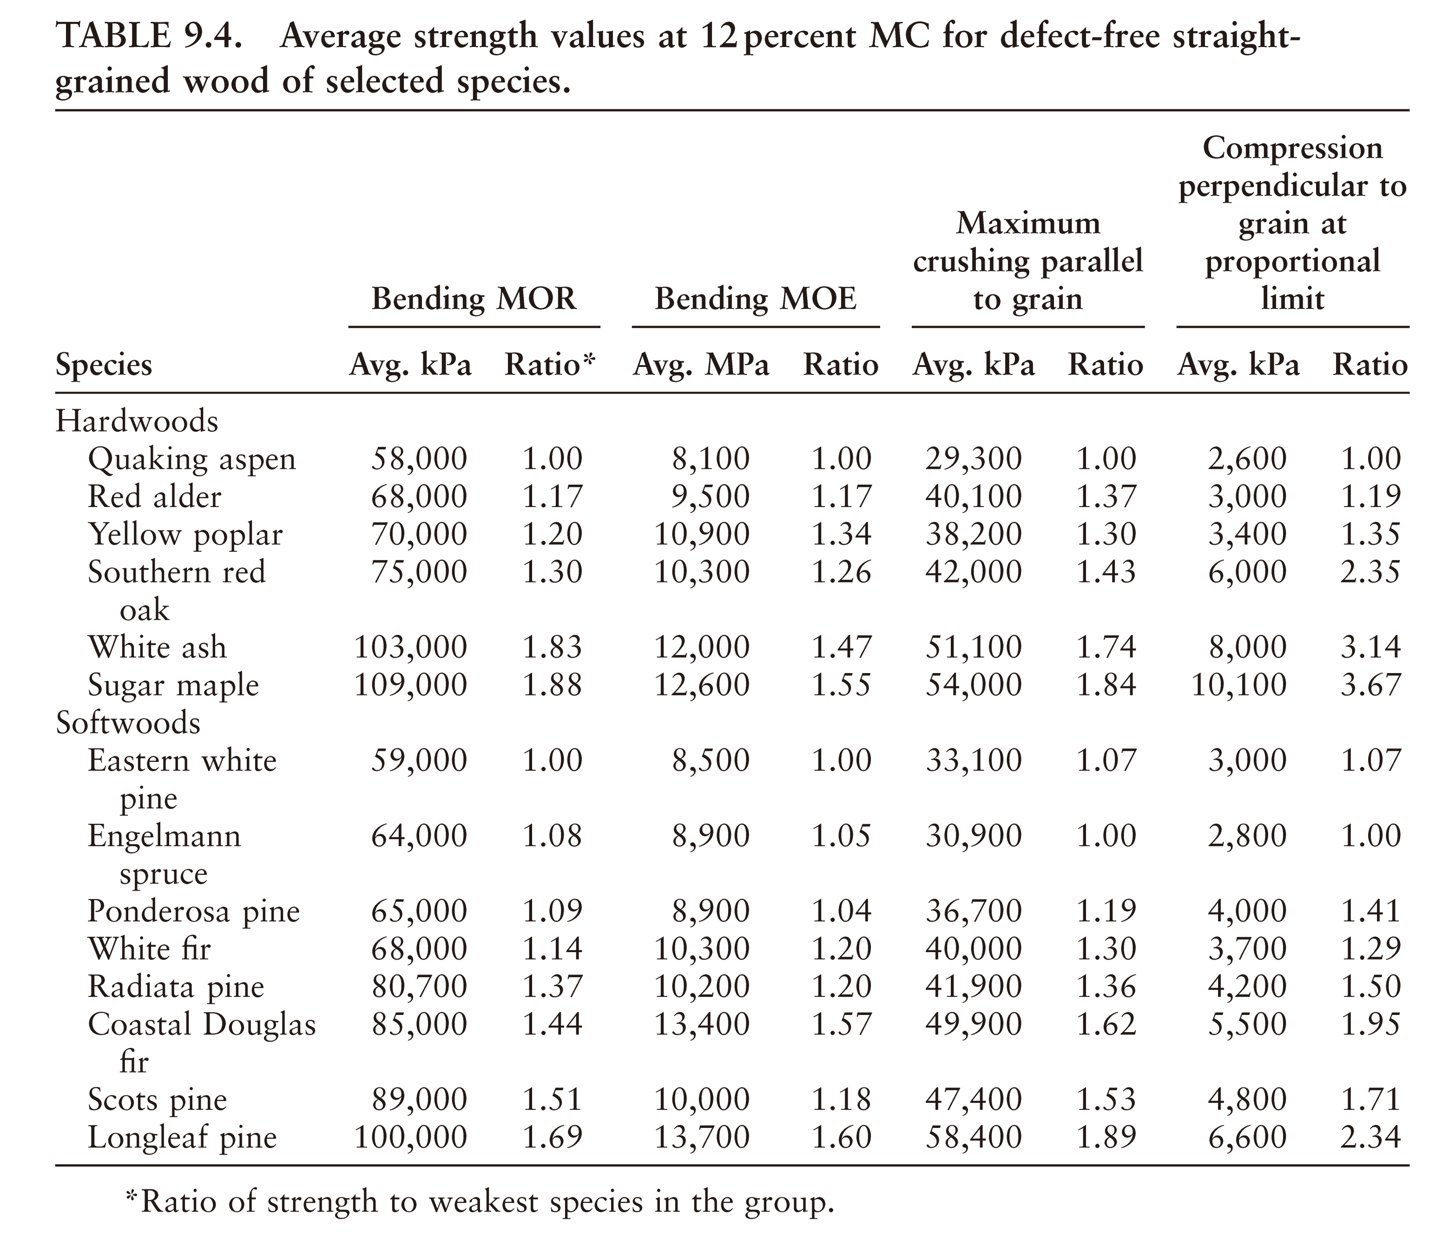
Relative strength among species
(Source: Shmulsky & Jones 2011)
Notes:
Wood is a natural material with generally a larger variation mechanical properties than other common structural materials such as steel and concrete. This table shows some mechanical properties values for common hardwood and softwood specie grown in North America.

Slide 65
Mechanical properties
Behaviour of wood under different types of stress
Methods of measurement for small clear wood
Factors influencing mechanical properties of wood
  Environmental (e.g. moisture, temperature)
  Growth features (e.g. grain, knots, density)
  Long-term loading

Slide 66
Test methods
Strength properties of various species are determined through standardized tests of small, clear (defect free) specimens at various moisture conditions.
Large pieces, containing defects typical of standard grades of lumber, are also tested to develop strength data (full-size test).
Notes:
There are two categories of test method to measure mechanical properties of wood. The first category is for small clear wood specimens. The second category is for structural size lumber that contains growth features, such as knots. In North America, most standard test methods are published in ASTM standards. The methods presented later in this lecture series belong to the first category ie for some clear wood.

Slide 67
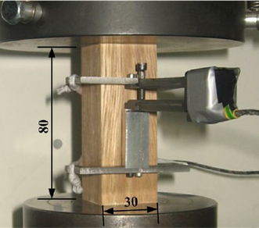
Compression parallel to grain
Maximum compressive strength
Modulus of elasticity
Proportional limit
P_{ucs}
P_{pl}
Load
(Source: researchgate.net)
Deformation
https://youtu.be/DFeHYFPElvE
Notes:
This is a picture of the test set-up for compression parallel to grain. The specimen is loaded via two steel platen in a universal test machine. A displacement transducer can be used to measure the compression over a gauge length. A plot of load-deformation can be obtained which can be used to extract compressive strength, modulus of elasticity (using the slope of the load-deformation line) and the proportion limit. A You-tube video of a compression parallel to grain test can be viewed by clicking the web link.

Slide 68
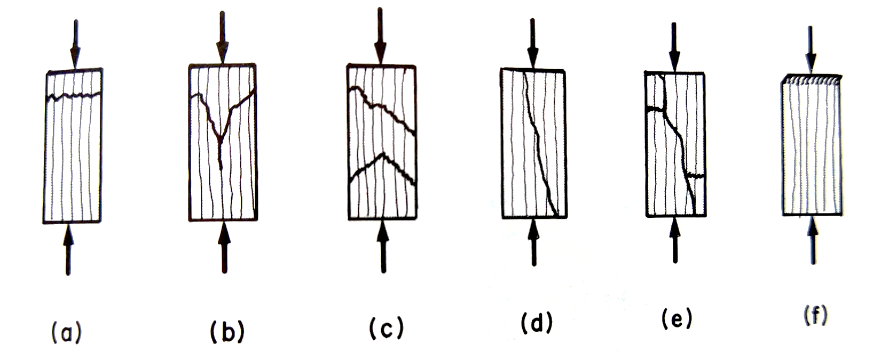
Failure modes
Failure types of nonbuckling clear wood in compression parallel to grain: (a) crushing, (b) wedge splitting, (c) shearing, (e) crushing and splitting, (f) brooming and end rolling.
(Source: Bodig & Jayne)
Notes:
These are some possible failure modes under compression parallel to grain tests. Note that mode f is likley caused by improper specimens alignment of machining and should be discarded if that mode occurs.

Slide 69
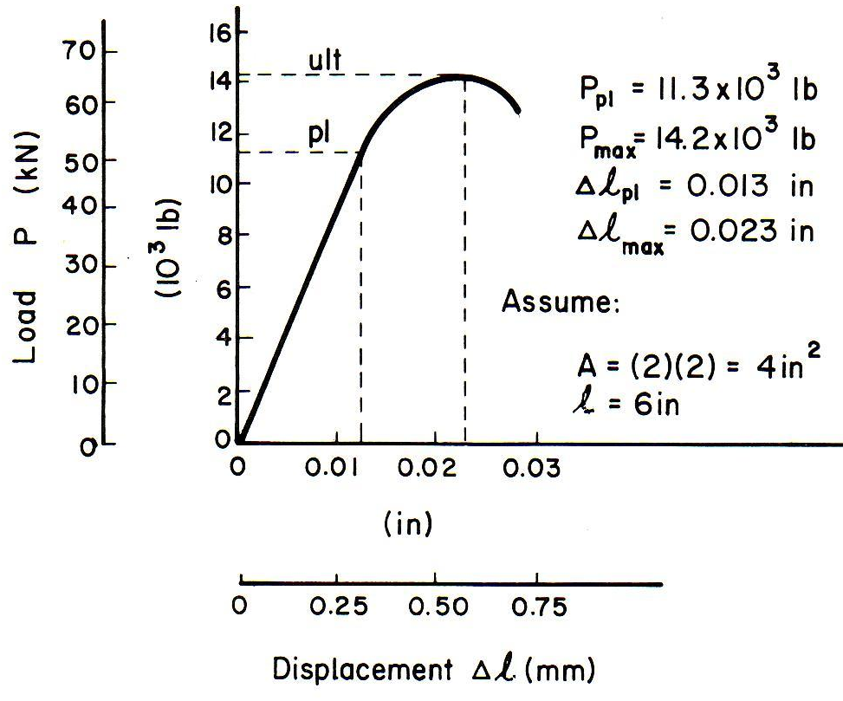
Example: compression parallel to grain
1) Proportional limit
2) Modulus of elasticity
3) Maximum compressive strength
Notes:
This slide illustrates how the three properties can be calculated from the load vs deformation plot.

Slide 70
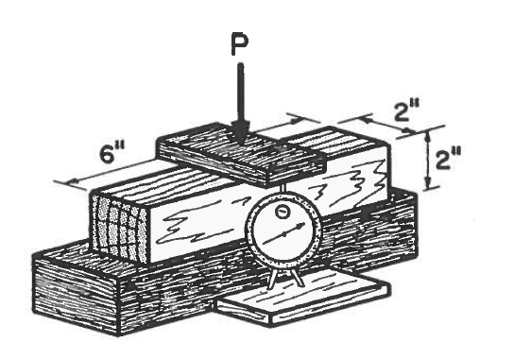
Compression perpendicular to grain
Proportional limit
Modulus of elasticity
May not have a clear failure
Load
https://youtu.be/yqAFSKlALwk
pl
Deformation
Notes:
This is a picture of the test set-up for compression perpendicular to grain. The specimen is compressed using a steel plate. A displacement transducer can be used to measure the the platen movement as a measurement of the compression deformation. A plot of load-deformation can be obtained which can be used to extract modulus of elasticity (using the slope of the load-deformation line) and the proportion limit. Note that under compression perp to grain, there may not be a well defined peak load. A You-tube video of a compression parallel to grain test can be viewed by clicking the web link.

Slide 71
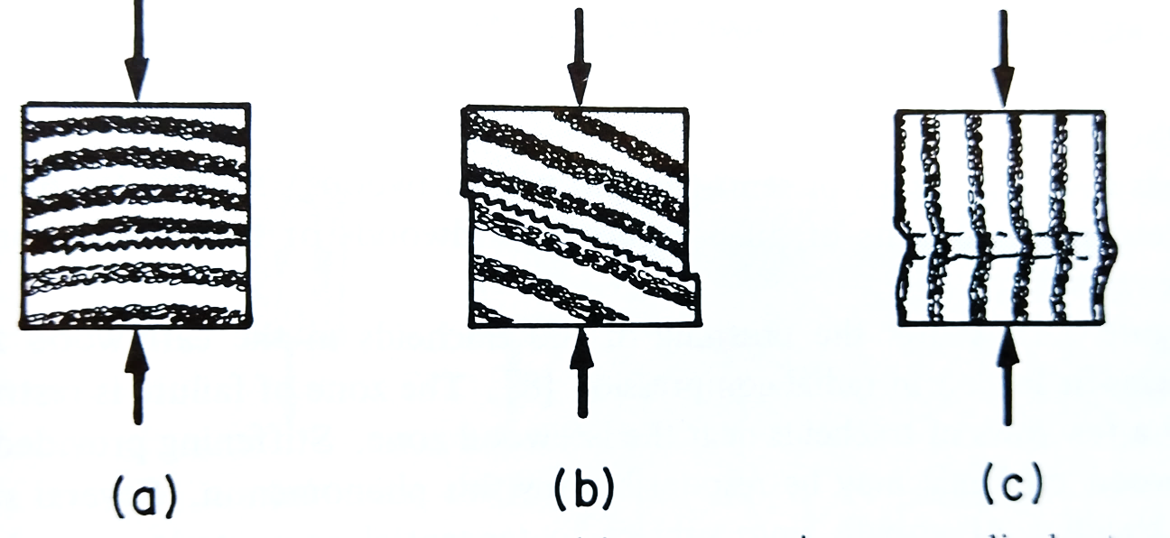
Failure modes
Failure types of clear wood in compression perpendicular to grain: (a) crushing of an earlywood zone, (b) shearing along a growth ring, (c) buckling of the growth rings.
Notes:
These are the three possible failure modes under compression perpendicular to grain.

Slide 72
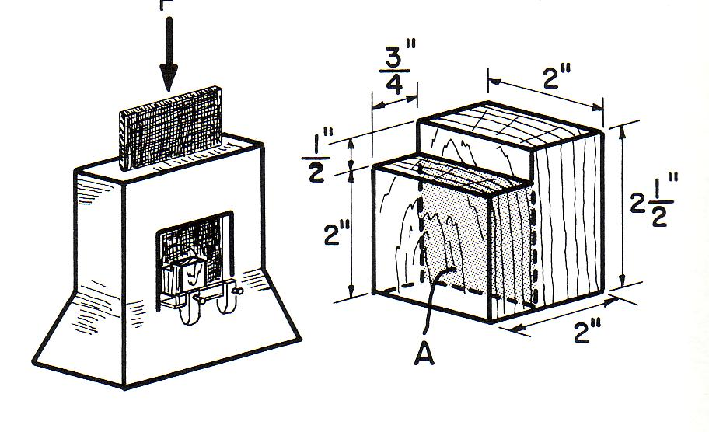
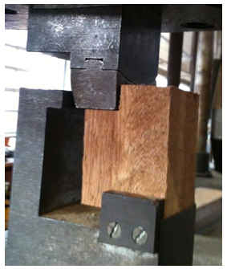
Shear parallel to grain (Longitudinal shear)
Shear strength
Load
P_{u}
where A = shear area
Deformation (Sliding)
Notes:
A step block specimen is used to measure longitudinal shear. The load is applied via two steel block. Shear strength is calculated by dividing the maximum force divided by the shear area.

Slide 73
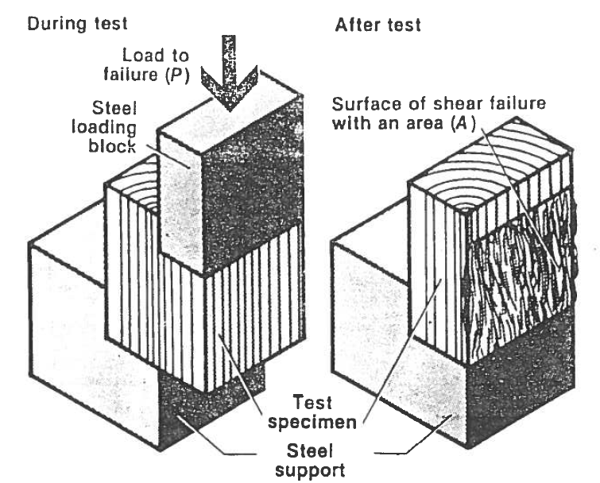
Failure mode
Notes:
The test set-up will ensure that the shear plane will occur at the edge of the steel blocks.

Slide 74
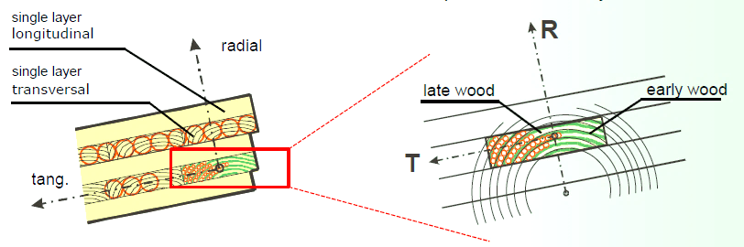
Shear through-thickness (rolling shear) properties of wood
Weakness between growth rings leads to a tendency for wood layers to slide over one another under shear stress
Failure mode is for layers of wood to roll over – rolling shear
Notes:
Growth rings are planes of weakness in wood. Therefore stressed in shear as shown in a cross layer in plywood or CLT, the earlywood and latewood will roll over each other, generating the so-called rolling shear failure, also scientifically know as shear through-thickness.

Slide 75



Rolling shear failure in CLT
  Under bending, failure could be rolling shear in a cross layer
  Rolling Shear failure
Shear stresses in cross layer
Notes:
Rolling shear failure can occur in CLT when loaded under out-of-plane bending.

Slide 76


Measurement of rolling shear properties
Steel plates
Two-plate shear test method
Shear strength = (P_{max} cos θ)/ bL
where b = width, L = length
θ
Notes:
Rolling shear strength can be measured using a two-plate shear test. The test setup is inclined at an angle theta. Equation for calculating shear strength is shown here. If shear modulus is desired, a displacement transducer can be used to measure the sliding of the two steel plates.

Slide 77

Tension parallel to grain
Tensile strength
Modulus of elasticity
Proportional limit
Load
P_{uts}
P_{pl}
Deformation
Notes:
This is a picture of the test set-up for tension parallel to grain. The specimen is loaded via two steel fixtures in a universal test machine. Sometimes, grips are used at the ends of the specimen to apply the tensile force. A displacement transducer can be used to measure the compression over a gauge length. A plot of load-deformation can be obtained which can be used to extract compressive strength, modulus of elasticity (using the slope of the load-deformation line) and the proportion limit.

Slide 78

Failure mode
Failure types of clear wood in tension parallel to grain: (a) splintering tension, (b) combined tension and shear, (c) shear, (d) brittle tension.
Notes:
These are the failure modes under tension parallel to grain.

Slide 79

Bending
Modulus of rupture (MOR)
Modulus of elasticity (MOE)
https://youtu.be/GnUpjeW8BT8
Notes:
Until bending test, the main properties to be determined are MOR and MOE. A displacement transducer is used to measure the beam deflection, usually at mid-span. You can watch a You-tube video clip of a bending test on lumber specimen.

Slide 80
Load-deflection response in bending
P
P_{max}
P
Δ
Slope = P/Δ
L
Δ
Notes:
The load-deflection response is often linear-elastic until failure. The peak load and slope of the load-deflection response are used in calculating MOR and MOE respectively.

Slide 81
Bending properties of wood
P
P
h
L
L/3
L/3
L/3
b
Centre point loading
Third point loading
P/Δ = slope of load-deformation line
P_{max} = load at failure
Notes:
There are different methods of loading the beam specimen. The most common one is the third-point loading on the right. Equations for calculating MOR and MOE for point load and third-point loading are given here.

Slide 82

Failure mode
What causes each mode?
Which failure mode will provide the lowest failure load?
What failure mode may have non-linear response?
Load
Failure types of clear wood in bending with span parallel to grain: (a) simple tension, (b) cross-grain tension, (c) splintering tension, (d) brash tension, (e) compression, (f) horizontal shear.
Deflection
Notes:
These are the failure modes under bending load. Mode f is actually a shear failure and usually occurs in short-span test or in specimen that already has an end check. Answer to 2 – usually (b) due to slope of grain. Answer to 3 – mode e due to compression failure, which exhibits some plastic behaviour.

Slide 83


Tension perpendicular to grain
Tensile strength
Radial/tangential
A
Notes:
This is the test set-up for tension perpendicular to grain. Wood is extremely weak in tension perpendicular to grain. A shaped specimen is required to ensure that failure occurs in the reduced cross sectional area.

Slide 84




Strength Requirements vs. Use
Which strength property is important depends upon the end application.

Slide 85

Wood Handbook - Mechanical properties of wood
Small clear wood with straight grain
Notes:
The Wood Handbook, which can be downloaded for free, is a good reference for mechanical properties of the majority of species grown in North America, as well as some exotic species. Here is one table from the Wood Handbook. Note that the properties are for small clear wood without defects and straight grain.

Slide 86
Notes on interpreting test data from literature
Small clear wood vs structural size lumber
Moisture condition of wood
Origin and growth conditions of trees – geographical locations
Graded vs ungraded wood
Notes:
When interpretating published mechanical properties of species, it is necessary to understand the origin of the data. Here are a number factors that you should be aware of when getting data from the literature.

Slide 87
Mechanical properties
Behaviour of wood under different types of stress
Methods of measurement for small clear wood
Factors influencing mechanical properties of wood
  Environmental (e.g. moisture, temperature)
  Growth features (e.g. grain, knots, density)
  Long-term loading
Notes:
Now we will discuss the factors that affect mechanical properties of wood. There are 3 main categories: environmental, natural growth features and long-term loading effect.

Slide 88

Moisture content
Fibre saturation point (FSP) is MC above which mechanical properties are not affected by MC
Slope - Similar among strength properties
FSP
Notes:
A major environmental factor is moisture content in wood. Mechanical properties of wood decreases near linearly with increasing moisture content from 0% MC to about FSP. Above FSP, there is no change in mechanical properties when there is any change in MC. The graph on the left shows the relationship for 4 mechanical properties.

Slide 89

Adjustment factor (α) of moisture content for clear wood
P₂: property at M₂ moisture content
P₁: property at M₁ moisture content
ΔM: change in moisture content, = (M₂- M₁)>0
Assuming linear between 0 and 25% moisture content.
Notes:
The table here from Wood Handbook provides an indication of percent change in mechanical properties for 1% change in MC (α) for clear wood. α is defined in the equation here.

Slide 90
Estimation of ‘strength’ of clear wood at a given moisture content
Notes:
The Wood Handbook provides mechanical properties for dry and green conditions. Dry condition is often defined as 12% MC. Often it is necessary to estimate the properties at a different MC. This equation can be used for that purpose.

Slide 91

Effect of temperature
Mechanical properties decrease when heated and increase when cooled
Change is dependent on MC of wood (note: when wood is heated MC changes also)
Below 100°C the change is reversible ie no permanent change in characteristics
Notes:
Wood is softened by increased temperature. Therefore mechanical properties decrease as temperature increases, and vice versa. However the process is reversible if the temperature is not increased above 100 degree C ie there is no permanent change in mechanical properties. However if wood is heated to above 100 degree C there is a long term degradation effect on mechanical properties as illustrated in the figure on the right. Note that there is a complex influence of MC since any heat would change the MC in wood as well as softening the wood.

Slide 92

Specific gravity and mechanical properties
Mechanical properties and Specific Gravity are correlated
Relationship depends on MC, properties and SW/HW
where
P: predicted property
G : specific gravity
a and b: constants dependent upon property
Notes:
Strength In general, the higher the specific gravity or density the higher the strength. This relationship is illustrated in the graph at the right.
This general relationship holds for static bending strength, compression and tension parallel to the grain, compression and tension perpendicular to the grain, hardness, and shear strength. The single exception is impact strength; very high specific gravity woods will occasionally shatter under an impact load, whereas less stiff woods will absorb the load without failing.

Slide 93

Wood Handbook
Notes:
This table is from Wood Handbook. It provides equations depicting the relationship between mechanical properties and specific gravity for clear wood. Different relationships are given for softwood and hardwood. Note the conditions appropriate for the the properties.

Slide 94



Slope of grain (SoG) in lumber product
SoG is one of the most important growth features affecting mechanical properties of lumber.
Arise from:
  When lumber is sawn not following the direction of the cell in the log
  Cells are aligned in living tree in a spiral grain pattern
(Source: woodmagazine.com)
Notes:
Slope of grain is a phenomenon where the grain direction in a piece of lumber is not parallel to the length direction of the piece. It can occur as a result of natural grain deviation in trees (see picture in bottom left) or a result of sawing process ie sawing not parallel to axis of the log. SoG is a major visual grading feature.

Slide 95

Measurement of grain angle
Measurement of grain angle in lumber
  Grain scribe
  Scanning machine
Influence of grain angle on strength properties
Notes:
SoG has a major impact on mechanical properties of wood – strength properties decrease exponentially with grain angle. SOG in lumber can be measured by a mechanical device called grain scribe or by a scanning machine.

Slide 96

Slope of Grain
Slope of Grain (1 in X) | Strength/ Straight grain strength
0 | 100%
1 in 20 | 93%
1 in 10 | 81%
1 in 5 | 55%
1
X
Notes:
Shown in the table are the percent reductions caused by specific SoG values.

Slide 97
Hankinson’s formula
P_{θ}: property when wood is loaded at an angle θ to the grain direction
P_{II}: property when wood is loaded parallel to grain (θ=0º)
P┴: property when wood is loaded perpendicular to grain (θ=90º)
n: property-dependent constant
P_{II}
P_{θ}
Property | n | P┴ / P//
Tension | 1.5-2.0 | 0.04-0.07
Compression | 2.0-2.5 | 0.03-0.40
MOR | 1.5-2.0 | 0.04-0.10
MOE | 2.0 | 0.04-0.12
θ
P┴
Notes:
The Hankinson’s formula is commonly used to calculate strength of wood when loaded at a grain angle or a lumber piece exhibits SoG.

Slide 98


Example
Known:
Species: Douglas Fir
Parallel tensile strength = 87.6 MPa
Perpendicular tensile strength = 2 MPa
Question: Tensile strength at 45 degrees?
Solution: Hankinson’s formula, let n=2
Notes:
A calculation example demonstrating the application of Hankinson’s formula.

Slide 99



Knots
Nature
  intergrown or tight
  encased or loose
Shape
  Round
  Spike
  Oval
Notes:
Knot is another major growth feature that affects mechanical properties. There are different types of knots depending on how lumber is sawn from the log and whether the branch that causes the knot in lumber is dead or live when the tree was harvested.

Slide 100


Knots
Source : Wood Handbook
Notes:
The table here shows the reduction in strength for different knot sizes on the wide face in 2x6 and 2x10 lumber. Strength reduction is greater when the knot Is at the edge compared with at the centre of a cross section.

Slide 101


Strength ratio concept
Form the basis of visual grading rules
Select Structure grade (67%)
Influence of edge knot on strength ratio
Source : Wood Handbook
Notes:
The visual grading rules used in North America are based on the strength ratio concept. Strength ratio is defined as the strength of wood with defect over the strength of clear straight grain wood. Using information shown on the right graph, the size of allowable edge knot can be determined for specific strength ratio. For instance Select Structural grade has a strength ratio of 67%, which led to the edge knot size ratio k/h as defined by the left figure.

Slide 102
Creep and creep rupture of wood
Wood continues to deform under the action of a constant sustained load – Creep
Wood subjected to a sustained load may fail over time – Creep rupture (also known as duration of load)
Notes:
Wood exhibits reduction in stiffness and strength under sustained loading. Creep is a phenomenon where a system continues to deform under the same magnitude of load over time. Other materials such as concrete also exhibits creep behaviour. In addition, wood strength decreases if a sustained load is applied over time, leading to potential unexpected failure. This phenomenon is known as creep rupture or duration of load (DoL) efffect.

Slide 103

Creep phenomenon
Creep is increased by fluctuating moisture condition
Long-term deflection needs to be accounted for under dead load in design
Notes:
Creep can be accelerated by moisture, especially if there is moisture fluctuation as shown in the figure on the right.

Slide 104
Creep rupture
Wood can carry a higher load for a short period of time than it can carry for a long period of time
Basis of duration of load effect factor in design standards is the Madison curve developed at US Forest Products Lab
Notes:
In the later half 20th century the DOL factors used in Canada and US codes were based on experimental results collected at the US Forest Products Laboratory. Using there results, a curve (called Madison Curve) was developed in earlier standards to explain load duration effects on strength.

Slide 105

Madison curve
1 h
Groups of lumber tested at different load levels relative to short-term strength
Load held constant until failure
Longest duration is 7 years
Applied load ratio
1 d
1 mth
1 yr
7 yr
Time (h)
Notes:
The Madison curve was developed based on the bending testing of lumber samples of various species and load ratio. Load ratio is defined as the applied stress over the short-term strength of the lumber. Each point on the graph indicates the time to failure of a piece of lumber at a specific strength ratio. The longest duration of loading was 7 years. The Madison curve formed the basis of the the duration of load factor in many countries.

Slide 106

Typical load duration factors for design
Standard Term
K_{D} :
Short-term 1.15
Standard term 1.0
Long term 0.65
Notes:
The figure here shows how the duration of load factor(K_{D}) in design was derived by referencing the standard term of loading, as defined by the design standard. For example in CSA O86 the standard term is a duration of roughly 7 days, giving a short-term value of 1,15 and a long-term value of 0.65.

Slide 107
Derivation of design properties
Design properties are derived based on either
  Testing (lumber, SCL, panels); or
  Calculation (wood I-joist, glulam, CLT)
Strength design properties (e.g. MOR) are based on 5th percentile with a 75 percent confidence
Stiffness design properties (e.g. MOE) are based on mean value
Notes:
The design properties in design standards are usually determined by testing of the product or for composite products, by calculations based on use of mechanics model and component properties. Specified strengths are based on lower 5th percentile value with a 75% confidence. Stiffness properties used in serviceability design calculations are based on mean value.

Slide 108
Derivation of design properties
Mechanical properties of wood products have high variability – relatively large sample size is required (>30)
A statistical distribution is fitted to test data (e.g. Weibull, Normal)
Product B will have a higher strength design property than Product A (a lower variability but similar mean value)
No.
B
A
A_{5%}
B_{5%}
Property value
A_{mean}
B_{mean}
Notes:
Wood is a natural material that exhibits a large variation in material properties. Generally to characterize the 5th percentile property well a relatively large sample size is required for testing. The material property distribution can be represented by a statistical distribution. Weibull distribution is commonly used as it has been found to represent wood properties well. The 5th percentile can then be determined from the equation defining the statistical distribution. The graph on the right illustrates the benefits of a low variability material in terms of design properties.

Slide 109
Derivation of design properties
For Limit States Design code,
  Specified strength = A_{5%} x K_{S} x K_{DoL} x K_{MC}
  where
  K_{S} = other factors that may be necessary
  K_{DoL} = Duration of load factor to convert from short-term test (5 min) to standard term (roughly 7 days)
  K_{MC} = Moisture adjustment factor to convert to 15% MC level (dry condition definition), if test condition differs
Notes:
Once the 5th percentile value at 75 percent confidence level (A_{5%}) is obtained the specified is calculated by applying factors to adjust for moisture condition and duration of load during the testing that deviate from the standard conditions specified in design standard. Other factors may be applied.

Slide 110
Design modification factors for timber structures

Slide 111
Modification factors for structural timber design
Duration of load factor K_{D}
  To reflect the effect of load duration on strength
Service condition factor K_{S}
  To take into account the effect of MC on strength
Size factor K_{Z}
  To take into account the effect of size on strength
System factor K_{H}
  To take into account the system behaviour
Treatment factor K_{T}
  To account for the influence of preservative and fire-retardant treatment
Notes:
The 5 major modification factors for timber design are listed here.

Slide 112
Duration of Load Effect
Wood can carry a higher load for a short period of time than it can carry for a long period of time
Basis of duration of load effect factor in design standards is the Madison curve developed at US Forest Products Lab
Notes:
In the later half 20th century the DOL factors used in Canada and US codes were based on experimental results collected at the US Forest Products Laboratory. Using there results, a curve (called Madison Curve) was developed in earlier standards to explain load duration effects on strength.

Slide 113
Modification Factors
Load duration factor, K_{D}
Short term (< 7 days), K_{D}=1.15 (wind, earthquake, formwork, impact)
Standard term, K_{D}=1.0 (snow, live, dead load in combination with snow or live)
Long term, K_{D}= 0.65 (dead load, earth pressure, retaining wall)

Slide 114

Duration of load factor, K_{D}
Notes:
This is the table in O86 that explains the basis of each duration term.

Slide 115
Duration of load effect, K_{D}
100
K_{D} = 1.15
Wind load
most design cases (~3 months)
90
K_{D} = 1.0
80
Specified strength %
Live load
70
K_{D} = 1.0 – 0.5 log (D/L) ≥ 0.65
60
K_{D} = 0.65
Dead load
50
2000
4000
6000
8000
1 year
10,000
Load duration (hours)
Notes:
In most designs, loads with different duration are combined. O86 allows for interpolation between long term and short term duration depending on the ratio of dead over live load ratio, using the equation shown in the figure here.

Slide 116


Modification Factors - K_{D}
1.25D+1.4W+0.5L
K_{D} = 1.15
Notes:
The equation in previous slide was implemented in O86 to allow for reduction in K_{D} where the long-term load is greater than the standard term load (4.3..2.3)
Also 4.3.2.4 states for combination of load durations, use K_{D} for the most dominant load. As an example for the load combination here, use K_{D}=1.15 because wind is most dominant.

Slide 117
Modification Factors
System Factor, K_{H}
  Repetitive members
  Load distributed over several framing members
Requirements:
  Case 1: three or more parallel members spaced no more than 610 mm apart, K_{H}=1.1
  Case 2: in addition, a sheathing material of a specific thickness is attached to the members, K_{H}=1.4
Notes:
System factor accounts for the ability of a structure to share applied load. A load-sharing system will have a lower safety risk because when a member fails the applied load can be re-distributed to other structural members, without collapse. Typically a value of greater than one is applied to a system that has main structural members closely spaced (not more than 610mm or 2ft). A greater increase is allowed if there are better mechanism such as fastened sheathing to transfer the load between framing members.

Slide 118
Load sharing K_{H}
3 or more members sharing
Case 1 system
K_{H} = 1.1
< 610mm
Notes:
This is the condition for using K_{H}=1.1, Case 1

Slide 119
Load sharing K_{H}
150mm edge nailing
300mm intermediate
9.5mm min. sheathing
3 or more members sharing
Case 2 system
K_{H} = 1.4
(visually graded:
bending & shear)
< 610mm
Notes:
These are the conditions for K_{H}=1.4. Essentially such a system occurs usually in light wood frame structures with specific fastening and sheathing panel requirements. This is case 2.

Slide 120

Modification Factors
System Factor, K_{H}
Notes:
Table 5.4.4 provide K_{H} value for Case 1 and 2 for different properties and products,

Slide 121
Modification Factors
Service Condition Factor, K_{S}
  Specified strengths of wood are based on test results for dry service condition, average 15% and not exceed 19%
  K_{S} can differ for different properties and wood products
Notes:
In O86 there are 2 moisture service conditions, dry or wet. Dry is defined as condition making MC in lumber of an average of 15%. Wet condition is defined as MC in lumber of consistnetly19% or higher.

Slide 122

Notes:
Designers would judge if the service condition would lead to MC higher than 19%, for example in a swimming pool. Note for dry condition, occasional wetting above 15% is permitted.

Slide 123

Modification Factors
Service Condition Factor, K_{S}
Notes:
Table 5.4.2 provide values for service conditions for different properties for lumber products. Different tables for provide for different products and for connections. Note that larger products are less affected by moisture condition since it will take longer time for large member to reach EMC than smaller member.

Slide 124
Modification Factors
Size Factor, K_{z}
  Larger members tend to be weaker than smaller members, due to the increased probability for defects
Notes:
It has been found that strengths of wood products decrease with member size or volume. This is know as the size or volume effect. This is because larger member has a higher probability of containing a strength governing defect, such as knot.

Slide 125

Size effect in timber
Strength properties decrease with increasing piece size – size (or volume) effect
Larger piece has a higher probability of containing more and larger defects
Apparent depth effect for Douglas Fir-Larch and Hem-Fir tested in bending
Notes:
This figure shows the decrease in bending strength for dimension lumber with lumber depth. Full size evaluation of 38 mm dimension lumber conducted at a constant length-to-depth ratio typically show that deeper members have lower strengths. For constant depth members, strength tends to decrease as member test length increases. The dependence of apparent strength on the member size and loading condition and the type of test specimen is called size effect phenomenon.
Size effects are less pronounced for ductile failures than for brittle failures.

Slide 126

Modification Factors
Size Factor, K_{z}
Notes:
Table 5.4.5 lists the values for size factor for lumber for different properties. The range is from 0.8 to 1.7.

Slide 127

Modification Factors
Treatment Factor, K_{T}
  Preservative treatment has little effect on structural properties
  Incisions made for better solvent penetration may affect the strength
Incised wood for better preservative penetration
Notes:
Chemical treatment is sometimes applied to wood products to improve decay resistance and reduce flammability. The chemical itself generally does not affect strength of wood, but the treatment process may. For instance if the wood is incised to facilitate penetration of chemical into wood. Incision is achieved by a sharp pin that is pushed into wood to fracture wood surface as shown in the picture.

Slide 128


Chemical treatment of wood against
decay and fire
Typically no effect, except when wood surface is incised
Fire retardant has a tendency to enhance moisture absorption leading to higher MC
Notes:
For fire retardant treatment. The treatment chemical may cause wood to absorb more moisture thereby indirectly reducing the mechanical properties of wood.

Slide 129

Treatment Factor K_{T}
Investigations of the influence of incising and treating on the strength properties of larger sections did not demonstrate any consistent reductions:
K_{T}=1.0
Notes:
Table 5.4.3 provides values for treatment factor for wood. Note that incising only affects strength properties and modulus of small dimension lumber members, and the effect is greater for dry wood than wet wood.

Slide 130
End
Lecture #1

Slide 131


Wood Handbook

