Slide 1
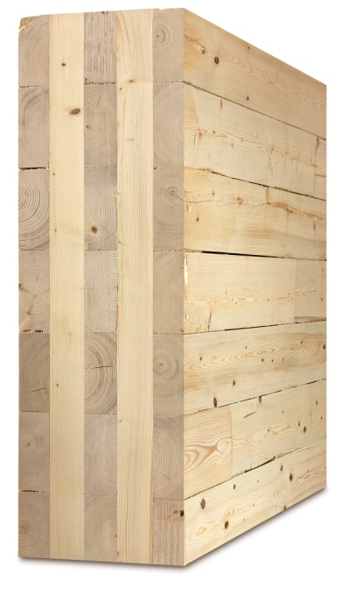
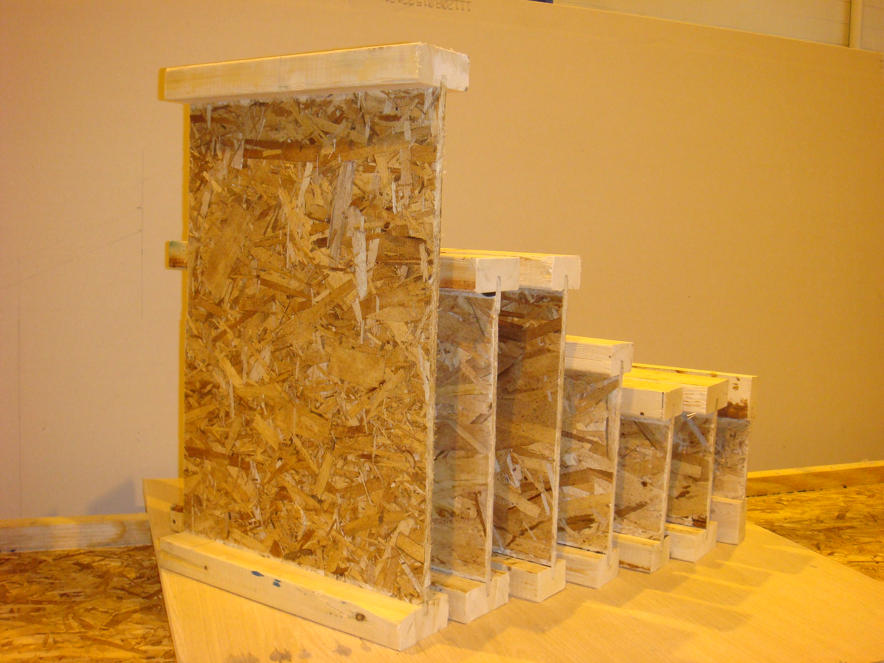
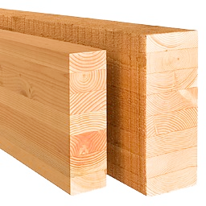
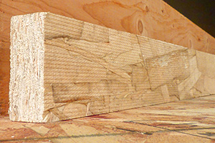
Lecture #2
– Structural Wood Products & Systems
Y. H. Chui
University of Alberta

Slide 2
Part I - Structural Wood Products
Sawn lumber
Structural panel products
Engineered wood products (EWP)
Notes:
This lecture provides an overview of the commercially important structural wood products. For each product, an overview of the manufacturing process, applications and special features is provided.

Slide 3
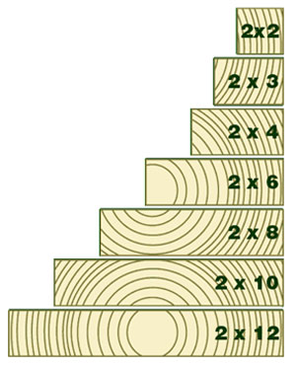
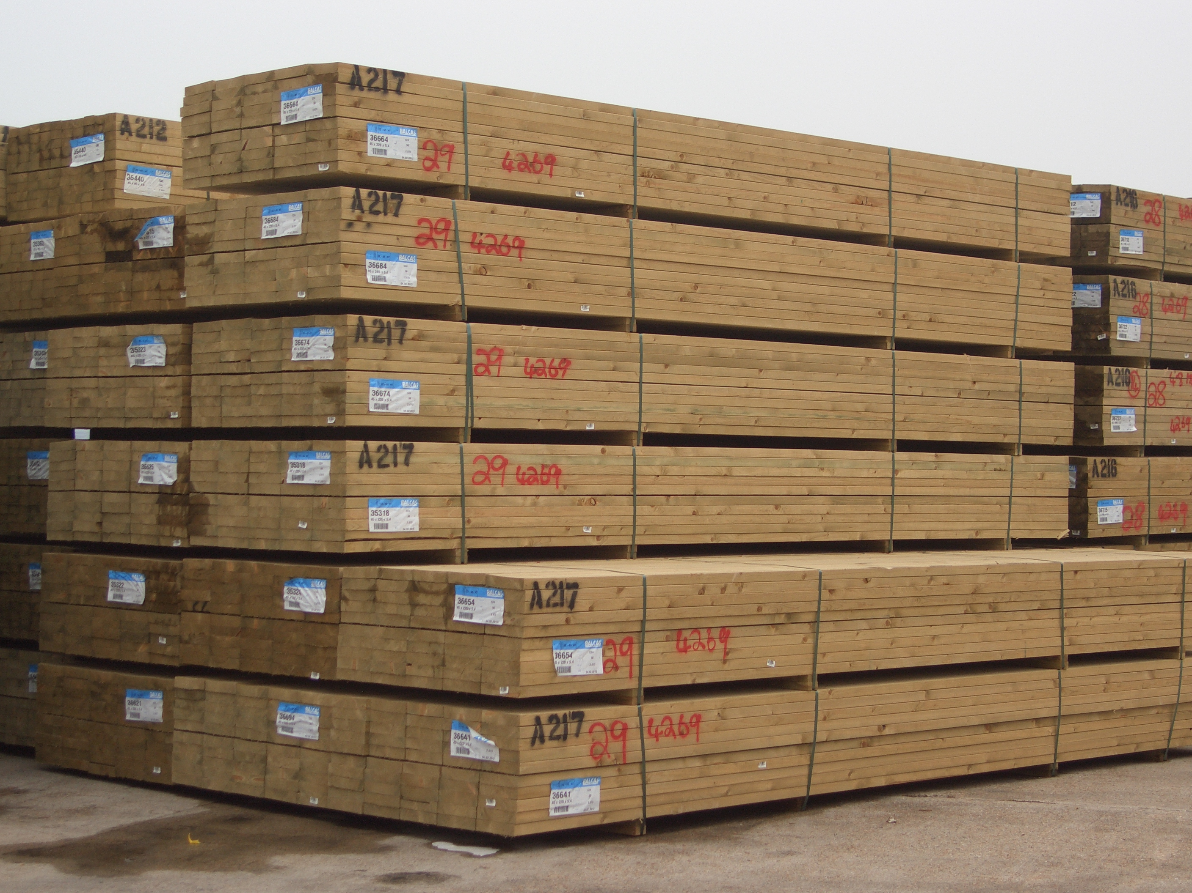
Sawn lumber for construction
Notes:
The most common sawn lumber used in construction is dimension lumber, so-called two-by lumber, from 2x3 to 2x12 are the most common sizes.

Slide 4
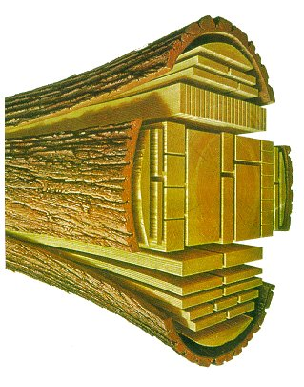
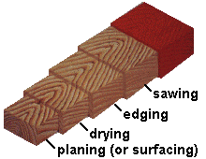
Dimension lumber – Manufacturing process
Log
Debarking
Log conversion
Edging
End trimming
Drying
Planing
Green, rough sawn
Grading
Notes:
Production of sawn lumber involves a number of steps, as outlined on the right. The final dimensions are smaller than the initial dimensions due to drying shrinkage and planing to provide smooth surfaces.

Slide 5
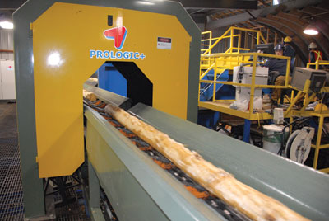
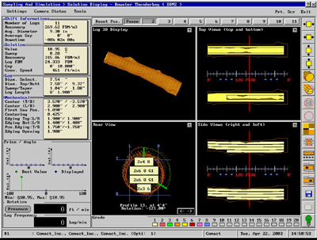
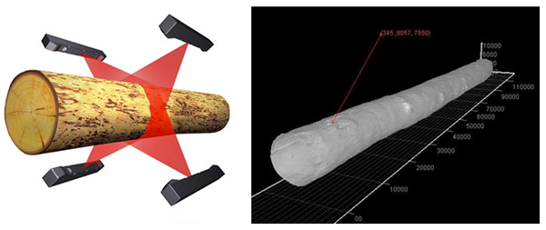
Advanced Lumber Production System – scanning machine
Use of advanced scanning system for log
– determine the best way to saw a log
Notes:
The sawmilling industry is now adopting electronic technologies to help improve its efficiency and final quality of the products. Scanning systems are commonly used to quantify the shape of the log, and then determine the best ways to saw the log into dimension lumber pieces with various sizes so that the final product value is maximized. Each log passing through a modern sawmill is scanned, imaged recorded and analysed. The picture on the bottom right shows the proposed breakdown of a logs by scanning system.

Slide 6
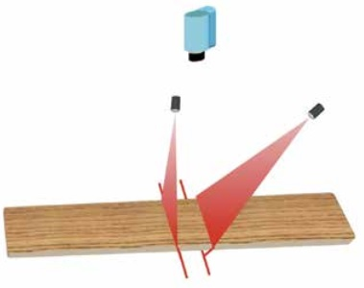
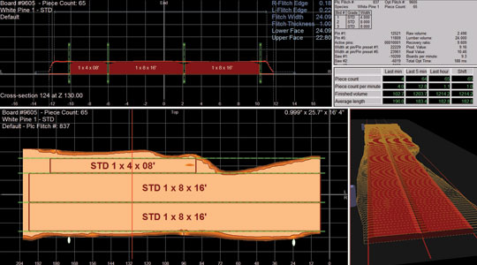
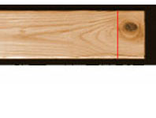
Advanced Lumber Production System – scanning machine
Use of scanning system for edging and trimming of lumber
Trimming
Edging
Notes:
The edging and trimming process of lumber can also be optimized through use of scanning system. Defects can also be removed to upgrade lumber.

Slide 7
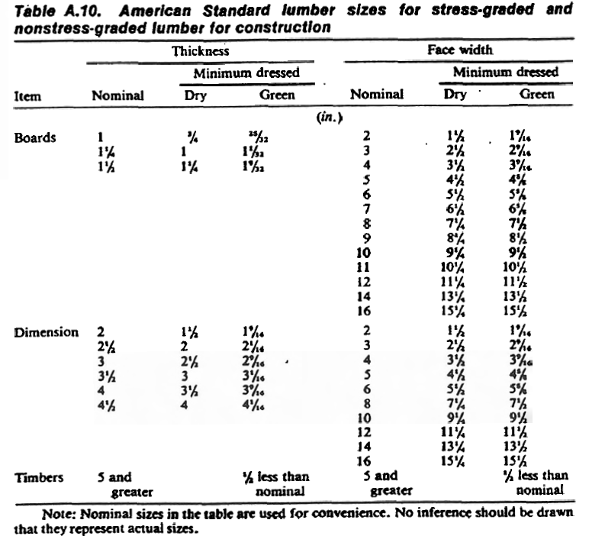
Sizes for lumber products
A 2x4 is not exactly 2” x 4”!!
½” smaller
½” smaller
3/4” smaller
Notes:
In addition to dimension lumber, there are also boards and timbers that are used in construction. Boards are thinner than dimension lumber, whereas timbers are larger. This table shows the green and dry sizes of boards, dimension lumber and timbers. Note that a 2x4 is not exactly 2inches by 4 inches. Generally the actual dimension is about ½” to ¾” smaller than the nominal dimension.

Slide 8
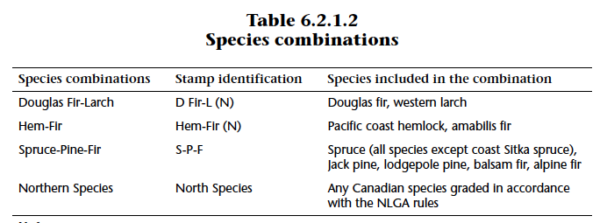
Lumber species groups
Canadian structural lumber is marketed under 4 main species groups
Notes:
A number of tree species are commonly harvested for lumber production. Properties of lumber differ by species. However for ease of harvesting, production, distribution and marketing, commonly used species are grouped together based on similarity of properties. In Canada, there are 4 species groups for structural lumber, as listed in the table, which is the same as Table 6.2.1.2 of CSA O86.

Slide 9
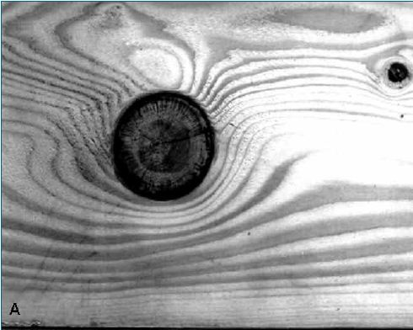
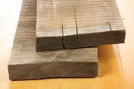
Natural defects in lumber
Clear and straight grain wood is the strongest and presence of defects reduces strength
Knots
  distortion of the fibres around the knot, resulting in cross grain and stress concentration
  Primarily reduce bending and tensile strength
End splits and checks
  Result of drying
  Primarily reduces shear strength
Notes:
The influence of a knot on the mechanical properties of a wood member is due to the interruption of continuity and change in the direction of wood fibers.
Most mechanical properties are lower in sections containing knots than in clear straight grained wood because (a) the clear wood is displaced by the knot, (b) the fibers around the knot are distorted, resulting in cross grain, (c) the discontinuity of wood fiber leads to stress concentrations, and (d)checking often occurs around the knots during drying.

Slide 10
Structural Strength Grading
Process by which wood product is classified into strength categories (i.e. grades)
Building code requires that lumber and timber be graded
Two processes:
  Visual grading – visual inspection of the number and size of natural defects
  Machine grading (Machine-stress rating or MSR) – measurement of strength prediction properties by a machine
Notes:
The quality and properties of wood are indicated by its grade. Each piece of lumber is inspected to determine its grade and a stamp is applied indicating the assigned grade, the mill of origin, a green or dry moisture content at time of manufacture, the species or species group and the grading authority having jurisdiction over the mill of origin.
Typically, lumber is graded into different classes according to the number of flaws that affect strength and durability. These classes are known as stress grades; the various grades are associated with a particular set of mechanical properties. The purpose of grading is to ensure that all lumber within a specific grade has at least the minimum mechanical capability critical to design parameters (standardization of mechanical properties).
Due to the high degree of natural variability within lumber, it is nearly impossible to develop an exact, uniform set of grading standards. Grading practices differ somewhat from country to country. In Canada, lumber is manufactured according to the National Lumber Grader Authority (NLGA) standard grading rules (approved by both the Canadian Lumber Standards Accreditation Board and the American Lumber Standard Board of Review).

Slide 11
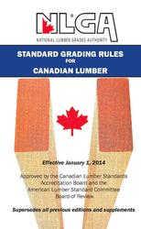
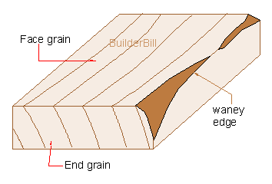
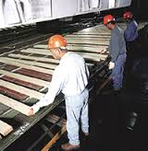
Visual grading process
Key characteristics used :
  size and location of knots
  slope of grain
  wane
  size of shakes, splits and checks
Used to be performed by humans, now vision scanning machines
Notes:
Lumber is graded by a visual examination of the material in accordance with the NLGA grading rules. These rules provide a list of permitted characteristics within each grade. Some of the characteristics that affect the strength and stiffness of lumber are size of knots…
Visual inspection – oldest and most common stress-grading method. The basic mechanical properties are determined by testing small, clear wood specimens. These results are then adjusted for allowable defects and characteristic for each class of wood. The grade of a given piece of lumber is based on visual observation of such characteristics as:
Density – related to the rate of growth and % of summerwood
Decay
Heartwood or sapwood – more important for durability considerations rather than for strength
Knots – type, size, location
Slope of grain (also known as cross grain)
Shakes, checks, splits
Wane
Pitch pockets – openings between growth rings containing resins or bark
There is a great deal of subjectivity in the quality of grading → in recent years there has been a move toward a more objective from of grading (machine-stress grading).

Slide 12
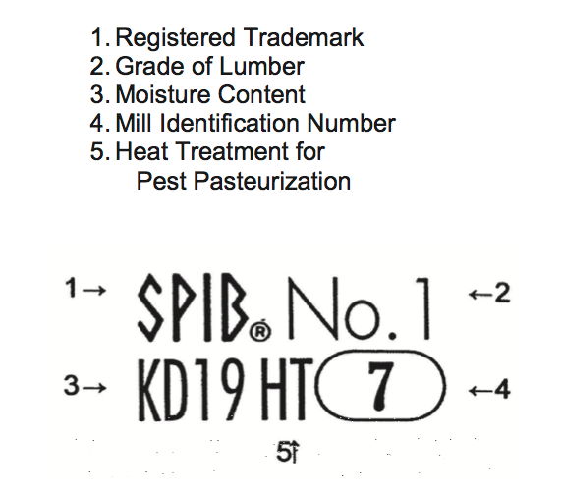
Visual grade stamp
(Grading agency)
3. KD (Kiln Dried): MC ≤ 19% (on average 15%)
5. HT: Heat treated at 56°C for 30 min minimum to eradicate eggs of bugs and inserts
Notes:
Graded lumber must have a grade stamp to indicate that it has been graded. This an example of a grade stamp. % pieces of information are included in the stamp information.
Grading softwood lumber has three MC classifications:
Surfaced dry (S-Dry) → MC < 19%
Surfaced green (S-Grn) → MC > 19%
Kiln dried to a 15% max. MC (MC15)
The grade stamp marks do not represent the actual MC of the piece of lumber, but express the MC during the manufacture process (surfacing operation).

Slide 13
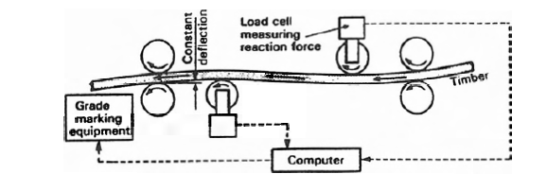
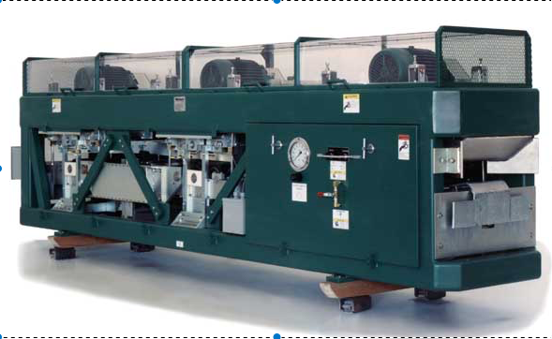
Machine grading
  Machine to measure a non-destructive property that correlates well with strength
    e.g. Modulus of elasticity and density
Bending-type grading machine
Picture of a grading machine
Notes:
MSR is dimension lumber that has been graded by mechanical stress rating equipment and manufactured in conformance with SPS 2.
MSR and MEL are basically interchangeable. MSR: 5th percentile >= 0.82 mean; MEL:5th percentile >= 0.75 mean. This results in slightly different compressive capacities.
Machine-stress – use of machines to measure the stiffness of each piece of wood. Each piece of wood is subjected to a bending stress. The stiffness is related to the modulus of elasticity. The grade designation identifies the modulus of elasticity and the allowable bending stress.

Slide 14
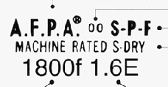
Machine Grade Stamp
Grading agency
- Alberta Forest Products Association)
Mill number
Species group
Moisture condition
– Surface dry
Machine grade
-1800 is bending design property in psi
- 1.6E is MOE in million psi
Notes:
This is a grade stamp for MSR lumber. Most information is similar to visual grade stamp, except the grade designation.

Slide 15
Comparison between visual and machine grading
Machine grading (MSR)
  Each piece is tested mechanically and qc requires strength testing
  Faster
  Can select grades with higher design properties
  Expensive
Visual grading
  No mechanical testing
  Slower process
  Grading rules are set – rigid system
  More cost-effective
Notes:
The slide compares the features, efficiency, and cost of visual grading and machine grading method. MSR process is generally more expensive, but faster and has a better capability to extract strong pieces from production.

Slide 16
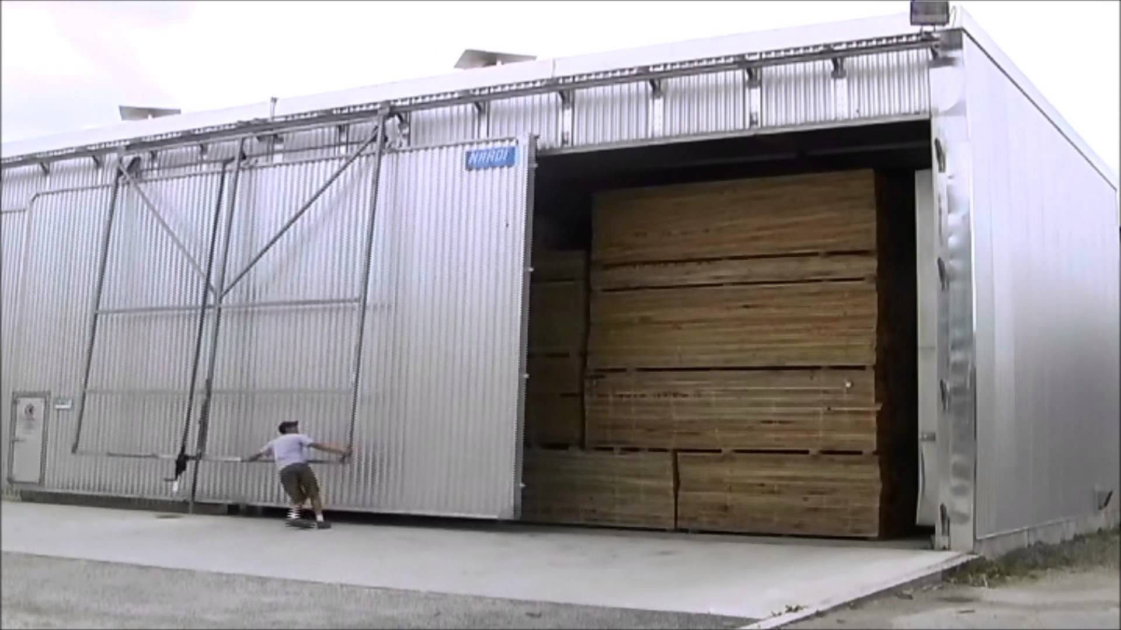
Kiln-drying of lumber
Lumber used in building construction must have MC ≤19%
Wet lumber can cause problems in service
  Lower mechanical properties
  Shrinkage may cause warping and twisting
  Potential of mould growth and decay
  Heavier leading to high shipping cost
Even kiln-dried lumber (MC 15% - 19%) will dry in service (EMC 8% - 12%)
Large dry kiln
Notes:
Building code stipulates that lumber must have MC no greater than 19% to prevent decay and mould growth. Wet lumber can cause problems in service as listed. In most applications, lumber will reach EMC of around 8-12% ie it will shrink. In sawmills kilns are often used to dry lumber. Kiln drying can speed up the drying process and allow the process to be better controlled compared with other methods of drying such as air drying.

Slide 17
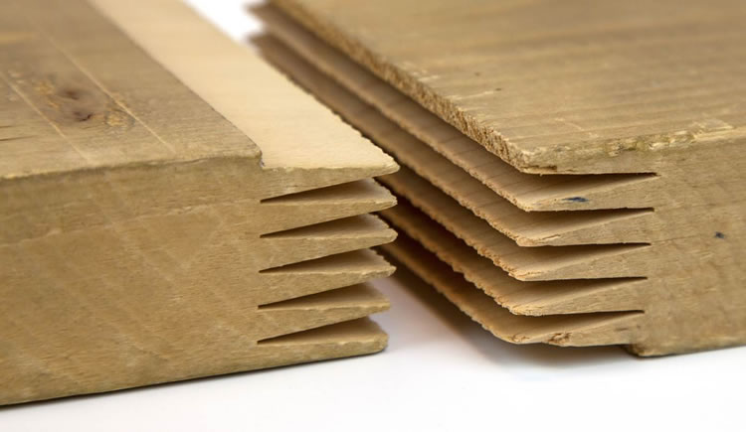
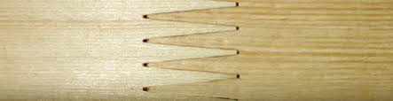
Finger-joined lumber
End grain (butt) joints are weak in tension
When bond line is sloped, applied force is partly resisted by shear
Allows short blocks to be end-joined to produce longer, more useful lumber
Tensile strength can be 80-90% of unjointed wood
Joint profile
Butt
θ
Scarf
θ
Finger
Notes:
Finger joint is an important invention that allows lumber to be end-joined into longer pieces using an adhesive. Strength of direct butt joint in lumber is very low because of the problem of retaining glue on end surface due to the voids in wood cells. When the joint is sloped at an angle part of the axial force is transferred via shear. Generally as the angle, θ, decreases proportion of shear transfer increases making the joint progressively stronger. However small angle means long joint, leading to material wastage. Finger joint allows small θ but reduce the length of the joint. Finger joint cannot be as strong as clear wood but structural finger joint with small θ can achieve 80-90% of clear wood strength.

Slide 18
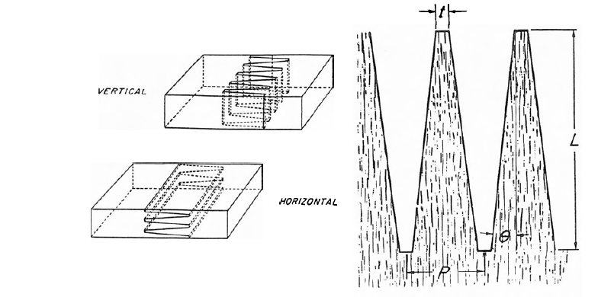
Finger joint characteristics
Finger joint strength is influenced by slope, length and tip width of finger profile
  Increases with slope (θ)
  Sharper tip (t) provides higher strength
  Increases with length (L)
Notes:
Strength of finger joint is affected by slope, tip and length. Pitch, angle and length are to some extent related.

Slide 19
Applications of finger-joined lumber
Used interchangeably with regular lumber i.e. finger joint is ignored in grading
  Defects such as knot have bigger impact on strength than finger joints
A major use is as stud (minimum twisting and warping)
Wood I-joist flanges
Laminations in glulam and CLT
https://youtu.be/Bxr96hqBtyw
Notes:
Finger joined lumber can be used interchangeably with unjointed lumber because the natural defects in lumber has a bigger impact on strength than finger joint (remember the strength ratio of visually graded lumber). Common uses of finger joined lumber are as wall studs and components on engineered wood products, such as I-joist, glulam and CLT.

Slide 20
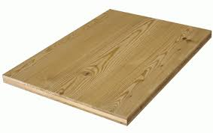
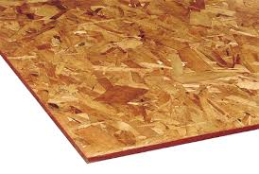
Structural Panel Products
Plywood – construction sheathing
Oriented Strand Board (OSB) – construction sheathing, I-joist web
Panel products not intended for structural applications:
Particleboard – furniture
Medium density fiberboard (MDF) – furniture, millwork, moulding
Plywood
Oriented strand board (OSB)
Notes:
There are two types of panel products accepted in engineering applications according to CSA O86 for which design properties are published. There are other wood-based panels such as particleboard, MDF that are mainly used in non-structural applications. Plywood is mainly used as construction sheathing for floor, roof and wall. OSB is used similarly in construction and is also used as web material for wood I-joists.

Slide 21
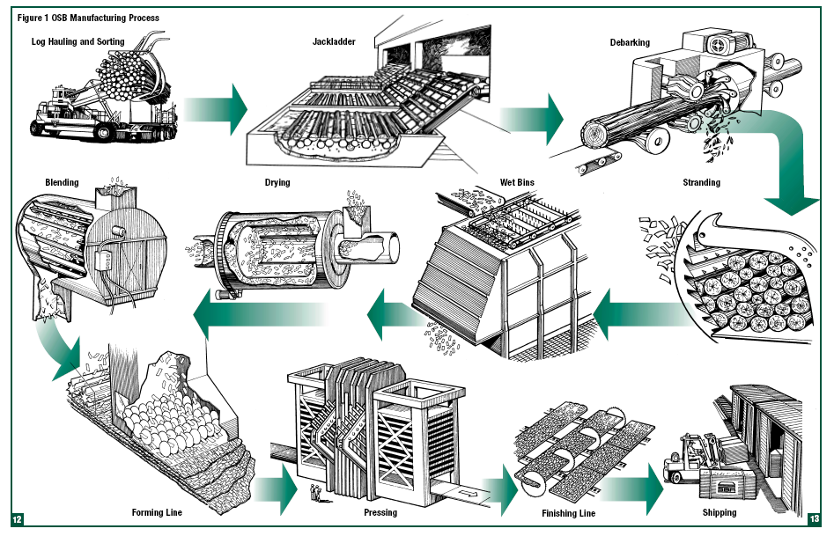
OSB
https://youtu.be/kz2_xIV-3Es
Notes:
This figure shows the manufacturing process for OSB. There is a You-tube clip for the process as well. Basically the logs are put through a strander to produce strands (thin wafers). The strands are then sorted according to size, dried and then mixed with resin. In the forming line stands of different sizes are placed onto the mattress. Generally linger strands are placed on the outside to maximize strength properties. The mattresses of wood strands and resin are then hot-press to accelerate the curing of adhesive. Panels are then sanded and cut into 4ft x 8ft (common) panels, and then placed in storage.

Slide 22
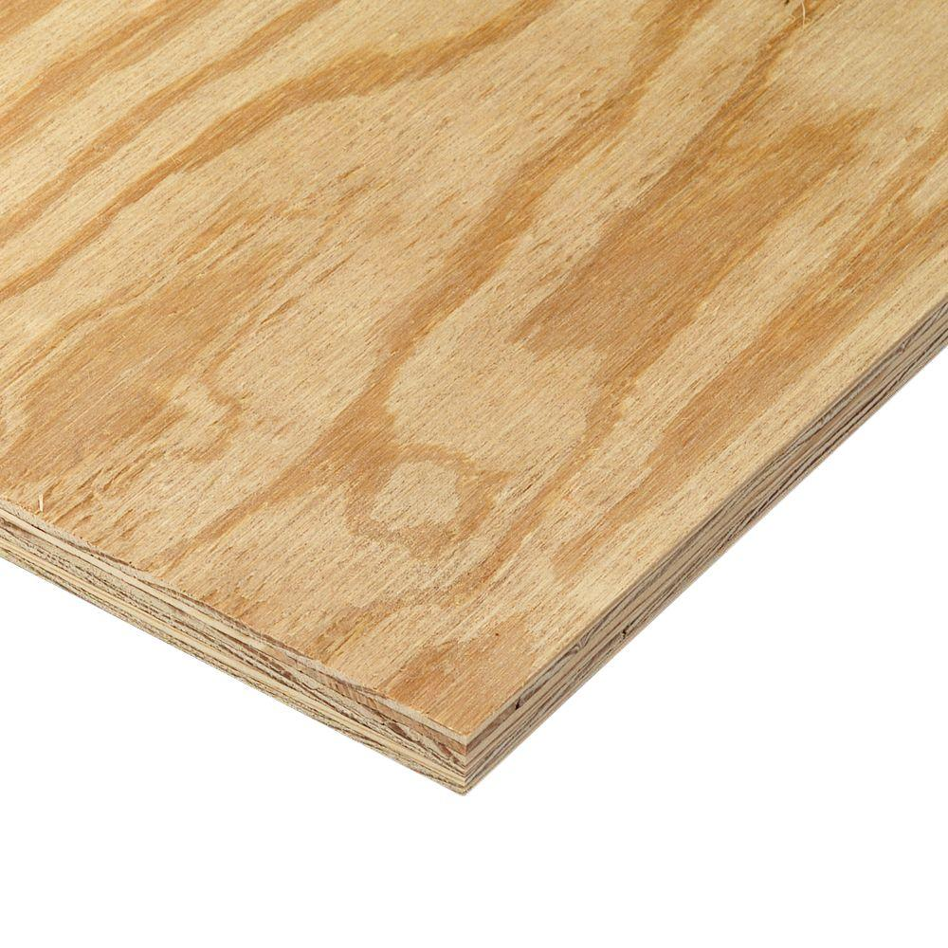
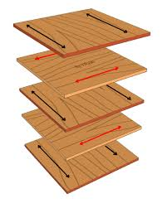
Plywood
Thin veneers that are cross-laminated for strength, stiffness and dimensional stability.
Notes:
Plywood is made by gluing alternating veneer sheets with grain oriented at 90 degrees to each other. This is done to minimize the cupping of plywood panels. This process also makes the panel less orthotropic in terms of mechanical properties.

Slide 23
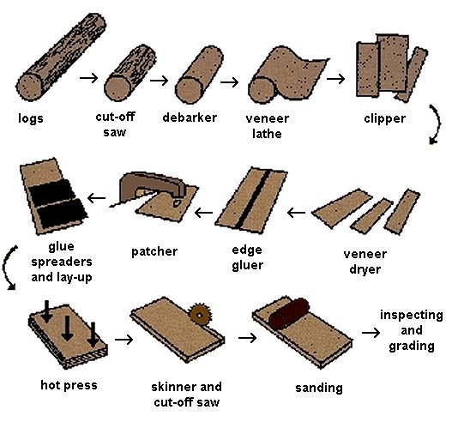
Manufacturing process
Notes:
This slide illustrates the manufacturing process of plywood. Firstly veneers are peeled from logsusing a lathe. The veneer sheets are clipped into regular shape. Glue is spread or sprayed on the veneer surface. Some repair and edge gluing may be done to improve the appearance of the product and reduce wastage. The veneers are then hot-pressed to accelerate glue curing. Panels are sanded and edges trimmed into 4ft x 8ft panel size.

Slide 24
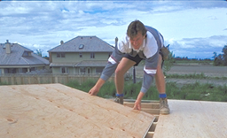
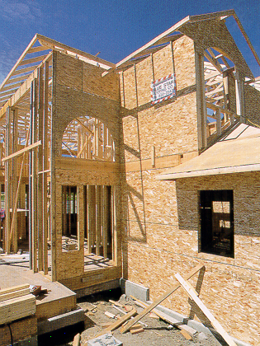
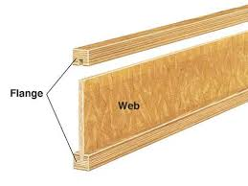
Applications
Floor / Roof sheathing
Wall sheathing
Web in wood I-joist
Notes:
Structural wood panels manufactured from rectangular-shaped strands of wood that are oriented length-wise, arranged in perpendicular layers, laid up into mats, and bonded together. Commonly used for sheathing, I-joist web material.

Slide 25
Comparison between plywood and OSB
Mechanical properties are similar - OSB tends to have higher shear strength
OSB swells more than plywood in thickness
OSB mechanical properties are more affected by moisture than plywood
OSB is for dry use only, whereas plywood can be used in wet applications
Density : 550 - 650 kg/m³ for OSB, 450 – 500 kgm³ for plywood (heavier to handle)
Notes:
Here is a comparison of the properties of plywood and OSB.

Slide 26
Engineered Wood Products

Slide 27
Engineered Wood Products (EWP)
  Glued-laminated timber (glulam)
  Wood I-joist
Structural composite lumber (SCL)
  Laminated veneer lumber (LVL)
  Parallel strand lumber (PSL)
  Oriented strand lumber (OSL)
  Laminated strand lumber (LSL)
Cross laminated timber (CLT)
Other mass timber panels
  NLT, GLT and DLT
Notes:
The rest of this lecture will cover engineered wood products, including glulam, SCL, wood I-joist, and mass timer panels such as CLT, NLT, GLT and DLT.

Slide 28
Characteristics of Product Engineering Process
Stronger materials are located at most stressed zones
Large defects are removed and defect sizes are minimized
Use of glue strengthens product
Use of heat and pressure for some products improves mechanical properties (densification)
Drier materials lead to a more stable product
Notes:
These products are called EWP not necessarily because they are used in engineering application. Rather they have been carefully engineered through research to achieve the best mechanical performance with minimum use of material. Here is a list of characteristics for EWP.

Slide 29
Product Engineering Process
In beams, maximum stresses are at the outer edges
Notes:
In beams the maximum stresses are at the outer edges.

Slide 30
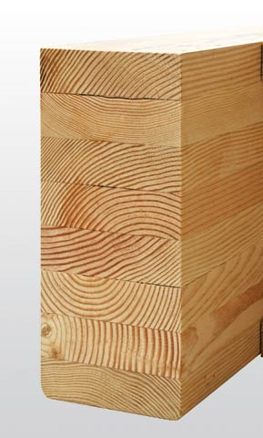
Product Engineering Process
Example : Glulam
Low quality laminates in the middle
Highest quality laminates on outside
Notes:
A good example of product engineering is glulam beam. Glulam beam is designed to have the strongest lamination on the outside and lowest quality lamination in the middle.

Slide 31
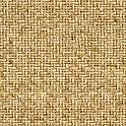
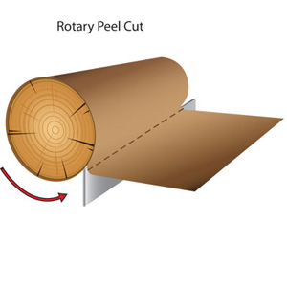
Product Engineering Process
Example : LVL
Veneer
Higher quality veneers on the surface
Dispersion of defects
Grading and Sorting of Veneers
Notes:
Another example is the development of laminated veneer lumber (LVL). The veneers in LVL are peeled from logs, thereby reducing the size of knots and dispersing the smaller knots throughout the product. Moreover the veneers are gradde using ultrasonic or sonic device based on MOE, with the bets quality veneers placed on the outer layers where stresses are higher under bending.

Slide 32
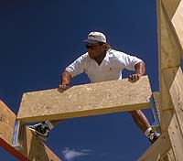
EWP in Residential Construction
Beam and Post
Header
Notes:
EWP are often incorporated into light wood frame construction to resist heavier loads such as header beam and posts.

Slide 33
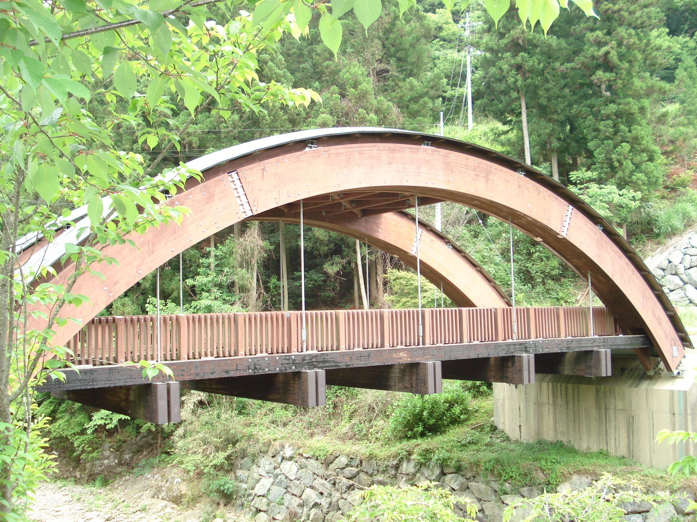
EWP in Bridge Construction
Vehicle bridge
Notes:
They are also used in bridge construction due to their large cross section sizes.

Slide 34
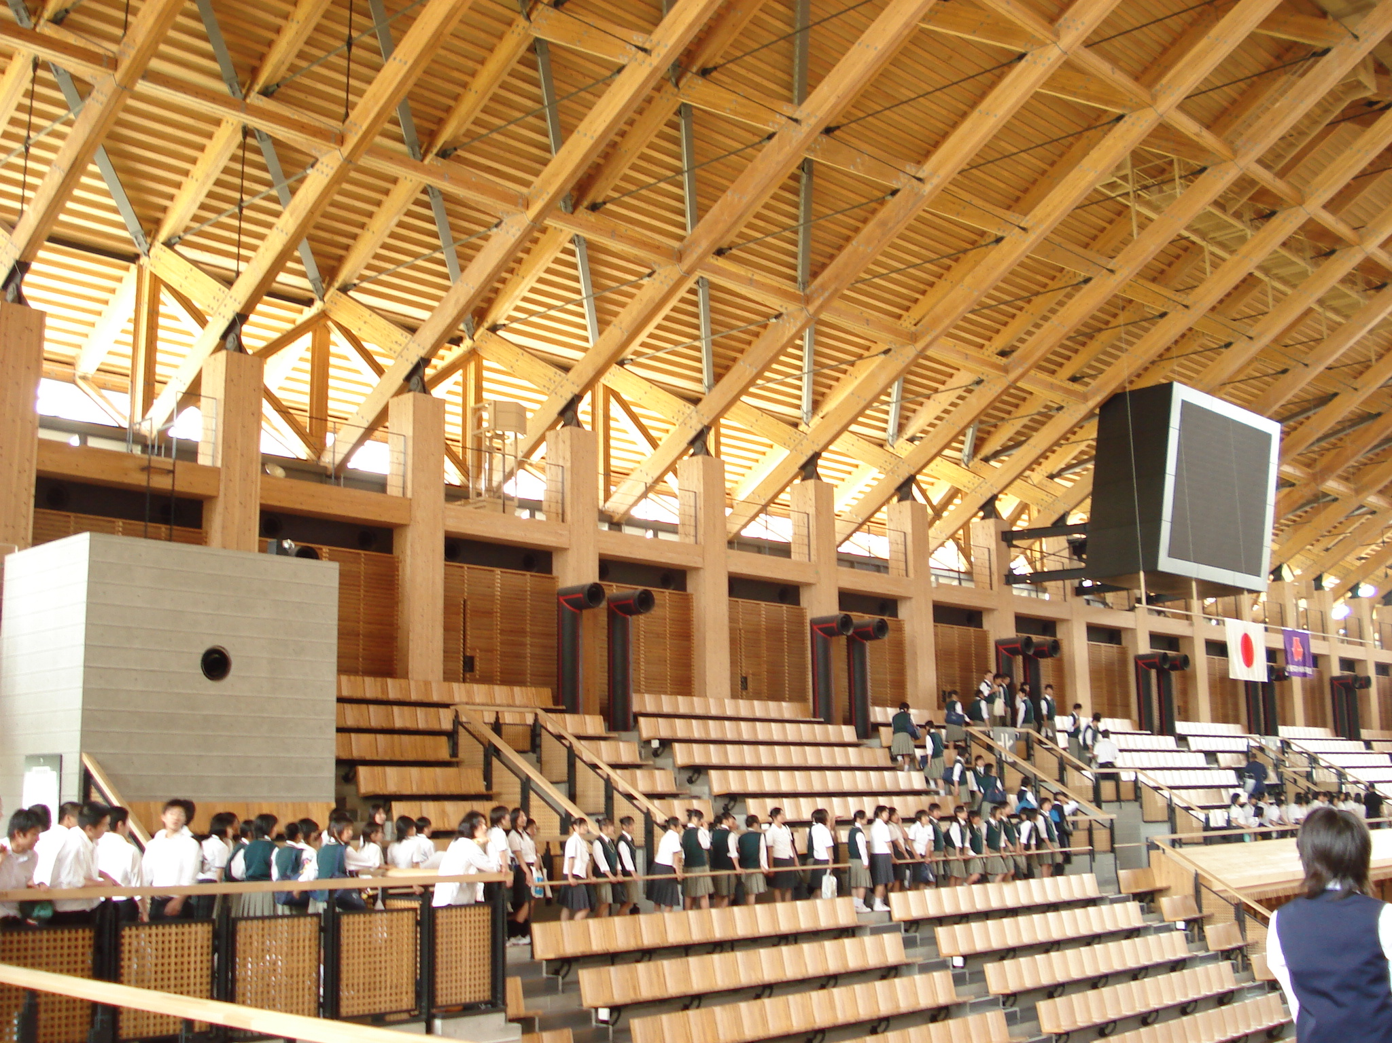
EWP in Commercial Structure
Sports hall
Notes:
Commercial structures such as gynasium

Slide 35
Glued-laminated Timber (Glulam)
The oldest engineered wood product – developed in 1903 in Germany
Low quality laminates in the middle
Highest quality laminates on outside
Notes:
The very first EWP developed was glued-laminated timber (glulam), which was invented in 1903 in Germany.

Slide 36
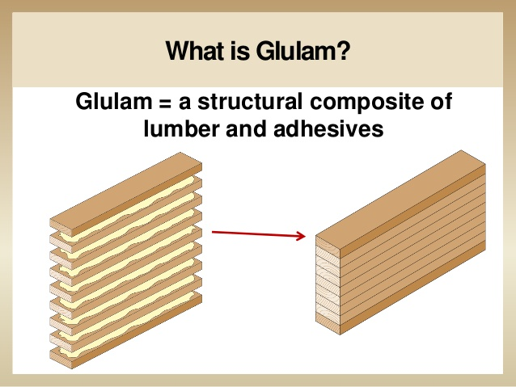
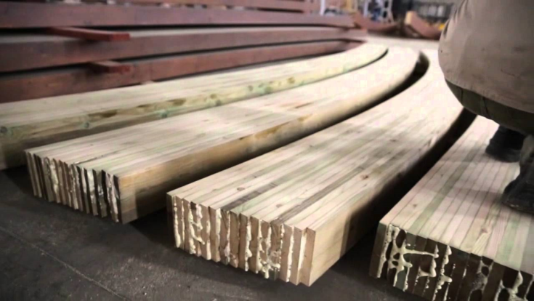
What is Glulam?!
A laminated member made of dimension lumber and a structural adhesive
Finger joint
Could be curved
Notes:
Glulam is made by gluing lumber lamination to form a deep, wide and long member. In theory there is no limit to the size achievable but transportation restriction would limit the sizes available. Finger joints are often present to allow long members to be made. Curve member can be easily made.

Slide 37
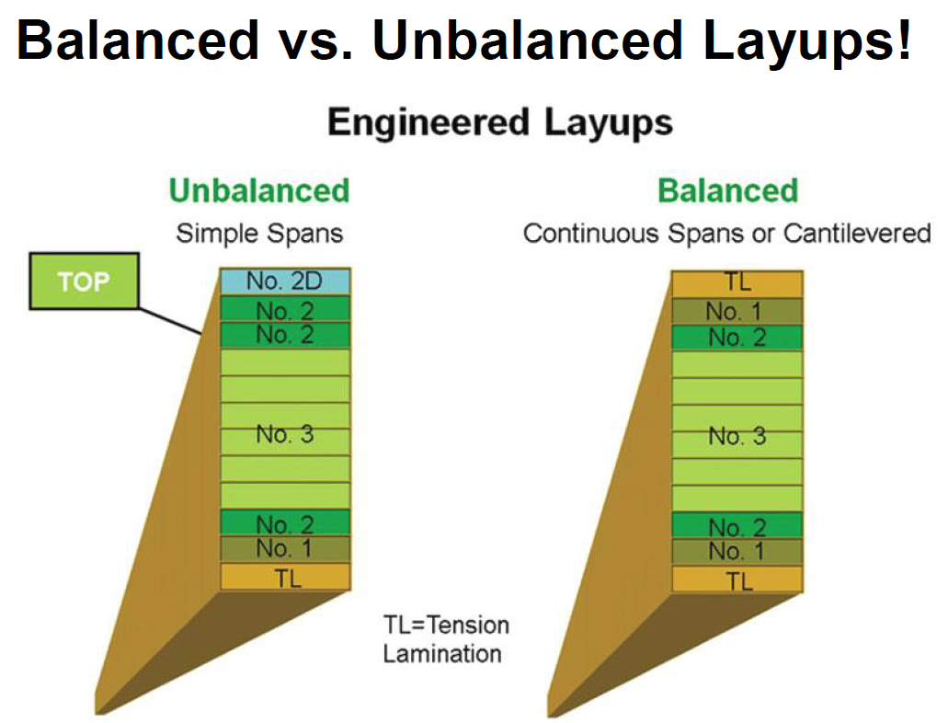
Glued-Laminated Timber (Glulam)
Quality
E EX
Notes:
Glulam beam lay-up of lamination can be balanced (EX) or unbalanced (E). Balanced layup has a high strength lamination at the bottom only and is used in bending with single curvature. Beams that experience positive and negative moment will need to use balanced layup where the string lamination is present in both top and bottom.

Slide 38
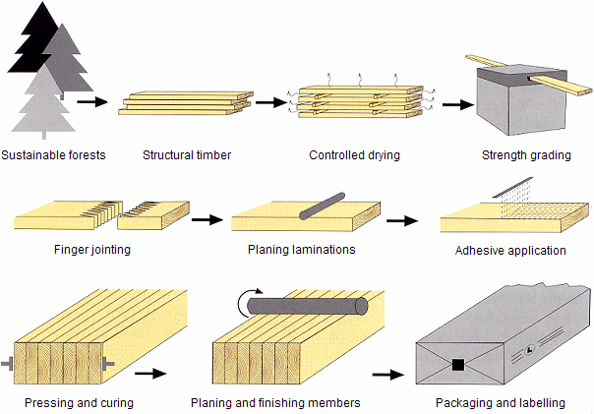
Glulam Manufacturing
Notes:
Here is an overview of the manufacturing process of glulam. Lumber is first dried and graded. Lumber pieces with the same lamination grade are end joined together through use of finger joints. Glue is spread on lamination surface and the whole layup is clamped or compressed with the appropriate grades of laminations in order. Pressure is maintained until the glue cures. The product is finished by planing and sanding.

Slide 39
It is manufactured as straight members most of the time..
https://youtu.be/OzCWStEJHfs
Notes:
Here is a a video that shows the manufacturing process of glulam. The following 2 slides show some straight glulam members in structures.

Slide 40
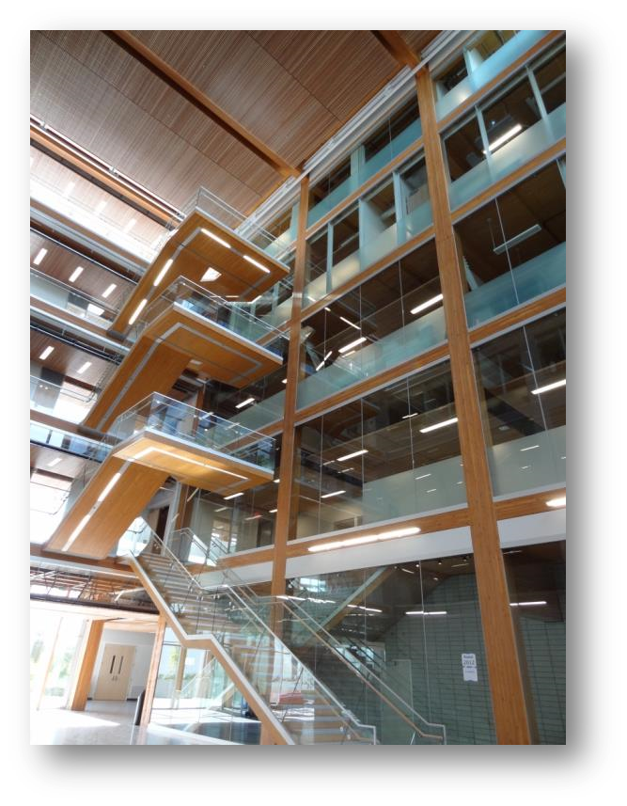
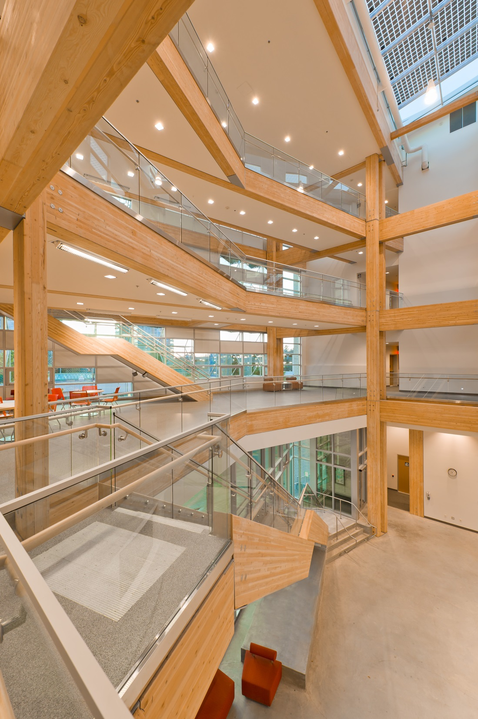
Notes:
This isi the Earth Science Centre at UBC. Note that cantilever staircase.

Slide 41

Notes:
Glulam truss

Slide 42
It can also be manufactured to be curved for particular applications such as arches…
Notes:
Glulam members curve profile and with complex curvature can be made relatively easily through the special detailing of the clamping device. The following few slides show some curved glulam members.

Slide 43

Source: Mohammad
Notes:
A new addition to an existing building as a cover.

Slide 44

Source: Mohammad
Notes:
Timber bridge with curve glulam girder and tied arch.

Slide 45

Source: Mohammad
Notes:
A dome stadium structure with glulam arches.

Slide 46
Structural Composite Lumber (SCL)
Made by bonding smaller wood components to produce large panels using durable adhesive
  Laminated Veneer Lumber (LVL)
  Parallel Strand Lumber (PSL)
  Laminated Strand Lumber (LSL)
  Oriented Strand Lumber (OSL)
Panel size can be up to 3m x 20m
Thickness can be up to 175mm for PSL or 75mm for other SCL
Commonly ripped into one-dimensional members for use as beams and columns
Veneer
Veneer ➔ strand
Flakes
Notes:
SCL is a family of composite mass timber panels. It includes LVL, PSL, LSL and OSL. They are made by gluing wood components in flakes, strands or veneer form into a large slab of typically 3m x 20m. Thickness can be as much as 175mm for PSL but the most common thickness is 38 – 45mm. They are ripped into dimension lumber sizes and often used as beams and columns.

Slide 47



Laminated Veneer Lumber (LVL)
Moderate strength and modulus
Tendency to split which may lead to weak connections
Notes:
LVL is made by gluing veneers together with the grain of veneers aligned in the same direction to maximum mechanical properties in the major strength axis. In service under bending load it can be used on edge or flat.

Slide 48


Parallel Strand Lumber (PSL)
Strand thickness : 3mm
Material with strength higher wood of the same species
Low connection strength due to voids in structure
Notes:
PSL is made by gluing strands of about 3mm thick and about 20mm wide. Due to the use of relatively thick strands the structure of PSL has numerous voids. The voids can be weak spots when under load, especially in connections. It can be produced with a thickness of 175mm.

Slide 49



Laminated Strand Lumber (LSL) & Oriented Strand Lumber (OSL)
Material with high in-plane strength but relatively low modulus
High connection strength due to cross grain and high density
Process is similar to OSB but strands are longer
Notes:
LSL and OSL are similar to each other. They are both made by gluing thin flakes or strands. The manufacturing process is similar to OSB but with longer strands. They have high material strength and ability to stop crack growth due to the cross grain arrangement of the strands.

Slide 50
Laminated Strand Lumber (LSL) & Oriented Strand Lumber (OSL)
Length, y
y
Thickness
t ≤ 2.5mm
LSL – strand aspect ratio y/t ≥ 150
OSL – strand aspect ratio y/t ≥ 75
Notes:
The main difference between OSL and LSL is in the target aspect ratio of the strands. LSL has a larger aspect ratio than OSL.

Slide 51
Applications of SCL and glulam
Beams and columns in residential and commercial buildings
LVL and LSL are used as flange material for wood I-joists
New applications for SCL as mass timber panels (similar to CLT)
Notes:
SCL and glulam are used as beams and columns in residential and commercial buildings. LVL and LSL are also used as flange in wood I-joists. Recently architects are engineers are starting to explore the use of SCL as mass timber panels, similar to CLT.

Slide 52

Wood I-joists
Flanges made of lumber or SCL
Web is either OSB or plywood
Gradually replacing lumber joists in floor construction (60% new floors in North America)
Available depths : 240mm to 610mm
Light weight and available in length up to 16m
Notes:
Wood I-joist is now a common product used in residential floor construction in North America. About 60-70% of new floors are built with wood I-joists. Flanges could be either lumber or SCL, whereas OSB is now exclusively used as web. Range of depth is 240mm – 610mm. Length of wood I-joist in most manufacturing facilities can be 16m.

Slide 53

I-joist
https://youtu.be/h99ScTThiXQ
Notes:
This figure illustrates the manufacturing process of wood I-joists. Basically there are two lines machining web and flange respectively. They are then brought to an assembly where they are bonded togather. A video clip is provided that illustrates the manufacturing process.

Slide 54

Bending property determination for wood I-joist
E_{f} , A_{f} , I_{f} , f_{tf}
t_{w}
E_{w}
d_{w}
NA
M_{r}
h
d
Moment capacity,
Bending stiffness,
Flange Web
Notes
F_{tf} is specified tensile strength of flange material (modified by size factor)
I_{f}, A_{f} and h should account for the rout in flange to connect to the web
Notes:
According the ASTM D5055 which is the wood I-joist product standard, the bending moment capacity and stiffness of wood I-joist can be determined from bending test or they can be calculated using accepted mechanics models. The truss analogy approach is used to calculate the bending moment capacity. Bending stiffness is calculated assuming the flange and web are rigidly connected by the glue.

Slide 55

Structural performance of wood I-joist
Flanges resist bending moment
Web resists shear stress
Deflection caused by transverse loading should account for contribution of shear deformation of the web
Presence of web opening reduces shear capacity
Notes:
The web properties dictate the shear resistance of wood I-joists. Also shear deflection of wood I-joist is not negligible due to low shear rigidity of OSB and should be accounted for in bending deflection calculation. Openings in web are often made to allow service ducts and pipes to pass through. These openings reduce shear strength of wood I-joists and should be accounted for.

Slide 56



Application of Wood I-Joist
Floor and Roof Joists
Notes:
Wood I-joists are used extensively in residential and light commercial construction for both floor and roof framing.

Slide 57


Cross Laminated Timber (CLT)
New generation of engineered wood product – developed in Europe about 20 years ago
Lumber planks stacked cross-wise and bonded with a glue
Cross grain effect:
  High in-plane shear strength
  Dimensionally stable
Product thickness : 50 to 300 mm
Product plane dimensions: 3m x 14m
Low shrinkage
Low shrinkage
High shrinkage
High shrinkage
Notes:
The concept of cross laminating timber planks has been around decades. Commercial production of CLT started in the 1990’s after product development work in Austria, Switzerland and Germany. CLT is made by cross laminating lumber to produce large panels using adhesive. It can be considered as a thick plywood. The cross lamination allows for high in-plane shear capacity, and a more dimensionally stable product by reducing high shrinkage in one direction as illustrated in the figure. Note for lumber there are two high shrinkage directions. In CLT there is only 1 direction – perpendicular to the plane of the panel. Product thickness can be up to 300mm and plane dimensions of the panel are 3m x 14m.

Slide 58


Hydraulic press systems
May be available
0.8 – 1.5 MPa
Most commercial systems can press up to 300mm thick panel
p_{v}
p_{h,l}
p_{h,t}
0.3 MPa
6.0 -14.0 m
2.4 - 3.4 m
Source : Schickhofer
Notes:
The pictrues here show the press used in manufacturing CLT panel. Note that side pressure is required in four edges to ensure that the lumber pieces are tight against each other.

Slide 59




Processing line - MINDA
https://youtu.be/jokkqSTtM74
Vacuum station
40 min. per cycle
20,000 m³/shift/yr
Press station
Glue station
© Pictures: MINDA
Notes:
Here is an overview of the production line for CLT with pictures provided for the three key stations. This production line is manufactured by MINDA from Germany.

Slide 60




Cutting and machining by CNC machine
CNC machine to cut to size, make opening, fastener hole, etc
Ready-to-Assemble building system
Notes:
One of the major advantages of CLT is the ease of prefabrication in the factory. With the use of advanced manufacturing equipment such as CNC machine panels with correct dimensions can be precisely cut from the original panel. Moreover openings for windows and door, fastening holes, notches, etc can be made in the factory. This allows for fast on-site erection and minimal construction waste.

Slide 61
Evaluation of CLT product properties
Some properties in CLT can be calculated using properties of laminates (e.g. bending)
Some properties are difficult to calculate or even measure (e.g. rolling shear)
Notes:
For CLT some properties can be measured by testing 9e.g. rolling shear). Bending properties can be calculated using mechanics equations and lumber properties.

Slide 62

Bending properties – floor and roof panels
Designs generally treat CLT as one-way beam and not two-way plate
One-dimensional beam
- Simple formula but conservative
Two-way plate
- More complex analysis, but accounts for real behaviour
Notes:
In structural design CLT is treated as a one-way system ie as a beam under out-of-plane loading, rather than as a plate. This is mainly because of the small width of CLT panels necessitating the use of panel-to-panel joint. These panel-to-panel joints are not rigid enough to transfer full moment across the joint.

Slide 63
Calculation of bending properties
Effective bending stiffness:
Layer, i=1…n
5
E_{5,} I₅, A₅
4
E_{4,} I₄, A₄
3
E_{3,} I₃, A₃
2
E_{2,} I₂, A₂
where
E_{i} = modulus of elasticity of layer i
I_{i} = second moment of area of layer i
A_{i} = cross sectional area of layer i
a_{i} = distance of centroid of layer i to centroid of cross section
1
E_{1,} I₁, A₁
Notes:
Effective bending stiffness of CLT can be calculated using this equation to combine the contributions of individual layers.

Slide 64
Calculation of bending properties
Bending strength (moment) capacity:
5
E_{5,} I₅, A₅
4
E_{4,} I₄, A₄
h_{tot}
3
E_{3,} I₃, A₃
2
E_{2,} I₂, A₂
For symmetric section
1
E_{1,} I₁, A₁
f_{b,1} = bending strength of laminate in layer 1
Notes:
The bending moment capacity can be calculated using this equation. It is a function of the bending strength of the outer laminate.

Slide 65



Rolling shear strength & modulus
  Under bending, failure could be rolling shear in a cross layer
  Rolling Shear failure
Shear stresses in cross layer
Notes:
Under out-of-plane bending the failure mode in CLT could be rolling shear as shown in the right hand figure.

Slide 66


Calculation of shear stresses under bending
Shear stresses in various layers can be calculated
Horizontal shear in longitudinal layers
Rolling shear in cross layers
Shear stress distribution
L
C
L
C
L
τ_{v,d} (longitudinal) and τ_{r,d} (rolling)
Notes:
Note that the shear failure could potentially occur in longitudinal or cross layer. Even though cross layer has lower shear stress under bending action, it also has low rolling shear strength. When checking the shear in the longitudinal layer the shear parallel to grain strength should be used. Longitudinal shear strength is usually higher than rolling shear strength.

Slide 67


Measurement of rolling shear properties of CLT
Two methods
  Bending
  Two-plate shear
Steel plates
Bending – North America
Two-plate shear
Notes:
There are two approaches for measuring rolling shear strength CLT. One if the short-span bending test which is adopted by the ANSI PRG320. The other is the two-plate shear test, originally developed for panel products.

Slide 68
CLT structures
Notes:
The next few slides show some pictures, demonstrating the wide range of applications for CLT.

Slide 69


Single-family houses
Under construction Finished structure
Source: KLH

Slide 70


Low-rise residential buildings
Under construction Finished structure
Source: KLH

Slide 71


Commercial - gymnasium
Under construction Finished structure
Source: KLH

Slide 72



Commercial – Office building
Under construction Finished structure
Source: KLH

Slide 73




Height progression of CLT buildings
??
2017
2015
18
2012
14
2008
9
Vancouver, Canada
7
Bergen, Norway
Melbourne, Australia
Växjö, Sweden
Notes:
CLT has been the primary engineered wood product use din constructing tall wood buildings around the world over the last 10 years. The Brock Commons building on UBC campus is currently the tallest modern wood building in the world but there are plans for projects to build wood buildings taller than that from around the world.

Slide 74



18-Storey Brock Common
Courtesy of UBC/FII
Notes:
Here are a few pictures from Brock Commons showing the construction process. Note the two concrete cores to resist lateral load. The last picture shows the prefab exterior wall which were installed in place immediately after the structural elements of each storey were installed.

Slide 75



Nail laminated timber (NLT)
Simple to make and design!
Width : up to 4m
Length : up to 20m
Lumber : 2×4 – 2×12
Notes:
Another mass timber panel product is nailed laminated timber (NLT). It is made by placing lumber on edge (2x4 – 2x12) and connecting them together using nails. Typically each nail penetrates 3 pieces. Width is limited by transportation and concerns about sideway shrinkage. NLT has been around for decades as floor deck or bridge deck, but has recently caught the attention of designers and builders due to its relative low production costs since only simple tools such as nail gun is required. It does not have some of the advantages of CLT such as high in-plane shear, low shrinkage in two directions, and aesethetically less pleasing due to uneven laminate height.

Slide 76
Design and fabrication of NLT
CSA O86 provides construction details in Clause 6.5.11.3.
Design assumes beam formula and using bending strength and stiffness of lumber
Unlike CLT, special product approval is necessary (similar to trusses) – engineer seal is sufficient
Notes:
Unlike CLT, NLT does not require expensive code approval and quality quality control testing since it can designed to CSA O86, as long as certain nailing pattern is used. Design assumes beam formula and is based on lumber properties as long as a prescriptive nailing pattern is used.

Slide 77


Glue laminated timber (GLT)
- Similar to NLT but with glue instead of nails
Pictures : Western Archrib, Edmonton
Notes:
GLT is a product that is similar to NLT, except that the laminates are glued together on edge instead of nailing. Essentially it is glulam placed on flat. These pictures show the GLT roof deck in Light Rail Train station in Edmonton.

Slide 78






NLT and GLT profiles
Curved
Flat
Fluted
Notes:
Normally NLT or GLT has a flat profile, but curve profile is possible. Occasionally it has a fluted profile on the underside of a floor or roof deck to reduce sound reverberation.

Slide 79


Dowel Laminated Timber (DLT)
Developed in early 1990’s in Europe
100% wood-based – no glue, no nails
Dry hardwood dowels – swelling of dowel provides tight-fitting
Faster process than NLT and GLT
Similar sizes to NLT but stiffer
Notes:
DLT uses wooden dowel instead of nails or glue to connect lumber pieces together. It was first developed in 1990’s in Europe in an attempt to produce a ‘green, ‘all wood’ mass timber panel product. A high production line to produce DLT was recently started in British Columbia. An advantage of DLT over NLT is that it allows a faster speed of production. (NLT requires nailing of one piece at a time whereas DLT can have the dowels that go through all lumber pieces in one step. The wooden dowels used are dry hardwood dowels which exhibit swelling after fabrication facilitating a tight-fitted assemblies. Because of this, DLT should have a similar stiffness to GLT but a higher stiffness than NLT.

Slide 80

Dowel Laminated Timber
Panel profiles
Notes:
Curve profile for DLT is challenging but fluted or grooved profiles are possible for enhanced acoustics performance. Here are a few DLT profiles available commercially.

Slide 81

Dowel Laminated Timber
Wall panels
Notes:
DLT can be used as wall panels as it could potentially provide high in-plane shear strength and stiffness. However wall application is not common.

Slide 82
Generic vs Proprietary EWP
Generic
  Standardized products according to published product standard e.g. CSA, ASTM
  Design properties are published in design standards
  Company X’s product has same design properties as Company Y’s for the same grade
Proprietary
  Usually no product standard
  Design properties are unique to the producer and approved by a third-party code approval agency
Notes:
Some of the EWP are proprietary products. Unlike generic products such as lumber, glulam, OSB and plywood, their design properties are specific to the producers and are usually published by the producers after a code approval process. Generic products are usually evaluated and produced according to a consensus product standards. Proprietary products generally have no consensus product standard and are evaluated according procedures developed by code approval agencies.

Slide 83

Where to find design properties for proprietary EWP?
Notes:
According to CSA O86 proprietary EWP are designed according to Clause 15, which provides design equation but essentially directs designers to manufacturer’s product approval documents for design properties. In Canada the Canadian Construction Materials Centre (CCMC) is one of those code approval agencies.

Slide 84


Where to find design properties for proprietary EWP?
Notes:
As an illustration this is the provision in CSA O86 that provide design equation for moment capacity of SCL. In this case fb is found in manufacturer’s evluation report.

Slide 85

Where to find design properties for proprietary EWP?
Design properties are developed according to procedures specified by product approval agency – NRC Canadian Construction Material Centre (CCMC)
Notes:
CCMC offers technical service to manufacturers of proprietary building products, usually not covered by any consensus standards. Here is the cover of a code approval report for an LVL product. These documents can be downloaded for free by an interested users. For engineering design, design properties as well as construction details are provided in the document.

Slide 86
Part II - Structural Wood Systems
Light wood frame construction
  Platform framing
  Balloon framing
Heavy timber
  Post-and-beam
  Mass timber panel
Hybrid
  Combination of above or different materials
Notes:
The second part of this lecture presents the different types of structural wood systems found in construction. They include light wood frame, heavy timber and hybrid (combining wood another one or more materials).

Slide 87
Factors in selection of construction type
Cost
Schedule
Function
  Clear span, clear height, open space, etc.
Code requirements
  Structural capacity, fire protection, sound transmission, durability
Appearance
  Aesthetic considerations
Environmental issues
  Energy efficiency, thermal insulation, disposal or recycle at end of life cycle
Notes:
Cost is usually the # 1 factor dictating the selection of structural system. Other factors may also affect the choice of system, including functional, code regulations, appearance and environmental issues.

Slide 88

Light wood frame construction
Primarily lumber members spaced closely together in a load-sharing arrangement
Structural resistance
  Main structural members: lumber
  Secondary structural component: sheathing
  Connected by light fasteners, e.g. nails
Advantages
  High strength-to-weight ratio
  Economical
  Ease of panelization
  Load-sharing in design
Notes:
Light wood frame construction primarily consists of dimension lumber and wood-based sheathing panels, attached together by small fasteners such as nails. The combination of sheathing and framing provides resistance to lateral load efficiently, and a space for installation of insulation, and surfaces for the application of interior and exterior finish materials. And the load sharing arrangements with adjacent members results in strong but light weight assemblies. One feature of light wood frame structures is that the framing members are closely spaced (less than 2ft spacing), thereby allowing for significant load-sharing and structural redundancy.

Slide 89


Light wood frame construction
Framing Types
  Platform framing
    Floor assembly is built separately from the wall, and therefore is a working surface for next floor up
    All walls are one storey high
  Balloon framing
    The studs for the exterior walls are continuous from the foundation sill plate to the top plate below the roof framing
Notes:
There are two main construction approaches to light wood frame buildings: platform frame and balloon frame. The main difference between the two is that in platform frame construction all the storeys are completed one at a time and once one storey is completed it provides a working platform the storey above. As such each wall is one-storey tall. For balloon frame construction the wall framing members from foundation sill plates to roof framing are typically erected first. The intermediate floors are then constructed after. Generally balloon framing is a faster process than platform framing.

Slide 90

Platform frame construction
Roof assembly
  Framing: truss or rafter
  Roof sheathing
Floor assembly
  Framing: joist
  Floor sheathing
  Rim joists
Wall assembly
  Framing: stud
  Sheathing: wood-based panels/GWB
  One storey high & consists of top plate (double or single), studs, and bottom plate
https://youtu.be/OMvKHw4F7MU
Notes:
Platform framing is commonly used for modern structures due to its simplicity and ease of erection. Its main advantage is that the floor assembly is built separately from the walls, and therefor the preceding floor provides a working surface on which to assemble and erect the walls and partitions. Wall components can also be prefabricated off-site and then erected in sections, thereby reducing on-site labour.
The plates provide a nailing surface for sheathing and interior finishes. They also act as firestops that resist the spread of fire from one floor to another in the wall cavity.
Also the sheathing in combination with framing provide lateral resistance effectively. The horizontal element is called diaphragm, and the vertical element is called shearwall.

Slide 91

Balloon frame construction
Wall studs are continuous between floors below the roof framing
  First-floor joists bear on the sill plate
  Second-floor joists bear on ribbon strip
https://youtu.be/Q1ZPw2cbxtc
Notes:
The figure here shows typical details for balloon frame construction. Ribbon strip has been let-in to the inside edges of wall studs to support the floor joists.

Slide 92

Platform vs Balloon Construction
Platform frame construction
  Advantages:
    Simplicity and ease of erection
  Disadvantages:
    More settlement due to shrinkage and compression deformation
Balloon frame construction
  Advantages:
    Less in total shrinkage
    Reduces variation in settlement of framing and the masonry veneer
  Disadvantages:
    Requirement for longer studs
    Difficulty in accommodating erection practices and fire-stopping
Stud
Bottom plate
Floor sheathing
Floor joist
Top plates
Stud
Notes:
Here is a comparison of the pros and cons of platform vs balloon frame construction.

Slide 93



Heavy timber – Post-and-Beam
Timber or glulam members spaced far apart in a non load-sharing arrangement
Main members are usually connected with heavy fasteners, e.g. steel dowels, bolts and lag screws, and steel plates
Notes:
Heavy timber construction generally consists of timber or glulam as main structural member, or mass timber panels, such as CLT. Secondary member utilizing dimension lumber and wood-based sheathing or plank decking may be present. Also heavier fasteners such as bolts or lag screws are often used. The top picture is a glulam post-and –beam structure, whereas the bottom right picture is a century old timber post-and-beam building in Toronto.

Slide 94

Heavy timber – Post-and-beam
Secondary members often are designed as stand-alone members e.g. purlins, floor/roof decking
May require diagonal braces and in-fill shear wall to avoid use of moment connections
Notes:
The figure on the right shows a schematic picture of a post-and-beam structure with lumber planks as roof and floor decking. In order to avoid use of moment connection, the lateral load may be resisted by diagonal braces or shear walls.

Slide 95


Heavy timber – Mass timber panel
Panelized construction for floor, wall, elevator shaft and roof
Products : CLT, NLT, GLT, DLT and SCL
May only require light gauge fasteners e.g. screws and steel brackets
Height limit ≈ 10 – 12 storeys
Notes:
Heavy timber structures could also utilize mass timber panels such as CLT, SCL, NLT< GLT and DLT. In this case the structure is primarily a panelized system with wall, floor and roof panels connected by threaded fasteners such as self-tapping screws and steel brackets. Without the use of other materials, a realistic height for heavy timber building is likely to be about 10 – 12 storeys. In the bottom pictures the elevator and stairwell shafts are constructed with CLT panels.

Slide 96



Hybrid – P&B + Mass timber panels
Allow longer spans to be achieved compared with mass timber panels alone
Same material used in whole building – no material incompatibility
Glulam P&B + CLT floor / roof
Brock Commons – glulam columns + CLT floor
CLT wall + glulam beam
Notes:
The third structural system is hybrid which consist of wood-only products or a combination of wood and other material. An example of wood-only system is post-and-beam plus mass timber panels. Here are three examples of wood-only hybrid systems. One major advantage of the all wood solution is that it would not have differential movement problem since only one material is used.

Slide 97
Hybrid – Different materials
One material can address the weaknesses of the other e.g. concrete core for lateral load and fire resistance
In predominantly wood structures, steel and concrete members may be used in locations where load level is extremely high e.g. bottom-storey columns in multi-storey buildings
Indeed nearly all buildings are hybrid to some extent, since foundation is typically concrete
Notes:
Hybrid system can consist of wood with steel or wood with concrete. It may also include all 3 materials. One obvious benefit of this type of hybrid system is that it allows strength of one material to address weakness of another.

Slide 98


Hybrid – Steel + Wood
Steel frame structure with CLT roof panels (MEC Building, Edmonton)
Steel frame building with light wood floor and wall panels
Notes:
Here are two examples of wood-steel hybrid structures. On the left there is steel frame with CLT panels. On the right the system is steel frame with in-fill light wood system.

Slide 99

Hybrid – Steel + Wood
GLT deck with steel column (LRT station, Edmonton)
Steel floor beam with timber columns and CLT floor deck
Notes:
Further examples of wood-steel hybrid system. On the left, the main beams are steel and the columns are glulam with a CLT floor deck. On the right, glulam beams are placed on top of steel column and a GLT deck.

Slide 100



Hybrid – Steel + Wood
6-storey CLT building with a steel LLRS, Portland, Oregon
Notes:
This is a 6-storey hybrid building with a steel frame lateral load resisting system (LLRS) in conjunction with a gravity load resisting system that consists of glulam beams and columns, and a CLT deck.

Slide 101


Hybrid – Concrete + Wood
Often rely on structural systems built with other materials to resist lateral load to avoid the need to use large connections
18-storey CLT
6-storey glulam
Notes:
There are two wood-concrete buildings. On the left is the 18-storey Brock Commons building with two concrete core to resist lateral load and glulam columns with CLT floor panels without beams. On the left was the first 6-storey wood building in Quebec that utilized glulam post and beam and concrete shear wall.

Slide 102




Hybrid – Concrete + Wood
Timber-concrete composite floor
Light-weight system (c.f. concrete)
Thermal
Fire
Acoustics
Notes:
Another wood-concrete system is in floor construction, where concrete is primarily required for acoustics and fire separation purposes. Also radiant heating can be installed in the concrete slab to provide effecient heating system. This type of construction can also be factory-built.

Slide 103

Hybrid – Concrete + Wood
Two main construction forms
Mechanical connectors, groove/notch and glue
Acoustics mat placed between concrete and wood
Mass timber panel – concrete slab
Timber beams – concrete slab
Notes:
Here are two types of concrete-wood composite floor systems. In both cases the two components are connected by mechanical fasteners, leading to partial composite actions. Sometimes grooves can be machined in wood provide a mechanical shear key to enhance the composite action. Full composite action can be achieved with the use of adhesive, but site application of the adhesive presents significant challenges.

Slide 104



CLT – Concrete floor
https://youtu.be/_RB5k77V89w
Notes:
Here are a few pictures showing the construction of a concrete-CLT composite floor system. The fasteners are self-tapping screws.

Slide 105
End
Lecture #2

