Slide 1
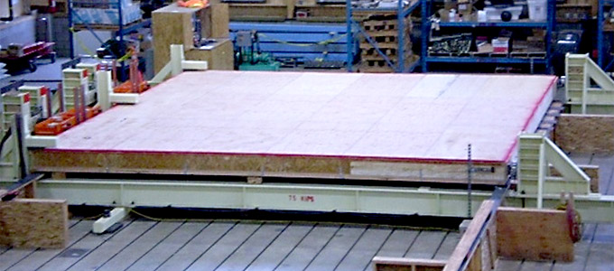
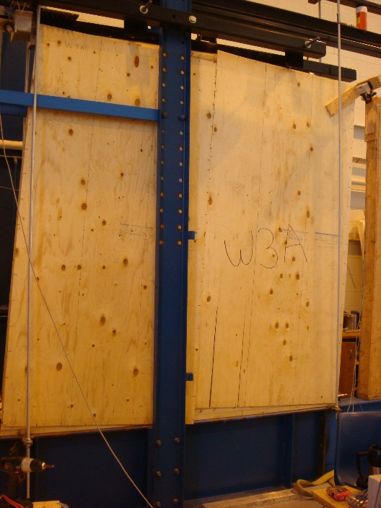
Lecture #5
– Shear wall and Diaphragm Design
Y. H. Chui
University of Alberta

Slide 2
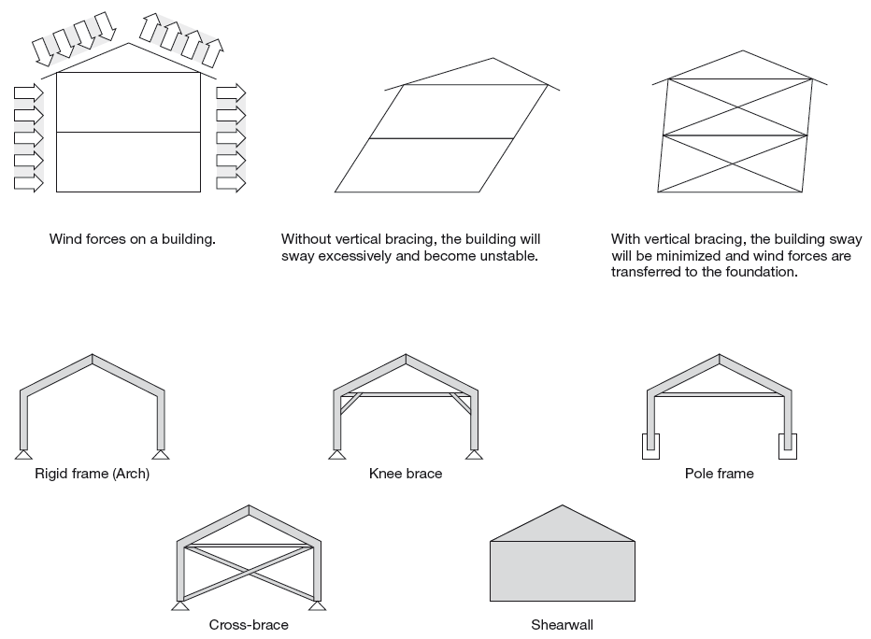
Lateral Load Resisting Structure – Vertical bracing system
Function of bracing system
Type of wood bracing system
Notes:
Shear wall and diaphragm are bracing systems that resist lateral loads, arising from wind and earthquake events. They are Lateral Load Resisting Systems (LLRS). There are a number of options for vertical LLRS for timber construction, including frames with moment resisting joints, frames with knee brace and cross brace, pole frame and shear walls. Shear wall can be light wood frame or mass timber panels such as CLT. Obviously they also resist gravity load as well.

Slide 3
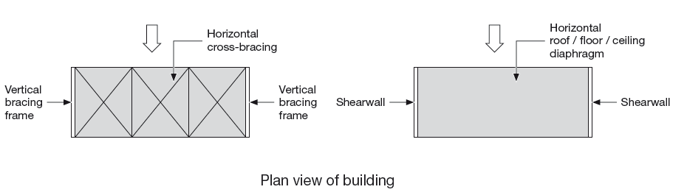
Lateral Load Resisting Structure – Horizontal bracing system
Notes:
Horizontal bracing systems can be either braced frame or diaphragms. A major function of horizontal bracing system is to distribute the externally applied lateral loads to the supporting shear walls. This distribution of forces is dependent on the stiffness of the horizontal bracing system relative to the stiffnesses of the shear walls.

Slide 4
Contents
Performance of wood frame construction
  Experience from earthquakes and hurricanes
Understanding load path
Design of light wood-frame lateral load resisting assemblies
  Failure modes
  Design principles for diaphragms
  Design principles for shear walls
Notes:
In this lecture, focus will be on light wood frame shear walls and diaphragms. An overview of the performance of these light wood frame systems under strong wind and earthquake will be provided. Before presenting the design approaches for diaphragms and shear walls, an understanding of load path and potential failure modes is critical.

Slide 5
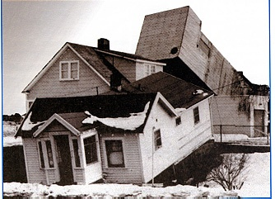
Performance of wood frame houses
Hurricanes
Earthquakes

Slide 6
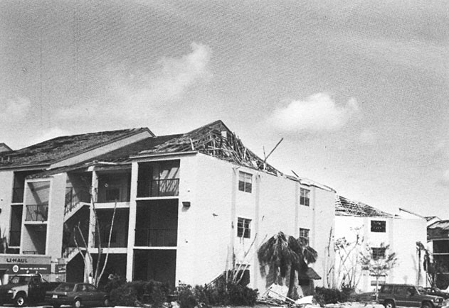
Damage to Housing in Hurricanes
Critical Details: Roof Sheathing
Gable end bracing details
Notes:
Common failure modes: loss of roof covering, roof sheathing, fastener failures, or broken doors and windows.

Slide 7
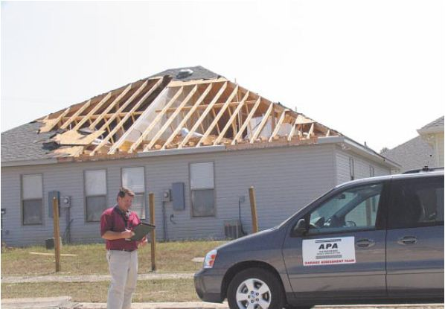
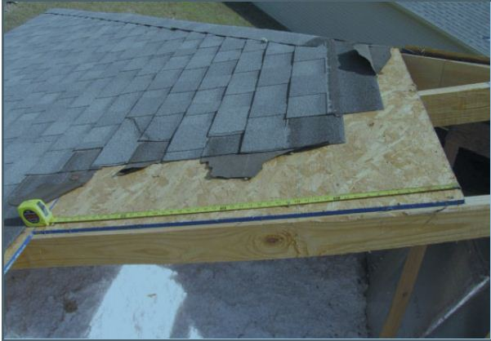
The APA Disaster Assessment Team evaluates a case of roof sheathing loss in Slidell, Louisiana after Hurricane Katrina.
Source: APA
Notes:
The roof sheathing loss was caused by inadequate attachment to roof framing. In this case staples were located greater than 12 inches on centre at panel ends, which was in excess of code minimum requirement, and many were missing the framing on this damaged roof.
Source: Hurricane Katrina – structural performance of wood-frame buildings in the aftermath, APA report.

Slide 8
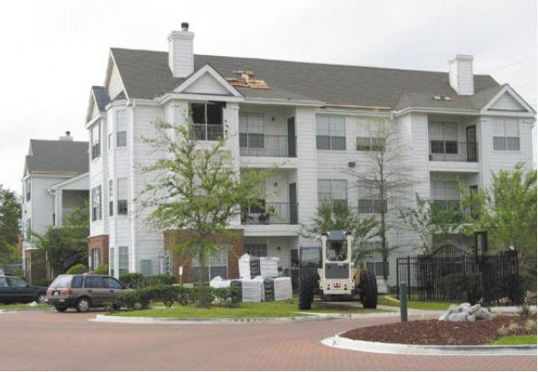
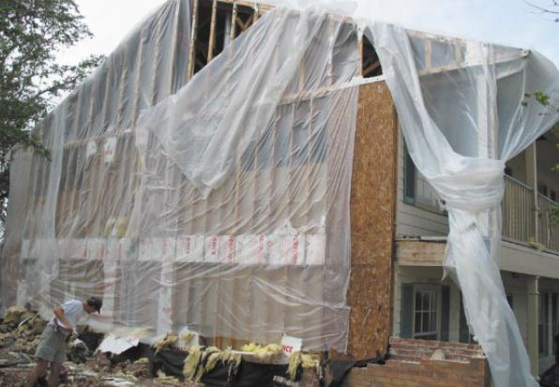
Built after Hurricane Andrew (1998)
Source: APA
Notes:
This three-storey wood framed apartment complex was built after hurricane Andrew (1998) and sustained virtually no damage. The picture shows a window breach and some shingle loss. However another apartment complex in the same neighbourhood built pre-Hurricane Andrew, sustained heavy damage. This complex was built to conventional construction provisions. The infilled panels were foam sheathing. The brick veneer was inadequately tied to the wall. Once the veneer was lost, the foam sheathing was also lost allowing significant building damage caused by rain infiltration.

Slide 9
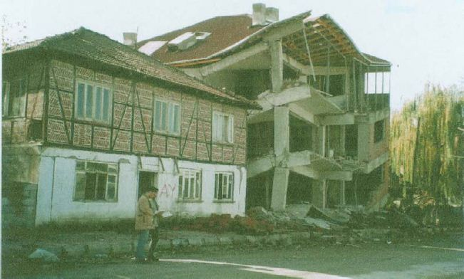
Seismic Performance of Wood-Frame Buildings
Strength and stiffness
  High strength-to-weight ratio
  Plywood or OSB Shearwalls are effective in resisting the racking forces
  Non-structural elements contribute to the lateral resistance
Ductility
  Allows building to dissipate
  energy
Redundancy
  Numerous load paths provide
  an extra level of safety
Notes:
Wood-frame buildings have properties that naturally enhance their performance in earthquakes. Wood frame buildings have high strength-to-weight ratio, making it a desirable structural system choice. Braced walls or shearwalls are critical for providing racking resistance during an earthquake. Walls constructed with plywood or OSB structural sheathing are very effective in resisting the racking forces. The stiffness and resistance of the walls can be augmented by increasing the thickness of the panel and increasing the number or size of the nails. In addition, research and experience have shown that non-structural elements contribute to the lateral resistance of the structure.
Compared to other materials such as masonry and concrete that have to be carefully designed and detailed to ensure good seismic performance, wood systems are inherently more ductile. Ductility is the ability of the structure to yield and to deform without collapse, allowing the buildings to dissipate energy. The numerous nailed connections are very effective in providing ductility to wood-frame buildings. (Picture Turkey earthquake in 1999)
Buildings that have numerous load paths are considered structurally redundant and provide an extra level of safety in earthquakes. Typical wood-frame construction is comprised of hundreds of structural elements and thousands of nail connections. This means that the failure of one load path can often be compensated for by adjacent members and joints.

Slide 10
Performance of Wood-Frame Buildings in Past Earthquakes
Recent California earthquakes
  San Fernando Earthquake 1971 (Richter scale 6.6)
  Loma Prieta Earthquake 1989 (7.1)
  Northridge Earthquake 1994 (6.7)
The majority of the wood-frame houses performed well from life safety point of view
Lessons learned from past earthquakes
Notes:
Three California earthquakes provide insight into the performance of North American style wood-frame construction.
The majority of the wood-frame houses performed well, especially from the standpoint of life safety.
However evaluation of building performance has identified problems with some wood-frame buildings, which are explained in the following slides to provide an understanding of failure modes and how they can be prevented.

Slide 11
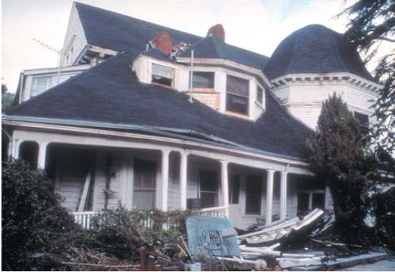
Connections to Foundations
This wooden residence sustained major damage when it moved off its foundation in the 1989 Loma Prieta Earthquake.
Notes:
Some old houses were built without using anchor bolts to connect the wood structure to foundation. Experience has shown that these structures may slide off their foundations during an earthquake. Connections to foundations should be properly designed and detailed using hold-downs or anchor bolts.

Slide 12
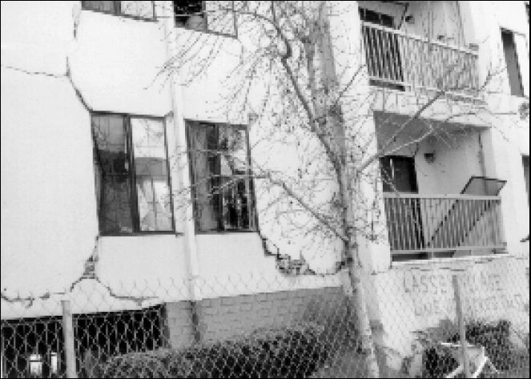
Weak and brittle sheathing material
Stucco failure
Notes:
Using weak and brittle shearwall sheathing materials permitted under previous codes is another problem with older buildings.

Slide 13
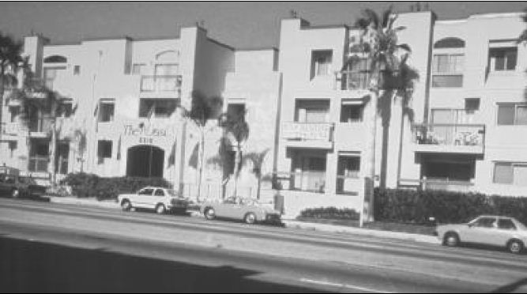
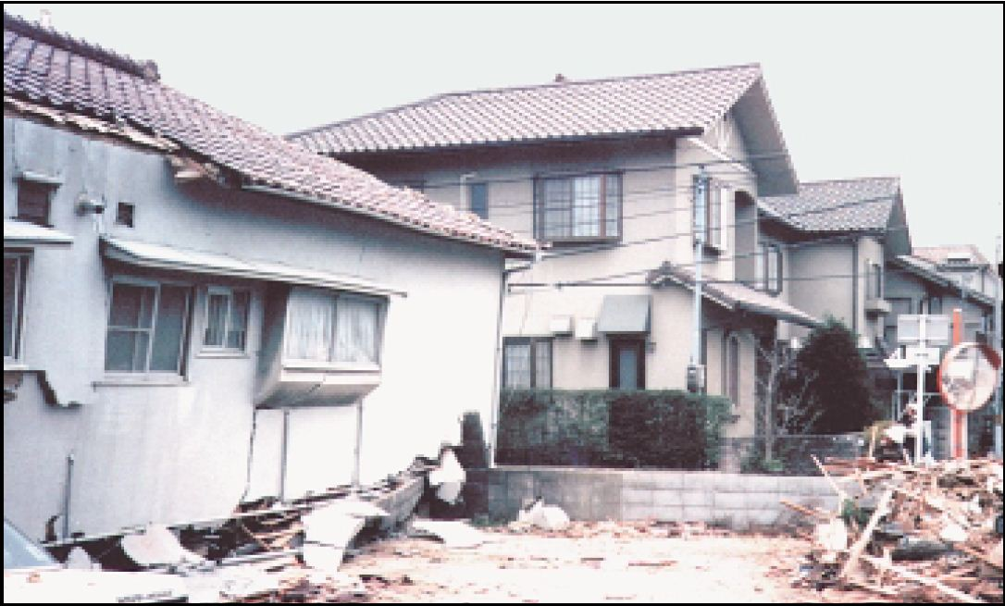
Success of full plywood coverage after Northridge earthquake
Undamaged modern Canadian-style wood-frame buildings after Japan’s 1995 Kobe earthquake
Notes:
However the photo at the top shows that the multi-storey building sheathed fully with plywood survived the Northridge earthquake undamaged.
The photo at the bottom was taken after Kobe earthquake in Japan. Older homes built in the traditional Japanese post-and-beam style which had minimal lateral resistance were shattered by this quake. The newer homes in the background built to Canadian seismic standards were virtually unaffected.

Slide 14
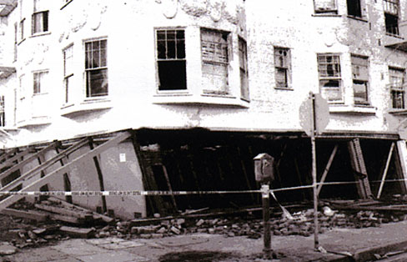
Weak First Storey
Openings in first storeys created soft storeys that led to failures
Notes:
California experience has shown that multi-family apartments built with first-storey garages are particularly vulnerable to earthquakes and building codes have recognized that buildings with soft storeys have to be carefully designed and detailed to resist earthquake.

Slide 15
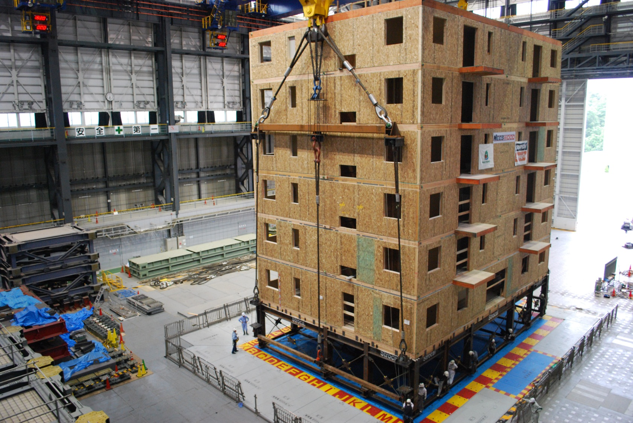

Research – Shake table test on 6-storey building (Neeswood Project)
https://www.youtube.com/watch?v=hSwjkG3nv1c
Notes:
The objective of the NEESWood project is the development of a new logical performance-based seismic design philosophy for mid-rise woodframe construction, thus enabling such construction to be an economic option in seismic regions in the U.S. and around the world.
On July 14, 2009, a six-story condominium building shook with the earthquake motions of the 1994 Northridge quake, but one and a half times as intense--more powerful than any earthquake California has experienced in modern times. It is the largest full-scale shake table test the world has seen to date.
NEESWood set out in 2005 to study how wood-frame structures--those consisting of mostly wooden parts, as opposed to concrete and steel--respond to the shaking of earthquakes. Wood-frame construction can be more affordable for mid-rise buildings than other methods, but little is known about how such buildings respond to earthquakes.
Using the 1988 Uniform Building Code as a guide for construction, the project engineers used the resulting test data to develop computer models that may help designers predict how wood-frame buildings will fare in an earthquake.
For the final experiment, project engineers worked with industry to develop a condominium building that has the design and detailing necessary to withstand forces that exceed even those in current safety specifications.
Capstone project objectives:
Objective 1: To confirm that a representative mid-rise woodframe structure designed using the NEESWood PBSD philosophy satisfies the performance objectives, as pre-defined during the design process.
Objective 2: Provide a general understanding of the behavior of a mid-rise woodframe structure similar to those currently in place in the Western U.S.
Objective 3: Confirm a representative mixed-use sevenstory SMF/woodframe building designed using the NEESWood design philosophy satisfies the performance objectives, as pre-defined during the design process.

Slide 16
Understanding the Load Paths

Slide 17

Lateral Load Path - Wind Loads
Pressure
or
Suction
Notes:
Under wind load, the applied force is acting normal to the plane of the building surface. The uniform load can be either be pressure (acting towards to the surface) or suction (acting away from the surface).

Slide 18
Wall Sheathing/Cladding to Studs
Notes:
The wind load is first distributed through cladding and sheathing to and resisted by the framing members in the wall and roof through out-of-plane bending action.

Slide 19
Studs to Diaphragms
Notes:
Since framing members are attached at the ends to diaphragms, the loads are then resisted by the diaphragm through in-plane action.

Slide 20
Diaphragm to shear walls
Shear Forces
Notes:
Since diaphragms are supported on shear walls, their loads are transferred to and resisted by the shear walls

Slide 21
Upper Storey Shear walls to Lower Storey Shear walls
Shear Forces
“F”
F_{roof}
F_{roof} +F_{floor}
Notes:
In addition, the load transfer between shear wall and diaphragm accumulates as we go from roof level to the bottom storey of a building.

Slide 22
Upper Storey Shear walls to Lower Storey Shear walls
Overturning
Forces, “R”
R_{roof}
R_{roof} +R_{floor}
Notes:
In addition to shear transfer between storeys, the lateral load also generates rotation and therefore over-turning moment of the shear walls. Such overturning moment will need to be resisted by perimeter members in shear wall and shear wall hold-down connections at the end of the shear walls.

Slide 23
Connection to foundation
Shear Forces
Overturning Forces
Notes:
The building will have to be tied to the foundation to prevent the building sliding off the foundation and overturning.

Slide 24
Shear walls to Foundation
Shear Forces
F_{roof} +F_{floor2} +F_{floor1}
Notes:
The base shear will be the sum of all the storey forces, and sufficient shear connection will need to be provided to adequately transfer the shear force to the foundation.

Slide 25
Shear walls to Foundation
Overturning
Forces
R_{roof} +R_{floor}
Notes:
Hold-down connections are usually required at the corners of bottom storey shear walls to resist overturning moment.

Slide 26
Members and connections in the load paths
Assemblies:
  Roof diaphragm
  Floor diaphragm
  Shear wall
Connections between assemblies:
  Shear wall-diaphragm
  Shear wall-foundation
  Diaphragm-foundation
Chord members
Sheathing-framing connections
Shear connections
Hold-down connections
Notes:
Note that at each load path, there is need to ensure that members and connections are adequate to transfer the force from one component to the other. Shown here is a list of members and connections within assemblies and connections between assemblies that are required to be designed.

Slide 27
Lateral Load - Wind and Earthquake
Loads are dynamic in nature
In National Building Code of Canada Part 4, If certain conditions are met, simplified Equivalent Static Procedure can be used for design
For wood construction, these conditions are generally met, hence Equivalent Static Procedure is used
Notes:
Wind and seismic loads are dynamic in nature. Part 4 of NBCC allows for an equivalent static load procedure if certain conditions related to building period, geometry and configuration are met. For wood buildings, these conditions are usually met.

Slide 28
• In light wood frame buildings, lateral loads are resisted by shearwalls and diaphragms (as lateral load resisting assemblies).
• Each load path must be considered in design to ensure that:
- Connections are adequate to transfer loads between assemblies
- Assemblies are adequate to resist applied lateral load without failure
• This lecture focuses on design of assemblies
All connections and assemblies must be designed!
Notes:
Shear wall and diaphragms act as LLRS in light wood frame buildings. As stated above each load path must be designed to ensure members and connections are structurally adequate. In this lecture, focus is on design of shear walls and diphragms.

Slide 29
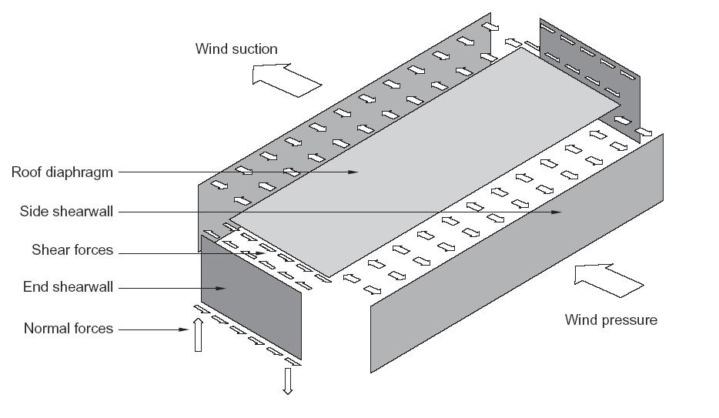
Shear wall and diaphragm action
Plate type structural elements designed to transmit force in their own plane:
Diaphragm:
  Horizontal element
    Floor
    Roof
Shearwall:
  Vertical element
    Walls
Each is assumed to act as a system, and design is to determine sheathing panels, framing members and sheathing-to-framing connection (nailed)
Notes:
Shear walls are vertical LLRS and diaphragms are horizontal LLRS. The design of light wood frame shear wall and diaphragm is to ensure that the combination of sheathing, framing members and sheathing-to-framing connection is adequate to resist the applied lateral load. Often, nails are used to fasten sheathing but other small fasteners, such as wood screws and staples, can be used. However the level of ductility arises due to fastener types is different, which means the seismic force modification factor differs for different types of fastener. Nails are considered to provide the best seismic performance. Wood screws and staples may lead to less ductile performance and therefore lower seismic modification factors.

Slide 30
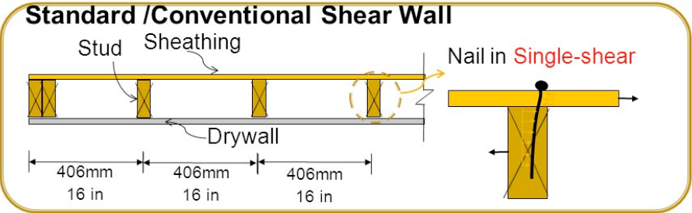
This combination determines the shear strength of shear walls and diaphragms
Notes:
Design of shear walls and diaphragms is to determine the following:
Lumber species and grade
Fastener diameter and length
Spacing of fasteners at sheathing panel edges
Sheathing type and thickness
Note that lumber member spacing is not an design factor because the shear strength is largely controlled by he sheathing-to-framing connection.

Slide 31
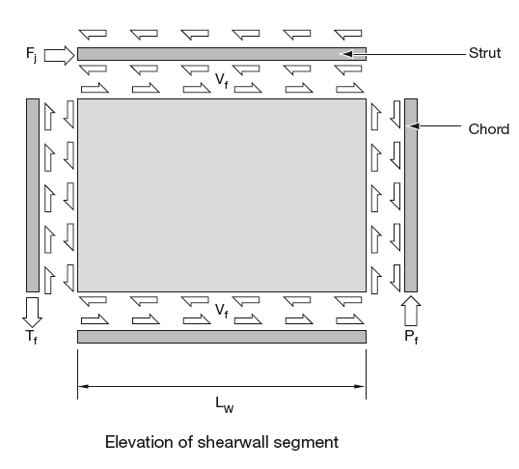
Free-body diagram for shear wall
Notes:
This figure shows the free-body diagram of the internal forces generated by the lateral load in a shear wall. Under the action of a lateral force, the shear wall resistance is provided by the sheathing-to-framing connections. Overturning resistance is provided by the hold-down connection at the ends of the wall. The axial resistance of the chord members should be adequate to resist the applied axial forces( Tf and Pf) generated by the overturning moment without tension or compression failure. Note that if there are splice connections in the strut members, they should also be designed to ensure adequate transfer of shear force.

Slide 32
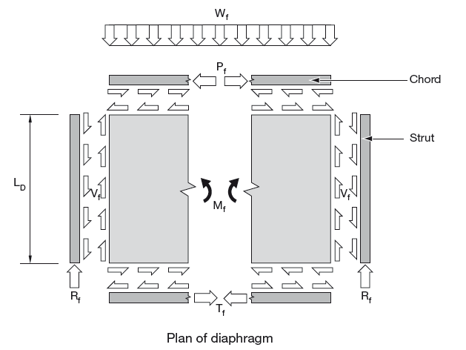
Free-body diagram for diaphragm
Deep beam analogy
Notes:
This figure shows the free-body diagram of the internal forces generated by the lateral load in a diaphragm. The diaphragm is treated as a deep beam under bending action of a UDL The shear resistance of the diaphragm is provided by the sheathing-to-framing connections. Similar to a beam under UDL, the maximum shear force occurs at the supports. The axial resistance of the chord members should be adequate to resist the applied axial forces (Tf and Pf) generated by the bending moment without tension or compression failure.

Slide 33
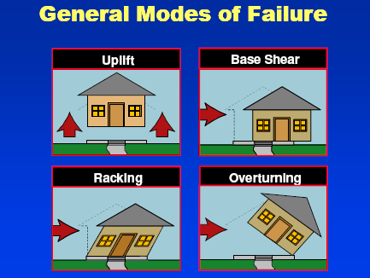
Failure modes in buildings under lateral load
Courtesy of APA
Notes:
The design procedure presented here for shear wall focuses on racking resistance only. However there are other failure modes that need to be checked. These are largely controlled by connection capacities, such as uplift, overturning and base shear.

Slide 34
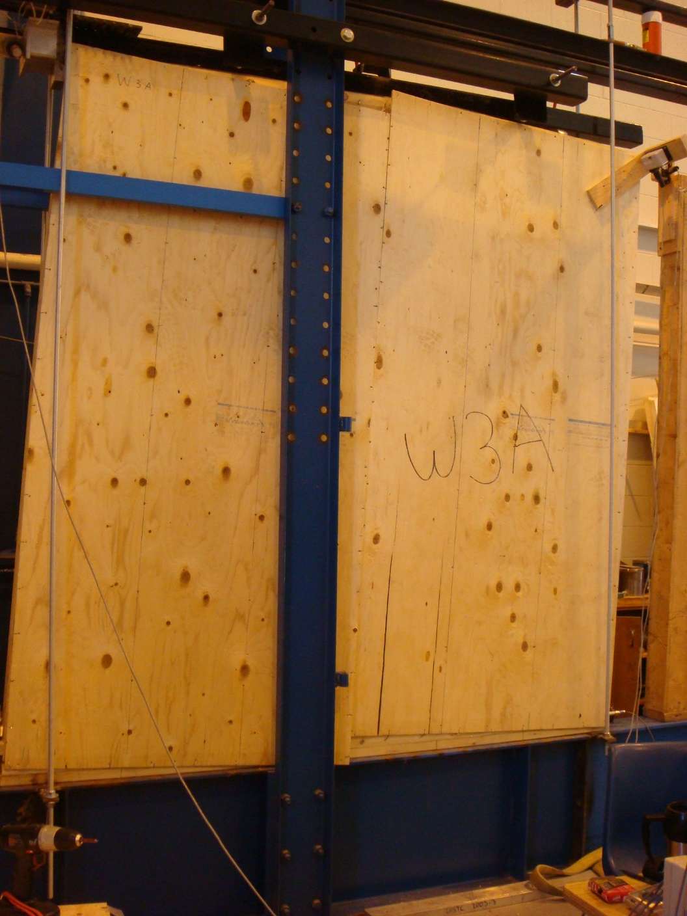
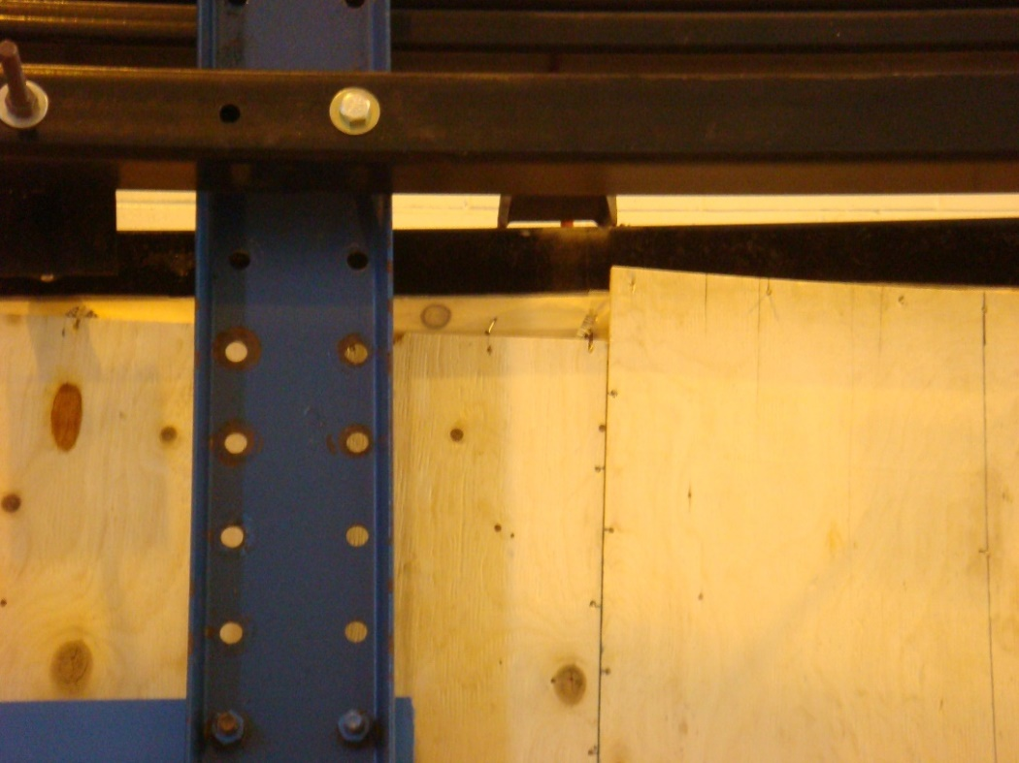
Failure modes in shear walls
Yielding of nails around the perimeter
Notes:
Here is an illustration of racking failure of shear wall test. As can be noted, the plywood sheathing remain relatively rigidly and rotates as a rigid body. The large deformation is possible due to the nail bending in the sheathing-to-framing joints.

Slide 35
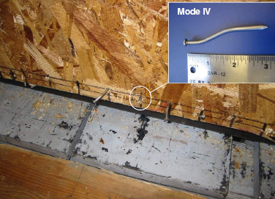
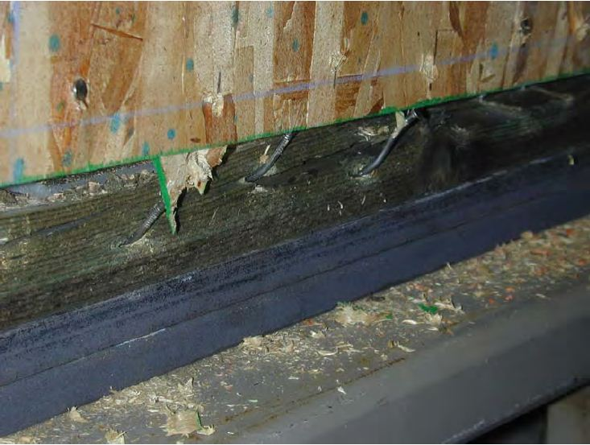
Failure modes in shear walls
Nail Yielding
Nail bending/ripping through sheathing
Source: APA & AWC
Notes:
Nail bending can be seen at the perimeter of the shear wall. As the load is increased, the nails can ripped through or nail head pulled out of the sheathing panels, depending on panel thickness and nail diameter.

Slide 36
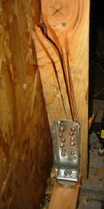
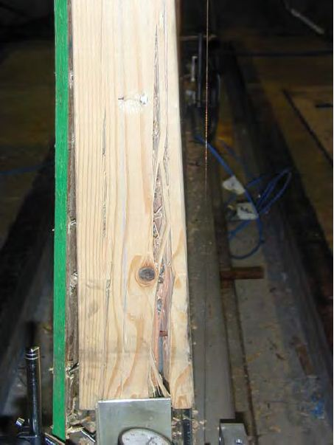
Failure modes in shear walls
Failure of boundary members
Source: APA & AWC
Notes:
If there are weak lumber members, failure could occur in the end stud subjected to tension load. This is the reason why the tensile strength of end stud needs to be checked to resist overturning.

Slide 37
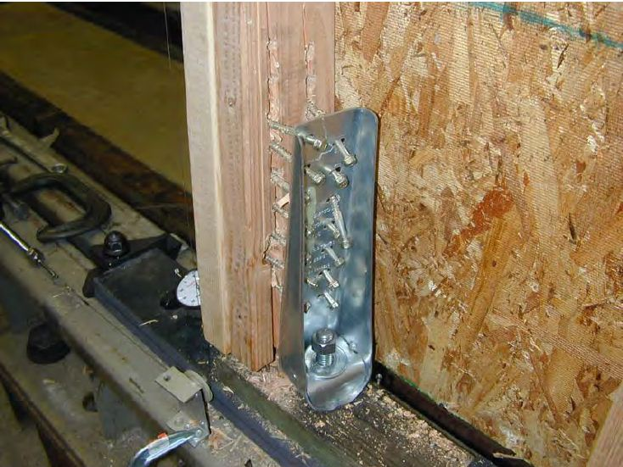
Failure modes in shear walls
End stud failure at hold-down
Source: AWC
Notes:
Overturning of shear wall is resisted by hold-down at the end of the wall. Here is a hold-down failure with nail pull out. A hold-down connector is usually a proprietary product, with their load-carrying capacity published by the manufacturer.

Slide 38
Design principles of CSA O86-14 for light wood frame shear walls and diaphragms
Notes:
The design principles for shear walls and diaphragms in CSA O86 are presented here.

Slide 39
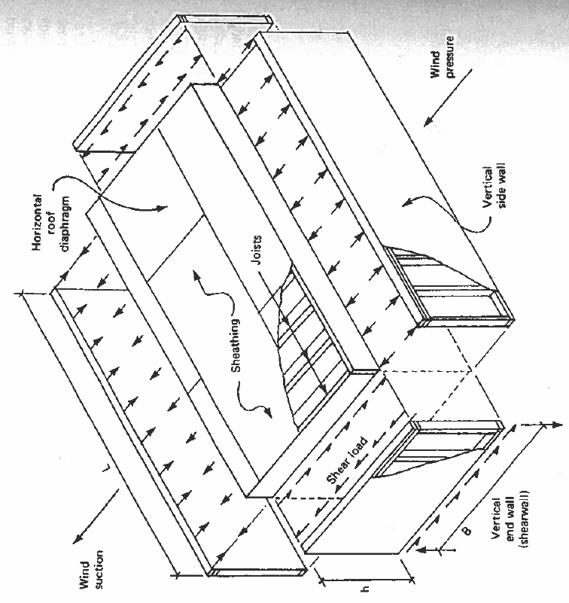
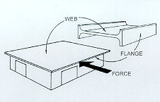
Diaphragm Design
Deep beam analogy
Shear resistance : sheathing (Web)
Flexural resistance: chords (Flanges)
Notes:
A diaphragm acts in a manner analogous to a deep beam, where the panels act as a “web”, resisting shear, while the diaphragm edge members perform the function of “flanges”, resisting the bending stresses. These edge members are commonly called chords in diaphragm design.

Slide 40
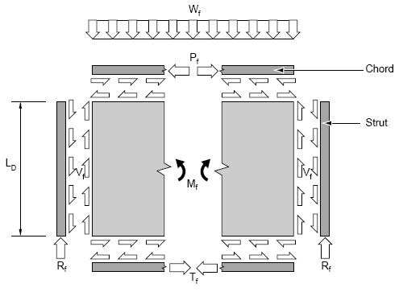
Calculation of applied force
h
(Centre-line distance between chords)
M
P_{f} and T_{f} = M_{f} / h
M_{f} = W_{f}L² /8
V
V_{f} = W_{f}L/2
Notes:
Here is the free-body diagram for a diaphragm with an applied uniform load. As stated above, the deep beam analogy is assumed meaning that the chord forces (one tension and one compression) are calculated from the applied bending moment, while the force is maximum at the two edges. The bending moment is then resisted by the chord members and the shear force is resisted by the sheathing-to-framing connections. Calculation of P_{f}, T_{f} and V_{f} is illustrated in the slide.

Slide 41
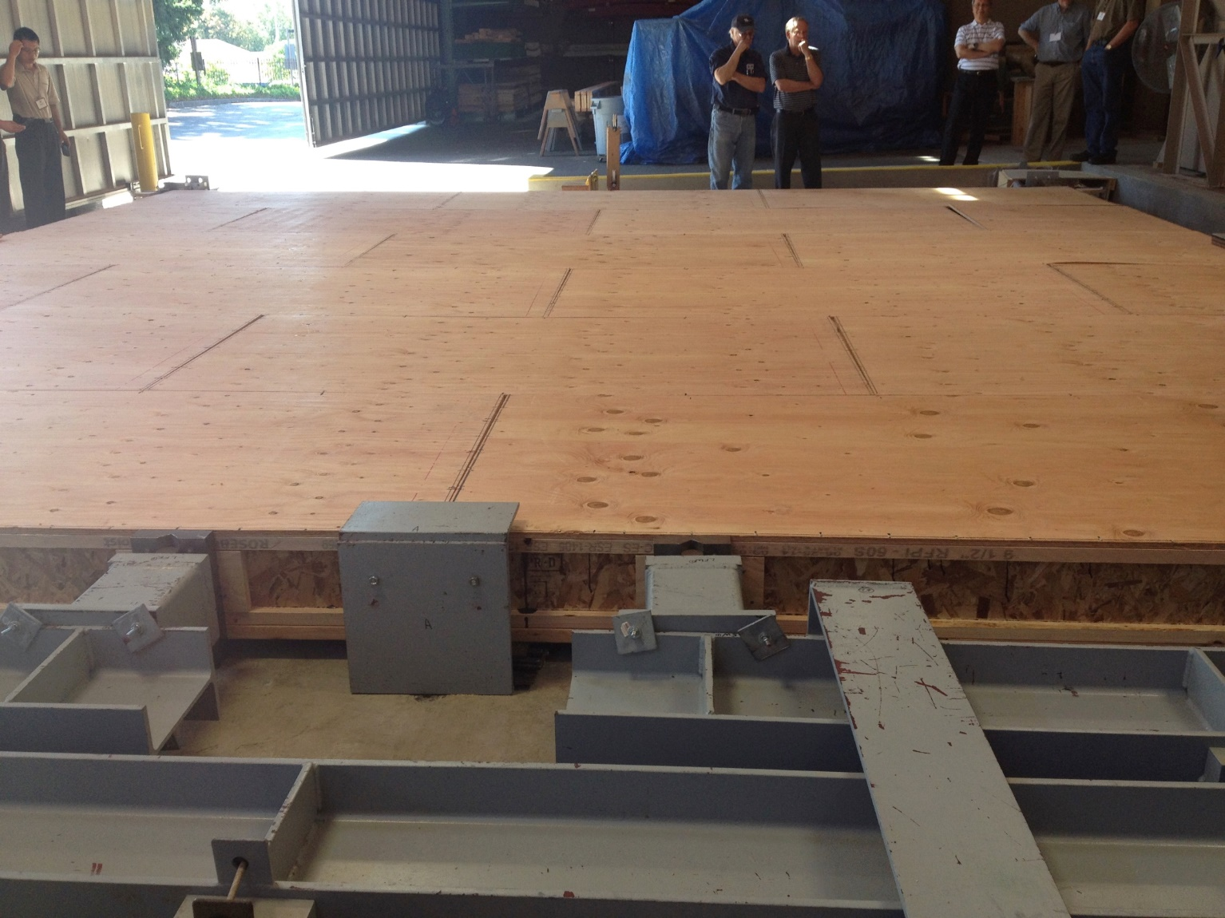
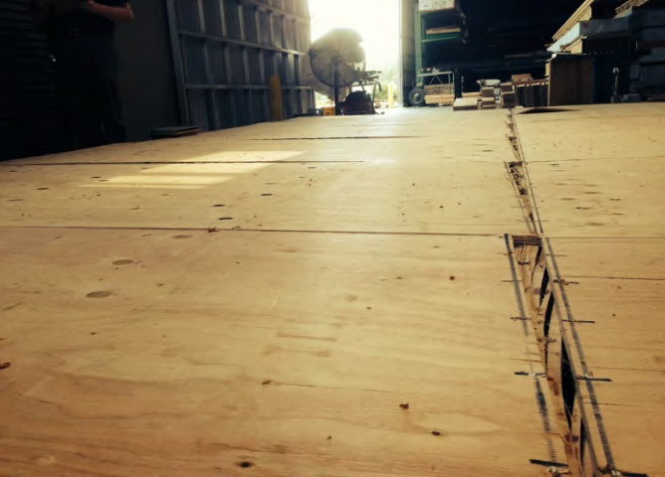
Shear resistance of diaphragm
Shear resistance provided by sheathing-to-framing joint leading to slippage of sheathing panels relative to floor joists
Notes:
These pictures show shear failure in a floor diaphragm under testing with slippage in the sheathing-to-framing nail joints.

Slide 42
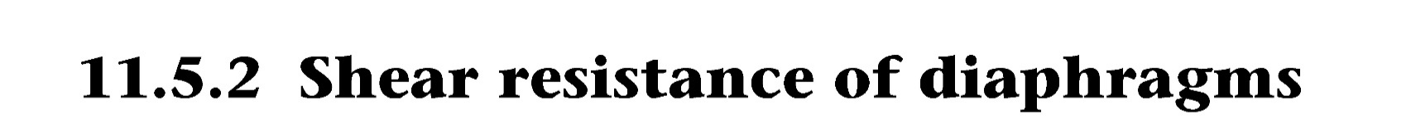
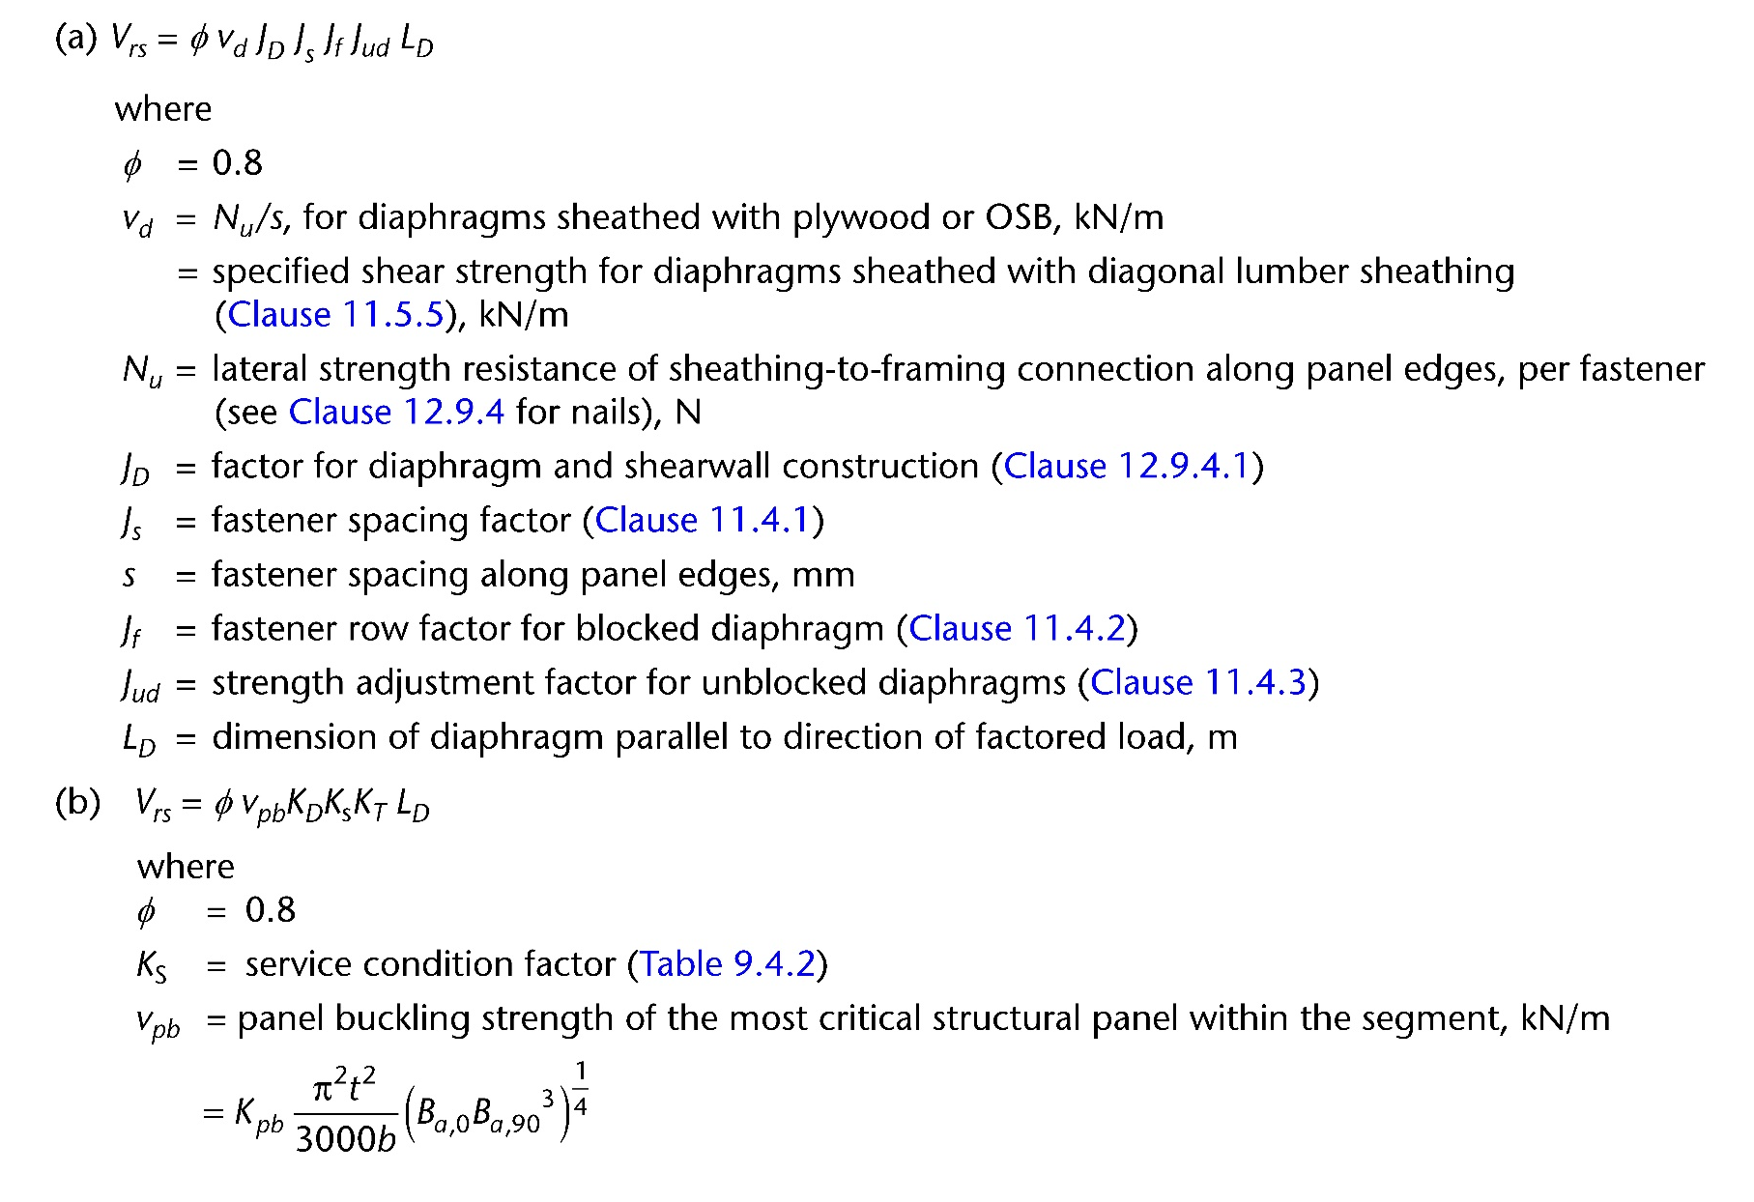
2 possible failure modes
Sheathing-to-framing joint failure
Sheathing panel buckling – only occurs in thin panels
Notes:
The design approach in CSA O86 was changed in the 2014 edition. Prior to 2014, the shear capacities of both shear walls and diaphragms were based on empirical test results. Research has shown that the shear strength of a shear wall or diaphragm is directly related to the total shear capacity of all sheathing-to-framing joints acting in the line of the shear force or the buckling strength of the sheathing panel in shear. See figures. As a result the design method for diaphragm in CSA O86 was changed in 2014 from a table format to a mechanics-based approach where two strength checks are required and the lower of the two governs the design. One check is for sheathing-to-framing connection and the other is for buckling of the sheathing panel. Clause 11.5.2 provides design equations for these two checks. The joint capacity Nu is calculated according to the nail joint design equations in clause 12. The buckling strength of OSB or plywood is related to the shear through thickness modulus and axial moduli in the two principal directions.

Slide 43
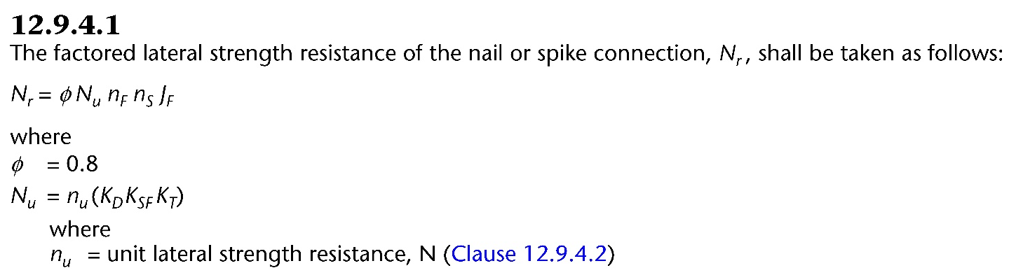
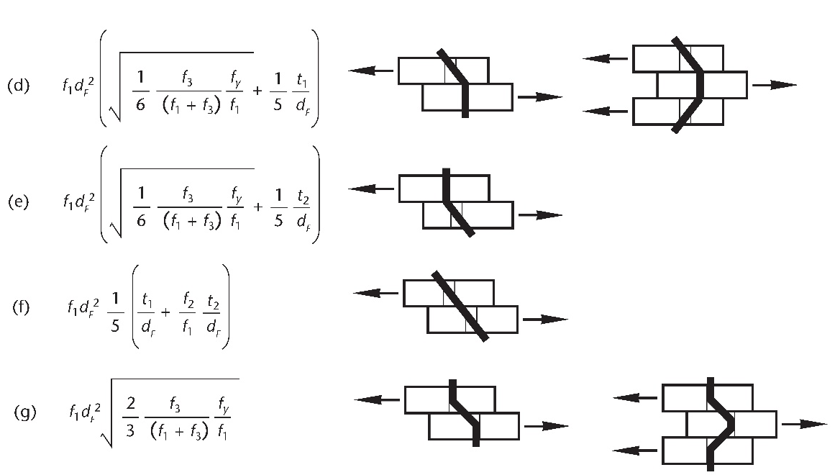

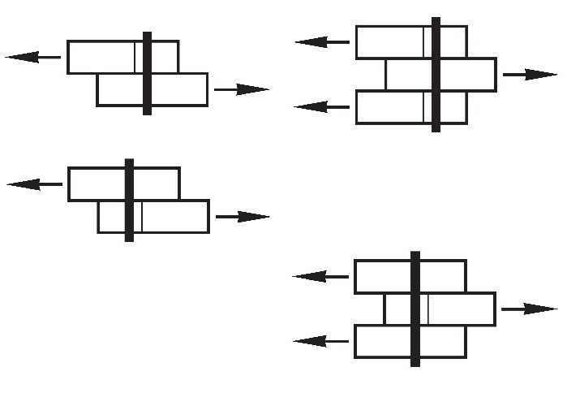
Lateral strength of nailed joint, N_{u}
Notes:
If the fastener is nail, Nu is calculated using clause 12.9.4.1. This will be covered in Lecture 6 – Design of connections. Basically clause 12.9.4.1 provides a series of equations to calculate various failure modes in the nail connection and the lowest value is the governing strength. The nail joint strength will depend on a number of factors, including nail diameter, nail length, yield strength of nail, sheathing panel thickness and embedment strength, and lumber embedment strength.

Slide 44
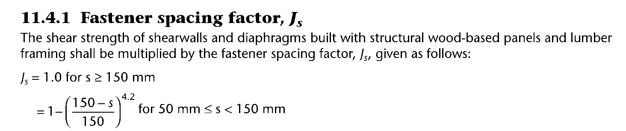
Modification factors for diaphragm shear
J_{D} = Diaphragm and shear wall construction factor (Cl. 12.9.4.1) = 1.3
J_{S} = Fastener spacing factor (Cl. 11.4.2)
Increased by 30% to account for the fact that more than one fastener resists applied load.
To account for the possibility that the framing members are cracked due to close fastener spacing (50mm-150mm).
Notes:
There are two modification factors in the design equation. J_{D} allows an increase of 30% in strength since in diaphragm (and shear wall) there are usually a large number of nails resisting the applied load, and not one nail which is the basis of the nail design capacity (lower tail strength). A second factor is J_{S} which accounts for the reduction in diaphragm strength when the nail spacing is closer than the common spacing of 150mm. Research has shown that the closer nail spacing tends to split the wood, leading to reduced nail joint strength. A reduction equation is provided for J_{S}.

Slide 45
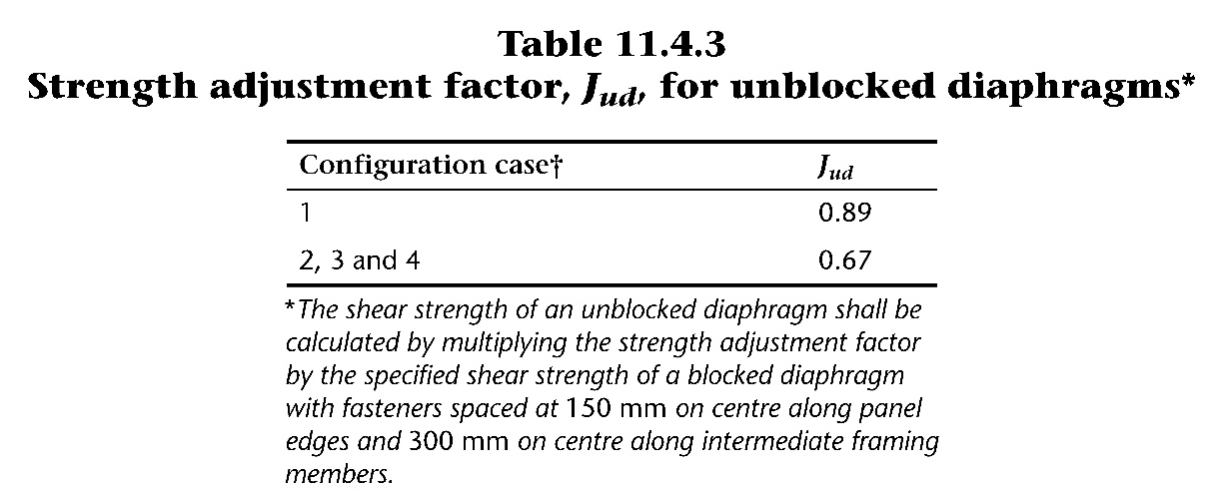
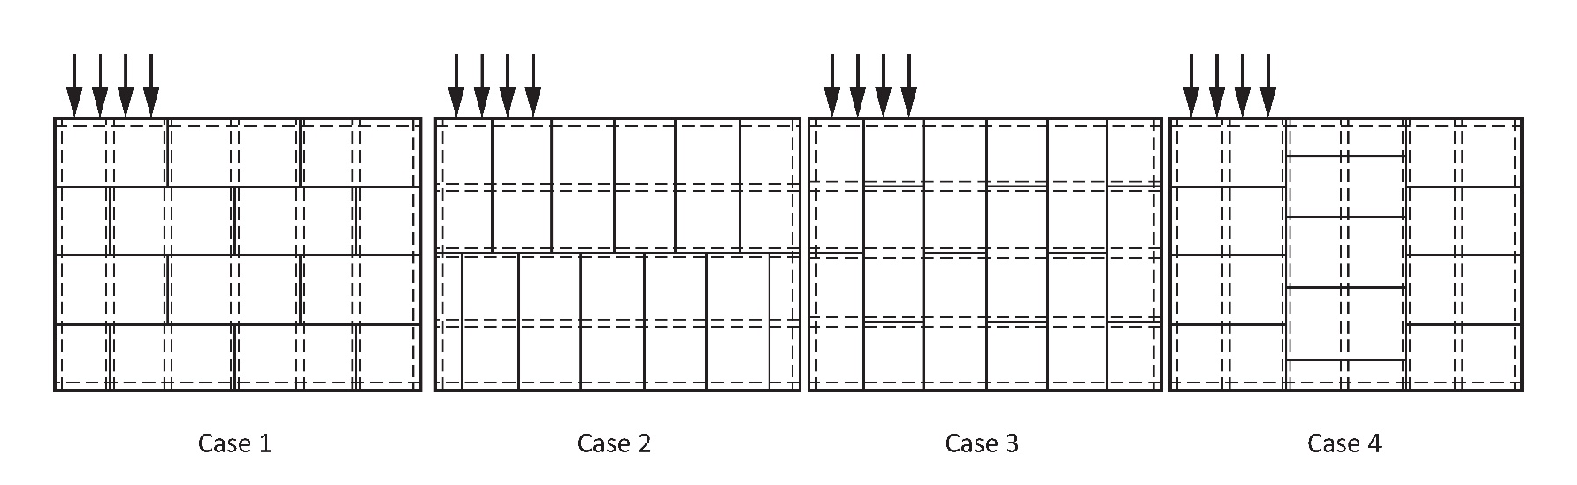
Modification factors for diaphragm shear
J_{ud} = Strength adjustment factor for unblocked diaphragms (Cl. 11.4.3)
Unblocked diaphragm does not have all sheathing panel edges supported
Unsupported panel edge
Supported panel edge
Notes:
The strength of diaphragm is maximized when every edge of the OSB or plywood panel is fastened to framing members for maximum transfer of shear force. To achieve this, blockings are required between studs. Fastening blockings to studs adds cost to construction. If designer chooses to eliminate blockings, a reduction in shear strength of diaphragm is applied through the use of J_{ud} factor. Note that the determination of specified capacity for unblocked diaphragmis based on a reference diaphragm(150mm edge nail spacing and 300mm nail spacing at intermediate framing members), reduced by a factor that is based on the sheathing panel orientation cases 1 to 4, with a larger reduction for 2-4, Table 11.4.3.

Slide 46

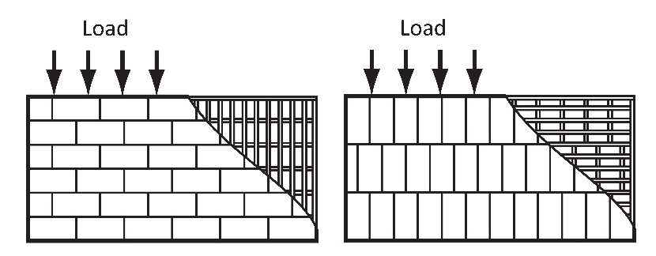
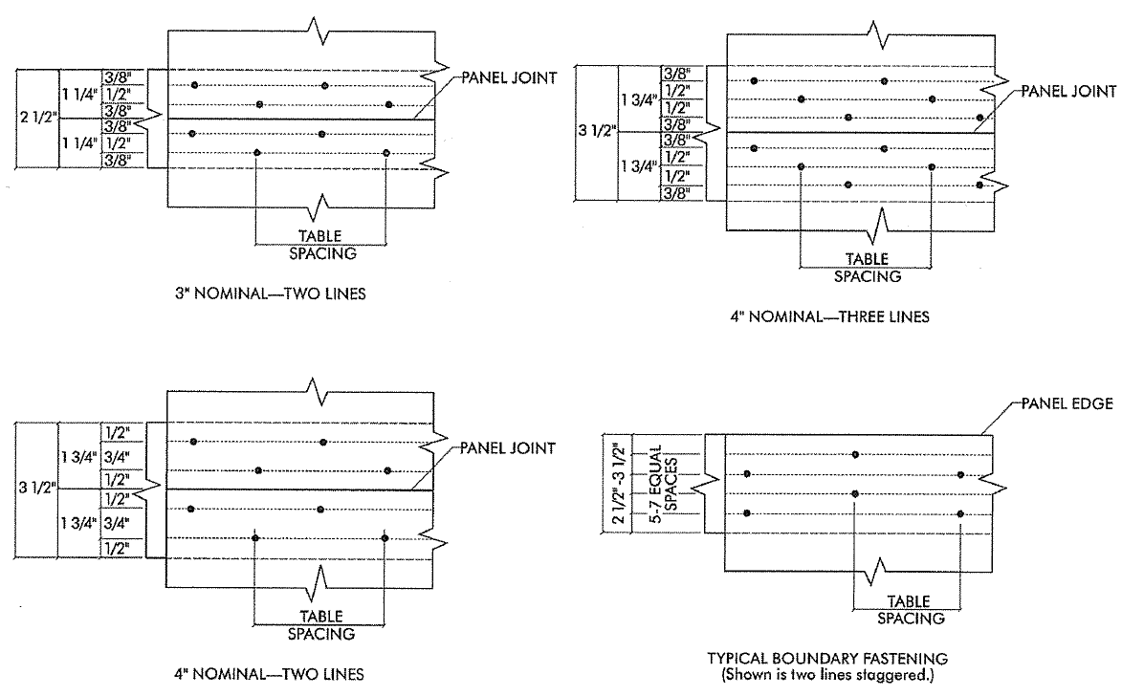
Modification factors for diaphragm shear
J_{f} = Fastener row factor for blocked diaphragm (Cl 11.4.2)
Blocked diaphragm has all sheathing panel edges supported on joist or blocking
Notes:
Since shear strength of diaphragm is related to connection strength, therefore increasing the number of rows of fasteners at sheathing panel edges would increase its strength. O86 allows for up to 3 rows of fasteners at panel edges. Note that a wider framing member of 64mm and 89mm is required for more than 1 row of fasteners. It was found that the diaphragm shear strength is not directly proportional to number of rows of fasteners. A J_{F} factor is used to adjust for the increase in shear strength as affected by the lumber width. Table 11.4.2 provides the values for J_{F}.

Slide 47
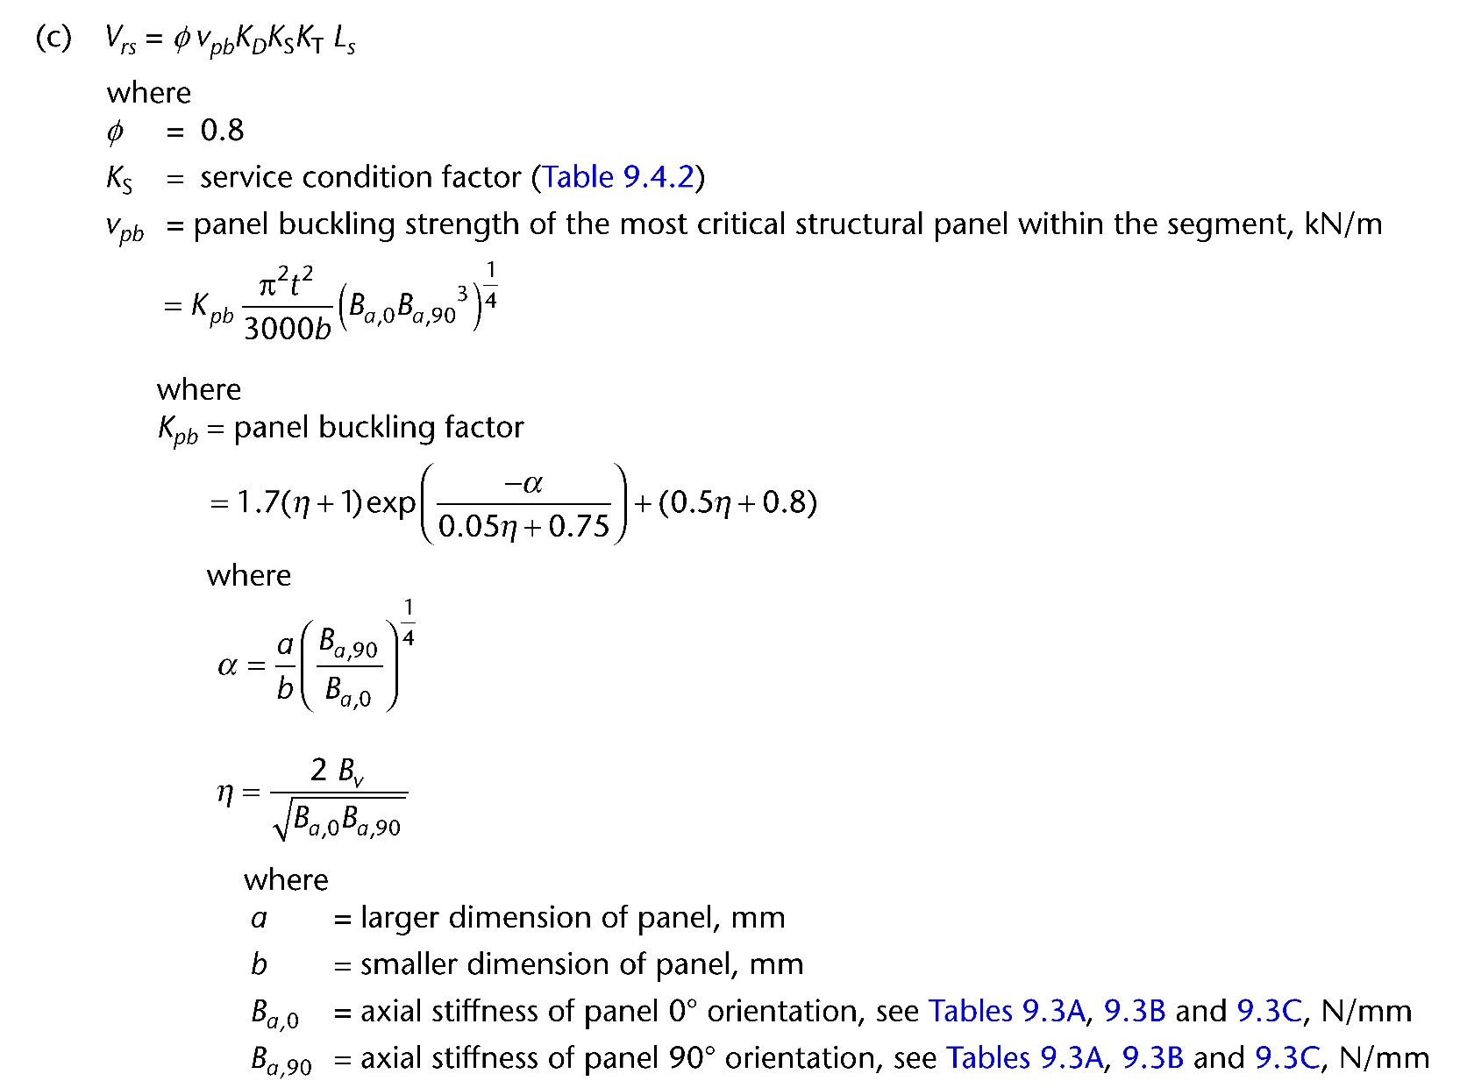
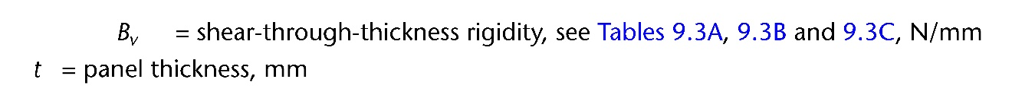
Panel buckling resistance, v_{pb}
Buckling resistance of a sheathing panel (plywood or OSB) is a function of the axial moduli and shear modulus of the panel.
Notes:
Buckling resistance of sheathing panel may occur when the its thickness is small. Essentially, the buckling resistance of the panel under shear is dependent on shear modulus and axial moduli in the two principal directions. Note that a shear wall usually contains more than one sheathing panel with different dimensions. For checking buckling resistance of a shear wall, the smallest panel would usually govern the buckling strength of the shear wall.

Slide 48
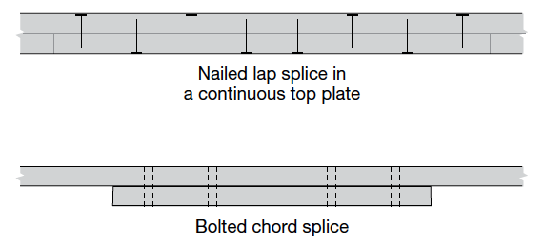
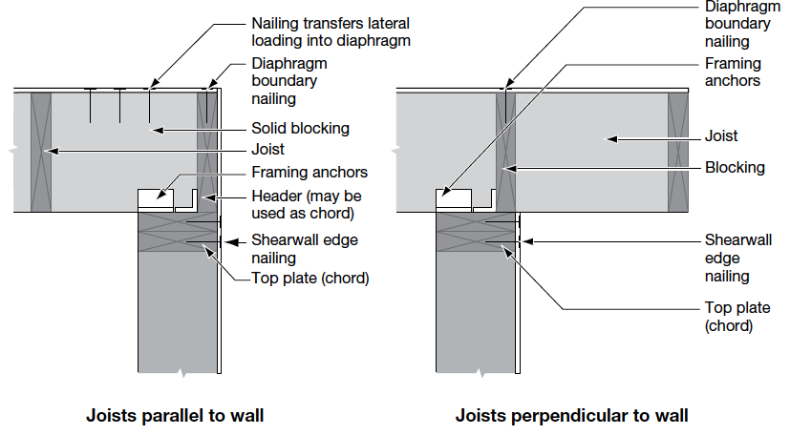
Other design checks for diaphragm
Chord member forces caused by bending moment: T_{f} and P_{f} (according to provisions for lumber tension and compression members)
Deflection of diaphragm (Cl. 11.7.2)
Connection in chord members
Connection to supporting shear wall
Connection in chord members
Connection to shear wall
Notes:
Apart from the sheathing-to-panel connection and panel buckling, there is also requirement to check chord forces, deflection, connection in chord members and connection to supporting wall for diaphragm. Here a few connection details are provided.

Slide 49
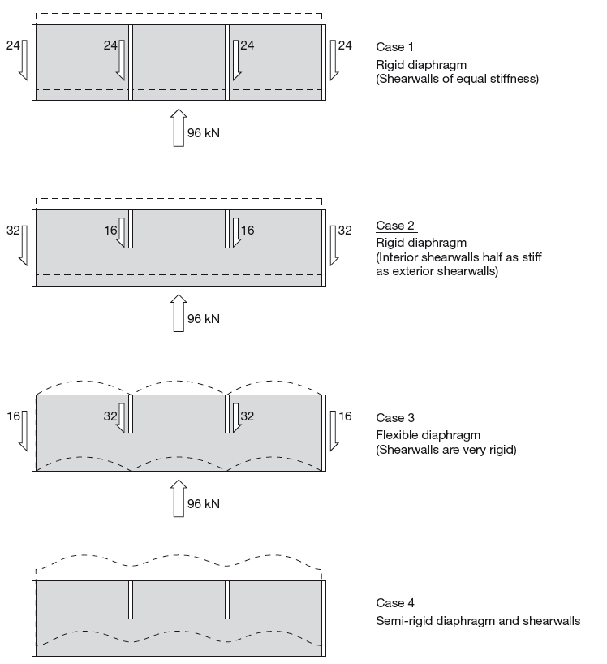
Distribution of forces to shear wall
Rigid diaphragm – depends on shear wall stiffness
More critical of the two approaches for each shear wall
Flexible diaphragm – based on tributary area
Semi-rigid – real case but complex
Notes:
One of the functions of a diaphragm is to transfer the external lateral load to individual shear walls supporting the diaphragm. The figures here illustrates the the different manners in which the diaphragm force is distributed to the shear walls. This distribution of shear force is dependent on the stiffness of the diaphragm relative to the stiffness of the shear walls. There are two extreme cases, where the diaphragm can be treated as rigid or flexible. However in reality the real behaviour is somewhere in between, known as semi-rigid. However to analyse the diaphragm-shear wall system requires that the stiffness of the components be known and the calculation is iterative. Therefore the analysis is more complex. Designers often assume either rigid or flexible diaphragm. If rigid diaphragm is assumed, the distribution of lateral force to shear walls is dependent on the shear wall stiffnesses. Essentially stiff walls attract more applied load. See cases 1 and 2 in the slide. If flexible diaphragm is assumed, the distribution is dependent on tributary area, as illustrated in case 3. Some designers may apply both rigid and flexible diaphragm assumptions and use the higher load applied to each shear wall from the two assumptions. This approach leads to conservative but safe design.

Slide 50
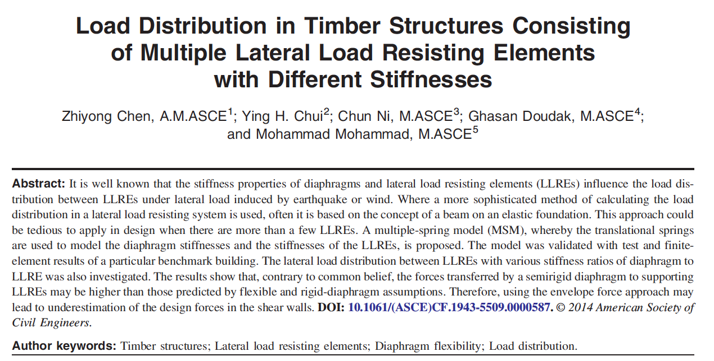
More sophisticated method
2014 paper published in American Society of Civil Engineering
Notes:
A sophisticated method of applying the semi-rigid diaphragm assumption has been presented by Chen et al 2014.

Slide 51
More sophisticated method
Single-storey building
Multiple spring model for a single-storey building
Notes:
In the proposed approach by Chen et al, the shear wall stiffness is represented by spring stiffness Ki and the diaphragm stiffness of KDi. A model was developed that calculates Pi based on the stiffness properties of diaphragm and shear walls, and applied forces.

Slide 52

Shear wall design
Vertical cantilevered member
- Shear resistance:
  Sheathing-to-framing connection
- Flexural resistance
  Shear wall chords
Notes:
If diaphragm is analysed as a deep beam subjected to a UDL, shear wall is treated similar to a cantilever subjected a shear force at the tip end. The shear resistance is provided by sheathing-to-framing connections at top and bottom and the end chords resisting the axial forces generated by the bending moment.

Slide 53

Calculation of chord forces
Vertical load due to Live (L) and Snow (S) load
M = V_{fs} x H
h
P_{f} = M / h + Vertical load component
T_{f} = M / h
(allowed to subtract vertical load component)
Notes:
Shear wall also resists gravity loads and these vertical load components should be accounted for in determining the chord forces as shown in the figure here.

Slide 54


Shear resistance of shear wall segment – sheathing-to-framing connection
(As for diaphragm)
(As for diaphragm)
Notes:
Similar to diaphragm design, the design provisions for shear wall was changed in 2014 to a mechanics-based method that requires the determination of nail joint strength and buckling of sheathing panels. The design equations in 11.5.1 are similar to diaphragm design equations. The main difference is in the use of a hold-down factor, J_{hd}, which is 1 if hold-downs are provided at ends of shear walls and less than one if limited or no hold-downs are provided, as will be explained later.

Slide 55




Lateral strength of nailed joint, N_{u}
Notes:
This slide was presented above to illustrate that the nail joint strength is calculated based on 12.9.4.1.

Slide 56

Shear resistance of shear wall segment – buckling of sheathing panel
Notes:
The same equation for checking buckling resistance of sheathing panel is provided.

Slide 57
Shear wall segments without hold-downs
Overturning tension force is resisted by sheathing panels and nails in sheathing-to-framing joints, thereby reducing shear strength of shear wall
Applied Force
F
Tension Zone
Notes:
Shear wall design strengths were measured or calculated based on full restraint against uplift at the end of the shear wall. If there is no hold-down provide, the sheathing-to-framing connection is then required to resist the uplift force, hereby reducing the capacity of the sheathing-to-framing joint to resist shear load.

Slide 58
Hold-down Effect Factor, J_{hd}
CSA O86 - 11.4.5
Case 1- J_{hd} = 1 if hold-downs are designed to resist all of the tension forces due to overturning
Case 2- if there are no hold downs at either end
P_{ij} = factored uplift restraint force for storey i at bottom of end stud of shear wall j
V_{hd} = factored shear resistance of the shear wall assuming J_{hd} = 1
H_{s} and L_{s} are height and length of shear wall
Case 3- If a lower storey segment is held at the bottom but not the top, and there is uplift restraint force at the top of end stud
P
P= uplift restraint force at top of end stud of shear wall (-ve)
Notes:
There are 3 possible cases for determining J_{hd}. Case 1 is when hold-downs are provided at all ends of all segments in a shear wall line. In that case J_{hd}=1 as there is no reduction in strength. Case 2 applies to the situation when there is no hold-down and some uplift restraint is provided by gravity load. The hold-down factor in this case is then a function of the ratio of the vertical load / full shear capacity (ie J_{hd}=1) and the aspect ratio of the wall. If limited hold-down is provided and there is restraint from vertical load, case 3 applies. J_{hd} is then a function of the force ratio as shown in the equation.

Slide 59


Modification factors for shear wall
J_{us} = Strength adjustment factor for unblocked shear wall (Cl. 11.4.4)
Unblocked shearwall does not have all sheathing panel edges supported
Supported panel edge
Unsupported panel edge
Notes:
Similar to diaphragm, there is a modification factor for unblocked shear walls. Note that the determination of specified capacity for unblocked shear wall is based on a reference shear wall (150mm edge nail spacing), reduced by a factor that is based on stud spacing and nail spacing at the intermediate studs in the wall.

Slide 60

Shear wall aspect ratio
Blocked shear wall
  Maximum aspect ratio (height-to-length ratio): 3.5:1
Unblocked shear wall
  Maximum aspect ratio: 2:1
  H≤4.88 m
Blocked
To prevent slender shear wall!!
Notes:
To prevent the use of slender shear wall which may produce stability and excessive bending problems, the aspect ratio of shear wall is limited to 3.5:1 for blocked and 2:1 for unblocked shear wall. Also the height of unblocked shear wall is limited to 4.88m.

Slide 61

Other design checks for shear wall
End stud axial forces caused by applied bending moment: T_{f} and P_{f} (according to provisions for lumber tension and compression members)
Deflection of shear wall (Cl. 11.7.1)
Connection to supporting diaphragm or foundation
Hold-down connection at end of shear wall segment (hold-down connectors are proprietary products)
Notes:
Other design checks required are: chord forces, deflection, hold-downs and shear connections to supporting diaphragm or foundation.

Slide 62
Design Example – Shear wall
Notes:
A design example is presented here for shear wall.

Slide 63

Wind load only
Dry service condition
Hold-down at all corners
Specified shear force from diaphragm = 30 kN
Factored shear wall force due to wind, V_{fs} = 1.4 x 30 kN = 42 kN
Notes:
Here are the shear wall dimensions and factored load. Ignore gravity loads.

Slide 64

Distribution of shear force to shear wall segments
Assumed to be proportional to strength of shear wall
If segments 1 and 2 have the same construction v_{rs,1} = v_{rs,2} (kN/m unit strength)
Since strength proportional to length:
  - V_{fs,1} = 28 kN, V_{fs,2} = 14 kN
V_{fs,1}
V_{fs,2}
Ignored
Segment 1
Segment 2
V_{fs,1}
V_{fs,2}

Slide 65
Trial shear wall details
Sheathing panel : 12.5mm Canadian Softwood Plywood (4-ply)
Stud : spruce-pine-fir 38mm x 140mm at 600mm spacing
Nail : 3mm diameter, 63mm length
Nail spacing at panel edge : 75mm
Blocked shear wall
Hold-down at all corner locations
Notes:
Start with some trial details for nail size and spacing, lumber grade/species and size, and sheathing type and thickness.

Slide 66



Calculation of nail joint strength, N_{u} – Clause 12.9.4
Failure load Failure mode
Calculate n_{u}
1146 N
3086 N
566 N
1263 N
846 N
673 N
d_{F} = 3mm
t₁ = 12.5mm
t₂ = 63 – 12.5 = 50.5mm
G = 0.42 for sheathing panel (CSP)
G = 0.42 for lumber stud (SPF)
J_{X} = 1.0 (not CLT)
f₁ = 30.6 MPa
f₂ = 20.4 MPa
f₃ = 22.4 MPa
f_{y} = 650 MPa
N_{u} = n_{u} (K_{D} K_{SF} K_{T}) = 566 N
Govern
Notes:
First calculate nail joint strength according to Clause 12.9.4.

Slide 67

Shear wall strength, V_{rs} based on joint failure – Clause 11.5.1 (b)
For segment 1
  ϕ = 0.8
  s = 75 mm
  n_{s} = 1
  J_{D} = 1.3
  J_{s} = 1 – ((150 – s)/150)^{4.2} = 0.95
  J_{hd} = 1
  v_{d} = N_{u} / s = 7.46 kN/m
  L_{s} = 4 m
V_{rs,1}= 0.8 x 1.3 x 0.95 x 7.46 x 4m = 29.5kN > V_{fs,1} = 28kN Ok
Similarly for segment 2, V_{rs,2}= 2m x 7.37 kN/m = 14.8 kN > V_{fs,2} = 14 kN Ok
Notes:
Calculate shear wall factored strength based on nail joint performance.

Slide 68

Shear wall strength, V_{rs} based on panel buckling – Clause 11.5.1 (c)
For segment 1
  ϕ = 0.8
  t = 12.5 mm
  K_{D} = K_{S} = K_{T} = 1
  L_{s} = 4 m
  a = 2440mm
  b = 1220 mm
  B_{a,0} = 55,000 N/mm
  B_{a,90} = 57,000 N/mm
  B_{v} = 5,700 N/mm
  α = 2.02
  η = 0.20
  V_{pb} = 24.87 kN/m
V_{rs,1}= 0.8 x 24.87 x 4m = 79.6kN > V_{fs,1} = 28 kN
See next slide
Similarly for segment 2,
  V_{rs,2} = 2m x 19.9 kN/m = 39.8 kN > V_{fs,2} = 14 kN
Buckling ok
Notes:
Calculate shear wall factored strength based on panel buckling.

Slide 69


Sheathing panel design properties
What else need to be checked?
Notes:
For design properties of Canadian Softwood Plywood, see Table 9.3B in Clause 9. Note that the properties of plywood are dependent on the veneer arrangement in the layup. Therefore for the same plywood thickness, the design properties may vary.

Slide 70


CLT Lateral Load Resisting System Design (11.9)
Shear wall and Diaphragm
Notes:
CLT was added in 2016 to allow its use as LLRS. The design provisions currently currently apply to platform-type construction with some height restrictions depending on the seismic hazard of the building location. The provisions assume that CLT panels act as rigid bodies and the resistance is provided by connections.

Slide 71

Seismic Resistance
R_{d} R_{o}= 3.0 if connection is able to dissipate energy (ductile) and capacity-based design is adopted
By comparison, for wood shear wall R_{d} R_{o}=5.1
Notes:
Seismic force modification factors of R_{d} R_{o}= 3.0 is specified if certain conditions are met, including rocking and sliding action, CLT panel aspect ratio, and capacity-based design approach.

Slide 72

Seismic Resistance
Information/data required to to allow designers to detail energy dissipative connections in CLT:
Yield vs brittle mode of failure is only defined for bolts and dowels in O86
How to define moderately ductile?
Deformation characteristics on connection are required
Notes:
In the current edition of CSA O86, there is insufficient information given to allow designers to adequately determine these three issues a), b) and c) relate to detailing energy dissipative connections for generic fasteners, such as bolts, dowels, wood screws, lag screws, timber rivets and nails.

Slide 73
Capacity-based design
Mechanical connections are the only source of energy dissipation in timber structures
Wood is brittle
Detail mechanical connections to fail by yielding
Could also detail certain connection (e.g. beam-column) to yield before other connection (e.g. base)
Notes:
In timber structures, since wood typically fails in a brittle manner except when stressed perpendicular to grain in compression, the only source of inelastic deformation and energy dissipation is in mechanical connections. Therefore to apply capacity-based design methodology it is often necessary to specify certain connection(s) as source of energy dissipation. It should be kept in mind that mechanical connections could also fail in brittle manner especially if large size fasteners are used. Therefore it is necessary to ensure that any mechanical connections designated as energy dissipating source do fail in the desirable ductile manner.

Slide 74



Capacity-based design
Notes:
For capacity-based design, the three locations specified for inelasltic deformation and energy dissipation are (a) vertical panel joints, (b) base shear between CLT panels and foundation/floor and (c) hold-down connections.

Slide 75

Capacity-based design
Non-dissipative connections and CLT elements (i.e. brittle elements) shall be designed for a higher load to ensure target ductile connection failure in the event of overload
5th %tile
95th %tile
Ductile connection design capacity
Design load level for non-dissipative connection and CLT
Notes:
Specified strengths for members and connections published in O86 are based on the lower tail 5th percentile of the strength distribution. Given the variability in properties, O86 specifies that any non-dissipative elements and connections are designed for a specified strength based on the upper tail 95th percentile. Unfortunately such information is not generally available to designers. Therefore at this moment, design of CLT LLRS can only be done by specialist designers who understand the process of design property development and have technical data related to ductility and deformations of connections.

Slide 76
End
Lecture #5
Acknowledgements:
- Some of the pictures and drawings are provided by Dr. Mohammad Mohammad, and Dr. Jasmine B.W. McFadden, and Dr. Ghasan Doudak

