Slide 1
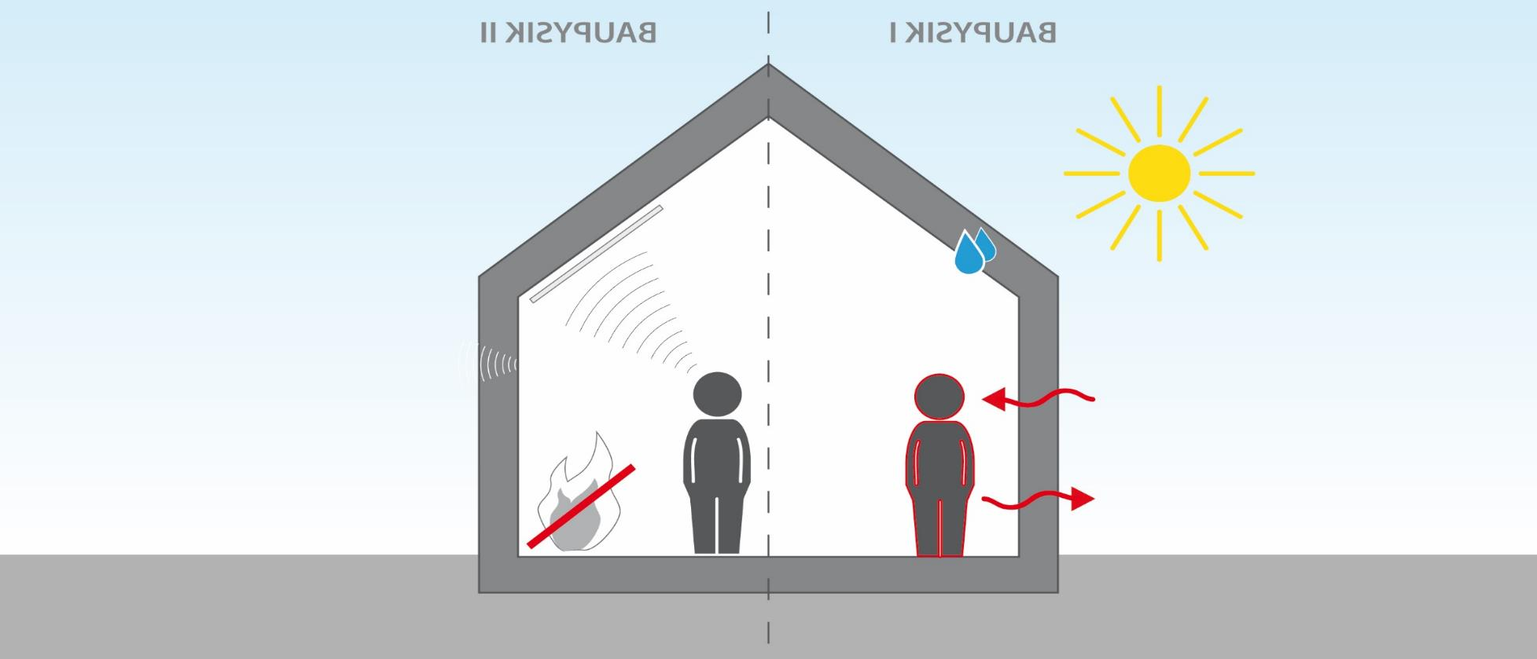
Building Science for Wood Buildings
Different Module
In this Module

Slide 2
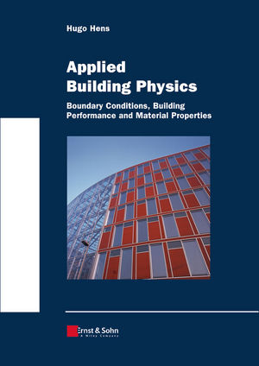
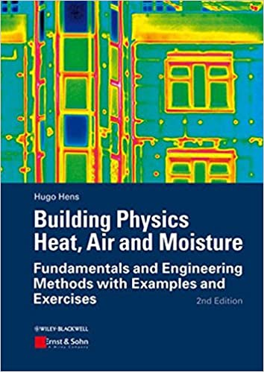

Literature suggestion
Building Physics Heat, Air and Moisture
Fundamentals and Engineering Methods with Examples and Exercises
By: Hugo Hens
Publisher: Ernst & Sohn
ISBN: 978-3-433-60127-3
Applied Building Physics
Boundary conditions, building performance and material properties
By: Hugo Hens
Publisher: Ernst & Sohn
ISBN: 978-3-433-02962-6
Building Physics
From physical principles to international standards
By: Marko Pinteric
Publisher: Springer
ISBN: 978-3-319-57483-7
Not mandatory for the course,
but recommended for further study
Notes:
These books are very well suited to explain the physics.

Slide 3
Building Science for Wood Buildings
Introduction
Thermal Performance
Thermal Bridging
Airtightness Basics and Material
Airtightness Details and Test
Vapour Diffusion and Moisture Management
Developing Durable and High Performing Envelope Assemblies and Details
Case Study: Wood Innovation Research Laboratory
Notes:
Acoustics and Fire Dynamics of Wood Buildings will be explored in a different module (also offered by CWC)
In this Module the main focus is the envelope and the aspects of thermal performance and hydrodynamics.
This also includes the mass and Heat transfer via convection.

Slide 4

Lesson 1: Introduction (45min + 5min Q&A)
Objectives:
Identify the general importance and potential impact of thermodynamics and hydrodynamics on wood buildings
Analyze the behavioral differences of wood buildings compared to other materials
Differentiate the advantages and disadvantages of wood buildings in terms of building science
Explain the principles of highly thermally insulated envelopes, including perception of the thermal insulation qualities
Compare general strategies to increase energy efficiency and reduce the environmental impact.
Canadian
Wood
Council
Conseil
canadien
du bois

Slide 5
Why do we built with Wood?
Less Resources needed
Less Energy Losses
Less Risk
Less Cost
Canadian
Wood
Council
Conseil
canadien
du bois
Notes:
The overall goal is to build better performing buildings to reduce the environmental impact and to offer the most comfortable indoor experience possible.
Wood has some significant advantages in this regard.
Wood is currently the main renewable construction material besides others such as Bamboo and Hemp.
In almost all of the Building Science Sub-Categories Wood is behaving fundamentally different than Steel or Concrete.
Often better, but sometimes worse, so it is worth while to take a closer look.

Slide 6

What are the Pros and Cons of Wood as Construction Material in regards to Building Science?
Cons
Combustible
Can rot
Structurally weak
Light weight
Flexible
Nonhomogeneous
…
Pros
Predictable fire resistance (charring)
Structurally very strong compared to weight
Light weight
Flexible
Low thermal conductivity
Environmentally friendly
…
Canadian
Wood
Council
Conseil
canadien
du bois
Notes:
If we compare wood to other construction materials, such as concrete or steel, we will find several advantages or disadvantages.
Wood is combustible but with smart design and the use of mass timber, very high fire resistance can be achieved. The charring layer slows down the decay and fire resistance is very predictable. It is possible to outperform a steel building. In addition non combustible layers (drywall) can further increase the fire resistance..
Wood can rot, but with proper details and protection against liquid water it is proven that wooden structures can last many centuries. Detailed design, keeping liquid water away and out of the construction and insuring a fast drying out if water penetrates are key.
Directly compared to steel, wood appears to be structurally weaker, but it is much lighter and has a better strength to weight ration than steel or concrete. This means that Wood can theoretically outperform Steel and Concrete.
Less mass can be both, a disadvantage e.g. in acoustics and an advantage in seismic design.
The flexibility is also a disadvantage and advantage at the same time, depending on what exactly my performance requirements are.
Wood is indeed nonhomogeneous as it is a naturally grown material and this calls for large safety measures in calculations.
The thermal conductivity is about 20 times lower than steel reinforced concrete, given wood the edge for reducing thermal bridges.
Wood is a renewable construction material and if sustainably grown and harvested, Wood sequesters carbon and can have a much better eco-balance than steel or concrete. The emphasis should be laid on sustainable grown and harvested, meaning no use of pesticides, clearcutting and slash piles.
This is not a comprehensive list, feel free to discuss more pros and cons.

Slide 7
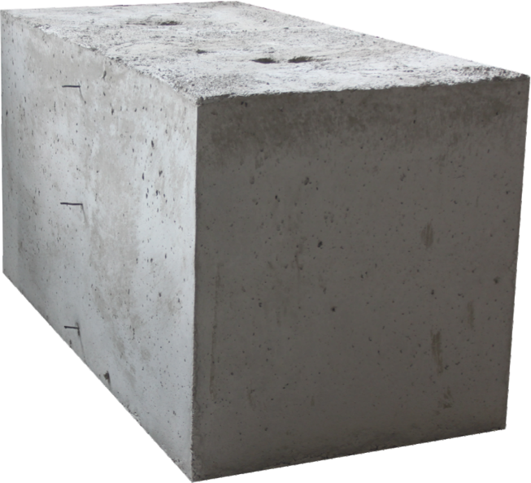
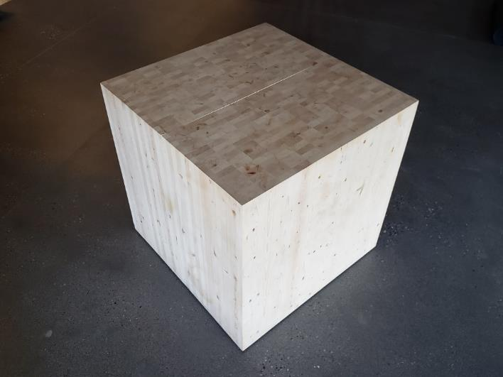
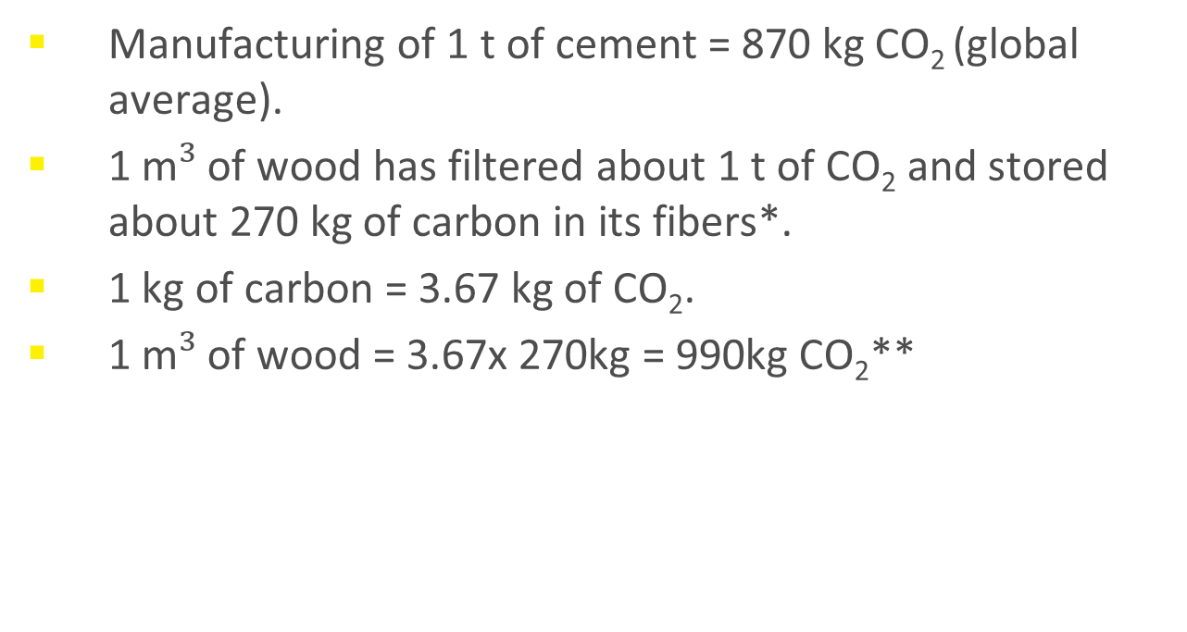
CO₂ Balance of Concrete and Wood in Construction
Manufacturing of 1 t of cement = 870 kg CO₂ (global average).
1 m$³$ of wood has filtered about 1 t of CO₂ and stored about 270 kg of carbon in its fibers*.
1 kg of carbon = 3.67 kg of CO₂.
1 m$³$ of wood = 3.67x 270kg = 990kg CO₂**
Author: Wimmers
Notes:
*at least short term (100 years). Current U.N. guidelines only allow countries to count the carbon stored in wood products created from domestic timber harvests, not the timber grown locally and shipped internationally, nor products produced from imported lumber. These regulations create a gap between the actual amount of carbon stored in the world's wood products and what is officially counted.
**all numbers are average values and might vary depending on species and climate
As mentioned earlier, there is certainly an impact on the environment when roads are driven into the forest, trees are cut, flora and fauna is disturbed in the harvesting process, CO2 is emitted through the engines driving the operation and lumber is hauled out of the forest and further processed. Still, the carbon balance looks very favorable when comparing to other materials.
The chemical composition of wood varies from species to species, but is approximately 50% carbon, 42% oxygen, 6% hydrogen, 1% nitrogen, and 1% other elements (mainly calcium, potassium, sodium, magnesium, iron, and manganese) by weight.
Photosynthesis has filtered about 1 t of carbon dioxide out of the air, released oxygen back into the air and stored about 270 kg or carbon in 1 m3 of Wood. This varies slightly by soft wood species (hard wood stores more carbon) and climate.

Slide 8
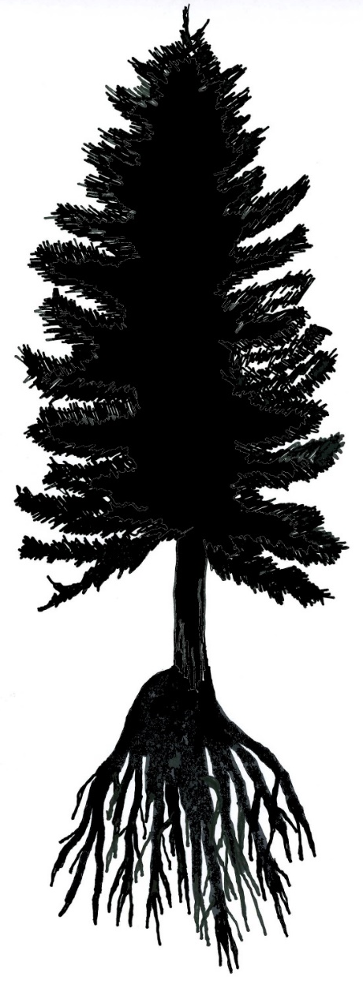
Yield of Forest Industry
CO2 storage through the wood product chain.
U.S. Forest Service. 2008. Forest Resources of the United States, 2007. WO-xxx. Washington, D.C.: U.S. Department of Agriculture, Forest Service. https://www.fs.usda.gov/treesearch/pubs/17334
Notes:
The entire biomass of a tree in the forest before it has been cut is defined here as 100%. Roots and limbs are left in the forest. Often the tree is already cut to 8, 10 or 12 foot pieces, leaving automatically large pieces which are just slightly below the required length in the forest. This leads to a relatively low recovery of only about 60% of the entire tree.
In the following process steps fuel wood (including bark), pulp (mainly including smaller diameter) and primary mill waste (saw dust and small dimensions) are reducing the actually used portion for construction wood down to roughly 15%.
Many engineered wood products are generated from wood fiber which is commonly not used for construction wood in North America.

Slide 9
What is Building Science?
Technical performance of Building
Environmental performance of Buildings
Building Materials
Thermal Performance of Buildings
Convection and Vapour Diffusion
Fire Dynamics
Acoustics
Light
EMF
Canadian
Wood
Council
Conseil
canadien
du bois
Notes:
To understand what the common definition of Building Science is and where it is coming from we have to go back a little further into history.
The modern day term Architect dates back to the mid 16th century, from the French architecte and Italian architetto, originating from the Greek arkhitektn, where arkhi means 'chief' and tektn 'builder'. 'Architects' first began to develop as a distinct discipline in Italy during the renaissance period.
In the 18th century, the term civil engineering was coined to incorporate all things civilian as opposed to military engineering. The first engineering school, The National School of Bridges and Highways, France, was opened in 1747.
A sub-category of civil engineering, architectural engineering was coined in the 20th century. Architectural engineering, in North America also referred to as building engineering, is an engineering discipline that deals with the technological aspects and multi-disciplinary approach to planning, design, construction and operation of buildings, including integrated project delivery, the integration of environmental, mechanical and structural systems, the behavior and properties of materials, building components, construction management and building science.
Building science is the collection of scientific knowledge that focuses on the analysis of the physical phenomena such as heat and mass transfer, sound, light (Electro Magnetic Fields), fire dynamics, affecting buildings. Building science is responsible for the physical functionality of buildings. And the knowledge domain is overlapping with the terms building physics, architectural science and applied physics.

Slide 10
Why is Building Science important?
Functionality of a Building
Performance of a Building
Well Being
Durability
Environmental Impact
Construction Costs
Operational Costs
Satisfaction with the Building
Author: Wimmers
Notes:
Building science is essential to achieve a well performing and functional building. Imagine a building where the users are suffering from too cold or too hot temperature, where they cannot focus because of distracting noise from adjunct rooms or the outside. Those and many more aspects influence the well being in a building and therefore its usability. Hidden problems coming from the inside or outside slowly causes decay and jeopardises the durability of a building. The selection of construction and finishing materials and the energy efficiency can influence the environmental impact of the building significantly. All these decisions also influence the construction and operational costs and lastly the overall satisfaction with the building.

Slide 11
Fields in Building Science
Heat and Mass Transfer
Thermal performance
Airtightness
Vapour diffusion
Acoustics
Building Acoustics
Room Acoustics
Fire Dynamics
Control
Suppression
Materials
Egress
Notes:
Acoustics and Fire are both large and complex topics and have their own module (to be) offered by CWC.
In this module we will mainly focus on the heat and mass transfer.
This includes the thermal conductivity, thermal bridging, airtightness and the vapour diffusion resistance of materials and envelope assemblies,

Slide 12
We use Building Science to
Increase the Energy Efficiency
Increase durability
Reduce the environmental impact
Select best sequence of materials in envelope
Select best performing materials
Increase healthy living
Optimize the long-term structural performance
Optimize economic performance
Author: Wimmers
Notes:
In recent years building codes in Canada begin to request an improved energy efficiency of buildings. This is done to reduce the energy consumption and consequently reduce the impact on the environment.
Building science, in particular the thermal performance, air tightness and vapor diffusion capabilities of materials helps us to assemble well performing and durable building assemblies.
This also helps to increase healthy living, safeguarding the structural components from rot and find an economic balance.

Slide 13

Operational Energy vs Embodied Energy
Traditionally Operational Energy was responsible for 80-90% ¹ of the environmental impact of buildings and Embodied Energy played an insignificant role.
Passive House Standard and similar initiatives radically reduce the Operational Energy Consumption.
Recent study shows reduction to roughly 60% ² of the Operational Energy Share of the total lifetime GWP is possible.
Embodied Energy Consumption gains relative importance, as the Building becomes more energy efficient.
¹ “The energy that buildings use for heating, lighting and cooling is the major component of their environmental impact – approximately 85% of the total life cycle impact for typical office buildings.”
[LEED; Cole & Kernan, 1996; Winistorfer and Chen, 2004; Trusty & Meil, 2000; CORRIM, 2004]
² “The building materials for the Passive House are in total responsible for approximately 38% of the Global Warming Potential.” [A. Wall, G. Wimmers, A comparative LCA of the Wood Innovation Research Laboratory, IPC Munich 2018]
Notes:
Building Science helps us to chose wisely the construction materials to reduce the embodied energy, more importantly building science helps us to develop and design well preforming envelope assemblies to reduce operational energy consumption, which traditionally is by far the largest impact on our environment.

Slide 14
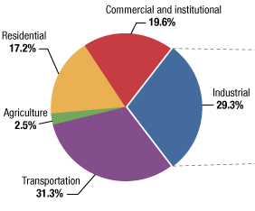
Energy Consumption in Canada
36.8 % of Canada’s energy consumption in 2009 was for heating and cooling of buildings
In 2016 this value sank to about 25%
Average energy density for residential space around 146 kWh/m²
Average energy density for commercial space around 231 kWh/m²
Passive House is limited to 15 kWh/m²
Source: NRCAN Energy Use Data Handbook 2010, National Energy Board, 2017
Notes:
In the big scheme of things, the energy consumption for heating and cooling of the build environment is responsible for 25% of Canada’s energy consumption in 2016.
In 2009 buildings were responsible for 36%. This change is not so much triggered by an increased energy efficiency of buildings, it is triggered by a rapid increase in energy consumption of all other factors such as Industry, Agriculture and Transportation.
The actual energy density of Canada’s residential space still remains relatively constant around 140-150 kWh/m² and is about 50% larger for commercial buildings.
Up-to date buildings such as Passive House are consuming only 15 kWh/m² or less. Some Canadian building codes begin to request a higher energy efficiency, leading the industry eventually towards 15-30kWh/m².
Those energy efficient buildings need far better envelope performance than traditional construction. This is where building science becomes important to insure durable, cost efficient and healthy construction.

Slide 15
5 Steps to Energy Efficient Buildings
compact architecture
right orientation
excellent insulation
no thermal bridges
air tightness
Author: Wimmers
Notes:
Some of these bullets are directly and some are indirectly related to building science.
By optimizing all these aspects we are at the same time reducing the risk of damages, overall costs and increases thermal comfort and well being.

Slide 16
Step 1 for Energy Efficient Construction
Compactness (Architectural Decision)
Responsible use of Resources
Reduction of Energy Losses
Cost Efficient
Canadian
Wood
Council
Conseil
canadien
du bois
Author: Wimmers
Notes:
The biggest Influence on the overall performance of Buildings (energy consumption, operational costs, maintenance cost, durability, environmental impact, etc.) is the compactness.
This is not directly a building science topic but influences building science indirectly tremendously as it influences the total envelope area and the complexity of details in terms of thermal bridging and airtightness.
Compactness is not only describing the architectural design but also defines the initial and operational costs as well as how efficiently materials are being used by the building.
Compactness is not necessarily limiting architectural beauty but might limit specific design ideas.

Slide 17
Compact Design
Influence of an increased perimeter for the same floor area (schematic floor plan)
Compact shape
4 Corners
Increase of wall area 10 %
8 Corners
Insulation ≥ 20mm
Increase of wall area 20 %
12 Corners
Insulation ≥ 40mm
Source: PHI, Graphic & Author: Wimmers
Notes:
Certified European Passive House Designer
Certified European Passive House Designer
The green sketch shows a very compact floor plan of a square. After a circle this is the most compact design possible, offering the most floor area for the smallest envelope area. Additional cost savings and risk reduction is achieved by offering the desired floor space with only 4 corners.
The yellow sketch shows a first deviation by subtracting an area and adding it to the building in a different location. This increases the wall area, and therefore the initial investment for the wall and the ongoing energy losses of the building throughout the wall by about 10%. To balance these additional energy losses about ≥20mm of insulation would have to be added (depending on climate), which again increases the construction costs and changes the building science equations.
The red example demonstrates a further decrease of compactness, increasing the initial and operational costs as well as the risk for envelop failures drastically. Each corner needs more materials, more labour, and ads risk in form of thermal bridges or airtightness failures but does not add more useable floor space. We will dive into what those issues can be and their consequences later on.

Slide 18
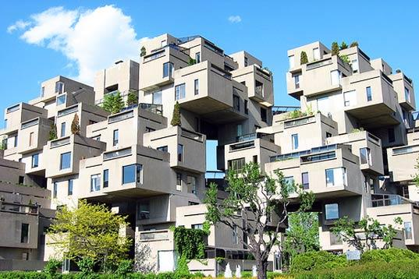
Non-Optimal Shape Factor
Photo: Habitat 67, Montreal
Notes:
Habitat 67 in Montreal is a milestone in architectural history but also a very extreme example of a lack of compactness.

Slide 19
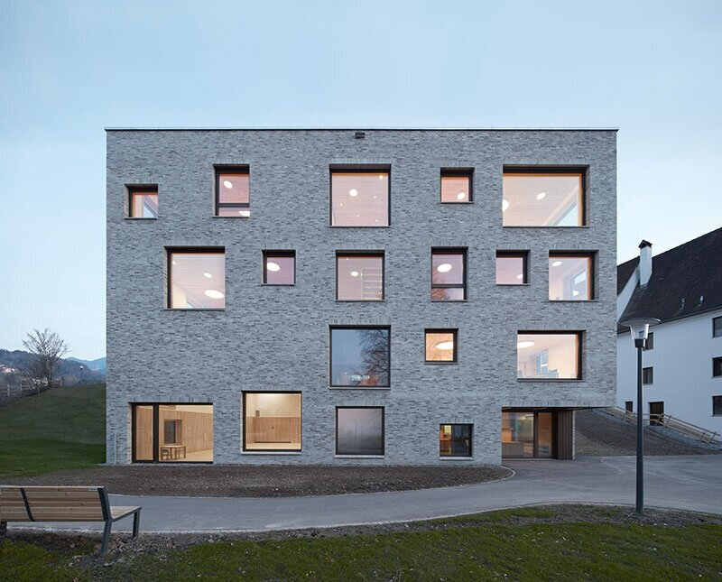
Optimal Shape Factor
Photo: Jochen Specht
Notes:
This Kindergarten and Elementary School in Sulz, Austria is an extreme example for very compact architecture and optimization of materials used. We do not necessarily need to build everything new as a cube but we certainly need to keep compactness in mind.

Slide 20
A/V-ratio (thermal envelope area/heated volume)
Favourable compactness ratio
A / V ≤ 0,7 m²/m³
1,2
A/V
1,0
1,1
0,9
0,8
0,7
be careful with natural daylight
0,6
0,5
1,0
0,9
0,4
0,8
0,7
0,3
0,6
0,5
0,4
minimise surface area/volume!
A/V
0,3
perimeter block development
0,2
perimeter block development
Grafik: PHD, Author: PHI
Notes:
Compactness can be measured. Commonly used is the A/V ration which is the entire envelope area A including all 6 sides of the building divided by the volume of the building.
Smaller building such as single family homes can achieve values between 0.8 and 1.0, but if no attention to compactness is given, values of 1.2 or 1.3 are possible too.
Duplexes and row houses can achieve values around 0.6-0.7 and midrise buildings can go as low as 0.4.
Besides the direct consequences on costs, compactness can be seen as risk factor, because dormers, setbacks, and bulk outs are typically increasing the risk for water damage and thermal bridges.

Slide 21
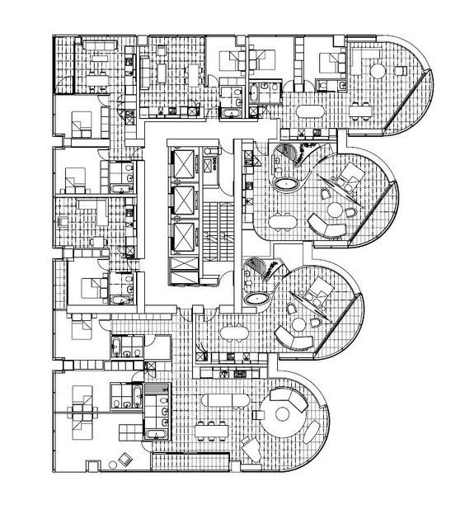
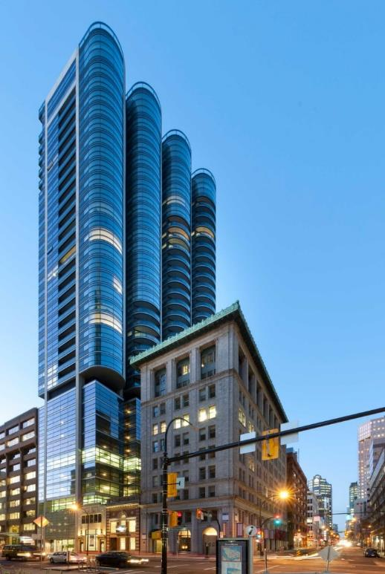
Example
100% wall area
838 W Hastings St. Vancouver, Author: Wim
Author: Wimmers
Notes:
As a further example we look in detail at the envelope of this building.
The given design is assumed as 100% wall area.

Slide 22
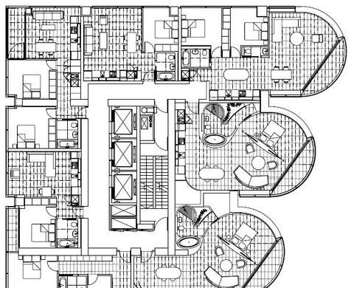
56 Corners
56 corners in total
Canadian
Wood
Council
Conseil
canadien
du bois
Author: Wimmers
Notes:
If we examine the floorplan further we can find a total of 56 corners.

Slide 23
4 Corners
In Total 4 corners possible
28% less wall area
Canadian
Wood
Council
Conseil
canadien
du bois
Author: Wimmers
Notes:
The same floor space can be offered with 4 corners and a by 28% reduced envelope area.
This triggers massive savings in initial investment and ongoing operational costs.
The purpose of this exercise is not necessarily to discredit the unique architectural design, but to rather sensitise the design community for the importance and potential of further optimizing the design towards compactness.
Besides the significantly lower costs, the compact floorplan would present far less building science related challenges and would increase durability and reduce maintenance.

Slide 24
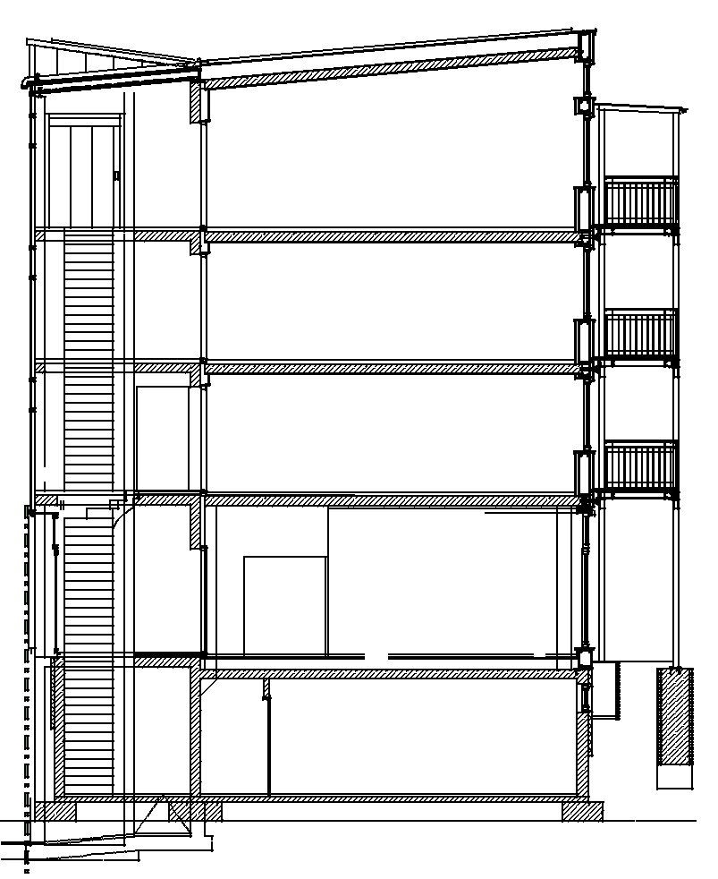
Exercise
Similar approach can be applied for every section of a building
Analyze the surface area of this building
Define the boundary layer
Canadian
Wood
Council
Conseil
canadien
du bois
Notes:
Please chose a floorplan or section of a building of your choice, analyse the envelope and surface of the building and define the boundary layer.
Lay out specific problems such as balconies or other thermal bridges, define heated and potentially unheated spaces, decide if basement is heated or unheated and think about the resulting details.

Slide 25
Step 2 for Energy Efficient Construction
Orientation (Architectural Decision)
Energy Efficiency strongly influenced by Orientation
Hydrodynamics in Envelope may vary strongly by Orientation
Canadian
Wood
Council
Conseil
canadien
du bois
Author: Wimmers
Notes:
Orientation is also a rather architectural decision but it can influence the building science related performance. Facades exposed to the winter sun might develop surprisingly high surface temperatures. Also, depending on the cladding material, it can influence the drying potential of a wall and in extreme cases even reverse the vapour diffusion pressure of a wall. Consequently a north oriented wall might behave significantly different from a south oriented wall.

Slide 26
Step 3 for Energy Efficient Construction
Excellent Insulation (Building Science)
Reduce the Environmental Impact of the Building
Reduction of heat losses from the building envelope
Optimize thermal bridges
Prevention of condensation and mould/rot on the inside
Safeguarding the performance of the insulation layer
Insure Thermal Comfort
Improving the sound insulation of building components
Improving the fire resistance of the buildings
Canadian
Wood
Council
Conseil
canadien
du bois
Author: Wimmers
Notes:
The thermal insulation of a building has several different impacts on the overall performance of a building. All of these topics except for the last two will be further explained throughout the course.
Thick layers of thermal insulation can have a very positive impact on sound insulation as well. This is particularly true for mineral and glass fibers, as well as cellulose and wood fiber insulation products. All insulation foam products (EPS, XPS, PU, Spay Foam) have only a very minimal or no positive influence on sound insulation.
Thick layers of thermal insulation can also have a very positive influence on the fire resistance of a building. Mineral fiber can increase the resistance drastically but even cellulose and wood fiber can have a positive impact on the behavior of a building when it is on fire. Fiber glass and insulation foam products generally do not have a positive influence on the fire resistance.

Slide 27
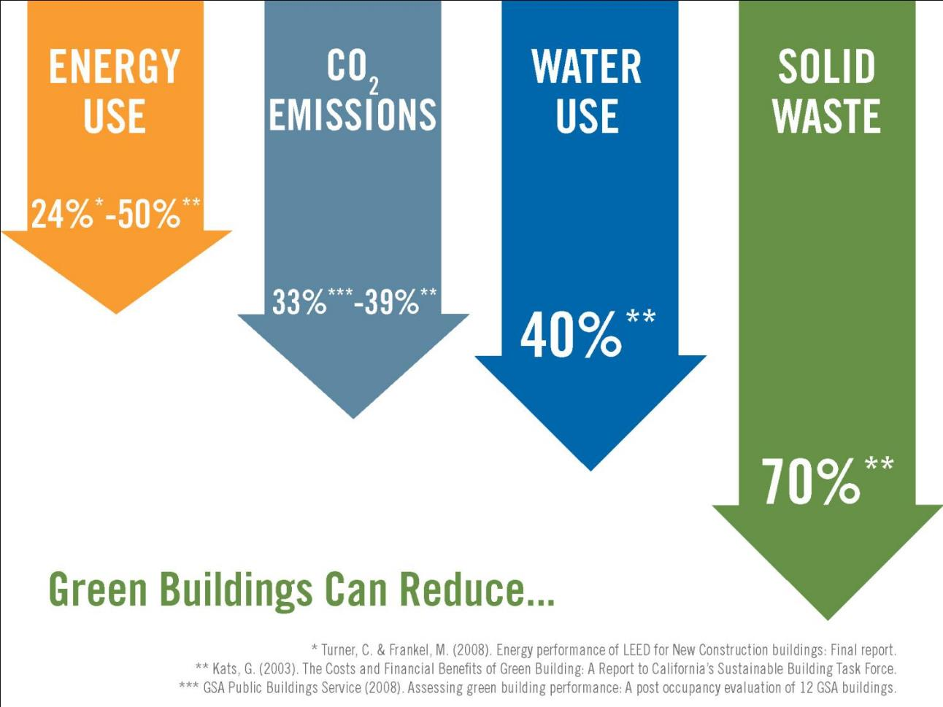
Past, Present and Future
ENERGY
USE
70% - 90%
CO2 EMISSIONS
50% - 70%
Notes:
For some time the construction industry was told that a mediocre reduction of energy consumption of 20-50% is a big achievement and more is, because of economical reasons, not possible.
Although we know since the Saskatchewan Conservation House in 1978 that much more radical energy savings are possible. Since the creation of the Passive House Standard in 1990 we also know that it is more economic to reduce your energy consumption if you look at the monthly costs of ownership.
Currently we are living in a transition time where codes and regulations in Canada start to tackle energy efficiency.

Slide 28
Energy Efficient = Thicker Walls
1 ½ ”
3 ½ ”
5 ½ ”
16” – 24”
16” – 24”
Energy efficient does not equal sustainable but without energy efficiency no sustainability!
Graphic & Author: Wimmers
Notes:
Consequently will the thickness of envelopes most likely be increased, assuming rather traditional materials will be used. This is something we have seen in various other nations over the last few decades that have codes requiring higher energy efficiency levels.
For example, a stud wall will increase in thickness to fulfil thermal requirements, or a 2x6 will need an additional layer of continuous insulation. Many options are possible, but something all have in common is that more materials will be needed. This leads to bulkier and heavier construction which most likely will trigger a transition towards prefabrication.

Slide 29
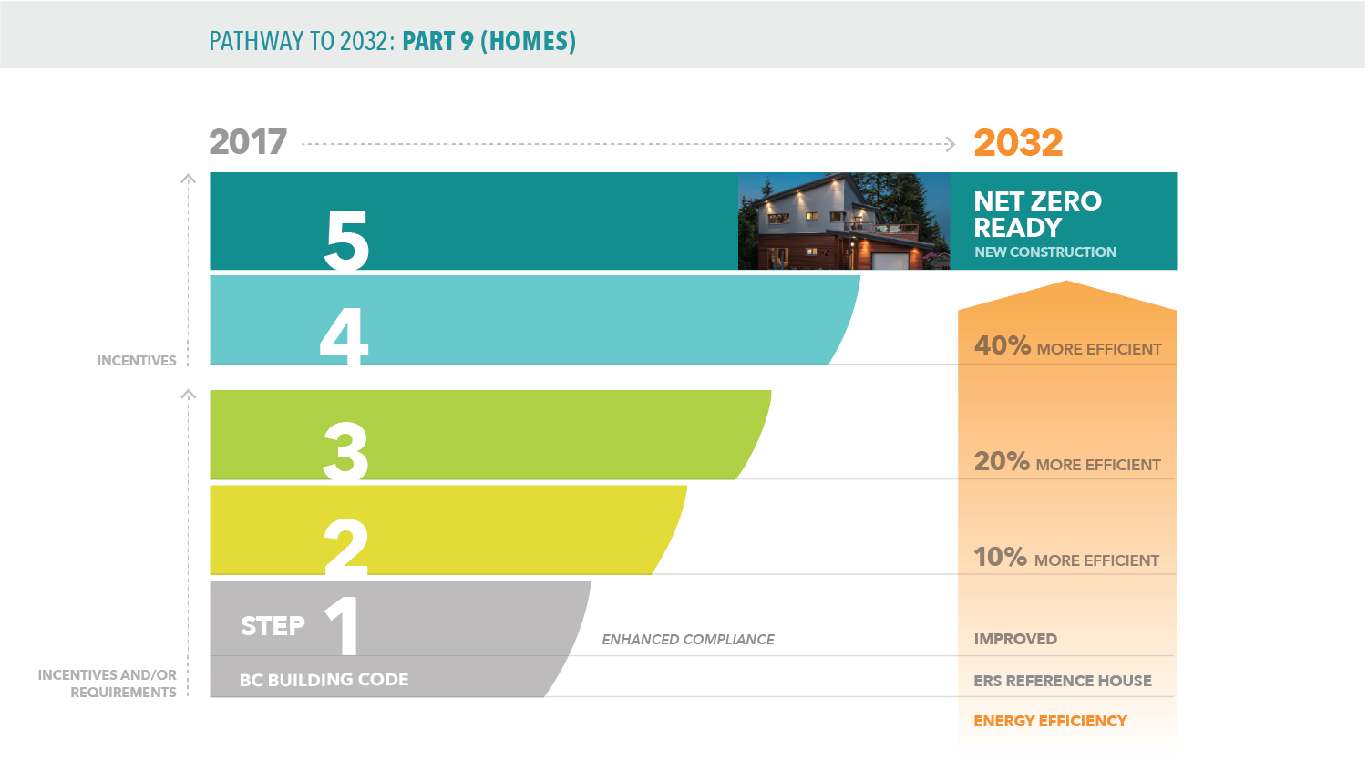

BC Energy Step Code 2017 and new NBC
Author:
Notes:
The National Energy Code of Canada for Buildings 2020 (NECB) will also include a tiered system with some resemblance to the BC Step Code as it was introduced in 2017.
The BC Step Code defines 5 steps (4 for commercial buildings) and also defines the exact methods to calculate the respective performance of each step. The highest step is called net-zero-ready because it is assumed that the energy efficiency of the building is developed far enough that investment into energy generation would make financial sense from this performance level on. Net –zero-ready does not mean net-zero, as a large investment in energy generating technology is not included. Net-zero ready comes closer to Passive House Standards but is not the same.

Slide 30
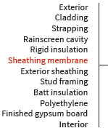
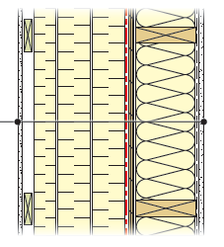
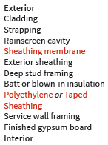
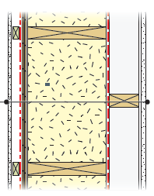
What does this change?
Envelope will get 42 – 77% heavier and will have 87 – 100% more volume! (all numbers are based on the 2017 BCESC)
Source: MOC 2019 Conference Paper: Consequences of the BC Energy Step Code on Offsite Construction
Notes:
As mentioned earlier, the highest performance step current or future codes will ask for, will demand thicker, bulkier and heavier envelope construction. This depends on the size and use of the building, as well as the climate zone, orientation and a few other minor factors.
The following lessons will get into the details on what the consequences for assembly and material selection are to fulfil the thermal performance, vapour diffusion and air tightness requirements.

Slide 31
Step 4 for Energy Efficient Construction
Airtightness (Building Science)
Reduce Energy Losses
Prevention of Condensation (Rot & Mold)
Assuring Healthy Living
Safeguarding the Performance of Insulation Layers
Prevention of Draft
Prevention of Cold Floors
Preventing Contamination of the Indoor Air
Insuring Effectiveness of the Ventilation System
Insuring Effectiveness Sound Insulation
Canadian
Wood
Council
Conseil
canadien
du bois
Author: Wimmers
Notes:
The airtightness of a building has several different impacts on the overall performance of a building. Energy efficiency and preventing rot and mold and thereby assuring healthy living are certainly the most important ones. Protecting the insulation from being washed by exterior air and therefore reduced in performance and the prevention of draft and cold floors is a combination of wind tightness and airtightness. If the envelope is not airtight, ventilation systems are limited in their efficiency to manage the air quality. Proper airtightness has also a positive impact on the sound insulation from the outside to the inside of a building and vice versa.

Slide 32
Step 5 for Energy Efficient Construction
Humidity Management (Building Science)
Increase Durability of Envelope
Prevention of Condensation (Rot & Mold)
Safeguarding the Performance of Insulation Layers
Insure Healthy Living Conditions
Safeguarding the Structural Performance
Canadian
Wood
Council
Conseil
canadien
du bois
Author: Wimmers
Notes:
Strongly related to airtightness is the general topic of humidity management and specifically vapour diffusion. Besides managing rainwater from above, the main purpose of an envelope is to properly control the vapour diffusion and to always allow moisture to dry out if it ever occurs inside of the envelope assembly. This is crucial to increase the durability, prevent humidity related damages and ensure healthy living as well as safeguarding the structural performance of the building in question.

Slide 33
Benefit of Energy Efficient Construction
Thermal Comfort (Building Science)
Optimize Well Being
Insure Healthy Living Conditions
Reduce Energy Consumption
Canadian
Wood
Council
Conseil
canadien
du bois
Notes:
If all the bullets on the former slides are successfully dealt with, we achieve on more important performance measure, the thermal comfort. Thermal comfort describes the well being of the majority of people using the building.

Slide 34


Thermal Comfort
Thermal comfort is defined in ASHRAE 55 or ISO 7730 or EN 15251 as:
The condition of mind which expresses satisfaction with the thermal environment.
Thermal comfort is defined by numerous parameters set by the majority, attempting to convert the condition of mind into physical parameters.
Value Sensation
+3 Hot
+2 Warm
+1 Slightly Warm
0 Neutral
-1 Slightly Cold
-2 Cool
-3 Cold
Source: ASHRAE, ISO, Author: Wimmers
Notes:
As specified in several codes and standards, thermal comfort is defined by numerous parameters and is aiming to quantify the well being of the majority of people, not necessarily the individual, and is the attempt to convert the condition of mind into physical parameters.
ASHRAE 55 and ISO 7730 are defining a derivation from the perfect temperature in one degree Celsius steps from neutral to hot or respectively cold.
If a person experiences thermal comfort the person would neither like to be warmer or colder. The heat loss of the person can not be too asymmetrical.

Slide 35
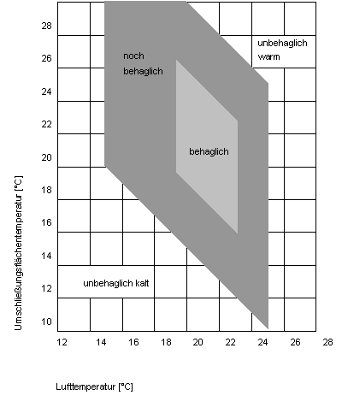
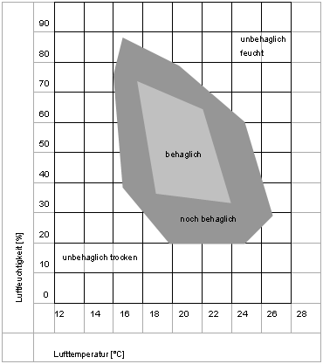
Interior Comfort
uncomfortable warm
uncomfortable humid
satisfactory
comfort
comfortable
Surrounding Surface Temperature [C°]
comfortable
Relative Humidity [%]
satisfactory
comfort
uncomfortable cold
uncomfortable dry
Air Temperature [C°]
Air Temperature [C°]
Source: O. Fanger, Graphic: Wimmers
Notes:
The first graphic defines the ration of surrounding surface temperature and the air temperature of a given room. The actual comfort depends on several more parameter such as the level of activity of a person.
The second graph explains the ratio or air temperature to relative humidity, another important influence on thermal comfort.

Slide 36
Health Benefits depending on Humidity
Ideal Zone
Bacteria
Viruses
Fungi/Mold
Dust Mites
Respiratory Infections
Allergic Rhinitis, Asthma
Ozone Production
0%
10%
20%
30%
40%
50%
60%
70%
80%
90%
100%
Relative Humidity
Source: Building Knowledge, Graphic: Wimmers
Notes:
The ideal interior humidity depends on several factors, such as airtightness, the absence of thermal bridges, heat recovery ventilation, the use of the room/building etc…
This graph shows a simplification of some risk factors in correlation of humidity.
The most common recommendation is to keep the interior humidity around 50%. If proper ventilation is installed (including commissioning), slightly lower humidity of 40% is usually good too (no recirculation and appropriate ventilation rate).

Slide 37
Lesson 2: Thermal Performance (45min + 5min Q&A)
Objectives:
Summarize the basics of thermodynamics
Identify all relevant units (thermal conductivity, thermal transmittance, thermal resistance)
Classify and ranking thermal conductivity of materials
Calculate thermal conductivity of materials.
Investigate heat transfer through building envelopes and calculation of heat flow values through simple assemblies (including effects of surface air layers).
Differentiate thermally high performing envelope assemblies from low performing assemblies.
Canadian
Wood
Council
Conseil
canadien
du bois

Slide 38
Basics of Thermodynamics in Construction
Units for Temperature
3 Laws of Thermodynamics
Heat Transfer
Thermal Energy and Heat Flow
Thermal Conductivity λ
R value and U value
Canadian
Wood
Council
Conseil
canadien
du bois
Author: Wimmers

Slide 39

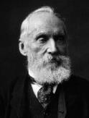
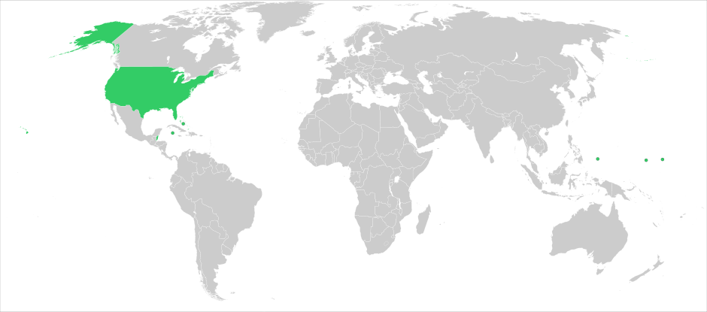
Units for Temperature
Degree Celsius (˚C) by Anders Celsius (1701 – 1744)
0 ˚C triple point of water, 100 ˚C boiling point of water
Kelvin (K) by Lord Kelvin (1824 – 1907)
0 K is absolute Zero, 273.15 K is the triple point of water
Climate in Prince George, BC ~ 243 – 303 K
USA uses Fahrenheit (˚F) by Daniel Gabriel Fahrenheit (1686 – 1736)
ratio to Celsius: ˚F = 32 + 9/5˚C
0 ˚F was the lowest temperature in Danzig in the winter 1708/09
32 ˚F triple point of water, boiling point of water 212 ˚F
Author: Wimmers
Notes:
Celsius was created by the Swede Anders Celsius around 1740 and defines the triple point of water (liquid, solid, gas) at 0˚C and the boiling point of water at 100˚C.
Lord Kelvin (UK) followed about 120 years later with the unit Kelvin, utilizing Celsius as the dimension for each incremental step but defining 0K as the Absolut lowest temperature physically possible. This would be equivalent to -273˚C. The advantage of Kelvin in building science is that the number is always positive.
Daniel Gabriel Fahrenheit, a merchant, was the first who created a temperature scale, in Danzig (today’s Poland). He defined the lowest temperature he could measure in the winter of 1708 in Danzig as 0˚F and aimed at the body temperature of a human being at 100˚F. This unit is not of scientific relevance and only used in the USA and a few small island states.

Slide 40
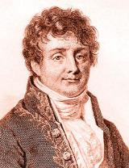
3 Laws of thermodynamics
1st law states that energy cannot be created or destroyed in an isolated system
2nd law states that the entropy of any isolated system not in equilibrium will tend to increase over time, approaching a maximum value at equilibrium
3rd law states that the entropy of a system approaches a constant value as the temperature approaches absolute zero
Entropy = thermodynamic property that is the measure of a systems thermal energy per unit of temperature that is unavailable for doing useful work
Author: Wimmers
Notes:
The first and second is also called Fourier’s first and second law as they were defined by Jean-Baptiste Joseph Fourier 1768 – 1830, France.
1st law of thermodynamics is a version of the law of conservation of energy, adapted for thermodynamic systems. In general, the law of conservation of energy states that the total energy of an isolated system is constant; energy can be transformed from one form to another, but can be neither created nor destroyed
2nd of thermodynamics indicates the irreversibility of natural processes, and, in many cases, the tendency of natural processes to lead towards spatial homogeneity of matter and energy, and especially of temperature.
3rd law of thermodynamics states that a system's entropy approaches a constant value as its temperature approaches absolute zero
Entropy = thermodynamic property that is the measure of a systems thermal energy per unit of temperature that is unavailable for doing useful work
There is also a 0th law of thermodynamics which says that no heat is transferred between two objects in thermal equilibrium; therefore, they are the same temperature.

Slide 41
3 ways of heat transfer
Conduction
Heat transfer through solids or stationary fluids
Convection
Heat transfer through motion of fluids
Radiation
Heat transfer through electromagnetic radiation
Author: Wimmers
Notes:
Generally, all three ways of heat transfer occur in buildings, but one of them has a minor influence.
Conduction
- Conduction always occurs from points at higher, to points at lower temperature.
- Conduction needs a medium and doesn’t include macroscopic movement.
Conduction occurs when energy in form of heat is traveling through the envelope of a buildings. The heat transfers through solid matter of construction and insulation material.
Convection
- Convection is macroscopic movement of molecules at a different temperature.
- Convection needs a medium, in gases and liquids convection is always also including conduction.
Convection occurs when energy in form of warm air is traveling through the envelope from the inside to the outside (in heating dominated climate zones) of a building (main chapter airtightness) but can also occur if air starts to circulate in enclosed pockets. This might be the small volume of a EPS bubble or the uninsulated cavity in an envelope assembly.
Radiation
- Heat transfer caused by emission and absorption of electromagnetic waves.
- Above 0 K every surface emits electromagnetic waves
- Radiation needs no medium, transfers best in vacuum
Radiation occurs when energy in form of heat transfers through radiation. This does also happen in construction but is in comparison to the other two ways of transfer negligible.

Slide 42
Units for Heat Transfer
Thermal Energy or Heat Transfer (Q)
1 J = 1W/s = 0.0003 Wh = 9.4787 x 10⁻⁴Btu
Heat Flow Rate (q)
1j/s = 1W = 3.4123 Btu/h
1 kWh = 3600 J = 3412 BTU
Heat Flux
1W/m² = 0.3171 Btu/h x ft²
1 J = energy to heat 1 g of water by 0.24⁰ Celsius (calorie is 1 g of water by 1⁰ Celsius)
1 Btu = energy to heat 1 pound of water by 1⁰ Fahrenheit
Author: Wimmers
Notes:
Heat transfer is the exchange of thermal energy between physical systems. Thermal energy is related to the temperature of matter. The higher the temperature, the greater the thermal energy (constant material and mass). Energy flow (heat flow) always occurs from hot to cold.
- Thermal Energy Transfer Q is expressed in Joule, which is one Watt per second
- The Heat Flow q has no relation to time and measured in Watt
- The Heat Flux is the Heat Flow per Area, measured in W per square meter

Slide 43


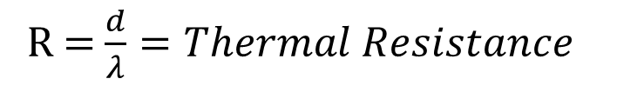
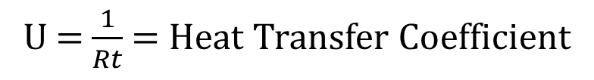
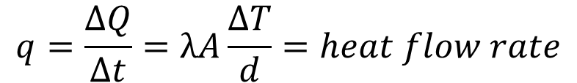

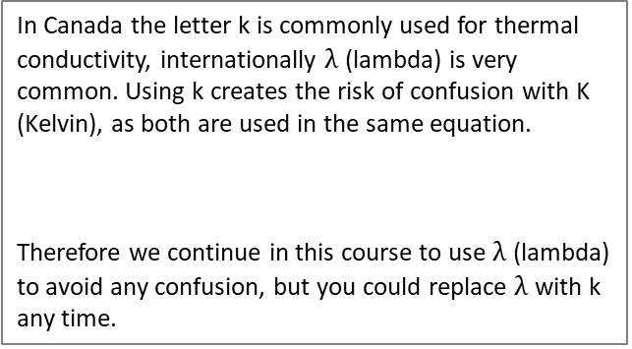

Heat Flow Rate q, R and U
$$q=\frac{∆Q}{∆t}=λA\frac{∆T}{d}=heat flow rate$$
Q = heat transfer
In Canada the letter k is commonly used for thermal conductivity, internationally $λ$(lambda) is very common. Using k creates the risk of confusion with K (Kelvin), as both are used in the same equation.
Therefore we continue in this course to use $λ$(lambda) to avoid any confusion, but you could replace $λ$ with k any time.
$$λ or k=thermal conductivity$$
A = area
$$k(or λ)=\frac{1W x 1m}{1m^{2} x K}$$
d = thickness (dimension)
Author: Wimmers
Notes:
In construction we use a version of the heat flow equation, including the thermal conductivity of the material in question λ, the area (usually 1m²) and multiply this by the temperature difference divided by the thickness of the material layer. Derived from this we can calculate the Thermal Resistance R value and the reciprocal, the Heat Transfer Coefficient U value.
The total R value is the surface resistance on the inside and on the outside of the envelop plus the thickness of the materials in question divided by their thermal conductivity λ.
There is no right or wrong way regarding the question whether to use k or $λ$. But there is the risk to confuse k with K in the same equation, therefor it is internationally common to use $λ. M$ainly the US with their imperial system use K to express the same thing.
In Canada the letter k is commonly used for thermal conductivity, internationally $λ$(lambda) is very common. Using k creates the risk of confusion with K (Kelvin), as both are used in the same equation.
Therefore we continue in this course to use $λ$(lambda) to avoid any confusion, but you could replace $λ$ with k any time.

Slide 44
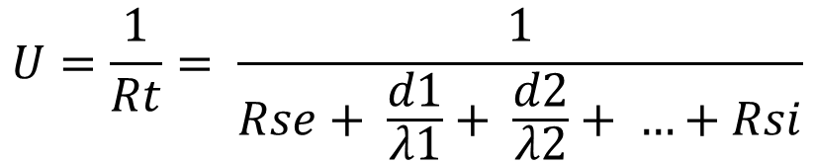
Heat Transfer Coefficient
U = Heat Transfer Coefficient [W/(m²K)]
R = Thermal Resistance [(m²K)/W]
Rt = Thermal Resistance Total
Rse = Resistance Surface Exterior (exterior air film)
Rsi = Resistance Surface Interior (interior air film)
d = thickness (dimension) of material [m]
λ = thermal conductivity [W/mK]
K = Kelvin, 0K = -273°C, 273K = 0°C
If you are only interested in the R value, you just use the denominator of this equation.
Using R or U is both correct as they both describe the same effect, just from the opposite point of view (resistance & conductivity).
Using U has a slight advantage, which will be explained in the following slides.
In Canada the total R value is commonly referred to as RSI (R Standard International) to emphasize that this is the metric R value. This triggers confusion with Rsi, the Interior Surface Resistance, called in Canada interior air film.
Author: Wimmers
Notes:
The heat transfer coefficient is the inverse of the resistance and is usually given in W/mK. This describes the Energy in Watt being transfer through a given material with the thickness of one meter and a temperature difference from the warm to the cold side of one Kelvin.
If you are only interested in the R value, you just use the denominator of this equation.
Using R or U is both correct as they both describe the same effect, just from the opposite point of view (resistance & conductivity).
Using U has a slight advantage, which will be explained in the following slides.
In Canada the total R value is commonly referred to as RSI (R Standard International) to emphasize that this is the metric R value. This triggers confusion with Rsi, the Interior Surface Resistance, called in Canada interior air film.

Slide 45
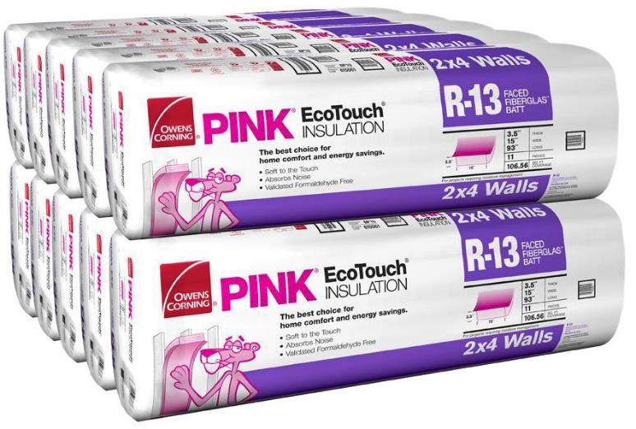
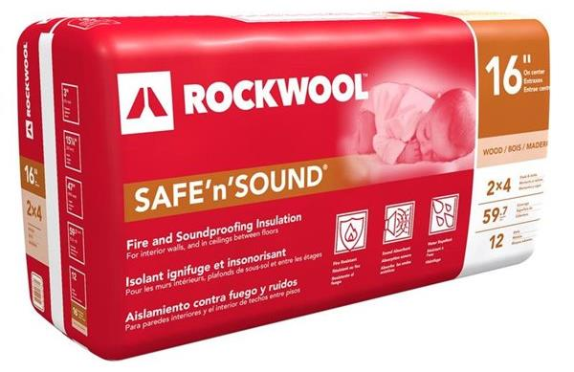
Practical differences between U and R
Which R value is shown?
Notes:
When searching for the thermal performance of insulation materials in any DIY shop or when talking to contractors, the R value commonly named is the imperial R value (factor 5.678), usually without the influence of studs or other penetrations (nominal R). This leads frequently to confusion and requires clarification if imperial or metric is talked about. The U value is much less used in the US, therefore it is much more common that if the U value is discussed, people are talking about the actual metric thermal conductivity.
When the R value is given in R per in, for correct calculation we can either recalculate what the λ value is and some manufactures give that information on their homepages. This is an important step because of two reasons. First, not every material has a linear increase of the thermal resistance with an increase of thickness. And secondly, the thought that each added inch adds the same resistance and therefore has the same value is in fact misleading.

Slide 46
Thermal Resistance R imperial
Graphic & Author: Wimmers
Notes:
The problem with R per inch
It is suggested that because every inch adds the same amount of resistance that each inch has a similar value to the performance of the envelope.
This encourages the practice of trading off:
You might be tempted to reduce the thickness of insulation in a wall, because it is more expensive and takes potentially more floor space away (if the local zoning still does not encourage energy efficient buildings) and add more insulation to the roof because it is so easy and cost efficient.
But the conductivity U (the inverse of R) shows something different.

Slide 47
Heat Transfer Coefficient U metric
Graphic & Author: Wimmers
Notes:
When looking at the conductivity it becomes obvious that not every cm of added insulation has the same impact/value. The energy flow through the envelope is drastically reduced by the first few cm, the thicker the insulation becomes, the smaller the impact of each added cm. There is an economical and ecological sweet spot for how much insulation makes truly sense. In Canadian climate zones this value, depending on the building, insulation material, usage, climate etc., is typically between 30 and 40 cm of insulation.

Slide 48
U & RSI
Graphic & Author: Wimmers
Notes:
This graph clearly shows the difference of the two approaches.
When talking about thermal resistance, each added cm adds linear to the resistance. One could think that the first cm is as valuable as the 30th
When looking at the U value (Heat Transfer coefficient) the logarithmic scales becomes obvious. The first cm has far more impact on the energy flow than the 30th
This visualizes that there is a limit to the useful amount of insulation.
And it also shows very clearly that trade offs do not work (adding a few more cm somewhere to balance a poor performing detail or area)!!!
Canada is officially using R values for opaque envelope components, and U values for windows. There is no right or wrong with either of the two methods.
The only difference is that U values make the actual impact much more obvious, as explained above. And there is usually no tumbling up with the R value of the US imperial system!

Slide 49
Economic and Ecological Balance
Economical sweet spot for the amount of insulation installed
ratio of additional initial investment compared to operational costs = “Monthly Costs of Ownership”
Ecological sweet spot for the amount of insulation installed.
Both are depending on several variables such as: location, climate,, insulation material, availability of materials and shipping, type of heating fuel…
10 - 30 % roof
30 - 60 % windows
Energy losses
20 - 40 % walls
10 - 20 % floor/basement
Graphic & Author: Wimmers
Notes:
The economical sweet spot can be calculated by looking at the life expectancy of the material application, the energy saved over this time frame, the costs for the energy and the installation costs. All together it will lead to the costs of a saved kWh. If these cost are lower than the actual energy price (including maintenance of the system), it is worth it. If these cost are equal, this equilibrium is called economic balance.
Same type of equation can be done for the ecological balance.

Slide 50
 | metric |  | imperial
 | U-value | RSI | U-value | R-value
 | [W/m²K] | [m²K/W] | [BTU/ft²Fh] | [ft²Fh/BTU]
 | U=1/R |  | U=1/R
 | 0.08 | 12.50 | 0.014 | 70.98
 | 0.09 | 11.11 | 0.016 | 63.09
 | 0.10 | 10.00 | 0.018 | 56.78
 | 0.11 | 9.09 | 0.019 | 51.62
 | 0.12 | 8.33 | 0.021 | 47.32
 | 0.13 | 7.69 | 0.023 | 43.68
 | 0.14 | 7.14 | 0.025 | 40.56
 | 0.15 | 6.67 | 0.026 | 37.86
 | 0.20 | 5.00 | 0.035 | 28.39
 | 0.25 | 4.00 | 0.044 | 22.71
 | 0.30 | 3.33 | 0.053 | 18.93
 | 0.35 | 2.86 | 0.062 | 16.22
 | 0.40 | 2.50 | 0.070 | 14.20
 | 0.45 | 2.22 | 0.079 | 12.62
 | 0.50 | 2.00 | 0.088 | 11.36
 | 0.55 | 1.82 | 0.097 | 10.32
 | 0.60 | 1.67 | 0.106 | 9.46
 | 0.65 | 1.54 | 0.114 | 8.74
 | 0.70 | 1.43 | 0.123 | 8.11
 | 0.75 | 1.33 | 0.132 | 7.57
 | 0.80 | 1.25 | 0.141 | 7.10
 | 0.85 | 1.18 | 0.15 | 6.68
 | 0.90 | 1.11 | 0.16 | 6.31
 | 0.95 | 1.05 | 0.17 | 5.98
 | 1.00 | 1.00 | 0.18 | 5.68
 | 1.10 | 0.91 | 0.19 | 5.16
 | 1.20 | 0.83 | 0.21 | 4.73
 | 1.30 | 0.77 | 0.23 | 4.37
 | 1.40 | 0.71 | 0.25 | 4.06
 | 1.50 | 0.67 | 0.26 | 3.79
 | 1.60 | 0.63 | 0.28 | 3.55
 | 1.70 | 0.59 | 0.30 | 3.34
 | 1.80 | 0.56 | 0.32 | 3.15
 | 1.90 | 0.53 | 0.33 | 2.99
 | 2.00 | 0.50 | 0.35 | 2.84
 | 2.10 | 0.48 | 0.37 | 2.70
 | 2.20 | 0.45 | 0.39 | 2.58
 | 2.30 | 0.43 | 0.41 | 2.47
 | 2.40 | 0.42 | 0.42 | 2.37
 | 2.50 | 0.40 | 0.44 | 2.27
Conversion
Conversion Factor between RSI and R imp = 5.678
Opake Envelope
Windows
Author: Wimmers
Notes:
The R is the invers of U and the conversion factor between metric and imperial is 5.678.
The yellow area between U 0.1 and 0.15 is recommended for energy efficient walls, even lower values are occasionally used for roofs.
U values between 0.65 and 0.80 are recommended for windows.
Those are very rough recommendations to achieve Passive House standard or similar efficiency, depending on the climate, size, compactness of the building and many other influences.

Slide 51
Thermal conductivity: λ-value [W/mK] (or k-value)
0,0045 - 0,005 VIP
0,02 - 0,035 Polyurethan
0,03 - 0,035 extruded Polystyrene (XPS)
0,034 - 0,037 Sheep Wool
0,034 - 0,042 Glass und Mineral Wool
0,035 - 0,044 expanded Polystyrene (EPS)
0,038 - 0,044 Flax; 0,04 Cotton
0,04 - 0,045 Cork
0,043 - 0,045 Straw (processed)
0,044 - 0,48 Cellulose; Wood Fibre Boards
0,065 - 0,070 clay agregate
0,064 - 0,01 Straw; 0,073 - 0,13 wooden boards (MDF – plywood)
The lower the λ- value, the less the conductivity.
Graphic & Author: Wimmers
Notes:
Lambda Value is expressed in Watt per meter Kelvin.
The thermal conductivity describes how much Energy flows through a one meter thick layer of material with a temperature difference of one Kelvin from one side to the other.
On the lowest end of the scale Vacuum Insulated Panels can be found with a conductivity almost 10 times lower than EPS. Polyurethane, depending on if an aluminum coating is present or if it is just the foam, has values around 0.0 to 0.035 W/mK. Following is the large group of conventional thermal insulation materials which all have a conductivity around 0.04 W/mK. CLT, glulam, dimensional lumber or plywood and OSB are all around 0.13 W/mK.

Slide 52
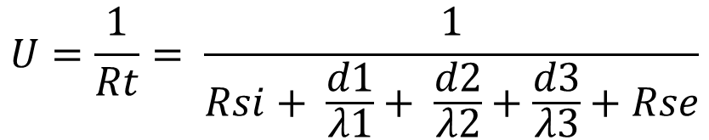
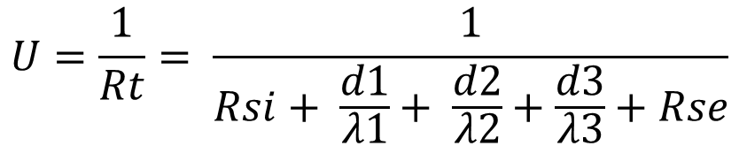
U-value calculation (ISO 6946)
d₁ d₂ d₃
R_{si}
Concrete
Insulation
Plaster
R_{se}
Source: PHI, Author: Wimmers
Notes:
Certified European Passive House Designer
Certified European Passive House Designer
The overall heat transfer coefficient (U-value) is calculated in accordance with the standard DIN EN ISO 6964.
If you prefer to stay in R values, you just look at the denominator.
Each layer of a building component has a thermal resistance value, which is determined by the thickness and thermal conductivity of the material. The overall thermal resistance (R-value) of the building element equals the sum of all thermal resistances and the inverse of the heat transfer coefficients on the inside and outside. The reciprocal is the U-value.
Please be careful with using $λ$ or k values published by different authorities following different testing scenarios. For example: in Canadian code the thermal conductivity of wood is assumed with 0.12 W/mK (ISO and Passive House accepts 0.13).
Be also careful of dimensions. Canadian code assumes a 2x6 with a depth of 140mm (theoretically 139.7mm). Reality is 139 or less. Those little differences add up!
For the PHPP calculation please use rated values for all materials in accordance with the PHPP handbook.

Slide 53
Exercise
U-values of homogeneous building elements (EN ISO 6946)
Exercise 1
Calculate the U-value of the following wall construction
d1 = 0.2 m, λ = 2.3 W/mK
d2 = 0.30 m, λ = 0.38 W/mK
d3 = 0.015 m, λ = 0.70 W/mK
R_{T} = Total thermal resistance (m²K/W)
R_{si} = Thermal resistance of inner surface = 0.13 m²K/W
R_{se} = Thermal resistance of outer surface = 0.04 m²K/W
U = Heat transfer coefficient (W/m²K)
Canadian
Wood
Council
Conseil
canadien
du bois
Author: Wimmers
Notes:
Certified European Passive House Designer
Certified European Passive House Designer
Each layer imposes a certain resistance towards the thermal transmittance. This resistance increases with the thickness of the component and decreases with its thermal conductivity.
Equation: R = d / λ
R = thermal resistance value in (m² * K) / W d = thickness in metres λ = thermal conductivity in W / (m * K)
The overall thermal resistance of the construction equals the sum of the single resistances.
This overall thermal resistance value R, however, does not represent the component’s total thermal resistance. The heat transfer coefficients, which describe the temperature gradients found at the surfaces of the component, also have to be taken into account.
The values for the thermal resistance (inverse of heat transfer coefficient) at the surfaces Rsi (interior) and Rse (exterior) can be found in DIN EN 6946 Section 5, Chart 1.

Slide 54
Exercise
1 1
U = ---- = --------------------------------------------------
R_{T} Rsi + d1/l1 + d2/l2 + d3/l3 + Rsa
1 1
U = ----- = -----------------------------------------------------------------------------------------------------------------------------------
R_{T} 0.13 m²K/W + 0.20 m/2.3 W/mK + 0.30 m/0.038 W/mK + 0.015 m/0.70 W/mK + 0.04 m²K/W
1 1
U = ----- = -------------------------------------------------------- ---------------------------------------------
R_{T} 0.13 m²K/W + 0.087 m²K/W + 7.895 m²K/W + 0.021 m²K/W + 0.04 m²K/W
1 1
U = ----- = -----------------------------------------------------------
R_{T} 0.13 m²K/W + 8.00 m²K/W + 0.04 m²K/W
1 1
U = ----- = -------------------- = 0.122 W/m²K
R_{T} 8. 17 m²K/W
Canadian
Wood
Council
Conseil
canadien
du bois
Author: Wimmers
Notes:
Certified European Passive House Designer
Certified European Passive House Designer

Slide 55
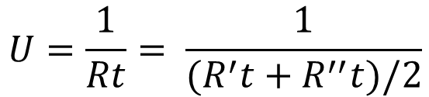
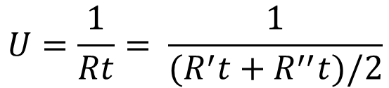
U-value calculation non homogenous components (ISO 6946)
d₁ d₂ d₃
̴20%
Upper Estimated R’t
̴20%
R_{si}
Plywood
Wood
WFB
R_{se}
̴80%
R_{si}
Plywood
Insulation
WFB
R_{se}
Lower Estimated R’’t
Wood
̴20%
R_{si}
Plywood
WFB
R_{se}
Insulation
̴80%
Cross Section of Stud Wall
Graphic & Author: Wimmers
Notes:
Certified European Passive House Designer
Certified European Passive House Designer
This example shows a non-homogeneous envelope assembly. Not all materials are applied in a consistently thick layer, parallel to the building component. The layer in the middle is not homogeneous and consist to 20% of wood and 80% insulation. This is an assumption for this example, for an actual project the actual percentage will have to be calculated. Including the doubling up of studs around doors and windows and other items such as base, bottom and top plate as well as headers above windows, the real wooden content of that layer in a typical stud wall (16” on centre) is often around 25%.
According to ISO 6964 we are now doing two calculations, the first with a 20/80 split (or different numbers depending on your actual envelope) from the beginning and a second starting with 100% for the homogeneous layer and then splitting into a 20/80 ratio only at the inconsistent layer. The first is called the upper estimated R value and the second is called the lower estimated R value. Both will differ slightly because of rounding effects. The correct value (following ISO 6946) to be used for further calculations is the average of the two.
The complexity can be further decreased by adding several non-homogenous layers to the envelope assembly. Calculation tools such as the Passive House Planning Package (PHPP) will allow for two inconsistent layers.

Slide 56
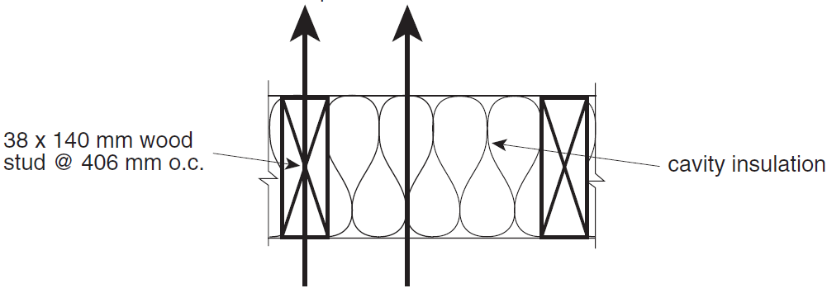
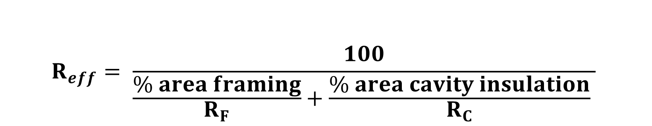
Effective R-value calculation for 2x6 wood studs and cavity insulation:
$$R_{eff}= \frac{100}{\frac{\% area framing}{R_{F}}+\frac{\% area cavity insulation}{R_{C}} }$$
23%
77%
23%
77%
Source: NBC A9.36.2.4
Author: Jonkman
Notes:
NBC A-9.36.2.4. is using the upper estimated R value (also called “isothermal planes method”) since 1997, before that NBC was using the lower estimated R value.
Because of using the upper value, the calculation according to NBC A-9.36.2.4. is theoretically slightly more conservative (please see next page!!!) then ISO 6946.

Slide 57
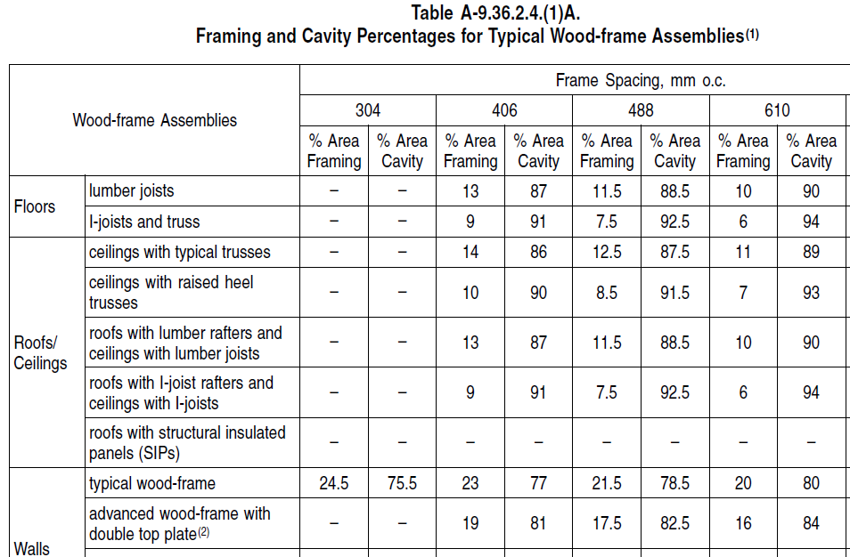
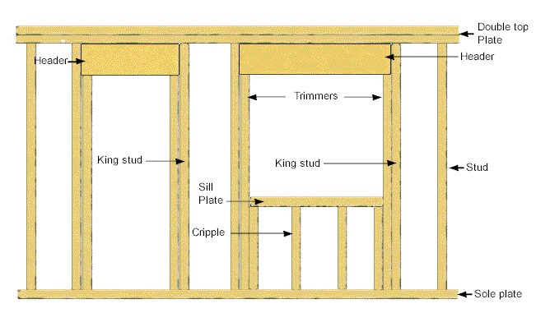
Wood Percentage in Framing
Graphic: NBC
Notes:
In the previous example we assumed that about 20% of the wall are wooden studs and the remaining 80% are insulation in the cavities. The correct average percentage should be calculated for each project.
NBC A-9.36.2.4. includes tables with percentage values. Those values are often too optimistic, therefore the results calculated according to NBC A-9.36.2.4. are often optimistic.
Further is the thermal conductivity of materials in Canada often assumed lower than in EN or ISO e.g. softwood with 0.12 W/mK (NBC A-9.36.2.4) or 0.13 W/mK (ISO 10456).
All this leads typically to more optimistic results when following NBC compared to ISO.

Slide 58
Lesson 3: Thermal Bridging
(5min summary + 40min + 5min Q&A)
Objectives:
Describe types of thermal bridges
Outline the principle of thermal-bridge-optimized construction, and appraise the impact thermal bridges play in overall building performance.
Qualitatively analyze a building envelope in terms of potential thermal bridges, and identifying which areas and details are most important.
Demonstrate calculation method for thermal bridges using heat loss programs (e.g. FLIXO)
Design details and compare to representative values via examples
Canadian
Wood
Council
Conseil
canadien
du bois

Slide 59
Thermal Bridging
Definition of Thermal Bridges
Types of Thermal Bridges
Avoidance and Optimization
Calculation of Thermal Bridge Coefficient Ψ
Canadian
Wood
Council
Conseil
canadien
du bois
Author: Wimmers

Slide 60
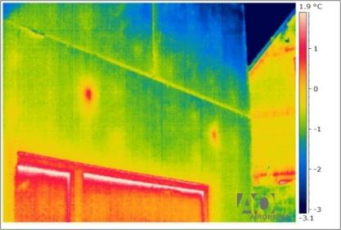
Thermal Bridge
A thermal bridge occurs if Isotherms are bend
There are Linear Thermal Bridges Ψ (psi) and Point Loads χ (chi)
Weakening of thermal properties of the envelope caused by:
Planning and design
Workmanship
Geometrical
Author: Wimmers, Photo: PHI
Notes:
A thermal bridge occurs if the isotherms of any component of the envelop are bend.
We can differentiate between linear thermal bridges and point loads.
Point loads are expressed with the Greek letter χ chi and have usually only a negative impact on the immediate surrounding area. This might cause condensation and the associated damage but usually does not cause significant impacts on the energy consumption of a building. Point loads, as long as they are not in large numbers and do not have devastating energy loss consequences (such as a steel beam or concrete post penetration) are typically ignored.
Linear thermal bridges are expressed with the Greek letter Ψ psi and can add up to hundreds of meters in a medium size building. This is a significant energy loss factor and a potentially health risk if condensation and the associated mold occurs.
Linear thermal bridges should be calculated and added to the energy losses as they easily add 20-30% or more to the energy losses of a building.

Slide 61

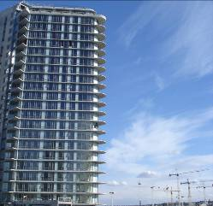
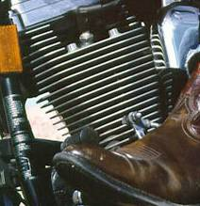
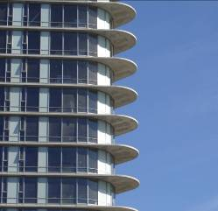
“Typical” Thermal Bridge
Photos: Harley Davidson, Wimmers
61
Notes:
The effect of thermal bridging can be nicely explained with the technically concept of an air cooled engine. Inside the engine is the combustion chamber and a lot of thermal energy is present, if this heat is not transferred to the outside the engine would overheat. Cooling fins are designed purposefully to cool the engine. In modern architecture large thermal bridges with the same principal can be found in form of concrete balconies. Those linear thermal bridges are penetrating the insulation layer with a material with high heat conductivity and are causing the unwanted effect of cooling the building in winter and overheating it in summer. The linear thermal bridges shown in the picture adding up to several hundreds of meters and can increase the energy consumption of a building by 20-30% and more.
61

Slide 62
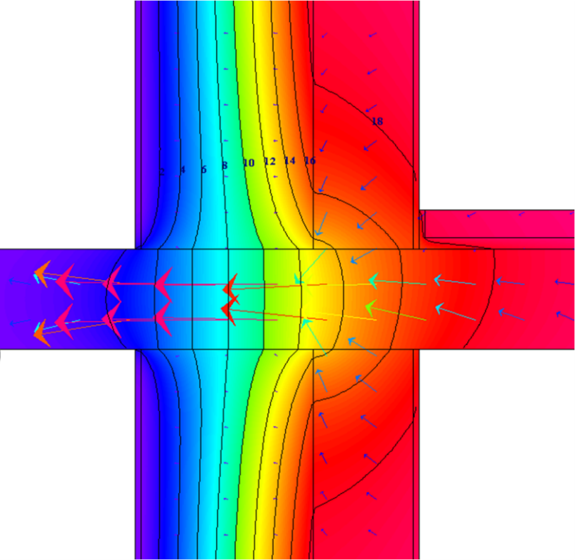
Isotherms
Energy flow
Isotherms
Source: PHI, Author: Wimmers
Notes:
An isotherm is a line where each dot on the line is of equal temperature. Isotherms usually get a temperature value assigned. On this picture the isotherms are shown in 2°C increments. The example shows a concrete wall with a thick layer of insulation on the outside and a penetrating balcony slap. The direction and intensity of the heat flow is shown with arrows, the larger the arrow, the larger the energy flow. Because the thermal resistance of the insulation layer is interrupted, energy gets transferred much more rapidly through the area of the concrete slap, resulting in cooler temperatures on the inside and warmer temperatures on the outside. This is a very large thermal bridge.

Slide 63
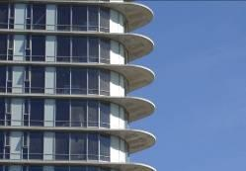
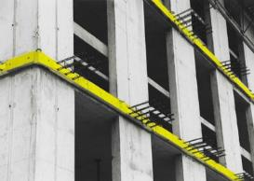
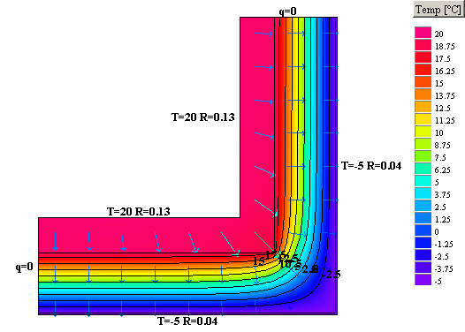
Avoid and Optimize
Avoid penetration of insulation with high thermally conductive materials.
If penetrations are necessary, optimize detail and select suitable materials to minimize thermal losses.
Optimize the geometry of the building (see compactness) by design less corners and ideally no corners <90°
Author: Wimmers
Notes:
If possible, avoid any penetration of the thermal envelope. For example, smaller buildings can have balconies build with a separate structure in front of the exterior wall. If this is not possible, optimize the penetrations as far as possible by reducing the length and utilize special connectors with much lower thermal conductivity than the concrete or steel. Further optimize the geometry of a building and avoid any corners with a sharper angle then 90°.

Slide 64
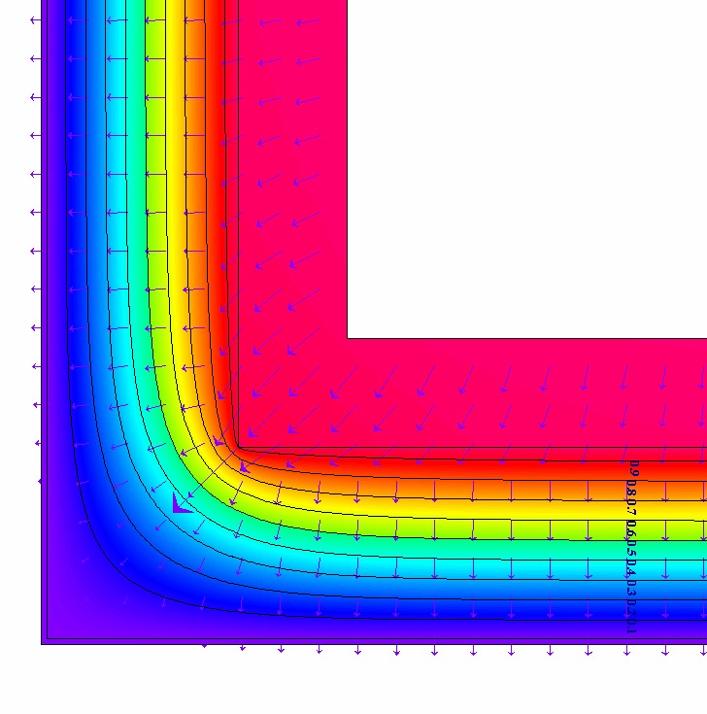
Geometry
S1 interior
S2 interior
S1 exterior
S2 exterior
Author & Graphic: Wimmers
Notes:
Imagine an exterior corner of a concrete wall with an exterior layer of insulation. Now imagine a small defined area (e.g. 1cm²) on the inner warm wall surface. All energy which is transferred into this 1cm² has a corresponding area of also 1cm² on the cold outside of the wall. For the energy, the entry area equals the exit area. Now imagine the same small area folded directly into the corner. The entry area for the energy has still the same size, but in the corner situation, the corresponding exterior area is much larger. This causes a geometrical thermal bridge; the corner will cool out much faster.
Geometrical thermal bridges cannot be avoided, theoretically a building in the form of a sphere would be the most optimized version regarding geometrical thermal bridges and this is not very practical. But at least sharp exterior corners should be avoided as the effect is even more pronounced if the corner angle is below 90°.

Slide 65

Penetration
S1 interior
S1 exterior
S2 exterior
S2 interior
Author & Graphic: Wimmers
Notes:
The penetration of the insulation layer with a material of higher thermal conductivity should be avoided as much as possible and if a penetration is necessary, materials of relatively low conductivity should be selected. Concrete and steel have very high thermal conductivity. Wood has an inherent advantage in this context as the thermal conductivity is only 0.13 W/mK. This is about three times more than typical insulation materials, so it cannot be neglected, but it is far less than other materials.

Slide 66
Where are Thermal Bridges?
Author & Graphic: Wimmers
Notes:
Looking at a schematic drawing of the section of a building, all four corners are geometrical thermal bridges. Every time an interior wall is connected to either the roof or to the thermally insulated floor it is a thermal bridge. Every time a floor is attached to the exterior wall it is a thermal bridge. The top and the bottom of each window as well as each door is a thermal bridge. The same exercise will have to be done with a floor plan to capture all thermal bridges of a building.

Slide 67
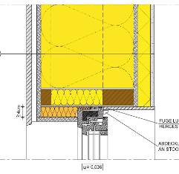



Thermal Bridges are a Design Exercise
Detailed Design, Thermal Bridge Calculation and Optimization, Installation and Site Supervision
Graphic: PHI, Wimmers, Photo: Wimmers
Notes:
Windows are representing, in most buildings, by far longest thermal bridge. The installation of windows is therefore one of the most crucial details, requiring comprehensive planning. A model is usually build in a thermal bridge calculation software tool. The simulation is calculated using the Finite Element Method and the chosen design has to be then correctly implemented on the construction side. Further design details will be covered later on.

Slide 68

Steel Stud Wall Assemblies
Thermal Bridge of Steel Studs reduces effective R value by 50-60%
Additional 30-40% reduction through thermal bridge of slab
Nominal R-12 wall results in effective R-3 to R-4
Same wall without any insulation would be R-2
Source: Energy Consumption Trends and Considerations for Deep Energy Retrofits, 2009, G. Finch, W. Knowles
Notes:
This research study shows the extreme but unfortunately common scenario of a thermal bridge. The example shows the enormous influence of implementing materials or components with a high thermal conductivity in the assembly of an exterior wall. The linear thermal bridges of the steel studs virtually eliminate the functionality of the insulation layer. The effective remaining thermal resistance is only about 25% of the thermal resistance of the insulation installed. Steel and concrete should not penetrate the insulation layer in the envelope of a building.

Slide 69

Impact of Exposed Slabs & Balconies a)
R-values for 8’8” High Wall - No Balcony or Eyebrow (Center of Wall)
Insulation Strategy | Effective R-value
3” EPS (R-12), Exterior Insulation | R-13.9
4” EPS (R-16), Exterior Insulation | R-18.0
6” EPS (R-24), Exterior Insulation | R-25.8
Exterior insulation over concrete wall
Results from thermal modeling using calibrated finite element 3-dimensional software
Source: RDH, G. Finch
Notes:
Another study published by Graham Finch and RDH in Vancouver was examining the influence of a penetrating concrete floor slap on the thermal performance projected on the entire wall.
The entire wall, 8’8” high, including an 8” thick interior concrete floor, was calculated with 3, 4 and 6 inch insulation. The total thermal resistance was always slightly higher than the thermal resistance of the insulation as the other materials in the wall also contribute to the overall performance.

Slide 70

Impact of Exposed Slabs & Balconies b)
R-values for 8’8” High Wall - No Balcony or Eyebrow (Center of Wall)
Insulation Strategy | Effective R-value
3” EPS (R-12), Exterior Insulation | R-13.9
4” EPS (R-16), Exterior Insulation | R-18.0
6” EPS (R-24), Exterior Insulation | R-25.8
R-values for 8’8” High Wall with Balcony or Eyebrow (Overall)
Insulation Strategy | Effective R-value
3” EPS (R-12), Exterior Insulation | R-7.4 (-47%)
4” EPS (R-16), Exterior Insulation | R-8.6 (-52%)
6” EPS (R-24), Exterior Insulation | R-10.6 (-59%)
Source: RDH, G. Finch
Notes:
Now the concrete floor is penetrating the thermal envelope with a thickness of 8” for a balcony or eyebrow. This linear thermal bridge at the bottom of the wall does reduce the total thermal resistance of the entire wall in average by more than 50%. The thicker the insulation layer is that gets penetrated by a thermal bridge, the larger the resulting reduction of the thermal resistance of the entire wall is.
This example explains not just the impact of thermal bridges on the thermal performance of entire buildings, but it also shows the inherent weakness of construction materials with a relatively high thermal conductivity.

Slide 71


Is this a Thermal Bridge?
Point load thermal bridges at Prince George Airport
Visualization of linear thermal bridge and installation of Isokorb.
This can reduce the thermal bridge by about 80%, but it is still worse than a continuous penetration with Wood.
Canadian
Wood
Council
Conseil
canadien
du bois
Photos: Wimmers, Schock Isokorb
Notes:
Wood has a much lower thermal conductivity than concrete, therefore penetrations do not have such as dramatic consequences as with concrete or steel. The first picture shows wooden beams penetrating the glass façade of a building. Is this a thermal bridge?
The thermal conductivity of wood is around 0.13 W/mK and the equivalent thickness of the insulating glass in wood (assumed 30mm) would result in an U value of over 4 W/m²K. Not knowing exactly the performance of the insulating glass, it is safe to say that it would be somewhere between 1.2 and 2 W/m²K. So the wood penetration is a point thermal bridge as each penetration reduces the thermal resistance of the envelope.
The right picture shows a photomontage of a separated balcony. At the layer of the thermal envelop, in this case the window, is a so called “Isokorb”, a device that thermally separates the inside from the outside but structurally connects the balcony to the building. The thermal bridge is reduced by roughly 80% compared to concrete penetrating. But the resulting thermal bridge of a well performing “Isokorb” is still larger than if a solid piece of wood would penetrate the envelope in similar length and size.

Slide 72
Compare λ or k values
Thermal condustivity λ of...
Steel:
Concrete:
Wood:
Insulation:
Canadian
Wood
Council
Conseil
canadien
du bois
Notes:
Do you know the numbers? Between all of those present, do we know the rough numbers for each material?
Steel ~48-58 W/mK, depending on the exact type, stainless steel as used in Isokorb is around 15 W/mK
Concrete ~2.3 W/mK for steel reinforced concrete, pure concrete is around 1.4 to 1.8 W/mK
Wood ~0.13 W/mK (NBC 0.12) for all typical softwoods and engineered products such as glulam, CLT, OSB and plywood
Insulation ~0.04 W/mK or slightly lower for the most common insulation materials.
Test scenarios differ, look carefully for who has tested and which procedure was followed. Published values in Europe usually include the degradation of performance over time and are typically much more conservative than US values (exemptions apply).

Slide 73

Finite Element Calculation of Thermal Bridges a) (as per DIN EN ISO 10211)
Example: Exterior Corner
Source: PHI/PHD Author & Graphic: Wimmers
Notes:
Calculation of a linear thermal bridge using the example of an external wall edge.
With FEM (finite element method) the 2D heat flow (Q2D) is calculated, then the 1D (exterior dimension) is subtracted to get to the thermal bridging coefficient Ψ (psi). Is Ψ=0, the overlapping (1D exterior dimension) at the corner was exactly right. Is Ψ<0, you have a “bonus” and is Ψ>0, your energy losses are even larger than the overlapping of 1D exterior dimensions suggests.
In this example one wall is shown purple and one wall is shown pink. In both cases the energy losses are calculated over the entire length of each wall (exterior dimension). This result in a virtually overlapping of the two calculations. The green area is part of the purple as well as the pink area. If the Q2D is identical to the sum of Q1D purple and Q1D pink, Ψ=0

Slide 74
Finite Element Calculation of Thermal Bridges b) (as per DIN EN ISO 10211)
Q_{1D} = A₁ * U₁ * ΔT₁ + A₂ * U₂ * Δ T₂
Example: U₁=U₂ = 1/(0.13+0.175/2.3+0.3/0.04+0.01/1+0.04)=0.129 W/(m²K)
1/(R_{si} + d₁/ λ ₁ + d₂/ λ ₂ + d₃/ λ ₃ + R_{se})
Q_{2D} = A₁ * U₁ * Δ T₁ + A₂ * U₂ * Δ T₂ + Ψ * l * Δ T_{max(1.2)}
Example : Q_{2D} = 8.0275 W/m as per HEAT2-6.0
Author & Graphic: PHI, Wimmers
Notes:
The Thermal bridge is calculated using the exterior dimensions of the envelope. The last layer of insulation is relevant, all other materials, such as cladding are not part of the equation as they do not contribute the thermal resistance.
The one-dimensional heat flow (U₁ * A₁ + U₂ *A₂) * ΔT, as explained earlier, is deducted from the two-dimensional heat flow (calculated with numerical two-dimensional heat flow program).
The result is divided by the length and the used temperature difference which gives the linear thermal bridge loss coefficient Ψ (Greek letter ‘Psi’).

Slide 75
Finite Element Calculation of Thermal Bridges c) (as per DIN EN ISO 10211)
Ψ = (Q_{2D} - A₁ * U₁ * Δ T - A₂ * U₂ * Δ T ) / l / Δ T_{max(1.2)}
Example : Ψ_{a} = (8.0275 – 0.129*1.485*2*25 )W/K / 1 m / 25 K = -0.062 W/(mK)
Ψ_{a} = -0.062 W/(mK) Q_{T84} = -5.2 kWh/(ma)
Example assumes 20m (4 corners, 5m high)
Resulting in 104 KWH/a “credit“
At a 200m² building the optimized thermal bridge has a positive impact on the energy density of 0.52kWh/(m²a).
Ψ_{a} = -0.062 W/(mK) Q_{T84} = -5.2 kWh/(ma)
T_{min} = 19.51 °C h_{RSI} = 0.98
T_{min} = 19.51 °C
Author & Graphic: PHI, Wimmers
Notes:
Exterior corners are usually the only thermal bridges who can result in a negative Ψ-value.
In the Example: Ψ_{i} = (8.0275 – 0.129*1.0*2*25 ) W/ 1 m / 25 K = -0.062 W/(mK)
Assuming a climate with 84,000 heating degree hours equals Q_{T84} = -5.2 kWh/(ma), which means 5.2 kWh are transferred per m length of the thermal bridge per year less than the sum of the two Q1D calculations for each wall. In this case, a credit is gained.
As an example, we assume that this is the corner of a single family house (4 corners x5m high) with a total length of 20 m. If the building has a 200m² floor space, the optimized thermal bridge has a positive impact on the energy density of 0.52kWh/(m²a). This seems to be a small bonus, but if your goal is to achieve Passive House Standard at 15kWh/(m²a), the 0.5 bonus might be the difference between certifiable or not.
FEM calculation tools also allow to check the temperature of the most critical areas to estimate the risk for increased humidity and consequently rot and mold.

Slide 76

Thermal Bridges of Studs and Posts
conventional
Double t-beam
Box beam
stud partition
i-beam
Ψ = 0.005 W/mK
Ψ = 0.013 W/mK
disregardable
U = 0.117 W/m²K
U = 0.128 W/m²K
thermal-bridges
+ 9% above u-value
+ 20% relevant !
at common joist grid
to be considered
Source: PHI. Sariri, Author: Schnieders
Notes:
As discussed earlier, studs in the exterior wall in the insulation layer are reducing the overall thermal resistance of a wall. If metal studs are used, the effect is devastating for the thermal performance of a wall and renders the insulation in the cavity in-between virtually useless. A continuous layer of insulation would be a possible solution.
With wooden studs the consequences are not as drastic, but each stud penetrates the insulation layer and causes a small thermal bridge. Even if this thermal bridge is relatively small ψ < 0.01 W/mK, because it is countless times reoccurring it adds up to a significant thermal bridge. The best way to deal with these reoccurring thermal bridges in walls is to use Passive House Planning Package (PHPP) or similarly capable U value calculation tools to capture these effects in the U value for a envelope component.

Slide 77




Thermally Optimized Rafters, Beams and Posts
Photos: M. Ploss, lignotrend, Wimmers
Notes:
The most common form of thermally optimized beams is the I joist which can in some countries also be used as a post. The relatively thin penetration of the OSB layer has a very small impact on the thermal performance. Larson trusses are a popular option for beams and posts, preliminary for projects to be built on site. The third picture shows a proprietary version of an upper and lower chord made of wood with a separating layer of wood fiber insulation. Traditional trusses can also be used horizontally or vertically to accommodate thicker layers of insulation. During the application of insulation attention has to be paid to avoid air pockets.

Slide 78
Effective R or U value or Thermal Bridge Calculation
PHPP or equivalent tools for accurate U-value calculation for non-homogenous multilayer envelope assemblies
Flixo, Heat or equivalent tools for wood construction detail
Resulting Ψ values have to be included in energy balance as relative impact increases with energy efficiency of building
Author: G. Wimmers
Notes:
To summarize:
Frequently reoccurring thermal bridges such as studs and beams are best included in the U-value (or R-value) calculation with tools which allow several non-homogenous layers, such as PHPP or others.
For all other details 2D thermal bridge calculators such as FLIXO, Heat or equivalent should be used. The tool THERM is another option and of interest as it is free ware, but expect reduced user-friendliness.
Resulting Ψ values have to be included in the energy balance as the relative impact increases with the energy efficiency of a building. Poorly solved thermal bridge details can have a significant impact on the overall energy efficiency of a well insulated building.

Slide 79

Typically the largest Thermal Bridge
Uw = 0.8 W/(m²K)
recommended installation
Ψinstall = 0.005 W/(mK)
Uw,eff = 0.78 W/(m²K)
extremly bad installation
Ψinstall = 0.015 W/(mK)
Uw,eff = 1.19 W/(m²K)
Resulting in 50% higher energy losses with equal components!!!
Insulation
Concrete
Source: W. Feist, F. Freundorfer, Volume 14 of Research group cost-effective Passive Houses: Passive House windows. Passivhaus Institut, Darmstadt 1998 (currently only available in German)
Graphic: G. Wimmers, CertiPHIers Cooperative
Notes:
Certified European Passive House Designer
Certified European Passive House Designer
To showcase the impact of a single, but often reoccurring detail, we compare a thermally good solution with a bad installation of a window. The assumption is a well performing window with a total U-value (including frame, spacer, glass) of Uw = 0.8 W/(m²K), installed in a well insulated concrete wall with 300mm or more insulation. The installation is thermally optimized with Ψ install = 0.005 W/(mK), resulting in an effective thermal performance of Uw,eff = 0.78 W/(m²K). We can see that the isotherms are relatively smoothly funneled from the thin glass layer of 36mm to the thick insulation layer of maybe 300mm. It is important that the window is in line with the insulation layer and that the fixed window frame is covered preferably entirely with insulation. As a rule of thumb the insulation thickness covering the frame should be approx. 6 cm (figure: horizontal thickness).
The same window installed in the same wall, but position inline with the concrete layer creates distortions for the isotherm, resulting in a thermally very poor performing installation Ψ install = 0.015 W/(mK) and an effective U value for the entire window of Uw,eff = 1.19 W/(m²K).
The result is 50% higher energy losses throughout the window. Assuming that windows have already the highest impact on the thermal losses of a building of about 50%, this thermal bridge would result into a potential increase of thermal energy losses for the entire building of 25%.
Wood buildings have an inherent advantage as the structural material has a relatively low thermal conductivity and it is easier to position the window in the thermally best performing position. Under optimal installation conditions (window in the centre of the main insulation layer) and symmetrical funnelling of the isotherms, installation psi-values of around 0 W/(mK) can be achieved.

Slide 80

Thermally Optimized Eaves, Wall to Roof (Prefab)
Canadian
Wood
Council
Conseil
canadien
du bois
Graphic: Wimmers
Notes:
This detail, particularly designed for prefabrication, shows the section of the transition of the wall to the roof. The inner layer of 2x4 dimensional lumber is called installation or service cavity and allows all services to be installed on the inside of the main wall, reducing thermal bridges. The wooden content of the eave is relatively low to reduce the thermal bridge. The overhang is structurally carried by the 2x4 which builds the ventilation layer on top of the insulated part and is therefore thermal bridge free.

Slide 81

Thermally Optimized Corner (Prefab)
Graphic: Wimmers
Notes:
This detail shows the installation of two prefabricated panels in the corner. The end piece of each wall is made of LVL and one wall has a second LVL parallel to the wall to allow for a simple installation and connection on site with two (one from the inside, one from the outside) slightly larger screws. At the moment of installation, the service cavity on the inside is still open.

Slide 82

Thermally Optimized Floor Connection (Prefab)
Graphic: Wimmers
Notes:
This prefabricated wall panel has a ledger (LVL or similar) screwed through the plywood on the inside to the 2x10 studs. The ledger sits in the service cavity and is on the outside completely covered with the main layer of insulation. The top chord of the prefabricated wall is not on the same level as the ledger, the wall is taller. This reduces the wood content around the ledger to further optimize the thermal bridge. This detail is not only offering a good thermal performance but, has also significant advantages in air tightness as shown later.

Slide 83

Thermally Optimized Footing Detail, no Basement (Prefab)
Author & Graphic: Wimmers
Notes:
The wall is sitting on a thickened edge slap, allowing the insulation properly being wrapped around the foundation detail.
The wooden content at the base plate is reduced to the structurally necessary portion to reduce thermal bridge.

Slide 84

Thermally Optimized Window Installation
Insulation overlapping Window Frame (if possible) to reduce thermal bridge.
Graphic: Wimmers
Notes:
The windows are located close to the centre of the overall insulation depth of the wall, slightly moved towards the outside to reduce the shadow effect of the reveal and increase the potential solar gains. The window is inward opening, therefore an additional layer of insulation over the frame reduces the thermal bridge further. This does not work with windows with aluminium cladding as the aluminium would be perpendicular to the isotherms and eliminate the positive impact of additional insulation. By using just one sturdier stud (e.g. LVL) on each side, doubling up of studs around the window can be avoided.

Slide 85

Window Installation
Graphic: Wimmers
Notes:
The thermal bridge is optimized by adding overlapping insulation at the top. The sash of the window cannot be overlapped with insulation as the drainage channels through the frame have to allow water to flow onto the metal flashing. The header over the window is thermally optimized by including a thick insulation layer.

Slide 86
Detail optimization with FEM tool
Graphic: Wimmers
Notes:
Thermal simulations with Finite Element Method (FEM) calculation tools allow to determine the thermally best performing position of the window

Slide 87


Analyze Window Details
Canadian
Wood
Council
Conseil
canadien
du bois
Photos: Wimmers
Notes:
87
These two pictures show the top cross-section of a thermally optimized window installation into a wood wall. Both examples feature inward opening windows as the overlapping insulation over the wood window frame increases the thermal performance.

Slide 88
Lesson 4: Airtightness Basics and Materials
(45min + 5min Q&A)
Objectives:
Contrast all relevant units (vapour diffusion resistance factor, vapour diffusion thickness, permeance)
Differentiate the different forms of moisture transport through a building envelope
Estimate the impact of different methods of vapour transportation
Evaluate available materials
Assess the consequences of underperforming or misplacement of the air barrier
Develop strategies for airtight building envelop assemblies
Canadian
Wood
Council
Conseil
canadien
du bois

Slide 89
Airtightness Basics
Importance of Airtightness
Air Flow through Envelope
Moisture Loads
Wind and Stack Effect
Airtightness as Design Task
Canadian
Wood
Council
Conseil
canadien
du bois

Slide 90
The Importance of Airtightness
Generally
Prevention of condensation and mould/rot in the construction
Safeguarding the performance of the insulation layer
Prevention of rafts
Prevention of cold floors in the ground floor
Preventing contamination of the room air
Reduction of heat losses from the building envelope
Securing the effectiveness of the ventilation system
Securing the sound insulation of building components
Wood reacts very sensitive to moisture
Author: Wimmers
Notes:
Airtight construction is important to avoid warm humid air to travel via convection through some cracks and gaps into the insulation cavity and out of the building. The air would pass through cold material layers and condensation can occur. Airtightness increases thermal comfort as cold floors and drafts are less likely. No contaminated air can enter the building from the outside and HVAC systems can work properly. Furthermore, airtightness is important for sound insulation. In many cases sound waves can travel with the air.

Slide 91
Clarification
Airtightness (on the inside)
Layer to stop airflow from inside to outside
Vapour retarder (on the inside)
Layer to reduce vapour diffusion from the inside into the insulation
Wind tightness (on the outside)
Layer to stop wind flow from outside to inside
WRB =
Weather Resistant Barrier or
Water Resistant Barrier or
Wind Resistant Barrier
Author: Wimmers
Notes:
Airtightness is key to prevent warm humid air of traveling via convection into the wall or roof cavities, and eventually causing condensation.
Vapour retarders are located on the inside of the envelope and prevent or slow down humidity traveling into the envelop via diffusion. Very often both functions, airtightness and vapour retarder, are fulfilled with the same material layer to reduce construction costs and to optimize performance.
Wind tightness prevents warm or cold exterior air to infiltrate into the envelope from the outside and reduce the effectivity of the insulation layer. This is particularly important with loose fill insulations such as blown in cellulose or mineral fiber or any kind or batt insulation.
WRB is not homogenously defined in literature. The WRB has to be on the outside.
In Canada the WRB is commonly understood as Water Resistance Barrier, aiming at liquid water coming from the outside (e.g rain).

Slide 92
Where are the crucial details for Airtightness?
Author & Graphic: Wimmers
Notes:
Very similar to the discussion about thermal bridges, we can identify the same neuralgic details for airtightness. The undisturbed wall or roof is usually not the challenge, the difficult task are the connections and transitions of components.

Slide 93


Principle of Thermal Insulation
Loose Insulation without Air or Wind Barrier
Loose Insulation with Air or Wind Barrier
Insulation with consistency to sufficiently block airflow
Author & Graphic: Wimmers
Notes:
Loose insulation without any wind barrier (similar to a knitted sweater) would allow air to flow through. The thermal insulation is severely reduced if wind occurs. The solution would be to either safeguard the loose insulation with a membrane (e.g. Gore-Tex) or use a denser, less permeable insulation layer such as a softshell.
In construction we follow the same principles.

Slide 94
Air Flow
Wood (studs and strapping)
Insulation
Drywall
Plywood or OSB
Cladding
Warm Air (interior, humid)
Cold Air (exterior)
Air Barrier
Wind Barrier
Vapor Diffusion Resistance Layer
Author & Graphic: Wimmers
Notes:
The cross section shows a generic wall assembly with wooden studs, insulation in the cavity, drywall on the inside and plywood or OSB on the outside, followed by some cladding material. The airflow requiring the most attention to is the warm humid air coming from the inside traveling into the wall (heating dominated climate). This airflow traveling from the inside to the outside of the envelope, will cool down and potentially increase the humidity in this area or even cause condensation.
Predominantly cold air washes the façade and potentially penetrates at least several cm into the insulation layer. This wind washing effectively reduces the efficiency of the insulation layer.
The air barrier is often in addition the vapour diffusion resistance layer, and the wind barrier can also be the secondary water barrier at the same time.

Slide 95
Convective Looping
If there is no interior air barrier, the wind barrier takes over partially the purpose of an air barrier as well and only a vapour diffusion resistant layer (e.g. “airtight drywall”) on the inside is used, convective looping can occur and trigger moisture accumulation in the cavity.
Vapor Diffusion Resistance Layer
Potential Condensation
Author & Graphic: Wimmers
Notes:
A relatively newly discussed phenomenon is convective looping. This is potentially triggered if the air barrier on the inside is not installed and the wind barrier takes over partially the function of stopping air flow from the inside to the outside. Convective looping can increase the moisture levels on the inside of the exterior layers of the wall.

Slide 96
Possible Locations of Air Barrier and Wind Barrier a)
Assembly 1)
Assembly 2)
Assembly 3)
Exterior Insulation Board (Mineral or Wood Fiber)
Exterior Structural Wood Fiber Board
Plywood or OSB
Author & Graphic: Wimmers
Notes:
Assembly 1)
Wall with poly-mil on inside as the air barrier, plywood towards outside with wind barrier on top of continuous layer of exterior insulation. Airtightness mediocre as layer penetrated by electrical and mechanical services
Assembly 2)
Wall with poly-mil on inside, plywood towards outside with wind barrier behind continuous layer of exterior insulation. Airtightness mediocre as layer penetrated by electrical and mechanical services
Assembly 3)
Wall with taped plywood towards the inside as air barrier and exterior wind barrier. Airtightness very good as no electrical or mechanical systems penetrate airtight layer

Slide 97
Possible Locations of Air Barrier and Wind Barrier b)
Assembly 4)
Assembly 5)
Exterior Insulation Board (Mineral or Wood Fiber)
Exterior Structural Wood Fiber Board
Classic wall with poly mil on inside, plywood towards outside and continuous layer of exterior insulation
Plywood or OSB
Author & Graphic: Wimmers
Notes:
Assembly 4)
Wall with taped plywood on the inside as air barrier and exterior wind barrier on top of exterior layer of insulation. Airtightness mediocre as layer penetrated by electrical and mechanical services
Assembly 5)
Wall with taped plywood towards the inside as air barrier and exterior wind barrier. Airtightness very good as no electrical or mechanical systems penetrate airtight layer. Exterior insulation layer safeguarded by wind barrier eliminating wind washing.

Slide 98


Possible Moisture Loads in Construction Assemblies a)
Scenario 1)
Scenario 2)
Diffusion $≈3\frac{g}{m^{2}day}$
Flank Diffusion $≈30\frac{g}{m^{2}day }$
Source: S. Peper, W. Feist, V. Sariri: Luftdichte Projektierung von Passivhäusern – eine Planungshilfe.
Fachinformation PHI 1999/6, Passivhaus Institut, Darmstadt 1999/ 9. Auflage 2008, Graphic: Wimmers
Notes:
Scenario 1)
Given is general roof structure with drywall on the inside followed by a vapour resistance layer (poly-mil or plywood), joists filled with insulation, a membrane, and strapping with a metal roof. The amount of humidity traveling via vapour diffusion into the cavity might be in the dimension of roughly 3g of water per m² roof area.
Scenario 2)
If other materials penetrate the vapour retarder on the inside, e.g. a concrete or CLT wall, moisture can travel through flank diffusion into the insulation cavity of the roof. This can be as much as 30g per m² affected roof area, about 10 times more than typically diffusion.

Slide 99


Possible Moisture Loads in Construction Assemblies b)
Scenario 3)
Scenario 4)
Outside 0°C; 80% relative humidity
Inside 20°C; 50% relative humidity
Drying of Wood $≈50\frac{g}{m^{2}day}$
Convection 1mm gap $>300\frac{g}{m^{2}day}$
(only short term)
Source: S. Peper, W. Feist, V. Sariri: Luftdichte Projektierung von Passivhäusern – eine Planungshilfe.
Fachinformation PHI 1999/6, Passivhaus Institut, Darmstadt 1999/ 9. Auflage 2008, Graphic: Wimmers
Notes:
Scenario 3)
If the construction is build with wet lumber or the lumber was exposed to rain during the construction, the excess humidity will eventually dry out of the wood over time. This process is typically only to be monitored over the first year but the resulting values can be around 50g of water per m² envelope.
Scenario 4)
If there is actual convection triggered by a 1mm gap in the airtight membrane and a temperature difference of 20K from the inside to the outside, an experiment published in 2008 has shown that potentially over 300g of water can travel into the cavity per m² affected roof area. This is roughly 100 times more than what would be expected through diffusion.
Airtightness or the lack thereof has a much larger influence on the durability of a building and on healthy living compared to vapour diffusion.

Slide 100


Experiment
Experimental Setup
Interior Temperature 20°C
Exterior Temperature -10°C
Pressure Difference 20 Pa,
2-3 Beaufort
Vapour Diffusion Resistance Sd 30m
Mineral Fiber Insulation 140mm
Without Gap
U = 0.3 W/mK
Water Transport via Diffusion = $0.5\frac{g}{m^{2}day}$
With Gap
U = 1.44 W/mK
Water Transport via Convection = $800\frac{g}{m^{2}day} per 1m length of 1mm gap$
Source: Institute of Building Physics, Stuttgart, DBZ 12/89, page 1639ff, Graphic: Wimmers
Notes:
Whether we talk about 300g/m2 (former slide) or 800g/m2 like shown in this experiment, that is secondary. The important message is that the moisture transport through convection can be two magnitudes larger than what would be typically expected from vapour diffusion.

Slide 101







Vapour to liquid Water
30
25
20
15
10
5
0
Absolute Humidity at Saturation[g/$m^{3}]$
100% $H_{rel}$@20 $℃$ = 17.3 g/$m^{3}$
Absolute Humidity in air[g/$m^{3}]$
50% $H_{rel}$= 8.65 g/$m^{3}$
Resulting in 1.85 g/$m^{3} condensation$
100% $H_{rel}$ @ 5 $℃$ = 6.8 g/$m^{3}$
-20 -15 -10 -5 0 5 10 15 20 25 30
Air Temperature [$℃]$
Author & Graphic: Wimmers
Notes:
The absolute saturation of air at a temperature of 20$℃$ is 17.3 g/$m^{3}$. If the interior humidity is not 100% but 50%, this results in an absolute water content of 8.65 g/$m^{3} at$20$℃$. If this air is now flowing over a surface with the temperature of 5$℃$, the temperature of the air will be cooled down.
At 5$℃$ the saturation of air is already reached at 6.8 g/$m^{3}$, resulting in 1.85 g/$m^{3}$ condensation. This effect can be easily shown with a cold beverage taken out of the fridge and put on a table in a warm room. Relatively soon condensation starts to appear on the surface of the beverage container. The same effect would happen if warm air flows through a cracks or gaps into the envelope and cools down on the its way out of the building.

Slide 102
Conclusions
There is no absolute protection against moisture
Air tightness is of high importance to reduce moisture load
For remaining moisture load, low vapour diffusion resistance towards the outside important to allow for drying out.
Author: Wimmers
Notes:
It is virtually impossible to avoid humidity inside the envelope, but liquid water should be avoided under all circumstances and the moisture load coming from the inside should be reduced as much as possible by installing a proper airtight layer. For all the remaining moisture in the envelope, vapour diffusion becomes crucial. Assure that the vapour diffusion resistance is reduced towards the outside of the envelope to allow for a high drying-out potential. This will be further discussed in the block 6, vapour diffusion and humidity management.

Slide 103


Driving Forces for Air Movement
BUOYANCY
WIND
The volume of infiltration and exfiltration due to leakages in the building envelope is identical
Author & Graphic: Schnieders, Wimmers
Notes:
Generally, air is moved by two different driving forces through building envelopes, either by wind or by buoyancy, occasionally also referred to as the stack effect.
Wind is causing a pressurized zone on one side (luv ward) and a depressurized zone on the opposite side (lee ward). The same amount of air which is infiltrating on one side of the building will leave the building more or less simultaneously through exfiltration on the opposite side.
Buoyancy is caused by a temperature difference inside the building (warm air is lighter and rises) and a potential temperature difference to the outside of the building. Because of the lower density of warmer air, the exfiltration happens predominately in the upper portion of the building. The infiltration necessary to balance the pressure, will happen at the lower portion of the building.
Special attention should be given to airtight basements as the connection of a traditional concrete floor to the foundation is extremely leaky. This can cause a steady flow of air, including radon, being sucked via stack effect into the building.

Slide 104


Wind
Velocity of Wind reduced to theoretically 0
After colliding with infinite Obstacle
(conversion from kinetic to potential energy)
-
-
-
+
-
+
-
$$p_{w}≈0.6C_{p}v^{2}$$
V
V=0
-
-
+
+
-
-
$C_{p}$= pressure coefficient (negative means depressurized and 0 equals free stream
Please see also 4.1.7.4 and following in NBC
-
-
-
Source: Applied Building Physics, Boundary conditions, building performance and material properties
Author: Hugo Hens
Notes:
To calculate the wind pressure National Building Code of Canada uses as simplified formula which can be further studied in section 4.1.7.4 in the NBC

Slide 105




Buoyancy
$$p_{T_{1−2}}≈ p_{a}∗g∗β∗θ_{1}−θ_{2}∗h$$
$$p_{T_{1−2}} =pressure driven by temperature difference$$
$$p_{a} =1.2 kg/m^{2}$$
$$g =9.81m/s^{2}$$
$$β =1/{273K}^{−1}$$
$$θ_{1}−θ_{2}=temperature difference inside/outside$$
$$h =hight difference of two openings$$
Source: Applied Building Physics, Boundary conditions, building performance and material properties
Author: Hugo Hens
Notes:
Buoyancy can be calculated by using the barometric pressure of air, the gravitational force g, the temperature factor, and the temperature difference of the two different openings in the building in question and their vertical distance.

Slide 106


Exercise
$$p_{T_{1−2}}≈ p_{a}∗g∗β∗θ_{1}−θ_{2}∗h$$
What is the pressure difference?
Assumption 20$℃$ inside and 0$℃$
Height difference of openings 2.5m
b) Assumption 20$℃$ inside and -20$℃$
Height difference of openings 10m
Author: Wim
Canadian
Wood
Council
Conseil
canadien
du bois

Slide 107
Airtightness as a Design Task
Decide where the airtight layer should be
Avoid penetrations
Define materials and connections
Draw out details on plans
Consider the durability of materials and connections
Check construction drawings (continuous airtight envelope)
Communicate the deails and give instructions
Author & Graphic: Wimmers
Notes:
Each envelope component needs to have one dedicated airtight layer. Define the position and material and all connection details. When designing the electrical and mechanical systems avoid penetrations as much as possible. After all details are carefully planned out, define appropriate and durable materials and check again all sections and cross-sections for the continuous airtight layer. Communicate all relevant details to the side supervision, contractors and trades. Discuss materials, sequence and processes with contractors and trades.

Slide 108
Airtight Materials
Membranes
Tapes
Gaskets
Canadian
Wood
Council
Conseil
canadien
du bois

Slide 109
Airtight Materials
Concrete*
Plywood and OSB**
Airtight membranes
Airtightness Tapes
*Concrete has to be free of air pockets
**B Grade plywood according to CSA O121 and CSA O151, grade C has often small air pockets in low grade veneer layers and is less airtight; OSB is also not 100% airtight but leakage is extremely small and <0.6 ach@50Pa will not be a problem.
Plywood and OSB have to be taped with appropriate material.
Source: PHI/ Kaufmann, Author: Schnieders, Wimmers
Notes:
*Concrete has to be free of air pockets
**B Grade plywood according to CSA O121 and CSA O151, grade C has often small air pockets in low grade veneer layers and is less airtight; OSB is also not 100% airtight but leakage is extremely small and <0.6 ach@50Pa will not be a problem.
Plywood and OSB have to be taped with appropriate material. If used structurally boards have to be tested according to CSA 086.
Plywood and OSB have to be taped with appropriate material. If used structurally boards have to be tested according to CSA 086.
Concrete can generally be assumed to be airtight, precondition is the absence of air pockets in the concrete.
Using plywood or OSB as the structural layer for lateral stiffness as the airtight layer, located on the warm side of the wall, as shown earlier on slide “Possible Locations of Air Barrier and Wind Barrier” assembly 3 and 5, is a very common method to achieve durable and superior airtightness in several European countries. This method only works for prefabricated wall assemblies.
There is a wide range of airtight membranes available, offering reliable airtightness. All those membranes have to be taped with a suitable tape. Transitions to other materials need often specific tapes and occasionally the use of primer.

Slide 110

Non Durable Materials for Airtightness
Masking Tape, Duct Tape, Tuck Tape
Adhesion to Concrete without Primer
Application on Humid Surfaces
Polyurethane Foam*
Caulking and Jointing with Silicone or Acrylic
Polyethylene (Poly-mil) plastic foil**
*there are exemption: specialty foams with improved elasticity, such as Rothoblaas Sealing Foam
** the connections are the problem, not the foil itself
Source: PHI/ Kaufmann, Author: J. Schnieders, G. Wimmers
Notes:
Non-durable materials or connections might offer a relatively good airtightness in the moment of the airtightness test, but have been proven to reduce their capabilities over time. Not suitable and therefore not durable tapes, such as the tuck tape on various materials (excluding Tyvek) is a common source of reduced airtightness over time. Not following the proper application methods can also reduce the effectiveness over time. Caulking with silicone or acrylic will have to be frequently renewed if airtightness should be maintained. Polyurethane foam becomes usually bridle over time and reduces its capability to stop air, but there are exemptions. Some manufactures offer sealing foam with improved elasticity which remain airtight over a long period of time. Polyethylene foil itself is airtight but the connections are often difficult to seal and do not last.

Slide 111
Leaky Materials for Airtightness
“Airtight Drywall” Approach
Spray Foam Insulation
Perforated Membranes (staples)
EPS or XPS Foam Boards
Brick Walls (Plaster is airtight layer)
Source: PHI/ Kaufmann, Author: J. Schnieders, G. Wimmers
Notes:
With the “Airtight Drywall” approach, the undisturbed panel might be sufficiently airtight. However, the joints, service openings (electrical outlet etc.), corners, and connections to windows and doors are usually not sufficiently airtight.
Spray foam insulation leaves small air pockets at each corner and does not seal between doubles studs or base and top plates. The resulting leakage is too large and airtightness levels of 0.6ach@50Pa are not reliably possible.
Perforated membranes and the gaps between foam boards eliminate those materials as reliable airtight layers as well.

Slide 112

Specialty Membranes
Wide range of Membranes available for interior use, from very high vapour diffusion resistance to relative low resistance.
Author & Photo: Wimmers
Notes:
Besides water resistant barriers and wind barriers, several manufacturers offer a wide range of airtight membranes with a range of vapour diffusion resistance for the use on the inside (warm side) of the envelope.

Slide 113

Specialty Tapes
Wide range of Tapes available, tailored to very specific tasks and to adhere to different surfaces.
Author & Photo: Wimmers
Notes:
Similar to the available spectrum of membranes, there is a large number of different tapes available. Some are specifically designed to be used on specific surfaces, or in specific geometrical applications such as corners, or for the installation of windows.

Slide 114


Corner Tapes
Corner tapes have two strip backing, so that one can be pulled of and glued down and then the second backing can be removed to finish the seal.
Author & Photo: Wimmers
Notes:
These tapes have a split backing which allows the adhesion to one surface first, and then the backing of the other half can be removed to continue.

Slide 115



Combine the right Membranes and Tapes
Spot the mistake
Author & Photo: Wimmers
Notes:
Membranes should be always sealed with the appropriate tape. Always combine the appropriate tape to the right membrane. One picture shows a combination which does not work properly. Just matching a blue membrane with a blue tape is not necessarily correct.
The PRO CLIMA tescon tape is meant to be used with the PRO CLIMA Intello membrane and should not be combined with the SIGA majvest membrane.

Slide 116

Specialty OSB Tape
OSP has a relatively rough surface and need specific tapes with a relatively thick adhesive layer and flexible consistency to properly seal all micro gaps
Author & Photo: Wimmers
Notes:
OSB usually has a rougher and a smother side. If the OSB is used as the airtight layer in the envelope, all joints will have to be sealed. Ideally the OSB is mounted with the smooth side towards the inside, this will allow a better bonding of the tape. Regardless, the surface is rougher than for example plywood and therefore needs tapes with a slightly thicker and/or more pliable adhesion layer. Each tape manufacture typicallyhas a tape in their portfolio which adheres nicely to OSB and offers a sufficient airtightness.

Slide 117


Specialty Foundation Tape
Tape to block moisture from below (typically concrete) and two expanding polyurethane foams to achieve airtightness on uneven ground.
Tape with two hollow rubber hoses to seal gap between floor and walls, staples on wood to achieve airtightness.
Author & Photo: Wimmers
Notes:
The left picture shows a specialty tape, designed preliminary for the transition of a concrete floor to a wooden wall. The tape is glued on the concrete; the membrane is water tight to not allow any humidity from the concrete to be transferred into the wood. Concrete floors, have by code, allowed a very large tolerance, which leads potentially to an inconsistent gap between the concrete and the straight wood construction. This gap can be closed airtight with the expanding foam tape, available in different widths and thicknesses.
The right picture shows a tape for the connection of two prefabricated wood components. The tape can be tacked to the one side and the second element is then put on top. The two very pliable rubber hoses will be squeezed and seal against air.

Slide 118


Butyl Tapes
Butyl tapes are used to adhere to concrete or other porous materials (primer might be needed) and if movement is to be expected. Careful: Very Sticky!
Author & Photo: Wimmers
Notes:
Butyl tapes are mainly used to connect wood structures to very porous surfaces such as concrete, because of their superior pliability and ability to adhere to porous surfaces. The surface has to be clean and free of dust, the use of primer is advisable. They can also be used if movement at the connection is to be expected over time. Because of its flexibility butyl tapes can be expanded many times their original length and still stick to the surface.
As accidentally shown when trying to remove the tape again, butyl tapes can handle very large movements without tearing and potentially still being airtight.

Slide 119



Grummets, Collars, Gaskets…
Various Sizes for Cables, Conduit and Plumbing Lines
Author & Photo: Wimmers
Notes:
A wide array of grummets, from 2-5 mm diameter of the penetration to 100 or even 200 mm or more are available to optimize the most common penetrations for electricians and plumbers. The costs per grummet appear substantial, but the speed of the application, the reliability of the product, and the flexibility of exchanging the penetrating medium (e.g. cables) usually justify the costs.

Slide 120


Sealing without gaskets
The material costs for appropriate Gaskets might be higher than for the tape but if possible, proper Gaskets should be used.
Source: PHI, Author: G.Wimmers
Notes:
If no grummets are available, penetrations can be sealed with common airtightness tapes, but more material and time will have to be spend to achieve, in the best case scenario, an equal performance.

Slide 121


Specialty Window Tapes, double sided or expanding Foam
Adhesive to Window
Adhesive to Wall
Double sides tape with butyl layer for wall (wood, concrete etc) and adhesive layer for wood or PVC windows. This tape allows to be “S” shapes to overcome the distance between wall and frame (rough opening) of 10-12mm.
Compressed Foam tape self expands after installation (30-90min, depending on temperature), achieving airtightness with defined vapour diffusion resistance.
Author & Photo: Wimmers
Notes:
To achieve an airtight connection of a window to a wall, specific tapes will be used. The left picture shows a double sided tape with an adhesive layer on the top, designed to adhere to wood or PVC, a midsection without any adhesive, and a butyl layer on the bottom to be connected to a wide variety of surface materials. These tapes are available in several widths, depending on the size of the gap between the window and the wall. The picture does not show any other necessary connection on the outside for water and wind protection.
The right picture shows a foam tape which comes compressed on a roll. This tape has two different types of expanding foam, one vapour resistant for the inside, and one vapour diffusion open for the outside. The self adhesive tape gets glued on the reveal of the wall into the rough opening and the window is then installed. The installation is time sensitive, depending on the temperature it takes between 30 and 90 minutes to fully expand.

Slide 122
Lesson 5: Airtightness Details and Test
(5min summary + 40min + 5min Q&A)
Objectives:
Analyze the principle challenges of airtightness in detail
Develop potential methods and solutions
Investigate the basics of the airtightness test (Blower Door Test)
Canadian
Wood
Council
Conseil
canadien
du bois

Slide 123
Airtightness Details
Various Details to improve Airtightness
Canadian
Wood
Council
Conseil
canadien
du bois

Slide 124
Basic Problem with Airtightness in Platform Framing
Author & Graphic: Wimmers
Notes:
A common problem of traditional platform framing is a lack of airtightness at the intersection with the floor. If the airtight layer on the inside is not continuous, higher concentrations of moisture can occur. A wrapping of the floor with the airtight layer is an improvement, but because the airtightness now moves at the level of the floor to the outside, the risk for condensation is reduced but not eliminated.

Slide 125
Airtight Floor Connection (Prefab)
Graphic: Wimmers
Notes:
The floor is connected to a ledger (LVL or similar) located in the service cavity. This allows the airtight layer, in this case a plywood, to run continuously through. The plywood should be extended to a height above the floor where there is easy access to seal the joint after everything is installed. This has the positive side effect that the top plate of the wall panel is not at the same height as the leger and the thermal bridge therefor vastly reduced.

Slide 126

Airtight Floor Connection to CLT
CLT is not Airtight!
Additional Membrane or Plywood necessary.
Careful with Penetrations for Electrical.
Ideally use CLT only for Interior Walls as airtightness is challenging.
Graphic: Wimmers
Notes:
CLT is not Airtight!
To achieve proper airtightness, an additional membrane or a layer of sealed plywood is usually installed on the outside of the CLT. Penetrations for electrical and mechanical services have to be sealed on the backside of the panel. This implies that pre-manufacturing is the most sensible solution. Ideally CLT should only be used for interior walls as achieving airtightness with exterior CLT panels is difficult. Other forms of mass timber panels, such as mass OSB or mass plywood are airtight and therefore also usable for airtight exterior walls.
Note: CLT panels used in the envelope are always a challenge because the electrical system or any other penetration is difficult to install airtight.

Slide 127
Airtight Eaves, Wall to Roof (Prefab)
Canadian
Wood
Council
Conseil
canadien
du bois
Graphic: Wimmers
Notes:
The service layer is extended into the roof, allowing for a fully protected continuous airtightness layer. This example shows a plywood as airtight layer, as it could be used in prefabricated panels. Instead, a membrane could be used in the same position, utilizing the same advantage.

Slide 128

Airtight Eaves, Wall to Roof (CLT)
Canadian
Wood
Council
Conseil
canadien
du bois
Graphic: Wimmers
Notes:
If a CLT panel is used, a continuous air barrier has to be applied on the outside of the panel. This results in a more difficult detail at the eave as the airtight layer of the roof has to be connected to the CLT back side. A wider strip of air barrier membrane glued to the air barrier on the outside of the CLT wall, will be fastened to the roof plywood, after the installation of the roof.
CLT panels used in the envelope are always a challenge because the electrical system or any other penetration is difficult to install airtight.

Slide 129
Airtight Footing Detail, no Basement
Graphic & Photo: Wimmers
Notes:
To seal the prefabricated wall panel to the inconsistent concrete floor, an expanding foam tape can be used. Those foam tapes have two foam blocks, one on the inside for the air tightness and one on the outside for wind tightness. In-between is a still air layer which becomes negligible as a thermal bridge. The foam block can have different thicknesses, depending on how large the concrete deviations are. In the shown example such tape would be glued to the concrete before the 2x6 sized LVL base plate gets mounted on top. Later the 2x10 equivalent LVL sits on top of the 2x6 and the airtightness is achieved by sealing the plywood to the concrete floor.

Slide 130
Thermally Optimized CLT Detail, no Basement
CLT is not Airtight!
Additional Membrane or Plywood necessary.
Careful with Penetrations for Electrical.
Ideally use Mass Timber only in the Interior as Thermal Bridges and Problems with Airtightness more likely if Exterior use.
Graphic & Photo: Wimmers
Notes:
Similar to the former example, the airtight connection between a concrete floor and the exterior wall is done through the base plate. The base plate is sealed to the concrete floor and to the airtight layer on the backside of the CLT.

Slide 131

Airtight Penetration
Graphic & Photo: Wimmers
Notes:
For all service penetrations, no matter if 2 mm or 200 mm in size, appropriate grummets can be used. A service cavity gives enough space to apply those seals, and still achieving a clean design, as everything is hidden behind the inner drywall.

Slide 132
Airtight Corner (Prefab)
Graphic: Wimmers
Notes:
The corner connection of the airtight layer on the inside can be achieved with a corner tape, does not matter if OSB, plywood or a membrane has to be connected. An expanding foam tape can be used on the outside for the wind tightness or the outer membrane gets taped.

Slide 133
Airtight Window Installation, sides
Graphic: Wimmers
Notes:
A window can be sealed in several ways. Either with a corner tape to the face of the frame, if it is later covered by drywall or an inside window sill, or with an expanding foam tape in the gap of the rough opening. Another option is with a double sided tape, as shown in the tape section. The exterior is sealed to the wind- and secondary water barrier. This seal has to remain vapor diffusion open.

Slide 134
Airtight Window Installation
Graphic: Wimmers
Notes:
The airtightness seal at the bottom is following the same principle design as the 2 sides and the top.

Slide 135
Airtightness Test
Blower Door Test Standards
Airtightness Milestones
Volume calculation
Canadian
Wood
Council
Conseil
canadien
du bois

Slide 136

Blower Door Test (BDT)
Blower Door Test Fan installed in opening
Pressurization and depressurization in 10 Pa increments
50 Pa is the important value in several codes
Hot 2000 (mid 80’s) ≤1.5 ach@50Pa
Passive House (beginning 90’s) ≤0.6 ach@50Pa
Photo: Retrotec.com Author: Wimmers
Notes:
The Blower Door Test, a Canadian invention (Harold Orr and his team in the late 1970’s), uses a large fan mounted in a test frame to be installed in the opening of a building, e.g. the entrance, and sealed. The fan pressurizes or depressurizes the building, typically in 10 Pa incremental steps. The airflow at 50Pa, measured through the fan’s RPM and pressure sensors, is the important value used in several codes. Depending on the code, specific rules apply on how to conduct the test. It specifies what has to remain open or untouched, and what can be sealed during the test.

Slide 137
BDT Standards
CAN / CGSB 149.10 - M86
ISO 9972
EN 13829 - 2001 [Method A & B]
Passive House Standard, Guidelines and Best Practices
Important:
Regardless the Standard used, BDT has to be tested in both direction, pressurization and depressurization to be conclusive! Just testing one direction can conceal significant leakage through valve effect.
Author: H&H
Notes:
Canadian Code is specifying the test only be done with pressurization. Just testing one direction can conceal significant leakage through valve effect.
Consequently you could use the Canadian Standard for Airtightness Testing, but you should always test in both directions.
This obviously causes problems with the traditional approach of having Poly-mil installed on the inside of the framing. Depressurization at 50Pa will potentially rip off the foil from the wall, but a testing with the drywall already up, would not allow to fix any weak spots.
As shown in Chapter “Airtightness Basics” on slide “Possible Locations of Air Barrier and Wind Barrier” scenario 1, 2 and 4 have this as an integral weakness.

Slide 138

BDT Volume in Passive House Standard
Calculation of the building volume [Vn50]
Room by Room [ width x length x height ]
Roof inclined, width x length x medium height
Volumes excluded :
Partition Walls, Floor Cavities, Bulkheads, Dropped Ceilings
PH uses a standardized calculation method for the internal air volume across all jurisdictions. This makes the 0.6 ach@50Pa significantly more difficult to achieve, compared to CAN / CGSB 149.10 - M86
Author: H&H
Notes:
To simplify, Canadian Code calculates the volume as the gross volume for the building, Passive House Standard calculates with the net volume of the building, which makes it significantly more difficult to achieve the same numerical value in Passive House Standard than in Canadian code.

Slide 139

Saskatchewan Conservation House 1978
Harold Orr and a Team of Scientists from NRCAN invented the Blower Door Test in 1977-79
0.8 ach@50Pa (pressurization)
Photo: H. Orr, Author: G. Wimmers
Notes:
The BDT was invented by Harold Orr together with several scientists from NRCAN in 1977-1979, when they were working on the Saskatchewan Conservation House in Regina. The House achieved 0.8 ach@50Pa in the pressurization test. This was the first BDT and therefore a world record.

Slide 140




Austria House, Whistler 2009
0.28 ach@50Pa, First Certified Passive House in Canada
pressurization @ 50 Pa = 0.26 air changes/hour
depressurization @ 50 Pa = 0.30 air changes/hour
Author & Photos: Wimmers
Notes:
The Austria House, build for the Olympic Winter Games in 2010 in Whistler was the first certified Passive House and the first DGNB certified building in Canada. The pressurization test achieved 0.26 ach@50Pa and the depressurization came to 0.30 ach@50Pa. The final average of 0.28 ach@50Pa was a Canadian record in airtightness at the time.

Slide 141





Canadian Milestones in Airtightness 2010-2011
0.35
ACH@50
Montebello Passive House
0.43
ACH@50
Kenworthy Passive House
0.25
ACH@50
Rainbow Passive House
0.20
ACH@50
Naugler House
0.5
ACH@50
Bedford Road House
Source: passivehousecanada.com, Author: G. Wimmers
Notes:
The first generation of Passive Houses in Canada was establishing BDT values in the range of 0.2 to 0.5 ach@50Pa and showed that, no matter if prefabricated or build on site, good airtightness was possible

Slide 142


Wood Innovation Research Laboratory, Prince George 2018
0.07 ach@50Pa, North America’s most Airtight Building (as of Dec 2020)
Author & Photos: Wimmers
Notes:
The Wood Innovation Research Center, build 2018 in Prince George was the first certified institutional Passive House in Canada and holds the current (2021) airtightness record in North America with 0.07 ach@50Pa. The resulting equivalent leakage area has the size of about 280 cm² (5.5”x8.5”).

Slide 143
Exercise
In a Passive House with a net air volume of 500 m³, an air flow rate of 420 m³/ h was determined with a differential pressure measurement at 50 Pa. Was the requirement for Passive Houses of n₅₀ < 0.6 1/h met in this measurement?
Calculation: measured air flow rate
net interior air volume
420 m³/h
500 m³
= 0,84 ¹/_{h} (n₅₀) (> 0,6 ¹/_{h} requirement not met)
Canadian
Wood
Council
Conseil
canadien
du bois
Author: Wimmers
Notes:
Give the students a few minutes to do this quick calculation.

Slide 144
Exercise
For a Passive House with a net air volume of 500 m³: How big is the maximum permissible air flow rate at 50 Pa pressure difference, so that the limit of <0.6 1/h is not exceeded?
V50 = VAir x n50
Calculation: 500 m³ x 0.6 ¹/_{h} = 300m³/h
Canadian
Wood
Council
Conseil
canadien
du bois
Author: Wimmers

Slide 145
Exercise
How big is the rough equivalent leakage area of a Passive House with a measured n₅₀ value of 0.35 1/h and a resulting volumetric air flow V₅₀ of 300 m³/h?
Calculation: 300m³/h
2 m³/(h*cm²)
= 150cm²
150 cm² = 15cm x 10 cm
The result for the equivalent leakage area (A₅₀) is expressed in cm² and represents an approximate value for illustrative purposes!
Canadian
Wood
Council
Conseil
canadien
du bois
Author: Wimmers

Slide 146
Lesson 6: Vapour Diffusion and Moisture Management
(5min summary + 40min + 5min Q&A)
Objectives:
Analyze the principles of vapor diffusion
Investigating the potential for associated problems within super-insulated building components (e.g. WUFI)
Evaluate available materials
Generate strategies for addressing vapor management in buildings with high thermal insulation performance
Canadian
Wood
Council
Conseil
canadien
du bois

Slide 147
Moisture Sources
Rain
Diffusion
Flank Diffusion
Drying of Materials
Convection
Canadian
Wood
Council
Conseil
canadien
du bois
Author: Wimmers
Notes:
The envelope of a building has to be protected from various sources of water. Wooden structures should always be properly protected from moisture from below (splashing rain or capillary forces). The building, depending on the climate, might be exposed to various intensity and frequency of rain. Depending on the wind forces, the façade could be subjected to almost horizontal rain.
How to protect a building against this is partially explained in the next chapter, here we focus on the more complex topic of water coming from within the building in the form of vapour.

Slide 148




Possible Moisture Loads in Construction Assemblies
Diffusion $≈3\frac{g}{m^{2}day}$
Flank Diffusion $≈30\frac{g}{m^{2}day }$
Outside 0°C; 80% relative humidity
Drying of Wood $≈50\frac{g}{m^{2}day}$
Convection 1mm gap $>300\frac{g}{m^{2}day}$
(only short term)
Inside 20°C; 50% relative humidity
Source: S. Peper, W. Feist, V. Sariri: Luftdichte Projektierung von Passivhäusern – eine Planungshilfe.
Fachinformation PHI 1999/6, Passivhaus Institut, Darmstadt 1999/ 9. Auflage 2008, Graphic: G. Wimmers
Notes:
Diffusion: varies with resistance of material and climate but generally only roughly 3g of water per square meter per day.
Flank diffusion can have a larger impact per area, but the area is usually much smaller.
Drying of wood has an even larger impact, but usually only in the first winter (careful: mold!)
Convection has by far the largest influence on humidity transport into the envelope.

Slide 149
Vapour Diffusion
Permeability
Resistance
Sd Value
Rules of Thumb
Glaser Diagram
Drying Out Potential
Canadian
Wood
Council
Conseil
canadien
du bois
Author: Wimmers

Slide 150
Vapour Diffusion Resistance factors: perms and Sd
Metric perm (used in Canada, SI unit kg/(s·m²·Pa))
Unit [ng/(s·m²·Pa)] (ASTM E96)
Metric perm = 60ng/(s·m²·Pa) defined as vapour barrier (by NBC)
Water Vapor Diffusion Thickness (used in Europe)
Sd = μ x d
μ = specific Vapour Diffusion Resistance of any given Material
d = Thickness of Material
Sd = 1 is the equivalent of the vapor diffusion resistance of 1m of air (EN 1931)
US perm (used in U.S.)
1.0 US perm = gr/(h·ft²·in. Hg) defined as vapour retarder
The units grain of water (64.8mg) and inch of mercury seemed to come from a different time
Author: Wimmers
Notes:
Canada uses generally metric perms.
The vapour diffusion thickness is gaining more popularity as the European manufacturer of advances membranes are commonly using them.
We focus only on metric units as “mercury” and “grain of water” seem hardly qualified to express something meaningful.

Slide 151
U.S. Perm
Vapor impermeable: <0.1 perms or less
Example: 6-mil polypropylene
Vapor semi-impermeable: 0.1 - 1.0 perms
Example: Bitumen-coated Paper, ½”Plywood (dry) = 0.5-1.0 U.S. perms
Vapor semi-permeable: 1.0 - 10 perms
Example: ½”Plywood (wet) = 9-10 U.S. perms
Vapor permeable: greater than 10 perms
Example: Most common house wraps e.g. Tyvek = 58 U.S. perms
Author: Wimmers
Notes:
Just for comparison

Slide 152
Vapour Diffusion Resistance µ - Value
Air µ = 1
Insulation µ = 1-10
e.G Mineral/Glass Wool, Cellulose Fiber, ...
Vapour Retarder µ > 10,000
Membranes
Vapour Barrier µ > 100,000
Bituminous Membranes, Foils
µ is the specific Vapour Diffusion Resistance of a specific material
µ has to be set into ratio to the thickness of the material in question to get the Vapour Diffusion Thickness, expressed as Vapour Diffusion equivalent Air Layer s_{d} in m for the component in question
Author: Wimmers
Notes:
1 µ is the vapour diffusion resistance of air. Open types of insulation have a low µ value, vapour retarders start at µ>10,000 and Vapour barrier at µ>100,000
µ has to be set into ratio to the thickness of the material in question to get the vapour diffusion thickness. This is expressed as vapour diffusion equivalent air layer s_{d} [m] for the component in question.
The Diffusion Resistance Factor of materials is a unit-free factor (the smaller the value, the lower the vapor diffusion resistance of the insulating material).
The µ (mü) value is for vapour diffusion what the λ (lamba) value is for vapour diffusion.

Slide 153
Vapour Diffusion Resistance of various Insulating Materials = μ - Value
1 Lamb‘s Wool, Flax Fibre
1 - 1,3 Glass and Mineral Wool
1 - 1,5 Cellulose
1 - 2 Cotton, Coconut Fibre
4 - 6 Wood-Wool Slab
4 - 9 Wood Fibre Insulating Board
1,5 - 30 Cork
Plywood wet
50
Expanded Polystyrene (EPS)
60
Polyurethane
50 - 100
Plywood dry, XPS, OSB wet 30-200
150
OSB dry
50 - 300
Glas, Foamglass
infinite
μ =
The Diffusion Restistance Factor of materials is a unit-free factor
(the smaller the value, the lower the vapor diffusion resistance of the insulating material)
Source: ISO 10456 Graphic: G. Wimmers
Notes:
Loose fill insulation or batt insulation usually have a very low vapour diffusion resistance between 1 and 2 because they consist to a large part of air. Wood fibre insulation boards are, depending on the density, between 4 and 9. The resistance of wet plywood is ~50 and of dry plywood ~150. OSB shows an even larger range, from ~30-200 wet and ~50-300 dry.

Slide 154



Water Vapour Diffusion Thickness s_{d} – Value Examples
$$s_{d}=μ∗d$$
$s_{d}=$ Water Vapour Diffusion Thickness as equivalent Air Layer [m]
$$μ=specific Vapour Resistance$$
$d=thickness \left(dimension\right) in [m$]
Example: vapour retarder/check
Resistance against vapour penetration: µ = 10,000
Thickness: d = 0.3 mm (0.0003 m)
Equivalent thickness of air layer s_{d}-value:
s_{d} = µ * s = 10,000 x 0.0003 m = 3.0 m 3.28/3.0 = 1.09 US perms
Example: s_{d} ½’’plywood = 150*0.0127 = 1.9m
Author: Wim
Author: Wimmers
Notes:
µ is multiplied by the material thickness to get the actual Water Vapour Diffusion Thickness equivalent Air Layer s_{d} in m for the component in question.
3.28 is the factor to convert s_{d} into US perms. In this case 3.28 : 3.0m = US perms

Slide 155
Water Vapour Diffusion Thickness s_{d} – Value (DIN 4108)
Vapour Diffusion open: s_{d} ≤ 0.5m
e.g. 0.3m Mineral Fiber Insulation s_{d} = 0.3-0.4m
Vapour Diffusion Retarder: 0.5m < s_{d} ≤ 10m
e.g. 12.7mm Plywood s_{d} = 1.9m, SIGA Majvest 200 s_{d} = 0.5m
Vapour Diffusion inhibiting: 10m < s_{d} ≤ 100m
e.g. common interior Membranes SIGA Majpell 25 s_{d} = 25m
Vapour Diffusion Barrier: 100m < s_{d} ≤ 1000m
e.g. RothoBlaas Barrier 200 s_{d} = 200m
Vapour Diffusion impermeable: >1500m (also ISO 12572)
e.g. Foam Glass Panels
Author: Wimmers
Notes:
SIGA, Rothoblass and other European manufacturer are becoming increasingly popular for energy efficient projects across Canada.
Plywood and OSB are in the category Vapour Diffusion Retarders with values between 1.9 and 3.8 if dry. Installing these materials on the inside allows them to stay dry and function as a vapour retarder. Plywood and OSB on the outside increases their humidity and simultaneously reduces the vapour resistance. This is the reason why there are relatively few rot and mould issues with exterior plywood across Canada.

Slide 156
Vapour Diffusion Rules
Vapour “barriers” are misleading if BDT is >0
Vapour diffusion “open” construction is safer
Vapour diffusion is important for drying out
Code is only asking for vapour retarder (such as Plywood)
If the airtightness on the inside is compromised, the vapor retarder/check is compromised!
Author: Wim
Author: Wimmers
Notes:
Vapour “barriers” are suggesting that no vapour gets through and trigger a false sense of safety. Depending on the airtightness of the building, convection usually transports far more humidity anyway so the vapour barrier is very limited in its efficiency.
Vapour diffusion “open” constructions have a vapour retarder on the inside and a low resistance towards the outside. This approach has been proven to increase the durability because of a high “dry-out potential”. With this approach moisture can never get trapped. Even if there is an occasional accumulation of moisture, the envelope will dry out fast. To block moisture in the envelope with a polyethylene sheet on the inside, and plywood or EPS or XPS on the outside, traps moisture and should be avoided.
Vapour diffusion is more important for drying out, then for protecting from moisture coming from the inside. There has to be some form of vapour retarder on the inside, relatively low vapour resistance as provided by plywood or OSB is sufficient, if the resistance towards the outside is even lower.
Airtightness has been proven to be a far greater impact on moisture transportation then diffusion, therefore the airtightness on the inside is of utmost importance.
Code is only asking for vapour retarder (such as 12.7 mm Plywood) not for a vapour barrier.

Slide 157
Positioning Rules of Thumb
1st RoT: Vapour Diffusion Resistance on inside (warm side) should be >3 (better 4) times higher than on outside
2nd RoT: Vapour retarder should be at the inner 1/3 (better ¼) of the wall
Exercise: Where is the safest position for the Vapour Diffusion Retarder?
a) b) c)
d) e) f) g)
Author: Wim
Author & Graphic: Wimmers
Notes:
Answer b) c) f) and g) would lead to moisture damages (similar to exterior XPS!)
a) and d) are acceptable but not ideal as these layers are often disturbed/damaged and penetrated,
e) is the safest and best performing option because it is protected and still on the inner/warm side (1/3 rule).

Slide 158
Discussion
The most important Rule: Decrease the Vapour Diffusion Resistance towards the outside!
This will allow any humidity, which found its way into the cavity, to dry out towards the outside, staying below the saturation pressure and not turning into liquid water.
How does the use of Plywood or OSB on the outside (cold side) of the envelope fit into this rule?
Canadian
Wood
Council
Conseil
canadien
du bois
Author: Wimmers
Notes:
If the vapour diffusion resistance is continuously increasing towards the outside, condensation can be avoided entirely.
Plywood and OSB are vapour retarders and should not be used on the cold side of buildings, as the risk of moisture related damages over time is increased. However, wet plywood and OSB have a strongly reduced vapour diffusion resistance and the capability to dry out fast, reducing the actual occurrence of damages.

Slide 159


Wood Fiber Board as Exterior Sheeting
Product manufactured in Europe for over 70 years
Used as breathable, insulating, structural sheathing
Very good for Soundproofing
Environmentally benign - made from forestry waste
One Canadian Manufacturer, BP Smart Core, but does not currently offer board for building insulation
Various Euro Manufacturers (underlined currently available in Canada) e.g. Agepan, Gutex, Homatherm, Pavatex, Schneider, Steico
Insulation performance λ $≈$ 0.04 W/mK (similar to EPS)
Vapor diffusion resistance μ $≈$ 5 (10x lower than EPS)
Tensile strength $≥$2.5kPa
Photo: Wimmers
Author: Wimmers
Notes:
Wood Fiber Boards are manufactured in a process similar to MDF. They are less compressed and therefore offer a very good thermal insulation λ $≈$ 0.04, excellent sound resistance, and a low vapour diffusion resistance μ $≈$ 5. Those properties making them very suitable for an exterior continuous layer of insulation. They also function as a wind barrier and some manufacturer offer them coated to function as the rain barrier as well. In several countries they can be used to carry light structural loads, however this testing has not been done yet (end of 2020) in Canada.

Slide 160

Glaser Diagram for Vapour Diffusion in Wall
Vapour Pressure and Temperature
temperature curve
dew-point interior
dew-point exterior
OSB taped
Insulation
Insulation
Drywall
Wood Fibre Board
At no point is the saturation pressure reached, no liquid water occurs
Vapour Pressure [Pa]
Temperature [$℃$]
ps saturation pressure
p actual pressure
Position in Envelope [cm]
Author & Graphic: Wimmers
Notes:
The Glaser Method (named after Helmut Glaser) calculates the temperature and the resulting vapour saturation pressure and actual vapour pressure. This is calculated using the specific vapour resistance µ, the thermal conductivity λ as well as the interior and exterior temperature, and humidity.
The graph shows 12.7mm drywall, followed by a 40mm insulation layer (service cavity), a 19 mm OSB, 160mm insulated stud wall and 60mm wood fibre board. The interior temperature is 20°C and the exterior at -20°C.
The blue curve shows the temperature declining through the different layers from the inside to the outside. The red curve is the vapour pressure saturation, and the green line is the actual vapour pressure. As long as the actual pressure stays below the saturation, no condensation is to be expected. The drop of the actual vapour pressure at the OSB shows the vapour retarder function of the material. This is sufficient to avoid any condensation from there on, towards the outside. In this example, even at the most outer layer, the actual pressure still stays slightly below the saturation pressure. This is possible because of a very low s_{d} value of about 0.3 supplied by the wood fiber board on the outside. Plywood, with a s_{d} between 0.7 and 1.8 would trigger condensation.
This calculation shows that even at -20°C a 19mm OSB (taped) is a sufficient vapour retarder to avoid any humidity related issues in the wall assembly if the appropriate materials on the outside are used.

Slide 161


Exercise
https://www.ubakus.com/en/r-value-calculator/
https://wufi.de/en/service/free-wufi-versions/
Canadian
Wood
Council
Conseil
canadien
du bois
Notes:
Open free versions of these software and create with the students some wall assemblies and discuss the performance.
The exercise is ideally continued by the students at home. (Assignment)

Slide 162


Vapour Membranes with Variable Diffusion Resistance
No Structural Damage due to Condensation because of Vapour Membranes with humidity depending variable diffusion resistance
Winter: protection against moisture entry
Summer: high drying potential
Author & Graphic: Wimmers
Notes:
Most membranes have a steady vapour diffusion resistance. However, there are several membranes available on the Canadian market, such as ProClima Intello or RothoBlaas Clima Control, which are variable. Those membranes open up for drying out to the inside in warm phases, particularly if a reversed vapour pressure is present.

Slide 163
Constant Diffusion Resistance
sd-mean value at varying humidity levels
Vapour Barrier
e.g. Polyethylene sheet sd-Value = 50 m
sd-value [m]
60
50
40
30
Winter
Summer
No possibility for construction assemblies to dry out through poly when unexpected moisture occurs - a moisture trap is formed
20
10
0
0 10 20 30 40 50 60 70 80 90 100
Average air humidity [%]
Author & Graphic: Wimmers
Notes:
A constant diffusion resistance, as provided by a polyethylene barrier or many other products, offers a consistent resistance, no matter the temperature or humidity. Building assemblies with relatively low s_{d} vapour retarders on the inside are typically not problematic, but the use of a high resistance, such as a polyethylene barrier, can cause a problem. When a polyethylene is used, moisture gets potentially trapped if the vapour pressure is reversed in some summer climates. Drying out towards the inside is not possible.

Slide 164

Variable Diffusion Resistance
sd-mean value at varying humidity levels
Vapour Membrane ‘Intello’
Variable sd-Value $≈$0.2 – 16m
sd-value [m]
16
14
In dry climate more tight against diffusion
12
10
Winter
Summer
8
Construction Assemblies can dry out when unexpected moisture occurs – no moisture trap is formed
6
4
In humid climate more open to diffusion
2
0
0 10 20 30 40 50 60 70 80 90 100
Average air humidity [%]
Author & Graphic: Wimmers
Notes:
Variable diffusion resistance membranes are allowing humidity to dry out towards the inside in warm and more humid summer climates. This avoids potential moisture being trapped.

Slide 165
Methods of Moisture Transport
Microporous Membrane (e.g. Typar, Tyvek)
Monolithic Membrane (e.g. pro clima)
Fleece
Fleece
Fleece
Fleece
Convection
Moisture Transport physically by air exchange not by diffusion
Passive transportation
Diffusion
Moisture transport along the molecular chains as chemical reaction
Active transportation
Author & Graphic: pro clima, Wimmers
Notes:
The difference of those two membranes is their structure and functionality. Traditional membranes are microporous membranes. Technically the transfer of moisture does not happen through diffusion but through convection.
Variable membranes are utilizing diffusion; the moisture transport is through molecular chains as a chemical reaction.

Slide 166
Façade Design, Capillary Break vs Ventilated Facade
Capillary Break <19mm:
Decent Protection against Rain
Be careful with Caulking as it has to be maintained, better design maintenance free
Very limited Moisture Transport from outside
very limited Ventilation
very limited Drying Potential
Ventilation Layer >19mm:
Good Protection against Rain
Very limited Moisture Transport from Outside
Better Ventilation
Better Drying Potential
Ventilated Facade:
Depending on Climate and Overhang, sufficient Protection against Rain
Occasionally Moisture Transport from Outside
Best Ventilation
Very fast Drying Out
When using Ventilation Cavities <19mm check with local Building Code and consider Fire Dynamics
Author & Graphic: Wimmers
Notes:
Some humidity will always travel from the inside to the outside, via diffusion or convection, caused by the remaining air leakage. The humidity eventually arrives at the outermost layer of the insulation and has to be transported away from there to not accumulate and potentially travel through capillary forces back into the envelope assembly. This transport of humidity via convection away from the façade is a crucial component to keep the envelop dry and durable.
Generally, there are three different types
- Capillary break
A capillary break is a thin air cavity, from a few mm to ~19mm. The aerodynamic resistance is high resulting in very little air movement and a limited drying potential. They protect sufficient from rain as long as caulking is frequently maintained. Openings for airflow are either at the top and bottom of the wall or not installed.
- Ventilation layer
The ventilation layer is wider >19mm (some countries specify >24mm), rain protection is similar to the former approach but a larger cavity triggers a lower aerodynamic resistance, resulting in more air movement and a higher drying potential. Linear horizontal openings for air movement are installed every floor. When using ventilation cavities >19mm check with local building code and consider fire Dynamics. To avoid issues with fire creeping up in those cavities, sheath metal strips limit the fire travel from floor to floor.
- Ventilated façade
In addition to a larger ventilation cavity the cladding itself is open every ~50-150mm. Usually the cladding is shaped rhombic, resulting in upwards tilted air gaps, reducing the possibility for rain to penetrate.
The protection against rain is not as good as the other two, but usually sufficient. Depending on climate and overhang the façade might experience occasional rain, but the airflow and the resulting drying out is very fast. This makes this solution to the most durable in many climate zones as long as overhangs reduce the exposure drastically. The water membrane has to be UV resistant. Creeping of fire can also be limited from floor to floor.

Slide 167
Exercise
Selection of materials (resistance)
Defining position (sequence)
Defining thickness (ratio)
What is the NBC saying about “Vapour Barrier”?
What happens if a “Vapour Retarder” of 1 perm is used on the outside of a façade?
Canadian
Wood
Council
Conseil
canadien
du bois
Author: Wimmers
Notes:
NBC stipulates a vapour barrier must have a water vapour permeance of less than 60 ng/Pa*s*m2 or 1.0 Perm. However, most Professionals specify the use of a polyethylene vapour barrier (with a vapour permeance rating of 3.4 ng/Pa*s*m2) installed between the drywall and framing.
The term BARRIER might be misleading as other codes call this rather a RETARDER.
½” of plywood has a 1.0 perm rating.
A vapour retarder on the cold side, e.g. a plywood of ½”, increases the risk for humidity related damages.

Slide 168
Lesson 7: Developing Durable and High Performing Envelope Assemblies and Details
(45min + 5min Q&A)
Objectives:
Apply basics of thermodynamics, hydrodynamics and air tightness by designing building envelope assemblies
Rank suitability of specific materials for different tasks
Evaluate or compare or rank their strengths and potential weaknesses
Canadian
Wood
Council
Conseil
canadien
du bois

Slide 169
Envelope Assemblies
Discussion of Examples
Databases
Design Exercise
Canadian
Wood
Council
Conseil
canadien
du bois

Slide 170
Basics of Durable Design for Wood Buildings
Protect façade from getting in touch with rain
Protect the base of the wall against humidity
Protect wall from water traveling further into the envelope.
Drying out potential usually more important than blocking moisture.
Avoid design which mandates maintenance (caulking)
Insure drainage around windows towards the outside
Author: Wimmers
Notes:
Protect Façade from rain, including wind-driven rain (consider orientation), using overhangs or other design features
Protect the base of the wall against humidity from below and from the side (splashing rain from adjoining surface)
Protect the wall from water traveling further into the envelope. A capillary break such as a common rain screen should be minimum in most Canadian climate zones; a ventilation layer is better in more humid areas.
The drying out potential is, in most climate zones, more important than blocking moisture.
Avoid designs which mandates maintenance (caulking), better design constructive protection, allowing proper water flow.
Ensure drainage around windows towards the outside by using well designed window sills and reveal details.

Slide 171

Vapour Diffusion from Outside
Vapour Diffusion from outside towards the inside is in Canada a rare phenomenon but can happen in two different scenarios
If exterior air is significantly warmer and more humid compared to the interior air of a buildings.
If the Cladding Material is very wet (through rain) and intense Solar Radiation (low altitude of sun) causing façade temperatures to reach 40 $℃$or higher.
Author: Wimmers

Slide 172

Analyze Assembly a)
What are the pros and cons?
Canadian
Wood
Council
Conseil
canadien
du bois
Author & Photo: Wimmers
Notes:
I beams used for studs: excellent thermal bridge reduction.
Careful: This method is not allowed in all jurisdictions.
Electrical system is on top of wall (not integrated): excellent for protecting airtight layer, less accepted by users.
Thick layer of ventilation behind the cladding, careful with fire spread/code.

Slide 173

Analyze Assembly b)
Analyze Assemblies
What are the pros and cons?
Canadian
Wood
Council
Conseil
canadien
du bois
Author & Photo: Wimmers
Notes:
Larson truss, well suited for diy. Membranes between the studs allow for filling with blown in fiber.
Wall is a proprietary panel system (CLT light), allowing to run electrical lines in the middle layer.

Slide 174

Analyze Assembly c)
What are the pros and cons?
Canadian
Wood
Council
Conseil
canadien
du bois
Author & Photo: Wimmers
Notes:
Again a Larson truss system, this time with a 60mm wood fiber board system on the outside. It is not clear where the electrical services would be located.

Slide 175

Analyze Assembly d)
What are the pros and cons?
Canadian
Wood
Council
Conseil
canadien
du bois
Author & Photo: Wimmers
Notes:
Very thin installation layer on the inside of only 25 mm.
Canadian electricians would prefer thicker layer. 38mm (1,5”) possible, 89mm (3,5”) is very comfortable.
As the OSB is the vapour retarder and airtightness barrier, the following wall has to be sufficient in thickness.
Please see “Positioning Rules of Thumb”

Slide 176

Analyze Assembly e)
What are the pros and cons?
Canadian
Wood
Council
Conseil
canadien
du bois
Author & Photo: Wimmers
Notes:
Very thick roof assembly, probably only necessary for smaller buildings in cold climate zones. Insulation: mineral fiber followed by wood fiber board.

Slide 177


Online Guides
https://cwc.ca/design-tools/
CWC Wood Design Tools
www.cwc.ca
Design Tools are several online Calculators including: Effective R Calculator and Carbon Calculator
www.dataholz.eu
dataholz is an online Database of sample envelope assemblies including: Fire Performance, U values, Acoustic Performance and Eco Sustainability
www.baubook.info
Baubook Construction Calculator is an online Database of sample envelope assemblies including: U values, Total of Non-Renewable Energy Embodied Consumption, Global Warming Potential and Acidification Potential
https://www.dataholz.eu/en.htm
https://www.baubook.info/?SW=6&lng=2
https://www.baubook.info/
Notes:
The effective R calculator is an easy to use multiple choice tool, but limited in input and imperial only.
We hope that this tool will be updated soon and offering more options for energy efficient buildings.
Dataholz is a very holistic database, showing multiple assemblies and details, including thermal, acoustic and fire performance as well as sustainability data.
Baubook is completely focussing on the environmental impact of the assemblies, offering numerous detailed information.

Slide 178
Design Exercise (10-15min)
Wall should be:
well insulated with U < 0.15 W/mK, Rsi > 6.67 m²K/W
Reliable Airtightness
Safe Humidity Management
Consider Durability
Consider Prefabrication as a Method
Present and Explain your Design
Canadian
Wood
Council
Conseil
canadien
du bois
Author: Wimmers
Notes:
Sketch and discuss a wall assembly and consider the aspects discussed so far.

Slide 179
Design Exercise
Roof should be:
well insulated with U < 0.15 W/mK, Rsi > 6.67 m²K/W
Reliable Airtightness
Safe Humidity Management
Consider Durability
Consider Prefabrication as a Method
Present and Explain your Design
Is there any significant difference to the Wall Design?
Canadian
Wood
Council
Conseil
canadien
du bois
Author: Wimmers
Notes:
This exercise is similar to the former, but can be given as an assignment with various degree of details requested.

Slide 180
Envelope Details
Discussion of Examples
Canadian
Wood
Council
Conseil
canadien
du bois

Slide 181

Rain Water Protection
Protect the building façade against water from above
Awning
Overhang per Floor
Rain Screen
Ventilation Layer
Base Detail
Drainage around window openings
Author & Photo: Wimmers
Notes:
The basic methods to protect buildings against rain are awnings. This method is used for many centuries. Also historically overhangs at each floor were used. Over the last few decades’ rain screens and ventilation layers became more popular. Common week spots are the base details and the drainage around windows.
The picture shows the WIDC in Prince George. The building features a rain screen façade and a specific base detail, shown a few slides down.

Slide 182


Pedestal Details a)
Wooden Glulam Post on elevated foundation
Potential week spots?
Canadian
Wood
Council
Conseil
canadien
du bois
Author & Photo: Wimmers
Notes:
What are the potential week spots?
The overhang is very short – not much protection
The base is high enough to protect against water and snow on the ground
The chamfer at the bottom of the post guides the water to the gap between the post and the concrete, this could cause significant problems!
The wholes for the bolts are open for capillary forces as well.

Slide 183



Pedestal Details b)
Base Details exposed to Weather. What is well designed, what could be improved?
Canadian
Wood
Council
Conseil
canadien
du bois
Author & Photo: Wimmers
Notes:
Left picture:
Excellent detail, well secured against rain and snow
Middle:
Fully exposed, coating would have to be renewed frequently
Right:
All areas are nicely covered with sheet metal, but what are the costs (financially and architecturally!)?

Slide 184


Pedestal Details c)
Base Details exposed to Weather. What is well designed, what could be improved?
Canadian
Wood
Council
Conseil
canadien
du bois
Author & Photo: Wimmers
Notes:
We don’t know the overhang.
Bolt wholes are not protected.
Left picture shows lifted well above the concrete surface.
Right picture shows no gap between steel plate and wood, base will get wet.

Slide 185


Exercise: Spot the Difference
The first building is featuring a compact thermal envelope. The building has four corners, one roof, and eyebrows or overhang and balcony to protect against overheating.
The second building is featuring, as far as shown on the photo, at least 16 corners and 7 roof areas, assuming that the two other facades have no further features.
The first building has 320mm thick walls, the second 6”.
Discuss construction costs and monthly costs of ownership.
Canadian
Wood
Council
Conseil
canadien
du bois
Author & Photo: Wimmers
Notes:
The left house has a superior envelope quality, compact, 13” thick walls and triple pane windows and a good airtightness.
If we disregard the quality differences and assume the same envelope performance for both buildings, the right house would be significantly more expensive because of the inefficient design and would consume much more energy because of the same reason.

Slide 186


Base Details a)
Base of the Wood Innovation Research Laboratory (WIRL) in Prince George. Mineral Boards cover the first 300 mm to protect the insulation behind and keep the wood façade out of the “splash zone”.
Base of the Wood Innovation Design Center (WIDC) in Prince George. Similar to former detail but one additional thought.
Canadian
Wood
Council
Conseil
canadien
du bois
Author & Photo: Wimmers
Notes:
The left picture shows the base of the Wood Innovation Research Laboratory (WIRL) in Prince George. Mineral Boards cover the first 300 mm to protect the insulation behind, and keep the wood façade out of the “splash zone”.
The right picture shows the base of the Wood Innovation Design Center (WIDC) in Prince George. Similar to the former detail but one additional thought.

Slide 187


Base Details b)
Base of the Wood Innovation Design Center (WIDC) in Prince George. The bottom 300 mm are sacrificial and could be replaced. The close-up also shows the shortcoming of the charring technique used in this particular case.
Canadian
Wood
Council
Conseil
canadien
du bois
Author & Photo: Wimmers
Notes:
The base of the Wood Innovation Design Center (WIDC) in Prince George uses a 300mm sacrificial layer at the bottom which could be replaced if necessary. The close-up also shows the shortcomings of the charring technique used in this particular case but this is not representative of all charred Façades.

Slide 188

Charred Facade
Facades exposed to rain (here the WIDC) can be protected from moisture by various coating, such as paint, oil finish or Nano coatings. A historical method experiencing a renaissance over the last 20 years in Europe and North America is charring.
Canadian
Wood
Council
Conseil
canadien
du bois
Author & Photo: Wimmers
Notes:
Façades exposed to rain can be protected from moisture by various coatings, such as paint, oil finish, or Nano coatings. Charring is a traditional method, currently experiencing a renaissance. It has been used in modern architecture over the last 20 years in Europe and the WIDC is the first example in Canada.
OPTIONAL tangent:
Charring is historically done several different ways. One method is to pull the board slowly over a fire pit. An optional additional step is to then brush the surface. Another additional option is to char it again after the brushing, creating a robust finish. This can be repeated several times, depending on the desired outcome. A traditional method utilised in Japan is to create a 3 sided chimney out of three boards tied together. This is then filled with kindle or straw which is ignited. In both cases the wood surface is exposed for a slightly longer period of time to flames with relatively low temperatures. If modern Bunsen burners with a blue flame are used, the heat is very high and the surface is charred quickly, but not deeply, resulting in a finish that can flake off at a later point. The charring gives the wood more resistance against insects and, similar to char coal, offers an almost hydrophobic surface.

Slide 189



Cedar Façade
Façade of the Wood Innovation Research Laboratory (WIRL) in Prince George. The open Red Cedar Façade allows for very high drying potential. The façade depths of about 80 mm reduces the amount of water reaching the membrane. Windows have a large reveal of about 200mm (500mm wall depth) with frame for water drainage.
Canadian
Wood
Council
Conseil
canadien
du bois
Author & Photo: Wimmers
Notes:
The façade of the Wood Innovation Research Laboratory (WIRL) in Prince George. The open red cedar façade allows for a very high drying potential. The façade depth of about 80 mm reduces the amount of water that reaches the membrane. Windows have a large reveal of about 200mm (500mm wall depth) with frame for water drainage.

Slide 190


Cement Fiber Board Façade
Cement Fiber Board Façade of the Wood Innovation Research Laboratory (WIRL) in Prince George. The open cladding allows for high drying potential. Perforated metal sheeting keeps insects and rodents out.
Canadian
Wood
Council
Conseil
canadien
du bois
Author & Photo: Wimmers

Slide 191


Metal Façade
Metal Façade of the Wood Innovation Research Laboratory (WIRL) in Prince George. The very limited ventilation layer of only 19mm and extremely small openings does not allow for much ventilation. Not advisable in more humid climate zones and/or buildings with higher internal moisture loads.
Canadian
Wood
Council
Conseil
canadien
du bois
Author & Photo: Wimmers

Slide 192


Discuss Façade
Wood Façade, WIDC, Prince George
Two very different facades with weak spots because of very different reasons. Left façade is the charred wood at the WIDC, the right façade is made of coated ~40mm thick OSB lamella, between ~200 and ~500mm deep.
RothoBlaas Headquarter, Kurtatsch, Italy
Canadian
Wood
Council
Conseil
canadien
du bois
Author & Photo: Wimmers
Notes:
WIDC:
No overhang
Inconsistent charring
No ventilation layer
…
RothoBlaas:
OSB very difficult to protect against weather
Extremely high drying out potential
…

Slide 193
Optimized CLT Detail, no Basement
CLT is not Airtight!
Additional Membrane or Plywood necessary.
Careful with Penetrations for Electrical.
Ideally use Mass Timber only in the Interior as Thermal Bridges and Problems with Airtightness more likely if Exterior use.
Reduced Thermal Bridge
Self expanding sealing tape underneath to seal irregularities in concrete floor
Thickened Edge Slab to ensure structural integrity, airtightness and thermal bridge free foundation
Continuous Layer of Insulation to avoid thermal bridges
Author & Graphic: Wimmers

Slide 194
Optimized Corner (Prefab)
Corner Thermal Bridge optimized as far as possible
Taped and/or expanding foam tapes for Airtightness
Continuous OSB or Plywood taped, continuous Airtight Layer, no Penetrations for Interior Electrical and Plumbing
LVL Ledger in Installation Layer
Author & Graphic: Wimmers

Slide 195
Window Installation
Header thermally optimized as far as possible
Overlapping Insulation on top and both sides
Position of Window thermally optimized as far as possible (symmetrically bend isotherms)
Airtight installation all around
Wind and Weather Barrier to keep liquid Water out
Author & Graphic: Wimmers

Slide 196
Lesson 8: Case Study
(45min + 5min Q&A)
Objectives:
Final discussion and critical evaluation of envelope details and assembly of project
Compare and rank performance of components and different design solutions

Slide 197

Constrains: Wood Construction, Passive House Certified, State of the Art Research Facility, Budget, Time line
Wood Innovation Research Laboratory (WIRL) for the University of Northern British Columbia (UNBC)
Graphic: STANTEC
Notes:
UNBC needed a new laboratory building directly beside the WIDC to offer the new Wood Engineering program sufficient space for the structural research. The existing laboratory in the WIDC could then be set up as a building science laboratory.

Slide 198


Location and Climate
Photo: STANTEC, BC Gov
Notes:
Prince George is located in a relatively cold climate about one flight hour north of Vancouver.
It is located at the northern edge of climate zone 6, with about 5000 HDD @18C

Slide 199

Requirements
1,042 m²
Single story, with a mezzanine
High head lab with overhead crane
Three offices
Seminar room for 30 people
Wood conditioning room
Dust extraction system
Design-build procurement
Passive House
Graphic: STANTEC

Slide 200
Passive House Key Requirements
Heating/Cooling energy demand 15 kWh/(m²a)
Heating/Cooling load 10 W/m²
Thermal performance of envelope U ≤ 0.15 W/(m²K)
Thermal bridge free design Ψ (Psi) ≤ 0.01 W/(mK)
Thermal performance of Windows U ≤ 0.8 W/(m²K)
Themal Comfort in Winter and Summer
Airtightness ≤ 0.6 ach@50Pa
10 W/m² = 3.171 BTU/hft²
ASHRAE 90.1 defines “semi heated space” as > 3.4 BTU/hft²
Author: PHI, Wimmers
Notes:
From the beginning the goal was to fulfill the key requirements, to build the first publicly funded building in BC not to LEED but to Passive House Standard.
Amusing side note:
ASHRAE 90.1 defines “semi heated space” as > 3.4 BTU/hft²
The requirement of PH is lower so we are building an unheated building according to ASHRAE, but it is thermally more comfortable than any ASHRAE building ☺

Slide 201

Challenge of Passive House
Compact
Super insulated
Minimize thermal bridging
No air leakage
Proper glazing
Efficient ventilation
Graphic: STANTEC, G. Wimmers
Notes:
One of the key requirement of Passive House is the energy density for heating, the heat demand (similar to TUI). All energy losses of the envelope are projected on the “treated floor area, basically the useable floor area. If the room is very high, all the energy losses of a virtually 3 floor tall building have to divided by the actually existing floor space to calculate the energy density. In this particular case the building had to be almost 3 times as energy efficient as it would have been as an ordinary office building with three floors, because there were only 1 and ¼ floors (yellow lines). The green lines are only virtual (none existing floor areas) showing how much floor area the height of the building would have theoretically supported.

Slide 202

Calculated Performance
Parameter | Value | Units
Treated Floor area | 1042 | m²
Volume of ventilated space | 9686 | m³
Heating Demand | 14 | kWh/m²a
Heating load | 15 | W/ m²
Primary Energy Demand | 120 | kWh/m²a
Primary Energy Renewable Demand | 65 | kWh/m²a
Airtightness (assumed value until blower door tests can be conducted) | 0.6 | ach @50 Pa
Component | U-Value (W/m²K)
Walls | 0.079
Roof | 0.056
Floor | 0.166
Windows (38.6 m²) | 0.67
Doors (11 m²) | 0.91-0.97
Graphic: STANTEC
Notes:
During the design phase, after many iterations, these were the preliminary performance values that were calculated. With those values as a base, the project was started.

Slide 203

Start of Construction
Photo: Wimmers
Notes:
After the remediation of a brownfield was finished, preparations of the foundation began in Spring 2017

Slide 204

Foundation Detail
Peel and Stick Membrane
Intello Vapor Barrier
Tyvek Weather Barrier
Underside Poly
Graphic: STANTEC
Notes:
The prefabricated exterior wall was cantilevering as far as possible over the foundation, entirely wrapped with insulation to reduce thermal bridges.
A winter rated soprema membrane was used because it could be applied up to -10C.
The Intello was left intentionally long to be attached to the LVL. Spray foam is expensive and the client was not interested in it due to the very high environmental impact. Blown in Mineral Fiber was chosen.
An Life Cycle Assessment was done parallel to support those design decisions.

Slide 205

Insulation under thickened Edge Slab
Photo: Wimmers
Notes:
The lowest layer of insulation underneath the thickened edge was installed first.
The cables are from thermal sensors which were installed in various positions to monitor the building over a long period of time.

Slide 206


Insulation forms thickened edge concrete slab
Photo: Wimmers

Slide 207

Concrete Pour Preparation
Photo: Wimmers
Notes:
All insulation 200mm thick was installed, including an array of sensors, before the thickened edge raft slap was poured.

Slide 208

Rebar and Floor Heating installed
Photo: Wimmers
Notes:
After the rebar was put into place, the installation of the floor heating lines (visible in white) started. The floor heating system allows for a low supply temperature, hovering around 20°C. In the background, the strong floor with it 1m thick steel reinforced concrete layer is visible.

Slide 209

Rebar for Strong Wall installed
Photo: Wimmers
Notes:
On top of the strong floor, a strong wall was erected, also consisting of 1m thick steel reinforced concrete.
The project team did explore the option to build the strong wall in mass timber. Technical it was feasible but financially not advisable.

Slide 210

Pouring concrete of Strong Wall
Photo: Wimmers
Notes:
This L shape wall has the dimensions of 6mx12m, 6m tall, and it sits on the 18m long strong floor.

Slide 211

Gluing Insulation against sealed Concrete Foundation
Photo: Wimmers
Notes:
After the concrete foundation was poured and cured for some time, blue skin was applied to the outside, followed by a 300mm thick layer of EPS insulation.

Slide 212


Glulam Connector
Photo: Wimmers
Notes:
The precut glulam posts and beams included the connection details (in this case the Knapp connector).

Slide 213

Prefabricated Post and Beam Glulam Structure
Photo: Wimmers
Notes:
On top of the glulam superstructure a roof with traditional trusses was installed

Slide 214


Prefabrication of Wall Panels
Photos: STANTEC
Notes:
The wall panels were partially prefabricated. A traditional truss (10mx0.5m) was connected to OSB boards with a membrane in between.

Slide 215
Upright Trusses as Wall Panels to fit 500mm Insulation
Photo: Wimmers
Notes:
To use these traditional trusses vertically (as walls) to accommodate 500mm of insulation was a first in Canada.

Slide 216



Sensors in Wall Panels
Graphic & Photo: Wimmers
Notes:
Similar to the floor, several humidity and temperature sensors were installed in three different heights and three different depths on the north and south side of the building.

Slide 217

Parapet Detail
Sopravapr Roof Membrane
Intello Vapor Barrier
Tyvek Weather Barrier
Vapour Barrier (Sopra R VB)
Graphic: STANTEC
Notes:
A sandwich-style roof that has a pressure treated plywood in the middle was installed. The reason the roof was layered in such a fashion was that the membrane manufacturer used, only warrantied insulation up to 200mm thick under the membrane.
By general contractor:
VB - SopraR VB on OSB sheathing
18" Type 2 EPS insulation (R72.72) (sweet spot on cost effective screws)
5/8" T&G Plywood
20" screws and plates
By Roofer - (10yr RCABC)
Tapered EPS 1-1/2" to 6-1/2" as per sketch (R16.6 avg)
Layer of 2" ISO insulation (R11.2 avg)
ISO Crickets
Mechanically fastened Sopr board
Torch layer Sopralene 3mm base sheet.
Torch layer Sopralene 180 cap sheet
26ga perimeter cap flashings
10yr RCABC warranty.

Slide 218

Partially prefabricated Wall Panels at installation
Photo: Wimmers
Notes:
Partially prefabricated panels were 3m wide and 10m tall.

Slide 219

Filling of Cavity with Blown in Mineral Fiber
Photo: Wimmers
Notes:
Panels were then filled with blown in mineral fiber.
This work would have been done far more efficient and more comfortable for the workers if prefabrication would have been utilized.

Slide 220



Sealing of Wall Panels
Photo: Wimmers
Notes:
The panels were sealed with a variable vapour diffusion resistance membrane (Intello) behind the inner OSB board. Since this cavity was still open and accessible from the outside, the panels were sealed with tape from the outside. All penetrations have been sealed with proper grommets.

Slide 221

Closing of Envelope
Photos: STANTEC
Notes:
On the outside, the façade was closed with traditional Tyvek.
The Tyvek is mainly a wind barrier.

Slide 222


Window Sill
Sill: 0.053 W/mK installation thermal bridge
Graphic: STANTEC
Notes:
The Ψ (psi) value at the jamb was 0.053 W/mK.
This is a decent performance for a sill detail.

Slide 223


Window Jamb
Jamb: 0.026 W/mK installation thermal bridge
Graphic: STANTEC
Notes:
The Ψ value for the jamb was 0.026 W/mK. For architectural design reasons, it was decided to not further increase the Ψ value by overlapping the insulation over the frame.
Thermally very good installations can go as low as 0.00x W/mK but this detail was performing well enough to achieve PH standard.

Slide 224

Insulation of Roof
Photo: Wimmers
Notes:
In total, 600mm EPSA were used for the roof insulation.
The potential advantages of prefab became very obvious at this stage.

Slide 225


Blower Door Test
Photo: Wimmers
Notes:
After all relevant component were installed, a Blower Door Test was done.

Slide 226

Most Airtight Building in North America
Photo taken during depressurization Test at 49.7 Pa (the goal was to take a picture at exactly 50Pa), showing an air change of 0.07195
Author & Photos: Wimmers
Notes:
The photo was taken during depressurization Test at -49.7 Pa (the goal was to take a picture at exactly 50Pa), showing an Air change of 0.7195.

Slide 227

BDT Result
Test was performed according to:
ISO 9972, EN 13829 - 2001 and
Passive House Standard Guidelines
Combined Average rounded 0.07 ACH50
0.07 < 0.6 = pass
Source: Morrison Hershfield
Notes:
The test was performed according to:
ISO 9972, EN 13829 - 2001 and
Passive House Standard Guidelines
Combined Average rounded 0.07 ACH50
These results are, to the present day (2021), the most airtight building in North America. In 2018 it was in the top 10 in the world.

Slide 228



Special Bay Door
EPDM layer reduces friction of seal against door
Pressure in sealing gasket adjustable
Author & Photos: Wimmers
Notes:
One of the weakest components of the envelope was, as expected, the large bay door.
Weakest is a relative term as it outperforms any components available in North America at that time.
It was sourced from the, at the time, only available airtight bay door manufacturer Hoermann (Germany). The sealing pressure was somewhat adjustable and to reduce the friction of the seals on the door UHMW strips were installed.

Slide 229

Total Equivalent Leakage Area of Building
Half Letter Size sheet of paper is the equivalent of the entire air leakage area of the building
Author & Photos: Wimmers

Slide 230

Gas Heater
power installed: 35 kW
Only 15 kW (10W/m² * 1042m² plus warm water) was necessary but Contractor could not source a smaller unit.
Author & Photos: Wimmers

Slide 231
Iterative Passive House Consultations
Date | Phase | Heat Demand kWh/m²a | Infiltration n₅₀/h | Primary Energy kWh/m²a | Comment
Passive House Requirement |  | 15.0 | 0.60 | 120
2017.03.14 | Bid Submission | 14.3 | 0.50 | 144
2017.07.13 | Precertification Submission | 14.2 | 0.60 | 148
2017.12.05 | Certifier Review | 14.9 | 0.60 | 115 | Gas fired boiler instead of electric
2018.04.24 | Certification Submission | 11.1 | 0.07 | 113 | Significant benefit from final air tightness test
Author: STANTEC
Notes:
Passive strategy helped position doors / windows etc…

Slide 232

PH Certification, final values

Slide 233
WIRL in comparison to UNBC campus
Author: Wimmers, Graphic: UNBC

Slide 234
Comparative LCA for Materials, Construction and End of Life
Passive House Version has a higher GWP than Code conforming Building.
Wood construction emits 50,000 kg of CO2 or 22% less GWP.
Authors: S. Wall, G. Wimmers
Notes:
In the study 4 different scenarios were compared:
A steel building brought to Passive House standard. The envelope itself was using a wood structure because PH standard was not achievable with commonly available steel envelope products.
An ordinary steel building (compliant with code) as it would be most commonly done for industrial facilities in northern BC.
A wood building (compliant with code)
A wood building to PH standard
The PH compliant versions have a higher embodied energy content as their code compliant counter parts, mainly because they use significantly more insulation.

Slide 235
Materials, Construction and End of Life compared to Operational Energy
Operational energy, even in the most energy efficient building standard, is still by far the largest impact on the environment. A Passive House steel building would outperform an ordinary wood building by far over its lifetime.
Conclusion:
Embodied Energy matters, as the related GWP is emitted shortly before and during construction.
Operational Energy matters more, as the total impact over the next 80 years is far larger than the embodied energy
Authors: S. Wall, G. Wimmers
Notes:
The left graph shows the impact of the embodied energy, the middle shows the operational energy over its lifetime (80 years) and the right shows the total accumulated impact after 80 years.
Operational energy, even in the most energy efficient building standard, is still by far the largest impact on the environment over the lifetime of the building (no matter if 80 or only 40 years would be assumed).
A Passive House steel building would still outperform a code compliant wood building by far over its lifetime.
This shows very clearly how important buildings science and energy efficiency of building is.

Slide 236






Thank you to the Project Partners of this case study
Research Funded by

