Slide 1
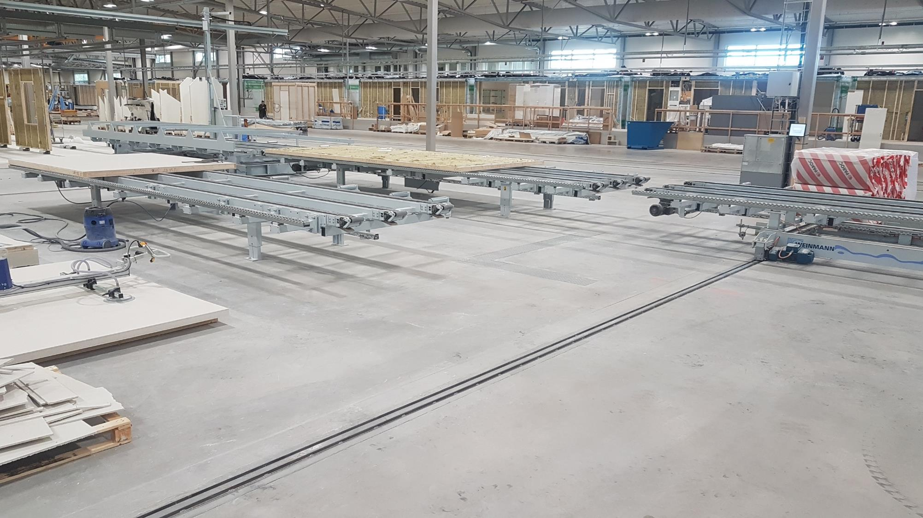

Prefabrication of Wood Buildings
This course is the intellectual property of Dr. Guido Wimmers
and subject to copyright.
Canadian
Wood
Council
Conseil
canadien
du bois
Notes:
This module was developed by Dr. Guido Wimmers for Canadian Wood Council. It remains the intellectual property of Dr. Wimmers and is subject to copyright.
The module is developed to be taught to students and professionals in either four blocks at 90-120 minutes each or as two blocks of 3-4h or one full day.
Please respect the copyright and give credit where credit is due.
The intend of this module is to give an introduction into the field of prefabrication with wood analyzing the different levels and methods available and develop a fundamental understanding of the advantages and disadvantages of prefabrication and its levels. Furthermore an overview of the different factors influencing the success of prefabrication in the market will be discussed.

Slide 2
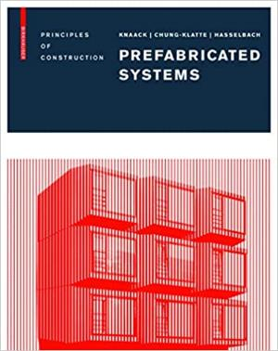

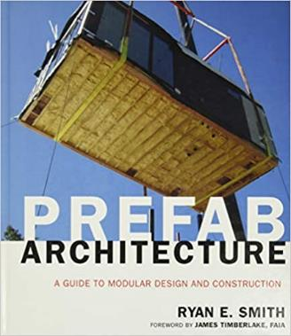
Literature Suggestion
Prefabricated Systems: Principles of Construction
by Ulrich Knaack, Sharon Chung-Klatte, Reinhardt Hasselbach
Publisher: Birkhäuser
ISBN-13 : 978-3764387471
Prefabricated Housing: Construction and Design Manual
by Philipp Meuser
Publisher: DOM Publishers
ISBN-13: 978-3869224275
Prefab Architecture: A Guide to Modular Design and Construction
by Ryan E. Smith
Publisher: Wiley
ISBN-13: 978-0470275610

Slide 3
Prefabrication of Wood Buildings
Lesson: Introduction and Classification
  History of prefabrication
  Driving factors for change
  Classification
Lesson: Prefabrication Process
  Influence on design process
  Influence on product
  Production process for panelized prefabrication
Lesson: Modular and Materials
  Pods production
  Modular production EU
  Modular production CAN
  Materials
Lesson: Pros & Cons and Case Studies
  Construction site
  Pros & Cons
  Case studies
Notes:
The lessons are designed to be taught in 90-120min, the exact time depends on the presenters knowledge and students interest. Ideally plenty of time for Q&A and discussion should be factored in.

Slide 4
Lesson 1: Introduction and Classification
History of Prefabrication
Driving Factors towards Prefabrication
Classification
Canadian
Wood
Council
Conseil
canadien
du bois

Slide 5
History of Prefabrication
Objectives:
Summarize the history of prefabrication
Identify the achievements throughout history
Canadian
Wood
Council
Conseil
canadien
du bois

Slide 6
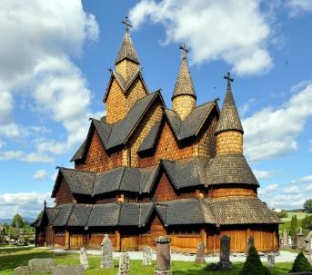

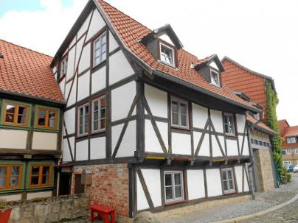
1242 Heddal Stave Church, Norway
1494 Casa Mutabile, Leonardo Da Vinci
1500’s Timber Framing, Central Europe
Early Examples of Prefabrication
Photos: Wikipedia
Notes:
To discuss prefabrication of buildings in more detail it is useful to look briefly at the history and comprehend where the prefabrication industry is coming from. Records mentioning Heddal Stave church in the 14th century, probably prefabricated and build around 1242. It is most likely the oldest still standing prefabricated wood building in the western world.
Leonardo DaVinci designed and fully prefabricated the Casa Mutabile which was supposedly installed in 1494 at the river Tigris.
Around the same time various systems, most of them a variation of timber framing emerged on several continents. The central European timber frame houses are still today influencing the streetscapes of many villages.

Slide 7
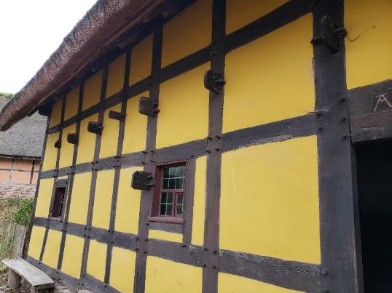
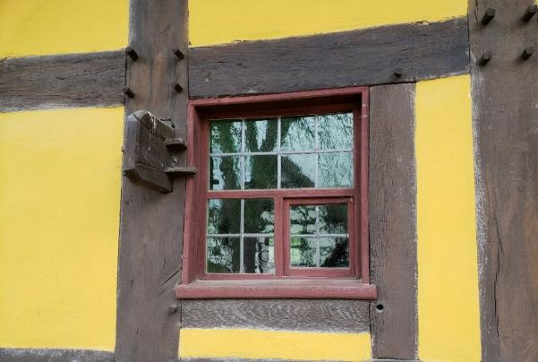
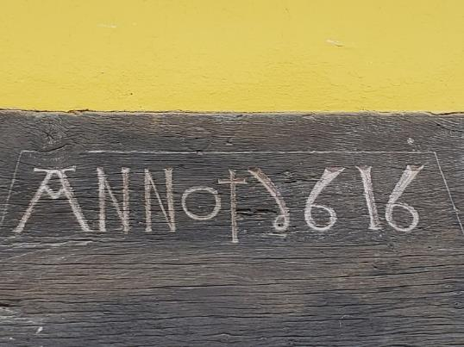
Historic Timber Framing Details
Photos: Wimmers
Notes:
The details show the level of prefabrication of those buildings. By todays standards the shipping distances were historically rather short, nonetheless the structural components were typically prefabricated.

Slide 8
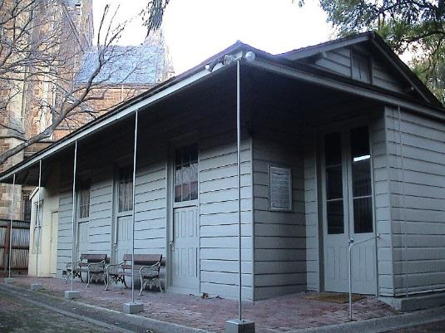
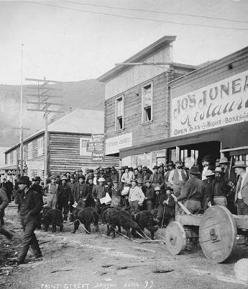
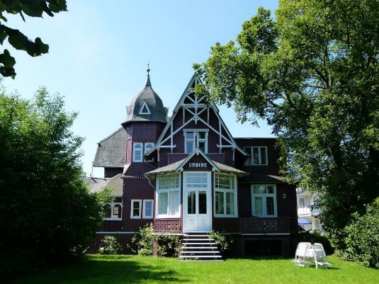
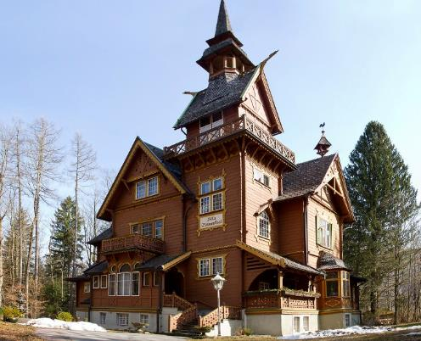
1840 Manning Cottage in Adelaide, Australia
1850’s Gold Rush, North America
1885 Villa Udine in Binz, Germany
1895 Villa Blumenthal in Bad Ischl, Austria
19th century
Notes:
A London carpenter, Henry Manning, constructed a house that was built in components, then shipped and assembled by British emigrants in Australia. This was published at the time (advertisement, South Australian Record, 1837) and a few still stand. The peak year for the importation of portable buildings to Australia was 1853, when several hundred arrived.
In North America prefabrication is used in a larger scale during gold rushes throughout the 1850’s
In Germany (Binz, Rugia Island) the Villa Udine was build in 1885 by Wolgaster Holzbau.
In Austria in Bad Ischl the Villa Blumenthal was build in 1895 for the artist Oscar Blumenthal. It is build with Canadian pitch pine. In 2015 the building changed owners for a sales price of 2.4 million Euros.
The two Villas prove that prefab was also used to build valuable buildings and the recent sales value of one of them proves that the quality standards used at the time were high.

Slide 9
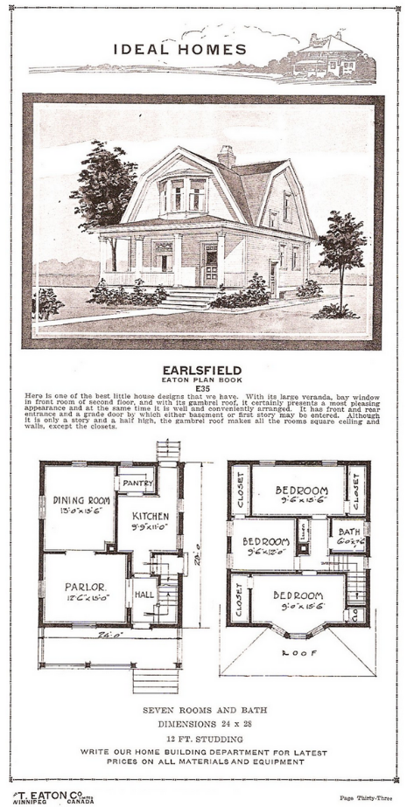
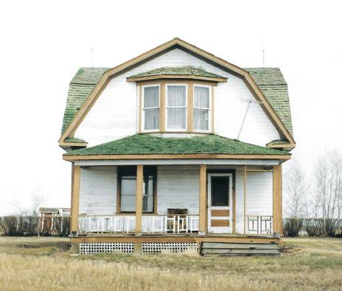
Canada at the beginning of the 20th century
Earlsfield catalogue house build in 1916 in Fielding Sask., by Eaton Co. Ltd, located in Winnipeg.
Photos: Les Henry and 1919 advertisement in Plan Book of Modern Homes
Notes:
Lumber was shipped from BC to Winnipeg, were the house packages were packed.

Slide 10
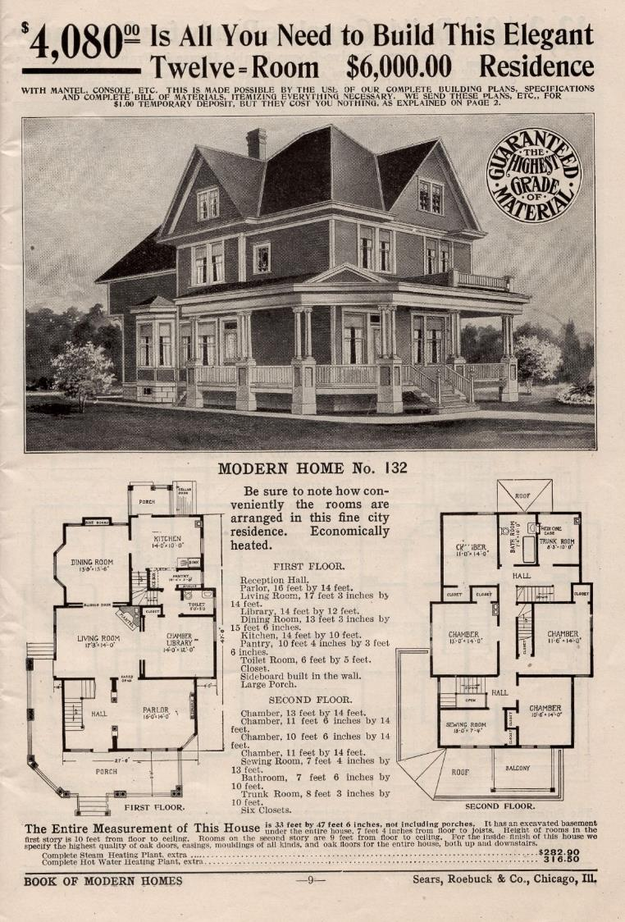
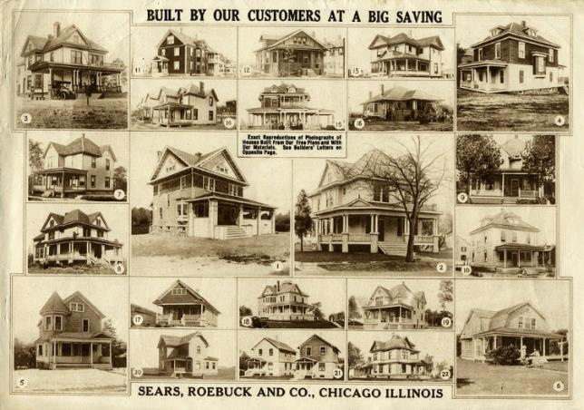
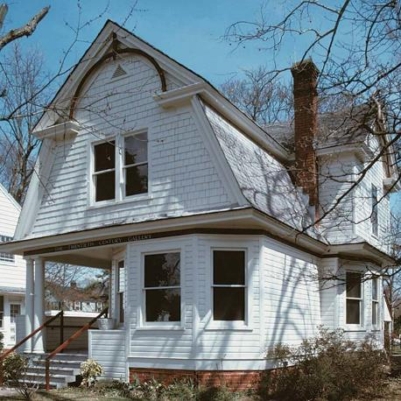
Model homes or catalogue homes by Sears 1920’s
Notes:
In the 1920’s Sears offered catalogue homes across the US. All lumber was precut and labeled so that the houses could be faster build. Also other materials that were needed, were included in the packages. Several are still standing today such as the one in Williamsburg, Virginia Photo: James C. Massey

Slide 11

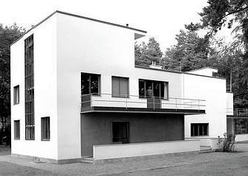
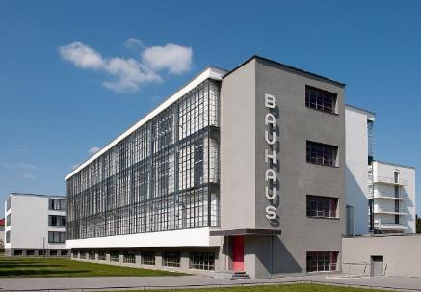
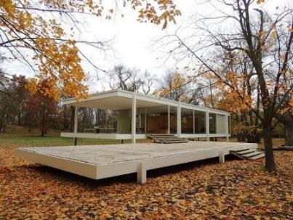
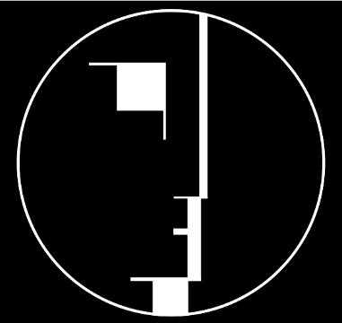

1920’s influential architectural school BAUHAUS
Notes:
Albert Einstein supposedly liked to relax in his prefabricated home close to Berlin.
Walter Gropius and several members of the BAUHAUS school (Mies van der Rohe, Behrens, Breuer, Kandinsky and others) created a new approach to art and several were focussing on architecture with industrial mass production in mind. The BAUHAUS school of architecture and design influenced modern architecture like no other movement in modern times and set the foundation for not just a plain and modern architecture, but also for a wide adoption of prefabrication.
Various systems, based on concrete or a variation of timber framing were following the school and were implemented on several continents. Steel was also becoming more common in the prefabrication of homes and buildings (including high rises!)
Mies van der Rohe continued his work later in the US where he builds some of the most iconic buildings, using prefabrication mainly in glass and steel.

Slide 12
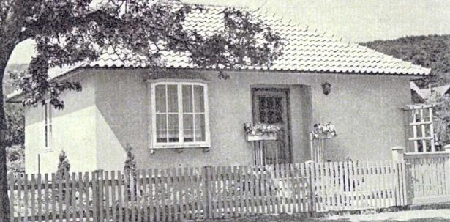
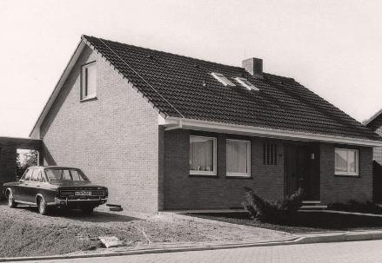
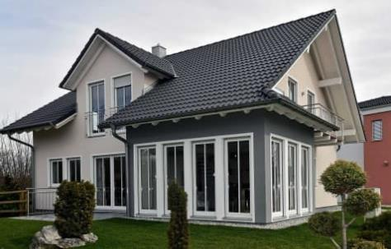
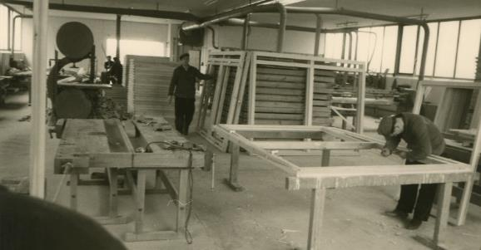
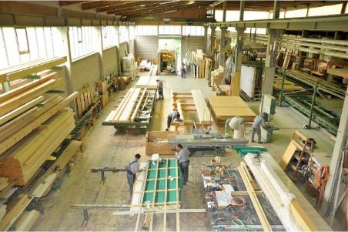
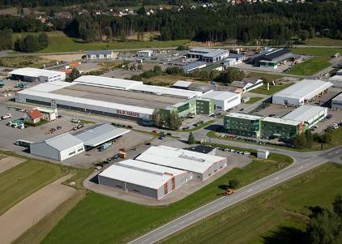
1950’s – 1990’s
Notes:
The market of prefabricated wooden homes developed slowly from the post war years to the 90’s. The technical development in Europe and North America was relatively comparable. This is remarkable as the market share of wood construction for small residential buildings was substantially different. Only in northern Europe wood construction was almost as popular as in North America. Central Europe preferred brick and concrete and wood construction were for decades far below 10% of new construction.
The technology implemented started to slowly become more different when comparing the North American and European market. In Europe companies typically started as small carpenter shops and ventured over time into medium sized companies. Until the 90’s the few prefabrication companies were mainly large “catalog homes” mass producers. In the early 90’s in central Europe a new bread of small or medium sized enterprises (SME), typically family owned, were starting to produce mass customized buildings.

Slide 13
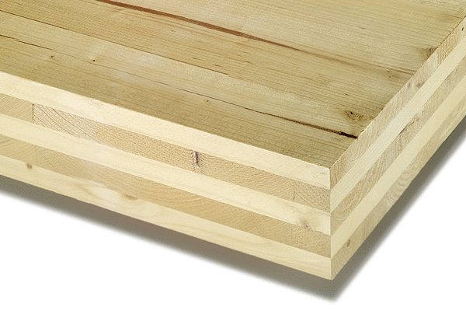
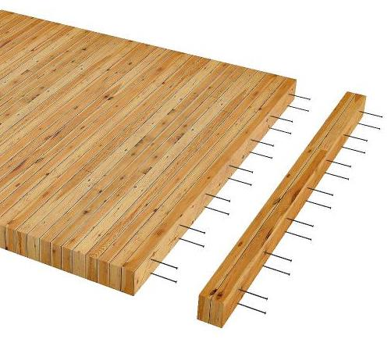
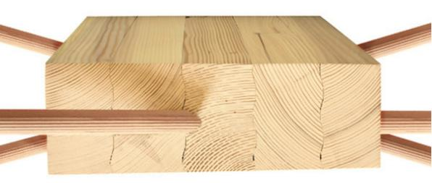
1990’s development or revival of EWP
Photos: DATAHOLZ, SOHM and STRUCTURECRAFT
Notes:
A new focus on the environment triggered a change of mindset with consequences for the selection of construction materials and consequently the wood construction industry. Green parties became more powerful, energy efficiency targets in building codes first introduced in the 80’s became much more meaningful in the mid 90’s. At the time the energy efficiency targets in central European countries were comparable to the lowest step of the 2017 introduced British Columbian Energy Step Code.
This is a key detail which helps to understand why the central European wood construction industry has a more than 20 years lead on the Canadian industry. Stronger energy efficiency requirements are triggering thicker wall and more labour steps to achieve airtightness and other performance requirements. This indirectly forced the wood construction industry into prefabrication much earlier than it is currently the case in British Columbia.
This pressure opened up new opportunities for advanced wood construction.
At the same time the wood construction industry realised that in the past they were gradually pushed to the edge of the market by other construction materials (mainly brick, steel and concrete). Only roofs were left for them to build. The percentage of new construction with wood was miniscule. Aggressive strategies to increase quality, reputation and sustainability were launched. Old engineered wood products (EWP) were experiencing a revival, such as NLT and glulam, and completely new materials were developed, such as CLT and DLT.
This lead to an entirely new situation, industrial wood construction took over. In the late 1990’s in central Europe wood buildings were not build on site anymore, the vast majority was prefabricated!

Slide 14
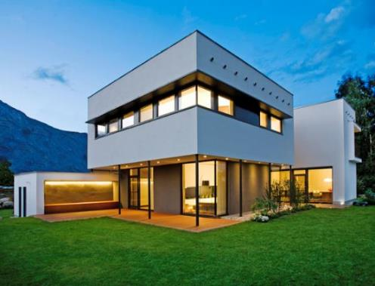
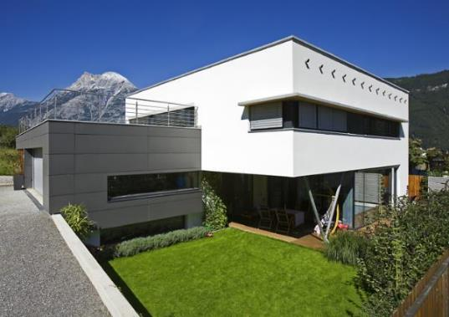
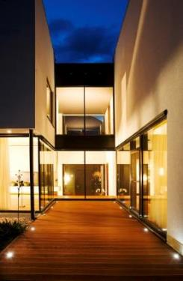
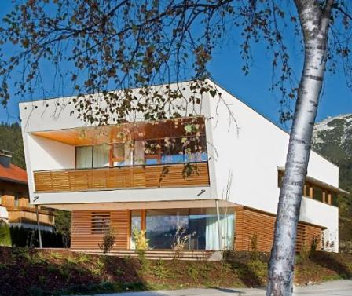
2000….
Photos: Arch. Melis-Melis-Wimmers
Notes:
The almost complete shift of wood construction in central Europe to prefabrication triggered the development of new architectural design strategies to fully explore the advantages of prefabrication. Besides the large “catalog homes” producers, mass customization became very popular. Carpentry companies produced highly customized, architecturally designed buildings. Usually those often family owned companies were producing 50-100 homes per year. The market share for wood buildings in new construction grew in some countries significantly over the 10% mark.

Slide 15
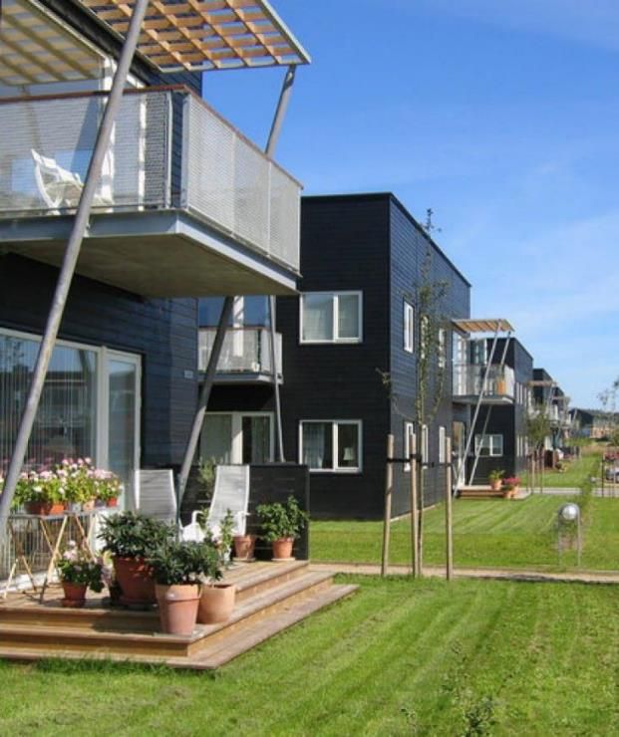
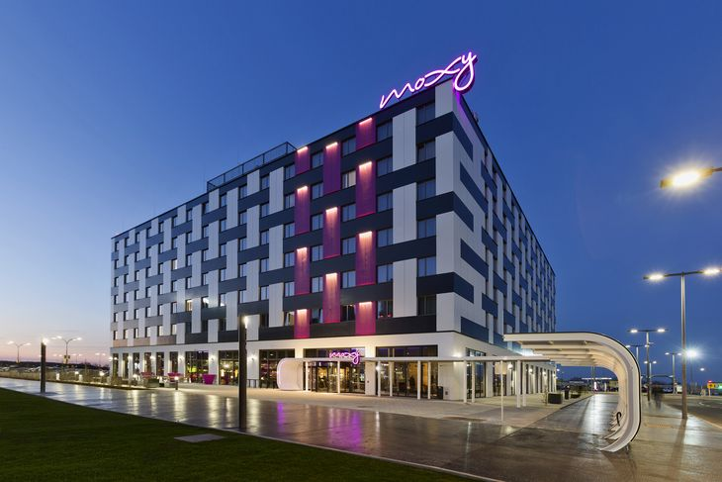
IKEA’s BoKlok and Moxy Hotels
Photos: IKEA
IKEA
Notes:
Also around this time new large players entered the prefabrication industry. For example, IKEA, together with Skanska, started BoKlok for duplexes and row houses and their hotel chain MOXY a few years later. BoKlok means “stay wise” or better “live smart”.

Slide 16
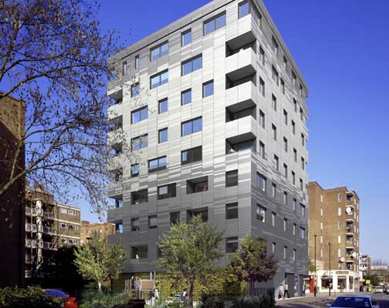
Tall Wood Buildings
Photo: WAUGH THISTLETON ARCHITECTS
Notes:
In 2008 the first “taller” wood construction (of modern times) was build in London. The 9 floors of the Stadthaus in the Murray Grove neighbourhood in London was assembled with prefabricated Austrian CLT panels.

Slide 17
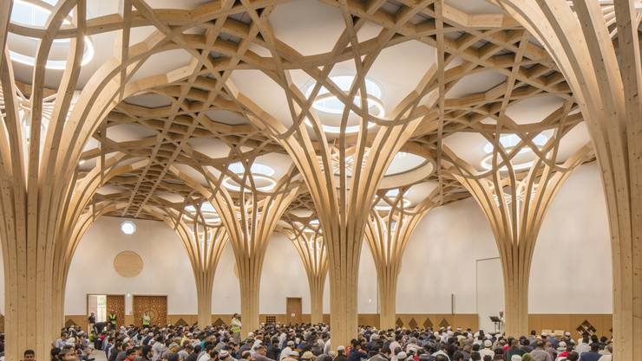
2010’s
Photo: BLUMER-LEHMANN
Notes:
The 2010’s were offering more complex 3D designs and parametric designs. BIM, first introduced by ArchiCad in 1987 (version 3.0) combined with digital manufacturing offering a new level of design. The limitations given through feasibility in manufacturing were step by step vanishing, architecture and design was becoming much more flexible and organic shapes or parametric design became possible and somewhat affordable.

Slide 18
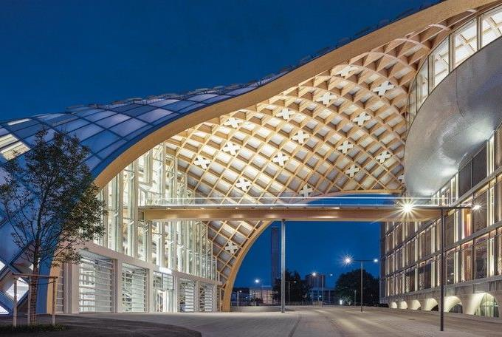
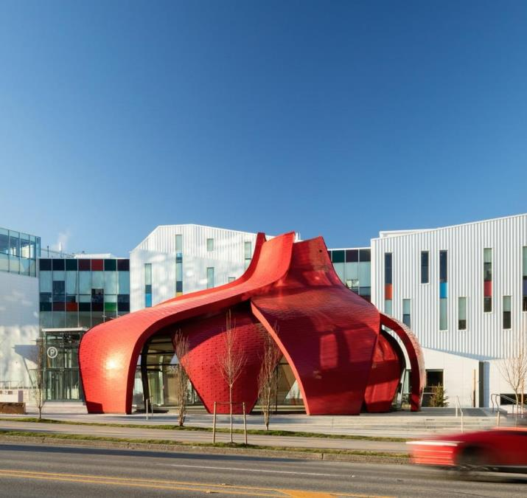
Parametric Wood Construction
Photos: BLUMER-LEHMANN and SPEARHEAD
Notes:
Parametric design and digital manufacturing now allows for a new level of complexity regarding the architectural form.

Slide 19
Driving Factors towards Prefabrication
Objectives:
Productivity
Automation
Lean manufacturing
Industry 4.0
Tall wood buildings
Energy efficiency requirements
Canadian
Wood
Council
Conseil
canadien
du bois

Slide 20
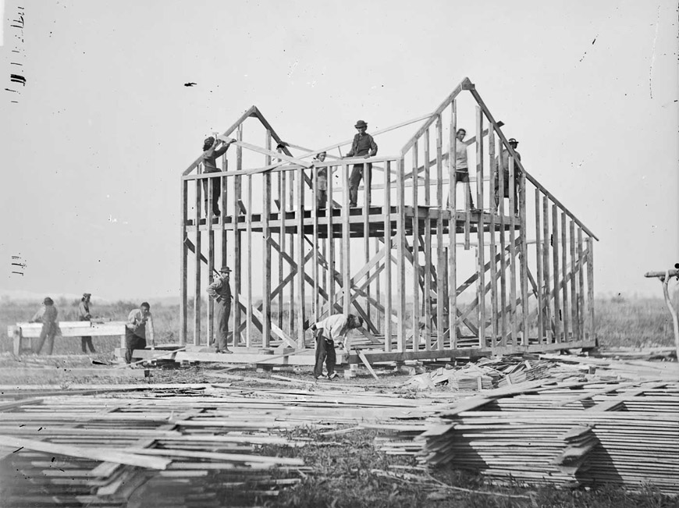
Stick frame 150 years ago
Evolution of wood construction in North America over the last 150 years?
Photo: William Henry Jackson
Notes:
The picture shows a typical wood construction site in North America around 1870. The techniques of nailing a bottom and top plate together with studs is still used today. In the 19th century only hand tools were used but otherwise the concept has not changed much over 150 years in Canada.

Slide 21
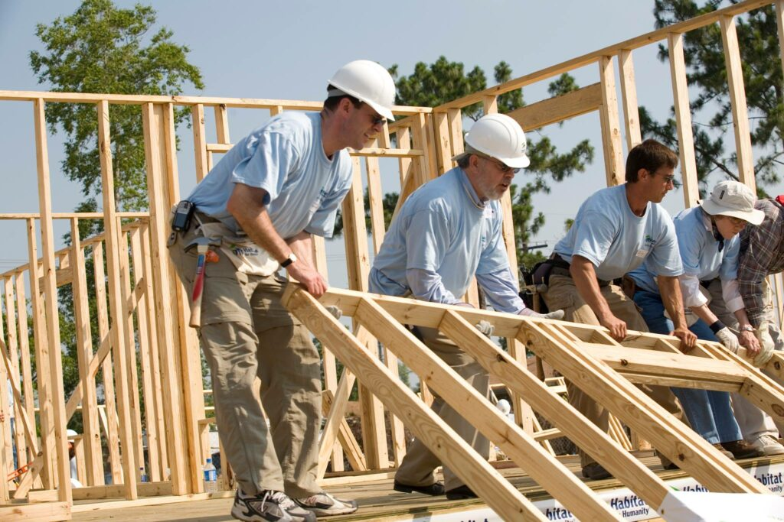
Stick Frame Today
Not much progress was made!
Photo: Habitat for Humanity
Notes:
If we look carefully how the vast majority of wooden structures are currently installed (across Canada), we can see small incremental improvement such as power saws, nailing guns and plywood. But generally the methods used are virtually the same as 150 years ago.
As long as only very simple structures with a low emphasis on thermal insulation, thermal mass, sound insulation and other building science related topics is requested, this method has been proven to be relatively cost efficient. But as soon as the building code is requesting some moderate improvement of the building science topics, the cost efficiency is shifting towards prefabrication. This was at least the case in central Europe 25 years ago and will be most likely also the case across Canada.
But since, with the exemption of a few, no further improvements were made, it is also obvious that the wood construction industry is not able to compete with other industries.

Slide 22

Future
Notes:
The “Shaping the Future of Construction” report, published in 2016, authored by the World Economic Forum and the Boston Consulting Group analyses mainly the USA construction industry. It is a well researched and summarized report of the current (2016) situation. Even though the report is focussing on the USA, most of the findings are applicable to the Canadian industry as well.

Slide 23
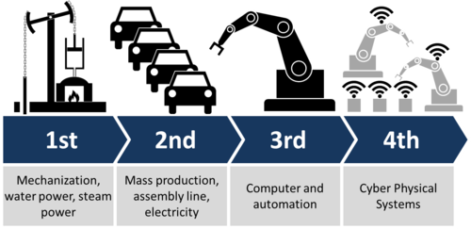
Industry 4.0
Graphic: Wikipedia
Notes:
To comprehend the findings of this report it might be helpful to look at the 4 phases of industrial revolution.
The first was the mechanization, the conversion of steam to power, the second was the electrification, introducing assembly lines and mass production, the third was the use of computers and automation and the fourth are cyber physical systems and AI.
Most modern industries are either located in the third or fourth phase. The automobile industry is a good example of the fourth industrial revolution as cars can communicate independently from the user in the cyber space.
In Europe the implementation of Industry 4.0 into the prefabrication industry is over the last 5 years at the center of discussion. The vast majority of prefabrication companies has adapted the third level, and implemented digital information management and automation and robotics in manufacturing.
In North America the prefabrication industry seems to be far less homogeneous. Only a few companies have adopted the third step, many are still in the second, without the use of mass production and assembly lines. Those are only used for some components, such as windows, but not for 2D elements such as walls, roofs and floors or even 3D modules.
Consequently, the productivity of the USA and Canadian wood construction industry is, with very few exemptions, rather low.

Slide 24
Construction Labor Productivity (USA)
250
+153%
200
Non-farm business
labour productivity
150
100
-19%
Construction
labour productivity
50
1964
1968
1972
1976
1980
1984
1988
1992
1996
2000
2004
2008
2012
Peer set based on US companies with engineering, construction and service-related standard industrial classification codes. Financials are inflation-adjusted and indexed to 1964; output per working hours.
Source: Global Vantage; Compustat; Bloomberg; www.aecbytes.com/viewpoint/2013/issue_67.html; www.nber.org/papers/w1555.pdf; S&P Capital IQ; BCG ValueScience Center; World Economic Forum
Graphic: Wimmers, based on report
Notes:
Not adopting modern technologies but slightly increasing requirements leads to reduced productivity.
If we look generally at the labour productivity over the last 50 years, we can see that the productivity went up by about 150%
This means that one man-hour is producing today 2.5 times of what was produced 50 years ago.
This is excluding farming. Farming would be completely off the chart.
Construction industry did behave quite differently over the past 50 years, reducing productivity by almost 20%.
These numbers are for the US American industry but it is safe to assume that the Canadian industry is fairly similar.
Certainly more challenging code requirements and higher environmental requirements might have caused some of the decrease, but the main reasons are others.

Slide 25
Why is the Construction Industry Performing so Poorly?
Lack of innovation and delayed adoption
Informal processes or insufficient rigor and consistency in process execution
Insufficient knowledge transfers from project to project
Weak project monitoring
Little cross functional cooperation
Little collaboration with suppliers
Conservative company culture
Shortage of young talent and people development
Source: World Economic Forum
Notes:
http://www3.weforum.org/docs/WEF_Shaping_the_Future_of_Construction_full_report__.pdf
The World Economic Forum prepared in collaboration with the Boston Consulting Group a 64 page report, analyzing the main reasons for the decline in productivity in the construction industry. The listed main reasons would be almost all automatically eliminated if modern prefabrication to level 2a or 2b (these levels will be explained later) would be implemented.
Summarized findings:
Lack of innovation and delayed adoption
Informal processes or insufficient rigor and consistency in process execution
Insufficient knowledge transfer from project to project
Weak project monitoring
Little cross functional cooperation
Little collaboration with suppliers
Conservative company culture
Shortage of young talent and people development
Interesting link for further background information
www.futureofconstruction.org

Slide 26
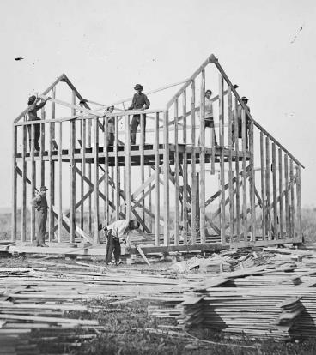
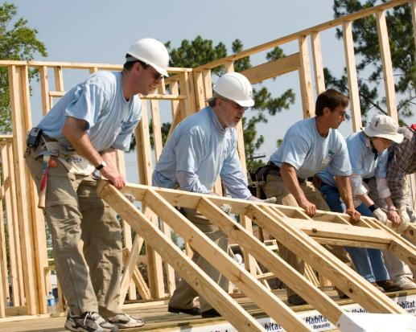
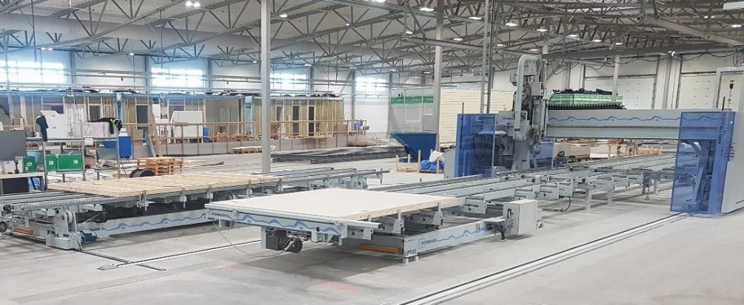
Productivity
Photos: William Henry Jackson, Habitat for Humanity, Wimmers
Notes:
The productivity has declined over many decades but could be increased drastically by implementing efficient prefabrication lines and an improved information flow.

Slide 27
New Driving Factors for Prefabrication in Canada
In recent years two major building code changes have started to transform the construction industry and will continue to increase their influence:
Tall wood buildings
Energy efficiency of buildings
Notes:
Besides the general need to increase the productivity for financial reasons, there are two relatively new influences for the Canadian market which will push or are already pushing the construction industry towards prefabrication. Prefabrication is mandatory in tall wood buildings and highly preferable for energy efficient buildings. As these two conditions become more accepted in the market, the essential manufacturing processes will spread to other building types, including basic ones.

Slide 28
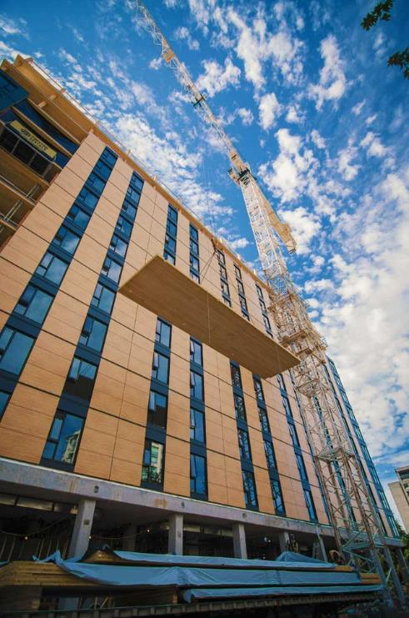
Tall Wood Buildings
Since 2020 the BCBC allows for 12 floor wood construction and the upcoming NBC goes in the same direction.
Without prefabrication, no wooden high-rise!
Notes:
The first major factor is new codes on the provincial and national level allowing to build taller buildings with wood. The traditional method with on-site framing is simply not an option for taller buildings as typically no scaffoldings are built for this type of buildings. The numerous labour steps to complete a wall are already inefficient on a normal construction site but basically impossible on tall building sites. The higher the level of prefabrication, the more cost efficient the construction.

Slide 29
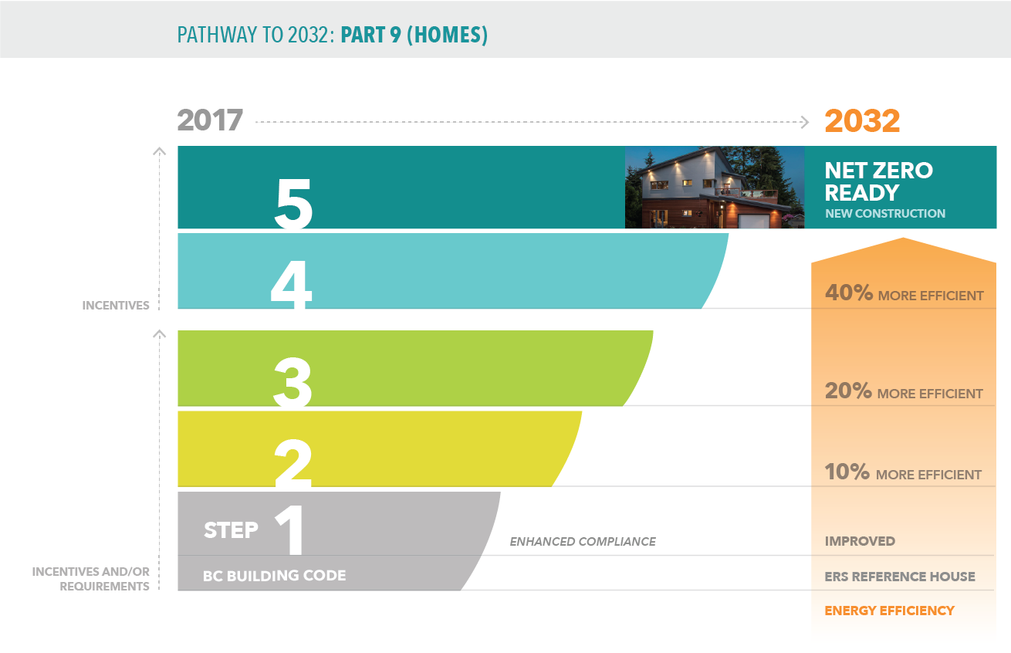
Energy Efficiency
The BC Energy Step Code has introduced a 5 tier system for the energy efficiency of BC’s buildings, leading to the highest step at latest in 2032.
Step 5 is typically called “net-zero ready”, not to be confused with Passive House. Passive House is still a level up and is occasionally referred to as “Step 6”.
Without prefabrication, no cost efficient construction of thermally higher performing envelopes.
Notes:
The second major factor are new codes on the provincial and national level, requiring for increased energy efficiency. This triggers thicker envelopes and also includes better levels of airtightness. The higher steps are more likely to be constructed with multiple layers, including potentially continuous layers of insulation on the outside of the building. All those things can be done on site but are far more efficient to do in an controlled environment with ergonomically well thought through work stations.
The increased required energy efficiency is the largest driver towards prefabrication. Over the last 25-35 years we have seen in Europe how the national energy efficiency requirements did change the wood construction and it can be expected that similar effects will occur when North American building codes start to request higher energy efficiencies. The BC Energy Step Code distinguishes even graphically the lower three from the upper two steps. More research has to be done but it is plausible that also at the 3 to 4 transition is the trigger point from which on prefabrication will be cheaper than on-site construction.

Slide 30
Energy Efficient = Thicker Envelope
Past
Intermediate
Future
1 ½ ”
¾ ”
8 ”
7 ½ ”
3 ½ ”
5 ½ ”
5 ½ ”
3 ½ ”
5 ½ ”
16”
16” – 24”
16” – 24”
16” – 24”
Traditional framing from ~1950’ to ~2005
Slightly better framing from ~2005 to ~2020
Intermediate step, risky with EPS/XPS! ~2015 to ~2025
Well preforming and well proven envelopes for energy efficient buildings, such as Passive House ~2010 and into the future
Graphic, Author: Wimmers
Notes:
By increasing the energy efficiency of building the thickness of envelopes will be increased, assuming rather traditional materials will be used. This is something we have seen in various other nations over the last few decades that had building codes in the past, requiring energy efficiency levels similar to those coming up in Canada over the next years. The increased energy efficiency requirements were a large part of the aspects, triggering the complete change to prefabrication in central Europe two or three decades earlier.
For Canadian construction this means for example: a stud wall will increase in thickness to fulfil thermal requirements, or a 2x6 wall will need an additional layer of continuous insulation. Many options are possible, but something all have in common is that more materials will be needed. This leads to bulkier and heavier construction which most likely will necessitate a transition towards prefabrication.
The intermediate version is (or was) to add a thin layer of continuous insulation on the outside. This is generally a good thing but was often done with less than ideal materials such as EPS or XPS. Those two add to the already relatively high vapour diffusion resistance of the plywood. Having a vapour retarder on the outside is risky as it might trigger humidity levels of over 80% or even liquid water.
Adding thicker layers of vapour diffusion open materials such as mineral or wood fibre insulation increases the thermal performance. Besides the improved energy efficiency this also triggers other benefits such as that the vapour retarder (1/2” plywood is classified as vapour retarder) will finally be used on the safe side, the warm side. This eliminates the risky construction so popular over decades, and offers much more durable and healthier buildings.

Slide 31
Classification
Objectives:
  Define the general levels of prefabrication
  Summarize the basics and the principles of each level
  Identify all relevant labour steps included in each level
  Discuss the necessity of multi trade collaboration in the advanced levels
  Estimate the financial and spatial dimensions of each level
  Investigate the advantages and disadvantages of each prefabrication level
Canadian
Wood
Council
Conseil
canadien
du bois
Notes:
In this section we will discuss the different types or classifications of prefabricated panels or modules, but this should not distract us from the key understanding of what prefabrication is:
Prefabrication is a process which includes the design, engineering, production of components such as panels or modules, services and finishes, and the installation on site.

Slide 32
Definitions
1D, 2D, 3D
Non-volumetric, Volumetric, Modular
Prefabricated housing involves the manufacturing and pre-assembly of components, elements or modules off-site, before their final installation at a chosen location (Goodier & Gibb, 2007).
Construction components are produced in a manufacturing factory, transporting complete or semi complete components to the construction site for final assembly to create building structures (Tam, Tam, Zeng & Ng, 2007).
Author: Wimmers
Notes:
Prefabrication can be defined in various ways, for example in 1D, 2D or 3D. Also important is to define what is pre-cut and pre-fab, at least for the further discussion. For example, mass timber components such as glulam, CLT, DLT and all other engineered wood products (EWP) panels are in European countries usually called pre-cut. The manufacturer produces those EWPs and then cuts them, including all openings and connection details according to specifications. It is still just a just EWP. The process does not include several other materials and trades which are necessary to finish a panel. At least in Europe the term “prefabricated” is commonly reserved for panels containing more than the actual EWP, including several materials and for which several trades were necessary to produce it.
In Canada the majority of the industry calls simple EWPs prefabricated. Even though there are good arguments to stay with pre-cut, we will simply accept common Canadian lingo and continue in this course to call them prefabricated. Just keep this difference in mind should you work/communicate outside of North America.
We are confronted with a similar situation when looking at trusses. Trusses are just an EWP but in Canada we have the tendency to also call those components prefabricated. For this course we will call them prefabricated.

Slide 33
Levels of Prefabrication
Level 1
Level 2
Level 3
Level 4
Engineered Wood Products
Prefabricated Panels
Pre-assembled Pods
Volumetric Prefabrication
Level 1a
Level 1b
Level 2a
Level 2b
Level 3a
Level 3b
Level 4a
Level 4b
Light Frame
Mass Timber
1 Side Closed Panels
2 Sides Closed Panels
Bathroom Pods
Mechanic. Pods
Manufact. Homes
Modular Constr.
Sources: Goodier C., Gibb A.: Future opportunities for offsite in the UK. Construction Management and Economics, 25(6), 585–595., 2007.
Goodland H., Lam A., Taylor M., Zadeh P.: Cost Implications of Accelerated Construction Schedules. Vancouver: FP Innovations, 2019.
Wimmers G: Wood Technology Solutions Report, Quesnel: City of Quesnel, 2020.
Graphic, Author: Wimmers
Notes:
Evaluating a wide range of literature and further adapting it to the specific situation of wood construction and accepting commonly used wordings in Canada, 4 general categories or levels of prefabrication can be defined.
Level 1 are engineered wood products. As mentioned earlier, this category might not be called prefabricated in other countries. Engineered wood products can be further divided in light frame products or mass timber products.
Level 2 are panelized prefabrication and can be further divided depending on the level of finishing.
Level 3 are the pods, the most complex category in prefabrication. Pods are volumetric units, including the entire or at least important parts of the mechanical systems. Kitchen or bathroom pods are used for any size residential buildings. Mechanical pods are specialized units including heating and cooling, warm water, ventilation and/or other systems for any building type.
Level 4 is volumetric prefabrication and can be divided in manufactured homes were one unit is a complete home, or in modular construction, were two or more units are assembled to build a building. Level 4 can be build in a factory by using level 2 panels and level 3 pods to create a home or a module.

Slide 34
Level 1
pre-cut and/or pre-assembled to size and specification
Level 1
Engineered Wood Products
Framing Packages or Trusses
Trades: one
Limited expertise in manufacturing, transportation and installation required
Some engineering involved
Moderate investment required
Incl. studs or joists, top and base plates, headers , nailing plates or nails or staples and sheathing
Level 1a
Level 1b
Light Frame
Mass Timber
Glulam, CLT, NLT, DLT, …
Trades: one
Expertise in manufacturing, transportation and installation required
Engineering involved, connections usually included
Manufacturing company may play a more central role in the design and construction process through the preparation of shop drawings
Higher investment required
Precut and predrilled panels or posts and beams, incl. connectors and cut-outs
Graphic, Author: Wimmers
Notes:
Level 1a: light framing packages or trusses; nailed, screwed or stapled together. Only one trade and limited engineering and expertise in manufacturing and installation is required. A very limited amount of different materials is used and a comparably modest investment is necessary.
Level 1b: all mass timber products including panels, posts and beams; glued, doweled or nailed together. Only one trade is required but more engineering and processing knowledge is necessary. A high expertise in manufacturing, transportation and engineering is required. A higher amount of different materials is used because typically all connections are prepared before shipped to site. A high investment into space and equipment is needed. Control of the raw material supply is essential for quality reasons and to control financial risk. So far, all larger CLT or glulam producer are vertically integrated saw mills.

Slide 35
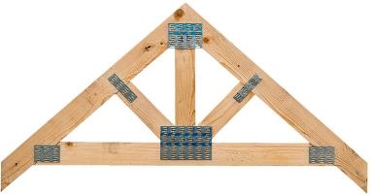
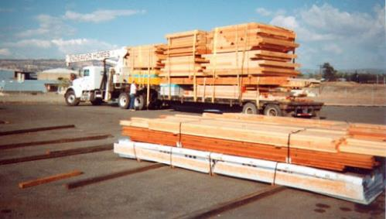

Level 1a: Trusses and Framing Packages
Moderate overall Investment required
Relatively small space required
Relatively small investment in equipment required
Photos: Homeadvisor, North East Remodeling Group
Notes:
Trusses are preassembled, structural connection between members is achieved through glue or nailing plates.
Framing packages can consist of only pre-cut lumber or of pre-framed panels or a mixture of both.
To produce these, the investment necessary is moderate. Space requirements are comparably low and only relatively little investment into equipment required.

Slide 36







Level 1b: Glulam, NLT, DLT, CLT, …
For DLT and NLT moderate investment in equipment required
For Glulam larger investment in space and equipment required
For CLT very large overall investment required
Photo: upper Dataholz, Structurecraft, lower Wimmers
Notes:
The investment into the production, including space and equipment is already high for glulam but significantly higher for CLT. Dowel and nail lamination have a comparably lower investment. Since connectors are usually preinstalled, high engineering skills are required if not outsourced.

Slide 37
Level 2
1 side closed
Trades: several (e.g. carpenters, insulators, window installers, etc.)
High expertise in manufacturing, transportation and installation required
Engineering involved, connections and weather barrier included
Prefabrication company plays a central role in the design and construction process through the preparation of shop drawings, coordination of sequencing, provision of specialized equipment, etc.
Level 2a
Incl. level 1 plus weather barrier on outside; can include insulation, services and windows
1 Side Closed Panels
1 side closed and finished
As above plus completely finished exterior and windows
Prefabricated Panels
Level 2b
2 sides closed
Trades: many (e.g. carpenters, insulators, window installers and potentially electricians, plumbers, installers of mechanical systems, etc.)
Very high expertise in manufacturing, transportation and installation required
Engineering involved, connections, weather barrier, airtightness and vapour retarder included
The prefabrication company plays now a vital role in the design and construction of the project and beside the multiple trades also an interdisciplinary design team is included.
2 Sides Closed Panels
Incl. all necessary layers to close the panel for air, vapour diffusion and weather; final layer on the inside and the outside not included; can include services and windows
2 sides closed and finished
As above plus completely finished exterior, services, windows and interior
Graphic, Author: Wimmers
Notes:
Level 2, panelized prefabrication is the category with the largest range of variations. This category can be further sub-divided into one side or both sides closed panels, and then further sub-divided by defining if the panel is not just closed but also finished on the in- or outside or both.
Level 2 could be also utilizing EWPs from level 1b, the mass timber products. This is commonly done for horizontal panels. For vertical panels mass timber is usually only used for inner walls. The more complex exterior walls are rarely using mass timber, mainly because of hydrothermal reasons.

Slide 38

Level 2a: Outside Closed, Inside Open
Higher overall investment than for 1a required
More space and more work stations than for 1a required
Investment in more equipment recommended but not necessary
Photo: UBC Brock Commons*, WoodWorks BC
Notes:
The overall investment is certainly higher than in 1a.
More work stations and more material storage results in more space required.
The investment into equipment can still vary widely but is usually larger as well.
This level is the minimum requirement for tall timber construction. The picture shows the prefabricated steel construction of the Brock Commons envelope elements. The wall panel consisted on an exterior sandwich panel, including the cladding, membrane, a thin layer of rigid foam insulation and windows, all mounted to steel studs. After installation the insulation, electrical, vapour barrier and drywall was installed on site. In this case the outside layer was not only closed (weather barrier) but also finished (cladding). On the outside only the transitions had to be finished on site, no scaffolding is needed.
*Technically the envelope panels of Brock Commons should not be listed in this segment as the envelope panels are NOT manufactured with wood.

Slide 39


Level 2b: Panel Closed (or finished) on both Sides
Higher overall investment than for 2a required
In addition to 2a more space and more work stations required for electrical, plumbing, air barrier, drywall and flooring
Investment in more equipment recommended, typically more automation
More storage space required
Photo: FAZ.net, Wimmers
Notes:
Panels are closed and finished on both sides, all services are installed, only the connections have to be completed on site.

Slide 40
Level 3
Level 3a
Trades: many (e.g. carpenters, tile setters, electricians, plumbers, installers of mechanical systems, etc.)
Highly specialized three-dimensional elements have been fabricated by multiple trades (focus is on electrical, mechanical) and are shipped fully finished from a factory to integration on-site or off-site
The specialized company works closely with the project team to customize, assemble, transport and install the units.
Examples include fully equipped mechanical rooms, most common are so called bathroom and/or kitchen “pods”.
Off-site those pods are integrated into modular construction
On-site those pods are then typically connected to either prefabricated panels according to level 2a or 2b or off-side integrated into modules as described in level 4.
Bathroom Pods
Complete installation of all plumbing and bathroom fixtures, including finishes such as tiles. Occasionally combined with kitchen fixtures preinstalled on one of the wall’s opposite sides.
For structural system wood or steel studs can be used.
Pre-assembled Pods
Level 3b
Mechanic. Pods
Similar to bathroom pods, mechanical pods entail all relevant mechanical system preinstalled and prepared for “plug and play”.
Mechanical pods are typically used in larger buildings and are not mass produced as bathroom pods as typically only one is needed per building
Graphic, Author: Wimmers
Notes:
Level 3 is for the most complex components as the 3 dimensional structures are completely finished and include complete bathrooms or kitchens or both. They can also include heating, cooling, ventilation and other mechanical components. The complexity in planning and design, manufacturing and transportation are the highest level. Pods can be delivered into modular plants to be further integrated or directly to the construction site to be combined with panels.

Slide 41


Level 3: In a Manufacturing Plant and Integration in Modules
Less investment in large machines required as pods are usually smaller
More investment in workstations for electrical and plumbing required
Storage space for many different types of material required
Photos: Tjiko, Wimmers
Notes:
Pods can be manufactured with a wood or a steel structure. Historically steel structure where preferred as the necessary stiffness for tiling and other finishes was easier to produce with steel. The structure should be as stiff as possible as tiles or other materials are bridle and particularly vulnerable during transportation. In recent years innovative companies entered the market with well designed wood structures for bathroom pods.

Slide 42
Level 4
Level 4a
Manufactured Homes
Constructed and completed in a factory and shipped in one piece to the final place. Customization is limited to structural and size constrains. These buildings are also occasionally referred to as mobile homes or trailer homes.
Trades: many (e.g. carpenters, insulators, window installers, tile setters, electricians, plumbers, installers of mechanical systems, etc.)
3 dimensional elements are shipped to site and put into position (manufactured home) or assembled to a larger building (modules)
The specialized company works closely with the project team to customize, assemble, transport and install the units.
The range of this category goes from mobile homes to tall residential wood buildings such as 14 floor Treet in Bergen (Norway)
Volumetric Prefabrication
Level 4b
Modular Construction
Constructed and ideally completed in a factory and shipped in several modules to the building site. Customization is possible. Large buildings are possible. Combinations of modular, panelised and pods are more common for very large buildings.
Graphic, Author: Wimmers
Notes:
Manufactured and modular homes or buildings are relatively similar as both are 3D and prefabricated in a factory. Usually the manufactured home is completely finished and shipped as one piece to the site. Manufactured homes have a rather bad reputation because of quality issues of cheap products for trailer parks or other low quality products. These quality issues have damaged the reputation of prefabrication, but prefabrication can (and should) achieve a higher quality than on-site construction.
Modular construction consists of at least 2 modules (can be many more), which will then be assembled on site.
Modular construction in Europe is either finished to a very high degree or completely finished. This is done to fully use the advantages of prefabrication and minimize the less efficient work on site. Only a few steps might be left to finish on-site, some companies for example leave mudding of drywall and painting left for on-site workers as drywall is prone for cracking during transportation. The quality of modular construction (architectural, build and finished quality) may vary very largely. Higher quality than on site construction is certainly possible but maybe currently not offered.
In NA modular construction is currently quite often (exemptions apply) not completely finished and delivered to site with many further work left for on-site construction. This leaves a very large part of the advantages of prefabrication not utilized but includes already one of the main disadvantage of prefabrication, the costs of a large facility. As this “in-between version” of modular construction is generally (exemptions apply) not viable, we did not create a separate category.

Slide 43


Level 4: Manufactured and modular Buildings
Photos: Rune Abrahamsen, Homes Direct
Notes:
Volumetric construction starts with “one unit” manufactured homes and goes to buildings such as the 15 floor tall multi residential high-rises. The 2015 finished TREET in Bergen, the world’s tallest timber building until overtaken by another building in Norway in 2020 was built using modular construction in addition to a brace-frame timber super structure. Please watch a video of this project in the last lesson.
Deconstruction should be discussed from a conservation of materials and labour perspective as well as the necessary design considerations. It cannot be an afterthought.

Slide 44

What Influences the Transition to Prefabrication?
How will current or future building codes potentially influence the prefabrication industry?
How large do you estimate the savings potential for more efficient manufacturing?
How does Canada’s prefabrication industry fit into the different prefabrication levels?
Canadian
Wood
Council
Conseil
canadien
du bois
Notes:
Discuss those and other questions with the students.
Potential answer to 1:
Code changes towards allowing taller wood buildings trigger growth in the prefabrication segment. Prefabrication is essential for building taller building.
Code changes towards more energy efficient buildings triggering the use of more insulation, which will make envelopes bulkier and heavier, making it very inefficient to build on-site.
Potential answer to 2:
Studies have shown that the waste reduction can be between 20-40%, meaning material costs can go down adequately. Productivity of workers will be strongly increased but at the same time investment into facility and machinery is increasing as well. Eventually it depends on each specific company but potentially relatively large savings are possible. Estimations range for overall savings from 20-40%.
Potential answer to 3:
There are only a few companies offering level 2a, the vast majority can be found in 1a. Technically there are many companies who offer modular construction, but the vast majority does not have preinstalled services and finished surfaces. Currently many Canadian modular manufacturers are only offering basic “raw” modules, not including electrical, mechanical and other services and are therefore relatively work intensive on site.

Slide 45
Lesson 2: Prefabrication Process
Influence on design process
Influence on product
Production process panelized prefabrication
Canadian
Wood
Council
Conseil
canadien
du bois

Slide 46
Influence on Design Process
Objectives:
  Define and compare the different approaches of conventional and Integrated Project Delivery (IPD)
  Discuss the elementary changes in the design and delivery process
  Discuss the necessity of Building Information Modelling (BIM) in prefabrication
Canadian
Wood
Council
Conseil
canadien
du bois

Slide 47
Unique Design Process Requirements
Architectural Design and Engineering (Integrated Design & Delivery Process)
Early engagement of entire team
Conceptual design becomes important and more detailed
Understand available systems
BIM highly advised (1st BIM tool ArchiCAD 3.0 introduced in 1987 )
Very detailed Shop Drawings
Vertical integration of builder/contractor is very helpful
Transition from 3D Drawings to Machine readable Information
Transportation and Installation Plan
Assembly and Connections different than in typical “On-site” Construction
Author: Wimmers
Notes:
Generally, the design process for prefabricated projects is much more “front heavy”. This means that the entire design, including all details has to be finalized before production begins. The optimization of the information flow is key and BIM is advised. One crucial advantage of a well thought through and designed project for prefabrication is the fact that the cost uncertainty is virtually eliminated and contingencies funds can be drastically reduced.

Slide 48


Integrated Project Delivery
Source: Integrated Project Delivery: A Guide 2007 AIA
Notes:
The key to integrated project delivery is the involvement of most/all designers, engineers and other stakeholders as early in the project as possible. This enables the team to get to a more detailed design stage earlier and therefore well founded answers to quality and cost related problems can be given much earlier in the process.

Slide 49


Integrated Project Delivery
Traditional Design Process
Integrated Project Delivery
Source: Integrated Project Delivery: A Guide 2007 AIA
Notes:
The project phases also change slightly because of this. Decisions are made sooner and faster and during the detailed design phase all stakeholders are involved in the project. The goal of the early involvement is to reduce uncertainties and lead to a higher quality outcome.

Slide 50
Schematic Timelines
On-site Construction
On-site construction, mechanical & electrical services, finishing
Design, Permitting,
Engineering, Approvals
Site Preparation, Civil Engineering, Construction Infrastructure
Off-site Construction (Mass Customization)
Design, Permitting, Engineering, Approvals
Site Preparation
On-site installation
Finishing
Off-site
manufacturing
Off-site Construction (Standardized)
Site Preparation
Finish.
Design, Permitting,
Engineering, Approvals
On-site
installation
Off-site manufacturing
Graphic, Author: Wimmers
Notes:
The schematic timelines are a strong simplification to explain the general sequence, many different variations are possible, depending on the project, the set up of the project team and the capabilities and integration of the manufacturer, as well as the level of standardization implemented.
Prefabrication typically needs more upfront planning and design, only if a high level of standardization is used the time frame might be shorter again. Site preparation is usually shorter. The actual manufacturing process is quicker than on site and is including installation and finishing, the total time needed to finish a project utilizing prefabrication is usually shorter than with on-site construction. Cost certainty is ideally reached at the end of the design phase or at the end of the site preparation phase vs. on-site construction reaches cost certainty towards the end of the construction phase as unforeseen or uncalculated details and change orders are influencing the cost to the very end.
If a high level of standardization is used, the total project duration can be shortened even further due to optimized planning, streamlined production and on-site installation.

Slide 51
Definition of BIM
A Building Information Model is a “shared digital representation of physical and functional characteristics of any built objects (including buildings) which forms a reliable basis for decisions.” ISO 29481
In addition:
The model can and should be maintained over the lifetime of the building to support maintenance, future renovations, extensions and other activities to generate the full potential over the lifetime of the building.
Author: ISO, Wimmers
Notes:
Besides the depth of the information available in a BIM model, the duration of the availability is key. Based on the BIM model, maintenance can be scheduled, parts can be exchanged and renovations or extensions can be planned and ultimately the disassembly and recycling and reuse can be organized.
Most value of BIM does not only lay in the design and construction phase but in the maintenance and refurbishing phases.

Slide 52
The BIM issue
The output of the design are not drawings!
It is the information presented on or imbedded into the drawings.
The “drawings” are simply a tool to carry multiple layers of information models that support the design, the construction process, the commissioning and the operation, including potential alterations at any given time over the life time of the building.
BIM is not an absolute necessity for successful prefabrication, but it is very beneficial and saves costs!
Author: Wimmers

Slide 53



Digital Project Delivery and Integrated Project Delivery
Photos: ICD University of Stuttgart, Jakob+MacFarlane
Notes:
Digital Project Delivery increases efficiencies throughout the projects life, including maintenance and renovations.
Digital Project Delivery opens up an entirely new world of design and manufacturing.
Parametric design and prefabrication makes complex forms feasible and achievable!
Architects are, once fully understood, embracing the untapped potential of prefabrication

Slide 54
Influence on Product
Objectives:
  Analyze qualitatively how off-site manufacturing leads to building science related assembly changes
  Discuss the changes in the procurement process and material flow
Canadian
Wood
Council
Conseil
canadien
du bois

Slide 55
Changes in Assemblies
The plywood issue:
Light frame construction needs something to handle lateral forces. Traditionally this is done with a sheet of plywood (or OSB)
12,7mm (1/2”) plywood is rated as a vapour retarder
Vapour retarders should always be on the inside (warm side) and are usually the same material as the airtight layer.
Because of the assembly sequence in on-site construction, plywood was traditionally installed on the outside of the insulated building envelope
Installed on the outside (cold side, layer e. on next slide) plywood triggers increased vapour pressure, potentially above saturation pressure and consequently condensation
Author: Wimmers

Slide 56
Changes in Assemblies
f
a
c
d
d
The plywood issue (continue):
This, combined with a lack of airtightness on the inside, became over time (decades) an added risk to common construction
Off-site construction opens up a more science based decision, where the plywood (vapour retarder) should be located
Plywood (or OSB) can take lateral forces but is also excellent as air barrier (needs to be taped) and vapour retarder
Using plywood on the warm side (layer c.) is much safer
Assuming an installation layer is introduced (layer b.) and special grommets are used to achieve airtightness, plywood can now fulfill 3 different functions at once
b
e
Assembly 1)
Assembly 2)
Graphic, Author: Wimmers
Notes:
The three functions of plywood or OSB installed towards the warm side of the envelope assembly are:
Structural layer for lateral forces,
vapour retarder (12.7mm are classified as vapour retarder by NBC of Canada) and
airtight layer, if all seams are sealed properly.

Slide 57




Prefab is a necessity because…
Envelope will get 42 – 77% heavier and will have 87 – 100% more volume!
Source: MOC 2019 Conference Paper: Conroy, Wimmers, Consequences of the BC Energy Step Code on Offsite Construction
Notes:
A study published in 2019 compared the BC Energy Step code step 1 with step 5 with several wall designs for a simple residential building. Depending on designs the weight per m² wall was increased by 42 – 77% and the volume of the wall (thickness) was almost doubled. This, combined with airtightness requirements makes prefabrication the more attractive method.

Slide 58

Changes in Planning and Design of Services
Photo: Tjiko
Photo: TECEsystem
The implementation of several trades in the prefabrication process requires a more detailed involvement of those trades/planners in the design phase
Notes:
The assembly of building elements allows the use of new methods and pre-manufactured service systems.
Services can be either directly integrated in the prefabrication process or at least partially outsourced by using pods (left picture) or “blocks”, like shown in the right picture.

Slide 59
Changes in Process
1 ½ ”
¾ ”
8 ”
7 ½ ”
3 ½ ”
5 ½ ”
3 ½ ”
5 ½ ”
16” – 24”
16” – 24”
Estimate additional labour steps needed
Estimate additional expenses on site
Compare to off-site construction
Graphic, Author: Wimmers
Notes:
Go through the entire process of traditional construction and then analyse the additional steps to prevent thermal bridges and achieve sufficient air tightness (<1.0 ach@50Pa).
Estimate the additional time/costs if these steps are taken on-site. Imagine the process and the efficiency.
Imagine an optimized production in a controlled environment and estimate time, cost and resulting quality.

Slide 60
Production Process
for panelized prefabrication
Objectives:
  Develop the generic outline of a prefabrication production line and evaluate the workflow
  Differentiate the requirements in production process depending on the level of prefabrication
  Outline the setup and ergonomics of different workstations in the production process
  Estimate the financial impact of different machinery and level of automation and their space requirements
Canadian
Wood
Council
Conseil
canadien
du bois

Slide 61
Procurement and storage
Prefabrication and the level of standardization changes the procurement processes. Depending on the size of the factory, larger amounts have to be delivered to the same address, allowing for bulk purchases, but require storage space.
The storage space is further increased if more mass customization is used.
For windows and other larger and more valuable components typically “just in time” delivery is preferred.
Author: Wimmers

Slide 62
What prefabrication should be
Clarifying what Prefabrication should be:
Prefabrication is not the continuation of the traditional process sequence in an controlled environment.
Prefabrication includes the optimization of all processes in an controlled environment, optimizing ergonomics and productivity and eliminating high noise levels, dust, heavy lifting and other health and efficiency reducing factors.
Optimized prefabrication processes have a balanced work flow, eliminating bottle necks!
Every company will have different limitations. Optimizing the process means always getting the highest “quality to effort ratio” for each aspects of the process.
Author: Wimmers
Notes:
Just moving the same traditional processes underneath a roof is not the idea of prefabrication! Prefabrication includes the entire optimization of the material flow, workstation and overall productivity by producing a superior quality compared to on-site construction! This increased efficiency should also reduce the overall cost.
This statement is probably the most important statement in this course!

Slide 63
Material flow of wooden prefabrication of buildings
Materials
Components
Elements
Assembly
Extraction:
Sand
Aggregate
Ore
Oil
Harvesting:
Wood
Bio Fibers
Cement
Glass
Insulation
Steel
Lumber
Polymers
Sealants
Coatings
Adhesives
OSB
Plywood
Drywall
Wires
Pipes
Screws
Nails
Seals
Tapes
Membranes
Doors
Windows
Hardware
Fittings
Wall Elements
Roof Elements
Floor Elements
EWP
CLT, …
Trusses
Frames
Completed or semi-completed structures or components:
Panels
Volumetric
Pods
Foundation
Services
Installation
Service connection
Finishing
Raw Materials
Processed Materials
Sub Components
Functional Components
Structural or semi-structural Elements
Off-site Assembly
On-site Assembly
Graphic, Author: Wimmers
Notes:
We use processed materials, such as lumber, and combine them with sub components and functional components and structural elements, such as CLT, to produce prefabricated panels. Then we can use those panels to build a building on site or to build modules in a factory.

Slide 64
Material flow
To minimize the need for storage space a different procurement process has to be applied than traditional construction
On-time delivery can be practiced to some degree
Standard design allows for faster flow and less storage space
Custom design requires more on-time delivery (e.g. windows)
Material should flow from storage to the stations with as limited as possible interference of production process
Author: Wimmers

Slide 65


Smaller Prefabrication Company…
Photos: BC PASSIVE HOUSE, Wimmers
Notes:
One of the smaller prefab companies is for example BC Passive House in Pemberton, BC. This company started to produce on approximately 1200m², grew over the last 10 years enough to have more than doubled their space in 2020. A video of the construction of the extension can be watched at the end of this session. 1200m² floor space in the production has been seen frequently to be a good dimension to start. Essentially this is roughly the space needed to produce the equivalent volume of one single family house per week.

Slide 66


Large Prefabrication Company
Photos: EXJÖHUS, Wimmers
Notes:
One of the larger prefab companies is for example Exjöhus in Sweden with a new production facility with the size of about 8400m² on a lot more than 4 times the size. Beside the production facility is a storage facility for more than 50 modules located, allowing for a continuous production even if on-site preparations are delayed, or more importantly, throughout the winter.

Slide 67
General Production Steps
Cutting of materials
Building structural system of panels
Installing membranes and windows
Installing electrical and plumbing services
Installing insulation
Preparing/finishing interior and exterior
Canadian
Wood
Council
Conseil
canadien
du bois

Slide 68
Schematic Prefabrication Plant Layout
Framing floors and roofs
Sheathing, membrane*, floor or roof finishes
Butterfly table
Plumbing electrical, services
Insulation, ceiling finishes
Material receiving
Cutting lumber, sheathing, other materials
Can include Level 1b elements
Framing walls
Sheathing, membrane, cladding or drywall
Plumbing, electrical, services
Butterfly table
panelized
Level 2
Load and ship panels
Panelized or modular
finishing
Window installation
Insulation, membrane, drywall or equiv.
modular
?
Graphic, Author: Wimmers
*if needed
Notes:
This organizational chart is a general schematic plant layout and can be adjusted individually in countless different ways. The exact definition on what process is done when and which processes are combined in one station depends on the individual layout of any plant. The size and floorplan of the facility has a large influence as well as the decision what the main product (level 2a, 2b or 4) of the company in question might be. In this schematic design we excluded pods production although the principles would be similar. Storage of materials and components such as fasteners, membranes and tapes, insulation, drywall, tiles, flooring and windows are not shown and should, if possible, be located close to the respective work station with delivery access on the opposite side to avoid cross traffic. The “fish bone” model is one of the well-suited layouts for larger plants.
The first step is to discuss a plant layout for panelized prefabrication. In the following session a modular prefabrication will be discussed.

Slide 69


Cutting lumber: Saw with Stop
BC PASSIVE HOUSE, Pemberton, BC
Photos: Wimmers
Notes:
Cutting lumber can be done without automation by using a miter saw and an apparatus to measure the length such as Tiger Stop. The costs for a system like this are fairly low.

Slide 70



Cutting timber: Turbo Drive, Speed Cut or Robot Solo…
UNBC Prince George
HUNDEGGER Germany
Photos: Wimmers
Notes:
Timber can also be cut semi automated by using CNC saws. Those machines are developed for European lumber, EWPs and glulam processing. North American “dimensional” lumber is often not dimensionally stable enough. It may be too warped, bend and/or twisted and error codes are frequently triggered. Furthermore, the actual dimensions of a 2x4, (38mm by 89mm) are sometimes off by 1mm or more, triggering additional errors. Large tolerances would have to be programmed into the cutting which automatically reduces the overall accuracy and risks assembly problems later on. The costs for those systems are comparable high. They are in the low to mid six figures.

Slide 71


Mass Timber Panel Saws
RUBNER, Italy
HUNDEGGER, Germany
Photos: Wimmers
Notes:
Mass timber panels can be cut without automation with a large panel saw or fully automated panel cutting machines can be used.
The price difference between the two option is very large, from around 1000 CAD to high 6 figures.

Slide 72



Stationary Framing Tables
SCHAFFERER Austria
HORIZON NORTH, Kamloops BC
Photos: Wimmers
Notes:
A simple but efficient form of work stations are stationary production tables. They are typically adjustable in height, offer a stop or fence on two axes and sometimes also a hydraulic or pneumatic clamping system to press lumber into a rectangular form.
On stationary tables the work piece/panel can be assembled but typically a crane is needed to move the panels from station to station. Those tables are fairly affordable but add a safety risk to the process and usually takes much longer than tables which can move the work piece.

Slide 73


Table moves panels
SCHLOSSER Germany
Photos: Wimmers
Notes:
This solution was designed and manufactured by the prefab company. The wood tables have several integrated rolls which can, if extended, lift the panel slightly and roll it to the next station. Once lowered the panel sits stable on the next work table.

Slide 74



Adjustable tables with conveyer belt
EXJÖHUS Sweden
Photo: Wimmers
Notes:
In this facility the tables consist only of a rubber belt system. The width of the belt system (light blue) can be hydraulically adjusted. The belts move the panels from one table to the next. Some tables can also be moved perpendicular to the production line to move a panel from line to another one.

Slide 75


Table moves with panel
SCHLOSSER Germany
Photos: Wimmers
Notes:
In the same factory, but different production line, benches are installed on rolls to be moved over the floor and be flexible to accommodate much larger sizes of panels. Overhead cranes are used to move panels.

Slide 76


Butterfly Tables
BoKlok Sweden
HOMAG Germany
BoKlug Sweden, HOMAG Germany
Photos: Wimmers, HOMAG
Photos: Wimmers, HOMAG
Notes:
Butterfly tables are a fast and safe way to flip a panel from one site to the other. No crane is needed, the process is automated, fast and keeps workers safe.

Slide 77

Nailing Bridge
EXJÖHUS Sweden
Photo: Wimmers
Notes:
Nailing or stapling sheets on frames can be done by hand with a nailing gun or automated with a nailing bridge. Nailing bridges are much faster but design and programming has to factored in into the calculation, as well as initial investment, downtime and maintenance. All factored in, nailing bridges do make sense if processing larger production volumes. Accuracy is a significant advantage as each and every staple or nail is exactly in the right position. This also saves costs.

Slide 78


Automated production line
EXJÖHUS Sweden
MYRESJÖHUS Sweden
Photos: Wimmers
Notes:
The left picture shows a fully automated production line, placing the top and bottom plate, adding the studs and connecting them and adding the insulation block from above into each cavity.
The right picture shows a similar line from a different manufacturer.

Slide 79

Robots
RANDEK Sweden
Photo: Butler
Notes:
The next level is the use of robots. Robots are very flexible, they can be utilized for more complex processes. The robots in this picture are positioning lumber on the table and attach it to the top and bottom plate. Robots can be used for a job that, for example a nailing bridge is designed to do, but they are not as fast as a machine designed to do one simple tasks, such as a nailing bridge.

Slide 80



Roof and Ceiling Panels
BoKlok, Sweden
EXJÖHUS Sweden
EXJÖHUS Sweden
Photos: Wimmers
Notes:
Floor, ceiling or roof panels can be manufactured on separate lines.
The left picture shows a roof element, membrane, drywall, electrical conduit and ventilation ducts already in place, and the installation of insulation in process.
The middle picture shows the base of a floor system and the right picture shows the finished floor, including electrical conduit, plumbing and a finished hardwood floor, covered with a protective layer.

Slide 81

Wall Panel
MYRESJÖHUS Sweden
Photo: Wimmers
Notes:
All panels, such as this wall panel should be prepared for services as far as possible. If the electrician is not installing the system fully in the prefab plant, conduits are an easy method to at least prepare and speed up future installation steps on site. All insulation is installed before the panel is closed. This ensures not just high efficiency but also higher accuracy.

Slide 82

Cellulose Application
SCHLOSSER Germany
Photo: Wimmers
Notes:
Blown-in insulation can also be used directly in the production line. The traditional method of using a tube to blow the insulation into a closed cavity works relatively well but still produces a considerable amount of dust and is relatively slow. The newer method of bringing in the insulation before the element is closed is more efficient and allows for better quality control.

Slide 83



Cellulose Application
SCHLOSSER Germany
Photo: Wimmers
Photos: Wimmers
Notes:
The apparatus fills one cavity after another with high consistency and near-perfect quality control.

Slide 84




Exterior insulation
ELK HAUS, Austria
Photo: Wimmers
Notes:
For more energy efficient buildings often the studs are not deep enough to accommodate a sufficient amount of insulation. In those cases, a continuous layer of insulation may be applied. The pictures show the manual application of glue and the installing of EPS insulation. Penetrations for conduits or other services are already prepared and sealed properly.

Slide 85




Plaster (Stucco) and Wall Storage
ELK HAUS, Austria
Photo: Wimmers
Notes:
After the insulation is installed the panels are lifted upright and are now hanging. In this position they are plastered and then stored for drying. The inside drywall is installed. This particular manufacturer continues with mudding either now or later, if the wall will be installed in a module.

Slide 86
Videos of production lines
Video
Tibeco Wood House, simple production line (2min)
https://youtu.be/pDPVNkFeiQM
Elk Haus, more advanced production line (2:40min)
https://www.youtube.com/watch?v=V8OByy4GGdU
Weinmann, fully automated (3min)
https://www.youtube.com/watch?v=P1uvwwI29Qg
BoKluk production [IKEA] (6min)
https://www.youtube.com/watch?v=wgu7ZK894gs
BC Passive House Extension 2020 (1:20min)
https://www.youtube.com/watch?v=U7E3xxMSGPo
Notes:
These videos are not selected to promote any of these companies, they are solely selected to show different levels of production lines.
The first video shows a very simple, mainly manual production of panelized prefab of a young company in Estonia
The second video shows a more advanced production line with some automation of a 40 years old company in Austria
The third video shows an animation of a very advanced fully automated production line of a leading equipment manufacturer.
The forth video is one of IKEA’s production lines. Please pay attention to the very high degree of finishing combined with the very low degree of automation.
The last video shows the construction of the extension of a BC based prefabrication company

Slide 87
What could prefabrication look like?
So what are the changes in the design and engineering phase?
What is important to have for a well working production line?
What equipment is necessary and what is optional?
Notes:
Potential answer for #1:
Prefab is more “top heavy”, meaning a much more detailed design is completed before production begins. Detailed solutions are standardised without compromising individual design. Crucial decisions will be made sooner in the process. Teamwork of entire team via some form of BIM increases efficiency and reduces potential mistakes.
Potential answer for #2:
Each production line will be different from the next as each company has a different history, different focus and skills and different monetary or space constrain. A well working production line is the best possible solution for each specific product line, trying to eliminate bottlenecks, optimize material and work flow and offer as pleasant and ergonomically optimized work environment.
Potential answer for #3:
Similar to the former question, the answer depends at least to some degree on the specific company. An investment into automation is not a necessity, much more important is that each work step is optimized as far as possible and the overall sequence and the material flow is optimized as well. Basic equipment for cutting, a few proper tables and an overhead crane are essential. For many steps a simple version as well as an advanced version exists.

Slide 88
Lesson 3: Modular and Materials
Production Process Pods
Modular Production EU
Modular Production CAN
Materials
Canadian
Wood
Council
Conseil
canadien
du bois

Slide 89
Pods Production
Objectives:
structural system
Installing all services
Installing surfaces and finishes
Canadian
Wood
Council
Conseil
canadien
du bois

Slide 90



Steel Pods
EXJÖHUS Sweden
Photos: Wimmers
Notes:
Over the last 20 years steel structures for pods dominated the market because of the rigidity compared to wood. The steel frames usually consist of some structural elements and C-studs. This manufacturer integrates pods, consisting of a steel structure, in their modular production line. The pods are equipped with sinks, bathtub or shower and a toilet, completely preinstalled and wired. All interior surfaces are completely finished, with tiles, glass or other materials. All service connections are accessible from the outside. After putting the pod in the correct position of the module’s floor panel, everything can be connected. Then the adjunct walls and the ceiling will be installed to finish the module.

Slide 91


Wood Pods
Video
Photos: Tjiko, Germany
Notes:
Wood pods are relatively new (2017) on the European market. This pod manufacturer is very innovative in this field and offers not only nice bathroom pods but integrated plug & play solutions for large buildings. The left picture shows an installation shaft added to the back of a pod, offering an all in one solution and extremely fast installation of the entire system on site.

Slide 92


Shipping and lifting
Photos: Tjiko, Germany
Notes:
With all prefabricated elements or modules, so also with pods, has transportation and installation to be thought through. The pods have to handle the structural forces in the finished building, but also the additional forces during shipping and lifting, with out causing any cracks on the inside. Tiles or drywall are relatively sensitive and cannot absorb movement of the structure well. Therefore, finished prefab elements and modules have to be designed appropriately and handled with care.

Slide 93


Pods installed
Photos: Tjiko, Germany, Wimmers
Notes:
After installation, a well designed pod is indistinguishable from a traditionally constructed bathroom, potentially of higher quality and typically easier to repair.

Slide 94
Modular Production EU
Objectives:
Panel production
Installation of all services
Installation of panels to 3D structure
Finishing surfaces as far as possible
Canadian
Wood
Council
Conseil
canadien
du bois
Notes:
Modular Production EU
Objectives:
Panel production
Installation of all services
Installation of panels to 3D structure
Finishing surfaces as far as possible
The production of modules is quite different in Europe compared to North America. For this purpose, we distinguish between those two.
In Europe, all 2D panels are finished to the highest level possible and then put together as a 3D structure. The advantage is that the ergonomics for all steps in the production can be optimized.

Slide 95
Schematic Prefabrication Plant Layout
Framing floors and roofs
Sheathing, membrane*, floor or roof finishes
Butterfly table
Plumbing electrical, services
Insulation, ceiling finishes
Material receiving
Cutting lumber, sheathing, other materials
Can include Level 1b elements
Framing walls
Sheathing, membrane, cladding or drywall
Plumbing, electrical, services
Butterfly table
panelized
Level 2
Load and ship panels
Panelized or modular
finishing
Window installation
Insulation, membrane, drywall or equiv.
modular
Level 4
Assemble modules
Finish services (electr., plumb., vent.
Finish exterior
(sealing, flashing)
Finish interior
(mudding, painting, sealing)
Install build-in furniture
Load and ship modules
Level 3
Pods
Graphic, Author: Wimmers
*if needed
Notes:
The prefabrication process for modules shown in the schematic layout is more or less identical up to the point when the panels are shipped to the site. If the process continues in the plant to build modules production line starts with the prefabricated floor panel and then installs step by step all other prefabricated panels on top to create a 3D structure. If pods are included, then they are typically the first item which is positioned on the floor panel. When the installation of all services is finished and all surfaces are finished, built-in furniture might be installed as well. For social housing complete kitchens can be pre-installed and for hotels it is typically the bathroom, the closet and occasionally the bed.

Slide 96

Installation of services
Photo: HOMAG
Notes:
Every module construction starts with the floor panel. Ideally all electrical, plumbing, ventilation and heating lines are preinstalled.

Slide 97


Modular as simple add-on to panel production
ELK HAUS, Austria
Photo: Wimmers
Notes:
A simple and relatively new modular production facility. The production of modules gained only recently (past ten years) more interest in the central European market. For many decades panelized prefabrication was the almost exclusively offered method. Modular construction is a niche product due to its inherent disadvantages over panelized construction, nonetheless, it is now more often used in cases where it is beneficial.

Slide 98


Services installed
ELK HAUS, Austria
Photo: Wimmers
Notes:
In this module all services are preinstalled. Light switches and outlets as well as conduits to be connected to the next module are clearly visible. Further more all plumbing and heating lines (traditionally hydraulic floor heating) are preinstalled as well.

Slide 99

Hardwood floor installed
ELK HAUS, Austria
Photo: Wimmers
Notes:
At a later work station, the walls are finished with paint. The workers in the picture are installing the last pieces of hardwood floor.

Slide 100
Modular finishing line perpendicular to the flow
Short term storage for finished modules
Multi stage finishing line, orientation of modules is perpendicular to the flow
First stage, assembly of prefabricated floor, walls and ceiling
Lifted traffic area (walkways and bridges)
Graphic: Wimmers
Notes:
One option for a modular finishing line is to have the modules orientation perpendicular to the flow. The modules are sitting on dollies which are running on tracks. Between each module is a bridge which allows workers to always stay on the same level (no steps). When a module is finished the bridge is then moved to the start of the line and put between the just assembled module and the module which

Slide 101


Wall panels added to floor
BoKlok, Sweden
Photos: Wimmers
Notes:
Finished wall panels are installed on the pre-finished floor panels. Once the 3D structure is completed the module is pushed perpendicular to its own axes on a production line to finish the interior. This modular manufacturer is already very experienced.

Slide 102




Finishing line, perpendicular
BoKlok, Sweden
Photos: Wimmers
Notes:
Once docked to the next module via a bridge to keep the traffic area of the workers on the same level, the modules move in perpendicular orientation to the production line direction. At the end of the production line a module is parked, ready to be lifted out of the facility and either stored or directly transported to the building site.

Slide 103
Modular finishing line linear to the flow
Short term storage for finished modules
Multi stage finishing line, orientation of modules is perpendicular to the flow
First stage, assembly of prefabricated floor, walls and ceiling
Lifted traffic area (walkway)
Graphic: Wimmers
Notes:
Another option for a modular finishing line is to have the modules orientation parallel to the flow. The modules are sitting on dollies which are running on tracks. In front of the modules is a linear elevated platform, similar to a train station. Also here the number of work stations depends on the space available.

Slide 104






Finishing line, linear
EXJÖHUS Sweden
Photos: Wimmers
Notes:
In this companies’ linear production line, the modules are traveling parallel to the platform. All service connections are pre-finished, all surfaces finished and all built-in furniture installed, as well as interior and exterior doors are pre-installed.

Slide 105
Modular Production CAN
Objectives:
Building structural system of panels
Installation of raw framing to 3D structure
Installing membranes, occasionally windows and potentially installing insulation
Preparing/finishing exterior
Canadian
Wood
Council
Conseil
canadien
du bois
Notes:
Modular construction in Canada (North America) is typically done (there are exemptions) by switching from 2D construction to 3D construction relatively soon in the process. Interior is often left open to allow services to be installed on site. The disadvantage is that many labour steps are executed in the same way as if the building would be located on the building site. Ergonomics are not optimized.

Slide 106



Modular Construction
Photos: Koo, Wimmers
Notes:
Panels are put together on a simple table utilizing a nailing gun. Usually the panels include a plastic foil as a vapour barrier. As soon as the panels are dimensionally stable, they are lifted with a crane and put on the floor panel to build a 3D structure.

Slide 107


The Ceiling Rig, a typical North American method
Photos: Koo, Wimmers
Notes:
The so called “ceiling rig” is a elevated table with an elevated surrounding walk way, which allows the worker to work on the top of the panel and at the same time workers can crawl underneath to work on both sides simultaneously. As tempting and efficient as this solution might appear at the first glance, the efficiency and accuracy for those processes done underneath and over-head should be questioned. The health and safety is much more at risk as well. Turning the panel around and addressing both sides of a panel with proper ergonomics is in many cases far more efficient.
This method is an excellent example that moving the same process (working over-head) from the construction site into a controlled environment is not an efficient way to do prefabrication.

Slide 108

Crane to flip panels
Photos: Wimmers
Notes:
This company does not use a ceiling rig but does not have a butterfly table. They flip the floor panels with the help of a crane. Butterfly tables would be faster and safer, but the advantage of better ergonomics for the workers is still used.

Slide 109



Construction as usual
Photos: Koo
Notes:
The panels are installed almost “raw”. No services or insulation are preinstalled. From here the construction process is similar to the process traditionally followed on site. Only a small portion of the potential advantages and efficiency increases of prefabrication are utilized, but a big cost factor, a large facility, is already implemented.

Slide 110




Construction as usual
Photos: Koo
Notes:
Insulation and all other additional steps are executed the same way as on-site construction. Even ladders and scaffoldings are necessary to continue working because elements are not finished to the highest degree possible as long as they are laying on a table with easy access. Only advantages in procurement, storage and availability and maintenance of equipment are utilized to some degree. Many advantages of prefabrication are not utilized.

Slide 111



Automated production line
Photos: Koo
Notes:
Only a few automated production lines, such as the one from the Swedish company RANDEK, can be found installed across the country. This particular production line is well suited for the North American market as it is optimized for Scandinavian light 45mm framing and not for the typical central European 60mm and therefore more cost efficient and well suited to handle the very light North American 38mm.

Slide 112
What are the next steps?
Where can the Canadian prefab industry increase their productivity?
What will be the consequences of an efficient prefabrication industry? (positive and negative)
What will happen to traditional builders?
Notes:
Possible answers:
Large part of the optimization potential are untapped resulting into mediocre or low productivity. Canadian companies can implement more trades, labour steps and materials into the prefabrication process.
Positive consequences: higher quality for a lower price, healthier, safer and more attractive work environment, lower environmental impact, export becomes a possibility, …
Negative consequences: If productivity is increased, but the overall market volume stays stable, in total less jobs will be provided by the construction industry, …
Traditional on-site construction will not vanish. In some cases, it might be still the preferred method, but for new construction the market share will be reduced. In the renovation market the implementation of prefabrication is more challenging and so for only used for large buildings. Renovations will keep a stronger “on-site approach” in the foreseeable future.

Slide 113
Materials (45min + 5min Q&A)
Objectives:
  Analyze the principal changes in material choices of envelope assemblies for prefabrication
  Compare and rank airtight materials, membranes and tapes for suitability in prefabrication
  Discuss building science related consequences of material choices in optimized prefabrication
  Discuss the potential problems resulting of the lack of dimensional stability of dimensional lumber in automated production lines
  Explore suitability of engineered wood products (EWP)
  Summarize of plausible material changes in prefabrication
Canadian
Wood
Council
Conseil
canadien
du bois

Slide 114
Material flow of wooden prefabrication of buildings
Materials
Components
Elements
Assembly
Extraction:
Sand
Aggregate
Ore
Oil
Harvesting:
Wood
Bio Fibers
Cement
Glass
Insulation
Steel
Lumber
Polymers
Sealants
Coatings
Adhesives
OSB
Plywood
Drywall
Wires
Pipes
Screws
Nails
Seals
Tapes
Membranes
Doors
Windows
Hardware
Fittings
Wall Elements
Roof Elements
Floor Elements
EWP
CLT, …
Trusses
Frames
Completed or semi-completed structures or components:
Panels
Volumetric
Pods
Foundation
Services
Installation
Service connection
Finishing
Raw Materials
Processed Materials
Sub Components
Functional Components
Structural or semi-structural Elements
Off-site Assembly
On-site Assembly
Graphic, Author: Wimmers
Notes:
All sorts of materials needed for the construction of a panel in a controlled environment have to organized to be quickly accessible when needed. Logistically the flow of materials from purchasing through receiving, storing and using has to be well organized.

Slide 115
Materials
Several materials, depending on the level of prefabrication, have to be ordered, stored, and installed in the facility:
  Lumber and sheathing
  EWPs
  Fasteners and connectors
  Membranes (ext. and interior) and tapes
  Windows
  Insulation
  Cladding
  Electrical material
  Plumbing material
  …
Author: Wimmers
Notes:
Most materials are the same as with on-site construction, only the structural components might differ, depending on the level of prefabrication. Therefore, the following slides are focussing only on the structural components. For structural materials we can chose either lumber and sheathing or a wide range of engineered wood products.

Slide 116
Lumber Requirements
The requirements for lumber used in prefabrication vary with the level of automation introduced to the process.
For best results humidity of lumber should be always close to the equilibrium humidity of the final project’s location, typically <12% at the core (not surface!).
Keep in mind that the equilibrium humidity in dry or cold climates can be very different (e.g. Prince George ~5-6%).
Dimensional stability and precision is crucial and gains importance the more automation is introduced into the project.
Author: Wimmers
Notes:
Lumber can be used in various thicknesses. In North America the nominal thickness is 38.1mm (even though it is called 2 inch), the actual thickness (with equilibrium humidity) is typically about 37mm. Others use 45mm (mainly Scandinavia) or 60mm (central Europe).

Slide 117

“Dimensional” Lumber
Advantages:
Availability of lower grades
Very cost efficient*, minimal knowledge and skill level necessary
Disadvantages:
Small width of 38 mm results in small distances between studs and only very small screw sizes can be used
Potentially very low dimensional stability (grade #2), lots of warping, twisting and bending
Low dimensional consistency and stability, therefore limited use for automation
Inconsistent and occasionally relatively high humidity levels
* Until summer 2020, future remains to be seen
Notes:
This material is the base for several EWP and, with finger-jointed lumber, the first step of refinement is introduced.
In North America Lumber is cut and milled to standard dimensions, called dimensional lumber. This construction material is by far the most commonly used in North America. The nominal values differ from the actual dimensions, expressed in inch they are 1.5 x 3.5, 1.5 x 5.5, 1.5 x 7.25, 1.5 x 9.25 and 1.5x11.25. Lumber qualities are graded as #3, #2, prime and J grade . The difference between #2 grade and J-grade is only visual, strength is the same. J-grade is only produced for the export. Countries, such as Japan are not willing to accept low lumber quality, hence J-grade. Dimensional lumber is mainly used for stick frame walls and trusses. For most EWPs such as CLT, DLT and NLT the rounded edges and the inaccurate dimensions require further processing, or so called lam-stock can be used.
Other dimensions, such as nominal 4x4 and up also exist, commonly referred to as heavy timber. Standard dimensions in other regions of the world differ from the inch-based system (1.5inch = 38mm). Common lumber size in Scandinavia is 45mm wide and in central Europe 60mm wide. The 60mm in central Europe are often already glued and laminated into posts and beams, commonly referred to as glulam.

Slide 118

The Lumber Issue
Dimensional lumber can be used for prefabrication if it is not perfectly straight!
Slight inaccuracies can be tolerated as long as the process is mainly manual and not much automation is integrated.
Inaccuracies of dimensional lumber can cause lower quality and higher labour costs (to force material into position).
Dimensional lumber #2 will usually have a relative high percentage of rejects (increasing handling, storage and shipping costs)
So-called dimensional lumber #2 is to a large extend not dimensionally stable and can only be used very limited for prefabrication (the quality of locally available lumber might vary significantly)
Author: Wimmers
Notes:
The most important requirement for lumber used in prefabrication is that the material has to be dry and straight, with consistent thickness. UNBC experimented with feeding dimensional lumber into a modern CNC machine with the result that frequently an error was triggered or inaccurate cuts were made because of varying dimensions of the lumber. It can be assumed that some of these issues can be mitigated by programming larger tolerances but that would most likely trigger inaccuracies in the final product.

Slide 119
Need for Engineered Wood Products
EWPs have the advantage of superior precision and low humidity compared to dimensional lumber
EWPs can be ordered and used for much larger spans
EWPs can handle much higher structural loads
Mixing EWPs with dimensional lumber can create challenges as the standard dimensions in North America are different for both products (e.g. 2x10 is 38mm x 235mm [1 ½ x 9 ¼], an equivalent LVL is 44.4mm x 241.3mm [1 ¾ x 9 ½ ])
Author: Wimmers
Notes:
To process studs, top and bottom plates in an automated production line, the materials have to be precise. This can be either achieved by increasing the quality of North American lumber to similar specs like European lumber or it can be achieved by utilizing EWPs. EWPs have a variety of advantages but are usually costlier than ordinary lumber. In addition, the Canadian market is only offering a fraction of the globally available EWPs. The next few years will show how and how fast the local markets will change. Companies like Alberta’s largest prefabrication company are using EWPs since several years to a large extend in their production line. Others, who are investing in automation will have to do the same.

Slide 120
Post & Beams (1D)
Glulam
I-beam
Laminated Strand Lumber
Oriented Strand Lumber
Parallel Strand Lumber
…
Canadian
Wood
Council
Conseil
canadien
du bois

Slide 121
Glulam
Advantages:
High structural strength and dimensional very stability
More efficient use of forest resource
Product can be mass produced
Consistent pricing over volume for variable dimensions
Many wood species can be used
Various structural and architectural qualities can be produced
Suitable for automation
Author: Wimmers
Notes:
Glulam is a linear material for posts or beams, consisting of several finger jointed smaller boards (lamellae), glued and laminated into one larger and thicker element. This can be done with a variety of wood species, such as Spruce, Pine and Fir, Douglas Fir and Aspen. The grain of the lamellae run parallel to the length of the beam. Glulam has excellent strength to weight ratios. Any deficiencies of an individual layer are compensated for by the other layers. Besides this, one of the biggest advantages, compared to sawn timber, is the dimensional stability and prospective accuracy of the end product.

Slide 122
Glulam (continue)
Disadvantages:
Relatively expensive manufacturing process, even if highly automated
Significant financial investments needed to produce in large volumes including automated sorting machine, finger jointer, glue applicator, high frequency kiln, press and planer
Author: Wimmers
Notes:
The smallest form, in Europe, is the commonly used 60mm stud, which can consisting of two or three layer of upright lamination instead of a solid piece of wood. Currently, this version of glulam does not play a significant role in the North American market. North American producers commonly use lamella sizes based on dimensional lumber sizes. While European producers commonly use 20mm increments making a large variety possible, depending on the costumer’s specifications. Currently (2021), only approximately 9 glulam manufacturers operate in Canada with a relatively low total production capacity (estimated for 2020 around 200,000 m³). The worldwide 10 largest glulam manufacturers (all located in Austria and Germany) produce between 100,000 to 400,000 m³ per plant per year. The total glulam production in 2019 of Germany and Austria combined was 2.75 million m³. In 2021 this number increased to 3 million m³ and is estimated to increase to 4 million m³ at the end of 2022. Canada has a significant advantage with the still large amount of fibre available but is unfortunately far behind other countries when it comes to value added or engineered wood products.

Slide 123

I-Beam (I-Joist)
Advantages:
Very cost-efficient product,
Structurally extremely efficient
Light and easy to handle on site
Dimensionally stable
Disadvantages:
Very low fire resistance
Sensitive to moisture damage
High glue content
Author: Wimmers
Notes:
I-beams, occasionally also referred to as I-joists, consist of two pieces of solid lumber or Laminated Veneer Lumber (LVL), where the upper cord functions, in most cases, as the compression cord and the lower as the tension cord. The upper and lower cords are held together by either plywood or Oriented Strand Boards (OSB). There are many different dimensions for the total height of the beam as well as the size of the cords are available. I-beams can carry very high loads compared to their own weight.
I-beams are available in up to 610mm height and up to 20m length. The cords can be up to 89 mm wide.
I-beams may be used as studs, but this would require a more complex approach by the structural engineer as the product is not accredited for this use. If used vertically, it allows for deep cavities for insulation and reduces the thermal bridge to a minimum.

Slide 124

Laminated Strand Lumber (LSL)
Advantages:
Very cost-efficient product
Dimensionally stable
Uniform material
Only small diameter trees needed
Uses several different species
Disadvantages:
Lower structural strength than LVL
High glue content
Very sensitive to moisture
Author: Wimmers
Notes:
Laminated Strand Lumber is a wood-based composite manufactured from a water-resistant adhesive and poplar wood strands, measuring 0.8 mm in thickness, 25 mm width and 300 mm in length. The wood strands are encapsulated in adhesive and due to the homogenous structure of the composite, LSL is partly weather-resistant (exposure to direct weathering should be avoided). Two types of LSL can be distinguished: Boards where the strands are all aligned in the direction of the major axis of the product, and boards where a portion of the strands are aligned on the minor axis of the product. The former is suitable for use as beams, rafters, sills, columns, and the latter for use as walls, floors, and ceilings.
LSL is made by aligning thin chips or strands of SPF, Aspen and Poplar wood and then gluing them under pressure. The wood grain of the strands is oriented parallel to the length of the member and then machined to consistent, finished sizes. It is strong when either face- or edge-loaded, but typically has lower strength and stiffness properties than LVL. LSL is used in a variety of applications, such as beams, headers, studs, rim boards, and millwork components.

Slide 125

Oriented Strand Lumber (OSL)
Advantages:
Very cost-efficient product
Only small diameter trees needed
Uses several different species
Disadvantages:
Lower structural strength than LSL
Very sensitive to moisture,
High glue content
Author: Wimmers
Notes:
Oriented Strand Lumber is made from flaked wood strands. The length to thickness ration is not around 300 as it is for LSL but around 75. Panels are made from narrow strands of fibre oriented length-wise and then arranged into layers at right angles to one another, laid into mats and bonded together with waterproof, heat-cured adhesives. OSL’s appearance is very similar to OSB but within OSL all strands and flakes throughout the material are oriented in one direction and not only the outer layers as in OSB. Commonly used species are Aspen and other Poplar.

Slide 126

Parallel Strand Lumber (PSL)
Advantages:
Very high structural strength (strongest EWP)
Homogenous performance
Visually appealing
Only small diameter trees needed
Relatively low sensitivity for moisture
Very good for pressure treatment
Disadvantages:
Relatively high glue content (lower than OSB and LSL)
Sensitive to liquid water
Author: Wimmers
Notes:
Parallel Strand Lumber is manufactured from veneers clipped to long flaked wood strands (longer than OSL) laid in parallel formation and bonded together with an adhesive to form the finished structural section. It is well suited for beams and columns in post-and-beam construction, beams, headers and lintels in light framing. PSL is dimensionally stable, offers high strength and stiffness. Visually attractive, PSL is also suited to applications where finished appearance is important. Commonly used Species is Douglas Fir.

Slide 127
Panels and Boards (2D)
3-Ply
Plywood
Oriented Strand Board
Laminated Veneer Lumber
Nail Laminated Timber
Cross Laminated Timber
Nail Cross Laminated Timber
Dowel Laminated Timber
Dowel Cross Laminated Timber
…
Canadian
Wood
Council
Conseil
canadien
du bois
Notes:
Two dimensional EWPs are panels used to build floors or walls.

Slide 128

3-Ply
Advantages:
Dimensional stable, shrinkage is effectively eliminated
Structurally strong
Number (always odd) and thickness of layers is flexible
Low glue content and excellent air tightness if joints are properly sealed
Disadvantages:
Manufacturing less efficient than plywood as lamellae are sawn and not peeled
Currently not produced in Canada
Photo: DATAHOLZ
Author: Wimmers
Notes:
3-Ply solid wood panels are individual softwood lamellae sorted, planed, and assembled into multi-layered boards (always odd numbers) consisting of parallel outer layers and at least one core layer perpendicular to the orientation of the outer layers. Adhesive is used to bond the lamellae. Swelling and shrinkage due to climatic changes is minimal because of the cross pattern. Solid wood panels have a symmetrical lay-up, and the thickness of the outer layers is recommended to be a minimum of 5mm, fulfilling the requirements for loadbearing structural timber components. No open joints are allowed in the core layer.
For many decades this has been commonly used in central Europe with similar applications as plywood for construction, sheer walls and furniture. In a research project, in Austria, in the early 1990’s the thickness of the layers of 3-Ply was significantly increased. The new product was coined: Cross Laminated Timber.

Slide 129

Plywood
Advantages:
Dimensionally stable, shrinkage effectively eliminated
Structurally strong
Number of layers (always odd) and thickness of layers (<7mm) is flexible
Medium glue content and good air tightness if joints are properly sealed
Can be used as airtight layer and vapour retarder
Disadvantages:
Relatively high price
Deciduous boards even higher price
Photo: HOME DEPOT
Author: Wimmers
Notes:
Plywood consists of at least three veneer sheets glued together crosswise. Therefore, the layers are placed adjacent to each other at right angles. The lay-up of veneer has to be symmetrical throughout the entire thickness with always odd numbers to avoid warping. The single veneer layers are manufactured by peeling steamed, round wood. The thickness of individual veneers must not exceed 7 mm (preferably <5mm, typically 3.2). Boards for applications in dry, humid, or exterior conditions are available. Plywood uses typically softwoods but deciduous plywood is available as well.
Plywood is commonly used to add lateral stiffness to framed walls, floors and several types of EWP such as DLT or NLT.
Plywood >12.7mm thickness generally qualifies as vapour retarder, according to NBC. If all joints are properly sealed with appropriate tapes, plywood is also a good air barrier. Because of this and its high sensitivity to moisture, it is most commonly used for sheathing on the inside in central Europe (prefabrication is precondition).
A new version of plywood is so called mass plywood, using the same principle but increasing the thickness from the common maximum of 1” to 2” – 12”.
Deciduous based plywood is most commonly utilizing Birch or Aspen. These boards either contain only Birch, only Aspen, or a certain percentage of each mixed with Spruce, Pine, or Fir (SPF). Using veneers from other species such as Beech is possible too.
Although structurally strong, deciduous based plywood is most commonly used in interior finishes and furniture due to its beautiful architectural finish.

Slide 130

Oriented Strand Board (OSB)
Advantages:
Very low price
Lightweight
Fasteners holding strength is high close to the edge
Excellent air tightness if joints are properly sealed
Only small diameter trees needed
Uses several different species
Disadvantages:
Slightly less strong than plywood
Sensitive to liquid water
High glue content
Photo: DATAHOLZ
Author: Wimmers
Notes:
Oriented Strand Boards are multi-layered, wood-based composites. The individual layers consist of long slender wood strands bonded by a polymeric adhesive. The strands on the surface layers are oriented on the major axis of the board. The high aspect ratio of the strands (length to width 10:1) increases the board's bending strength in the direction of the strand. Strands in the core layer can be distributed randomly, but generally, they are aligned perpendicular to the grain of the surface layer (minor axis).
OSB is commonly used to add lateral stiffness to framed walls, floors and several types of EWP such as DLT or NLT. OSB has already some vapour diffusion resistance and can be used for airtightness if all joints are sealed. Because of this and its high sensitivity to moisture, in central Europe, it is most commonly used for sheathing on the inside (prefabrication is precondition).
OSB comes in panels, commonly starting at around 9 mm and is available up to 30mm. When several panels are glued together, OSB can be used as mass timber.

Slide 131

Laminated Veneer Lumber (LVL)
Advantages:
Cost efficient
High structural strength
Can be visually very appealing
Less sensitive to moisture
Versatile application
Can be used as board or as beam
Disadvantages:
Slightly more difficult to cut, hard on blades
Photo: CWC
Photo: POLLMEIER
Author: Wimmers
Notes:
LVL is mainly used as a panel or beam product. It consists of peeled spruce or pine layers up to 6 mm thick, commonly 3mm. These wood veneers are bonded with their individual ends offset and with fibres oriented primarily in the same direction. LVL is manufactured in a continuous process in large boards, using a phenolic resin. LVL contains veneers with fibres aligned primarily in the major axis, but sometimes veneers align on the minor axis. LVL is then commonly cut into beams.
LVL can be used as a bracing element in load-bearing floors and ceilings. LVL containing veneers with fibers aligned exclusively in the major axis is used in load-bearing structures, trusses, beams and rafters. LVL can be used for the same applications as glued laminated timber. LVL is suited for pressure treatments and thus can be designed for special applications, such as in areas with high risk to biological attack (e.g. by fungi or insects) or where special climatic conditions prevail.
LVL is most commonly used as lumber 45mm wide and 241mm to 606mm depth. Other sizes are possible.
LVL is commonly produced with coniferous species but can be produced with deciduous species such as Birch, Aspen or Beech. For example, in Germany, structural beams and panels, using Beech are available.
In LVL the direction of the fibre usually runs parallel to the plane of the panel but by cutting and re-gluing, the direction of the fibre can also run perpendicular to the plane of the panel.
LVL products are structurally very capable and are usually left visible due to their beautiful architectural appearance.

Slide 132

Nail Laminated Timber (NLT)
Advantages:
Very simple production process
Relatively high fire rating possible, charring used as protective layer
One of the most cost efficient option of mass timber panels
Suitable for automation
Photo: STRUCTURECRAFT
Boards can be profiled before nailing to create acoustic ceiling
Disadvantages:
Spans only one directional, potentially needs additional sheathing for lateral loads
Very moisture sensitive, panel can swell perpendicular to the span
Cutting limited due to nails
Author: Wimmers
Notes:
Nail Laminated Timber is the oldest of the mass timber panels with the earliest application more than 100 years ago. NLT is typically created by fastening individual dimensional lumber (2x4, 2x6, 2x8, 2x10, or 2x12), stacked on edge, into one structural element with nails. But some manufacturers position the boards in a crossing pattern, similar to CLT, and nail one layer after another together. One proprietary system (Hundegger) uses aluminum nails which allows any CNC mill to cut the panel. The nailing process is completed by manual labour or fully automated with so-called nailing bridges. NLT panels are utilized for load bearing walls, but without additional materials very limited lateral stiffness is offered. Spanning in one direction the only typical applications are floors, decks, and roofs. NLT offers a consistent and attractive appearance for decorative and exposed applications. In addition, sheathing added to one topside provides a structural diaphragm allowing its use as a wall panel element. Another proprietary option (Beck) is the use of beech wood nails, compressed and with an epoxy, applied with a slightly modified nailing gun.

Slide 133

Nail Cross Laminated Timber
Advantages:
Very simple production process
Low quality lumber can be used in the mid layers
Dimensionally exceptionally stable and relatively moisture resistance
Can be machined with CNC (if aluminum or wood nails are used)
Performs well and predictable in case of fire due to charring layer
Disadvantages:
Only used for walls
Limited lateral stiffness
Photo: HUNDEGGER
Author: Wimmers
Notes:
Similar to CLT, Nail Cross Laminated Walls are solid wood elements, just nailed instead of glued. The structural performance is lower than CLT but the manufacturing costs are also much lower. The boards are typically nailed with aluminum nails, this allows cutting the panels with wood cutting blades and tools.

Slide 134
Cross Laminated Timber (CLT)
Advantages:
Low grade lumber can be used in the middle layers
Spanning (to some degree) in two directions possible
Offers significant lateral stiffness and carries high loads
Dimensionally exceptionally stable and relatively moisture resistance
Can be machined with CNC
Performs well and predictable in case of fire due to charring layer
Disadvantages:
Higher production costs compared to NLT and DLT
Lumber shall have consistent m.c. of ~12%
Less strong in main axis compared to NLT, DLT or glulam on flat when used as floor
Photo: DATAHOLZ
Author: Wimmers
Notes:
In the early 1990s, Cross Laminated Timber was developed in Austria and pioneered by KLH (Kreuz Lagen Holz, German for Cross Laminated Timber). In Europe, it is seen as an evolution of the popular 3-Ply. The concept of cross lamination is identical to the popular 3 ply but increasing the dimensions of the lumber and the increased number of layers, always odd numbers.
CLT consists of at least three layers of layer-glued softwood timber planks where the direction of the grain in adjacent layers is perpendicular to each other. Individual planks are either visually or machine graded. CLT has to be symmetrical in cross section of the product. Planks may be joined by edge-gluing or be finger-jointed in the longitudinal direction.
CLT is an engineered wood panel typically consisting of boards in three, five, or seven layers, oriented at right angles to one another and then glued to form structural panels able to span to some degree in both dimensions, with exceptional strength, dimensional stability, and rigidity. Commonly used increments are 20mm in Europe and 35mm in North America.
Currently out of the worlds five largest CLT producers, four are located in Austria and one is a Swedish-Norwegian company with its CLT production lines in Austria.
In Canada currently (2021) only the CLT manufacturers Nordic and Kalesnikoff operate their own saw mills and control all or part of their raw material supply. This is an important advantage to be competitive.
Binder and other Europeans have invested into large sawmills over the last two years in south-east USA to build large production CLT lines. One of these factories will have a production capacity of around 400,000 m³ and is expected to go online in 2023. This is more than all current Canadian producers together, with around 300,000 m³ in 2021.

Slide 135

Dowel Laminated Timber (DLT)
Advantages:
Simple production process
Suitable for automation, can be fully CNC machined
Boards can be profiled before dowelling to create acoustic ceiling
Best environmentally performing mass timber product as no glue or metal is required
Performs well and predictable in case of fire due to charring layer
Photo: SOHM
Disadvantages:
Spans only one directional and might need additional sheathing for lateral loads
Panel width limited by dowelling technology (currently up to 1.2m)
Very moisture sensitive due to swelling perpendicular to span, better if diagonally doweled
Author: Wimmers
Notes:
Doweled Laminated Timber is the only all-wood mass timber product with the exemption of CDLT and NLT with wooden nails. It can be used for floor, wall, and roof structures. Hardwood dowels are dried to very low humidity and then pushed in pre-milled and pre-drilled boards together on edge. Swelling of hardwood dowel due to the adjusting to humidity of the boards around 12%, creates a friction fit. The dowels are driven in either perpendicular to the grain into the panel or diagonally.
Another option is the orientation of boards in a crossing pattern, similar to CLT, and using dowels perpendicular to the panels plane. The diagonal doweling system is less moisture sensitive as swelling will be minimized due to the forces taken by the dowels. To gain increased lateral stiffness in the DLT, additional sheathing can be applied. With no metal fasteners, panels can be easily processed using CNC machinery, creating a high tolerance panel that may contain pre-integrated acoustic materials, electrical conduit, and other service interfaces.

Slide 136

Cross Dowel Laminated Timber
Advantages:
Simple production process
Suitable for automation, can be fully CNC machined
Best environmentally performing mass timber product as no glue or metal is required
Performs well and predictable in case of fire due to charring layer
Disadvantages:
Only used for walls
Limited lateral stiffness
Photo: HOLZ 100
Author: Wimmers
Notes:
Cross Dowel Laminated (CDLT) Walls are solid wood elements, using dowels similar to DLT to cross laminate, similar to CLT and Nail Cross Laminated Walls. The dowels are perpendicular to the wood layer.
The structural performance is lower than CLT but the manufacturing costs are also much lower. The boards are typically doweled with hard wood.

Slide 137
Other EWPs
Wood Trusses and Nailing Trusses
Box Beams
Kielsteg
Canadian
Wood
Council
Conseil
canadien
du bois
Notes:
Other Engineered Wood Products are products which are not clearly identifiable as a beam (1D) or panel (2D)

Slide 138


Wood Trusses, Nailing Trusses
Advantages:
Very simple production
Structurally very efficient, light
Can be assembled manually or with a high level of automation in a truss plant
Disadvantages:
Nailing Trusses are very poor performance in case of fire if not further protected as nailing plates become soft very quickly. Wood Trusses are slightly better
For larger trusses additional bracing necessary during lifting and throughout installation
Photo: HOMEADVISOR
Photo: TRIFORCE
Author: Wimmers
Notes:
Trusses are built with all different kinds of timber dimensions, the most common type in North America, is dimensional lumber, typically utilizing 2x3 up to 2x8. Individual members are connected to a larger two-dimensional structure, serving either as a beam, column or in a more complex structure, a triangular shape, to build a sloped roof. Light frame trusses can span up to 20m and beyond. Nailing plates are most commonly used for connections but can be done via finger jointing (better fire performance). In timber framing, other connections are occasionally used as well.
Trusses can be categorized as an Engineered Wood Product or as a prefabricated product. During transportation, storage and installation lateral bending has to be prevented, resulting typically in temporary bracing during lifting and permanent bracing after installation.

Slide 139

Box Beam
Advantages:
Relatively simple and cost-efficient manufacturing process
Flexible system with multiuse of cavity, small and light segments possible
Predictable in case of fire, thickness of boards can be increased to increase fire safety by adding additional charring layer
Disadvantages:
Limited level of prefabrication possible, still several labor steps on site necessary
Width of beams is limited by maximum width of boards available, hence relatively small size and large number necessary to build floor
Photo: LIGNOTREND
Author: Wimmers
Notes:
Box beams, are beams consisting of four parts, two vertical and two horizontal boards glued and potentially mechanically fastened to form a long rectangular beam. Usually, dimensional lumber is used to glued together these beams but variations utilizing glulam exist as well. These beams or panels are dimensionally very stable. Their structural performance, compared to the amount of wood used, is optimized and each single element is typically light enough to carry. The cavity can be used as a service cavity or partially filled with other materials to increase e.g. the acoustic performance. By adding several beams horizontally, a floor panel can be built. This can be done in a factory or on-site.

Slide 140

Kielsteg
Advantages:
Excellent strength to weight ratio
Very large spans possible (up to 27m or even 35m)
Very light and efficient system
Relatively simple production process
Disadvantages:
Medium fire performance without further protection
When used as floor, vibrations and serviceability might become a concern due to very light weight
Proprietary system
Photo: KIELSTEG
Author: Wimmers
Notes:
Kielsteg, is a proprietary system, developed in Austria, therefore no generic name for this type of product has been coined yet. The unique design can be seen as an evolution or derivation of the I-Beam. This product is currently only used in horizontal applications for floors and roofs. The upper and lower cords are designed to take the compression or tension forces. The web uses plywood stapled and glued parallel to the span and with an slight offset, resulting in a curved position. The diagonally bend plywood adds additional strength for lateral stiffness.
The height of the panel varies from 228mm to 800mm and depending on this dimension and on the dimension of the lumber used in the upper and lower cords, very large spans (up to 27m or even 35m) are possible. Panels are produced with limited width to allow for easier trucking and lifting.

Slide 141
Materials
What are the upcoming challenges regarding the manufacturing and use of EWPs?
Is the Canadian industry well prepared for this shift?
Besides higher quality, why is switching from resource extraction to value added manufacturing beneficial for the Canadian forest industry?
Why did it not or only very seldom happen over the last 25 years?
Notes:
Potential answer for #1:
Currently only a few EWP are available and most of them not in large numbers. Canada does not have a significant EWP production industry. For example, all Canadian CLT production is still smaller than the annual production of one of the leading companies. Most EWPs are not manufactured in Canada or available in only very small amounts and for very high prices. This triggers difficulties for those companies who would like to use EWPs. Many are importing those materials from the USA or Europe.
Potential answer for #2:
Not very well, only a very few sawmills started to vertically integrate (e.g. Nordic, Kalesnikoff). Vertical integration is generally a necessity, companies who start to produce EWP without having full control of the raw material supply are more vulnerable. The advantage the industry has had over decades by having access to a very large fiber basket, such as in BC, was not used to develop the company and their products for the time after the beetle harvesting. European companies have roughly a 20-25 years lead in this field and are currently investing in a large scale into the upcoming largest fiber basket in North America. Canadian sawmills will have a difficult time to compete in the future.
Potential answer for #3:
Especially in western Canada the fiber supply (Allowable Annual Cut) is today significantly lower than just a few years ago (approximately 50%). Canadian sawmills will not be able to compete by price/volume with the southern US. Canadian industry will have to step up in the chain of custody and start to add more value to their products. Just cutting it up and sell it off won’t be sufficient with smaller volumes in the future. In addition there could be potentially changes in pushing the industry towards sustainability. When environmental harmful ongoing practices such as clear cutting, burning slash piles and spraying glyphosate against native species such as birch and aspen become eventually outlawed, the forest industry has to find ways to maintain or increase their profits with less fiber and more costly operation. Eventually Canadian forest industry will lose their current advantages, compared to European EWP manufacturers of low environmental requirements and large fiber supply. Canadian forest industry will keep their disadvantage of having an unfavorable ration between market size and shipping distance.
Potential answer for #4:
The political influence of forest companies is historically relatively large and grew in the last four decades even further. Extracting vast amounts of raw material, cutting it up and selling it off was a very simple and successful business model over decades. An economy based on natural resource extraction is commonly associated to less developed countries. The public opinion and provincial decision makers supported the exploitation of the natural resources over decades. With the argument of creating jobs, political influence was gained and power established. Even the closure of numerous mills and dismissing numerous employees, breaching the moral contract with society to supply jobs and investing large gains outside of Canada was not changing much and did not put sufficient pressure on Canadian forest industry to change their business model/attitude. On the contrary, during the phase of extraordinary lumber price increases in 2020 and 2021 the share price for the publically trades sawmills increased by roughly 400%.
Because all this was possible, there was no immediate need to behave differently, as it was in other countries with much more rigid environmental laws and more sophisticated consumers and construction industry. So why is Canada roughly 25 years behind? Simply because there was no force, neither politically, society driven or economically, motivating the industry to behave differently.

Slide 142
Lesson 4: Pros & Cons and Case Studies
Construction Site
Pros & Cons
Case Studies
Canadian
Wood
Council
Conseil
canadien
du bois

Slide 143
Construction Site
Objectives:
  Identify elementary steps of construction site preparation
  Generate strategies for transportation
  Discuss basic rules for installation process
  Identify size, type, access and location of crane
  Compare several structural connection systems for prefabrication
  Develop strategies to protect building during construction from unfavourable weather
  Discuss the durable implementation of weather, vapour and air barriers
Canadian
Wood
Council
Conseil
canadien
du bois

Slide 144
Video
Installation
How to build successfully a house in 8 hours:
Production in prefab facility to high level of accuracy including preparation of all structural and service connection
Preparation of foundation to the same specs and dimensions of the prefab package
Position the right size of crane (reach and load capacity) in the best possible position
Experienced and well trained (in prefab install) crane operator
Accessibility for delivery truck
Experienced and well trained (in prefab install) installation crew
Some luck with weather (rain and wind)
Author: Wimmers
Notes:
Please click on “Video” and watch 3:40 min video, showing the time-lapse installation of a single family house in one day
https://www.youtube.com/watch?v=KML2oafKi4k
This particular company is in the prefabrication business since over 90 years but by no means the oldest in Europe. To get to this level of accuracy and speed to consistently install single family homes in a day, many years of experience are necessary.

Slide 145
Site preparation
Foundation and/or basement to be installed during prefabrication time
High 3D accuracy necessary for proper transition between materials
Preparation for installation simultaneous to prefabrication to ensure readiness when panels or modules are finished
Area for delivery trucks for unloading required
Area for crane (if not mounted to delivery truck) required
Crane has to get close enough to installation site
If necessary install tower crane including power line
Author: Wimmers
Notes:
Foundations and/or basement have to be prepared while the prefabrication in the factory is ongoing. A high level of accuracy is necessary, prefabricated panels have typically a tolerance of 1-3mm. Concrete has to be poured as precise as possible.
Some prefabrication companies have a very limited storage capacity. This implies that the installation site should be properly prepared when the panels or modules are ready to ship. Areas for the crane and the delivery trucks has to be strategically planned to ensure a flawless installation process.

Slide 146



Shipping horizontally loaded
Photo: Koo, QUALITY HOMES, Canada
Notes:
If panels are left unfinished to a large degree (level 1), they can be loaded horizontally, but this limits further the panel height as 2.6m is commonly the maximum width for unaccompanied trucks without additional permit. In prefabrication floors are typically hanging inside the building and are fastened to the walls, because this presents an easy and reliable solution to eliminate thermal bridges and guaranty air tightness. Considering this, 2.6m (about 8.5 feet) wall height is too small. Routine truck permits are available for loads up to 4.4m.

Slide 147


Shipping
Photo: NASS TRANSPORTE, Germany
Load must be secured against movement, wind and moisture
Panels allow much higher shipping density then volumetric
Generally, all panels are loaded upright
Load and deliver according to installation sequence
Author: Wimmers
Notes:
All prefabricated panels or modules have to be properly tied down and durable secured against wind and water. Panels can be shipped with a higher density (roughly double) compared to modular as modules are rooms filled with air. All panels are usually upright, this allows for easier loading and unloading and allows some room for error regarding the loading sequence. If windows are already preinstalled, upright shipping is absolutely mandatory. In addition, vertical loading allows typically for taller walls. 4.15m are the maximum total height without additional permit. Most stepdeck trailers have a 1m height deck, leaving 3m (about 10’) height for walls or other panels. For routine truck permits there is no general limit, the limitation depends on the exact travel route.
Highly finished panels or modules are more sensible to the slightest movement of the structure than elements where the inside surfaces are not finished. Trucking is considered the gentlest form of transportation as acceleration and breaking is relatively soft and vertical movement is buffered by the trucks suspension and shock absorbers. Transporting by train can cause jerky horizontal forces when the train breaks and increases potentially the costs as shipping mode would be changed twice. The highest forces occur when containers are loaded on a ship or train as they occasionally get dropped several cm.

Slide 148



Installation with crane
Photos: Fertighau.com, ZIMMEREI OCAK, Germany
Telescopic mobile crane or truck mounted cranes can be used for small and medium size projects, depending on weight of panels. The installation of a tower crane is preferred if a large or tall building has to be installed.
Author: Wimmers
Notes:
To install the prefabricated panels on site, a crane is needed. For small and medium size projects, or for large low rises, mobile cranes are preferred as the crane is usually used less than one day in the same position. For high-rises, tower cranes are also an option because far-reaching mobile cranes have higher daily costs. The weight depends on the size of the panels, the level of completion and if mass timber elements are used or not and can roughly vary between 1000kg and 4000kg. For modular construction the weight increases significantly and varies between 2500 to 7000kg. If wood concrete composites are used 5000kg and more has to be expected. This also explains the limitation of truck mounted HIAB, PALFINGER or similar systems. To lift prefabricated panels usually at least midsize system of those manufacturers have to be utilized to get the reach and loading capacity necessary. For modular construction truck cranes have to be positioned strategically.

Slide 149


Special lifting equipment
Crane type, reach and capacity
Additional equipment such as spreader bar and lifting clamps
Staging area for trucks to stop and crane to lift
Just-in-time delivery (assuming storage and space requirements)
Sequencing of lift
Temporary bracing if needed
Awareness of wind
Protection against rain
Photo: PITZL panel lifting device, Germany
Photo: BOSCARO spreader bar, USA
Notes:
To lift large panels or modules additional specialized lifting equipment is useful as it increases the speed and accuracy. For example, the lifting clamp (by Pitzl) is a dowel-like system which spreads wider under tension and therefore is able to lift heavy panels, using only a hole in the panel. The clamp can be detached in a matter of seconds and very fast attached again at another panel. This system saves valuable installation time. Spreader bars are common to lift several lifting points simultaneously.

Slide 150

Panel to panel connection systems
Structural wood screws
Hex bolts
Specialty connectors such as Knapp or Pitzl
Photo: GRK screws, Germany
Notes:
A proper structural wood screw such as a self cutting high strength Torx, is often the most efficient method as the costs per connector is with typically around 2CAD relatively low, the labour cost per installation is also low, fairly high load bearing capacity is achieved, as some wood screws deliver a withdraw capacity of over 2 tons. A low level of accuracy is needed as elements have to be aligned and screws can be simply driven into the material in the approximate area specified.

Slide 151


Hex bolts
Photos: Wimmers
Notes:
Hex bolts trigger relatively low cost to purchase but the installation needs significantly more time because each hole has to be predrilled before the panel is lifted into position and large opening have to be prepared to allow to tighten nuts after installation. Then those openings have to be closed. The load bearing capacity is relatively low and accuracy needs is relatively high. Overall hex bolts are usually less competitive.

Slide 152




Small and medium steel connectors
Photos: Wimmers and KNAPP Germany
Notes:
For example, the companies KNAPP and PITZL offer a wide range of steel connectors to be preinstalled on a variety of components.
The price per piece is relatively high, depending on the size, installation needs lots of time, load bearing capacity can be very high, required accuracy is very high too as the two corresponding part have to align perfectly. Speed of assembly on site is high and finished product is very accurate. Easy disassembly possible.

Slide 153


Heavy duty connectors
Photos: Wimmers
Notes:
Two different types of heavy duty KNAPP connectors for very high loads. When recessed as shown, the connectors are hidden and secured from direct exposure to fire.

Slide 154




High strength aluminum connectors
Photo: PITZL Germany and HERMANN FRAME Ottawa
Notes:
The company PITZL offers a wide range of high strength aluminium* connectors to be preinstalled on all components.
The price per piece is very high, depending on the size, installation needs lots of time. Load bearing capacity can be very high, required accuracy is very high but resulting accuracy and ease of installation is very high too. The ease of assembly on site is the largest advantage compared to other competitors as the shape is optimized to let heavy elements effortlessly, without budging, sliding into the final position. Disassembly is an option in the future.
The large heavy duty double connector shown on the right side was developed specifically for the construction of the Wood Innovation Design Center in Prince George, BC build in 2013.
*Yes, aluminium! Because PITZL is German and in Germany (and any other country except USA and Canada) this metal is called aluminium ☺

Slide 155
Protection of prefabricated panels or modules
Prefabricated panels or modules have to be handled very carefully and should not experience any larger mechanical force, other than transportation and lifting
If finished surfaces (e.g. drywall or visible wood surface) are installed, be extra careful to not allow mechanical (forklift, hammer, drill), moisture (rain) or chemical (glue, solvent, paint) damage
Any cutting or grinding of metal in proximity of prefabricated panels is to be avoided
Floors, facades and walls can/should be secured with protective layer during installation
Preinstalled glazing has to be handled extra carefully
Author: Wimmers

Slide 156
Weather protection
During the installation, the structure should be protected from moisture as well as possible
Small buildings usually wait for a day without rain
Large buildings might have to temporarily protect the structure from rain
A short shower on glulam or CLT is not necessarily a big concern
Wet insulation is a concern as the drying out time is usually longer
If rain cannot be avoided, the installation of insulation, services and finishes might have to be moved to the building site or the panels have to be well enough protected to avoid penetrating humidity
If water has penetrated the insulated wall cavities, drying out should be accelerated by ventilation and potentially heat as much as possible
Generally, wood can get wet. It can’t stay wet.
Author: Wimmers

Slide 157
Weather tight Facade
After the envelope panel is installed and structurally secured, the most important step is to seal the weather barrier on the outside to avoid the penetration of liquid water and to secure the insulation layer.
The transition from panel to panel, horizontally and vertically have to be sealed.
This can be done by accessing the panel from the outside, or by design, if appropriate gaskets have been designed and installed so that no access from the outside is required. This solution is certainly preferred for mid- and high-rises.
Author: Wimmers

Slide 158
Airtightness
After the envelope panel is installed, structurally secured, the weather barrier is sealed and all services are connected, the next important step for the envelope is to seal the airtight barrier*, typically in conjunction with the vapour barrier.
*The airtight barrier should always be on the warm side to avoid long-term damages. Please see CWC module on building science for wood structures.
Author: Wimmers

Slide 159
Pros and Cons
Objectives:
  Summarize the general advantages and disadvantages of traditional construction and prefabrication
  Compare panelized and modular prefabrication
  Qualitatively assess the improvement potential in modular construction in Canada
  Evaluate cost implications of accelerated construction processes.
  Estimate the general economic opportunities of prefabrication companies
  Evaluate the specific economic opportunities of prefabrication companies located in rural areas
Canadian
Wood
Council
Conseil
canadien
du bois

Slide 160
Advantages of off-site
Video
Prefabrication offers a variety of advantages, some of them are explained in the video (click upper left corner) by John Boys of Nicola Logworks in BC. John and his team were in charge of the installation of several larger mass timber buildings, such as the Wood Innovation Design Center in Prince George or the Earth Science Building at UBC.

Slide 161
Preconditions for successful adaptation of prefabrication in the Market…
The Market has to:
Overcome prejudices
Be educated and demand quality
Follow a rigorous Building Code
Be ready for energy efficient buildings (step code 4-5 and PH)
Request cost certainty
…
Author: Wimmers

Slide 162
Advantages of Prefabrication
Better cost control
Better quality control
Faster on site – and overall
Less impact on environment/traffic
Climate independent
More efficient use of labor
Healthier, safer workplace
More efficient use of materials -> less waste, less transportation costs
…
Author: Wimmers

Slide 163
Vandalism and theft
Construction period and therefore exposure to potential criminal activity is much shorter than traditional construction
If seen necessary, security guards can be hired for a much shorter period
Closing building against access is potentially already possible on the first evening
As less work steps are done on site, much less material is stored on site
As less work steps are done on site, fewer tools are needed on site
Author: Wimmers

Slide 164
Fire safety
Panels are potentially already cladded with fire resistant layers, e.g. drywall, minimizing the risk of fire on site drastically.
During construction on site one side open wall structures are exposed for a much shorter time span, minimizing the risk of fire.
Mass timber panels, post and beams can already be pretreated if necessary.
Be careful regarding fire spread in modular construction as potentially cavities between modules (horizontally and vertically) allow hot gasses to travel if not sealed properly. If structure is built with modules each wall has two layers and each horizontal layer has typically a floor and a ceiling.
Author: Wimmers

Slide 165
Airtightness
Further advanced designing of details allows for more precise solutions
Pre-manufacturing process allows for smaller tolerances
Materials to seal can be easier applied and taped to each other
Installation of gaskets around panels possible on tables
Author: Wimmers

Slide 166
Workers health and safety
Ergonomically optimized workspace (tables)
Mechanical help for lifting (cranes)
Less tripping hazard (no materials and less cables on floor)
Fewer falling items (no one works above)
Better sound protection possible (machines can be muffled)
Better dust and fumes control (dust and fume extraction)
Climate optimized for good working conditions (temperature, humidity, draft)
Author: Wimmers

Slide 167
Productivity
Ergonomically optimized workspace
Mechanical help for lifting
Overall good working environment
Optimized work stations with appropriate machinery
Spare parts always available
Optimized material flow and storage
Short distances to retrieve parts or materials
Materials always available
Author: Wimmers

Slide 168
Optimized use of materials
Optimized planning allows for more efficient use of materials
Cut offs are reused for other parts, resulting in very small waste production
Waste can be sorted and recycled or reused for other applications
Very little remaining waste production on site
Modular construction uses double walls and floors/ceilings. Generally there is a risk that this reduces the efficiency of material usage
Specifically the first statement became much more important in recent time.
The price of lumber increased from spring 2020 to spring 2021, depending on where you are located by 300-400%. One 8ft 2x4 rose from ~2.5 CAD to 8-10 CAD.
Reducing waste in the production/construction process becomes a crucial factor and can help to balance price increases to some degree.
Author: Wimmers

Slide 169

Shipping
As there is very little remaining waste production on site, less material has to be shipped to the site and less waste has to be removed from the site
The materials necessary for the production are shipped in larger amounts to the production facility
Both effects together are resulting in a reduction in trucking, generally prefabrication reduces shipping costs
A potential exemption are modular constructions as the shipping from the factory to the construction site is very inefficient and can only be justified in specific situations
Author: Wimmers

Slide 170
Impact on the surroundings
Shorter construction period
Less noise
Less dust
Less traffic infringement
Potentially short term road closure due to large crane
Author: Wimmers

Slide 171
Pros and Cons
Advantages
Challenges
Higher quality control
Cost control
Productivity increased
Systematic approach (potentially shorter lead time)
Historical and probably justified negative perception of quality (clients and architects)
Costs of land for facility (capital costs)
Investment in equipment (capital costs)
Highly detailed design required (BIM highly advisable)
In transition period potentially longer lead time
Higher upfront costs
Author: Wimmers
Notes:
Due to the highly detailed planning required by prefabrication there is a high level cost control and cost certainty. It also produces much less waste so the clients get more of the value they are paying for. There is also less insurance cost during the construction period since the construction period on site is drastically reduced, exposing it to less weather, vandalism and fire. With the reduced construction time on site, there is less noise and traffic infringement on the surrounding are. In busy areas, traffic disturbances can be quiet costly. Also only what is needed is shipped to the work site.
Now some of the challenges are the high overhead cost that prefabrication companies have to contend with due to the facility and equipment that is required. Transportation cost can be impactful as well for certain projects, depending on the size of the components, distance and special requirements.
Another significant challenge the market is currently facing is the high upfront cost for the client. Banks have a typical payment key for mortgages according to progress. This key is not applicable for prefab!

Slide 172
Pros and Cons
Advantages
Challenges
Productivity
Consistent labour force
Automation possible
Healthy and ergonomically optimized production
Waste reduction
Labour and skills shortage
Trade schools have not educated in this field over the last 20 years
Finding educated /skilled/trained labor
Architects and Engineers only limited educated in this field
No local equipment available
Author: Wimmers
Notes:
The construction industry in Canada is facing a large labour shortage. Now this can be an advantage for prefab since it increases the productivity. Automation is also an option. The work environment is much nicer for construction workers since most of the time is spent in climate controlled large facilities that do not move, are ergonomically optimised and safer. That gives them a more reliable job. It also allows the company to keep working through out the winter months, preparing projects which can be shipped out as soon as the weather allows for it. A huge challenge the prefab industry is currently facing is the lack educated, skilled labour. There are initiatives by some schools and universities to remedy that but it will take time.

Slide 173
Pros and Cons
Advantages
Challenges
Seldom change orders due to advanced planning, BIM and virtual models
More efficient transportation
Less noise, dust and traffic on site
Far shorter construction time on site
Smaller risk for fire and theft
Change orders are usually very expensive
Potentially large shipping distances
Crane needed
Site Inspections
Highly detailed design required (BIM highly advisable)
Perceived quality
Author: Wimmers
Notes:
General advantage is that there should be no change orders. Now this can be a disadvantage as well. Once the project is planned out, there is little room for flexibility so unexpected challenges can be very costly. A shorter lead time can be achieved since multiple construction process can take place at the same time.

Slide 174
Discussion volumetric
inherent disadvantage of volumetric construction:
all walls and floors/ceiling are double
potential gap between the walls and floor to ceiling can increase the risks of hidden channels allowing fire and smoke to travel
volumetric construction has an advantage if:
large number of similar or identical modules are requested
installation speed on site has to be extraordinary high (> 1 floor per day).
well engineered the potential gap and separation between the walls and floor to ceiling can increase the acoustic performance of the finished building.
Author: Wimmers
Notes:
When volumetric prefabrication is chosen, generally all walls, ceilings and floors are doubled up, because each module is typically closed on at least 4 of the 6 sides. This generally increases the consumption of materials and labour involved. This inherent disadvantage of volumetric construction can only be overcome under very specific circumstances.
The potential gap between the walls and floor to ceiling can increase the risks of hidden channels allowing fire and smoke to travel over far distances inside a building, potentially undetected. To address this issue with appropriate compartmentalization is particularly important with volumetric construction.
Volumetric construction might have an advantage if a large number of similar or identical modules are requested (e.g. Hotel, Student residence etc.) or if the installation speed on site has to be extraordinary high (rule of thumb: faster than one floor per day).
If well engineered the potential gap and separation between the walls and floor to ceiling can increase the acoustic performance of the finished building.

Slide 175


Current fundamental differences in modular construction
Warning: Simplification
North America
Central Europe
2D components are connected into a 3D structure as soon as possible (Level 1a). Many ergonomic advantages to optimize productivity and quality are not utilized.
Modular construction often used as default, not always questioning if this is the most efficient method
2D components have been fabricated and finished as far as possible (Level 2a or 2b)
Modular construction only used if it truly makes sense (e.g. large number of repetition, extreme fast construction period on site necessary), 2D panels will be connected to 3D structure and then shipped to site.
Photos, Author: Wimmers
Notes:
Discussion volumetric
As already shown earlier, there are fundamental differences in how volumetric construction is done in Canada or in other parts of the world. The following slides are giving a direct comparison.
In modular construction we can find fundamental differences regarding the strategies between countries. In both countries exemptions to the rule can be found, here we are focussing on the majority.
Canada
Generally, the 2D components (walls roof, floors) are put together to a 3D structure as soon as possible, usually already after reaching level 1a. All other steps now must be done in a 3D environment and the ergonomic advantages of production on large tables is lost.
Architecturally, modular construction is often quite obvious and triggers therefore some resistance in the architectural community and on the consumer side.
Europe
All components (walls roof, floors) are brought at least to level 2a or 2b to use as much of the advantages prefabrication can offer.
The final step of putting them together in a 3D format is only done if it actually makes sense. On site everything is plug & play and pods can be integrated. Architecturally it is often difficult to recognize what type of prefabrication was used.

Slide 176

Current fundamental differences in modular construction
Warning: Simplification
North America
Central Europe
Membranes, insulation, electrical, plumbing and other services, drywall, cladding etc. are often either installed off-site in 3D structure or installed on-site.
Three-dimensional elements can be shipped relatively “raw” or fully finished from a factory to a project site for integration into a permanent or semi-permanent building.
Typically all services (electrical, plumbing, ventilation etc.) are preinstalled, using “plug & play” on site. Modules are fully finished including final surface of walls, ceiling and floor and built-in furniture are installed as well.
Photo: HOMAG
Author: Wimmers

Slide 177


Current fundamental differences in modular construction
Warning: Simplification
North America
Central Europe
Modular prefabrication is often very obviously visible after the building is finished. Architects are challenged to create good architecture.
To be more architecturally appealing, ideally the level of prefabrication is not obviously visible after the building is finished.
Photo: METRIC MODULAR
Photo: KAUFMANN BAUSYSTEME
Author: Wimmers

Slide 178
Prefab may not make sense if:
Low thermal performance is requested
Lesser quality is sufficient
Long construction periods acceptable
The same methods and sequence of on-site construction are used and are just moved in a controlled environment
Prefab is challenging if:
Industry is not sufficiently trained
Prefabrication has historically a suboptimal reputation in North America
Building Inspection system is not prepared for advanced construction methods
Author: Wimmers
Notes:
The first two bullets are partially dependent on the building codes used across Canada. Current building codes are none homogenous when it comes to thermal performance and quality related issues such as air tightness and humidity control. Generally, it should be understood that building codes are not describing good quality or performance, or anything which could be considered up-to-date. Because of several reasons, building codes are running often behind what the industry is able to provide. This delay can easy be more than 20 years.
Informed clients would also trigger a change in construction industry.
The training and education for all involved parties, including architects, engineers, building authorities and inspectors, builders, trades and the clients is essential to change the quality and culture.
As explained in the first lesson, building codes are currently changing and are becoming more demanding over the next 10 years. In the case of BC, the Energy Step Code defines a reasonable minimum performance and quality for 2032 which can likely be achieved more cost effectively by utilizing prefabrication. As long as the local code allows exterior walls to be build with only a 2x6 stud wall without exterior insulation, prefabrication will probably not be the method of choice. So the transition or the speed of transition to prefabrication depends largely on the requirements defined in national, provincial or local building codes.
As explained in the first section of lesson three, utilizing the same procedures and methods of on-site construction and just moving them into a controlled environment is not the idea of prefabrication and leaves the optimization potential largely untouched.
In the transition phase the implementation of prefabrication is challenging as large parts of the industry are not familiar of the potential of prefabrication and is also not sufficiently trained. It will take several years and probably several thousand successful projects to overcome the largely suboptimal reputation of prefabrication, largely triggered by trailer homes and traditional modular construction.
Site inspections of insulation, electrical and plumbing will have to be reorganized to be more accommodating for prefabrication. Many central European countries reduced site inspections to only one final inspection or eliminated them entirely.

Slide 179
Prefab makes sense if:
The required thermal performance of the envelope is higher (> 6 inch insulation)
High overall quality level is requested
Prefab companies are capable of delivering high quality
A large part of the optimization potential is utilized
Lots of precipitation or cold temperatures are expected
It is difficult to get skilled trades on site
Author: Wimmers
Notes:
Prefabrication becomes competitive or superior if more emphasis is put on quality and energy efficiency. To achieve this, many existing prefabrication companies have to go through an internal quality improving process and education will have to be offered for existing and new companies. This will also enable existing and new prefab companies to optimize their production process to increase competitiveness.

Slide 180

Processes Included in Prefab in Canada
Warning: Simplification
Planning and Design
Structure and Envelope
Services (Electrical, Plumbing, HVAC, etc…)
Finishes (Floor, Fixtures, Furniture, Equipment, etc…)
Depends…
Only partially
Not included!
Not included!
Only a fraction of the optimization potential is currently utilized!
Author: Wimmers
Notes:
Only a small portion of all processes necessary to build a building are currently offered by the majority of prefabrication companies in Canada. There are some exemptions! But a large amount of steps which could be included and decrease the overall costs are currently rarely presented.
Imagine you apply this to the process of buying a car. You get the body delivered to your home but the interior, electrical system, mechanical parts, the engine and everything else has to assembled on site.

Slide 181
Case Studies and Discussion
Objectives:
  Discuss following aspects by utilizing case studies of your choice
  Recall process sequence of design, manufacturing and installation
  Discuss the obstacles during the transition from current status to prefabrication
  Evaluate potential obstacles in the regularity system such as current set-up of building code and building inspections
  Discuss potential obstacles in the financial system
Canadian
Wood
Council
Conseil
canadien
du bois
Notes:
Case Studies and Discussion
Objectives:
Discuss following aspects by utilizing case studies of your choice
Recall process sequence of design, manufacturing and installation
Discuss the obstacles during the transition from current status to prefabrication
Evaluate potential obstacles in the regularity system such as current set-up of building code and building inspections
Discuss potential obstacles in the financial system

Slide 182
Examples:
  Austria House, 2009 Whistler, a milestone in Canada’s construction industry. 1st CLT and DLT application and 1st Passive House in Canada.
  Passive House, 2011 Langley, conservative architecture, high level of prefabrication
  Rainbow House, 2011 Whistler, duplex, high level of prefabrication
  LCT 1, 2012 Austria, 27m, 8 floors in 8 days, very advanced hybrid prefabrication
  Forte, 2012 Melbourne, 32m, world’s tallest timber building at the time, direct comparison to concrete building next door
  Wood Innovation Design Center, 2014 Prince George, 29.5m, tallest timber building in North America at the time
  Treet, 2015 Bergen Norway, 44m, world’s tallest timber building at the time
  Brock Commons, 2016 Vancouver, 53m, world’s tallest hybrid building at the time
  Origine, 2017 Quebec City, 41m, tallest timber building in North America at the time
  WIRL, 2018 Prince George, first industrial PH building
  Mjøstårnet, 2019 Norway, 85.4m, currently the world’s tallest timber building
  HoHo, 2020 Vienna, 84m, currently the world’s tallest hybrid building
Canadian
Wood
Council
Conseil
canadien
du bois

Slide 183



Austria House in Whistler 2009-2010
Video
The Austria House (build in 2009) stands for a new generation of energy efficient, thermally comfortable and innovative prefabricated wood buildings.
Photos: Wimmers
Notes:
Click on “video” right upper corner to start a 3 1/2 minutes video
https://www.youtube.com/watch?v=NgDRKSQp2RI
The Austria House, built in Sept. – Oct. 2009 in Whistler, was used as the national house for the Austrian's during the 2010 Olympic Winter Games. The building was completely pre-manufactured, excluding the foundation, shipped from Austria to Whistler and in fall of 2009 installed.
The building offered several unique features, novel to Canada at the time.
It was the first use of Dowel Laminated Timber, the first use of Cross Laminated Timber and the first certified Passive House in Canada.

Slide 184




Slide 185





The entire building, including the interior was delivered prefabricated and shipped in containers
Milestone in BC’s construction
Photos: Wimmers
Notes:
The Austria House was one of the first projects, being imported to Canada utilizing level 1b and 2a prefabrication. In total 6 sea containers included the entire structure, envelope and mechanical system.
Level 2b was simply not possible as the electrical system had to be installed by a BC company and no electrical systems for 110-120 Volt were available in Central Europe. Everything was shipped in 6 standard 40’ sea container with interior length of 12.19m and width of 2.44m. So called “open lid” containers were used to allow unloading via a large truck crane from above.

Slide 186





1st Building in Canada using DLT
Photos: Wimmers
Notes:
Diagonally dowel laminated timber with integrated acoustic profile was used for all walls and the roof. The surfaces were kept exposed as part of the architectural concept

Slide 187







Diagonally Doweled Timber
Photos: SOHM HOLZBAU
Notes:
The family owned wood construction company SOHM in Austria agreed to manufacture most of the prefabricated panels. The company invented several years earlier a unique method to diagonally dowel timber to increase lateral stiffness and the dimensional stability.

Slide 188



1st Building in Canada using CLT
Photos: Wimmers
Notes:
The floor of the building consists of 200mm CLT panels, produced by one of the 5 largest CLT producing companies, Binder Holz, with a production volume of around 220,000m³ in 2019. Binder Holz is the Tyrolean company who invested in a large scale on the east coast to produce over 400,000m³ in the US in 2023. This is significantly more than Canada’s entire production in 2021.

Slide 189




1st Passive House in Canada
Photos: Wimmers
Notes:
The large picture shows a wall panel including the outer weather barrier (impregnated and water repellent wood fiber boards), insulation and the airtight layer and vapour retarder on the inside. The Austria House was also the first certified Passive House in Canada, achieving an average airtightness (pressurization and depressurization) of 0.28 ach @ 50Pa. All windows are insulated wood frames with triple glazing, achieving overall U value of 0.78 W/m². At the time it was the by far most energy efficient building in Canada. The project had a far reaching influence on the Vancouver Code and BC Energy Step Code and was a trail blazer for DLT and CLT in Canada. Further it stimulated the construction industry to venture towards prefabrication.

Slide 190


Langley Passive House, 2011 Langley
Graphics: Wimmers
Notes:
In the wake of the Austria House two more prefabricated Passive Houses were built in BC the following year. In 2012 many more were built across the country but not all of them utilized prefabrication.
The design of the Langley Passive House was rather traditional, showcasing that energy efficiency or panelized prefabrication does not have to feature modern architecture.

Slide 191




Cutting and waste minimization
Photos: CUT MY TIMBER
Notes:
From the beginning waste minimization was key, the architectural design was optimized to have as little offcut as possible. The cutting was done with a Hundegger and CadWorks and left only a few short offcuts but mainly saw dust.

Slide 192



Labelling and prefabrication
Photos: CUT MY TIMBER
Notes:
Precut lumber was automatically labeled to allow for fast assembly. Roofs and walls were filled with insulation and closed on the outside with a vapour diffusion open, water repellent wood fiber board.

Slide 193




Insulation and taping of airtight interior plywood
Photos: CUT MY TIMBER
Notes:
After insulating the cavities, the inside was closed with plywood and then taped. The plywood is a durable airtight layer and vapour retarder.

Slide 194



Loading and securing against rain
Photos: CUT MY TIMBER
Notes:
All panels are loaded upright on two trucks, secured against rain and then shipped to the site

Slide 195


Installation on site
Photos: Wimmers
Notes:
The installation of the panels for the 450m2 large building was finished in 5 days. All panels were perfectly fitting. The continuous thermal insulation layer consisting of a wood fiber board on the outside was than quickly wrapped and closed with a vapour diffusion open membrane. After this the cladding was installed on site.

Slide 196


Installation cavity
Photos: CUT MY TIMBER
Notes:
The installation cavity on the warm side was left open for electrical, plumbing and ventilation. After everything was installed, the cavity was insulated with RockWool and then closed with drywall.

Slide 197


Pre-drywall airtightness test
Notes:
Pressurization and depressurization tests are mandatory for Passive House. Using the taped plywood as vapour retarder and airtight layer is a over decades proven method in other countries. This building was the first proof in Canada that 12mm plywood is an absolutely sufficient vapour retarder (together with FPInnovation a research project including numerous sensors installed in the walls) and airtight layer. The here shown depressurization result at was 0.36 ach@50Pa.
Thermal performance of envelope:
Slab on grade U = 0.221W/(m²K) [R25 actual]
Walls U = 0.138W/(m²K) [R41 actual]
Roof U = 0.108W/(m²K) [R52 actual]
Windows Uw = 0.77W/(m²K) [SHGC 61%]
Mechanical system:
HRV = 92% (2x Zehnder America units)
Condensing gas boiler

Slide 198

Rainbow House, 2011 Whistler
Video
Photo: MARKEN DESIGN
Notes:
Click on “video” right upper corner to start a 3 1/2 minutes time-laps video
https://www.youtube.com/watch?v=nHt3InxyvSg
Also built in 2011 was another prefabricated Passive House in Whistler. The project was built by the general contractor and the structural engineer of the Austria House.

Slide 199



LCT 1, 2012 Dornbirn, Austria
Video
Notes:
Click on “video” right upper corner to start a 4 1/2 minutes video, explaining the construction of the structural system
https://www.youtube.com/watch?v=YRtmyF5DT40
Life Cycle Tower one was the first prototype of the CREE system. This system is a hybrid structural system, designed for large commercial buildings.
Not just the advanced structural system but also the very low labour force on site during installation and the very short duration of 8 days for 8 floors was a milestone in prefabricated wood construction in 2012.
LCT 1 is a Passive House.

Slide 200

Forte, 2012 Melbourne, Australia
Video
Notes:
Click on “video” right upper corner to start a 2 1/2 minutes video, showing the construction of the building.
https://www.youtube.com/watch?v=QR8Z-5cyzrI
Please also pay attention to the second building site in the background. When the wood building finished the 8th floor, the concrete building in the background was starting the second floor. Large differences in weight (foundation) and speed (prefabrication) are the main contributors.
In 2012 the FORTE in Melbourne Australia did set a new record for tallest wood building in the world with 32.2m.
The building used level 1b and 2a.

Slide 201

Wood Innovation Design Center, 2014 Prince George
Video
Photo: Ema Peter
Notes:
Click on “video” right upper corner to start a 8 minutes video about the entire process of the WIDC
https://www.youtube.com/watch?v=be1LVts-yjU&t=37s
Please pay attention to 5:25 and following. John Boys, the contractor who was in charge of on-site installation clearly stated, that prefabrication can be very advantageous if everything works well together.
The building used level 1b for the structural system. The CLT and glulam was precut, some connectors were already preinstalled. Only occasionally inaccuracies had to be worked on with a chain saw. The WIDC was the first of its kind in Canada and many lessons had to be learned.
The WIDC is today home of the Wood Engineering department of the University of Northern British Columbia

Slide 202


TREET, 2015 Bergen, Norway
Video
Photo: Wimmers, Abrahamsen
Notes:
Click on “video” right upper corner to start a 3 minutes video about the TREET building in Bergen
https://www.youtube.com/watch?v=e5XsqauBCX4
This 44m tall building features a unique structural system comprising of a glulam super structure, building on the 5th and 10th floor a bridge like structure as a base for the 5 floor high modular construction.
The TREET is a Passive House, using prefab level 1b, 2a and 4

Slide 203


Brock Commons, 2016 Vancouver
Video
Photo: UBC
Notes:
Click on “video” right upper corner to start a 3 minutes video about the Brock Commons in Vancouver.
https://www.youtube.com/watch?v=Fmuj4XeHsbo
The 53m tall Brock Commons was, when finished in 2016, the tallest hybrid building until the HoHo was finished in 2020 with 84m height. The Origine in Quebec City built in 2017 is still North America’s tallest timber building with 41m and the world’s tallest timber building is currently the Mjøså Tower with 85m.
The building used prefabrication level 2a for the envelope, consisting of the cladding, membrane and a thin layer of continuous XPS, mounted to a steel structure. All services, insulation and interior layers had to be done on site.

Slide 204

Photo: UBC
Notes:
The two concrete cores had to be built first before the structural mass timber parts and the metal panels for the envelope were shipped to site. The concrete cores take all lateral forces of the building and are reaching over the entire height of the building. Because of having the first floor also constructed in concrete as a base, it is occasionally referred to as a 17+1, 17 floors were built in hybrid construction and one floor in concrete.

Slide 205




Photo: Urban One
Notes:
In addition to the concrete cores, prefabrication level 1b elements have been used to complete the structural system. The glulam post carry only the vertical loads and to avoid the compression of the CLT simple metal connectors were used. The lateral loads are transferred by the CLT panels into the concrete cores.

Slide 206


Origine, 2017 Quebec City
Photo: NORDIC
Notes:
Origine was build in 2017 and is still with its 41m the tallest timber building in North America. Prefabrication level 1b was used, precut CLT and glulam was installed on site. All envelope layers such as cladding, membranes, insulation etc was installed on site as well as all services.

Slide 207

Wood Innovation Research Laboratory, 2018 Prince George
Video
Photo: UNBC
Notes:
Click on “video” right upper corner to start a 3:30 minutes video about the design and construction of the WIRL
https://www.youtube.com/watch?v=Bkf26XdW7E4
The Wood Innovation Research Laboratory is a 31m x 31m, 10m tall laboratory building utilizing prefab level 1a for the envelope and 1b for the structural system. The 10m tall and about 3m wide panels included a truss system as structure, OSB for lateral forces and a membrane. The successful construction was a good example for how far companies with no or very limited experience in prefabrication can take a project, if truly motivated. The WIRL is a certified Passive House and still North America’s record holder in airtightness with 0.07ach@Pa.

Slide 208

Mjøstårnet, 2019 Brumunddal, Norway
Video
Photo: MOELVEN
Notes:
Click on “video” right upper corner to start a 4:30 minutes video about the Mjøså Tower in Norway
https://www.youtube.com/watch?v=GvHx_NS9wWw
The Mjøså Tower is with over 85.4m currently by far the worlds’ tallest timber building. The entire structure is build with LVL, glulam and CLT. It is even taller than the tallest hybrid buildings, such as the HoHo and the Brock Commons, both featuring concrete core(s).

Slide 209

HoHo, 2020 Vienna
Video
Photo: Baudevelopment GMBH
Notes:
Click on “video” right upper corner to start a 3:20 minutes video about the HoHo in Vienna.
https://www.youtube.com/watch?v=IRyuLLmTEG4
With 84m the 25 floors Vienna HoHo (Hohes Holz – Tall Wood) is currently the second tallest wood building in the world. The HoHo started in 2017 with the goal to be the tallest timber building after completion but sever project delays allowed the about 1m taller Mjøstå Tower to finish a few months earlier. The HoHo, similar to the Brock Commons, is not a pure wood tower as it feature a concrete core for the stair case. The envelope components are Passive House quality.

