Slide 1

Chapter 1 Introduction to Timber Structures
CIVE480 Timber Structures
2019

Slide 2

1.1 Timber Structures in History

Slide 3
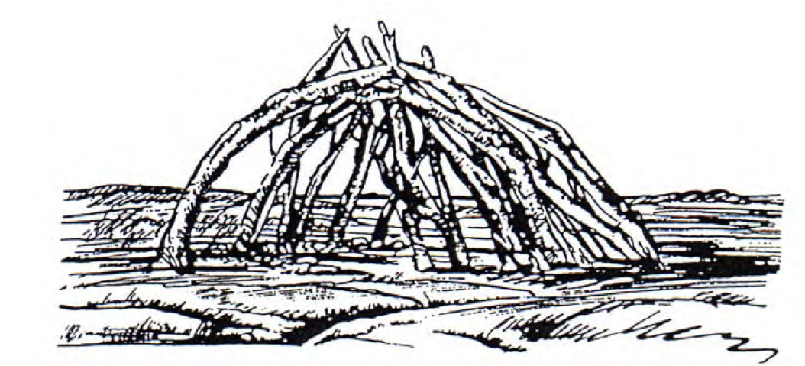
1) Earliest shelters (Europe)
“Timber has been available as a construction material for most societies since the human race first started to build crude shelters at the dawn of civilization.” (Kuklik 2008) [1]
Tree branches
Covered with grass
Circular floor plan
The shelter framework of primeval man (120 000 – 40 000 BC) [1]
Notes:
1) Survived several large earthquakes throughout the centuries. 2) It is the oldest existent fully wooden pagoda still standing in China.

Slide 4
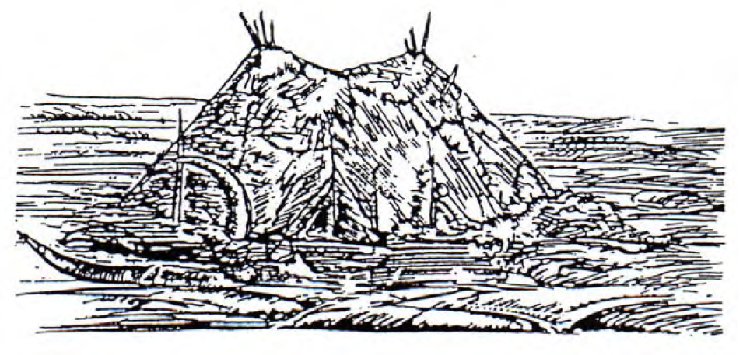
1) Earliest shelters (Europe)
“Timber has been available as a construction material for most societies since the human race first started to build crude shelters at the dawn of civilization.” (Kuklik 2008) [1]
Tree branches
Covered with hides
Elliptical floor plan
Primeval mankind shelter (40 000 – 10 000 BC) [1]
Notes:
1) Survived several large earthquakes throughout the centuries. 2) It is the oldest existent fully wooden pagoda still standing in China.

Slide 5
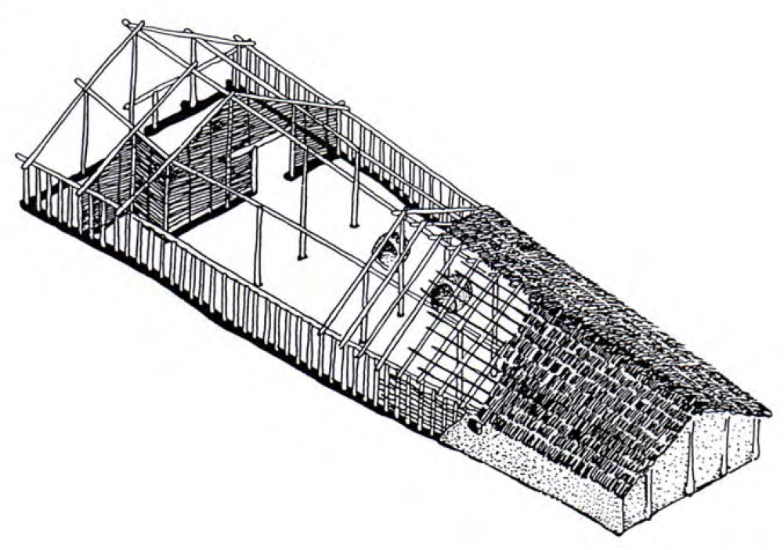
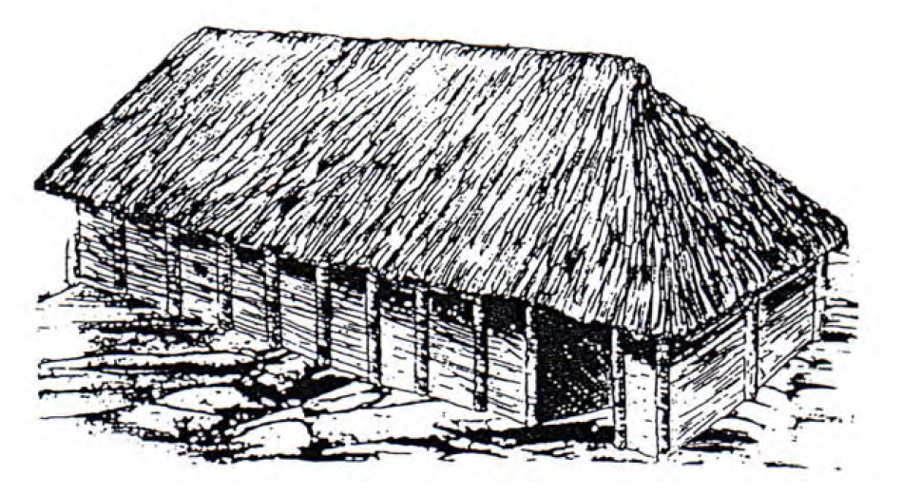
2) First timber-framed houses (Europe)
Rafter
Purlin
Log
Longhouse (4 500 BC) [1]
Longhouse (3 000 BC) [1]
Durability: less than 20 years
Floor: 5.5-7m width, 20-45m long
Floor: a little trapezoidal
No windows
Notes:
1) Survived several large earthquakes throughout the centuries. 2) It is the oldest existent fully wooden pagoda still standing in China.

Slide 6
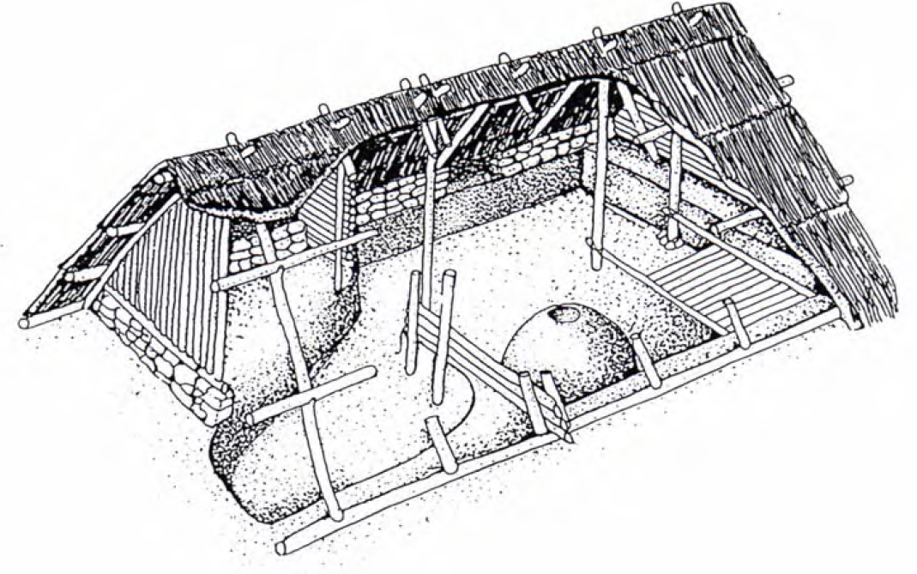
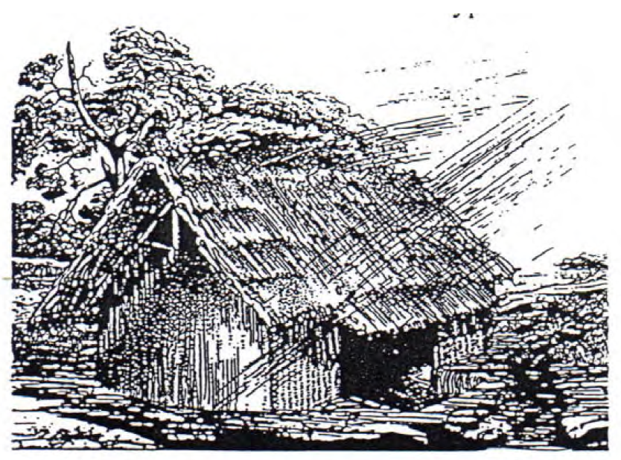
3) Timber-framed houses (Europe)
House constructed by the Celts (400 BC) [1]
House constructed by the Teutons (0 - 500 AD) [1]
Stone pedestal
Primitive and small (5m×6m or 4m×5m)
Notes:
1) Survived several large earthquakes throughout the centuries. 2) It is the oldest existent fully wooden pagoda still standing in China.

Slide 7
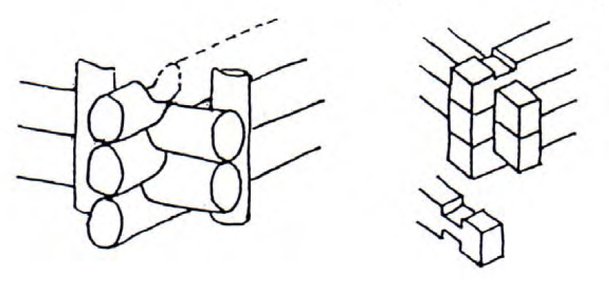
4) Rural houses (Europe)
Between the 13th to the 15th century: timber, stone (foundations and walls) and clay (nogging)
Logs laid horizontally to form walls
Notching at the corner intersections to provide stability
Details of log house corners [1]

Slide 8
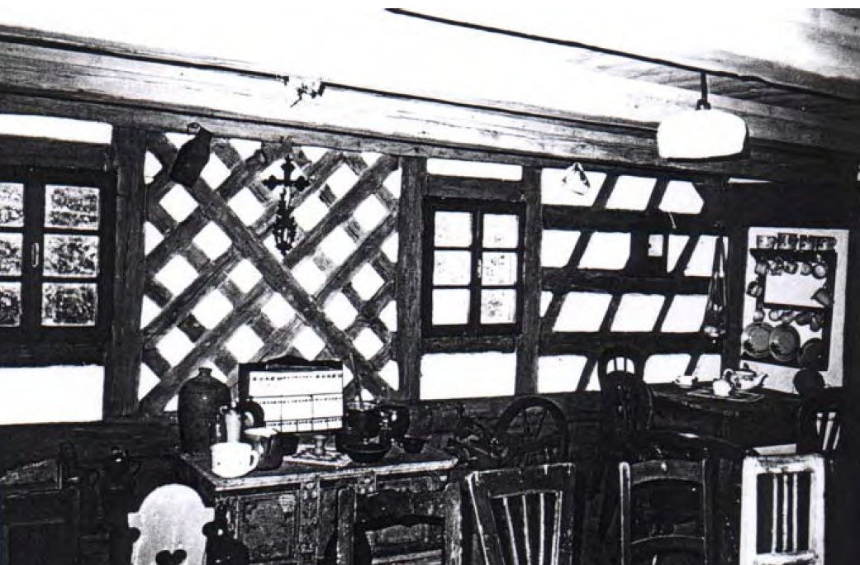
4) Rural houses (Europe)
Half-timbered house: short logs, clay (nogging)
12th century in Germany, first used in town houses
15th century, also used in rural houses
Half-timbered wall [1]

Slide 9
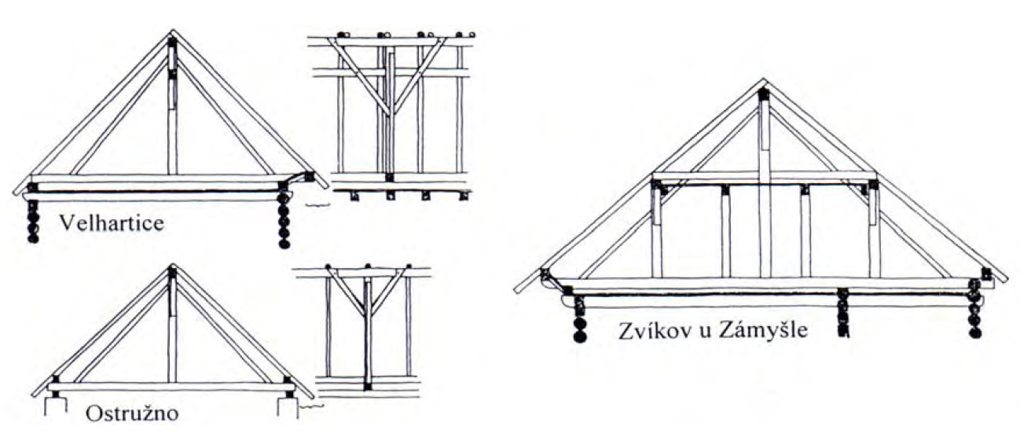
4) Rural houses (Europe)
Bracing used in the longitudinal direction
Roof Structures [1]

Slide 10
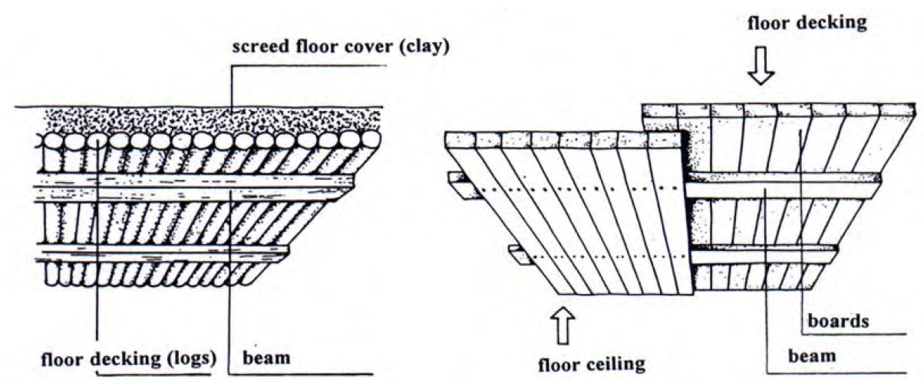
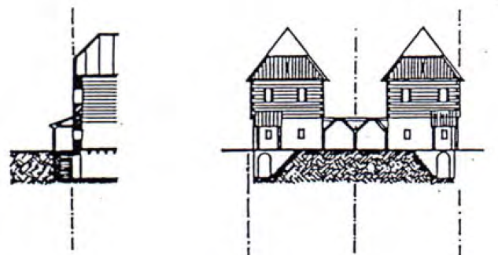
5) Urban houses (Europe)
14th century, stone and brick as structural materials (fire resistance)
16th century, brickwork structures (predominant)
18th century, timber prohibited in towns, except for floors, separating walls and roofs
Floor structures [1]
Attaches house [1]

Slide 11
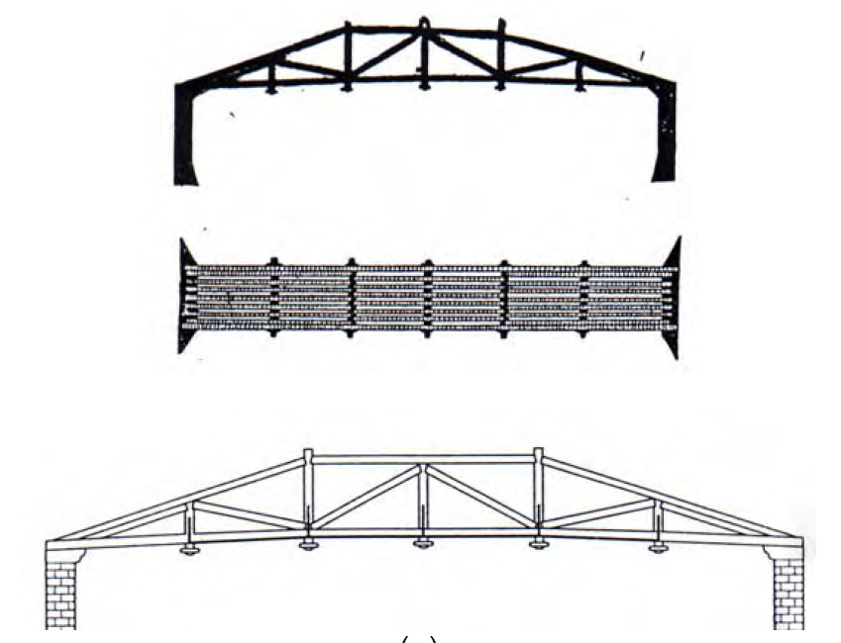
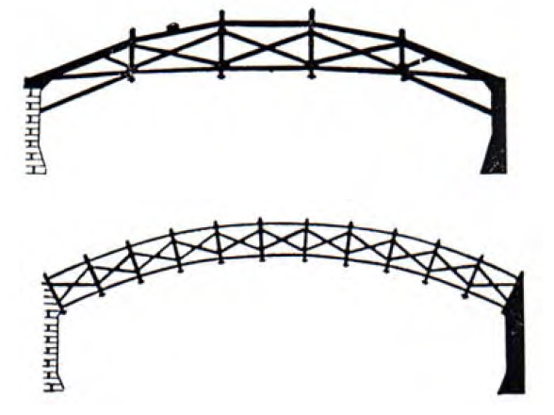
6) Timber bridges (Europe)
The oldest know timber bridges go back to 600 BC
Trussed bridges (Palladio 1570) [1]

Slide 12
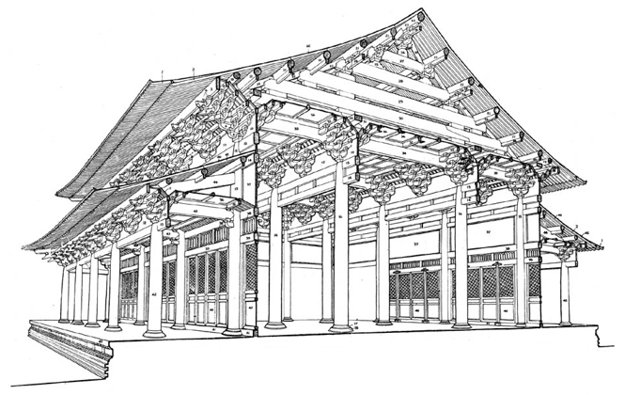
7) Timber structures (China)
Since 1500 BC, Tenon and Dougong connections have been used in traditional Chinese timber structures.
Dougong: a unique structural element of interlocking wooden brackets
Post-beam structures (Yingzao Fashi)
Notes:
1) Survived several large earthquakes throughout the centuries. 2) It is the oldest existent fully wooden pagoda still standing in China.

Slide 13
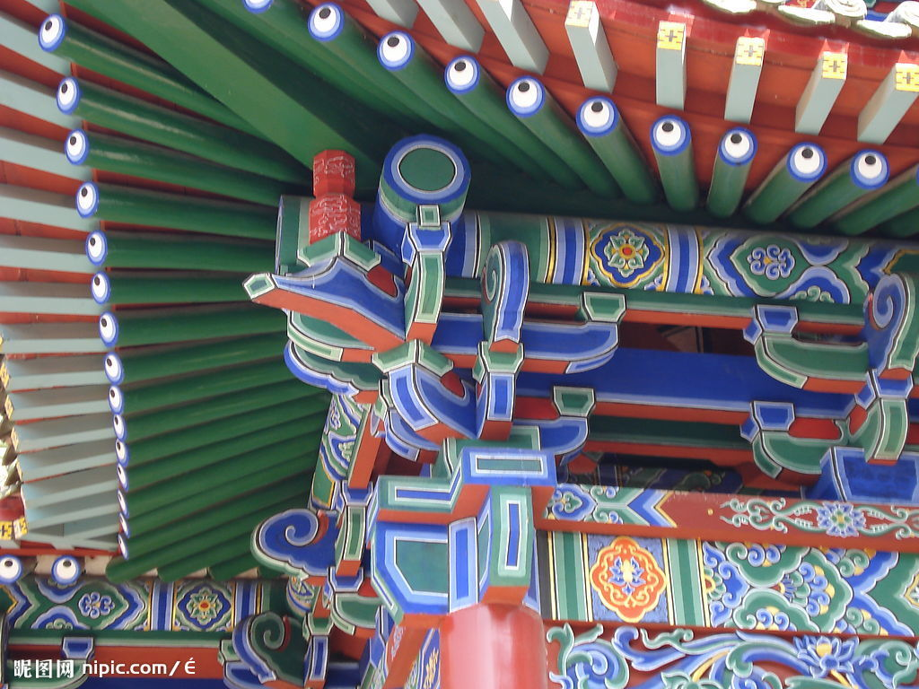
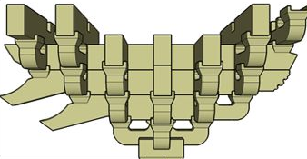
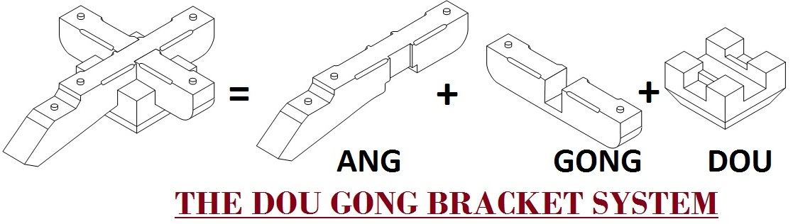
8) Dougong (China)

Slide 14
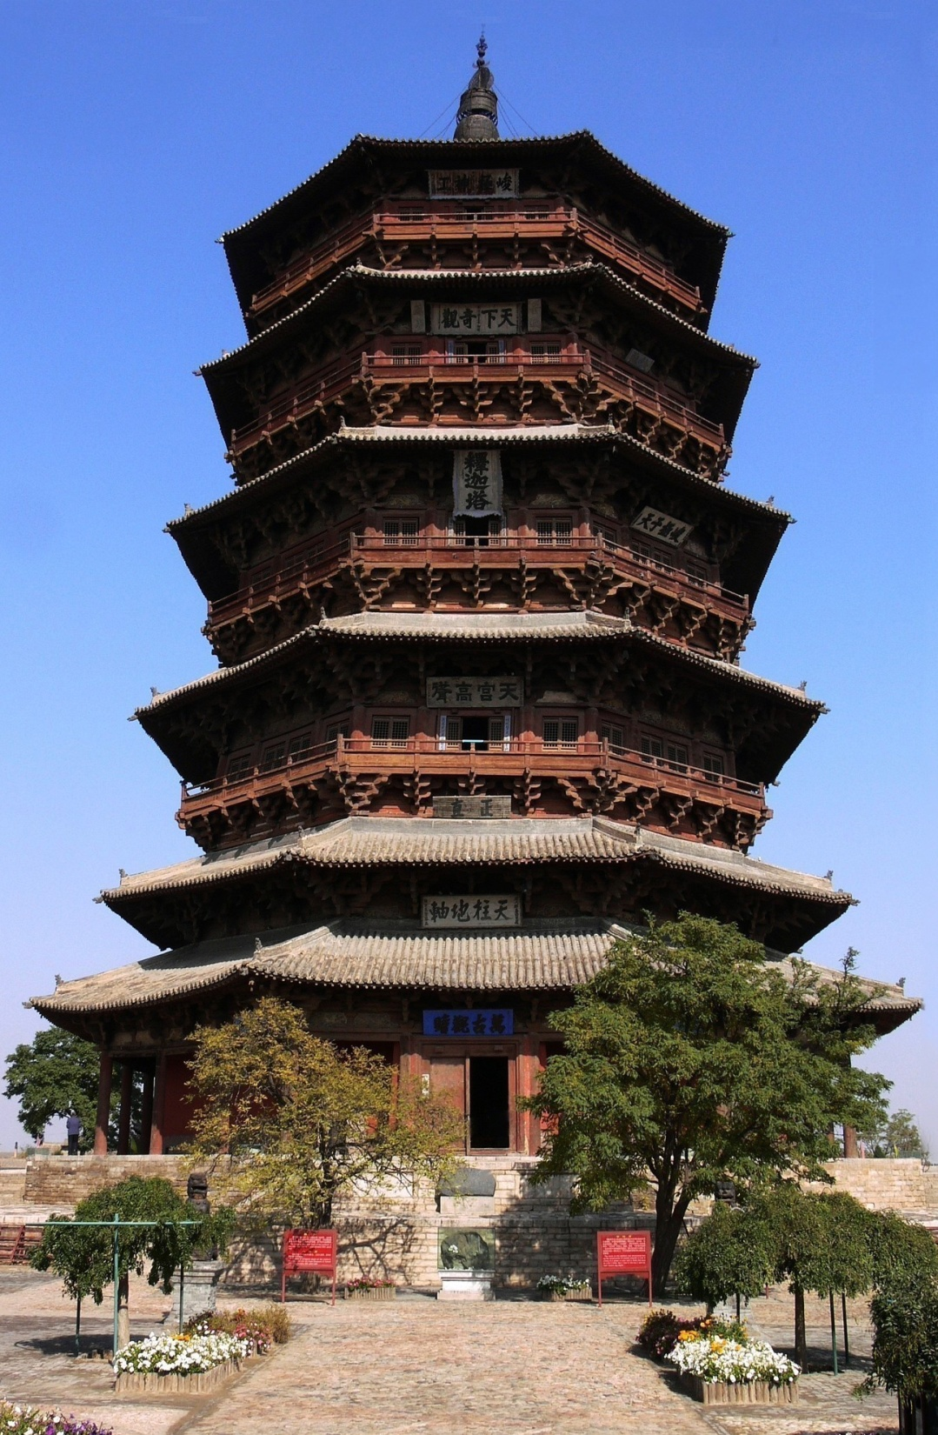
9) Yingxian Pagoda (China)
Built in 1056
Height: 67.31m
54 different kinds of Dougong connections
Survived several large earthquakes throughout the centuries
Notes:
1) Survived several large earthquakes throughout the centuries. 2) It is the oldest existent fully wooden pagoda still standing in China.

Slide 15
1.2 Current Timber Structures and Trends

Slide 16
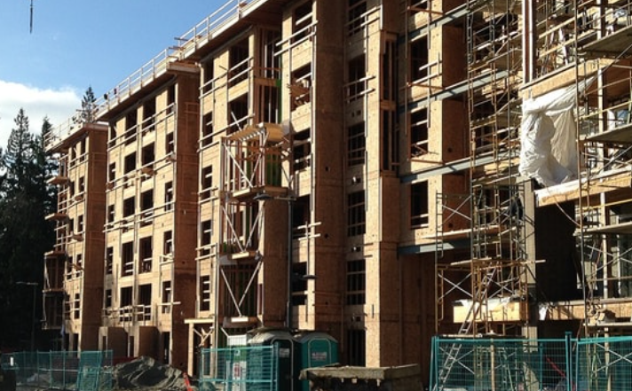
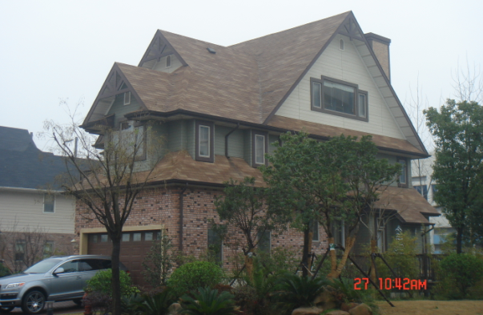
1) Light wood frame structures
Residential buildings
Up to 6-storey (BC 2009)
(Susan M Boyce)
Single family house
Multi-story apartment under construction

Slide 17
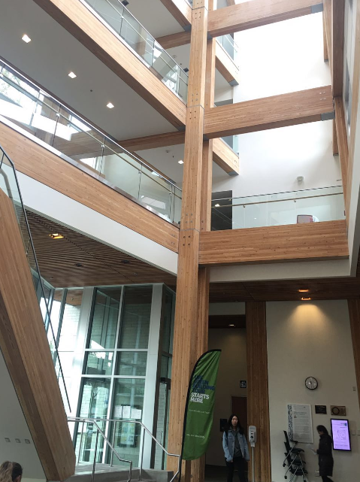
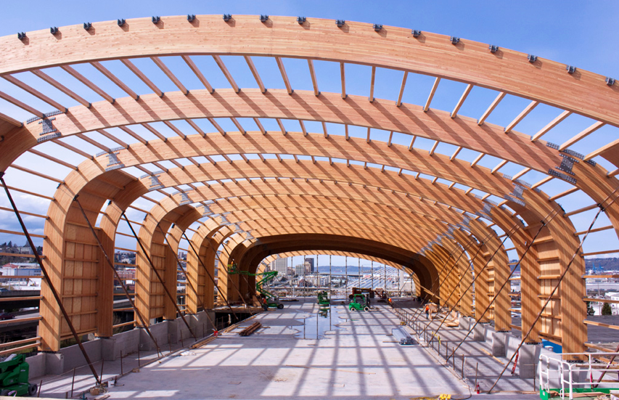
2) Heavy timer structures
Commercial buildings
Structures exposed
(Western Wood Structures, Inc.)
A car museum in Tacoma WA
The Centre for Interactive Research on Sustainability (UBC)
Notes:
1) Survived several large earthquakes throughout the centuries. 2) It is the oldest existent fully wooden pagoda still standing in China.

Slide 18
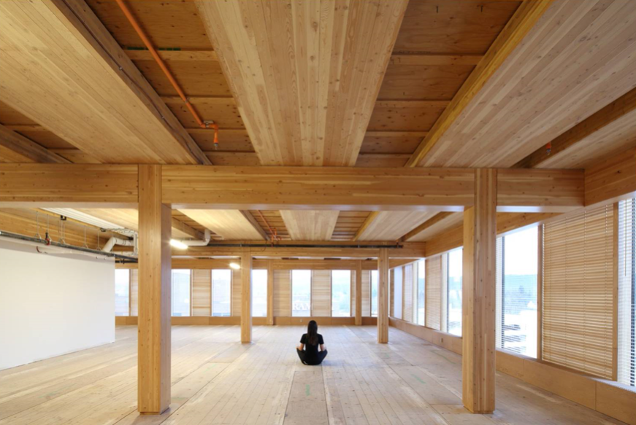
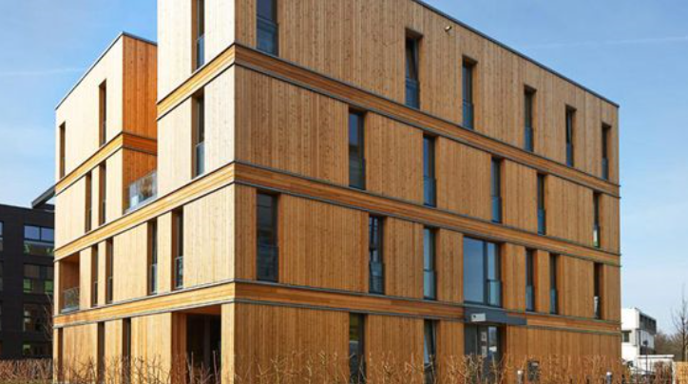
3) Mass timber structures
Mass timber panel
(kihusa.com)
(structurlam.com)
Cross laminated timber (CLT)
Wood Innovation and Design Centre (UNBC)

Slide 19
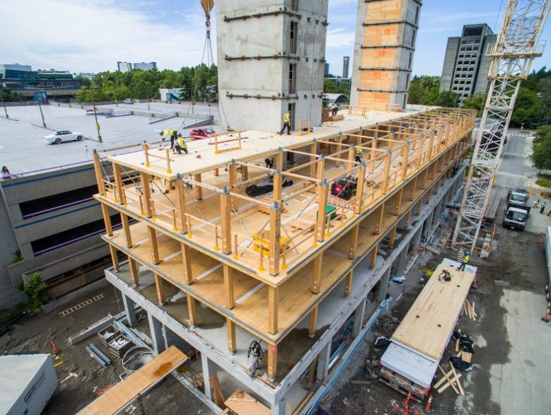
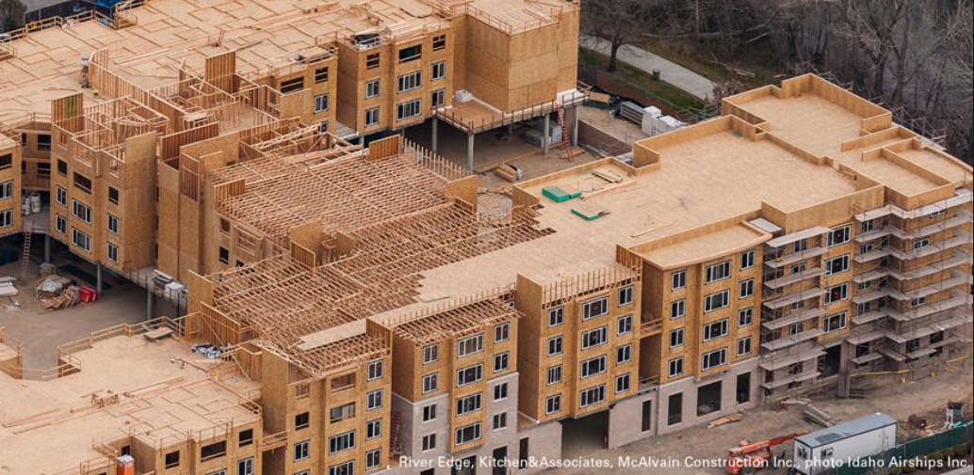
4) Hybrid timber structures
(Idaho Airships Inc.)
(Liz Brown)
Reinforced concrete podium and core
+ CLT floor and Glulam column
Reinforced concrete podium
+ light wood frame structure

Slide 20
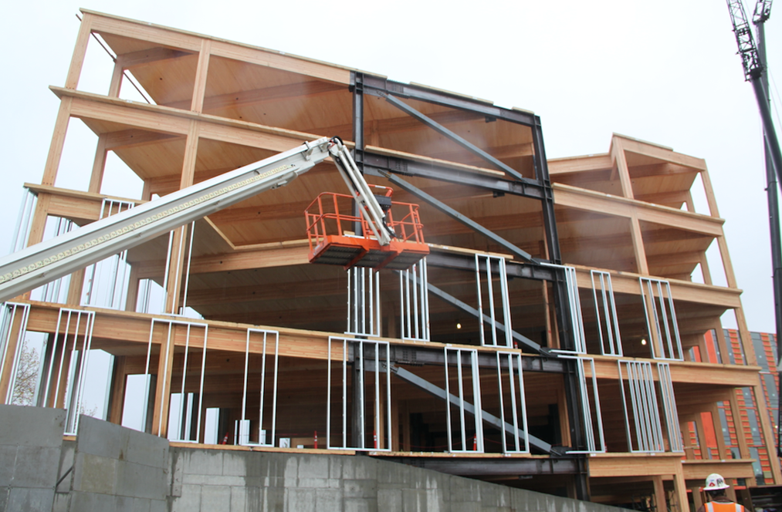
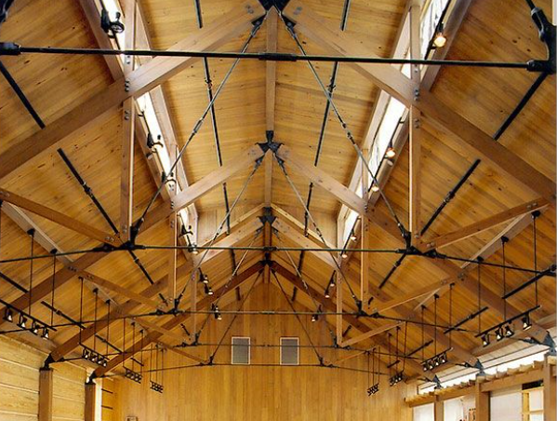
4) Hybrid timber structures
(structurlam.com)
https://www.pinterest.ca/oguzakdenizz/roof-structure/
Timber floor and column
+ steel lateral bracing
Hybrid timber-steel roof

Slide 21
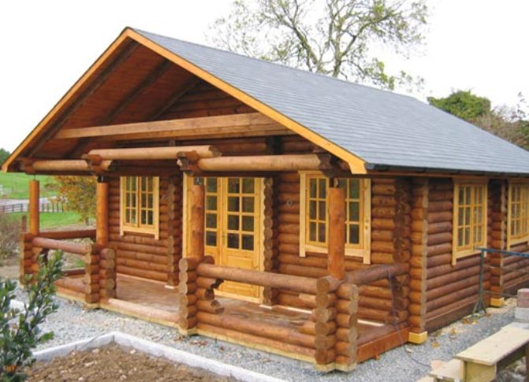
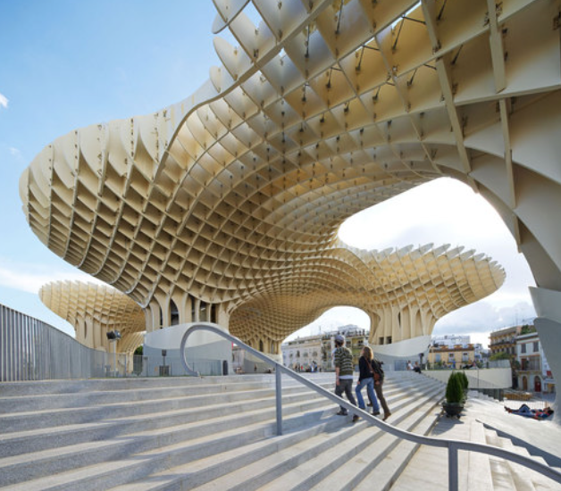
5) Other timber structures
(Wildwood Log Cabins)
(AWR)
Round log cabin
Metropol Parasol, Spain

Slide 22
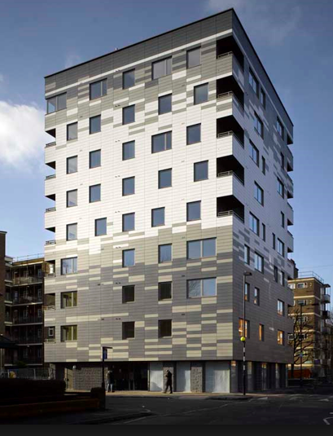
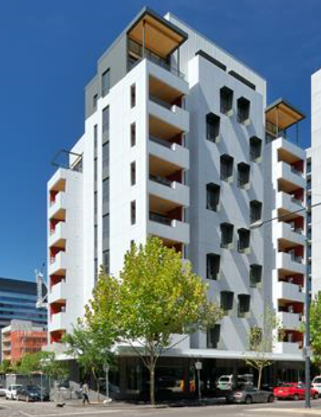
6) Trends
(Will Pryce)
(Victoria Harbour)
9-storey, Murray Grove, London, 2009
10-storey, Forté, Melbourne, 2012

Slide 23
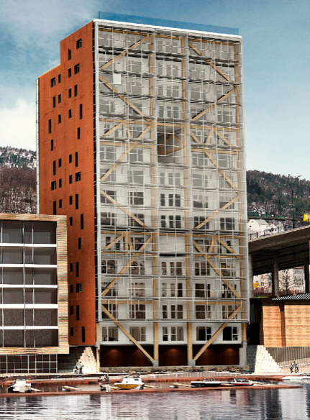
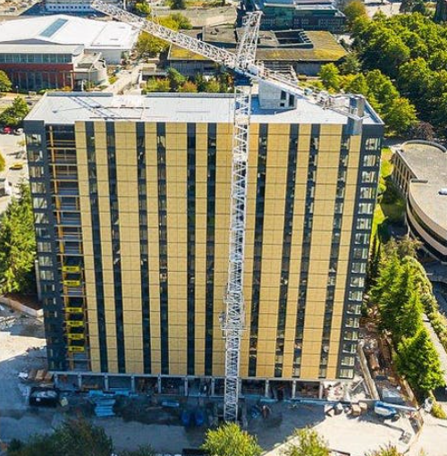
6) Trends
(Malo K.A. et al 2016)
(naturallywood.com)
14-storey, Treet, Norway, 2015
18-storey, Brock Commons, Vancouver, 2017

Slide 24
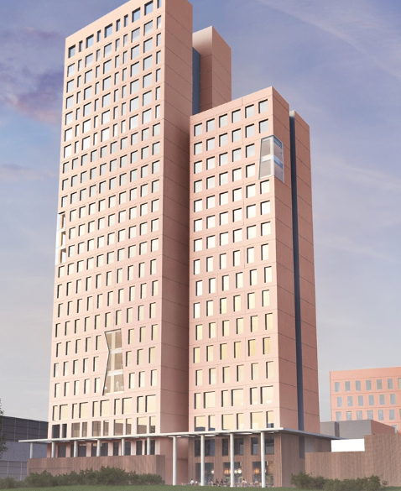
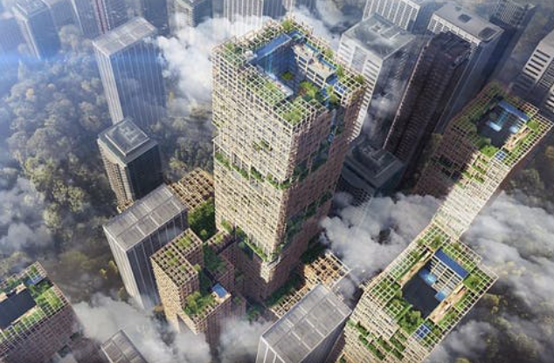
6) Trends
(newcivilengineer.com)
(Sumitomo Forestry)
24-storey, HoHo, Vienna, under construction, 2018
70-storey, W350, Japan, Proposed for 2041

Slide 25
1.3 Characteristics of Timber Structures

Slide 26
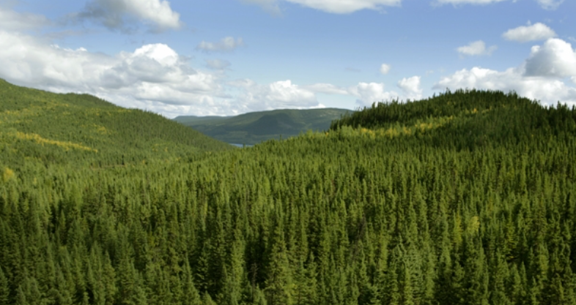
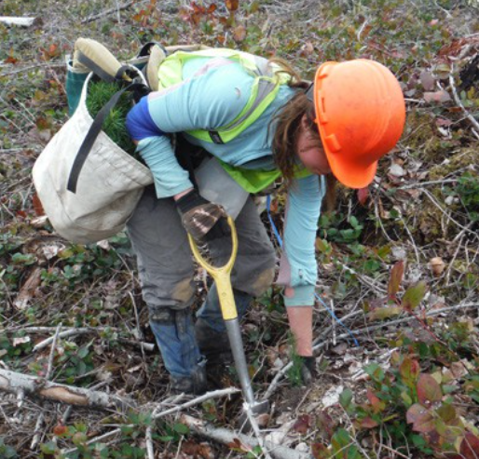
1) Advantages ― Green Building
Wood is renewable material
TimberWest
CWC
Sustainable forestry harvesting
A total of 5.35 million native species planted on Vancouver Island in TimberWest’s spring 2015 planting season

Slide 27
1) Advantages ― Green Building
Green and environmentally friendly
(remove carbon from the atmosphere)
Example: embodied effects of a single family home (CWC report [2])
Relative to the wood design, the steel and concrete designs
Energy: 26% 57%
Greenhouse gas: 34% 81%
Air pollution: 24% 47%
Water pollution: 4 times 3.5 times
Resources: 11% 81%
Solid waste: 8% 23%

Slide 28
1) Advantages ― Structure
Light weight
Higher strength to weight ratio
Good seismic performance
  Structural redundancy
  Deformation
  Energy dissipation
 | Average building weight [3]
Timber | 1.9-2.4 kN/m²
Steel framed | 2.9-3.6 kN/m²
Reinforced concrete | 5.3-6.2 kN/m²

Slide 29
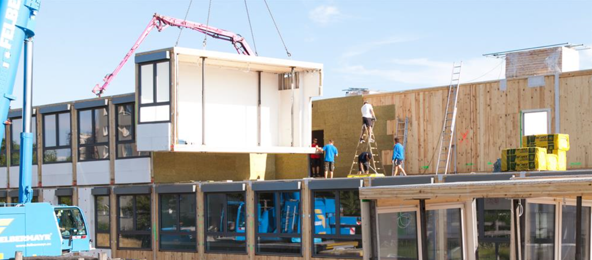
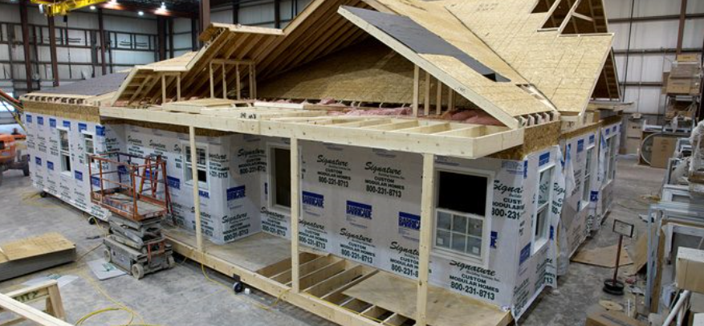
1) Advantages
Modular and offsite construction
Stora Enso
A timber school for Vienna - with CLT
  Fast construction
  Quality control
bonestructure.ca
A light wood frame building

Slide 30
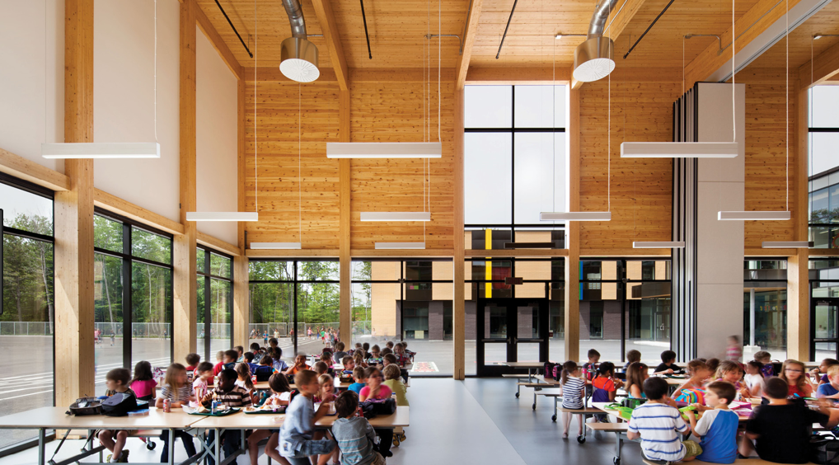
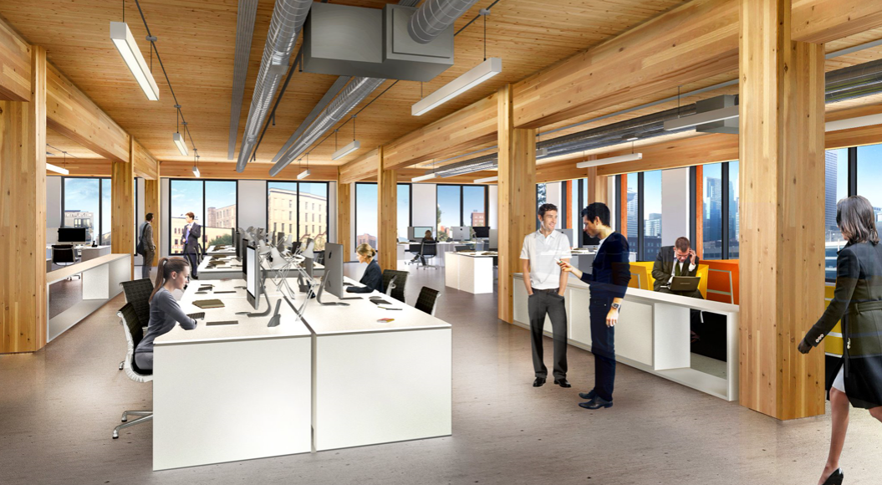
1) Advantages
Aesthetic benefit
Nordic
structurecraft.com

Slide 31
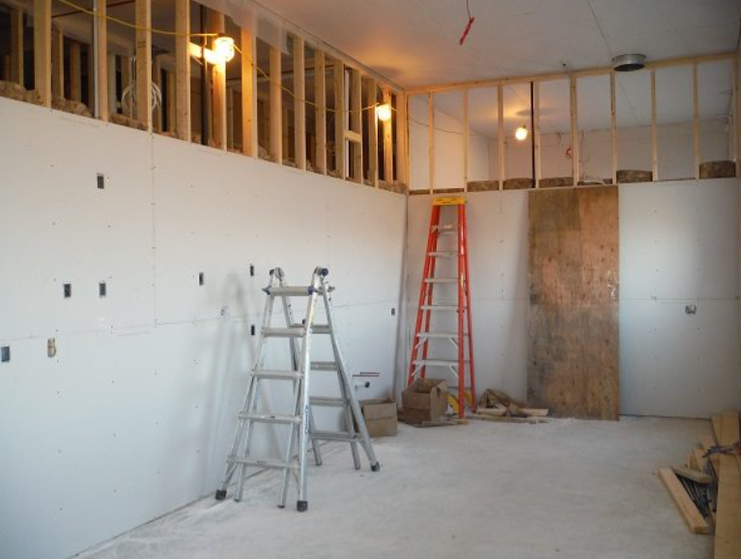
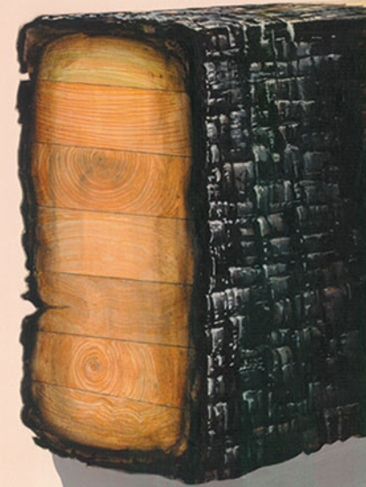
2) Challenges ― Fire
Timber is a combustible material
Light wood frame
Mass timber
Gregory Havel
R.H. White and F.E. Woeste
Gypsum drywall board firebreak
Char layer

Slide 32
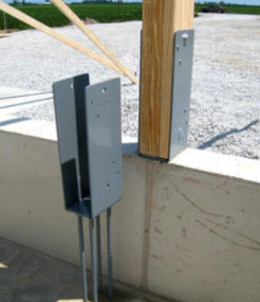
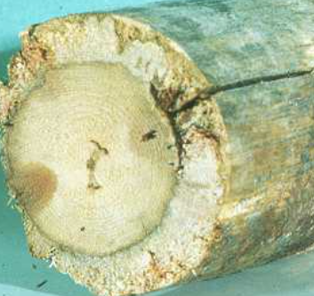
2) Challenges ― Durability
Wood is biodegradable
Details example: timber separated from concrete
CWC
Bosssheds
Decay
Sturdi-Wall Brackets
  Moisture control

Slide 33
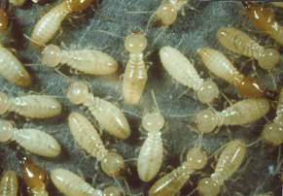
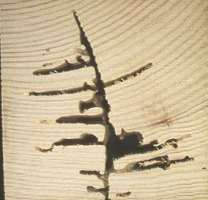
2) Challenges ― Durability
Wood is biodegradable
Integrated control: The 6Ss
Suppression
Site management
Soil barrier
Slab/foundation details
Structural durability
Surveillance and remediation
(http://cwc.ca/wp-content/uploads/controllingtermites-TermiteControlThe6Ss.pdf)
CWC
CWC
Termites
Attached by termites

Slide 34
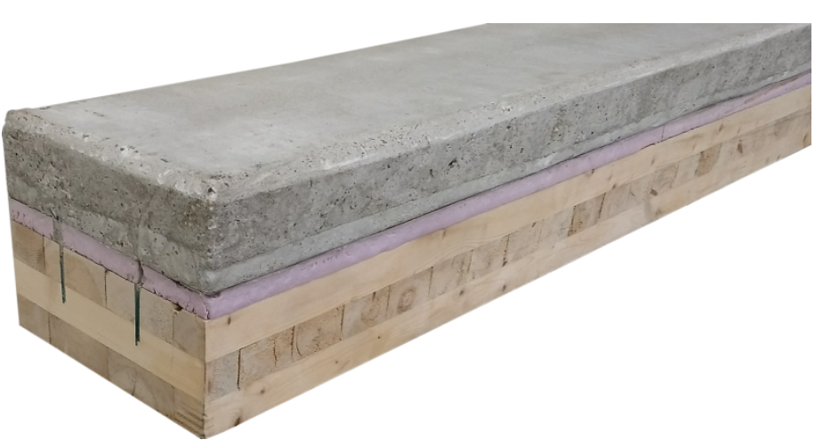
2) Challenges ― Vibration and acoustic
Composite timber and concrete floor
  Less susceptible to vibration
  Better acoustic separation
  Stiffer
Ryan Rendano
Top: Poured concrete
Middle: Rigid foam board insulation
Base: CLT structural floor system

Slide 35
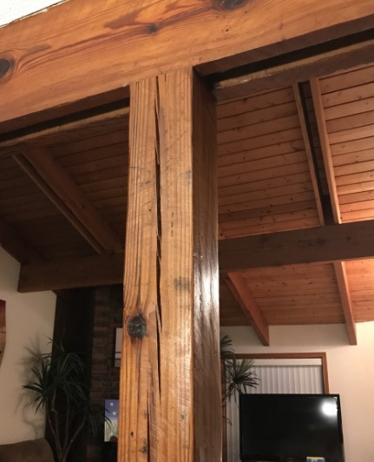
2) Challenges ― Moisture content
Timber shrinks and swells with changes of moisture content
  Caused by moisture loss in the outer fibers
  Usually has minimal effect on the strength
  Needs to be evaluated
https://inspectapedia.com/structure/Beam_Log_Checking_Cracks.php
Checking

Slide 36
References
[1] Kuklik, P. 2008. History of timber structures. Leonardo da Vinci Pilot Project, CZ/06/B/F/PP/168007, Educational materials for designing and testing of timber structures. Czech Technical University in Prague, Prague, Czech Republic.
[2] Canadian Wood Council (CWC). Energy and the environment in residential construction. Ottawa, ON, Canada. http://cwc.ca/wp-content/uploads/publications-Energy-and-the-Environment.pdf
[3] Hibbeler R.C. 2018. Structural analysis. Pearson Education, Inc. Hoboken, NJ, USA.

