Slide 1

Chapter 10 Design for Fire Safety
CIVE480 Timber Structures
2019

Slide 2

10.1 General Information

Slide 3
1) Design requirements
Based on Division B, Part 3, Fire Protection, Occupant Safety and Accessibility, of the National Building Code of Canada (NBCC).
Fire protection objectives:
Structural stability under fire conditions,
Protection against fire spread, and
Safe means of egress.

Slide 4
2) Fire protection systems
Passive systems
  Escape routes or “exits” → ensure a means of escaping a life- threatening situation
  Fire compartments → ensure a safer environment during a fire for the building occupants
Active systems
  Fire alarm systems → provide detection, early warning
  Automatic fire sprinklers → control/suppression of fire

Slide 5
3) Wood construction
Permitted based on occupancy, building height and area
Table 10.1b Examples of maximum building area permitted per floor
 | Use | Building Height in Storeys | Number of Sides With Access & Sprinklering | Maximum Building Area Per Floor (m²)
Major Occupancy Group C | Residential Apartments, hotels, motels | 3 | 1, unsprinklered | 600
 |  |  | 2, unsprinklered | 750
 |  |  | 3, unsprinklered | 900
 |  |  | 1, sprinklered | 1800
 |  | 2 | 1, unsprinklered | 900
 |  |  | 2, unsprinklered | 1125
 |  |  | 3, unsprinklered | 1350
 |  |  | 1, sprinklered | 2700
 |  | 1 | 1, unsprinklered | 1800
 |  |  | 2, unsprinklered | 2250
 |  |  | 3, unsprinklered | 2700
 |  |  | 1, sprinklered | 5400

Slide 6
4) Fire-resistance ratings
The time that a component will withstand heat and flames under standard test conditions.
Many wood-frame assemblies meets the range: 0 to 2 hours.
Methods to determine the fire-resistance ratings
1. Standard fire-resistance test
2. Appendix D (Fire Performance Ratings) of the NBCC
3. Other methodologies (Annex B of the CSA O86)

Slide 7
10.2 Light Wood Frame Structures

Slide 8
1) Component additive method (CAM)
NBCC Division B, appendix D-2.3. – Component Additive Method
Adding the time assigned to the protective membrane (e.g. gypsum board) on the “fire side” to the time assigned to the structural framing members
Used for assign a fire-resisting rating up to 1.5 hours
For wall assemblies, rating is based on fire exposure on one side (interior partitions, use the lowest ratings of both sides)
For floor or roof assemblies, rating is based on performance from fire exposure from below

Slide 9
1) Component additive method (CAM)
Tables 10.2a Time assigned for the contribution of protective membranes on the fire-exposed side of wood-frame walls
Description of Finish | Time, minutes
 | Loadbearing Walls | Non-loadbearing Walls
11.0 mm Douglas Fir plywood phenolic bonded | - | 10
14.0 mm Douglas Fir plywood phenolic bonded | - | 15
12.7 mm Type X gypsum wallboard | 25 | 25
15.9 mm Type X gypsum wallboard | 40 | -
Double 12.7 mm Type X gypsum board | 50 | 80
Tables 10.3 Time assigned for contribution of wood-frame members
Description of Frame | Time, minutes
Walls – wood studs spaced ≤ 400 mm o.c. | 20
Walls – wood studs spaced ≤ 600 mm o.c. | 15
Floors – wood joists, wood I-joists, and wood trusses spaced ≤ 600 mm o.c. | 10
Roofs – wood joists spaced ≤ 400 mm o.c. | 10
Roofs – metal-plate-connected wood trusses spaced ≤ 600 mm o.c. | 5

Slide 10

Example 1: Using NBCC Division B, Appendix D-2.3 – Lightweight woodframe interior partitions
Determine the fire-resistance rating of an interior partition (i.e. interior non-loadbearing wall assembly) with 12.7 mm Type X gypsum board (GB) on both sides of wood studs spaced at 400 mm on center.
38 × 89 mm (minimum) wood studs, 400 o.c. (20 minutes)
One layer 12.7 mm Type X gypsum board (25 minutes)

Slide 11
Example 1 – Solution
Tables are located on Slide #9
From Table 10.2a:
  Time assigned to 12.7 mm Type X GB 25
From Table 10.3:
  Time assigned to wood studs at 400 mm o.c. 20
Fire-resistance rating of interior partition: 45 minutes

Slide 12
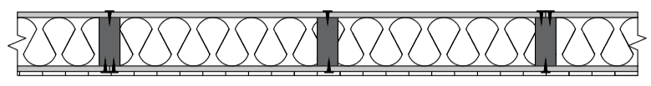
Example 2: Using NBCC Division B, Appendix D-2.3 – Lightweight woodframe exterior wall assemblies
Determine the fire-resistance rating of a loadbearing wood stud exterior wall assembly with 12.7 mm Type X gypsum board (GB) on the interior side and plywood sheathing and wood shingle siding on the exterior with studs spaced at 400 mm on the center.
Mineral fibre insulation, mass per unit area not less than 1.22 kg/m² of wall surface (rock or slag 15 minutes)
One layer 12.7 mm Type X gypsum board (25 minutes)
Interior (fire side)
Exterior (unexposed side)
38 × 89 mm (minimum) wood studs, 400 o.c. (20 minutes)
7.5 mm exterior grade plywood & wood shingle siding

Slide 13
Example 2: Solution
Table 10.5 Examples of time assigned for additional protection
Description of Additional Protection | Time, minutes
Add to the fire-resistance rating of wood stud walls, sheathed with gypsum board or lath and plaster, if the spaces between the studs are filled with preformed insulation of rock or slag fibres conforming to CAN/ULC-S702, Mineral Fibre Thermal Insulation for Building, and with a mass per unit area of not less than 1.22 kg/m² of wall surface | 15
Add to the fire-resistance rating of non-loadbearing wood stud walls, sheathed with gypsum board or lath and plaster, if the spaces between the studs are filled with preformed insulation of glass fibres conforming to CAAN/ULC-S702, Mineral Fibre Thermal Insulation for Building, and with a mass per unit area of not less than 0.6 kg/m² of wall surface | 5
Add to the fire-resistance rating of loadbearing wood stud walls sheathed with gypsum board if the spaces between the studs are filled with insulation of cellulose fibres conforming to CAN/ULC-S703, Cellulose Fibre Insulation (CFI) for Buildings, and having a density of not less than 50 kg/m³ | 10

Slide 14
Example 2 – Solution
From Table 10.2a:
  Time assigned to 12.7 mm Type X GB 25
From Table 10.5:
  Time assigned to mineral fiber insulation 15
From Table 10.3:
  Time assigned to wood studs at 400 mm o.c. 20
Fire-resistance rating of exterior wall: 60 minutes

Slide 15
10.3 Mass Timber

Slide 16
1) Mass timber
Large-cross-sectioned solid-sawn beams and columns
Glued laminated timber (glulam)
Structural composite lumber (SCL)
Built-up solid wood walls, floors and roofs
Cross-laminated timber (CLT)

Slide 17
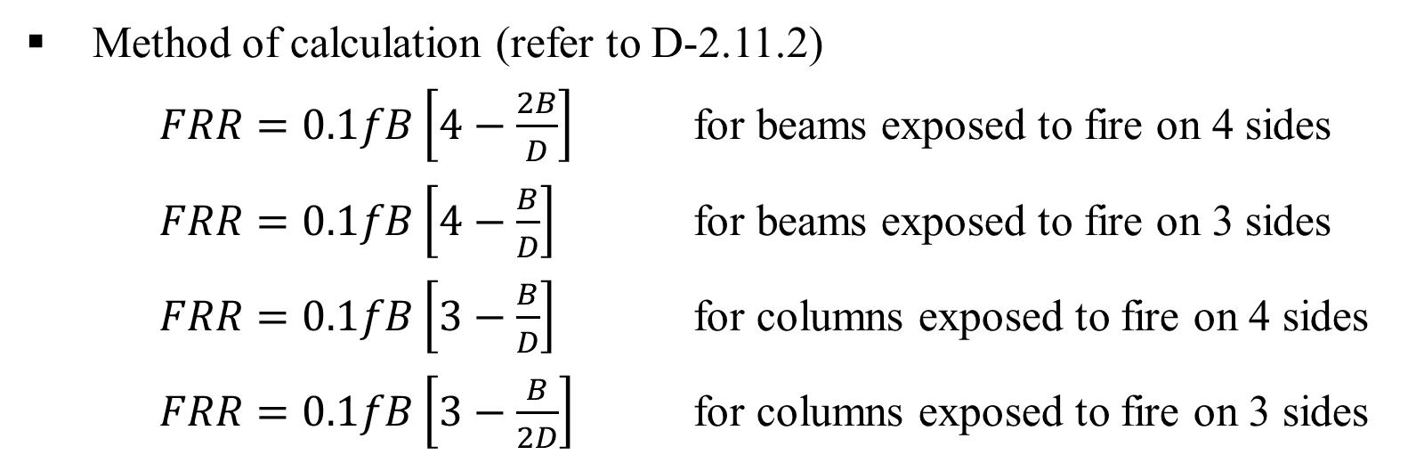
2) NBCC Division B, Appendix D-2.11 Method for Glulam Beams and Column
Method of calculation (refer to D-2.11.2)
$FRR=0.1fB\left[4−\frac{2B}{D}\right]$ for beams exposed to fire on 4 sides
$FRR=0.1fB\left[4−\frac{B}{D}\right]$ for beams exposed to fire on 3 sides
$FRR=0.1fB\left[3−\frac{B}{D}\right]$ for columns exposed to fire on 4 sides
$FRR=0.1fB\left[3−\frac{B}{2D}\right]$ for columns exposed to fire on 3 sides
where:
FRR = fire resistance time in minutes
f = the load factor shown in Figure 10.1 on next slide
B = the full dimension of the smaller side of the beam or column in mm before exposure to the fire
D = the full dimension of the larger side of the beam or column in mm before exposure to fire

Slide 18
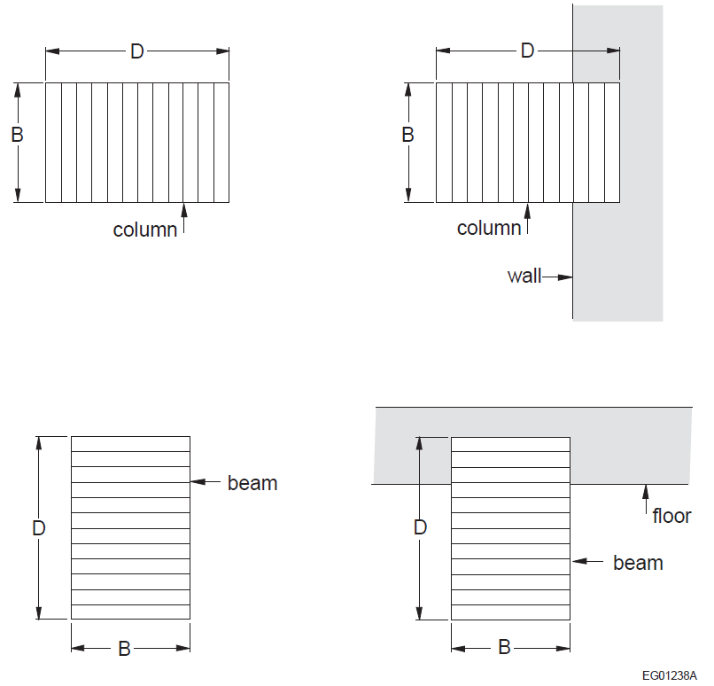
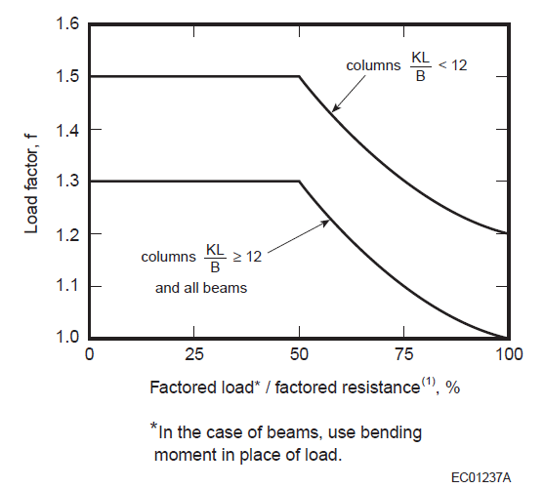
Figure 10.1 Load factor for glulam fire-resistance calculations (NBCC 2015)
k = the effective length factor obtained from CSA O86, “Engineering Design in Wood,”
L = the unsupported length of a column in millimetres.
Figure 10.2 Full dimensions of glued-laminated beams and columns

Slide 19
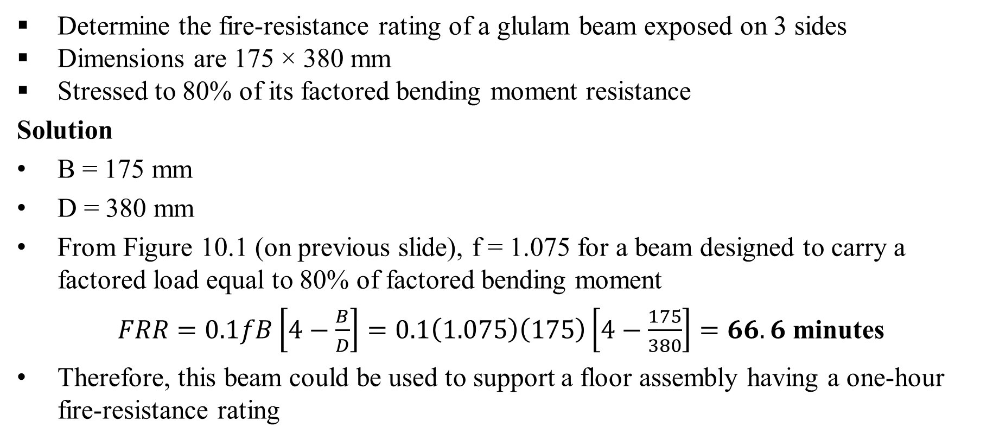
Example 3: Using NBC Division B, Appendix D-2.11 – Beams
Determine the fire-resistance rating of a glulam beam exposed on 3 sides
Dimensions are 175 × 380 mm
Stressed to 80% of its factored bending moment resistance
Solution
B = 175 mm
D = 380 mm
From Figure 10.1 (on previous slide), f = 1.075 for a beam designed to carry a factored load equal to 80% of factored bending moment
$FRR=0.1fB\left[4−\frac{B}{D}\right]=0.1\left(1.075\right)\left(175\right)\left[4−\frac{175}{380}\right]=66.6$ minutes
Therefore, this beam could be used to support a floor assembly having a one-hour fire-resistance rating

Slide 20
3) CSA-O86 Annex B Method (Alternative)
Reduced cross-section approach
Adjustment factor for fire resistance, K_{fi} (refer to B.3.9 of Annex B)
Table B.3.9: Adjustment Factor for Fire Resistance, K_{fi}
Product | K_{fi}
Timber and plank decking | 1.5
Glued-laminated timber | 1.35
Structural composite lumber | 1.25
Cross-laminated timber -V1-V2 stress grade -E1-E3 stress grade | 1.5 1.25
Note: adjustment factor for fire resistance, K_{fi}, converts specified strength to mean strength

Slide 21
4) Char Depth
Design charring rates
Table B.4.2: Design Charring Rates for Wood and Wood-based Products, mm/min
 | β_{o} | β_{n}
Timber and plank decking | 0.65 | 0.80
Glued-laminated timber | 0.65 | 0.70
Structural Composite Lumber | 0.65 | 0.70
Cross-laminated timber | 0.65 | 0.80

Slide 22
4) Char depth
One-dimensional char depth
x_{c,o} = β_{o}t
where:
β_{o} = one-dimensional charring rate, mm/min
t = fire exposure duration, min
Notional char depth
x_{c,n} = β_{n}t
where:
β_{n} = notional charring rate, mm/min
t = fire exposure duration, min

Slide 23
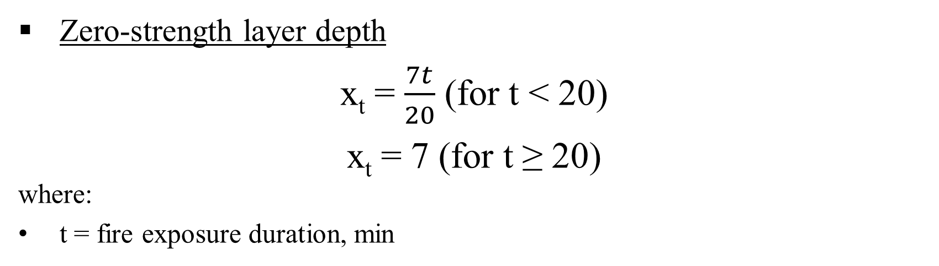
5) Zero-strength layer
Zero-strength layer depth
x_{t} = $\frac{7t}{20}$ (for t < 20)
x_{t} = 7 (for t ≥ 20)
where:
t = fire exposure duration, min

Slide 24
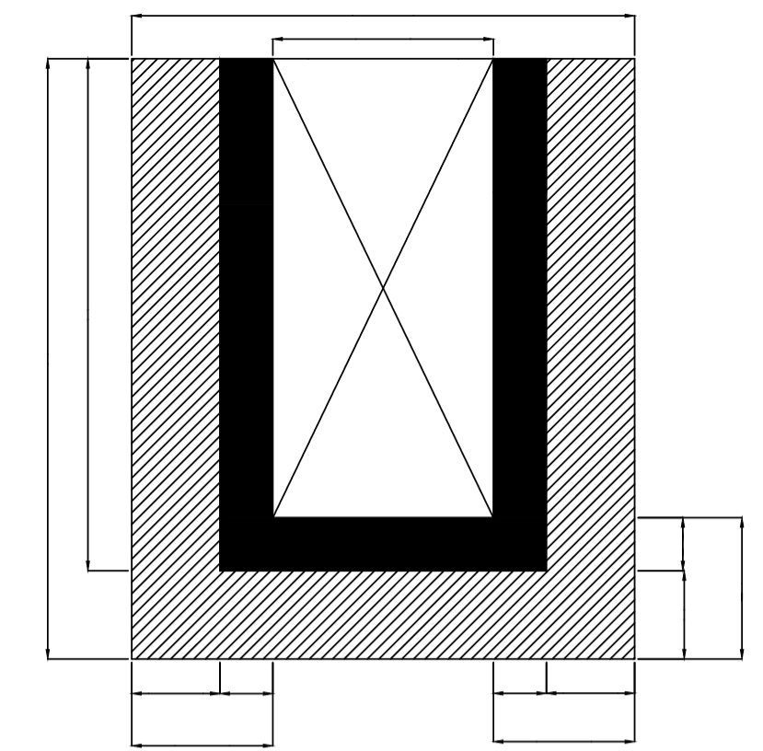
Example 4: Using CSA O96 Annex B Calculation Method – Beams
The following example illustrates how a 1-hour fire-resistance rating may be verified for a glulam beam using the calculation method in Annex B of CSA O86, under the following conditions:
Species and grade: D.Fir-L, 20f-E
Beam dimensions: 215 × 456 mm
Compressive edge assumed fully laterally supported by floor deck (K_{L} = 1.0)
Tributary width of floor deck for beam is 4.0 m
Beam span = 7.0 m
Specified dead load = 2.0 kPa (includes partitions)
Specified live load = 2.4 kPa (commercial use and occupancy)
Exposed to fire on three sides (top side protected by floor deck)
b
b_{f}
d
d_{f}
x_{t}
x_{r}
x_{c,n}
x_{c,n}
x_{t}
x_{t}
x_{c,n}
x_{r}
x_{r}

Slide 25
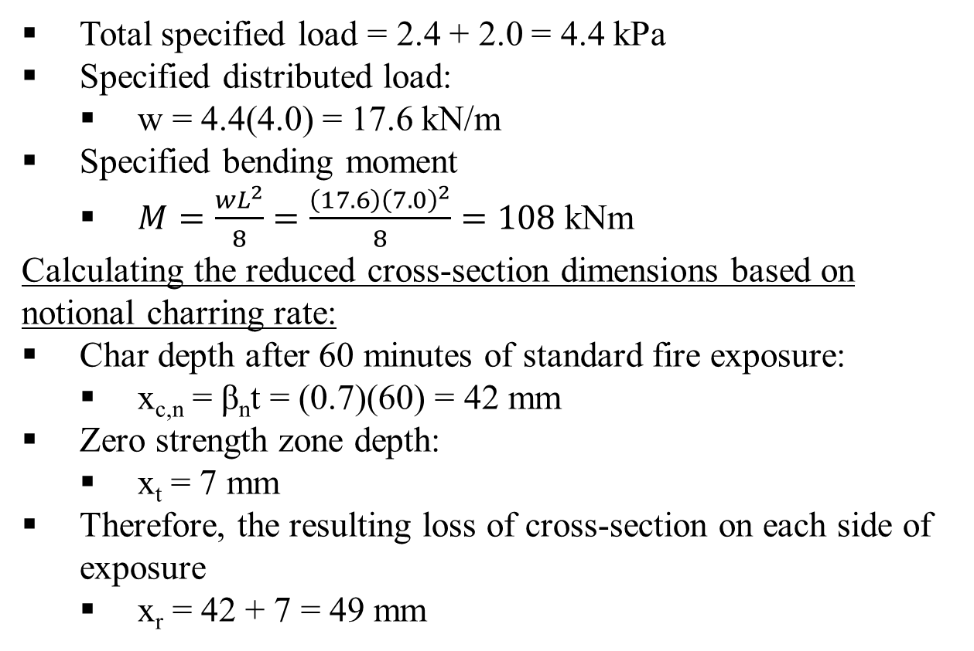
Example 4 – Solution
Total specified load = 2.4 + 2.0 = 4.4 kPa
Specified distributed load:
  w = 4.4(4.0) = 17.6 kN/m
Specified bending moment
  $M=\frac{wL^{2}}{8}=\frac{\left(17.6\right){\left(7.0\right)}^{2}}{8}=108$ kNm
Calculating the reduced cross-section dimensions based on notional charring rate:
Char depth after 60 minutes of standard fire exposure:
  x_{c,n} = β_{n}t = (0.7)(60) = 42 mm
Zero strength zone depth:
  x_{t} = 7 mm
Therefore, the resulting loss of cross-section on each side of exposure
  x_{r} = 42 + 7 = 49 mm
b
b_{f}
d
d_{f}
x_{t}
x_{r}
x_{c,n}
x_{c,n}
x_{t}
x_{t}
x_{c,n}
x_{r}
x_{r}

Slide 26
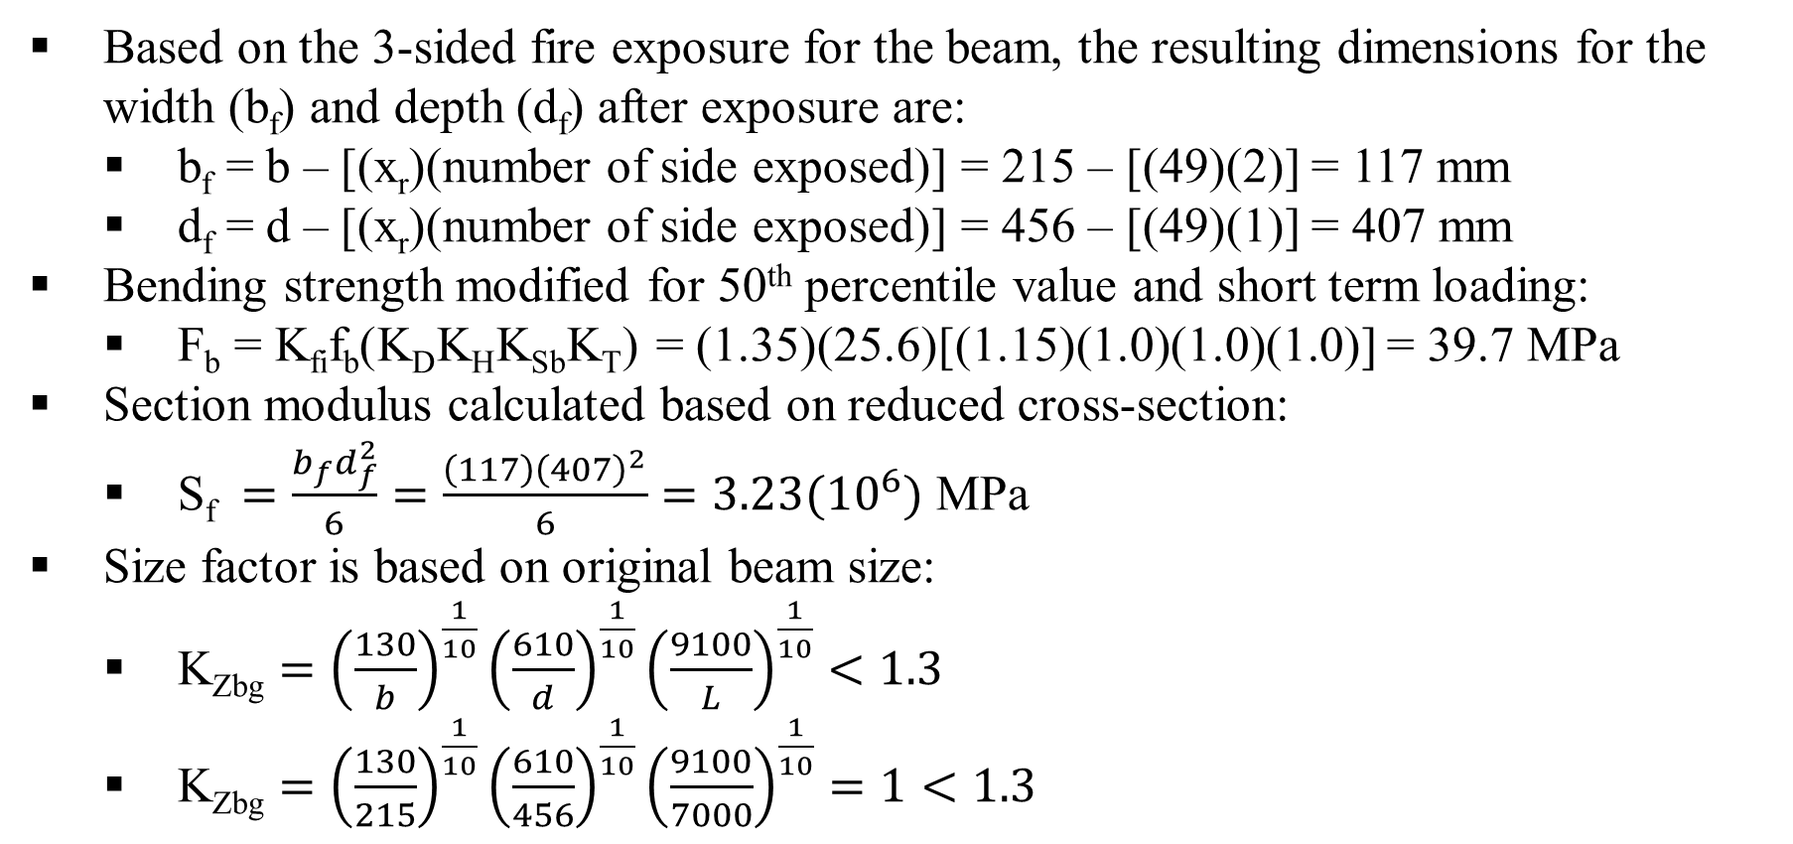
Example 4 – Solution
Based on the 3-sided fire exposure for the beam, the resulting dimensions for the width (b_{f}) and depth (d_{f}) after exposure are:
  b_{f} = b – [(x_{r})(number of side exposed)] = 215 – [(49)(2)] = 117 mm
  d_{f} = d – [(x_{r})(number of side exposed)] = 456 – [(49)(1)] = 407 mm
Bending strength modified for 50th percentile value and short term loading:
  F_{b} = K_{fi}f_{b}(K_{D}K_{H}K_{Sb}K_{T}) = (1.35)(25.6)[(1.15)(1.0)(1.0)(1.0)] = 39.7 MPa
Section modulus calculated based on reduced cross-section:
  S_{f} $=\frac{b_{f}d_{f}^{2}}{6}=\frac{\left(117\right){\left(407\right)}^{2}}{6}=3.23({10}^{6})$ MPa
Size factor is based on original beam size:
  K_{Zbg} $={\left(\frac{130}{b}\right)}^{\frac{1}{10}}{\left(\frac{610}{d}\right)}^{\frac{1}{10}}{\left(\frac{9100}{L}\right)}^{\frac{1}{10}}<1.3$
  K_{Zbg} $={\left(\frac{130}{215}\right)}^{\frac{1}{10}}{\left(\frac{610}{456}\right)}^{\frac{1}{10}}{\left(\frac{9100}{7000}\right)}^{\frac{1}{10}}=1<1.3$

Slide 27
Example 4 – Solution
Since K_{Zbg} = K_{L} = 1.0, calculation of bending moment resistance ofr reduced cross-section:
  M_{r} = ϕF_{b}S_{f}K_{X}K_{Zbg} = (1.0)(39.7)(3.23 × 10⁶)(1.0)(1.0) = 130 kNm
The moment resistance of the reduced cross-section after 1 hr of fire exposure is 130 kNm, which is greater than the specified-load-induced moment of 108 kNm
The structural fire resistance of the glulam beam is greater than 1 hr

Slide 28
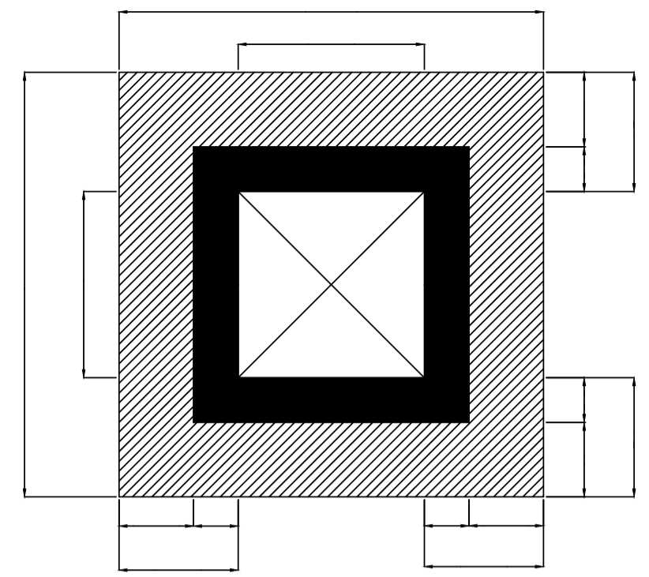
Example 5: Using CSA O86 Annex B Calculation Method – Columns
The following example illustrates how a 45-minute fire-resistance rating may be verified for a solid-sawn timber column using the calculation method in Annex B of CSA O86 under the following conditions:
species and grade: D.Fir-L, No.1
Column dimensions: 241 × 241 mm
Column height is 3.5 m
Specified dead load = 130 kN
Specified live load = 150 kN
Column is effectively pinned at both ends (K_{e} = 1.0)
Exposed to fire on four sides
b
b_{f}
x_{c,n}
x_{r}
x_{t}
d
d_{f}
x_{t}
x_{r}
x_{c,n}
x_{c,n}
x_{t}
x_{t}
x_{c,n}
x_{r}
x_{r}

Slide 29
Example 5 – Solution
Total specified load = 130 + 150 = 280 kN
Calculating the reduced cross-section dimensions based on notional charring rate:
Char depth after 45 minutes of standard fire exposure:
  x_{c,n} = β_{n}t = (0.8)(45) = 36 mm
Zero strength zone depth: x_{t} = 7 mm
Therefore, the resulting loss of cross-section on each side of exposure:
  x_{r} = 36 + 7 = 43 mm
Based on the 4-sided fire exposure for the column, the resulting dimensions for the width (b_{f}) and depth (d_{f}) after exposure are:
  b_{f} = b – [(x_{f})(number of sides exposed)] = 241 – [(43)(2)] = 155 mm
  d_{f} = d – [(x_{f})(number of sides exposed)] = 241 – [(43)(2)] = 155 mm
b
b_{f}
x_{c,n}
x_{r}
x_{t}
d
d_{f}
x_{t}
x_{r}
x_{c,n}
x_{c,n}
x_{t}
x_{t}
x_{c,n}
x_{r}
x_{r}

Slide 30
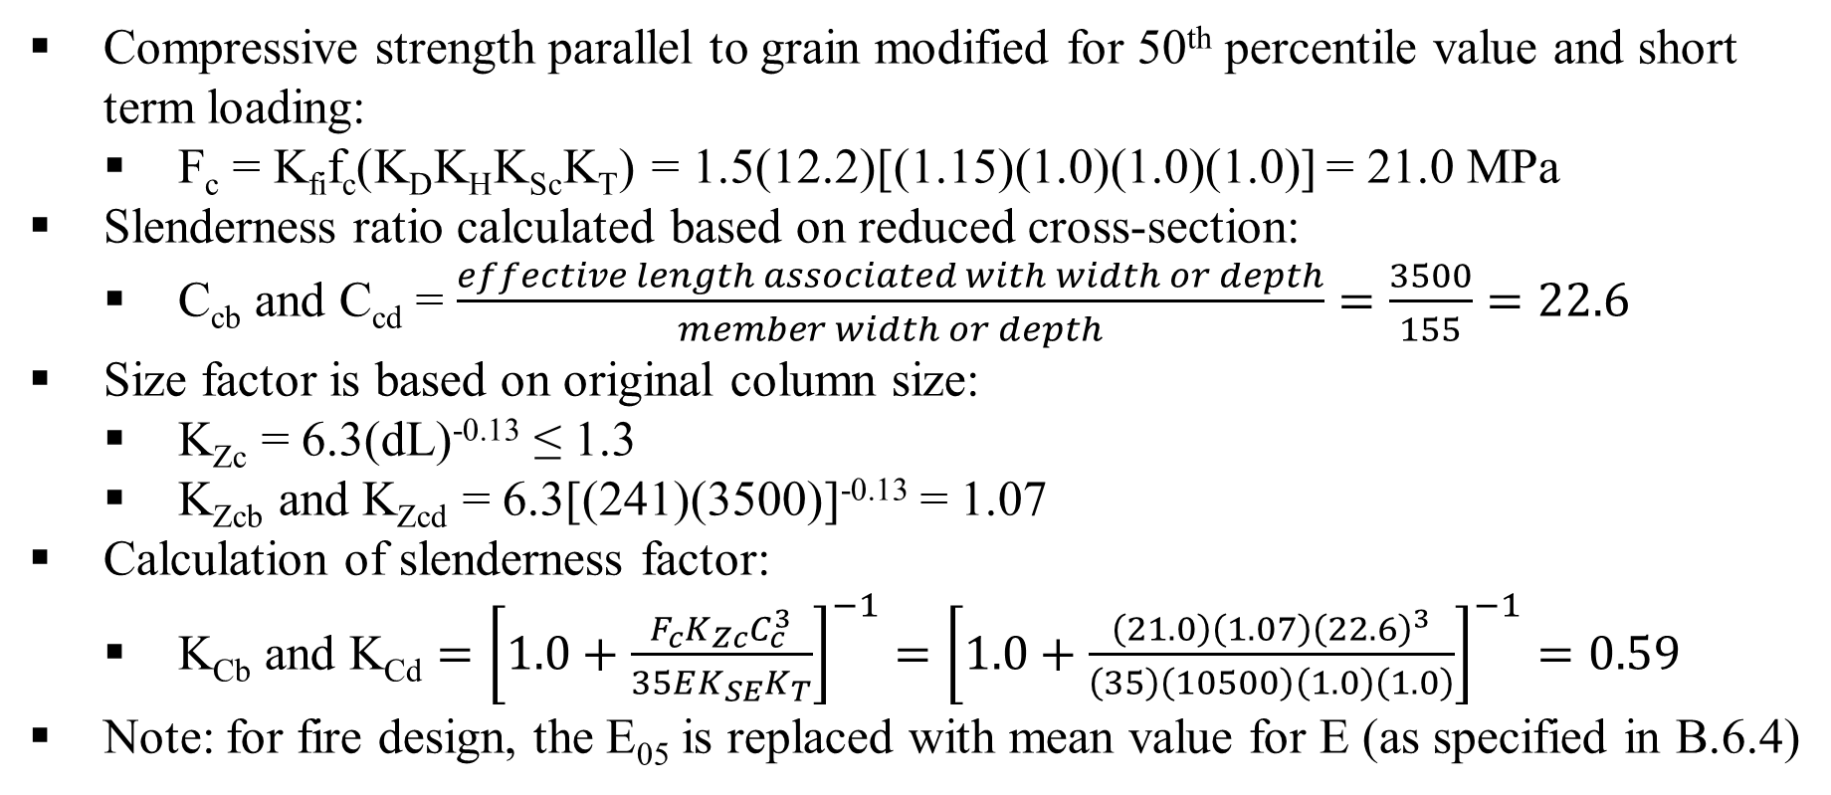
Example 5 – Solution
Compressive strength parallel to grain modified for 50th percentile value and short term loading:
  F_{c} = K_{fi}f_{c}(K_{D}K_{H}K_{Sc}K_{T}) = 1.5(12.2)[(1.15)(1.0)(1.0)(1.0)] = 21.0 MPa
Slenderness ratio calculated based on reduced cross-section:
  C_{cb} and C_{cd} = $\frac{effective length associated with width or depth}{member width or depth}=\frac{3500}{155}=22.6$
Size factor is based on original column size:
  K_{Zc} = 6.3(dL)^{-0.13} ≤ 1.3
  K_{Zcb} and K_{Zcd} = 6.3[(241)(3500)]^{-0.13} = 1.07
Calculation of slenderness factor:
  K_{Cb} and K_{Cd} $={\left[1.0+\frac{F_{c}K_{Zc}C_{c}^{3}}{35EK_{SE}K_{T}}\right]}^{−1}={\left[1.0+\frac{\left(21.0\right)\left(1.07\right){\left(22.6\right)}^{3}}{\left(35\right)\left(10500\right)\left(1.0\right)\left(1.0\right)}\right]}^{−1}=0.59$
Note: for fire design, the E₀₅ is replaced with mean value for E (as specified in B.6.4)

Slide 31
Example 5 – Solution
Calculation of axial compressive resistance for reduced cross-section:
  P_{rb} and P_{rd} = ϕF_{C}AK_{Zc}K_{C} = 1.0(21.0)[(155)(155)](1.07)(0.59) = 319 kN
The axial resistance of the reduced cross-section after 45 minutes of fire exposure is 319 kN, which is greater than the total specified load of 280 kN
The structural fire resistance of the solid-sawn timber column is greater than 45 minutes

Slide 32
Example 6: CLT Floor and Roof Panels
The following example illustrates how a 2-hour fire-resistance may be verified for a 5-ply CLT floor assembly using the calculation method in Annex B of CSA O96 under the following conditions:
5-ply CLT panels, 35 mm thick plies (175 mm total thickness)
CLT Stress Grade – V2
Bending strength f_{b} in the longitudinal plies is 11.8 MPa
1 Layer of 15.9 mm Type X gypsum board directly applied to underside of CLT panels
Simply supported span of 4732 mm
Specified dead load = 4.0 kPa (including self-weight)
Specified live load = 4.27 kPa
Note that floor and roof assemblies are rated for exposure to fire on the underside

Slide 33
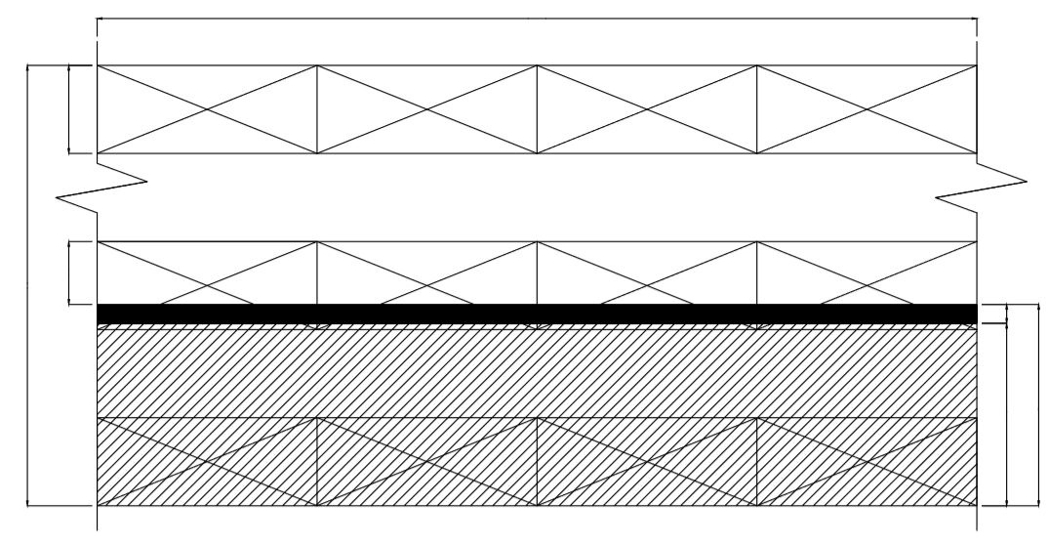
Example 6 – Solution
Unit width
d₁
d₂
x_{t}
d
x_{r}
x_{c,n}

Slide 34
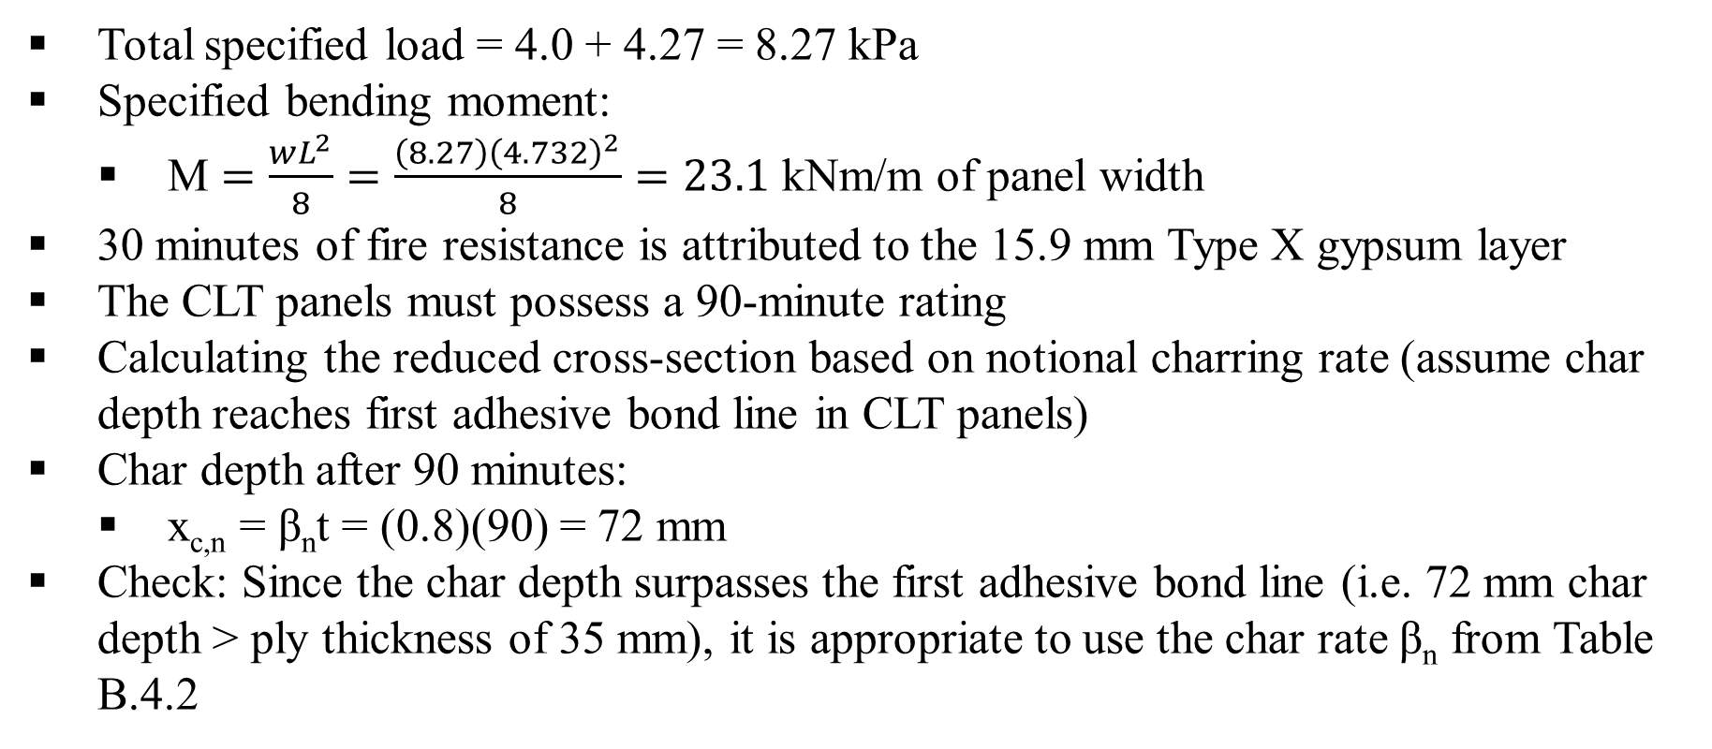
Example 6 – Solution
Total specified load = 4.0 + 4.27 = 8.27 kPa
Specified bending moment:
  M $=\frac{wL^{2}}{8}=\frac{\left(8.27\right){\left(4.732\right)}^{2}}{8}=23.1$ kNm/m of panel width
30 minutes of fire resistance is attributed to the 15.9 mm Type X gypsum layer
The CLT panels must possess a 90-minute rating
Calculating the reduced cross-section based on notional charring rate (assume char depth reaches first adhesive bond line in CLT panels)
Char depth after 90 minutes:
  x_{c,n} = β_{n}t = (0.8)(90) = 72 mm
Check: Since the char depth surpasses the first adhesive bond line (i.e. 72 mm char depth > ply thickness of 35 mm), it is appropriate to use the char rate β_{n} from Table B.4.2

Slide 35
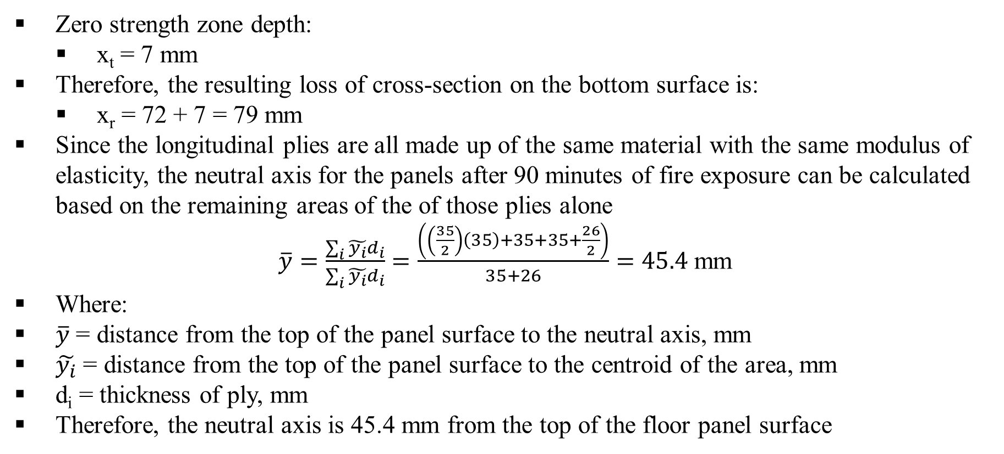
Example 6 – Solution
Zero strength zone depth:
  x_{t} = 7 mm
Therefore, the resulting loss of cross-section on the bottom surface is:
  x_{r} = 72 + 7 = 79 mm
Since the longitudinal plies are all made up of the same material with the same modulus of elasticity, the neutral axis for the panels after 90 minutes of fire exposure can be calculated based on the remaining areas of the of those plies alone
$\overline{y}=\frac{\sum_{i}{\tilde{y_{i}}}d_{i}}{\sum_{i}{\tilde{y_{i}}}d_{i}}=\frac{\left(\left(\frac{35}{2}\right)\left(35\right)+35+35+\frac{26}{2}\right)}{35+26}=45.4$mm
Where:
$\overline{y}$ = distance from the top of the panel surface to the neutral axis, mm
$\tilde{y_{i}}$ = distance from the top of the panel surface to the centroid of the area, mm
d_{i} = thickness of ply, mm
Therefore, the neutral axis is 45.4 mm from the top of the floor panel surface

Slide 36
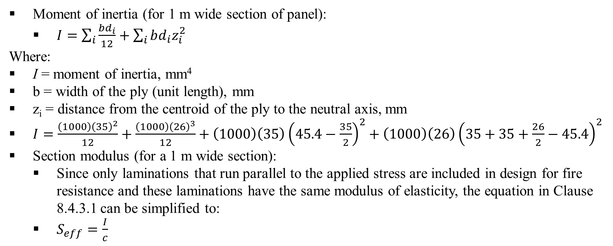
Example 6 – Solution
Moment of inertia (for 1 m wide section of panel):
  $I=\sum_{i}{\frac{bd_{i}}{12}}+\sum_{i}{bd_{i}z_{i}^{2}}$
Where:
I = moment of inertia, mm⁴
b = width of the ply (unit length), mm
z_{i} = distance from the centroid of the ply to the neutral axis, mm
$I=\frac{\left(1000\right){\left(35\right)}^{2}}{12}+\frac{\left(1000\right){\left(26\right)}^{3}}{12}+\left(1000\right)\left(35\right){\left(45.4−\frac{35}{2}\right)}^{2}+\left(1000\right)\left(26\right){\left(35+35+\frac{26}{2}−45.4\right)}^{2}$
Section modulus (for a 1 m wide section):
  Since only laminations that run parallel to the applied stress are included in design for fire resistance and these laminations have the same modulus of elasticity, the equation in Clause 8.4.3.1 can be simplified to:
  $S_{eff}=\frac{I}{c}$

Slide 37
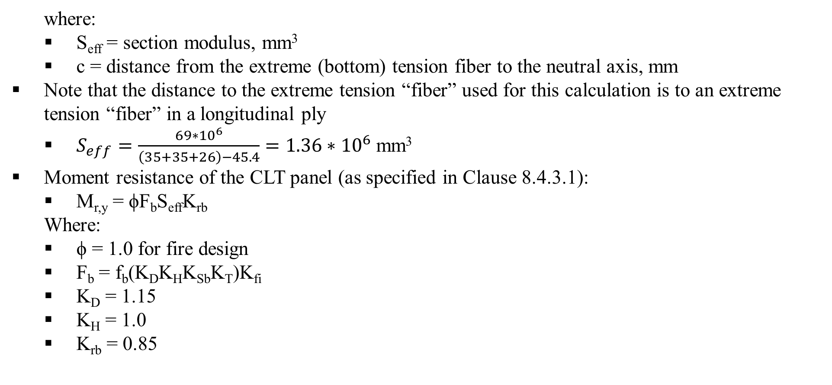
Example 6 – Solution
  where:
  S_{eff} = section modulus, mm³
  c = distance from the extreme (bottom) tension fiber to the neutral axis, mm
Note that the distance to the extreme tension “fiber” used for this calculation is to an extreme tension “fiber” in a longitudinal ply
  $S_{eff}=\frac{69∗{10}^{6}}{\left(35+35+26\right)−45.4}=1.36∗{10}^{6}$ mm³
Moment resistance of the CLT panel (as specified in Clause 8.4.3.1):
  M_{r,y} = ϕF_{b}S_{eff}K_{rb}
  Where:
  ϕ = 1.0 for fire design
  F_{b} = f_{b}(K_{D}K_{H}K_{Sb}K_{T})K_{fi}
  K_{D} = 1.15
  K_{H} = 1.0
  K_{rb} = 0.85
  K_{Sb} = 1.0
  K_{T} = 1.0
  K_{fi} = 1.5
  F_{b} = (11.8)[(1.15)(1.0)(1.0)(1.0)](1.5) = 20.4 MPa
  M_{r,y} = (1.0)(20.4)(1.36 × 10⁶)(1.0)(0.85) = 23.6 × 10⁶ Nmm/m
  M_{r,y} = 23.6 kNm/m of panel width

Slide 38
Example 6 – Solution
The moment resistance after 90 min is 23.6 kNm/m, compared to the moment induced by the applied load of 23.1 kNm/m (i.e. M_{r} >M)
The CLT floor panels provide at least 90 minutes of structural fire resistance without gypsum protection, and the CLT floor assembly provides at least 2 hours of structural fire resistance with one layer 15.9 mm Type X gypsum board

Slide 39
This lecture is developed based on the Wood Design Manual [1], CSA O86-2014 [2] and National building code of Canada 2015 [3].
References
[1] Canadian Wood Council (CWC). 2017. Wood design manual. Ottawa, ON, Canada.
[2] Canadian Standards Association (CSA). 2017. Engineering design in wood. CSA O86-14, Toronto, ON, Canada.
[3] National Research Council (NRC). 2015. National building code of Canada 2015. Ottawa, ON, Canada.

Slide 40
Additional Examples

Slide 41
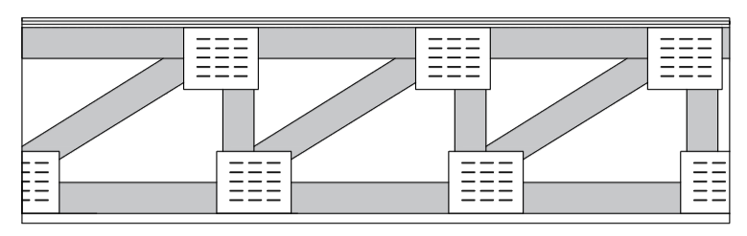
Example 7: Using NBC Division B, Appendix D-2.3. – Lightweight wood truss floor assemblies
Determine the fire-resistance rating of the wood truss floor assembly
Ceiling is 15.9 mm Type X gypsum board (GB) directly applied
Trusses are spaced at 600 mm on center
15.5 mm T & G plywood or 15.5 mm oriented strandboard
Wood truss 600 mm o.c. (10 minutes)
One layer of 15.9 mm Type X gypsum board (40 minutes)

Slide 42
Example 7 – Solution
Tables located on Slide #9
From Table 10.2b [2]:
  Time assigned to 15.9 mm Type X GB 40
From Table 10.3:
  Time assigned to wood trusses 10
Fire-resistance rating of wood truss floor assembly: 50 minutes

Slide 43
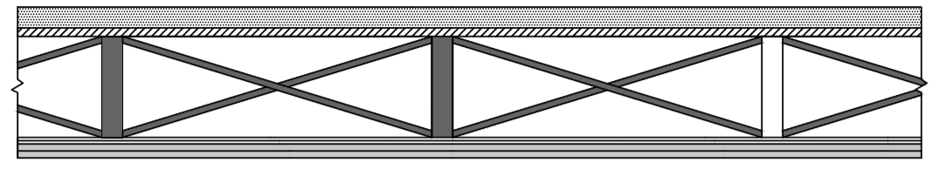
Example 8: Using NBC Division B, Appendix D-2.3 – Lightweight wood joist floor assemblies
Determine the fire-resistance rating of the wood joist floor assembly
Ceiling is two layers of 12.7 mm Type X gypsum board attached with resilient metal channels spaced at 600 mm on center and joists spaced at 600 mm on center
There is 38-mm-thick concrete topping the subfloor
15.5 mm T&G plywood or 15.5 mm OSB
38-mm-thick concrete topping (5 minutes)
38 × 184 mm (minimum) wood joists, 600 mm o.c. (10 minutes)
Resilient metal channels 600 mm o.c.
Two layers 12.7 mm Type X gypsum board (45 minutes)

Slide 44
Example 8 – Solution
Tables located on Slides #9 and #13
From Table 10.2b [2]:
  Time assigned to two layers of 12.7 mm Type X GB 45
From Table 10.3:
  Time assigned to wood joist at 600 mm on center 10
From Table 10.5:
  Time assigned to concrete topping 5
Fire-resistance rating of wood joist floor assembly: 60 minutes

Slide 45
Example 9: Using Selection Tables for Fire Resistance – Beams
Design single-span floor beams for the following conditions:
Beam spacing = 3.0 m
Beam span = 6.0 m
Specified dead load = 1.5 kPa (includes partitions and self-weight)
Specified live load = 2.4 kPa (commercial use and occupancy)
Exposed to fire on three sides (top side protected)
1-hour fire-resistance rating
Dry service condition
Untreated
Use D.Fir-L No.1 sawn timber

Slide 46
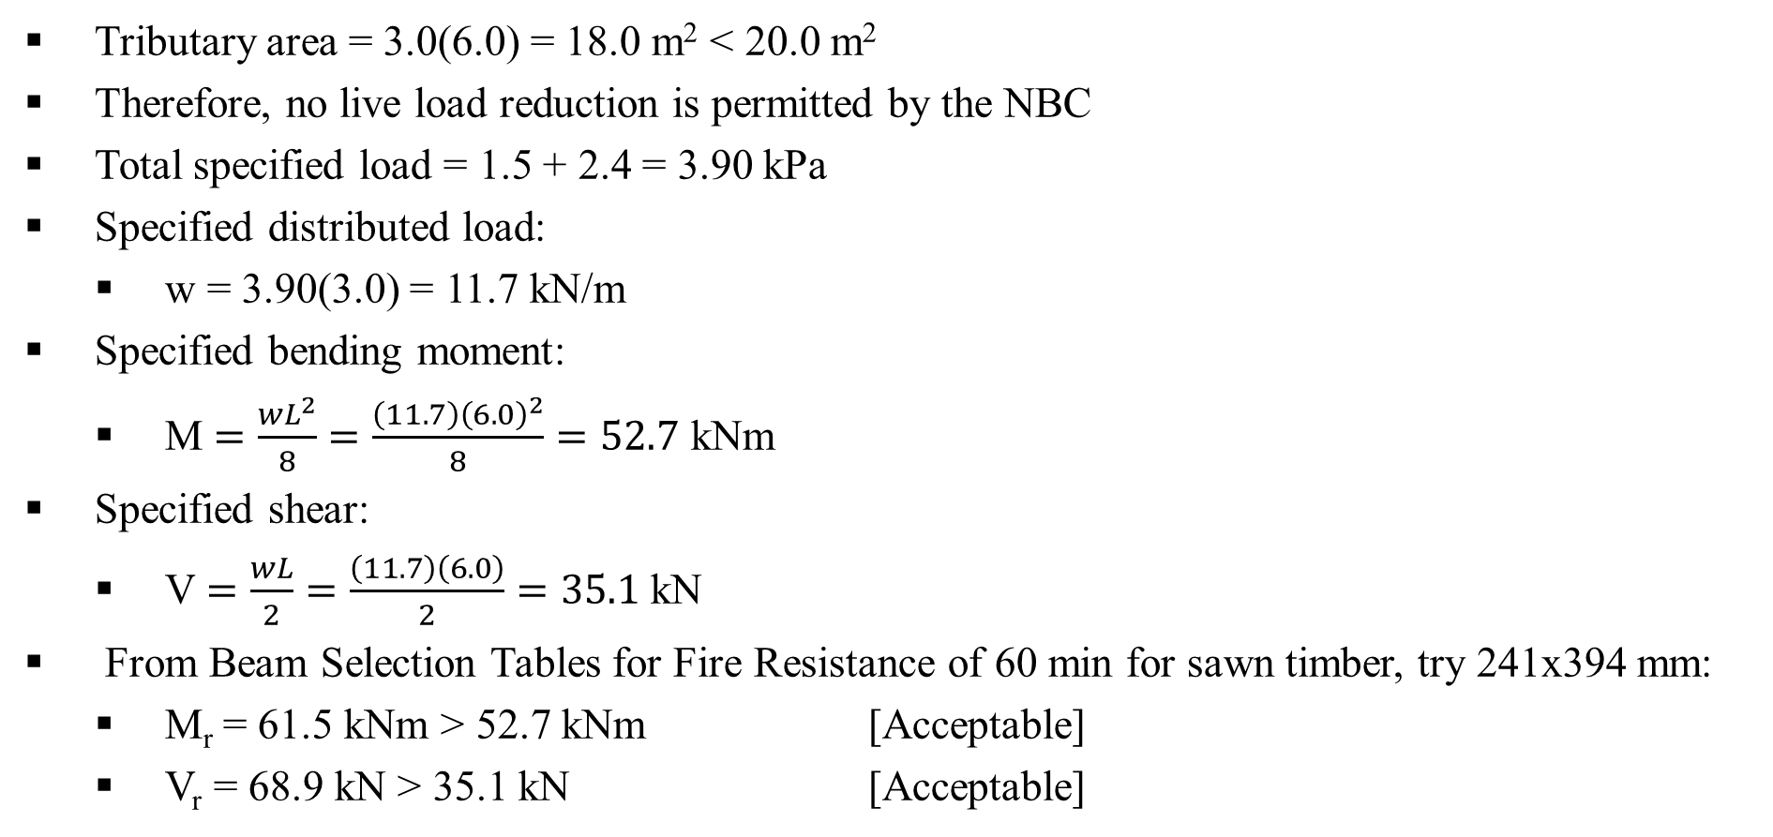
Example 9 – Solution
Tributary area = 3.0(6.0) = 18.0 m² < 20.0 m²
Therefore, no live load reduction is permitted by the NBC
Total specified load = 1.5 + 2.4 = 3.90 kPa
Specified distributed load:
  w = 3.90(3.0) = 11.7 kN/m
Specified bending moment:
  M $=\frac{wL^{2}}{8}=\frac{\left(11.7\right){\left(6.0\right)}^{2}}{8}=52.7$ kNm
Specified shear:
  V $=\frac{wL}{2}=\frac{\left(11.7\right)\left(6.0\right)}{2}=35.1$ kN
From Beam Selection Tables for Fire Resistance of 60 min for sawn timber, try 241x394 mm:
  M_{r} = 61.5 kNm > 52.7 kNm [Acceptable]
  V_{r} = 68.9 kN > 35.1 kN [Acceptable]
Use 241×394 mm No.1 D.Fir-L

Slide 47
Example 10: Using Selection Tables – Beams
Design single-span floor beams for the following conditions:
Beam spacing = 5.0 m
Beam span = 7.5 m
Specified dead load = 2.0 kPa (includes partitions and self-weight)
Specified live load = 2.4 kPa (commercial use and occupancy)
Exposed to fire on three sides (top side protected)
2-hour fire-resistance rating
1 layer of 15.9 mm Type X gypsum board directly applied to bottom and sides of beams
Dry service condition
Untreated
Compression edge assumed fully laterally supported by floor system
Use D.Fir-L 20f-E glulam

Slide 48
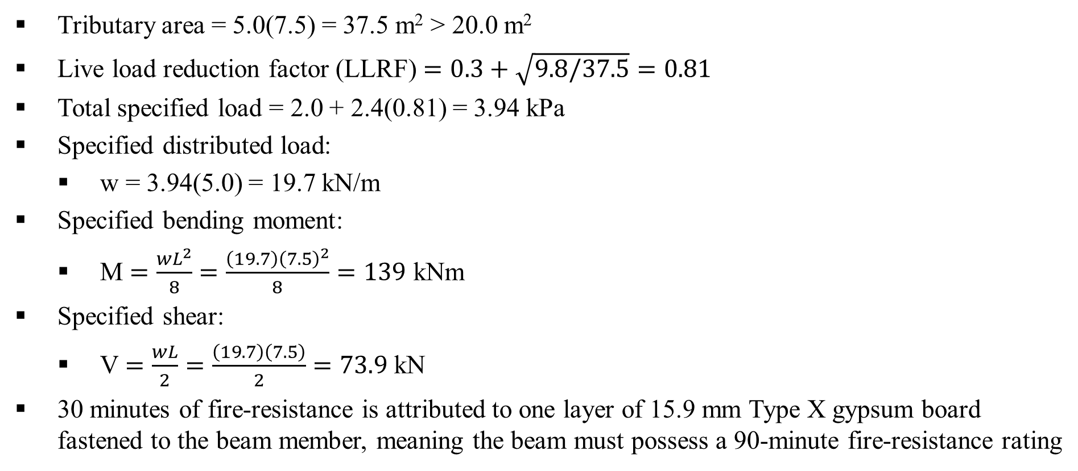
Example 10 – Solution
Tributary area = 5.0(7.5) = 37.5 m² > 20.0 m²
Live load reduction factor (LLRF) $=0.3+\sqrt{9.8/37.5}=0.81$
Total specified load = 2.0 + 2.4(0.81) = 3.94 kPa
Specified distributed load:
  w = 3.94(5.0) = 19.7 kN/m
Specified bending moment:
  M $=\frac{wL^{2}}{8}=\frac{\left(19.7\right){\left(7.5\right)}^{2}}{8}=139$ kNm
Specified shear:
  V $=\frac{wL}{2}=\frac{\left(19.7\right)\left(7.5\right)}{2}=73.9$ kN
30 minutes of fire-resistance is attributed to one layer of 15.9 mm Type X gypsum board fastened to the beam member, meaning the beam must possess a 90-minute fire-resistance rating

Slide 49
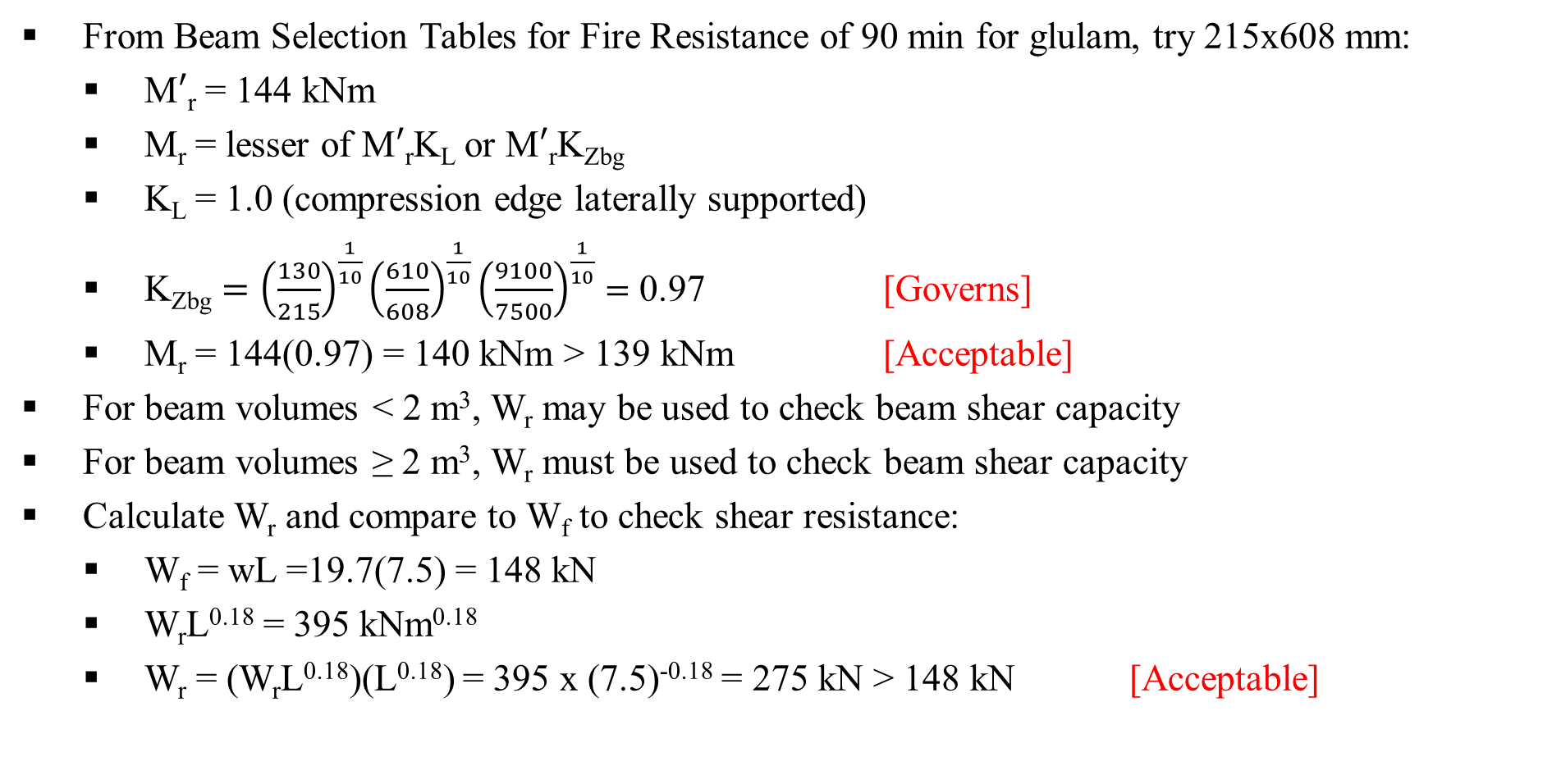
Example 10 – Solution
From Beam Selection Tables for Fire Resistance of 90 min for glulam, try 215x608 mm:
  M$′$_{r} = 144 kNm
  M_{r} = lesser of M$′$_{r}K_{L} or M$′$_{r}K_{Zbg}
  K_{L} = 1.0 (compression edge laterally supported)
  K_{Zbg} $={\left(\frac{130}{215}\right)}^{\frac{1}{10}}{\left(\frac{610}{608}\right)}^{\frac{1}{10}}{\left(\frac{9100}{7500}\right)}^{\frac{1}{10}}=$ 0.97 [Governs]
  M_{r} = 144(0.97) = 140 kNm > 139 kNm [Acceptable]
For beam volumes < 2 m³, W_{r} may be used to check beam shear capacity
For beam volumes ≥ 2 m³, W_{r} must be used to check beam shear capacity
Calculate W_{r} and compare to W_{f} to check shear resistance:
  W_{f} = wL =19.7(7.5) = 148 kN
  W_{r}L^{0.18} = 395 kNm^{0.18}
  W_{r} = (W_{r}L^{0.18})(L^{0.18}) = 395 x (7.5)^{-0.18} = 275 kN > 148 kN [Acceptable]
Use 215 × 608 mm 20f-E D.Fir-L glulam

Slide 50
Example 11: Using Selection Tables for Fire Resistance – Columns
Design columns for the following conditions:
Specified dead load = 2.0 kPa
Specified live load = 2.4 kPa (residential use and occupancy)
Tributary area = 25 m²
Unbraced length = 5 m
Exposed to fire on four sides
1-hour fire-resistance rating
Dry service condition
Untreated
Column effectively pinned at both ends (K_{e} = 1.0)
No eccentricity considered
Use No.1 D.Fir-L

Slide 51
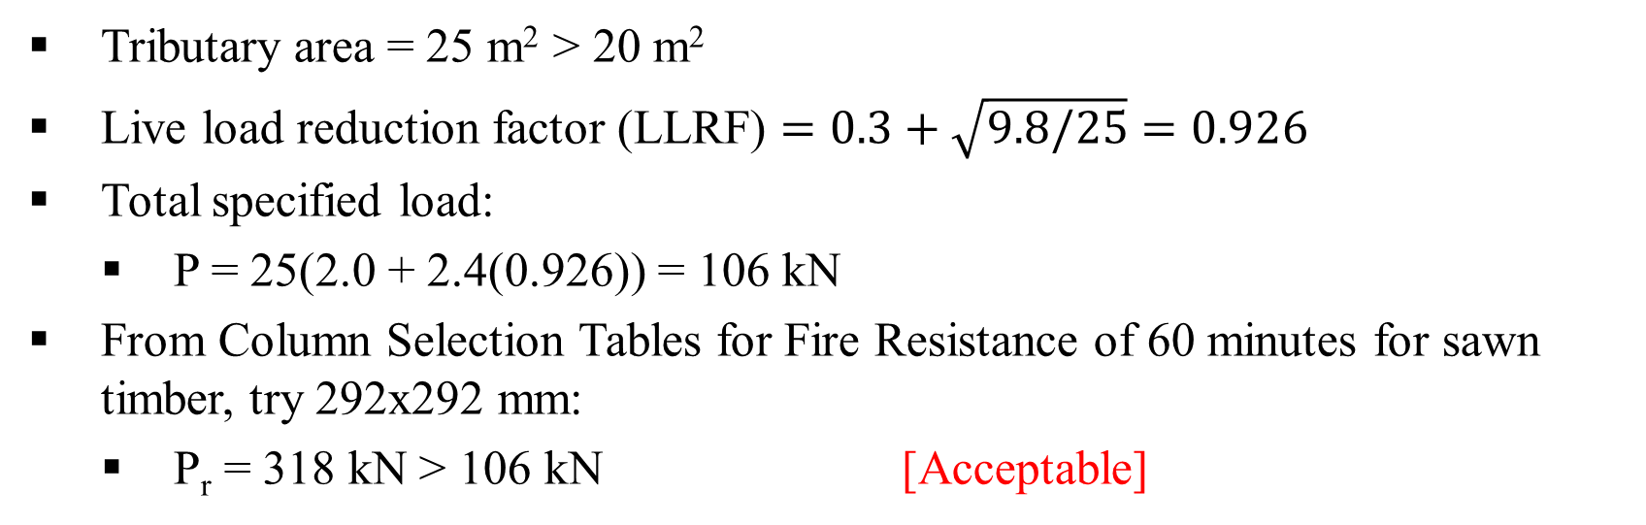
Example 11 – Solution
Tributary area = 25 m² > 20 m²
Live load reduction factor (LLRF) $=0.3+\sqrt{9.8/25}=0.926$
Total specified load:
  P = 25(2.0 + 2.4(0.926)) = 106 kN
From Column Selection Tables for Fire Resistance of 60 minutes for sawn timber, try 292x292 mm:
  P_{r} = 318 kN > 106 kN [Acceptable]
Use 292 × 292 mm No.1 D.Fir-L

Slide 52
Example 12: Using Selection Tables for Fire Resistance – Columns
Design columns for the following conditions:
Specified dead load = 1.0 kPa
Specified live load = 1.9 kPa
Specified snow load = 2.0 kPa
Tributary area = 25 m² (for both snow and live load)(residential use and occupancy
Unbraced length = 5 m
Exposed to fire on four sides
2-hour fire-resistance rating
2 layer of 15.9 mm Type X gypsum board directly applied to all four sides of column
Wet service condition
Treated with a preservative
Column effectively pinned at both ends (K_{e} = 1.0)
No eccentricity considered
Use No.1 D.Fir-L

Slide 53
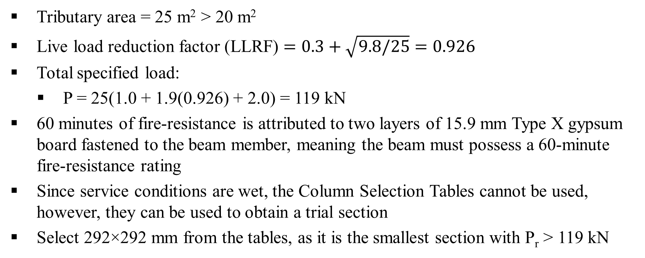
Example 12 – Solution
Tributary area = 25 m² > 20 m²
Live load reduction factor (LLRF) $=0.3+\sqrt{9.8/25}=0.926$
Total specified load:
  P = 25(1.0 + 1.9(0.926) + 2.0) = 119 kN
60 minutes of fire-resistance is attributed to two layers of 15.9 mm Type X gypsum board fastened to the beam member, meaning the beam must possess a 60-minute fire-resistance rating
Since service conditions are wet, the Column Selection Tables cannot be used, however, they can be used to obtain a trial section
Select 292×292 mm from the tables, as it is the smallest section with P_{r} > 119 kN

Slide 54
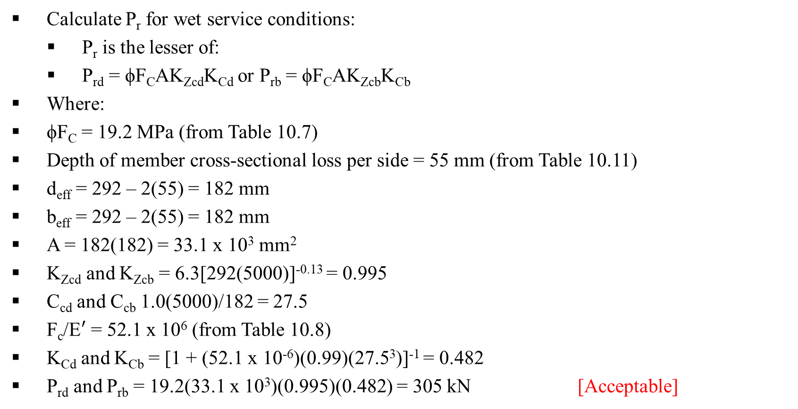
Example 12 – Solution
Calculate P_{r} for wet service conditions:
  P_{r} is the lesser of:
  P_{rd} = ϕF_{C}AK_{Zcd}K_{Cd} or P_{rb} = ϕF_{C}AK_{Zcb}K_{Cb}
Where:
ϕF_{C} = 19.2 MPa (from Table 10.7)
Depth of member cross-sectional loss per side = 55 mm (from Table 10.11)
d_{eff} = 292 – 2(55) = 182 mm
b_{eff} = 292 – 2(55) = 182 mm
A = 182(182) = 33.1 x 10³ mm²
K_{Zcd} and K_{Zcb} = 6.3[292(5000)]^{-0.13} = 0.995
C_{cd} and C_{cb} 1.0(5000)/182 = 27.5
F_{c}/E$′$ = 52.1 x 10⁶ (from Table 10.8)
K_{Cd} and K_{Cb} = [1 + (52.1 x 10⁻⁶)(0.99)(27.5³)]⁻¹ = 0.482
P_{rd} and P_{rb} = 19.2(33.1 x 10³)(0.995)(0.482) = 305 kN [Acceptable]
Use 292×292 mm No.1 D.Fir-L column

Slide 55
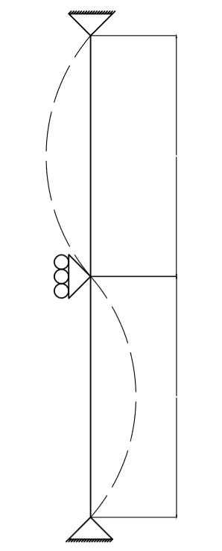
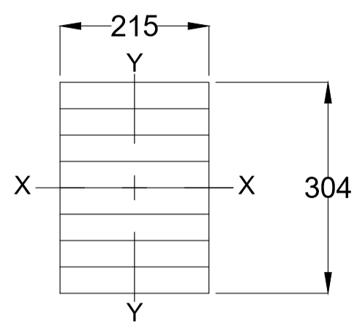
Example 13: Using Selection Tables for Fire Resistance – Columns
Is a 215 × 304 mm 12c-E Spruce-Pine glulam column adequate for the following conditions:
Specified dead load = 1.5 kPa
Specified snow load = 3.5 kPa (residential use and occupancy)
Tributary area = 30 m²
Total length = 7 m
1-hour fire-resistance rating
1 layer of 12.7 mm Type X gypsum board directly applied to all four sides of column
Dry service condition
Untreated
No eccentricity considered
The column is effectively pinned at both ends and braced at mid-height
3.5 m
Buckled shape (about Y axis)
3.5 m

Slide 56
Example 13 – Solution
The column supports dead plus snow loads only; no live load reduction factor
Total specified load:
  P = 30(1.5 + 3.5) = 150 kN
15 minutes of fire-resistance is attributed to one layer of 12.7 mm Type X gypsum
The beam must possess a 45-minute fire-resistance rating
Slenderness ratio, C_{c}:
  Effective depth of member cross-sectional loss per side = 38.5 mm (from Table 10.11)
  d_{eff} = 304 – 2(38.5) = 227 mm
  b_{eff} = 215 – 2(38.5) = 138 mm
  C_{cx} = K_{e}L_{d}/d_{eff} = 1.0(7000)/227 = 30.8 [Governs]
  C_{cy} = K_{e}L_{b}/b_{eff} = 1.0(3500)/138 = 25.4

Slide 57
Example 13 – Solution
Buckling about X axis is the governing case
Since the effective column length in the direction of buckling is equal to the total column length (K_{e}L_{d} = L), the Column Selection Tables may be used
From Column Selection Tables for Fire Resistance:
  P_{rx} = 260 kN > 150 kN [Acceptable]
The 215 × 304 mm 12c-E Spruce-Pine glulam section is adequate

Slide 58
Example 14: Using Selection Tables for Fire Resistance – Columns
Is a 215 × 304 mm 12c-E Spruce-Pine glulam column adequate for the following conditions:
Specified dead load = 1.5 kPa
Specified snow load = 3.5 kPa (residential use and occupancy)
Tributary area = 30 m²
Total length = 7 m
1-hour fire-resistance rating
1 layer of 12.7 mm Type X gypsum board directly applied to all sides of column
Dry service condition
Untreated
No eccentricity considered
The column is effectively pinned at both ends and braced at mid-height in all directions

Slide 59
Example 14 – Solution
Effective column length about X and Y axis (K_{e}L_{d,b} = 1.0(4.5) = 4.5 m) is not equal to total column length (L = 9.0 m)
Therefore, Column Selection Tables cannot be used
Total specified load:
  P = 30(1.5 + 3.5) = 150 kN
12.7 mm Type X gypsum attributes 15 minutes of fire-resistance
The beam must possess 45-minutes of fire-resistance

Slide 60
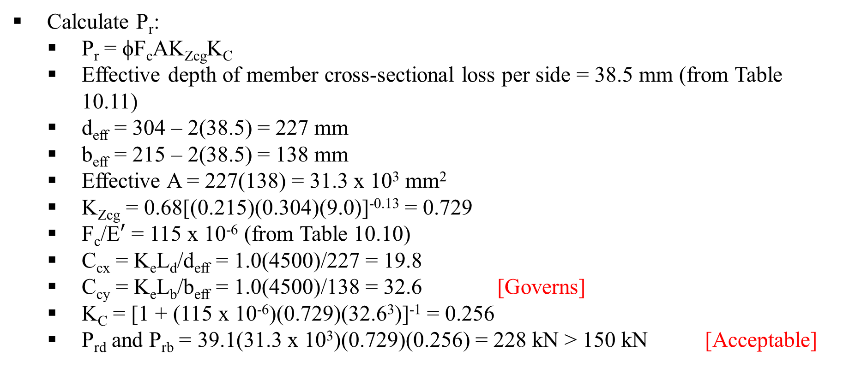
Example 14 – Solution
Calculate P_{r}:
  P_{r} = ϕF_{c}AK_{Zcg}K_{C}
  Effective depth of member cross-sectional loss per side = 38.5 mm (from Table 10.11)
  d_{eff} = 304 – 2(38.5) = 227 mm
  b_{eff} = 215 – 2(38.5) = 138 mm
  Effective A = 227(138) = 31.3 x 10³ mm²
  K_{Zcg} = 0.68[(0.215)(0.304)(9.0)]^{-0.13} = 0.729
  F_{c}/E$′$ = 115 x 10⁻⁶ (from Table 10.10)
  C_{cx} = K_{e}L_{d}/d_{eff} = 1.0(4500)/227 = 19.8
  C_{cy} = K_{e}L_{b}/b_{eff} = 1.0(4500)/138 = 32.6 [Governs]
  K_{C} = [1 + (115 x 10⁻⁶)(0.729)(32.6³)]⁻¹ = 0.256
  P_{rd} and P_{rb} = 39.1(31.3 x 10³)(0.729)(0.256) = 228 kN > 150 kN [Acceptable]
The 215 × 304 mm 12c-E Spruce-Pine glulam section is adequate

Slide 61
Example 15: Using Selection Tables for Fire Resistance – CLT floor and roof panels
Design single-span CLT floor panels for the following conditions:
Specified dead load = 1.5 kPa
Specified live load = 2.4 kPa
Panel span = 6 m
Panel width (unit width) = 1 m
1-hour fire-resistance rating
Dry service condition
Untreated
Use CLT Stress Grade V1, with 35 mm ply thickness for all plies

Slide 62
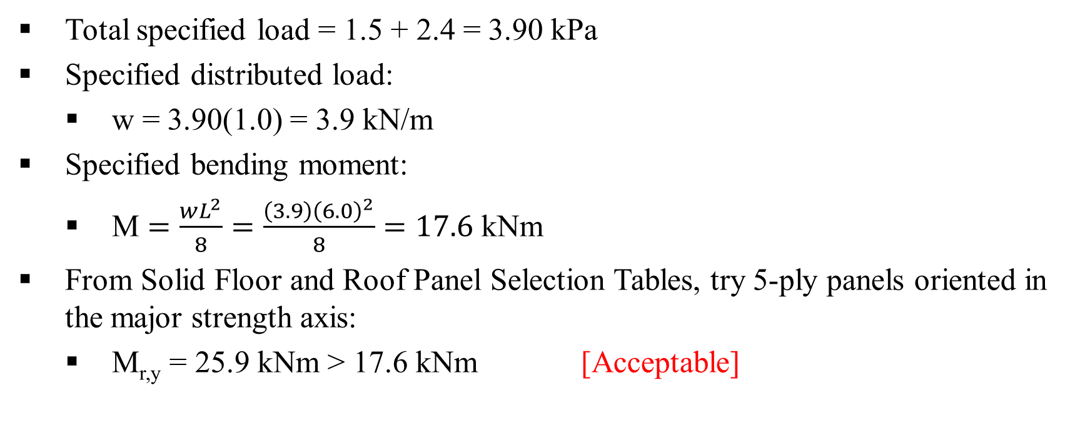
Example 15 – Solution
Total specified load = 1.5 + 2.4 = 3.90 kPa
Specified distributed load:
  w = 3.90(1.0) = 3.9 kN/m
Specified bending moment:
  M $=\frac{wL^{2}}{8}=\frac{\left(3.9\right){\left(6.0\right)}^{2}}{8}=17.6$ kNm
From Solid Floor and Roof Panel Selection Tables, try 5-ply panels oriented in the major strength axis:
  M_{r,y} = 25.9 kNm > 17.6 kNm [Acceptable]
Use 5-ply V1 CLT floor panels oriented in the major strength axis

Slide 63
Example 16: Using Selection Tables for Fire Resistance – CLT floor and roof panels
Design single-span floor CLT panel for the following conditions:
Specified dead load = 2.0 kPa
Specified live load = 2.4 kPa
Panel span = 8 m
Panel width (unit width) = 1 m
2-hour fire-resistance rating
1 layer of 15.9 mm Type X gypsum board applied directly to underside of CLT floor panels
Dry service conditions
Untreated
Use CLT Stress Grade E2, with 35 mm ply thickness for all plies

Slide 64
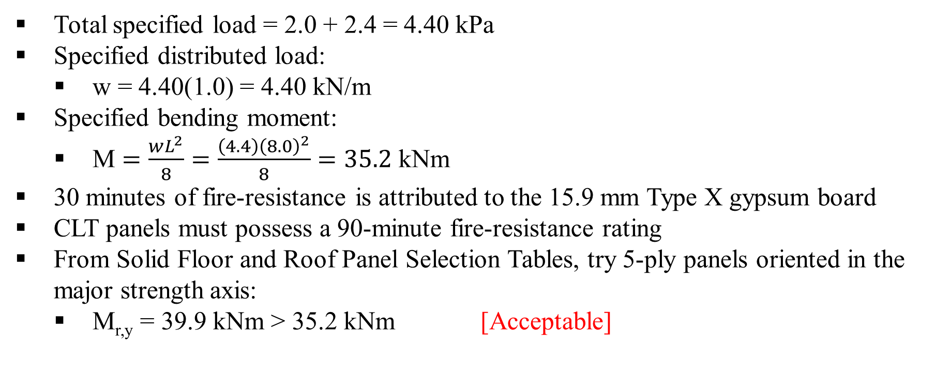
Example 16 – Solution
Total specified load = 2.0 + 2.4 = 4.40 kPa
Specified distributed load:
  w = 4.40(1.0) = 4.40 kN/m
Specified bending moment:
  M $=\frac{wL^{2}}{8}=\frac{\left(4.4\right){\left(8.0\right)}^{2}}{8}=35.2$ kNm
30 minutes of fire-resistance is attributed to the 15.9 mm Type X gypsum board
CLT panels must possess a 90-minute fire-resistance rating
From Solid Floor and Roof Panel Selection Tables, try 5-ply panels oriented in the major strength axis:
  M_{r,y} = 39.9 kNm > 35.2 kNm [Acceptable]
Use 5-ply E2 CLT floor panels oriented in the major strength axis

