Slide 1

Chapter 4 Timber Design Code
CIVE480 Timber Structures
2019

Slide 2

4.1 Design Method

Slide 3
1) Design goal — SAFE
Timber design code: O86-14 Engineering Design in Wood (CSA 2017)
Load effect ≤ Resistance
Random variables
Random variables
Reliability-based (or probabilistic) design
Limit states design

Slide 4
2) Limit states design
Strength
limit states
Maximum load-carrying capacity of the structure
Limit states design
Serviceability limit states
Restrict the normal use and occupancy of the structure
(e.g. excessive deflection, vibration…)

Slide 5
2) Limit states design — performance function
Principles of reliability-based design consider all of the uncertainties involved in the design process.
Performance function: Z (x₁,x₂,…,x_{N}), (x_{i}: design variable)
By convention: Z = R-S, (R: capacity, S: demand)
The probability of non-performance: P (Z < 0)
The probability of performance: P (Z > 0)
Limit state: Z = 0

Slide 6
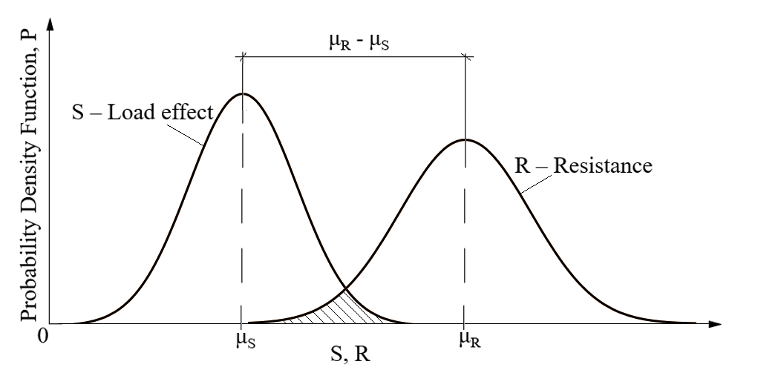
2) Limit states design — probability of failure
Probabilistic design
Each variable is a probability distribution (not a single value)
Shaded area stands for the probability of failure, where S > R

Slide 7
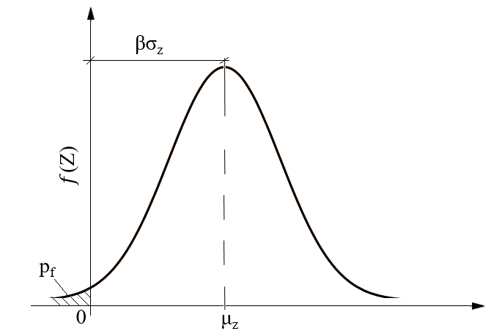

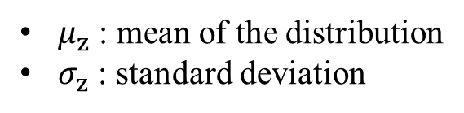
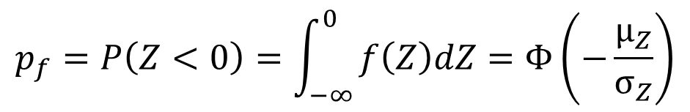

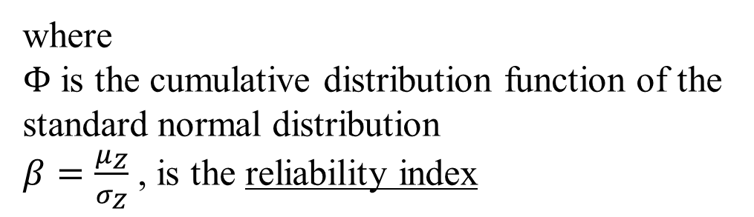
2) Limit states design — reliability index $β$
Performance function: Z = R-S
Probability of failure: $p_{f}$
$$p_{f}=P\left(Z<0\right)=\int_{−∞}^{0}{f\left(Z\right)dZ=Φ\left(−\frac{μ_{Z}}{σ_{Z}}\right)}$$
$$p_{f}=Φ(−β)$$
where
$Φ$ is the cumulative distribution function of the standard normal distribution
$β=\frac{μ_{Z}}{σ_{Z}}$ , is the reliability index
Probability density function of f(Z)
$μ_{z}$ : mean of the distribution
$σ_{z}$ : standard deviation

Slide 8

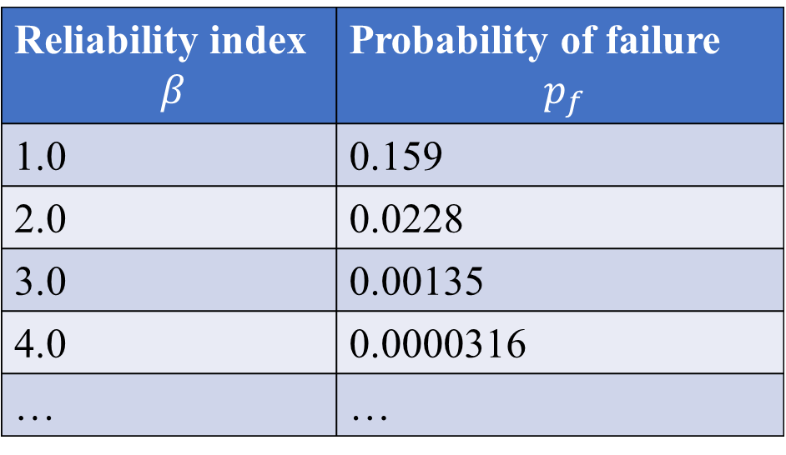
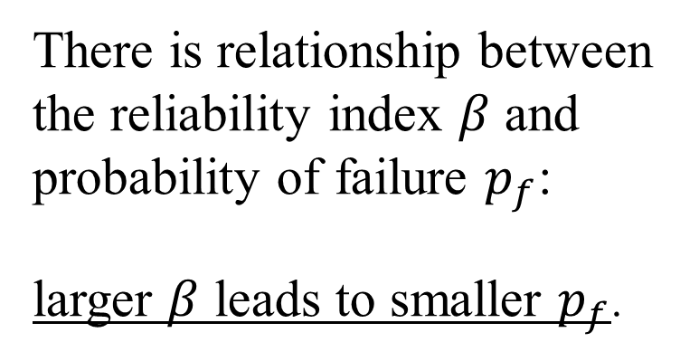
2) Limit states design — reliability index $β$
$$p_{f}=Φ(−β)$$
Reliability index $β$ | Probability of failure $p_{f}$
1.0 | 0.159
2.0 | 0.0228
3.0 | 0.00135
4.0 | 0.0000316
… | …
There is relationship between the reliability index $β$ and probability of failure $p_{f}$:
larger $β$ leads to smaller $p_{f}$.

Slide 9
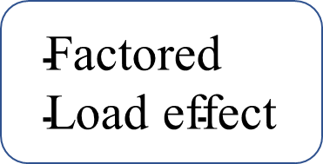
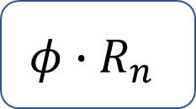

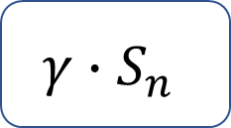
2) Limit States Design — Factored load and resistance
Strength
limit states
$$\text{Factored} \text{Load} \text{effect}$$
$$\text{Factored}$$
$$\text{Resistanceed}$$
≤
$$γ∙S_{n}$$
$$φ∙R_{n}$$
Load
factor
Specified loads
Resistance
factor
Specified
resistance

Slide 10
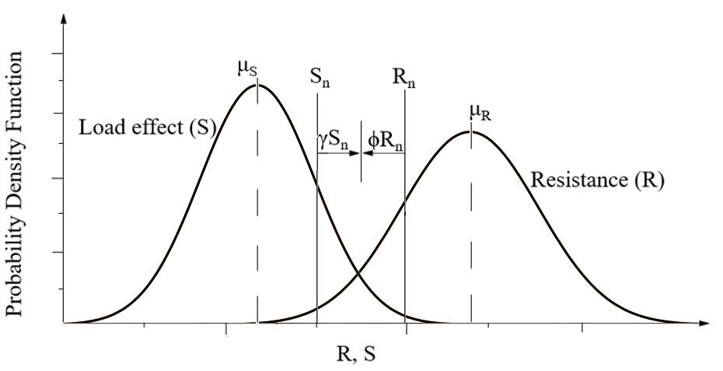

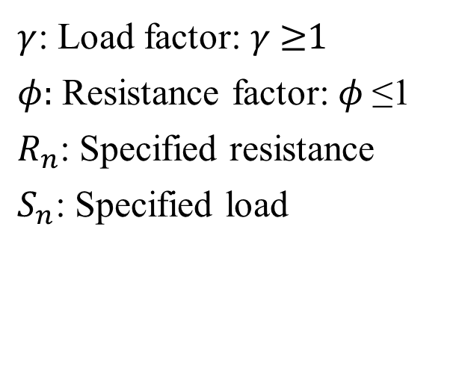
2) Limit states design — load and resistance factors
$$γ∙S_{n}≤φ∙R_{n}$$
$γ$: Load factor: $γ$≥1
$φ:$ Resistance factor: $φ$≤1
$R_{n}$: Specified resistance
$S_{n}$: Specified load
The resistance factor $φ$can be calibrated to meet target reliability

Slide 11
4.2 Load Types

Slide 12
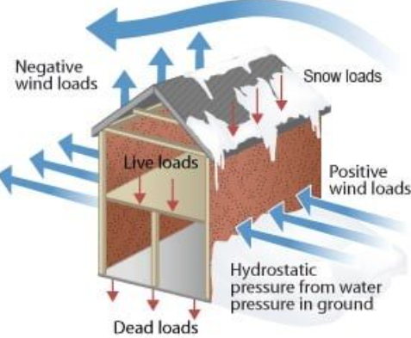
1) Specified loads
The loads that need to be considered are as follows:
D – Dead load due to weight of building components
E – Load due to earthquake
L – Live load due to use and occupancy
S – Load due to snow (ice and rain)
W – Load due to wind
……
theconstructor.org

Slide 13
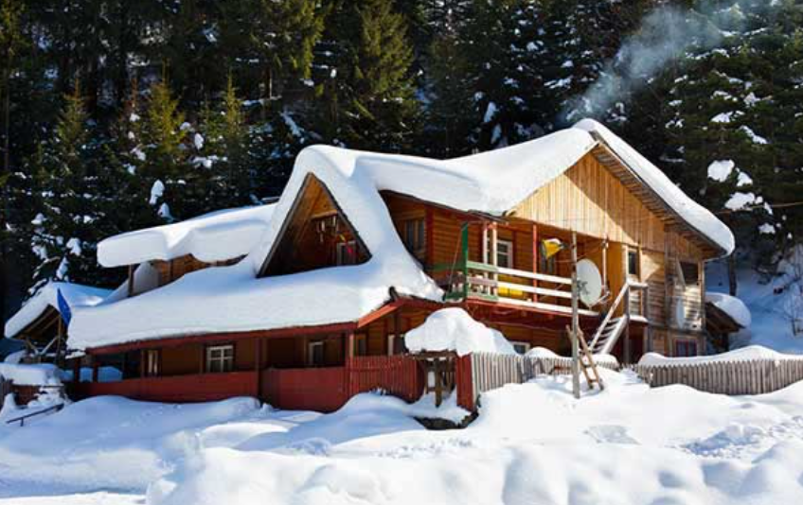
2) Importance factors
Depend on the type of load and the building use and occupancy.
Applied to:
E (earthquake)
S (snow)
W (wind)
roofdoctorutah.com

Slide 14
2) Importance factors
Depend on the type of load and the building use and occupancy.
 | Snow Loads, I_{S} |  | Wind Loads, I_{W} |  | Earthquake Loads, I_{E}
Importance category | Limit State |  | Limit State |  | Limit State
 | Ultimate | Serviceability | Ultimate | Serviceability | Ultimate | Serviceability
Low | 0.8 | 0.9 | 0.8 | 0.75 | 0.8 | -
Normal | 1.0 | 0.9 | 1.0 | 0.75 | 1.0 | -
High | 1.15 | 0.9 | 1.15 | 0.75 | 1.3 | -
Post-Disaster | 1.25 | 0.9 | 1.25 | 0.75 | 1.5 | -

Slide 15
2) Importance factors
Importance categories:
Low — Low hazard to human life in the event of failure
Normal — All buildings except low, high, or post-disaster
High — Buildings likely to be used as post-disaster shelters (e.g. schools and community centres)
Post-disaster — Buildings essential to provide services in a disaster

Slide 16
3) Load combinations — ultimate limit state
Most unfavourable effect considering all possible load combinations
(principal loads only and principal loads + companion loads, 4.1.3.2. 3) of NBCC 2015)
Case | Principal Loads | Companion Loads
1 | 1.4D
2 | (1.25D or 0.9D) + 1.5L | 1.0S or 0.4W
3 | (1.25D or 0.9D) + 1.5S | 1.0L or 0.4W
4 | (1.25D or 0.9D) + 1.4W | 0.5L or 0.5S
5 | 1.0D + 1.0E | 0.5L + 0.25S

Slide 17
3) Load combinations — serviceability limit states
Case | Principal Loads | Companion Loads
1 | 1.0D | -
2 | 1.0D + 1.0L | 0.5S or 0.4W
3 | 1.0D + 1.0S | 0.5L or 0.4W
4 | 1.0D + 1.0W | 0.5L or 0.5S

Slide 18
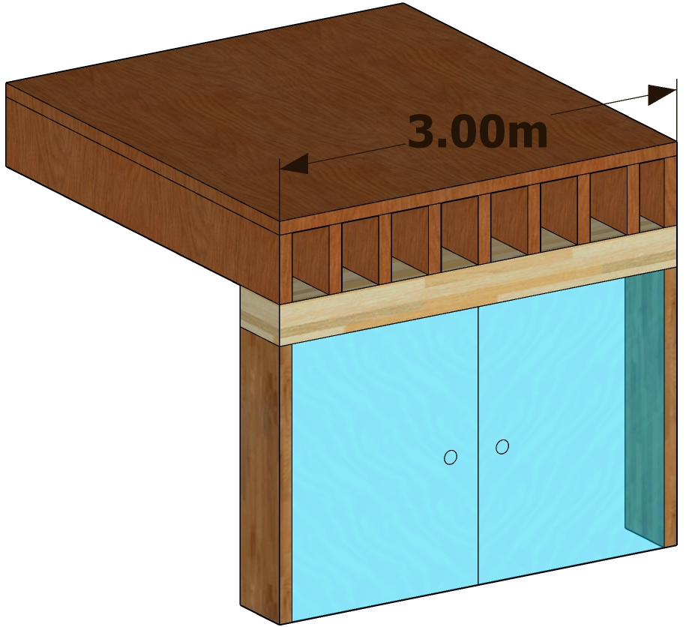
Example 1: Lintel loads
Determine the design loads for the following conditions:
3 meter long lintel supporting roof and one floor of a school
Tributary width of both roof and floor = 3 m
Specified roof dead load = 1 kPa
Specified floor dead load = 1.5 kPa
Minimum specified roof live load = 1.0 kPa
Specified floor live load = 2.4 kPa
1 in 50 year ground snow load, S_{S} = 1.8 kPa
1 in 50 year associated rain load, S_{r} = 0.2 kPa
Basic snow load factor, C_{b} = 0.8
Snow load wind exposure factor, C_{w} = 1.0
Snow load slope factor, C_{s} = 1.0
Snow load shape factor, C_{a} = 1.0
Floor
Lintel
Roof not shown in the figure
Door Frame

Slide 19

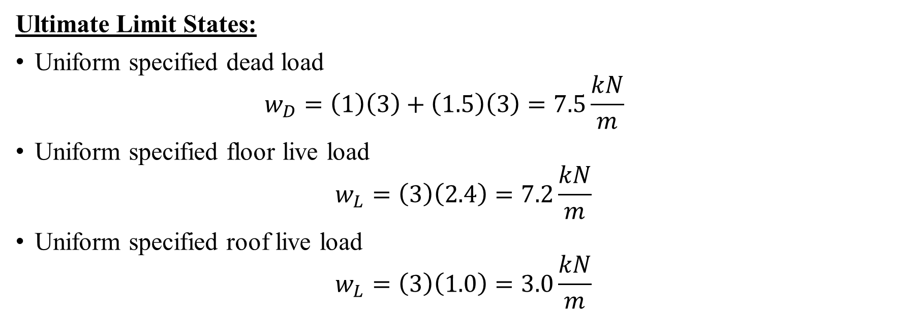
Solution part 1: Lintel loads
Ultimate Limit States:
Uniform specified dead load
  $$w_{D}=\left(1\right)\left(3\right)+\left(1.5\right)\left(3\right)=7.5\frac{kN}{m}$$
Uniform specified floor live load
$$w_{L}=\left(3\right)\left(2.4\right)=7.2\frac{kN}{m}$$
Uniform specified roof live load
$$w_{L}=\left(3\right)\left(1.0\right)=3.0\frac{kN}{m}$$
D_{roof} = 1 kPa
D_{floor} = 1.5 kPa
L_{roof} = 1.0 kPa
L_{floor} = 2.4 kPa
Tributary width = 3 m

Slide 20
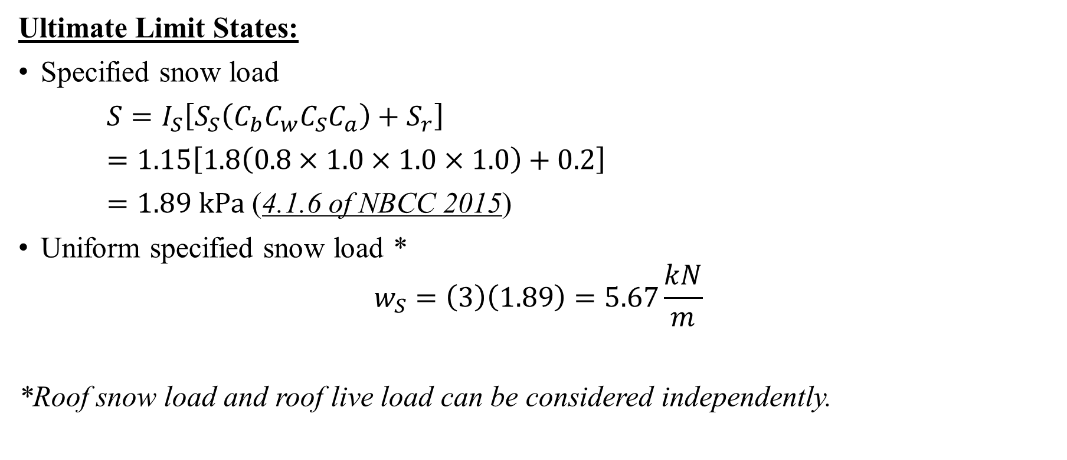
Solution part 1: Lintel loads
Ultimate Limit States:
Specified snow load
$S=I_{S}\left[S_{S}\left(C_{b}C_{w}C_{S}C_{a}\right)+S_{r}\right]$
$=1.15\left[1.8\left(0.8×1.0×1.0×1.0\right)+0.2\right]$
$=1.89 kPa$ (4.1.6 of NBCC 2015)
Uniform specified snow load *
$$w_{S}=\left(3\right)\left(1.89\right)=5.67\frac{kN}{m}$$
*Roof snow load and roof live load can be considered independently.

Slide 21
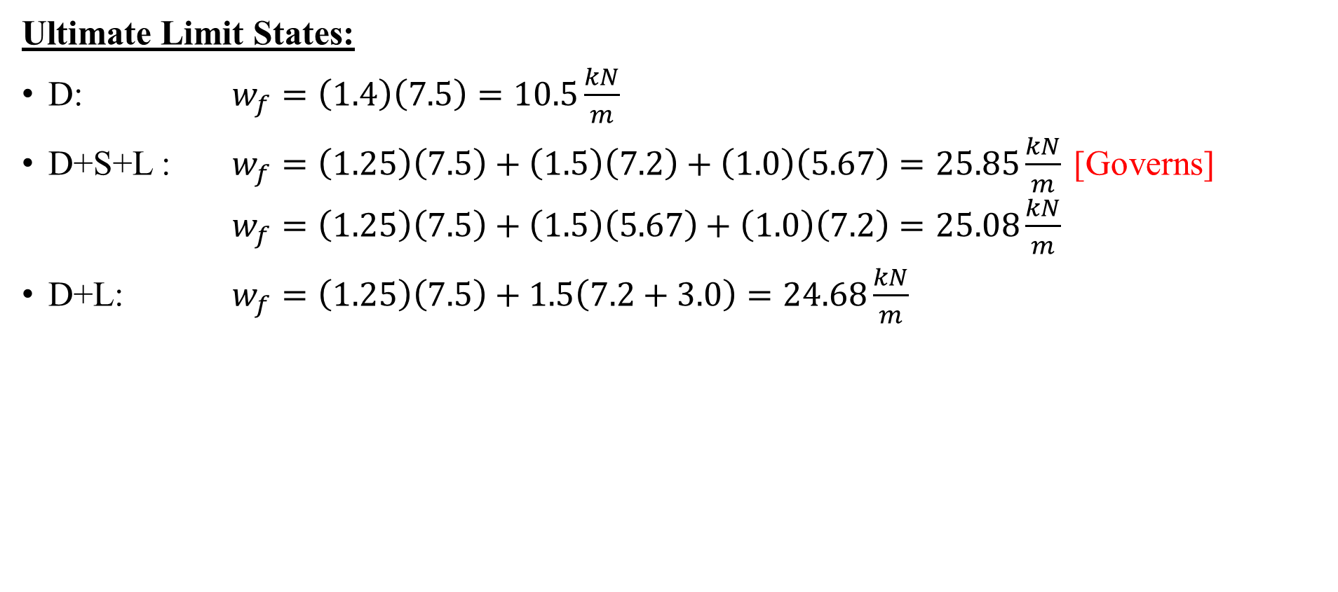
Solution part 1: Lintel loads
Ultimate Limit States:
D: $w_{f}=\left(1.4\right)\left(7.5\right)=10.5\frac{kN}{m}$
D+S+L : $w_{f}=\left(1.25\right)\left(7.5\right)+\left(1.5\right)\left(7.2\right)+\left(1.0\right)\left(5.67\right)=25.85\frac{kN}{m}$ [Governs]
  $w_{f}=\left(1.25\right)\left(7.5\right)+\left(1.5\right)\left(5.67\right)+\left(1.0\right)\left(7.2\right)=25.08\frac{kN}{m}$
D+L: $w_{f}=\left(1.25\right)\left(7.5\right)+1.5\left(7.2+3.0\right)=24.68\frac{kN}{m}$

Slide 22

Solution part 2: Lintel loads
Serviceability Limit State:
Specified snow load
$S=I_{S}\left[S_{S}\left(C_{b}C_{w}C_{S}C_{a}\right)+S_{r}\right]$
$=0.9\left[1.8\left(0.8∗1.0∗1.0∗1.0∗1.0\right)+0.2\right]$
$=1.48 kPa$
Uniform specified snow load:
$$w_{S}=\left(3\right)\left(1.48\right)=4.43\frac{kN}{m}$$

Slide 23
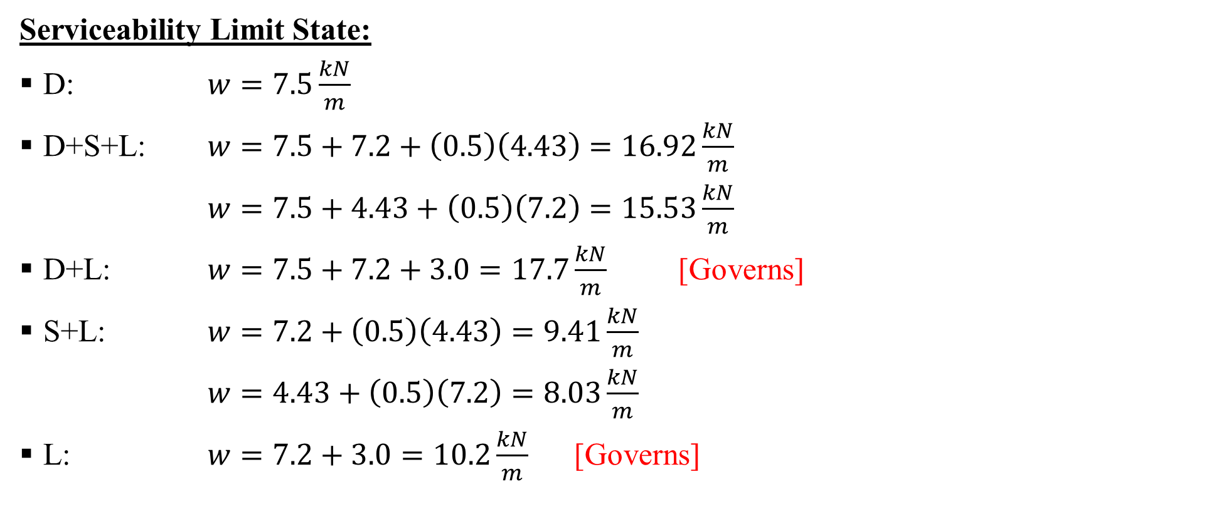
Solution part 2: Lintel loads
Serviceability Limit State:
D: $w=7.5\frac{kN}{m}$
D+S+L: $w=7.5+7.2+\left(0.5\right)\left(4.43\right)=16.92\frac{kN}{m}$
$w=7.5+4.43+\left(0.5\right)\left(7.2\right)=15.53\frac{kN}{m}$
D+L: $w=7.5+7.2+3.0=17.7\frac{kN}{m}$ [Governs]
S+L: $w=7.2+\left(0.5\right)\left(4.43\right)=9.41\frac{kN}{m}$
$w=4.43+\left(0.5\right)\left(7.2\right)=8.03\frac{kN}{m}$
L: $w=7.2+3.0=10.2\frac{kN}{m}$ [Governs]

Slide 24
Solution part 3: Lintel loads
Use the following loads for design:
Ultimate limit states — 10.5 kN/m for D;
25.85 kN/m for D+S+L or D+L
Serviceability limit states — 7.5 kN/m for D;
17.7 kN/m for D+S+L or D+L;
10.2 kN/m for L or S+L

Slide 25
4.3 Design Factors

Slide 26
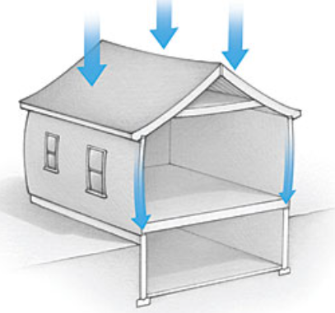
1) Load duration factor, K_{D}
Intensity and duration of applied loads influence the strength of wood (similar to fatigue in metals)
Strength losses even under static loading may lead to failure after a given time
By Rob Munach
Dead load: self weight of roofs, walls and floors

Slide 27
1) Load duration factor, K_{D}
The specified strengths and capacities in CSA O86 are based on the standard-term duration of the specified loads
Load duration | K_{D} | Explanatory notes
Short term | 1.15 | Last no more than 7 days (e.g. wind, earthquake…)
Standard term | 1 | Between short and long term (e.g. snow, occupancy, wheel loads…)
Long term | 0.65 | Subjected to more or less continuous load (e.g. dead loads, fixed machinery…)
(Table 5.3.2.2 of CSA O86)

Slide 28
1) Load duration factor — Long-term load factor
For standard-term loads where P_{L} is greater than P_{S}
where:
P_{L} = specified long-term load
P_{S} = specified standard-term load
= S, L, S + 0.5L, or 0.5S + L, determined using importance factor equal to 1.0
$$K_{D}=1.0−0.5\log\left(P_{L}/P_{s}\right)≥0.65$$

Slide 29

2) Service condition factor, K_{S}
Applied when materials are used in service conditions other than dry
Strengths and capacities are multiplied by the service condition factor, K_{S}
Greatnortherndocks.com
Wood dock

Slide 30


3) Preservation treatment factor K_{T}
Exposed to conditions that cause decay or deterioration, wood should be treated with preservatives
Dip
treated timber
Pressure
treated timber
gardenfurnitureland.com
Preservatives only penetrate the surface of the wood, offering limited protection
Preservatives are forced deep into the wood, offering better protection
Pressure treated timber

Slide 31
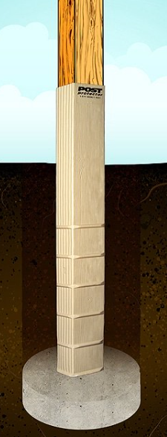
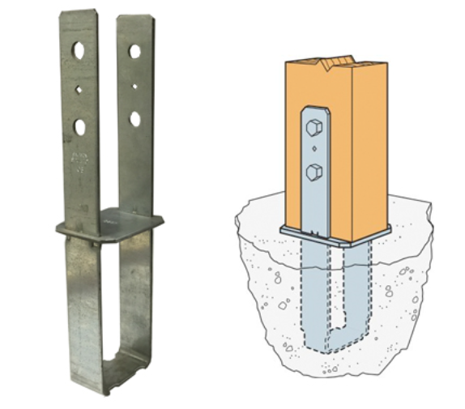
3) Preservation treatment factor K_{T}
Untreated wood should not be in direct contact with masonry, concrete, or soil when moisture transfer can occur
mogams.com
postprotector.com
Post mounts
Post protector

Slide 32
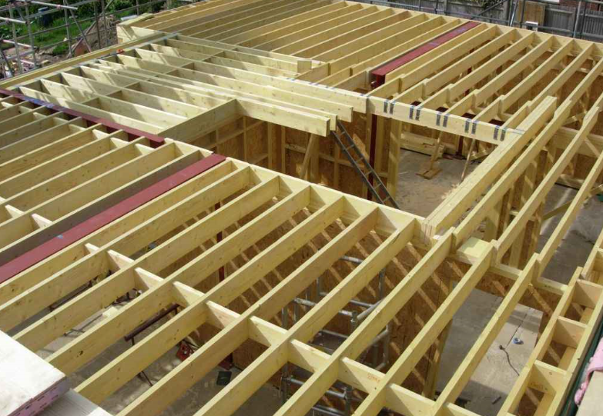
4) System factor, K_{H}
Accounts for members acting as part of a system, not independently (e.g. repetitive member systems)
Floordecorate.com
Timber floor joist

Slide 33
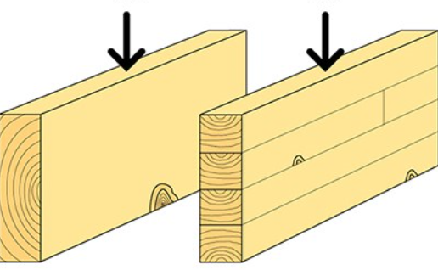
5) Size factor, K_{Z}
Strength properties depend on member size and loading conditions, known as “size effect”
A larger volume of member tends to reduce the apparent strength.
swedishwood.com

Slide 34
6) Serviceability limit states
Elastic deflection (not exceed 1/180 of the span)
Permanent deformation (upper limit of 1/360 of the span due to long term loads if the long term loads excess 50% of the load combinations for serviceability limit states.)
Vibration (carpet, concrete topping)
Moisture content change (design details)

Slide 35

6) Serviceability limit states — Moisture content
Shrinkage or swelling of a wood member can be estimated using the following equation:
where:
S = shrinkage or swelling in the dimensions being considered
D = actual dimensions
M_{i} = the lesser of the initial moisture content or the fibre saturation point (28%)
M_{f} = the final moisture content
c = shrinkage coefficient
= for lumber (0.002 perpendicular to grain, 0.00005 parallel to the grain)
$$S=D\left(M_{i}−M_{f}\right)c$$

Slide 36
This lecture is developed based on the Wood Design Manual [1] and CSA O86-2014 [2].
References
[1] Canadian Wood Council (CWC). 2017. Wood design manual. Ottawa, ON, Canada.
[2] Canadian Standards Association (CSA). 2017. Engineering design in wood. CSA O86-14, Toronto, ON, Canada.
[3] National Research Council (NRC). 2015. National building code of Canada 2015. Ottawa, ON, Canada.

