Slide 1

Chapter 9 Design of CLT Structures
CIVE480 Timber Structures
2019

Slide 2

9.1 Introduction of CLT (cross-laminated timber)

Slide 3
1) History
CLT was first developed in Europe
In the mid 1990s, industry-academia joint research (Austria) → modern CLT
In early 2000s, construction in CLT increased significantly (driven by green building movement…)

Slide 4
2) In Canada
In 2005, FPInnovations launched a CLT research program,
→ Prepared CLT Handbook (2011)
NSERC Network — NEWBuildS (CLT is one of its four themes) (2010-2015)
→ CLT was introduced into the CSA O86-14 “Engineering design in wood” 2014 edition update 1 (May 2016)

Slide 5
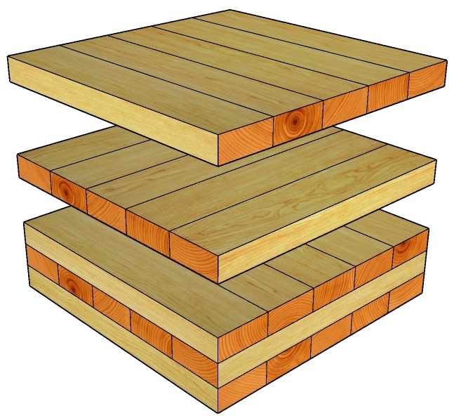
3) Definition
CLT panels consist of several layers of boards stacked crosswise (typically at 90 degrees) and glued together on their wide faces and, sometimes, on the narrow faces as well.

Slide 6
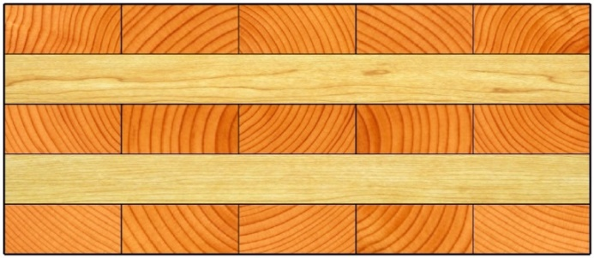
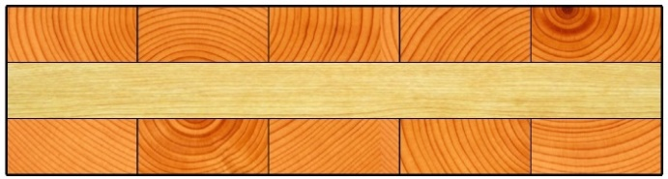
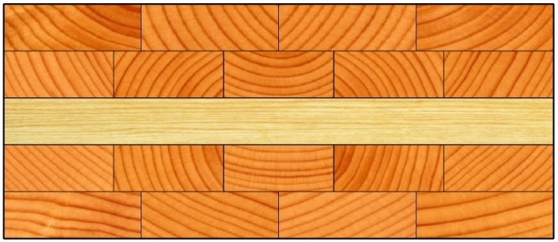
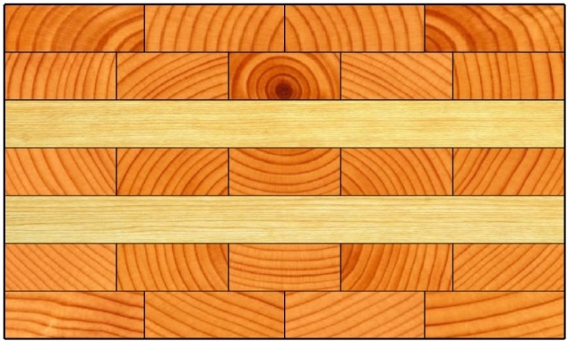
4) Cross section
Typically consist of 3 to 9 alternating layers
Same grade and species of sawn lumber in one lamination
Consecutive layers may be placed in the same direction
Consecutive layers

Slide 7
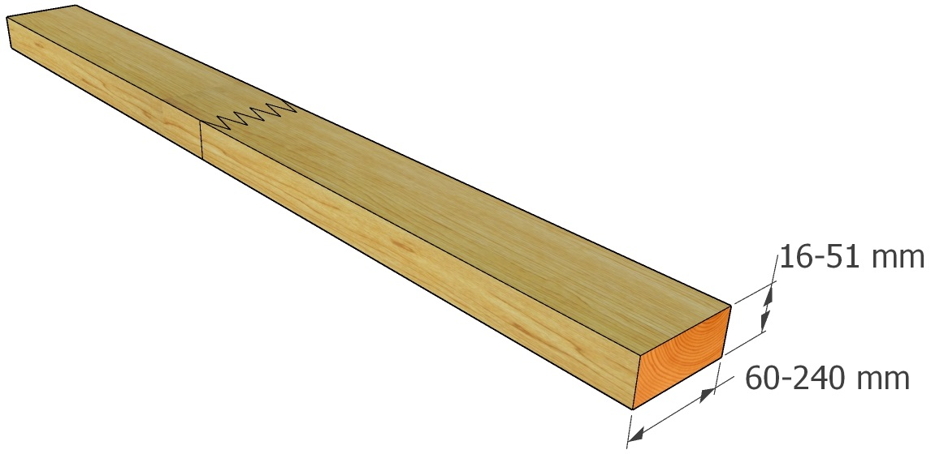
5) Individual board
Size: 16-51 mm thick, 60-240 mm wide
Finger joint using structural adhesive, kiln dried
Finger joint

Slide 8
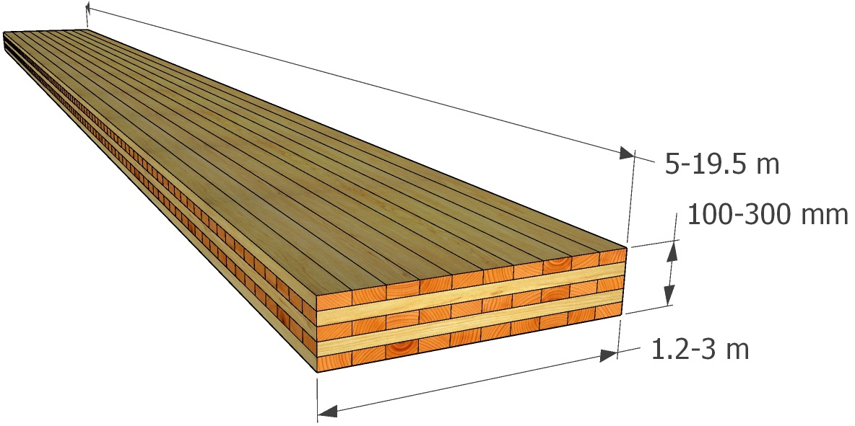
6) CLT panel
Size: width (1.2 m to 3 m), length (5 m to 19.5 m), thickness (100 mm to 300 mm)
Limited by the size of manufacturer’s press and transportation regulations

Slide 9
7) Stress grades
Five primary CLT stress grades (E1, E2, E3, V1, and V2)
“E” ― machine stress rated (MSR, or E-rated)
“V” ― visually graded lumber
Lumber strength in longitudinal direction strength > transverse direction (Table 8.2.3 of CSA O86)
 | Longitudinal layers | Transverse layers
E1, E2, E3 | MSR | Visually graded
V1, V2 | Visually graded | Visually graded

Slide 10
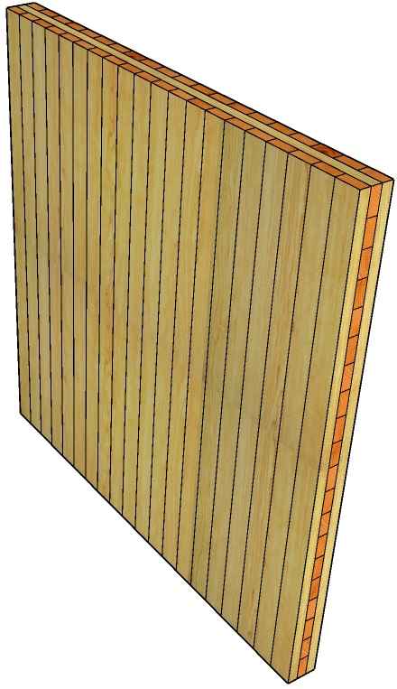
8) Advantages (walls and floors/roofs)
Outer layers oriented vertically
Improved dimensional stability (wide and long walls and floors)
Increase splitting resistance of some CLT connections
CLT Wall

Slide 11
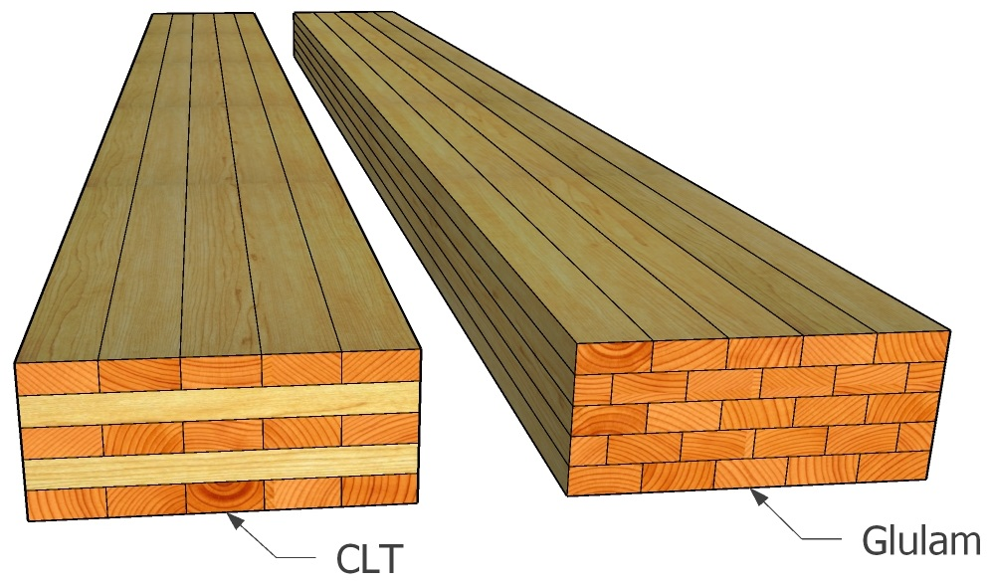
9) Benefits of cross laminating
Two-way action capability of floors
CLT panel vs Glued-laminated timber

Slide 12
10) Other advantages
Easy handling in construction
High level of prefabrication
Good thermal insulation
Good sound insulation
A fairly good performance under fire conditions

Slide 13
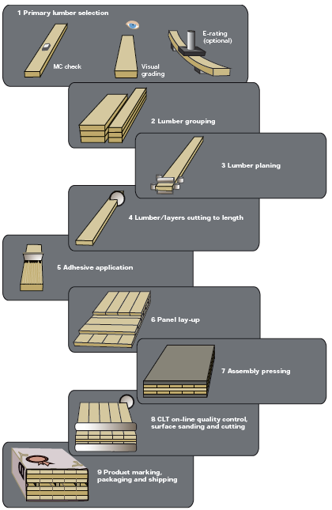
11) Manufacturing process
Lumber selection (quality consistency)
Lumber grouping and planning
Adhesive application (adhesive bond quality control)
Panel lay-up and pressing
Product cutting
Marking and packaging
The manufacturing process of CLT products [1]

Slide 14
9.2 Structural design and serviceability considerations of CLT

Slide 15
1) Floor/roof elements
In-plane and out-of-plane bending and shear strength and stiffness
Short-term and long-term behavior:
Instantaneous deflection
Long-term strength for permanent loading
Long-term deflection (creep deformation)
Compression perpendicular to grain strength (bearing)
Fire performance, durability, vibration performance, acoustic performance

Slide 16
2) Wall elements
In-plane and out-of-plane bending and shear strength and stiffness
Short-term and long-term behavior:
Instantaneous deflection
Long-term strength for permanent loading
Long-term deflection (creep deformation)
Loading-bearing capacity (critical)
Fire performance, durability, vibration performance, acoustic performance

Slide 17
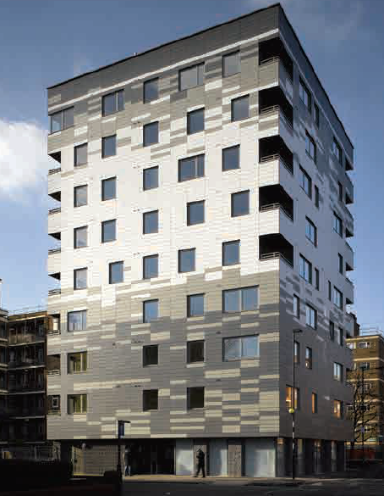
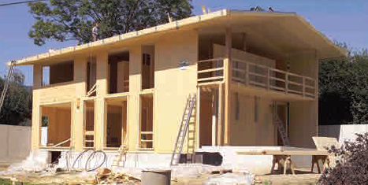
3) CLT in Construction
Single-family house in Klagenfurt, Austria (courtesy of KLH) [1]
Multi-family building in London, United Kingdom (courtesy of KLH and Waugh-Thistleton) [1]

Slide 18
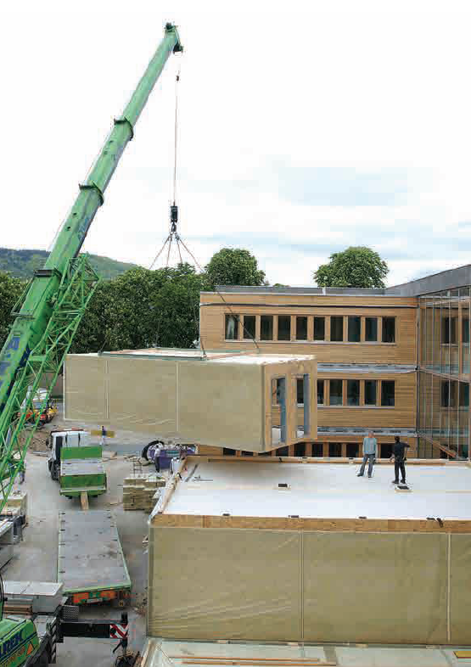
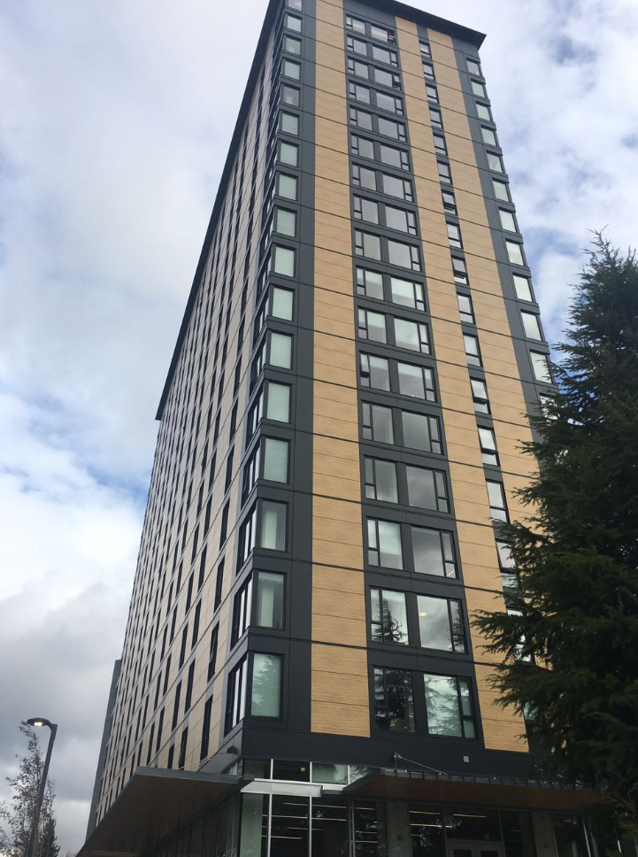
3) CLT in Construction
Impulsezentrum, Graz, Austria (courtesy of KLH) [1]
Brock Common Building at UBC

Slide 19
9.3 Design of CLT panels as flexural members

Slide 20
1) Design
Factored moment resistance M_{r} ≥ maximum factored moment M_{f}
Factored shear resistance V_{r} ≥ maximum factored shear force V_{f}
(loads within a distance from the support equal to the depth of the member may be neglected ?)
Factored bearing resistance Q_{r} ≥ maximum factored reaction Q_{f}
Maximum deflection under specified loads < deflection criteria
Actual span does not exceed the span determined by vibration criteria

Slide 21
2) Design Factors
Load duration factor, K_{D}
Service condition factors, K_{S}
System factor, K_{H}
Treatment factor, K_{T}

Slide 22
3) Load duration factor, K_{D}
The specified strengths and capacities in CSA O86 are based on the standard-term duration of the specified loads
Load duration | K_{D} | Explanatory notes
Short term | 1.15 | Last less than 7 days (e.g. wind, earthquake…)
Standard term | 1 | Between short and long term (e.g. snow, occupancy, wheel loads…)
Long term | 0.65 | Subjected to continuous load (e.g. dead loads, fixed machinery…)
(Table 5.3.2.2 of CSA O86)

Slide 23
3) Load duration factor, K_{D}
For standard-term loads, P_{L} is greater than the P_{s}
$$K_{D}=1.0−0.5\log\left(P_{L}/P_{s}\right)≥0.65$$
Where:
P_{L} = specified long-term load
P_{s} = specified standard-term load based on S and L loads acting alone or in combination
= S, L, S+0.5L, or 0.5S+L, determined using importance factors equal to 1.0

Slide 24
3) Load duration factor, K_{D}
For standard-term loads, P_{L} is greater than the P_{s}
$$K_{D}=1.0−0.5\log\left(P_{L}/P_{s}\right)≥0.65$$
K_{D} |  | Specified standard-term load Ps (kPa)
 |  | 1.0 | 1.9 | 2.0 | 2.4
Specified long-term load P_{L} (kPa) | 1.5 | 0.91 | 1.00 | 1.00 | 1.00
 | 2.0 | 0.85 | 0.99 | 1.00 | 1.00
 | 2.5 | 0.80 | 0.94 | 0.95 | 0.99

Slide 25
4) Service condition factors, K_{S}
Unless specifically permitted by the manufacturers, CLT panels are only used in dry service conditions for which
$$K_{Sb}=K_{Sc}=K_{Sp}=K_{St}=K_{Sv}=K_{SE}=1.0$$
5) System factor, K_{H}
K_{H} is to be taken as 1.0 for all strength properties of CLT panels.

Slide 26
6) Treatment factor, K_{T}
CLT shall not be treated with water-borne preservatives after gluing
For CLT treated with fire-retardant or other potentially strength-reducing chemicals, strength and stiffness is required to be based on documented results of tests.

Slide 27
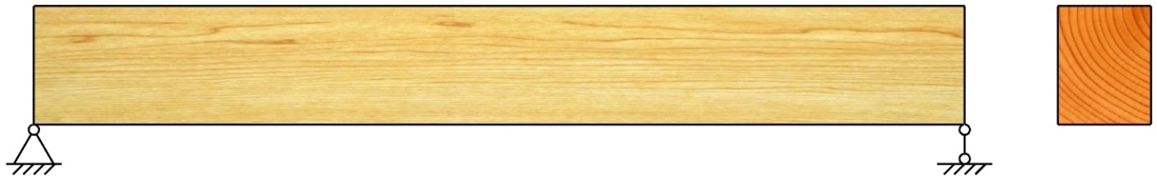
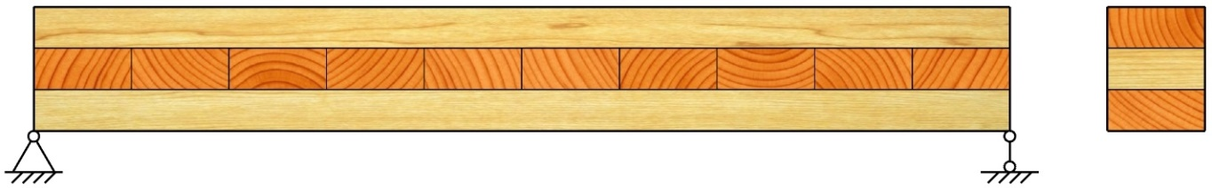
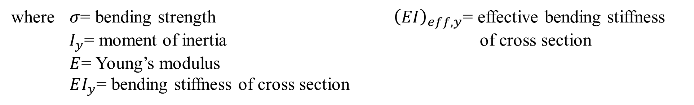
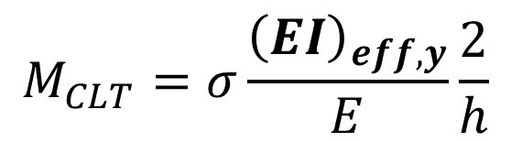
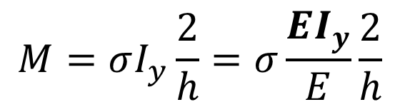
7) CLT under bending
P
┌ A
P
┌ B
y
y
h
h
z
z
└ A
└ B
A-A
B-B
$$M=σI_{y}\frac{2}{h}=σ\frac{EI_{y}}{E}\frac{2}{h}$$
$$M_{CLT}=σ\frac{{\left(EI\right)}_{eff,y}}{E}\frac{2}{h}$$
where $σ$= bending strength ${\left(EI\right)}_{eff,y}$= effective bending stiffness
$I_{y}$= moment of inertia of cross section
$E$= Young’s modulus
$EI_{y}$= bending stiffness of cross section

Slide 28
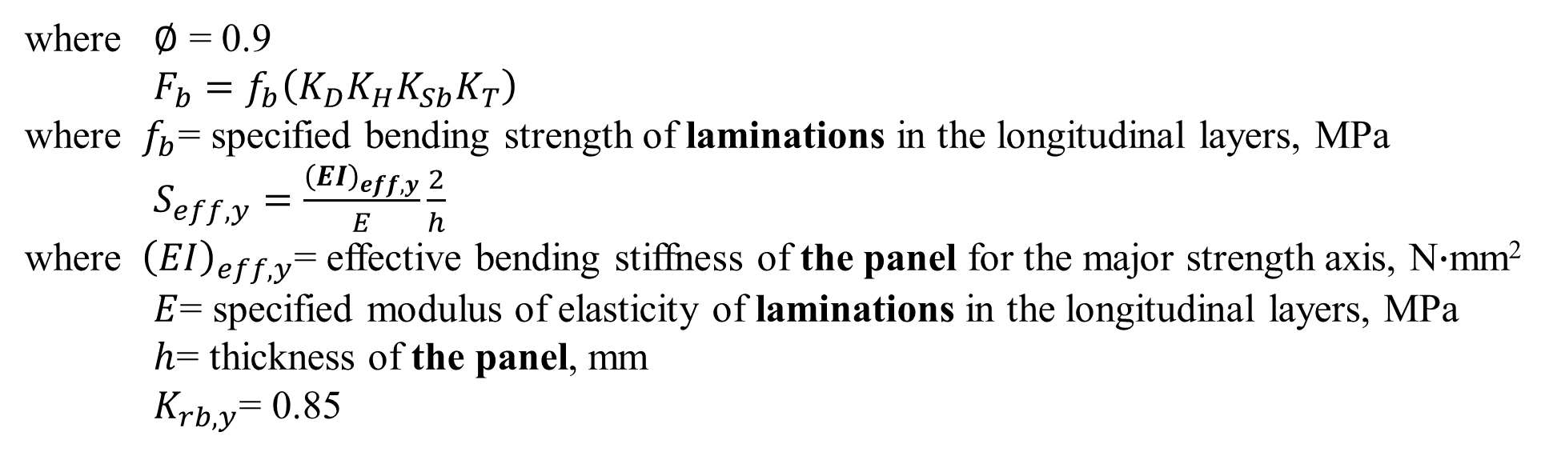
7) CLT under bending
The out-of-plane factored bending moment resistance:
(a) For the major strength axis
$$M_{r,y}=∅F_{b}S_{eff,y}K_{rb,y}$$
where $∅$ = 0.9
$F_{b}=f_{b}\left(K_{D}K_{H}K_{Sb}K_{T}\right)$
where $f_{b}$= specified bending strength of laminations in the longitudinal layers, MPa
$S_{eff,y}=\frac{{\left(EI\right)}_{eff,y}}{E}\frac{2}{h}$
where ${ \left(EI\right)}_{eff,y}$= effective bending stiffness of the panel for the major strength axis, N$∙$mm²
$E$= specified modulus of elasticity of laminations in the longitudinal layers, MPa
$h$= thickness of the panel, mm
$K_{rb,y}$= 0.85

Slide 29
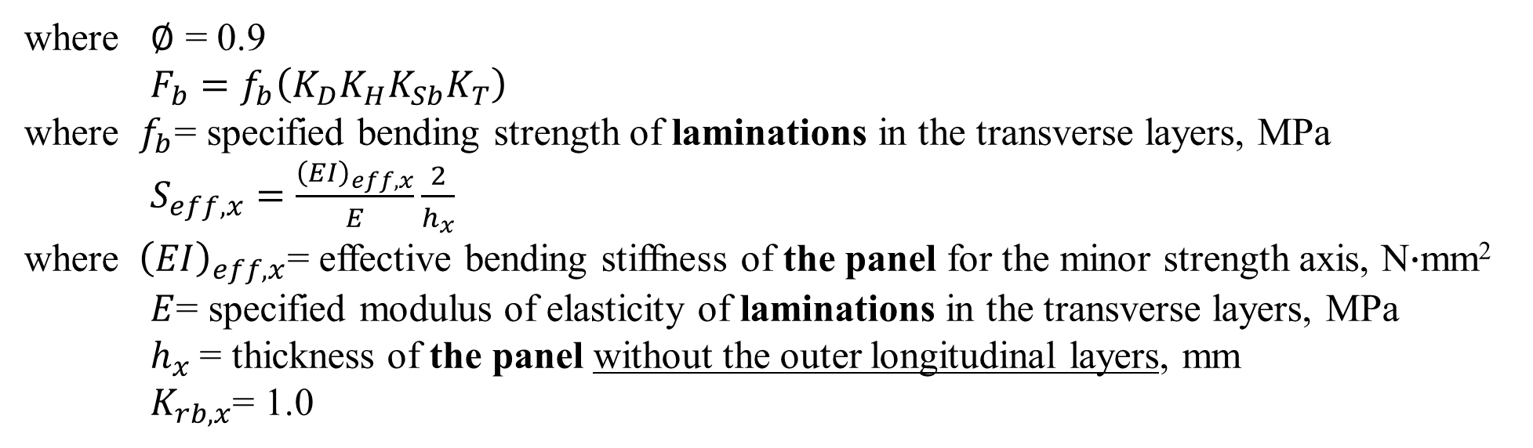
7) CLT under bending
The out-of-plane factored bending moment resistance:
(b) For the minor strength axis
$$M_{r,x}=∅F_{b}S_{eff,x}K_{rb,x}$$
where $∅$ = 0.9
$F_{b}=f_{b}\left(K_{D}K_{H}K_{Sb}K_{T}\right)$
where $f_{b}$= specified bending strength of laminations in the transverse layers, MPa
$S_{eff,x}=\frac{{\left(EI\right)}_{eff,x}}{E}\frac{2}{h_{x}}$
where ${ \left(EI\right)}_{eff,x}$= effective bending stiffness of the panel for the minor strength axis, N$∙$mm²
$E$= specified modulus of elasticity of laminations in the transverse layers, MPa
$h_{x}$= thickness of the panel without the outer longitudinal layers, mm
$K_{rb,x}$= 1.0

Slide 30


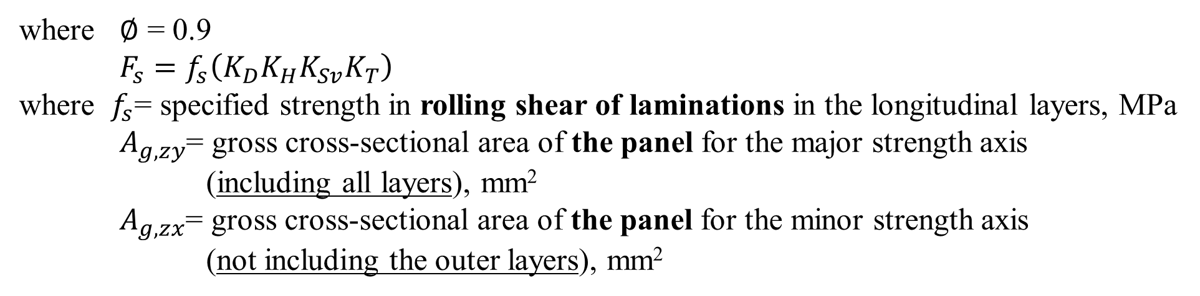
7) CLT under bending
The factored shear resistance:
For the major strength axis
For the minor strength axis
$$V_{r,zy}=∅F_{s}{{2A}_{g,zy}}/3$$
$$V_{r,zx}=∅F_{s}{{2A}_{g,zx}}/3$$
where $∅$ = 0.9
$F_{s}=f_{s}\left(K_{D}K_{H}K_{Sv}K_{T}\right)$
where $f_{s}$= specified strength in rolling shear of laminations in the longitudinal layers, MPa
$A_{g,zy}$= gross cross-sectional area of the panel for the major strength axis
(including all layers), mm²
$A_{g,zx}$= gross cross-sectional area of the panel for the minor strength axis
(not including the outer layers), mm²

Slide 31
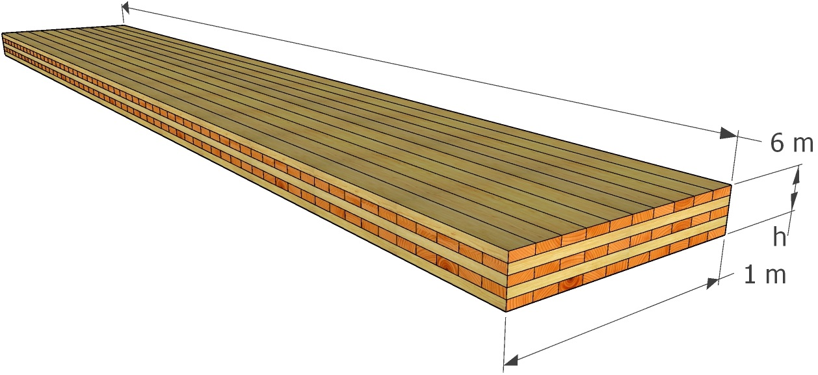
Example 1: CLT floor panel (Strength)
Design single span floor CLT panels
Conditions:
Panel span = 6 m
Panel width = 1 m
Specified dead load = 1.5 kPa
Specified live load = 2.4 kPa
Standard load duration
Dry service condition
Untreated
Use stress grade V1 oriented about its major strength axis.
The thickness of each ply is 35 mm.

Slide 32

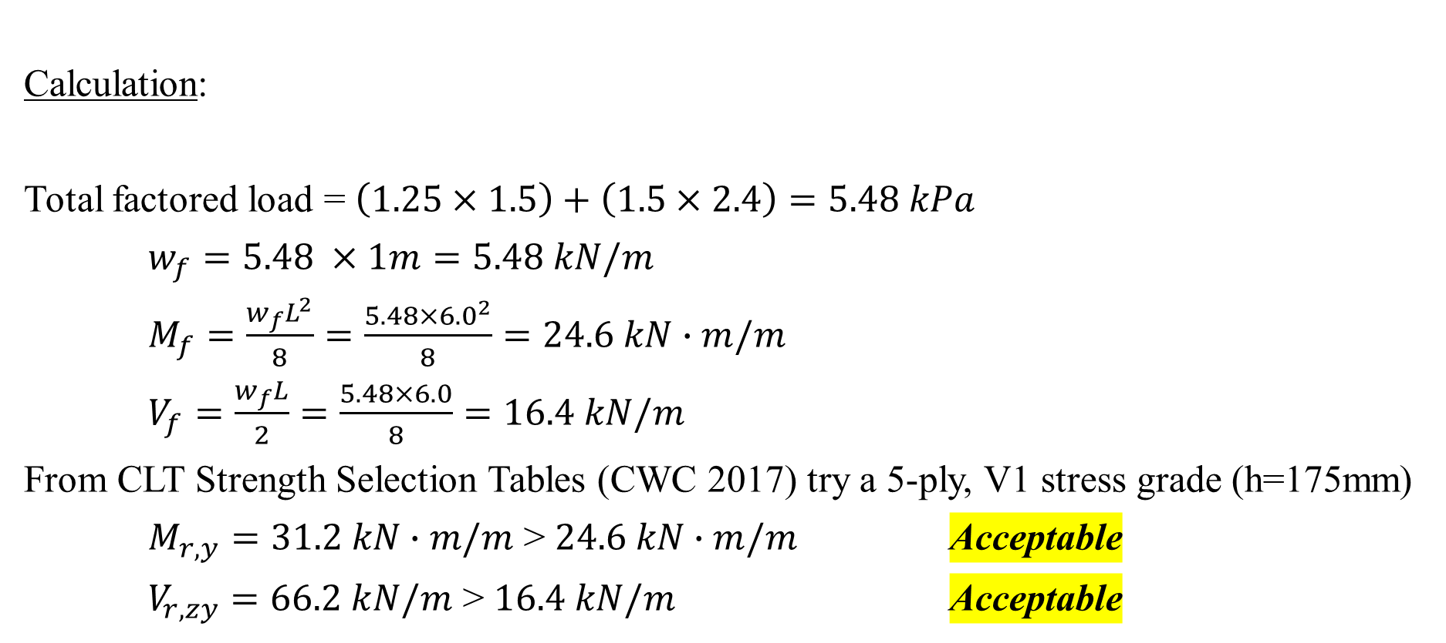
Example 1: CLT floor panel (Strength)
Calculation:
Total factored load = $\left(1.25×1.5\right)+\left(1.5×2.4\right)=5.48 kPa$
$w_{f}=5.48 ×1m=5.48 kN/m$
$M_{f}=\frac{w_{f}L^{2}}{8}=\frac{5.48×{6.0}^{2}}{8}=24.6 kN∙m/m$
$V_{f}=\frac{w_{f}L}{2}=\frac{5.48×6.0}{8}=16.4 kN/m$
From CLT Strength Selection Tables (CWC 2017) try a 5-ply, V1 stress grade (h=175mm)
$M_{r,y}=31.2 kN∙m/m$ > $24.6 kN∙m/m$ Acceptable
$V_{r,zy}=66.2 kN/m$ > $16.4 kN/m$ Acceptable

Slide 33

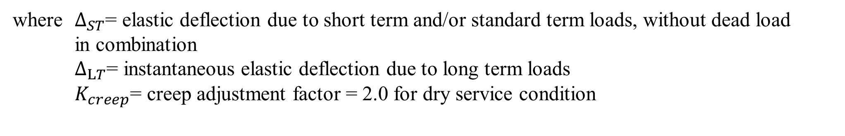
8) Serviceability check
Deflection (bending, shear and creep effects)
$$∆_{max}=∆_{ST}+∆_{LT}K_{creep}$$
where $∆_{ST}$= elastic deflection due to short term and/or standard term loads, without dead load
in combination
$∆_{LT}$= instantaneous elastic deflection due to long term loads
$K_{creep}$= creep adjustment factor = 2.0 for dry service condition

Slide 34


8) Serviceability check
Deflection under a specified uniformly distributed load, ω
$$∆=\frac{5}{384}\frac{ωL^{4}}{{(EI)}_{eff}}+\frac{1}{8} \frac{ωL^{2}κ}{{(GA)}_{eff}}$$
where ${(EI)}_{eff}$= effective bending stiffness
${(GA)}_{eff}$= effective in-plane (planar) shear rigidity
For a concentrated line load, P, in the middle of a single span CLT panel
$$∆=\frac{1}{48}\frac{PL^{3}}{{(EI)}_{eff}}+\frac{1}{4} \frac{PLκ}{{(GA)}_{eff}}$$
where $κ$= form factor
= for rectangular cross-sections

Slide 35

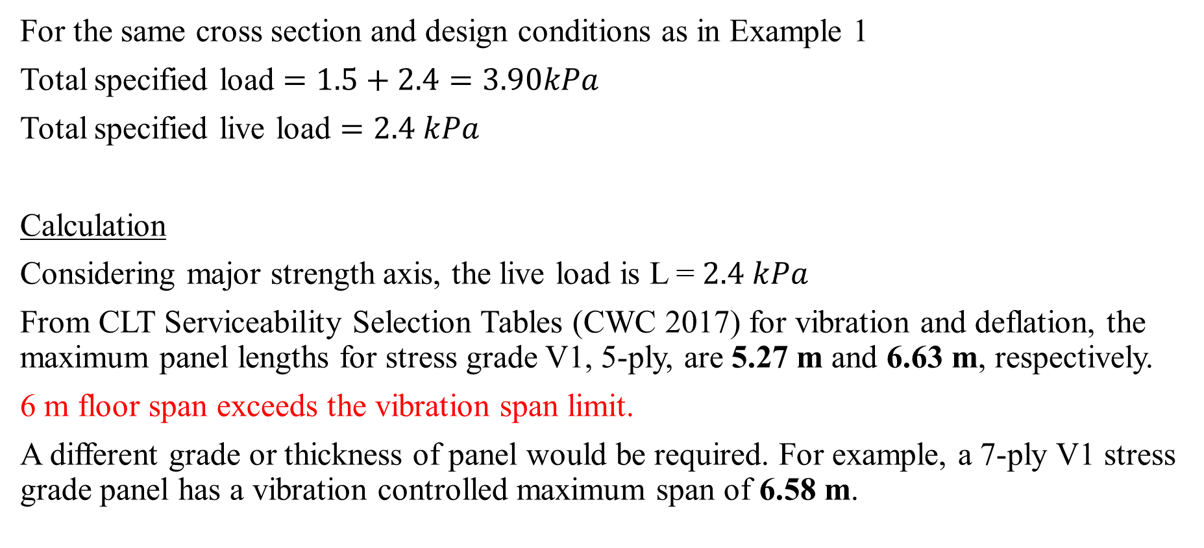
Example 2: CLT floor panel (Serviceability)
For the same cross section and design conditions as in Example 1
Total specified load $=1.5+2.4=3.90kPa$
Total specified live load $=2.4 kPa$
Calculation
Considering major strength axis, the live load is L = $2.4 kPa$
From CLT Serviceability Selection Tables (CWC 2017) for vibration and deflation, the maximum panel lengths for stress grade V1, 5-ply, are 5.27 m and 6.63 m, respectively.
6 m floor span exceeds the vibration span limit.
A different grade or thickness of panel would be required. For example, a 7-ply V1 stress grade panel has a vibration controlled maximum span of 6.58 m.

Slide 36
9.4 Design of CLT shearwall

Slide 37
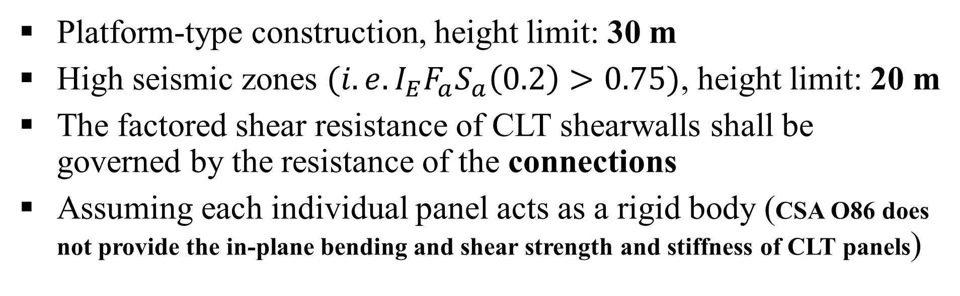
1) General
Platform-type construction, height limit: 30 m
High seismic zones ${(i.e.I}_{E}F_{a}S_{a}\left(0.2\right)>0.75)$, height limit: 20 m
The factored shear resistance of CLT shearwalls shall be governed by the resistance of the connections
Assuming each individual panel acts as a rigid body (CSA O86 does not provide the in-plane bending and shear strength and stiffness of CLT panels)

Slide 38
2) Seismic design consideration (Capacity design principles)
Energy dissipative connections
(wall-foundation, wall- supporting floor, wall-parallel wall, discrete hold-downs)
Non-dissipative connections
(continuous steel rods, floor-supporting wall, wall-perpendicular wall

Slide 39
3) Energy-dissipative connections
Yielding mode governs the resistance
At least moderately ductile
Possess sufficient deformation capacity to allow for the CLT panels to develop their assumed deformation behaviour (rocking, sliding)

Slide 40
4) Non-dissipative connections
Not to yield while the energy-dissipative connections reach their ultimate resistance, and to tolerate the displacement demands when the energy-dissipative connections reach the target displacement
The factored resistance of the non-dissipative connections > strength demand on them when the energy-dissipative connections reach their 95th percentile of ultimate resistance under cyclic loading

Slide 41
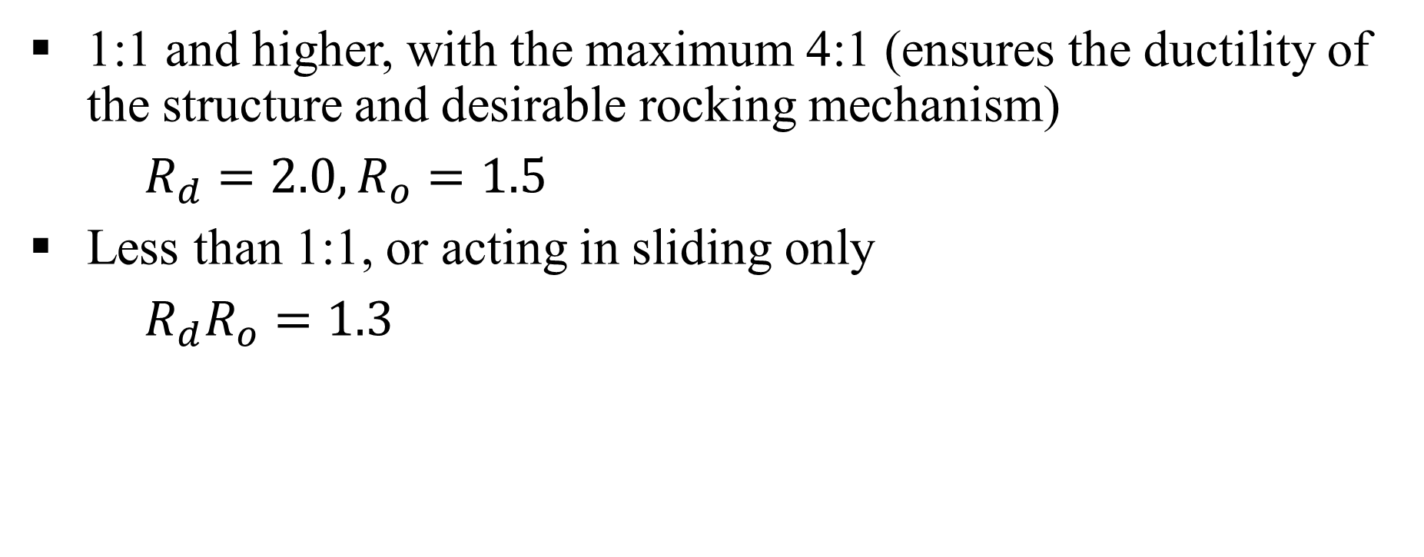
5) Aspect ratios of CLT shearwalls
1:1 and higher, with the maximum 4:1 (ensures the ductility of the structure and desirable rocking mechanism)
$R_{d}=2.0,R_{o}=1.5$
Less than 1:1, or acting in sliding only
$R_{d}R_{o}=1.3$

Slide 42
6) Deflections
In principle, it should account panel bending, shear, sliding, rocking and deformation of supports
For simplicity in design situations, the O86 assumes CLT panels act as rigid bodies, and therefore panel bending and shear deformation may be ignored

Slide 43
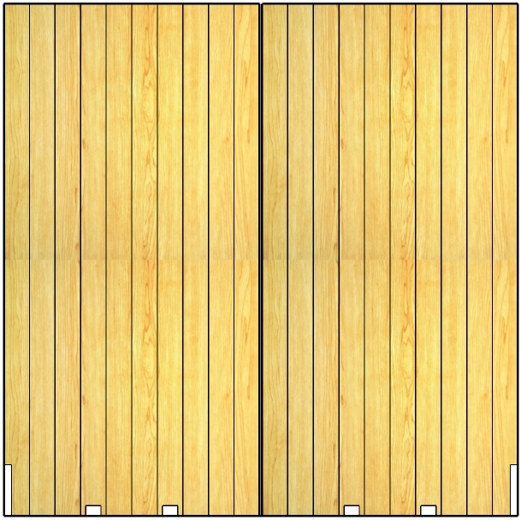
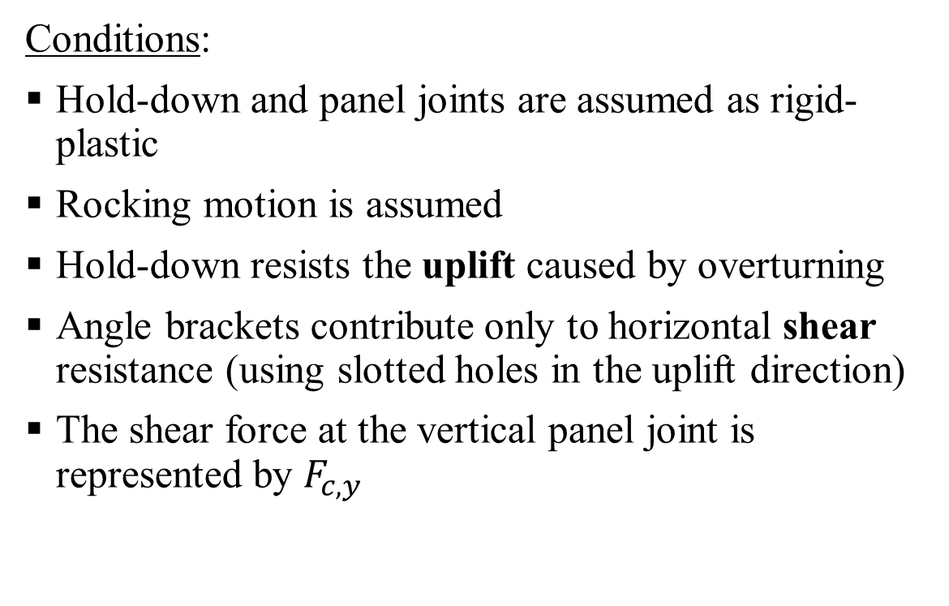
Two-panel CLT shearwall strength
Conditions:
Hold-down and panel joints are assumed as rigid-plastic
Rocking motion is assumed
Hold-down resists the uplift caused by overturning
Angle brackets contribute only to horizontal shear resistance (using slotted holes in the uplift direction)
The shear force at the vertical panel joint is represented by $F_{c,y}$
q
F
F_{c,y}
F_{c,y}
h
T
F_{a}
F_{a}
F_{a}
F_{a}
T
b
b

Slide 44
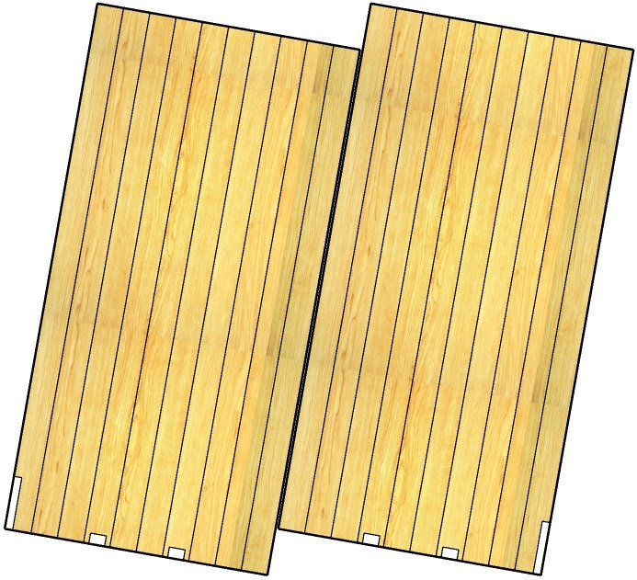
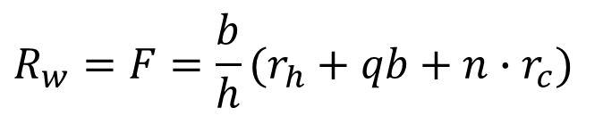
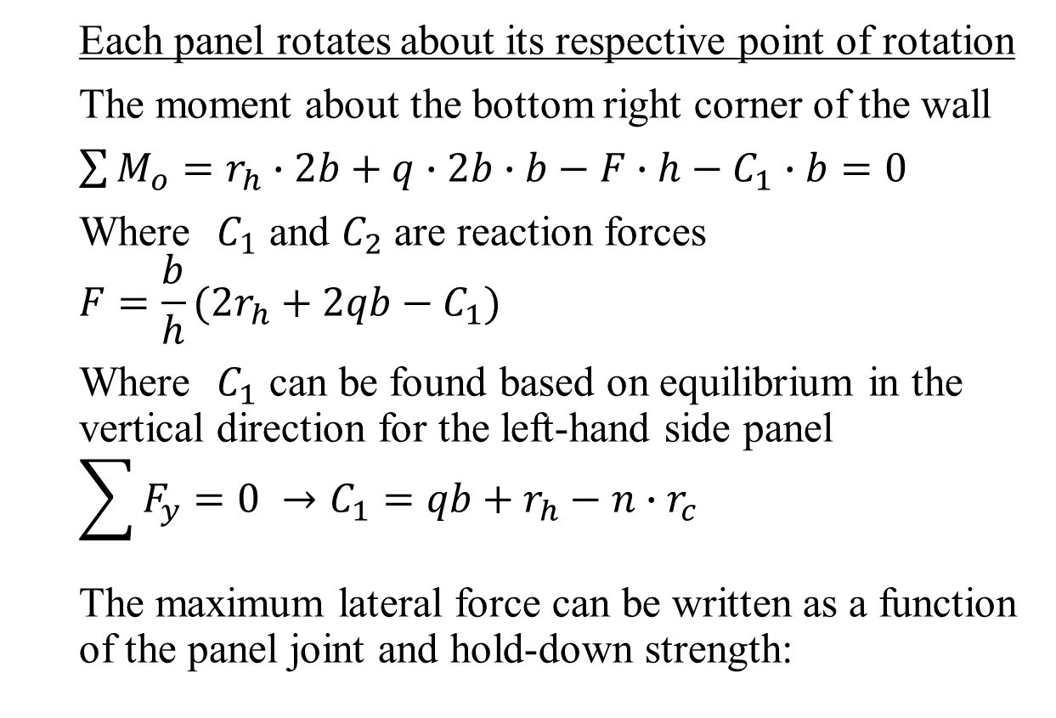
Couple-panel (CP) kinematic mode
Each panel rotates about its respective point of rotation
The moment about the bottom right corner of the wall
$\sum{M_{o}}=r_{h}∙2b+q∙2b∙b−F∙h−C_{1}∙b=0$
Where $C_{1}$ and $C_{2}$ are reaction forces
$$F=\frac{b}{h}(2r_{h}+2qb−C_{1})$$
Where $C_{1}$ can be found based on equilibrium in the vertical direction for the left-hand side panel
$$\sum{F_{y}}=0 →C_{1}=qb+r_{h}−n∙r_{c}$$
The maximum lateral force can be written as a function of the panel joint and hold-down strength:
q
F
nr_{c}
nr_{c}
r_{h}
C₁
C₂
$$R_{w}=F=\frac{b}{h}(r_{h}+qb+n∙r_{c})$$

Slide 45
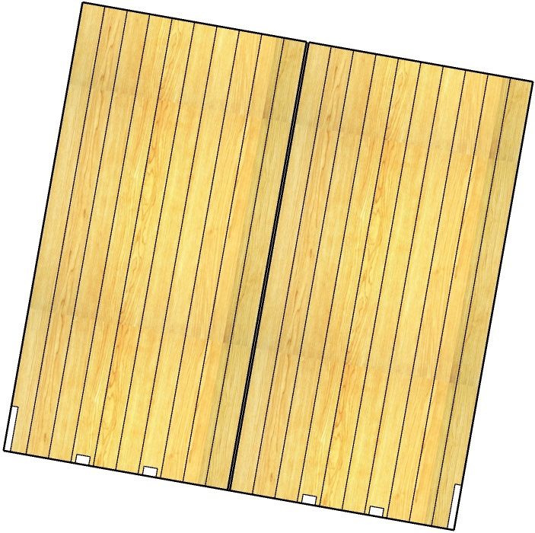
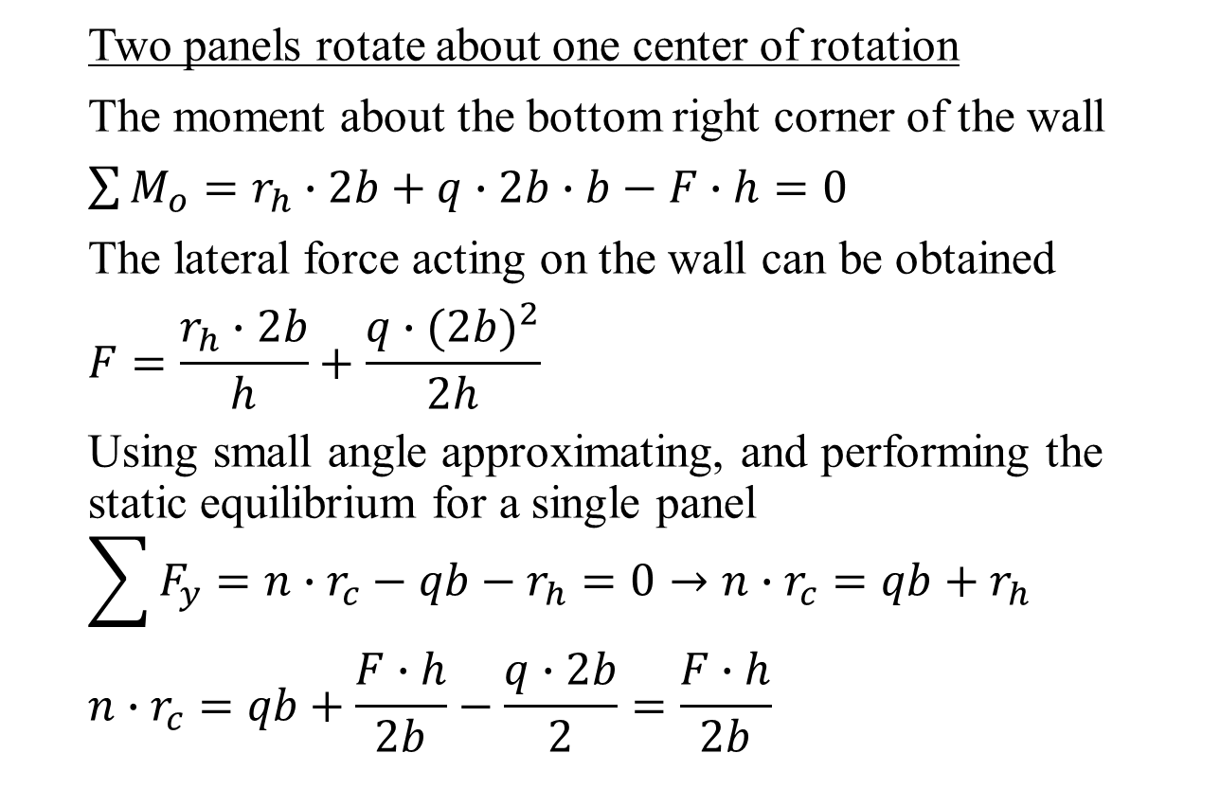
Single-wall (SW) kinematic mode
Two panels rotate about one center of rotation
The moment about the bottom right corner of the wall
$\sum{M_{o}}=r_{h}∙2b+q∙2b∙b−F∙h=0$
The lateral force acting on the wall can be obtained
$$F=\frac{r_{h}∙2b}{h}+\frac{q∙{(2b)}^{2}}{2h}$$
Using small angle approximating, and performing the static equilibrium for a single panel
$$\sum{F_{y}}=n∙r_{c}−qb−r_{h}=0→n∙r_{c}=qb+r_{h}$$
$$n∙r_{c}=qb+\frac{F∙h}{2b}−\frac{q∙2b}{2}=\frac{F∙h}{2b}$$
q
F
nr_{c}
nr_{c}
r_{h}
C₂

Slide 46
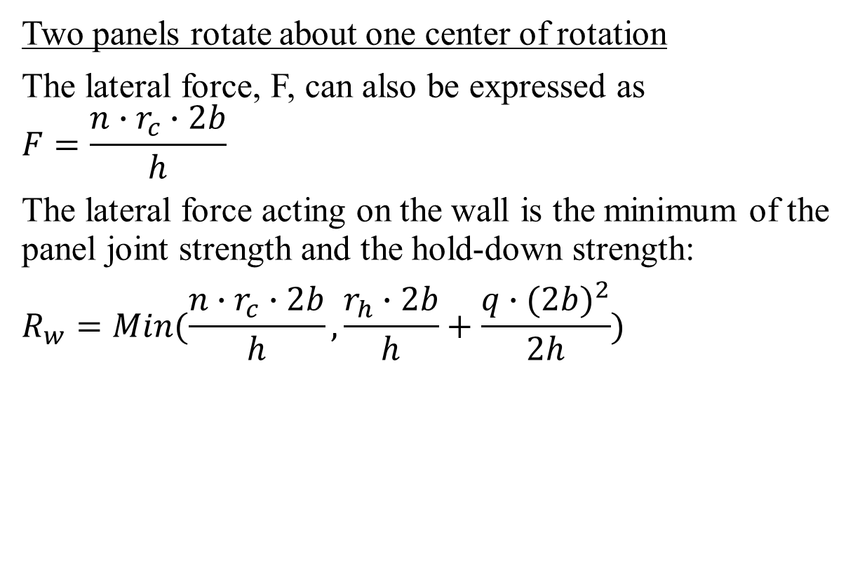
Single-wall (SW) kinematic mode
Two panels rotate about one center of rotation
The lateral force, F, can also be expressed as
$$F=\frac{n∙r_{c}∙2b}{h}$$
The lateral force acting on the wall is the minimum of the panel joint strength and the hold-down strength:
$$R_{w}=Min(\frac{n∙r_{c}∙2b}{h},\frac{r_{h}∙2b}{h}+\frac{q∙{(2b)}^{2}}{2h})$$
q
F
nr_{c}
nr_{c}
r_{h}
C₂

Slide 47
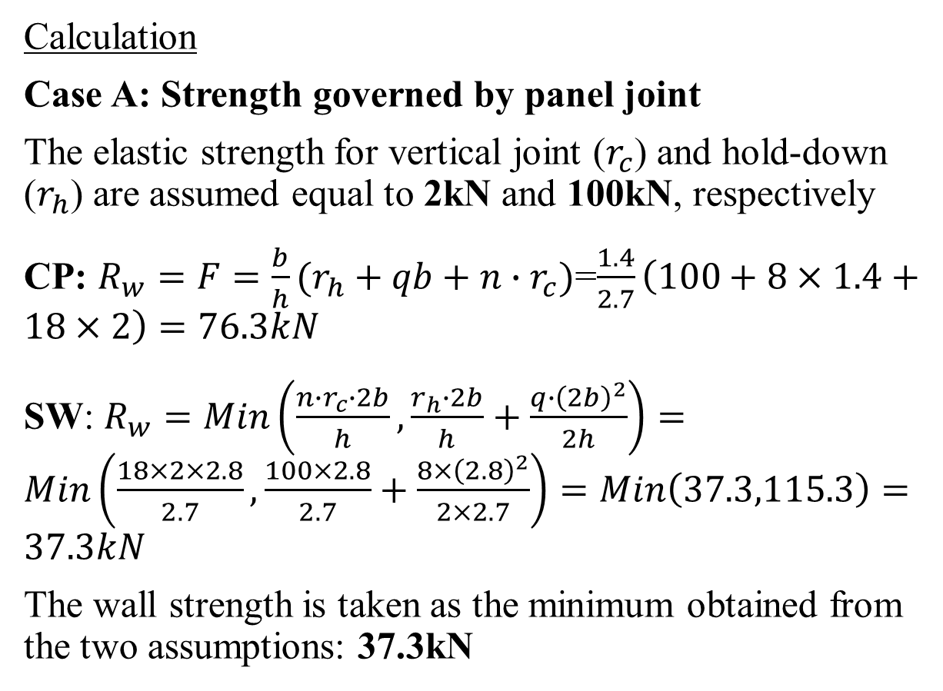
Example 3: Two-panel CLT shearwall strength
Calculation
Case A: Strength governed by panel joint
The elastic strength for vertical joint ($r_{c}$) and hold-down ($r_{h}$) are assumed equal to 2kN and 100kN, respectively
CP: $R_{w}=F=\frac{b}{h}(r_{h}+qb+n∙r_{c})$=$\frac{1.4}{2.7}\left(100+8×1.4+18×2\right)=76.3kN$
SW: $R_{w}=Min\left(\frac{n∙r_{c}∙2b}{h},\frac{r_{h}∙2b}{h}+\frac{q∙{\left(2b\right)}^{2}}{2h}\right)=Min\left(\frac{18×2×2.8}{2.7},\frac{100×2.8}{2.7}+\frac{8×{\left(2.8\right)}^{2}}{2×2.7}\right)=Min\left(37.3,115.3\right)=37.3kN$
The wall strength is taken as the minimum obtained from the two assumptions: 37.3kN
8 kN/m
F
18r_{c}
18r_{c}
2.7m
T
F_{a}
F_{a}
F_{a}
F_{a}
T
1.4 m
1.4 m

Slide 48
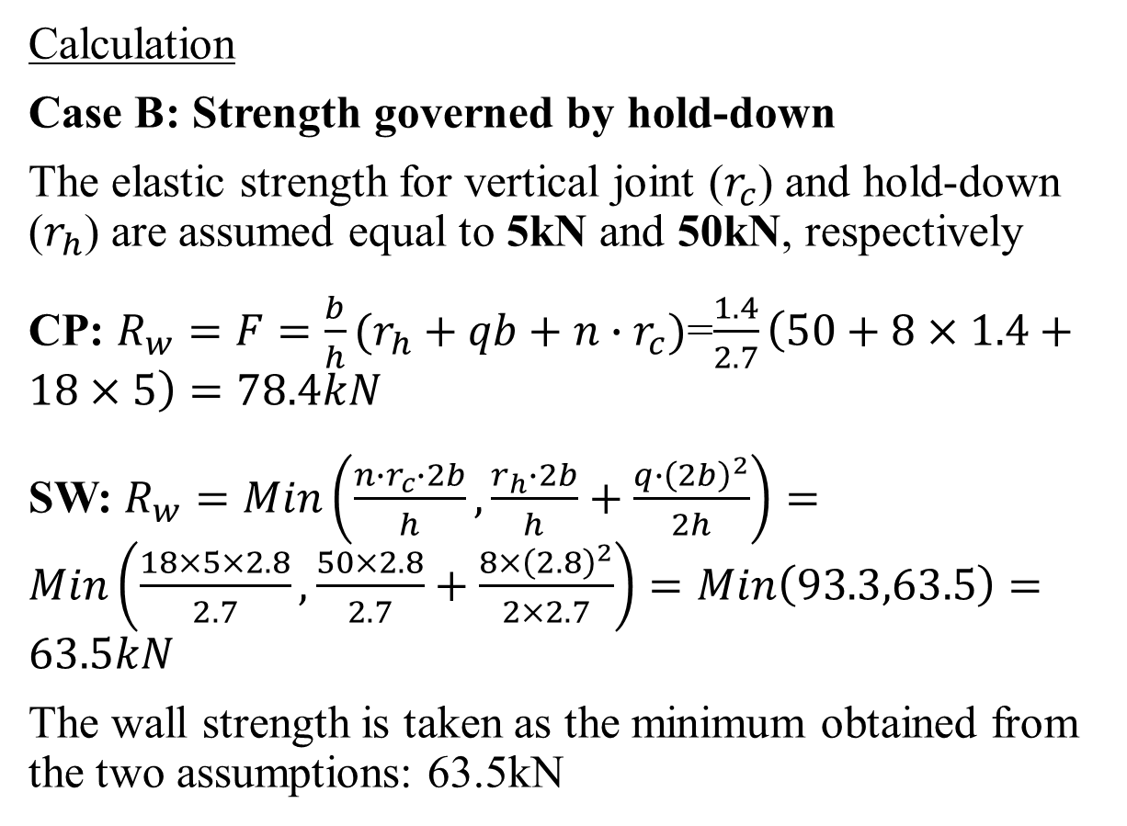
Example 3: Two-panel CLT shearwall strength
Calculation
Case B: Strength governed by hold-down
The elastic strength for vertical joint ($r_{c}$) and hold-down ($r_{h}$) are assumed equal to 5kN and 50kN, respectively
CP: $R_{w}=F=\frac{b}{h}(r_{h}+qb+n∙r_{c})$=$\frac{1.4}{2.7}\left(50+8×1.4+18×5\right)=78.4kN$
SW: $R_{w}=Min\left(\frac{n∙r_{c}∙2b}{h},\frac{r_{h}∙2b}{h}+\frac{q∙{\left(2b\right)}^{2}}{2h}\right)=Min\left(\frac{18×5×2.8}{2.7},\frac{50×2.8}{2.7}+\frac{8×{\left(2.8\right)}^{2}}{2×2.7}\right)=Min\left(93.3,63.5\right)=63.5kN$
The wall strength is taken as the minimum obtained from the two assumptions: 63.5kN
8 kN/m
F
18r_{c}
18r_{c}
2.7m
T
F_{a}
F_{a}
F_{a}
F_{a}
T
1.4 m
1.4 m

Slide 49
This lecture is developed based on the CLT Handbook [1], Wood Design Manual [2] and CSA O86-2014 [3].
References
[1] FPInnovations. 2011. CLT Handbook. Quebec, QC, Canada
[2] Canadian Wood Council (CWC). 2017. Wood design manual. Ottawa, ON, Canada.
[3] Canadian Standards Association (CSA). 2017. Engineering design in wood. CSA O86-14, Toronto, ON, Canada.

