Slide 1
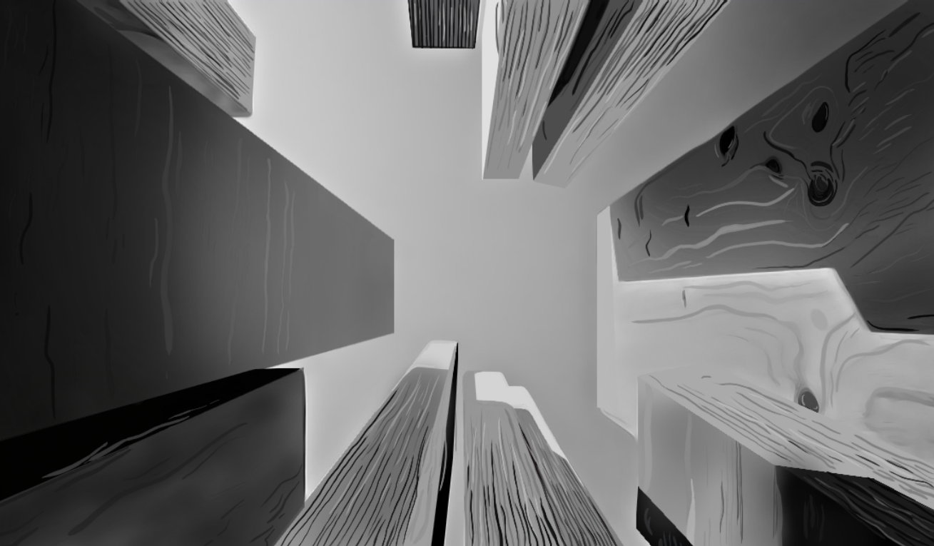

Lab 1: Flexural Timber
Instructor’s/ TA Version
Canadian
Wood
Council
Conseil
canadien
du bois

Slide 2

Objective
The aim of the laboratory is to determine the flexural strength of wood. The lab will provide experience measuring strength properties and links to these associated graduate attributes.
Testing the specimens in bending allows the students to observe both tension and compression effects. Bending and shear are also available.
A separate tension and compression test may also complement this lab should you have the resources available and capacity of your laboratory frame. A bending test will likely be under the compressive peak load.
Canadian
Wood
Council
Conseil
canadien
du bois

Slide 3
Course Learning Outcomes
Prepare a professional laboratory report including engineering charts, tables and graphs to present results effectively [CLO 10]
Interpret laboratory data to generate load-displacement plots, shear force and bending moment diagrams corresponding to the peak load [CLO 11]
Interpret laboratory data to assist calculations in determining the proportional limit and modulus of rupture for the timber specimens tested [CLO 11]
Conduct experimental testing to understand mechanical behaviour of timber specimens and provide experience measuring strength properties [CLO 12]
Canadian
Wood
Council
Conseil
canadien
du bois

Slide 4
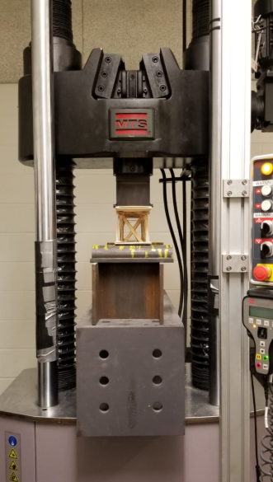
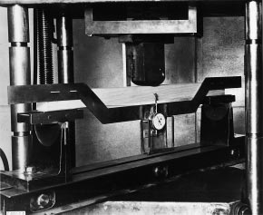
Equipment Required
In accordance with ASTM D143, the required equipment includes the following:
Linear potentiometers may be used to measure specimen deflection
  The stroke of a testing machine is a combination of the frame deformation and the specimen it will only give you the shape and not the true structural properties.
Universal Testing Machine
  Although testing assumes peak specimens loads less than 25KN for specimens of higher grade it is best to use a frame with a minimum 150KN. Floor tests can also be considered if your institution has a strong floor and space for a built up frame.
3-point bending test fixture
  This may be adhoc and built up but there can be safety risks to this, full testing kits are available with adequate capacity – do not use aged cast iron kits these may break.
Canadian
Wood
Council
Conseil
canadien
du bois

Slide 5
Materials Required
The wood samples for this laboratory may be purchased at your local hardware store (ie. in Ontario Home Depot is a relatively cheap supplier of the materials). The number of samples should be scaled to the number of lab sessions and groups you have. The sample type should be specified to your intended learning outcomes. If the lab is held later in the year substitution with LVL units can be considered as these are relatively cheap and exhibit engineered behaviour.
As of 2021, the samples (stud grade) required for this lab will cost:
SPF 2x2x8 – $6.20/each
https://www.homedepot.ca/product/hdg-2x2x8-spruce-pine-framing-lumber/1000173732
SPF 2x3x8 – $4.55/each
https://www.homedepot.ca/product/thd-2x3x8-framing-lumber-finger-jointed/1000112106
SPF 2x4x8 – $6.98/each – purchase 2x to illustrate 4x2 effects.
https://www.homedepot.ca/product/2-inch-x-4-inch-x-8-ft-spf-dimensional-lumber/1000112108
Cedar 2x4x8 – $15.31/each
https://www.homedepot.ca/product/porcupine-premium-2-inch-x-4-inch-x-8-ft-western-red-cedar-deck-board/1000167650
Canadian
Wood
Council
Conseil
canadien
du bois

Slide 6
Wood Samples for Testing
Type of Wood | Nominal Dimensions* Height x width (in x in) | Typical Load Capacity (kN)
S‐P‐F | 2 x 2 | 6
S‐P‐F | 2 x 3 | 18
S‐P‐F | 2 x 4 | 25
Cedar | 2 x 4 | 18
S‐P‐F | 4 x 2 | 18
All Specimens to be cut to be sized to at least 8 inches long
These are the nominal dimensions. The actual dimensions will differ and must be measured.
Canadian
Wood
Council
Conseil
canadien
du bois

Slide 7
Procedure
Each lab session will test five (5) wood sizes to determine the loads and displacements at failure due to the three‐point bending test. The laboratory work involves the following:
Specimen Measurements
NOTE: The following should be completed prior to testing.
Measure the length of the wood samples to be tested.
Measure the actual height and width of the cross section of each wood sample to be tested.
Measure the distance between the centre‐to‐centre of the roller supports of the test setup placed within the Universal Testing Machine. This is the clear span that will be used to determine the shear force and bending moment diagrams.
Measure the distance from the centre of the point load to the centre of each end support.
Canadian
Wood
Council
Conseil
canadien
du bois

Slide 8
Procedure
P
L
Three‐Point Bending Test
Place the wood sample over the roller support system located within the Universal Testing Machine. Ensure that the height is placed vertically in the testing machine.
Lower the bearing block connected to the Universal Testing Machine such that it just touches against the top surface of the wood sample.
During testing, the load imposed by the bearing block shall be applied at a continuous rate of 2.5 mm/min to failure.
Canadian
Wood
Council
Conseil
canadien
du bois

Slide 9
Procedure
Three‐Point Bending Test
Record the applied load and the displacement of the bearing block throughout testing using the built‐in load cell and displacement reading from linear potentionmeters (or the Universal Testing Machine).
Record the mode of failure.
Repeat the same procedure for all wood samples.
Canadian
Wood
Council
Conseil
canadien
du bois

Slide 10
Relevant Bending Theory
P
P
h
L
L/3
L/3
L/3
b
Centre point loading
Third point loading
P/Δ = slope of load-deformation line
P_{max} = load at failure
Canadian
Wood
Council
Conseil
canadien
du bois

Slide 11
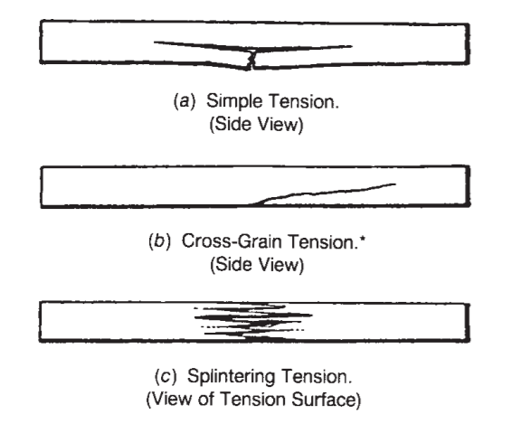
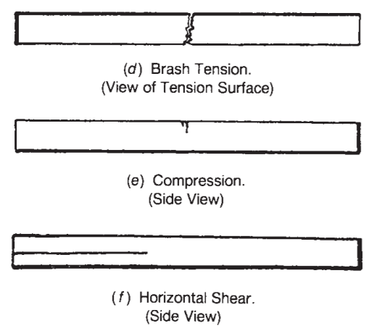
Types of Wood Failure in Static Bending
Types of Wood Failure in Static Bending (ASTM D 143)
Note there are specific causes to each mode of failure. During the laboratory the teacher should prompt the students to discuss
Which failure mode will provide the lowest failure load? (check slope of grain)
What failure mode may have non-linear load deflection response? (compression failure inducing plastic response)
Canadian
Wood
Council
Conseil
canadien
du bois

Slide 12
Results
Report the following information:
Actual measurements of each wood sample tested.
Actual measurements of the clear span between supports and location of the point load.
Load‐displacement plots for each wood sample tested.
Identify the maximum load and corresponding displacement for each wood sample tested.
Identify the force that corresponds to the proportional limit (PL) for each wood.
Identify the type of failure experienced by each wood sample while explaining the causes of this failure mode.
Canadian
Wood
Council
Conseil
canadien
du bois

Slide 13
Results
Draw the shear force and bending moment diagrams that correspond to the peak recorded force for each wood sample. Note that you will need to determine the reaction forces for this task.
Calculate the MOR (modulus of rupture) for each wood sample. Ie ., stress in the wood when it physically breaks
Summarize the maximum force and corresponding displacement, maximum shear force and bending moment, proportional limit, and type of failure in the table. Discuss the relationship between the height of the samples and the ultimate strength for the SPF specimens.
Canadian
Wood
Council
Conseil
canadien
du bois

