Slide 1
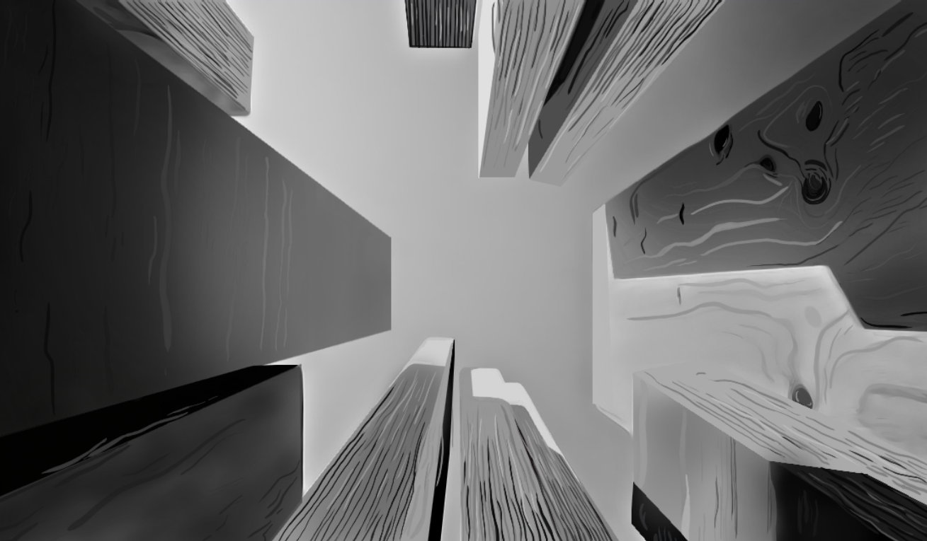
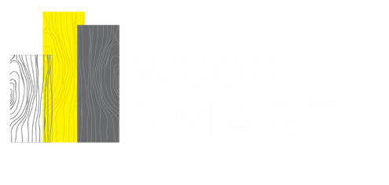
Steel Wood Course Hybrid
Module 2: Design of Timber
Canadian
Wood
Council
Conseil
canadien
du bois

Slide 2

Hybrid Course Outline
This module series can be used with 3rd/4th year steel design providing these listed topics are discussed.
The module series takes approximately 4 50 minute lectures. It is based on the construct of :
Chorlton, B., Mazur, N and Gales, J. (June 2019) Incorporating Timber Education into Existing Accredited Engineering Programs. 10th Canadian Engineering Education Association’s Annual Conference., Ottawa, Canada. 8pp.
This second module is not intended to be included with second year curriculum as it requires knowledge of limit states.
Week | Planned Content
1 | Module 1 Introduction – Limit states
2 | Module 2 Tension
3 | Module 3 Compression
4 | Module 4 Corrosion and Software
5 | Module 6 Beams
6 | Module 7 Beam Columns and Plate Girders
7 | Module 7 Steel Connections
8 | Module 8 Composite Steel Design
9 | Module 1a Introduction to Timber
10 | Module 2a Design of Timber 2
Canadian
Wood
Council
Conseil
canadien
du bois

Slide 3
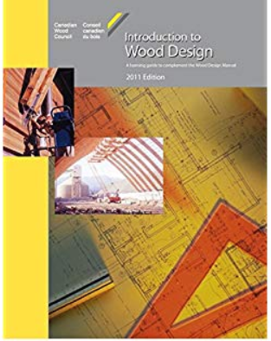
Typical Timber Undergraduate Course Outline
Introduction
Wood as a green building material
History of wood structures
Physical and mechanical properties of wood
Molecular and cell structure
Physical properties
Mechanical properties
Structural wood products & structural forms
Strength and modification factors
Specified strength of wood, size, use, species and grades
Modification Factors
Shrinkage calculation
Modification factors
Fire safety
Design Process
Limit States Design – Ultimate & Serviceability Limit States
Design of Tension Members
Design of Compression Members
Design of Bending Members
Combined bending and axial load
Connections
Purple we will cover in Module 2.
Blue is covered elsewhere in Steel Design.
Red covered elsewhere in Module 1.
Diaphragms are not covered herein
Canadian
Wood
Council
Conseil
canadien
du bois

Slide 4
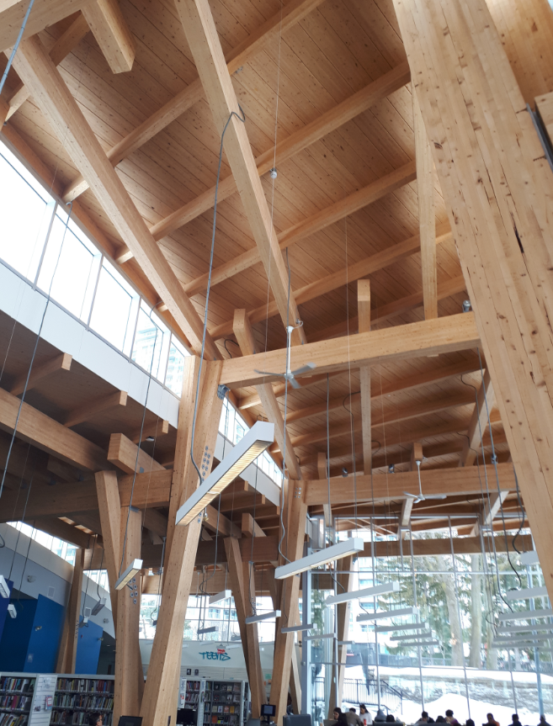
Canadian
Wood
Council
Conseil
canadien
du bois

Slide 5
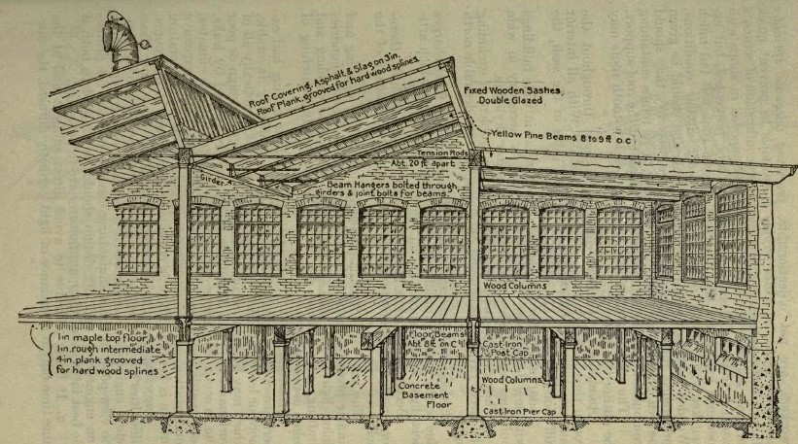
Axial loading

Slide 6

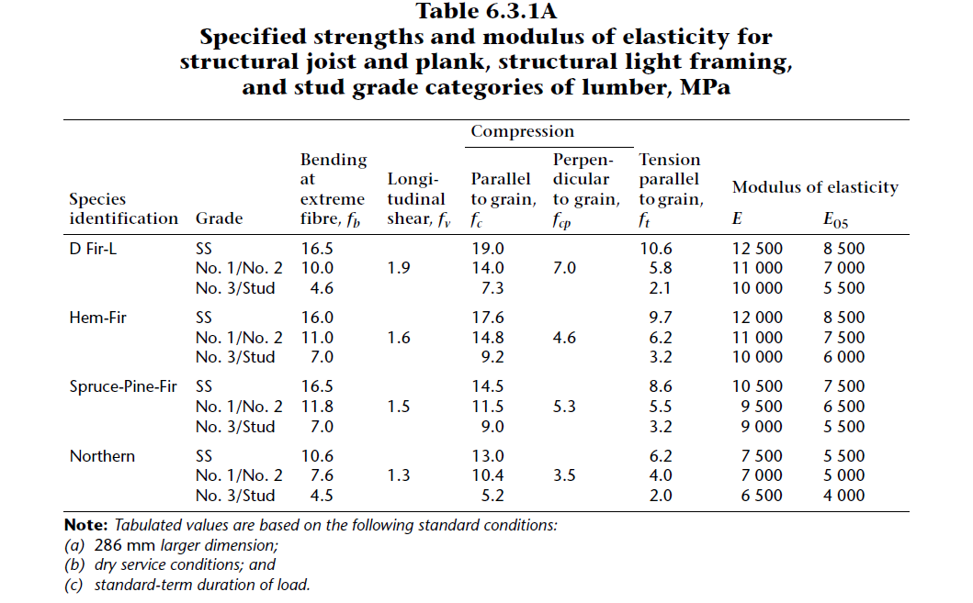
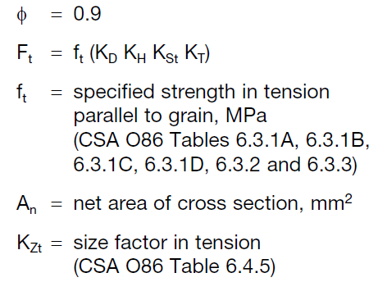
Sawn Lumber (Tension)
Tensile resistance parallel to the grain can be taken as:
Where:
Recall regarding modification and specified strength factors :
Canadian
Wood
Council
Conseil
canadien
du bois

Slide 7
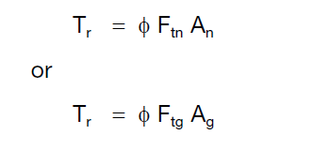
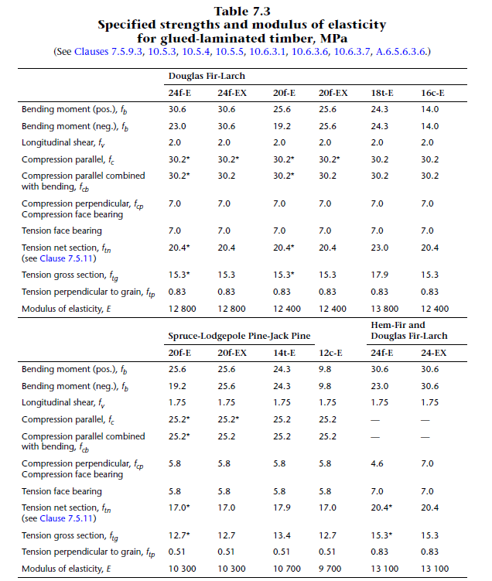
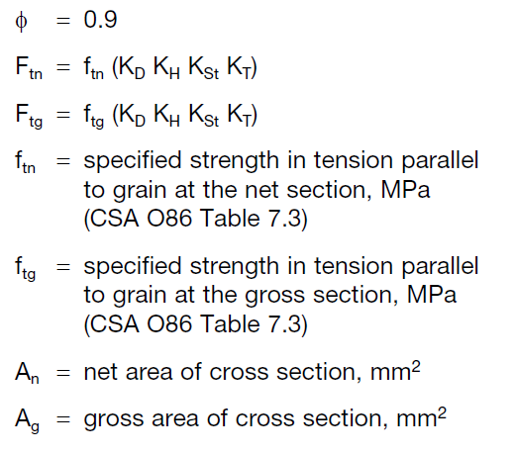
Glulam Members (Tension)
The factored tensile resistance , Tr, parallel grain is calculated as the lesser of :
Where:
Canadian
Wood
Council
Conseil
canadien
du bois

Slide 8
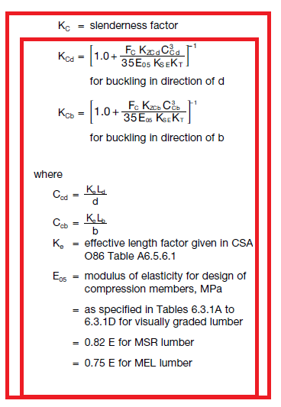
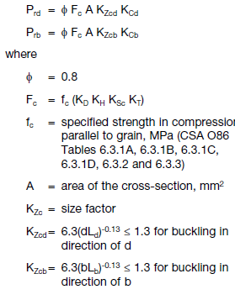
Sawn lumber (Compression)
Not as simple as timber. Slenderness factor, Kc, is used to relate the slenderness to load capacity. It is based on a cubic expression (Rankine- Gordon). Reliability is set to 0.8 is based on a nominal load eccentricity of 5% of the member dimension in the direction of buckling (averaged). Slenderness ratio Cc, is restricted to a max of 50 (if violated add supports or increase size).
Canadian
Wood
Council
Conseil
canadien
du bois

Slide 9
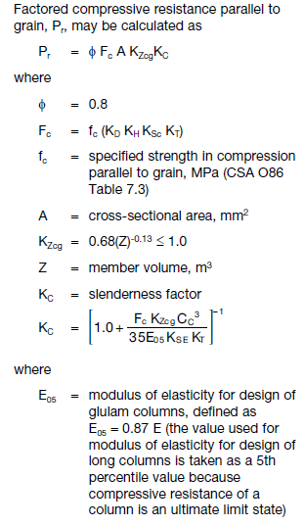
Glulam (compression)
For cases where compression is alone, 16c-E Douglas Fir or and 12c-E in spruce pine is recommended. Where combined with bending effects. It is generally most economical to use bending grades in either of the above group combinations.
The wood design manual contains column selection tables that assist in determining appropriate column sections.
Canadian
Wood
Council
Conseil
canadien
du bois

Slide 10
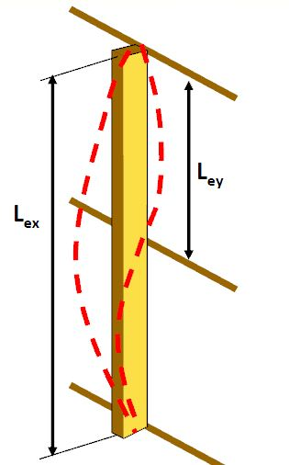
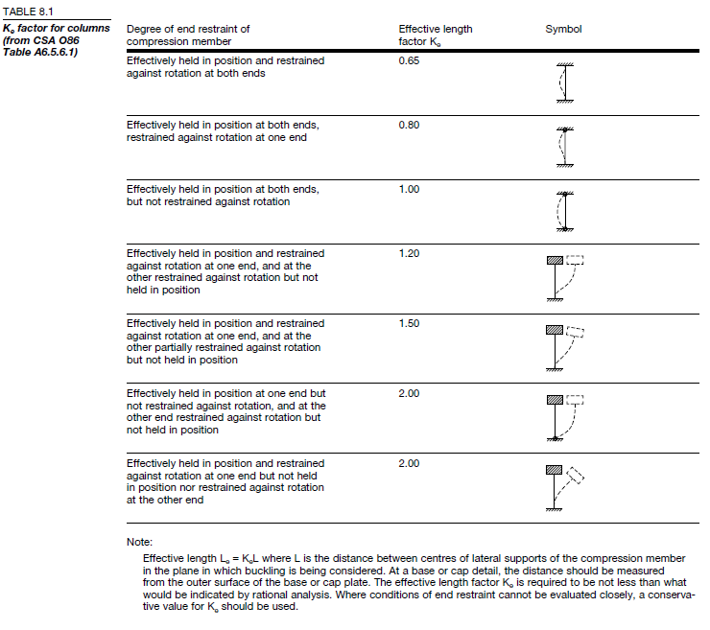
Effective length
Canadian
Wood
Council
Conseil
canadien
du bois

Slide 11
Considerations for CLT (compression walls)
CLT panels are more commonly being used for wall applications to resist axial loads in the plane of the panel. The contribution of the orientation of the layers of the panel are very important as most contribution comes from those parallel to applied load. Those perpendicular are generally neglected (see CL 8.2.4). The effective thickness is proportional to the effective radius of gyration (calculated only for contributing planes). Design is similar to sawn lumber, in that slenderness effects are still at play but calculated differently however these are limited now to 43 and not 50 as before.
Canadian
Wood
Council
Conseil
canadien
du bois

Slide 12
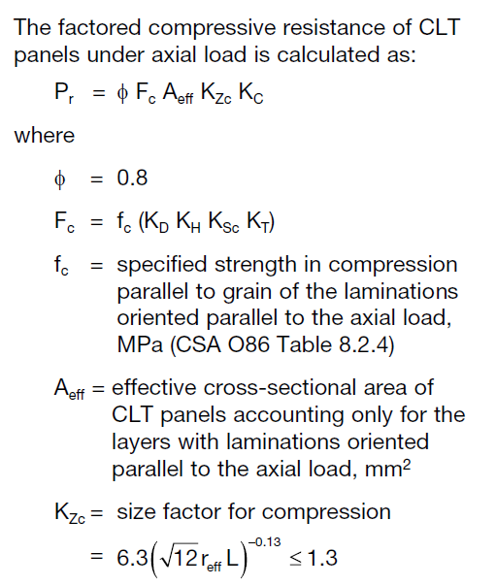
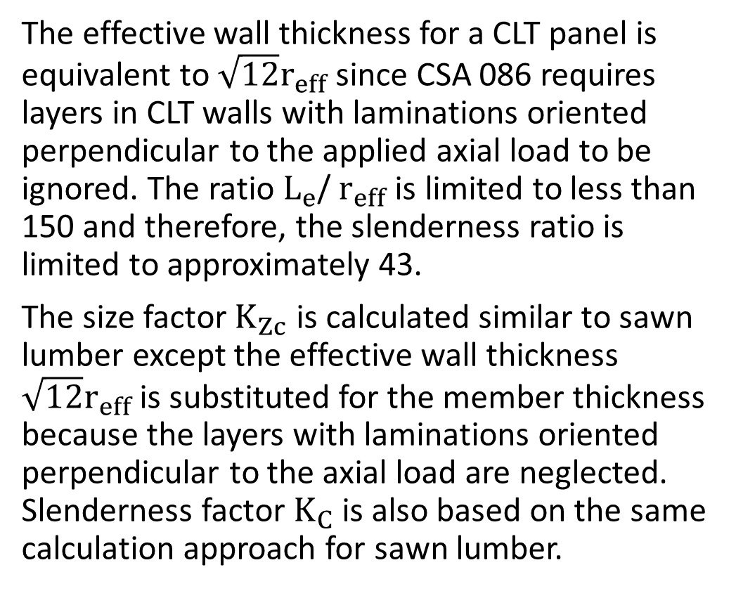
Considerations for CLT (compression walls)
The effective wall thickness for a CLT panel is equivalent to $\sqrt{12}r_{eff}$ since CSA 086 requires layers in CLT walls with laminations oriented perpendicular to the applied axial load to be ignored. The ratio $L_{e}$/ $r_{eff}$ is limited to less than 150 and therefore, the slenderness ratio is limited to approximately 43.
The size factor $K_{Zc}$ is calculated similar to sawn lumber except the effective wall thickness $\sqrt{12}r_{eff}$ is substituted for the member thickness because the layers with laminations oriented perpendicular to the axial load are neglected. Slenderness factor $K_{C}$ is also based on the same calculation approach for sawn lumber.
Canadian
Wood
Council
Conseil
canadien
du bois

Slide 13
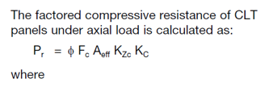
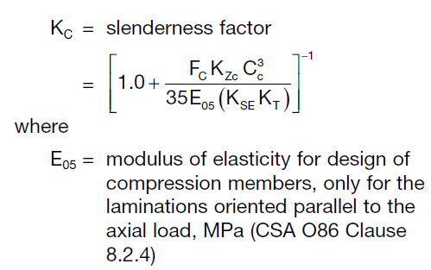
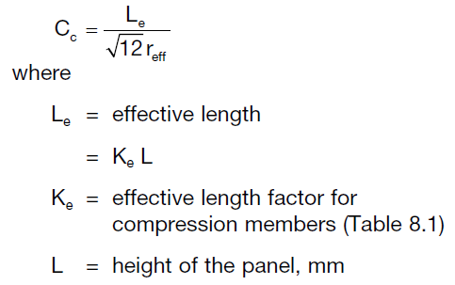
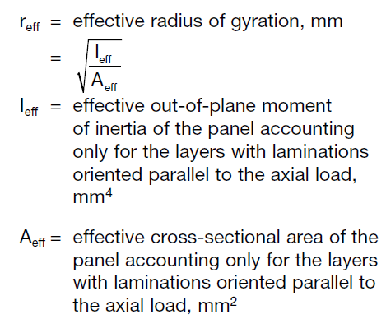
Considerations for CLT (compression walls)

Slide 14
Design for Bending

Slide 15
Sawn Lumber / Glulam / CLT
Governed through six limit states which require consideration. These are
Moment (bending) resistance (ultimate)
Shear resistance (Ultimate)
Bearing with compression perpendicular to the grain (Ultimate) – refer to Module 6 for details on how to consider this.
Deflection (service)
Vibration (service)
Canadian
Wood
Council
Conseil
canadien
du bois

Slide 16
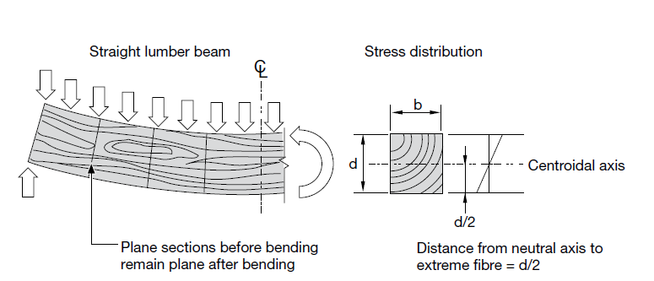
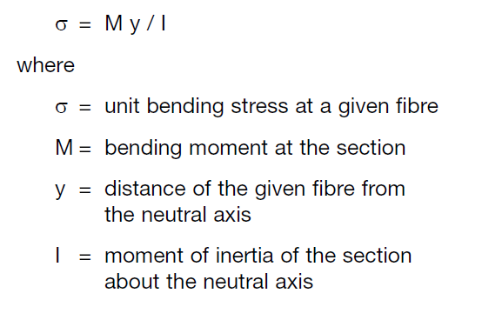

Bending theory
Bending about the principal axis
where S = section modulus = I / y and
Bending members are subjected to out-of-plane loading applied perpendicular to the longitudinal axis of beam or plane of panel
Applications:
  Joists, beams and purlins
  Sheathing and decking
Canadian
Wood
Council
Conseil
canadien
du bois

Slide 17
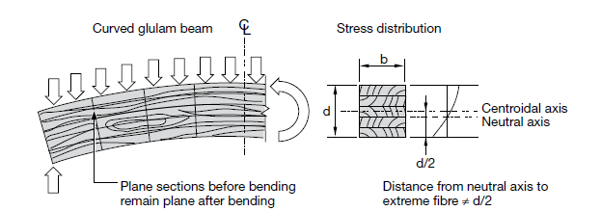
Bending theory
Similar to sawn lumber, glulam bending stress is assumed to be proportional to strain and is directly proportional to the distance of the neutral axis
Canadian
Wood
Council
Conseil
canadien
du bois

Slide 18
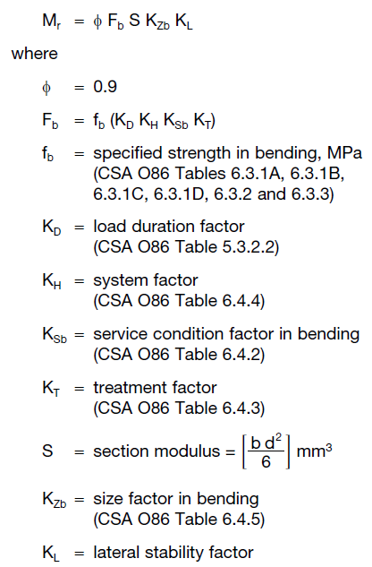
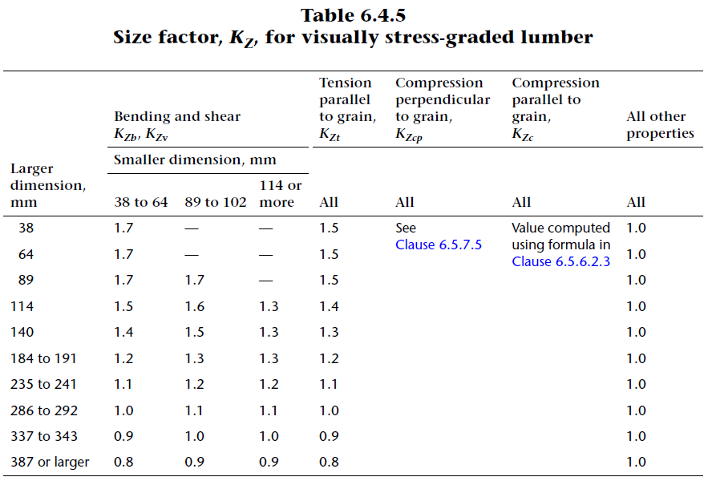
Sawn Lumber (bending resistance)
While considering bending resistance, lateral stability also needs consideration (buckling)
Canadian
Wood
Council
Conseil
canadien
du bois

Slide 19

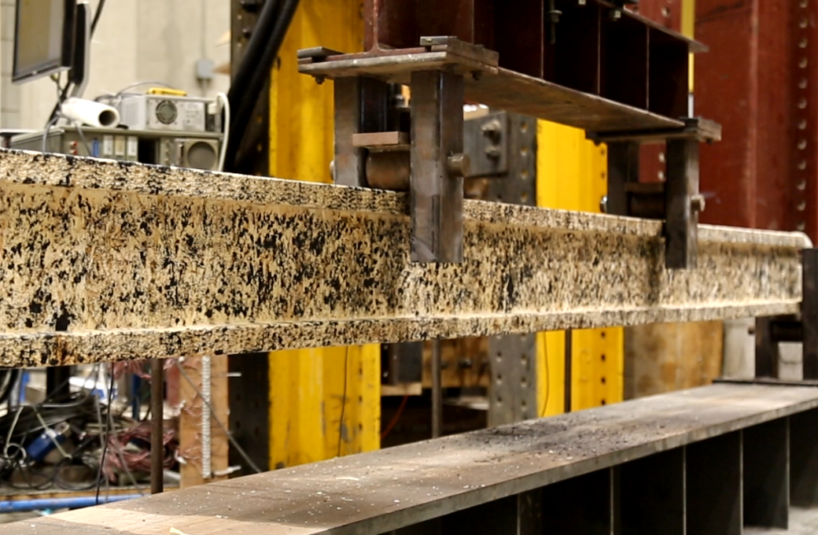
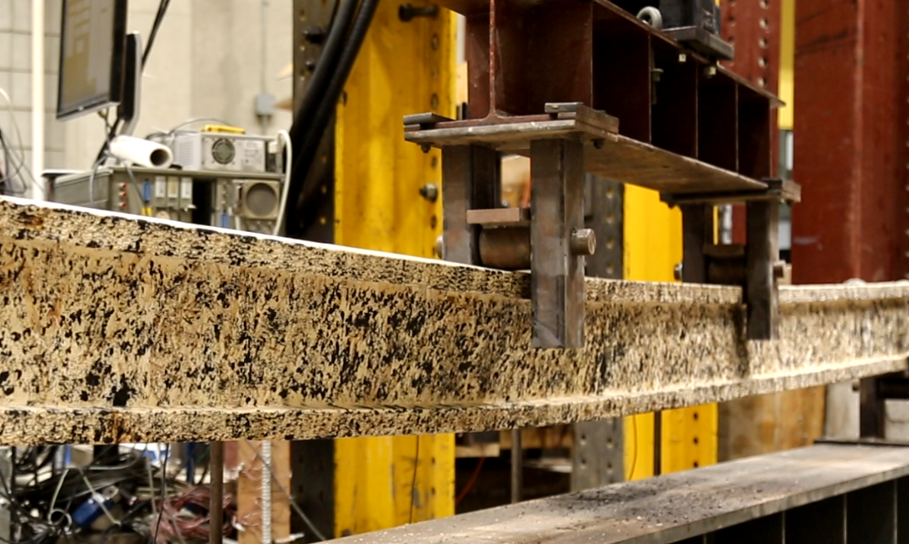
Lateral stability explanation
where
EI_{y} = bending stiffness in the lateral direction
GJ = St. Venant torsional rigidity
L_{e} = effective length
The effective length depends on the unsupported length of the beam and the loading and support conditions. The unsupported length is the length between those supports that prevent the beam from buckling. (the supports which keep the compression fibres restrained from lateral movement
Canadian
Wood
Council
Conseil
canadien
du bois

Slide 20
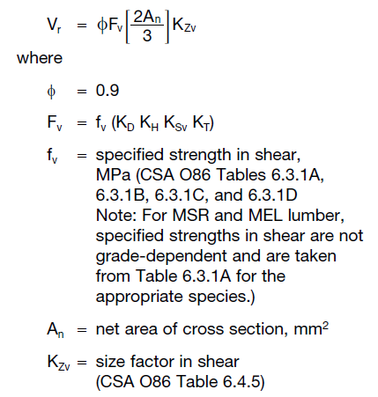
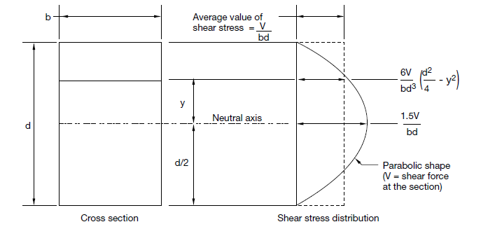
Sawn Lumber (Shear)
Loads are considered to be distributed down through the member in compression perpendicular to the grain. In this case longitudinal shear stress is parabolically distributed over the depth of the member. At neutral axis, the shear stress is 1.5x the average shear stress.
Effect of all loads acting within a distance from a support equal to depth of member shall be ignored.
Canadian
Wood
Council
Conseil
canadien
du bois

Slide 21
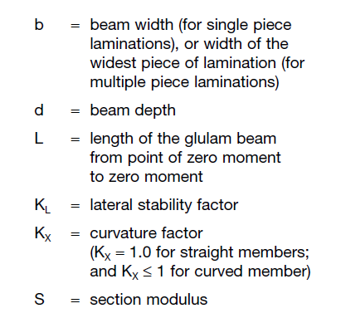
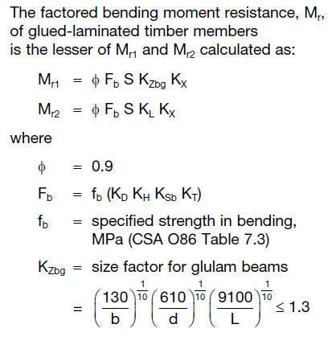
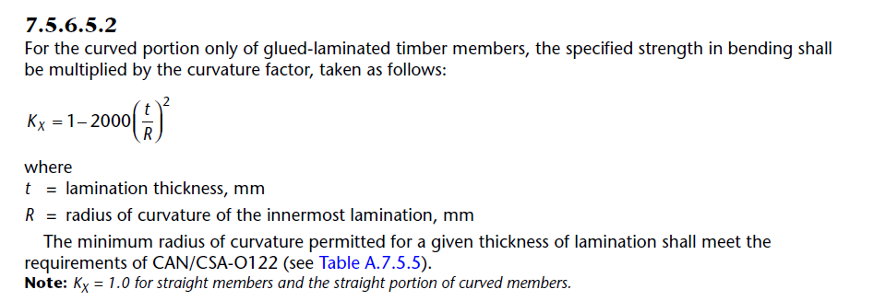
Glulam (bending resistance)
While considering bending resistance, lateral stability also needs consideration (buckling)
Assumptions for treating as unity are the same for sawn lumber, but if outside these bounds direct calculation is required
For curvature, refer to Kx in 7.5.6.5.2
Canadian
Wood
Council
Conseil
canadien
du bois

Slide 22
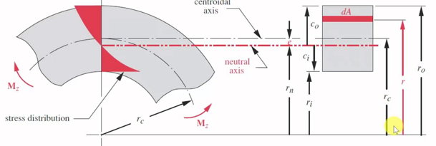
Glulam (Curvature effect-Kx)
K_{X} is required to account for the shifting of neutral axis, creating a larger extreme fibre stress than when the NA is located at the centroid for straight beam.
Pearson, 2011
Canadian
Wood
Council
Conseil
canadien
du bois

Slide 23
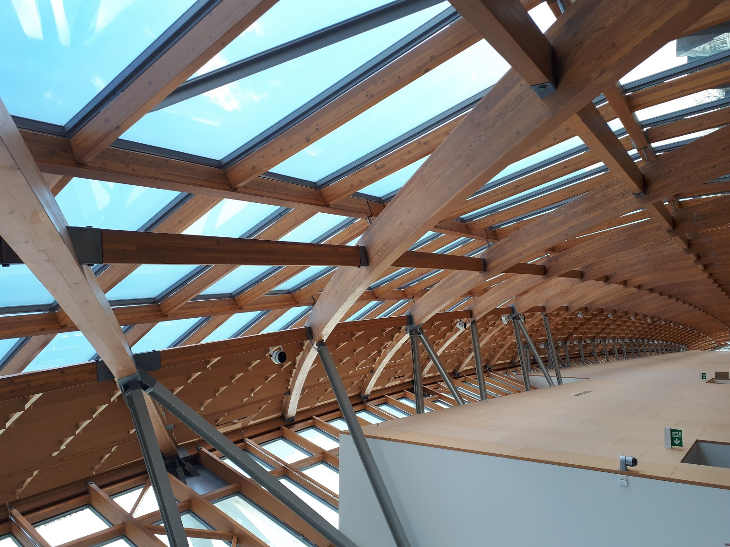
Glulam (Curvature effect-Kx)
Canadian
Wood
Council
Conseil
canadien
du bois

Slide 24
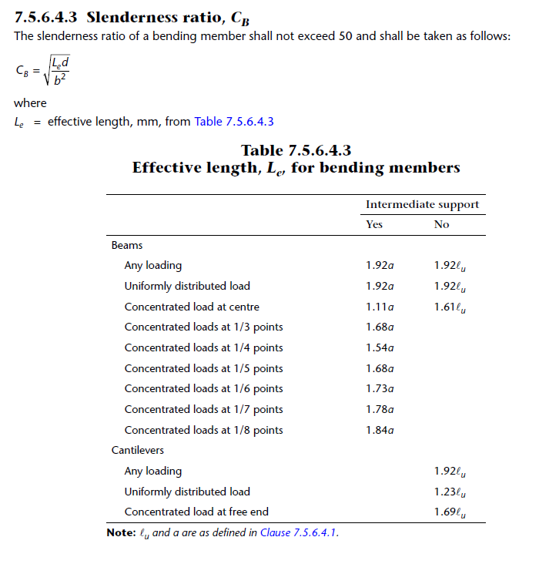
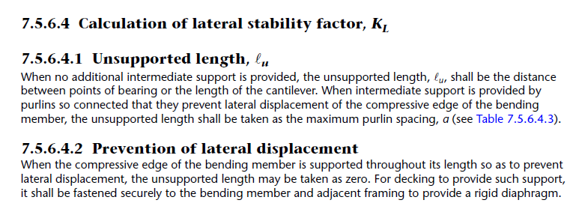
Glulam (lateral stability - slenderness ratio)
Canadian
Wood
Council
Conseil
canadien
du bois

Slide 25
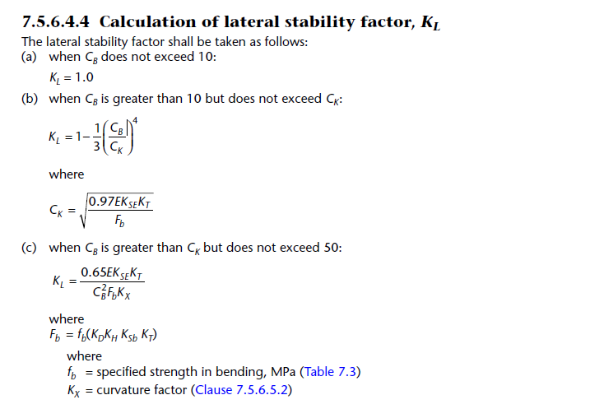
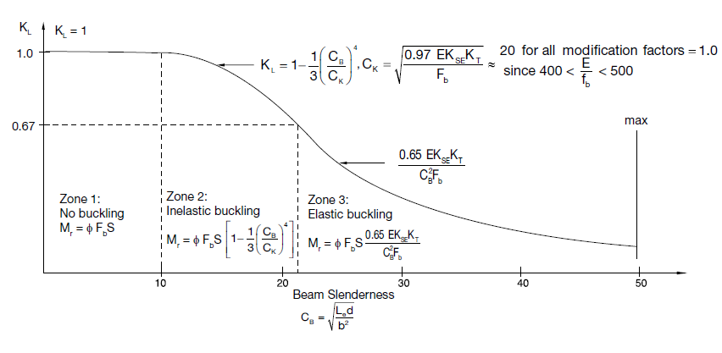
Glulam (lateral stability)
Recall:
Canadian
Wood
Council
Conseil
canadien
du bois

Slide 26
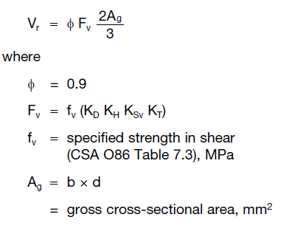
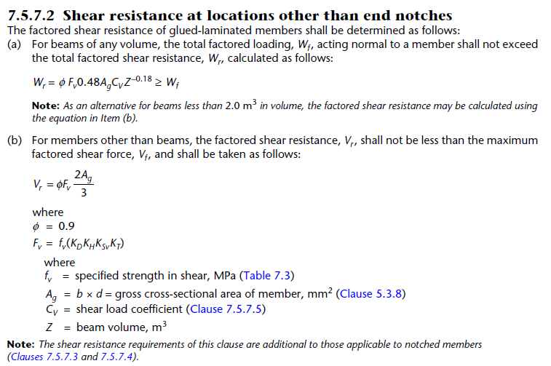
Glulam (Shear- no notch)
Simplified approach (Volume <2m³)
Advanced approach (Volume > 2m³ or simplified method does not satisfy required resistance)
Tables 7.5.7.5 a-e give direct values for Cv. If the loading condition is not in these tables. This value needs to be calculated directly
Canadian
Wood
Council
Conseil
canadien
du bois

Slide 27
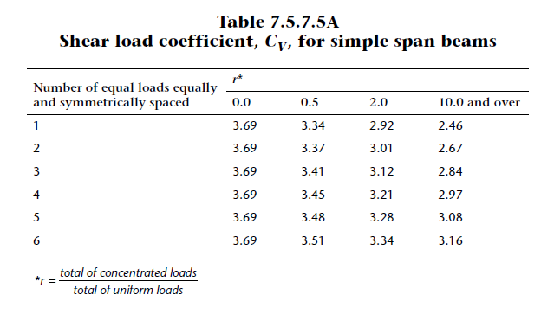
Glulam (Shear- no notch)
Canadian
Wood
Council
Conseil
canadien
du bois

Slide 28
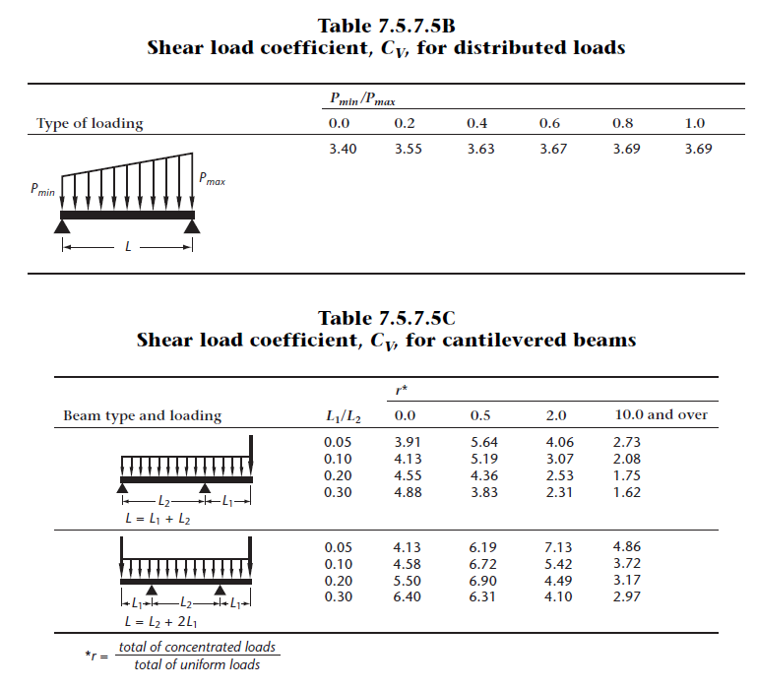
Glulam (Shear- no notch)
Canadian
Wood
Council
Conseil
canadien
du bois

Slide 29
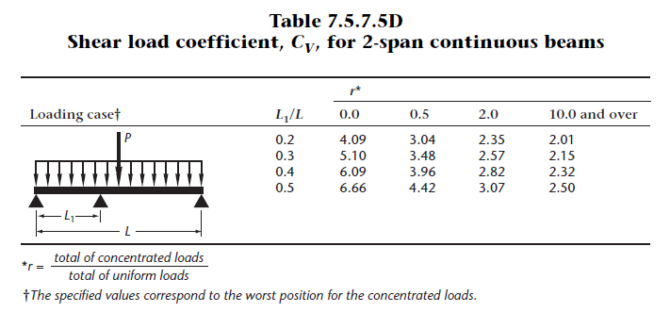
Glulam (Shear- no notch)
Canadian
Wood
Council
Conseil
canadien
du bois

Slide 30
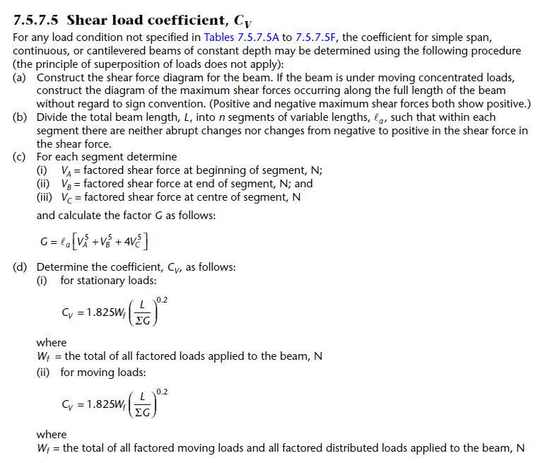
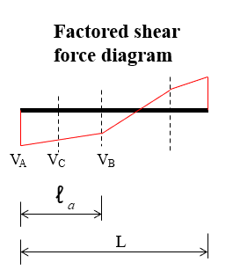
Glulam (Shear- no notch)
The procedure involves a number of steps and requires prior determination of the shear force diagram of the beam
Canadian
Wood
Council
Conseil
canadien
du bois

Slide 31
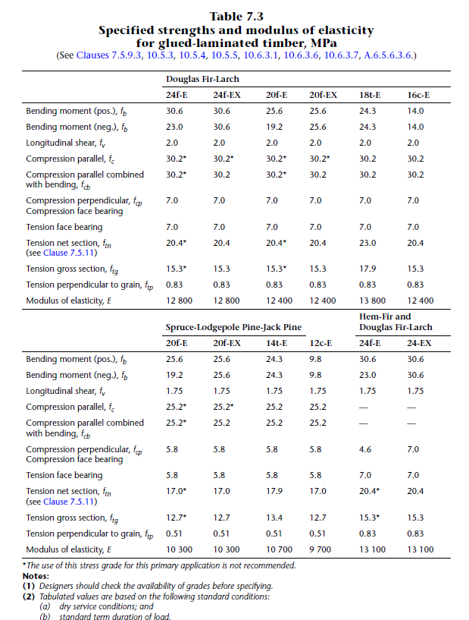
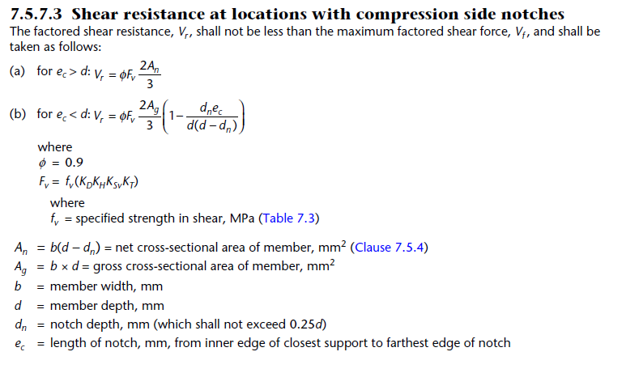
Glulam (Shear- with notch)
Canadian
Wood
Council
Conseil
canadien
du bois

Slide 32
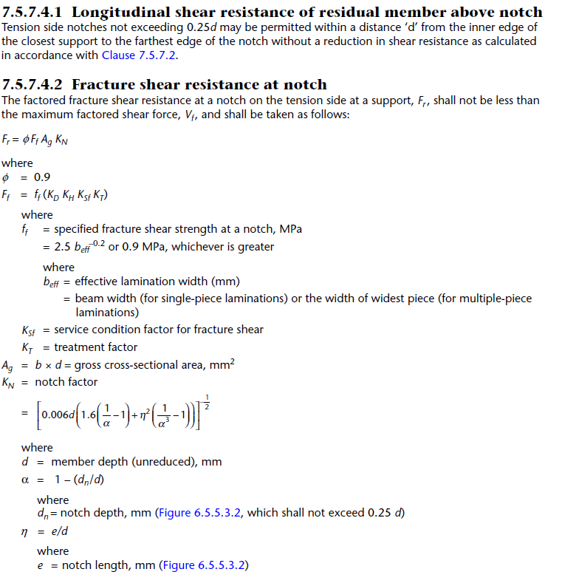
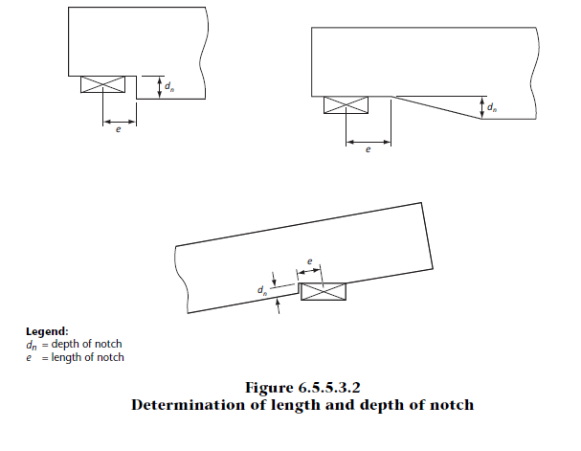
Glulam (Shear- with notch)
Canadian
Wood
Council
Conseil
canadien
du bois

Slide 33


Cross Laminated Timber
Out of plane bending design is prescribed in O86 and based on panels made in accordance to ANSI/APA PRG 320 standard with alternating orthogonal layers. These panels may be subjected to bending in either the major or minor direction. The major direction refers to the length wise or parallel orientation of the grain of the limitations in he outer layers of he panel.
Longitudinal layers refer to laminations oriented parallel to the major strength direction, else they are transvers layers.
Canadian
Wood
Council
Conseil
canadien
du bois

Slide 34
Cross Laminated Timber
For short or intermediate spans, moment and shear will govern, as the spans increase though deflection and serviceability effects will govern the design.
Mechanical properties of CLT panels are directionally dependent. Higher strength laminations are placed in the longitudinal layers. Bending is placed with the grain direction of the longitudinal layers parallel to the direction of the induced bending stress.
Canadian
Wood
Council
Conseil
canadien
du bois

Slide 35

Cross Laminated Timber
Analytical methods aimed to determine the basic mechanical properties and stress distributions are provided in the FPInnovations CLT handbook.
Methodologies therein describe the shear analogy method which is considered the most accurate.
The methodology characterizes the a CLT panel as two virtual beams. Beam A captures the inherent flexural stiffness of individual layers along their own neutral axes, whereas Beam B includes additional flexural stiffness of individual layers when measured against the panel neutral axis and the panel shear stiffness.
The twin beams are assumed to be connected by infinitely rigid members so equal deflection is obtained. The distributions between the beams oof shear and bending are based on the continuity of the two beams. The procedure is similar though not identical to the concept of deflection compatibility in composite beam (steel) theory
Canadian
Wood
Council
Conseil
canadien
du bois

Slide 36



Cross Laminated Timber – Shear Analogy Method
Canadian
Wood
Council
Conseil
canadien
du bois

Slide 37

Cross Laminated Timber – Shear Analogy Method
Canadian
Wood
Council
Conseil
canadien
du bois

Slide 38

Cross Laminated Timber – Shear Analogy Method
Canadian
Wood
Council
Conseil
canadien
du bois

Slide 39

Cross Laminated Timber – Shear Analogy Method
Rolling shear is affected by the cross-layer density, lamination thickness, moisture content and sawing configuration. It is important to consider as it accounts for the shear stress acting on the radial –tangential plane perpendicular to the grain. It basically is the rolling fibres on to of one another as can be seen below
Canadian
Wood
Council
Conseil
canadien
du bois

Slide 40


Cross Laminated Timber – Shear Analogy Method
Canadian
Wood
Council
Conseil
canadien
du bois

Slide 41


Cross Laminated Timber – Shear Analogy Method
Canadian
Wood
Council
Conseil
canadien
du bois

Slide 42

Cross Laminated Timber – Shear Analogy Method
Canadian
Wood
Council
Conseil
canadien
du bois

Slide 43

Cross Laminated Timber – Shear Analogy Method
Canadian
Wood
Council
Conseil
canadien
du bois

Slide 44

Cross Laminated Timber – Shear Analogy Method
Canadian
Wood
Council
Conseil
canadien
du bois

Slide 45


Cross Laminated Timber – Shear Analogy Method
Rolling shear strength of wood is low when compared to the longitudinal shear strength. For this reason , only the rolling shear strength is used for the shear resistance. Other types of lumber such as sawn or EWPs, this is not the case.
Canadian
Wood
Council
Conseil
canadien
du bois

Slide 46
Combined Bending and Axial

Slide 47

Combined Bending and Axial Loading
Many structural systems have an element of combined loading effect. This may be from eccentric loading, or members with lateral load conditions such as that from wind. Inclined columns will also have this effect that needs to be considered.
Canadian
Wood
Council
Conseil
canadien
du bois

Slide 48


Combined Bending and Axial Loading
For most members combined bending can be considered following this formula:
Canadian
Wood
Council
Conseil
canadien
du bois

Slide 49


Combined Bending and Axial Loading
For most sawn lumber truss members combined bending can be considered following this formula:
Note that the K factors used for each variable may be different in the calculation for studs. Additional some loads may be directionally dependent based on the applied eccentricity.
Canadian
Wood
Council
Conseil
canadien
du bois

Slide 50


Combined Bending and Axial Loading
For CLT combined bending can be considered following this formula:
Recall the importance for consideration in the effects of shear with CLT!
Canadian
Wood
Council
Conseil
canadien
du bois

Slide 51
Connections

Slide 52


Types of Fasteners
Covered here:
Shear plates and split rings
Nails and spikes
Bolts
Wood screws
Drift pins
Lag screws
Timber rivets
Truss plates
Joist hangers
Right photo from Chris Naum of a timber mill showing a connection circa 1871. Left photo of the Scarborough Library glulam connection circa 2019.
Modern connections can be made through advancements in precision cutting.
Canadian
Wood
Council
Conseil
canadien
du bois

Slide 53



Canadian
Wood
Council
Conseil
canadien
du bois

Slide 54

Shear Depth (de)
Particular to a wood member loaded at an angle. This results in a shear component that induces tensile stresses perpendicular to the grain of the wood. Stress is greatest at the boundary of the fasteners. we need to limit the total depth to an effective one.
The shear force to utilize is from the shear force diagram.
Canadian
Wood
Council
Conseil
canadien
du bois

Slide 55

Consideration for Moisture (Service Condition)
Wood is weaker when wet so wood connections used in wet service conditions will have less resistance. When fasteners are installed in wood that will dry in service or where wood moisture contents fluctuate seasonally, shrinkage damage may occur. In fastenings, shrinkage damage may result in splits at the connections.
A service condition factor, Ksf reflects that wood is generally weaker when wet, and that shrinkage can occur when installed from drying. This may split at the fastener weakening the connector unless accounted for. Shrinkage in wood is greater perpendicular to the grain direction and splitting will result from wood’s low tensile resistance perpendicular to the grain.
Canadian
Wood
Council
Conseil
canadien
du bois

Slide 56


Consideration for Moisture (Service Condition)
Splitting may be prevent with detailing to these conditions:
Assemble wood structures at a moisture content that will be used in service conditions
Use nails or slender bolts which are ductile
One line of fasteners
Minimize fasteners perpendicular to the grain
Separate splice plates for each row of fasteners
Slot splice plates perpendicular to the grain where practical to allow the wood to move.
Canadian
Wood
Council
Conseil
canadien
du bois
Module 10: Introduction to Timber

Slide 57

Load Duration
Assume the same behaviour as the wood itself for Kd
Treatment (preservative)
If the treatment contains copper it will be reactive (corrosive risk) for metallic connections so care needs to be taken for preservative treatment of exterior connections outside. Fire protection preservatives mechanisms can also effect the strength of he timber.
Canadian
Wood
Council
Conseil
canadien
du bois

Slide 58


Geometry of Fasteners
Early theories supported the total strength of a joint with fastenings (small ductile, and widely spaced) is the product of the single fastener times the number of fasteners. Though more modern tests have indicated that the strength is lower. For spilt rings, shear plates and lag screws the load carrying capacity per fastener decreases with the number of fasteners in a row parallel to the load, but there is no reduction for the number of rows. A group modification factor (Jg), is provided below for split rings, shear plates and lag screws.
Canadian
Wood
Council
Conseil
canadien
du bois

Slide 59

Geometry of Fasteners
The capacity of a bolted connection is dependent on the number of bolts in a row, number of rows and the geometry (right for interpretation especially when staggered lines are considered).
Truss plates and joist hanger are developed empirically from tests, the group effect is direct incorporated into the resistance values. Likewise timber rivet connections.
Smaller joints made of ductile nails and spikes the group effect is ignored.
Canadian
Wood
Council
Conseil
canadien
du bois

Slide 60
Net Area Reductions
AN = AG - AR
where:
AG = gross cross-sectional area
AR = area removed due to drilling, boring, grooving or other means
AR must not exceed 0.25 AG
For;
• split rings
• shear plates
• bolts
• lag screws
• drift pins
Area reduction due to bolt, lag screw or drift pin holes is equal to the diameter of the hole multiplied by the thickness of the member.
For staggered rows of fasteners, adjacent fasteners must be
considered to occur at the same cross-sectional plane when the centre-to-centre
spacing along the grain is less than the following values:
2 x fastener diameter for split rings and shear plates
8 x fastener diameter for bolts, lag screws or drift pins
Canadian
Wood
Council
Conseil
canadien
du bois

Slide 61

Net Area Reductions
Canadian
Wood
Council
Conseil
canadien
du bois

Slide 62

Geometry of Fasteners
The arrangement of fasteners in a connection is defined in terms of end
distance, edge distance and spacing as shown. A row is defined as one or more bolts, lag screws, shear plates or split rings aligned in the direction of the load.
Canadian
Wood
Council
Conseil
canadien
du bois

Slide 63

Loading
The lateral resistance of most fasteners depends upon the angle of load to grain. The angle is 0° when the load is parallel to grain, and 90° when the load is perpendicular to grain. Loading at an intermediate angle to grain may be calculated from the following empirical equation:
Nr = factored resistance at an angle θ to grain
Pr = factored resistance parallel to grain
Qr = factored resistance perpendicular to grain
θ = angle between grain direction and direction of load
Nr ; may also be determined from Design Handbook (Table 7.1)
Canadian
Wood
Council
Conseil
canadien
du bois

Slide 64

Design Tables (7.1-Handbook)
Canadian
Wood
Council
Conseil
canadien
du bois

Slide 65

Other Considerations
Notching
joints that cause tension perpendicular to grain stresses should be avoided. This occurs for example in cases where simple beams have been notched on the tension side at the supports. In this case, tension perpendicular to grain stresses can be caused by
prying action caused by secondary moments.
Decay Prevention
Moisture barriers, flashing and other protective features should be used to prevent moisture or free water from being trapped. Adequate site drainage must always be provided, all metals should be protected against corrosion by use of corrosive-resistant metals or resistant coatings or platings.
Lateral Restraint at Supports
Lateral restraint to prevent displacement and rotation must be provided at points of bearing for all beams with a depth-to-width ratio greater than 2.5.
Canadian
Wood
Council
Conseil
canadien
du bois

Slide 66
Connection Design

Slide 67

Split Rings and Shear Connectors
Round steel connectors installed in grooved wood. Split Rings are mainly for wood to wood connection. Formed through identical grooves in matching faces of two members. Shear plates are best adapted for wood steel, but can be used in wood wood connections. Shear plates transfer shear through the fastener (bolt or lag screw) through the center of the connector.
Split rings and shear plate joints are used more generally in heavy timber or glulam structures where there are large loads to be resisted (trusses, purlin to beam, column to foundation, arch peaks, or bridges).
Canadian
Wood
Council
Conseil
canadien
du bois

Slide 68


Split Rings and Shear Connectors
Canadian
Wood
Council
Conseil
canadien
du bois

Slide 69





Design of Split Rings and Shear Connectors
Factored lateral Strength resistance parallel to the grain
Factored lateral Strength resistance perpendicular to the grain
Canadian
Wood
Council
Conseil
canadien
du bois

Slide 70




Design of Split Rings and Shear Connectors
The capacity of a split ring is dependent upon the combined action of the bolt and ring. The capacity of the connector unit of the shear plat e is limited by the shear strength of the bolt.
Canadian
Wood
Council
Conseil
canadien
du bois

Slide 71

Design of Split Rings and Shear Connectors
If lag screws are used instead of bolts, resistance is dependent on the depth of penetration (table 12.3.5 O86) gives requirements. Specific detailing is required to utilise the full capacity of the connection. Holes must first be drilled and then installed.
Canadian
Wood
Council
Conseil
canadien
du bois

Slide 72

Bolts and Dowels
Design information is provided in the Wood Design Manual based on bolts and dowels conforming to the requirements of ASTM Standard A307 or SAE J429 Grade 2 bolts and dowels. The holes for bolts and dowels must meet the requirements of CSA O86. Bolts are required to have pre-drilled holes that are between 1 mm and 2 mm larger than the bolt diameter.
The bolt and dowel design provisions in CSA O86 address:
-Yielding of the bolt or dowel
-Wood failure mechanism around the connection including:
  Row shear parallel to grain along each fastener row
  Group tear-out of a connection with multiple rows of bolts loaded parallel to grain
  Net tension of member loaded parallel to grain, and
  Splitting of members loaded perpendicular to grain.
Canadian
Wood
Council
Conseil
canadien
du bois

Slide 73


Sizing of Bolts and Dowels
Canadian
Wood
Council
Conseil
canadien
du bois

Slide 74

Tension Resistance of Bolts and Dowels
Canadian
Wood
Council
Conseil
canadien
du bois

Slide 75

Modification Factors of Bolts and Dowels
Canadian
Wood
Council
Conseil
canadien
du bois

Slide 76


Minimum Spacing Bolts and Dowels
Canadian
Wood
Council
Conseil
canadien
du bois

Slide 77
Design of Bolts and Dowels
Bolts can be hot dipped galvanized, stainless steel (including washers and nuts) or plated to provide resistance to corrosion.
Bolts are widely used in applications of heavy loads. They are seen in purlin to beam, beam to column, column to base, truss, arches, post and beam, pole-frame, bridges and marine structures (with care for corrosion considered.
There are a suite of equations provided from Clause 12.4.4.2 which capture the possible modes of failure. In this case the minimum resulting value is the selected lateral resistance.
Canadian
Wood
Council
Conseil
canadien
du bois

Slide 78




Design of Bolts and Dowels
The factored lateral resistance depends upon the angle of load to grain and is
calculated as follows;
Canadian
Wood
Council
Conseil
canadien
du bois

Slide 79

Design of Bolts and Dowels
Yielding resistance is a function of the number of shear planes in the connection it is based on the unit lateral yielding resistance which is determined based on the number of member connections;
Canadian
Wood
Council
Conseil
canadien
du bois

Slide 80



Design of Bolts and Dowels
Canadian
Wood
Council
Conseil
canadien
du bois

Slide 81




Design of Bolts and Dowels
Recall from the module on Tension;
Canadian
Wood
Council
Conseil
canadien
du bois

Slide 82

Design of Bolts and Dowels
Canadian
Wood
Council
Conseil
canadien
du bois

Slide 83


Design of Bolts and Dowels
Designing of bolts and dowels tends to be a trial and error process; Selection tables from 7.4 from the Hand book assists:
Canadian
Wood
Council
Conseil
canadien
du bois

Slide 84


Design of Bolts and Dowels
Designing of bolts and dowels tends to be a trial and error process; Selection tables from 7.4 from the Hand book assists:
Canadian
Wood
Council
Conseil
canadien
du bois

Slide 85


Design of Bolts and Dowels
Designing of bolts and dowels tends to be a trial and error process; Selection tables from 7.4 from the Hand book assists:
Canadian
Wood
Council
Conseil
canadien
du bois

Slide 86


Design of Bolts and Dowels
Designing of bolts and dowels tends to be a trial and error process; Selection tables from 7.4 from the Hand book assists:
Canadian
Wood
Council
Conseil
canadien
du bois

Slide 87

Design of Bolts and Dowels
Designing of bolts and dowels tends to be a trial and error process; Selection tables from 7.4 from the Hand book assists:
Canadian
Wood
Council
Conseil
canadien
du bois

Slide 88

Drift Pins
These are round steel dowels that do not have heads and are not threaded. The ends are shaped so that the pin can be inserted in a pre-drilled hole to minimize wood damage. Members are aligned and geld in place. Hole diameters are slightly undersized 1mm to give a tight fit.
These are usually used where gravity or mechanical restraint prevents axial tension stress. These may also be used to anchor beams and columns.
Canadian
Wood
Council
Conseil
canadien
du bois

Slide 89


Design of Drift Pins
The factored lateral resistance will be 60% of that of a bolt or dowel in single shear. At any shear plane with two overlapping members, a maximum of two drift pins can be considered as resisting shear forces.
Drift pins should be slightly shorter than the combined members depth so to prevent interface between the pins in successive layers as they are tightened.
Canadian
Wood
Council
Conseil
canadien
du bois

Slide 90


Lag Screws
Also known as lag bolts, are larger than screws, and installed in one face of the member. Shown right is a typical member. Very specific detailing is required in installation where a lead hole is made for the threaded portion and a counter bore for the unthreaded portion. The screw is turned with a wrench. If the procedures are not followed the load carrying capability is reduced.
They are used to anchor metal or wood in places where through bolts are undesirable or impractical. They may be loaded laterally or where withdrawal resistance is desired.
Canadian
Wood
Council
Conseil
canadien
du bois

Slide 91

Spacing of Lag Screws
Same as bolted equations but with certain exceptions:
Canadian
Wood
Council
Conseil
canadien
du bois

Slide 92


Design of Lag Screws
Yield Model (European) is used for the ultimate strength of a lag screw connection. The same yield equations as used for bolts are used. The embedding strengths are also the same, however modification factors are not incorporated (load, treatment, service conditions). Phi is also changed to 0.6 as opposed to 0.8 as is seen in bolts. Section 7.6 gives selection guidance in the handbook.
These resistancess are for members laterally loaded, for perpendicular, resistance is 2/3 the calculated value if wood plates are used, if steel , - 1/2.
Canadian
Wood
Council
Conseil
canadien
du bois

Slide 93

Design of Lag Screws
Withdrawal resistance also needs consideration. It is a function of the screw diameter and length, and specific gravity. The effective length in withdrawal is equal to the threaded length excluding the length of the tip. The screw should also be checked for resistance. These are the same criterion for ASTM A307 bolts.
Canadian
Wood
Council
Conseil
canadien
du bois

Slide 94

Timber Rivets
Timber rivets were formerly known as glulam rivets. These are high strength fasteners that are now used for glulam and heavy timber construction as seen below,.
These are a favoured construction technique for glulam because they are stiffer and transfer greater loads, drilling is not required, simplifies fabrication as gross cross section can be relied on, easy to inspect ad favoured for as asethics reasons.
Rivets must be used with atleast 3.2mm thick steel plates.
Canadian
Wood
Council
Conseil
canadien
du bois

Slide 95

Design of Timber Rivets
Usually found in truss connections, purlin beam connections, beam column connections, arch to base connections. Assembly is done on site to prevent damage.
It is a good alternative to lag screws because neither will penetrate the member full, and driving can be easier that turning. However, it requires more materials than lag screws would.
O86 Appendix A 12.7.2.3 gives formulas for these failure modes which is largely trail and error. To simplify the process, basic resistance values are tabulated for typical design configurations. When outside this, the appendix is used,
Canadian
Wood
Council
Conseil
canadien
du bois

Slide 96



Design of Timber Rivets
Canadian
Wood
Council
Conseil
canadien
du bois

Slide 97


Truss Plates
These are used to assemble dimensional lumber in roof and floor trusses. The are produced by punching 16-20mm gauge galvanized steel. The pattern of the teeth varies to the manufacturer.
These would be installed every joint of a light frame wood truss. The plate size would vary depending on the loads that need to be transferred. These would be embedded via a hydraulic press and by the manufacturer. So the design is largely proprietary as a consequence. Though this must follow specific standards (tightfitting, non deformed, direction normal to the surface of the lumber, fully embedded to a specific depth, and the quality of the lumber)
Canadian
Wood
Council
Conseil
canadien
du bois

Slide 98

Nails and Spikes
Manufactured in many lengths and diameters (see text book figure 11.27). Nails are usually 1 to 6 inches and spikes are 4 inches to 14 inches. Nails are normally made of low or medium carbon steels or aluminum.
Splitting can be reduced by blunting the point of the nail before driving. A long diamond point may be easier to drive but it can split harder wood species. Uncoating in cedar species can cause staining of the wood galvanization is an alternative.
Nails are common in all types of construction, but seen mostly with wood frame, post and beam, heavy timber, shear walls, nailed gussets and panel assemblies.
Canadian
Wood
Council
Conseil
canadien
du bois

Slide 99

Edge Distances for Nails and Spikes
Canadian
Wood
Council
Conseil
canadien
du bois

Slide 100

Edge Distances for Nails and Spikes
Fig 7.4 handbook
Canadian
Wood
Council
Conseil
canadien
du bois

Slide 101


Design of Nails and Spikes
O86 applies only for common round steel wire nails and spikes and common spiral nails spiralled to head as defined in CSA Standard B111 Wire Nails, Spikes and Staples.
Nails are usually specified by the type and length in inches. Nails are available
in lengths from 1/2 to 6 inches and spikes range in size from 4 to 14 inches.
Canadian
Wood
Council
Conseil
canadien
du bois

Slide 102


Design of Nails and Spikes
Canadian
Wood
Council
Conseil
canadien
du bois

Slide 103

Design of Nails and Spikes
Withdrawal resistance is based on the squeezing effect of broken and displaced fibres from the installation process. With time this will relax., and the depth, duration of loading and service conditions will become more important to the strength.
If nails are clinched, withdrawal resistance will increase by 60%. Nails in end grain have no resistance. Toe nails are partially resisted in the end grain of the wood, about 67% when installed in the side grain
Canadian
Wood
Council
Conseil
canadien
du bois

Slide 104


Design of Joist Hangers
Proprietary product generally made of 16 to 20 gauge galvanized steel. Most are face mount, but top mount is possible for heavier loads.
Installation is with the manufacturer's requirements. Where specifying a joist hanger, designers must ensure that the hanger is at least half the depth of the joist, and capable of providing lateral support; the hanger is fastened to both the header and joist. Detailing to splitting must be considered as well as lateral support.
Since joist hangers are proprietary, CSA O86 provides a method for determining design values but does not provide the design values in the Standard. Instead it requires that joist hangers be tested in accordance with ASTM Standard D 1761 Standard Test Methods for Mechanical Fasteners in Wood.
Canadian
Wood
Council
Conseil
canadien
du bois

Slide 105


Design of Wood Screws
CSA O86 is applicable only for wood screws that meet the requirements of ASME B18.6.1 Wood Screws. Procedure is very similar to nails with small exceptions
Canadian
Wood
Council
Conseil
canadien
du bois

Slide 106



Design of Wood Screws
Canadian
Wood
Council
Conseil
canadien
du bois

Slide 107


Design of Wood Screws
When using selection tables note the omissions of information and how the equations are re-arranged
Canadian
Wood
Council
Conseil
canadien
du bois

Slide 108
Design Examples

Slide 109

Example 1: Tension Member
Check the adequacy of the bottom chord member shown. The member is 140 x 191 mm No.1 grade D.Fir-L, connected with a single row of 4” diameter shear plates with 3/4” diameter bolts. The conditions are as follows:
• factored tensile force = 144 kN (dead plus snow load)
• dry service conditions
• untreated
• truss spacing exceeds 610 mm
Canadian
Wood
Council
Conseil
canadien
du bois

Slide 110
Example 1: Tension Member
For sawn lumber or sawn timber:
TrN = φ Ft An Kzt (N)
Ft = ft (KD KH KSt KT) (MPa)
ft = specified tensile strength (MPa)
An = net area of cross section (mm2)
φ = 0.9
For glulam:
TrN = φ FtN An (N)
TrG = φ FtG Ag (N)
FtN = ftN (KD KH KSt KT) (MPa)
FtG = ftG (KD KH KSt KT) (MPa)
ftN = specified tensile strength at net section (MPa)
ftG = specified tensile strength at gross section (MPa)
An = net area of cross section (mm2)
Ag = gross area of cross section (mm2)
φ = 0.9
Canadian
Wood
Council
Conseil
canadien
du bois

Slide 111


Example 1: Tension Member
Calculation
Tf = (factored tensile load)= 144 kN
Since the chord is connected with shear plates, the tensile resistance at net section must be checked.
From the Tension Member Selection Tables:
Tr = 185 kN > 144 kN Acceptable
Use 140 x 191 mm No.1 grade D.Fir-L.
Canadian
Wood
Council
Conseil
canadien
du bois

Slide 112
Example 2: Compression
Design columns for the following conditions:
• specified dead load = 2.0 kPa
• specified live load = 2.4 kPa
• tributary area = 25 m2
• unbraced length = 5 m
• dry service conditions
• untreated
• column effectively pinned at both ends (Ke = 1.0)
• no eccentricity considered
Use No.1 D.Fir-L.
Canadian
Wood
Council
Conseil
canadien
du bois

Slide 113


Example 2: Compression
Available sizes (sawn)
Available sizes (glulam)
Canadian
Wood
Council
Conseil
canadien
du bois

Slide 114

Example 2: Compression
Canadian
Wood
Council
Conseil
canadien
du bois

Slide 115

Example 2: Compression
Table 3.6
Canadian
Wood
Council
Conseil
canadien
du bois

Slide 116

Example 2: Compression
Table 3.7
Canadian
Wood
Council
Conseil
canadien
du bois

Slide 117

Fig 3.1
Canadian
Wood
Council
Conseil
canadien
du bois

Slide 118

Example 2: Compression
Canadian
Wood
Council
Conseil
canadien
du bois

Slide 119


Example 2: Compression
Calculation
Tributary area > 20 m2
Therefore, live load reduction factor from Part 4 of the NBC is:
Total factored load:
Pf = (1.25 × 2.0 + 1.5 × 0.926 × 2.4) × 25
= 146 kN
From Column Selection Tables select 191 x 191 mm:
Pr = 186 kN > 146 kN Acceptable
Use 191 x 191 mm No.1 D.Fir-L column.
Canadian
Wood
Council
Conseil
canadien
du bois

Slide 120


Example 3: Bending
Design the glulam beams for the flooring system shown using 20f-E bending grade Spruce Pine. Because the joists are closely spaced, the loading on beam B1 may be considered as uniformly distributed. Note beam tables need to be provided to students in this example.
Unfactored loads
Dead load = 1.2 kPa (not including self weight)
Live load = 4.8 kPa
Plan elevation
Canadian
Wood
Council
Conseil
canadien
du bois

Slide 121
Example 3: Bending
Use the tributary area to convert the area loads into linear loads
Calculate load combinations and maximum factored shear and bending moment
Determine the standards modification factors
Collect the needed specified strengths for the type and grade
Use the beam selection tables to select a member
Calculate the size factor for bending and the lateral stability factor
Calculate bending and shear resistance
Check deflection
Canadian
Wood
Council
Conseil
canadien
du bois

Slide 122
Example 3: Bending
Convert the area loads into uniformly distributed linear loads using the tributary width for B1
B1
6000 mm
Tributary width for B1 =1.5m + 1.5m = 3.0m
Use the distance from center to center not edge to edge
Dead load (not including self weight )
D = 1.2 kPa * 3.0 m = 3.6 kN/m
Estimated self weight = 0.4 kN/m
Total dead load W_{D} = 3.6 + 0.4 = 4.0 kN/m
1500 mm
1500 mm
Canadian
Wood
Council
Conseil
canadien
du bois

Slide 123
Example 3: Bending
Case | Load combination
 | Principal loads | Companion loads
1 | 1.4D | -
2 | (1.25 or 0.9D) + 1.5L | 1.0S or 0.4W
3 | (1.25 or 0.9D) + 1.5S | 1.0L or 0.4W
4 | (1.25 or 0.9D) +1.4W | 0.5L or 0.5S
5 | 1.0D + 1.0E | 0.5L + 0.25S
Live load W_{L} = 4.8 kPa x 3.0m = 14.4kN/m
Using the specified linear loads apply load case combination 2 to find the factored design load
W_{f} = 1.25 W_{D} + 1.5 W_{L} = 1.25 x 4.0 + 1.5 x 14.4 = 26.6 kN/m
Using the design load find the maximum factored shear force and the maximum factored bending moment
V_{f} = W_{f} L / 2 = 26.6 kN/m x 6m / 2 =79.8 kN
M_{f} = W_{f} L² / 8 = 26.6 kN/m x 6m² / 8 =120 kN m
Canadian
Wood
Council
Conseil
canadien
du bois

Slide 124
Example 3: Bending
As no additional information was given assume 1.0 for all modification factors excluding K_{L} and K_{Zbg} which will be calculated later
K_{D} = K_{H} = K_{Sb} = K_{Sv} = K_{Scp} = K_{SE} = K_{T} =1.0
As the beam is a straight member
K_{X} =1.0
Use Table 7.3 of CSA O86 to find the specified strength for 20f-E Spruce- Pine Glulam
Notice note 2 at the bottom of the table
(2) Tabulated values are based on the following standard conditions:
(a) dry service conditions; and
(b) standard term duration of load.
If the modification factors did not equal one the values taken from the table would need to be multiplied to account for them
Canadian
Wood
Council
Conseil
canadien
du bois

Slide 125

Glulam Beam Example – Specified Strength
f_{b} = 25.6 MPa f_{V} = 1.75 Mpa E=10300 MPa
Canadian
Wood
Council
Conseil
canadien
du bois

Slide 126


Example 3: Bending
The plan design was created with an assumed width of b = 130 mm
130 mm
Use the provided beam selection tables to find the depth of a 130 mm wide Spruce-Pine 20f-E member with
M’_{r} ≥ M_{f} =120 kN m
While the 130 x 494 member has sufficient moment resistance shear is the governing value in this case
V_{r} ≥ V_{f} =79.8 kN
A 130 x 608 member will be sufficient for both moment and shear
^{Page 68 of WDM}
d=608 mm
Canadian
Wood
Council
Conseil
canadien
du bois

Slide 127
Glulam Beam Example – Size Factor for Bending
With all three dimensions of the beam known the size factor for bending of a glulam member can be calculated
b=130 mm
d=608 mm
L=6000 mm
K_{Zbg} = (130/b)^{0.1} x (610/d)^{0.1} x (9100/L)^{0.1} ≤ 1.3
K_{Zbg} = (130/130)^{0.1} x (610/608)^{0.1} x (9100/6000)^{0.1} = 1.04
K_{Zbg} = 1.04 ≤ 1.3 Okay
Additionally volume needs to be calculated to verify if the simplified shear method can be used, as volume is less than 2 m³ the simplified method can be used
V= b x d x L = 0.13 x 0.608 x 6.0 = 0.47 m³
Canadian
Wood
Council
Conseil
canadien
du bois

Slide 128

Glulam Beam Example – Effective Length
Per the plan we can see the distance between supports L_{u} = 400 mm
Referring to Table 7.5.6.4.3
For a uniformly distributed load with no intermediate supports
The effective length
L_{e} = 1.92 L_{u} = 1.92 x 400 = 768 mm
The slenderness ratio
C_{B} = (L_{e} d / b² )^{0.5} = (768 x 608 / 130² )^{0.5}
C_{B} = 5.3
Canadian
Wood
Council
Conseil
canadien
du bois

Slide 129

Glulam Beam Example – Lateral Stability Factor
Look to Clause 7.5.6.4.4 for determining K_{L}
C_{B} = 5.3 < 10
K_{L} = 1.0
The section modulus
S = b x d² / 6 = 130 x 608² / 6
S = 8.01 x 10⁶ mm³
The factored bending strength
F_{b} = f_{b} (K_{D} K_{H} K_{Sb} K_{T}) = 25.6 (1 x 1 x 1 x1)
F_{b} = 25.6 MPa
Canadian
Wood
Council
Conseil
canadien
du bois

Slide 130
Glulam Beam Example – Moment Calculations
The factored bending moment resistance
M_{r1} = φ F_{b} S K_{Zbg} K_{X}
M_{r1} = 0.9 x 25.6 x 8.01 x 10⁶ x 1.04 x 1.0 = 192 x 10⁶ N mm
M_{r1} =192 kN m
≥ M_{f} =120 kN m Okay
M_{r2} = φ F_{b} S K_{L} K_{X}
M_{r2} = 0.9 x 25.6 x 8.01 x 10⁶ x 1.0 x 1.0 = 185 x 10⁶ N mm
M_{r2} = 185 kN m
≥ M_{f} =120 kN m Okay
Notice M_{r1} = 192 kN m > M_{r2} = 185 kN m , M_{r2} governs
Canadian
Wood
Council
Conseil
canadien
du bois

Slide 131
Glulam Beam Example – Shear Calculations
The factored shear strength
F_{v} = f_{v} (K_{D} K_{H} K_{Sb} K_{T}) = 1.75 (1 x 1 x 1 x1)
F_{v} = 1.75 MPa
The factored shear resistance
V_{r} = φ F_{v} (2 x b x d /3)
V_{r} = 0.9 x 1.75 (2 x 130 x 608 /3 ) = 83000 N =83.0 kN
V_{r} = 83.0 kN ≥ V_{f} = 79.8 kN Okay
Canadian
Wood
Council
Conseil
canadien
du bois

Slide 132
Glulam Beam Example – Deflection Calculations
The deflection limit for floors is suggested to be L/360 for the specified (unfactored) live loads . See Table 2.1 of the WDM for different deflection criteria for different systems
Δ_{allowable} = 6000 /360 = 16.7 mm
The flexural rigidity of the 130 x 608 beam
E_{s} I= E (K_{SE} x K_{T} ) ( b x d³ /12)
E_{s} I= 10300 ( 1 x 1 )( 130 x 608³ /12) = 25100 x 10⁹ N mm²
The deflection of the 130 x 608 beam
Δ = 5 W_{L} L⁴ /384 E_{s} I
Δ = ( 5 x 14.4 x 6000⁴ ) / (384 x 25100 x 10⁹ )
Δ = 9.68 mm < Δ_{allowable} =16.7 mm Okay
Canadian
Wood
Council
Conseil
canadien
du bois

Slide 133
Glulam Beam Example – Summary
In summary
M_{r1} = 192 kN m > M_{r2} = 185 kN m > M_{f} =120 kN m Okay
V_{r} = 83.0 kN ≥ V_{f} = 79.8 kN Okay
Δ = 9.68 mm < 16.7 mm Okay
Therefore a 130 x 608 beam is adequate for bending moment, shear and deflection additional bearing calculations would also be required
Canadian
Wood
Council
Conseil
canadien
du bois

Slide 134

Example 4: Combined Loading
Design the glulam column shown below. Use untreated 20f-EX Spruce-Pine glulam in dry service conditions. The axial load consists of 10 kN dead load and 40 kN snow load. The specified wind load is 10 kN for strength calculations and 7.5 kN for serviceability calculations. The specified wind loads are based on the q1/50 hourly wind pressure, wind importance factors, internal and external pressure coefficients and the tributary wind load area. (To really practice this problem you do need the handbook)
Canadian
Wood
Council
Conseil
canadien
du bois

Slide 135

Example 4: Combined Loading
Calculation
Load Case 1: (1.25D + 1.5S)
Pf = (1.25 x 10) + (1.5 x 40) = 72.5 kN
Load Case 2: (1.25D + 1.4W + 0.5S)
Pf = (1.25 x 10) + (0.5 x 40) = 32.5 kN
Wf = 1.4 x 10 = 14 kN
Load Case 3: (1.25D + 1.5S + 0.4W)
Pf = (1.25 x 10) + (1.5 x 40) = 72.5 kN
Wf = 0.4 x 10 = 4 kN
1. For Load Case 1 (standard term load)
Select initial trial section 130 x 152 mm:
Governs
Since buckling about X axis governs, Column Selection Tables may be used
because Ke Ld = L.
Therefore, from Column Selection Tables:
Pr = Prx = 101 kN > 72.5 kN Acceptable
The 130 x 152 mm section is adequate for Load Case 1.
Canadian
Wood
Council
Conseil
canadien
du bois

Slide 136
Example 4: Combined Loading
Calculation
Load Case 1: (1.25D + 1.5S)
Pf = (1.25 x 10) + (1.5 x 40) = 72.5 kN
Table 1.3 – Load combination of ultimate limit states
Case | Load combination
 | Principal loads | Companion loads
1 | 1.4D | -
2 | (1.25 or 0.9D) + 1.5L | 0.5S or 0.4W
3 | (1.25 or 0.9D) + 1.5S | 0.5L or 0.4W
4 | (1.25 or 0.9D) +1.4W | 0.5L or 0.5S
5 | 1.0D + 1.0E | 0.5L + 0.25S
Load Case 2: (1.25D + 1.4W + 0.5S)
Pf = (1.25 x 10) + (0.5 x 40) = 32.5 kN
Wf = 1.4 x 10 = 14 kN
Load Case 3: (1.25D + 1.5S + 0.4W)
Pf = (1.25 x 10) + (1.5 x 40) = 72.5 kN
Wf = 0.4 x 10 = 4 kN
1. For Load Case 1 (standard term load)
Select initial trial section 130 x 152 mm:
Governs
Since buckling about X axis governs, Column Selection Tables may be used
because Ke Ld = L.
Therefore, from Column Selection Tables:
Pr = Prx = 101 kN > 72.5 kN Acceptable
The 130 x 152 mm section is adequate for Load Case 1.
Canadian
Wood
Council
Conseil
canadien
du bois

Slide 137

Example 4: Combined Loading
Canadian
Wood
Council
Conseil
canadien
du bois

Slide 138


Example 4: Combined Loading
2. Check 130 x 152 mm section for Load Case 2 (short term load)
a) Calculate Pr
For short term loads Column Selection Tables cannot be used.
Pr = φ Fcb A KZcg KC
φ Fcb = 23.2 MPa from Table 5.2
A = 130 x 152 = 19760 mm2
KZcg = 0.68 (0.130 x 0.152 x 5.0)^{-0.13} = 0.92
Fcb / E´ = 92.4 x 10-6 from Table 5.3
KC = [1.0 + 92.4 x 10-6 x 0.92 x (32.9)3]-1 = 0.25
Pr = 23.2 x 19760 x 0.92 x 0.25 = 105 kN
Canadian
Wood
Council
Conseil
canadien
du bois

Slide 139
Example 4: Combined Loading
b) Determine Mr using Beam Selection Tables:
A review of the checklist for beams indicates that the tabulated M'r values may
be multiplied by 1.15 for short term loading. (Note that KZbg = 1.22 and KL = 1.0)
Mr = 1.15 x 11.5 = 13.2 kNm
Mf = 17.5 kNm > 13.2 kNm Not Acceptable
c) Select a larger section:
Try 130 x 228 mm section
Ccx = 1.0 x 5000 / 228 = 21.9 Governs
A = 130 x 228 = 29640 mm2
KZc = 0.68 (0.13 x 0.228 x 5.0)^{-0.13} = 0.87
KC = [1 + 92.4 x 10⁻⁶ x 0.87 x (21.9)³]⁻¹ = 0.54
Pr = 23.2 x 29640 x 0.87 x 0.54 = 323 kN
Mr = 1.15 x 26.0 = 29.9 kNm
Note that since d / b < 4, the factor KL may be taken as unity.
According to Table 2.10, KZbg = 1.17.
Canadian
Wood
Council
Conseil
canadien
du bois

Slide 140

Example 4: Combined Loading
d) Calculate amplified bending moment and verify interaction equation:
e) Check shear
Vf = 14/2 = 7.0 kN
beam volume = 0.130 x 0.228 x 5.00 = 0.148 m3 < 2.0 m3
Check Vr from the Beam Selection Tables.
Vr values may be multiplied by 1.15 for short term loading.
Vr = 1.15 x 31.1 = 35.6 kN > 7.0 kN Acceptable
Canadian
Wood
Council
Conseil
canadien
du bois

Slide 141


Example 4: Combined Loading
f) Check L/180 deflection limit based on serviceability wind load
3. Check 130 x 228 mm for Load Case 3 (short term load)
Use 130 x 228 mm 20f-EX Spruce-Pine glulam.
Canadian
Wood
Council
Conseil
canadien
du bois

Slide 142

Example 5: Tension Splice
An arena roof is to be framed with heavy timber trusses. The bottom chords are 130 x 342 Douglas-fir glulam. The bottom chord splice is constructed with four 10 x 100 mm steel side plates and sixteen 2- 5/8” shear plates per side. There are two shear plates per 3/4” bolt arranged as two rows of four pairs per side.
What is the net section of the bottom chord?
What is the group modification factor?
The arena will be subject to changes in moisture content. What can be done to minimize splitting at the connection?
Canadian
Wood
Council
Conseil
canadien
du bois

Slide 143

Example 5: Tension Splice
Net section
A_{net} = A_{gross} – Area removed for connection
= 130 mm x 342 mm – 2(3.73 x 10³ mm²)
= 37.0 x 10³ mm²
A_{net} $≥$ 0.75A_{gross} (Acceptable)
Canadian
Wood
Council
Conseil
canadien
du bois

Slide 144

Example 5: Tension Splice
Determine J_{G}
A_{m} = 130 mm x 342 mm
= 44 500 mm²)
A_{s} = 4(10 mm x 100 mm)
= 4000 mm²
A_{m}/A_{s} = 11.1
Four fasteners in a row
From CSA 086 Table 12.2.2.3.4B
J_{G} = 0.95
Canadian
Wood
Council
Conseil
canadien
du bois

Slide 145
Example 5: Tension Splice
c) Details to prevent splitting:
Use of separate splice plates for each row of fastenings
Minimize spacing between rows for fastenings
Maximize end distance in the connection
Use a different detail which will only use one row of fastenings. For example: design joint with 4” diameter shear plates.
Canadian
Wood
Council
Conseil
canadien
du bois

Slide 146


Example 6: Split Ring Tension Splice
The bottom chord of a truss consists of two 89 x 286 mm S-P-F lumber members spaced at 306 mm on centre. A tension splice for the chord consists of 64 x 286 mm spruce lumber side plates on both sides of each member, with split rings between each member and side plate, and a filler to close up the connection. The truss members will be unseasoned when assembled but will be used in a dry service location.
Canadian
Wood
Council
Conseil
canadien
du bois

Slide 147
Example 6: Split Ring Tension Splice
Design a 4” diameter split ring connection for a tensile force of 160 kN due to factored dead and snow loads.
Factored lateral strength resistance of 4” diameter split ring connection, parallel to grain, P_{r}, is given by:
where
P_{f} = 160 kN
P_{r} = φ P_{u} n_{F} J_{F}
P_{u} = φ p_{u} (K_{D} K_{SF} K_{T})
p_{u} = 45 kN (CSA 086 Table 12.3.6A)
P_{u} = 45 x (1.0 x 0.80 x 1.0) = 36 kN
Canadian
Wood
Council
Conseil
canadien
du bois

Slide 148

Example 6: Split Ring Tension Splice
J_{F} = J_{G} J_{C} J_{T} J_{O} J_{P}
where
J_{G} and J_{C} are assumed to be 1.0, but should be verified once the number of split rings and joint configuration has been determined.
J_{T} = 1.0 (CSA 086 Table 12.3.4 since thickness > 76 mm)
J_{O} = 1.0 (side grain installation)
J_{P} = 1.0 (bolts used and not lag screws)
J_{F} = J_{G} J_{C} J_{T} J_{O} J_{P}
= 1.0 x 1.0 x 1.0 x 1.0 x 1.0
= 1.0
Canadian
Wood
Council
Conseil
canadien
du bois

Slide 149



Example 6: Split Ring Tension Splice
P_{r} = 0.6 x 36 kN x n_{F} x 1.0
= 21.6 n_{F} (P_{r} kN)
P_{r} $≥$ P_{f}
21.6 n_{F} $≥$ 160 kN
n_{F} $≥$ 7.41
Therefore, use eight, 4” split rings as shown
J_{G} = 1.0 (since two fasteners per row)
Adjust J_{C}, so that n_{F} = 8.0 and P_{r} = 160 kN
J_{C} = 7.41/8.0
= 0.93
Canadian
Wood
Council
Conseil
canadien
du bois

Slide 150



Example 6: Split Ring Tension Splice
Angle of load to grain: $θ$ = 0°
Angle of connector row to grain: $β$ = 0°
Minimum edge distance = 65 mm
Minimum end distance = 245 mm for J_{C} = 0.93 (CSA 086 Table 12.3.3B)
Canadian
Wood
Council
Conseil
canadien
du bois

Slide 151


Example 6: Split Ring Tension Splice
Minimum spacing between connectors for J_{C} = 0.93 is, by interpolation (CSA 086 Table 12.3.3C)
$125+\left[\frac{0.93−0.75}{1.00−0.75}\right]×\left[230−125\right]$= $201$mm
Therefore, use the following:
Edge distance
143 mm $>$ 65 mm (Acceptable)
End distance
250 mm $>$ 245 mm (Acceptable)
Spacing between connectors
230 mm $>$ 201 mm (Acceptable)
Canadian
Wood
Council
Conseil
canadien
du bois

Slide 152


Example 7: Shear Plate – Beam to Girder
A 130 x 342 mm Douglas fir glulam floor beam is supported by a hanger on a 175 x 608 mm Douglas fir glulam girder. The hanger is connected to the girder using shear plates, transferring specified dead and live loads of 7.5 kN and 22.5 kN respectively from the floor beam. Design the connection using 2-5/8” diameter shear plates.
Canadian
Wood
Council
Conseil
canadien
du bois

Slide 153
Example 7: Shear Plate – Beam to Girder
Factored load from the beam:
Q_{f} = 1.25D + 1.5L
= 1.25(7.5) + 1.5(22.5)
= 43.1 kN
Factored lateral strength resistance of 2-5/8” diameter shear plate perpendicular to grain,
Q_{r} = φ Q_{u} n_{F} J_{F}
Q_{u} = q_{u}(K_{D} K_{SF}K_{T})
= 23 kN (1.0 x 1.0 x 1.0)
= 23 kN
J_{F} = J_{G} J_{C} J_{T} J_{O} J_{P}
= 1.0 x 1.0 x 1.0 x 1.0 x 1.0
= 1.0
Canadian
Wood
Council
Conseil
canadien
du bois

Slide 154


Example 7: Shear Plate – Beam to Girder
Q_{r} = φ Q_{u} n_{F} J_{F}
= 0.6 x 23 x n_{F} x 1.0
= 13.8 n_{F} (kN)
Q_{r} $≥$ Q_{f}
13.8 n_{F} $≥$ 43.1 kN
n_{F} $≥$ 3.1
Therefore, use four 2-5/8” diameter shear plates in two rows.
Factored load per shear plate:
43.1 kN/4 = 10.8 kN
From CSA 086 Table 12.3.6C maximum factored strength resistance per shear plate is:
18 kN > 10.8 kN (Acceptable)
Canadian
Wood
Council
Conseil
canadien
du bois

Slide 155


Example 7: Shear Plate – Beam to Girder
J_{G} = 0.1 (since two fasteners per row)
Adjust J_{C} so that n_{F} = 4.0 and Q_{r} = 43.1 kN
J_{C} = 3.1/4 = 0.78
Angle of load to grain: $θ$ = 90°
Angle of connector row to grain: $β$ = 90°
Minimum loaded edge distance = 45 mm (for J_{C} = 0.83, CSA 086 Table 12.3.3A)
Minimum unloaded edge distance = 40 mm
Loaded edge distance is determined by the floor beam’s depth:
608 – 342 + 38 = 304 mm
Canadian
Wood
Council
Conseil
canadien
du bois

Slide 156

Example 7: Shear Plate – Beam to Girder
Minimum spacing between connectors for J_{C} = 0.78 is, by interpolation (CSA 086 Table 12.3.3C)
$90+\left[\frac{0.78−0.75}{1.00−0.75}\right]×\left[110−90\right]$= $92$mm
Therefore, use the following:
Loaded edge distance
304 mm $>$ 45 mm (Acceptable)
Unloaded edge distance
204 mm $>$ 40 mm (Acceptable)
Spacing between connectors
100 mm $>$ 92 mm (Acceptable)
Canadian
Wood
Council
Conseil
canadien
du bois

Slide 157

Example 8: Bolts
Determine if two rows of 1/2” bolts are adequate for the attachment of the beam to the wooden tension member. The wood tension member consists of two 38 x 140 mm D.Fir-L No.2 grade, untreated sawn lumber members. The beam is 89 x 140 mm D.Fir-L No.2 grade, untreated sawn lumber. The total factored tension force is 20 kN. The load duration is standard, the material is seasoned, and the service conditions are dry.
Canadian
Wood
Council
Conseil
canadien
du bois

Slide 158
Example 8: Bolts
Yielding Resistance
Factored yielding resistance of a bolted connection, N_{r}, is given by: N_{r} = φ_{y} n_{u}n_{s}n_{F}
where
φ_{y} = 0.8
n_{u}= unit lateral yielding resistance, N
n_{s} = 2 (number of shear planes in connection)
n_{F} = 4 (number of fasteners in connection)
Determine the unit lateral yielding resistance, n_{u}, for each shear plane of each bolt.
d_{F} = 1/2 inch (12.7 mm)
f_{y}= 310 MPa for ASTM A 307 bolts
Canadian
Wood
Council
Conseil
canadien
du bois

Slide 159


Example 8: Bolts
Modification Factors
KD = 1.0 (loading is standard term)
KDy = 1.0 (loading is standard term)
KSF = 1.0 (service conditions are dry, material is seasoned)
KSv = 1.0 (dry service conditions)
KSt = 1.0 (dry service conditions)
KT = 1.0 (wood members are not treated)
f₁ = f_{1P}K_{D}K_{SF}K_{T} for $θ$ = 0° (parallel to grain loading) where
f_{1P} = 50G (1 -0.01 d_{F}) J_{x}
G = 0.49 (CSA 086 Table A.12.1)
f_{1P} = 50 x 0.49 x (1 -0.01 x 12.7) x 1.0
= 21 MPa
f₁ = 21 x 1.0 x 1.0 x 1.0 = 21 MPa
f₂ = f_{2Q}K_{D}K_{SF}K_{T} for $θ$ = 90° (perpendicular to grain loading) where
f_{2Q} = 22G (1 -0.01 d_{F})
G = 0.49 (CSA 086 Table A.12.1)
f_{2Q} = 22 x 0.49 x (1 -0.01 x 12.7)
= 9.4 MPa
f₂ = 9.4 x 1.0 x 1.0 x 1.0 = 9.4 MPa
t₁ = 38 mm and t₂ = 89 mm
Canadian
Wood
Council
Conseil
canadien
du bois

Slide 160





Example 8: Bolts
For a three member connection, n_{u} will be the minimum of the following equations:
n_{u} = f₁ d_{F}t₁ = 21 x 12.7 x 38
= 10.3 kN
n_{u} = $\frac{\text{1}}{\text{2}}$ f₂ d_{F}t₂= $\frac{\text{1}}{\text{2}}$x 9.4 x 12.7 x 89
= 5.32 kN
n_{u} = f₁${\text{d}\text{F}}^{\text{2}}\left(\sqrt{\frac{\text{1}}{\text{6}}}\frac{\text{f}\text{2}}{(\text{f}\text{1}\text{+}\text{f}\text{2}\text{)}}\frac{\text{f}\text{y}}{\text{f}\text{1}}+\frac{\text{1}}{\text{5}}\frac{\text{t}\text{1}}{\text{d}\text{F}}\right)$
= 21 x ${\text{(}\text{12.7}\text{)}}^{\text{2}}$x $\left(\sqrt{\frac{\text{1}}{\text{6}}}\frac{\text{9.4}}{(\text{21+9.4}\text{)}}\frac{\text{310}}{\text{21}}+\frac{\text{1}}{\text{5}}\left(\frac{\text{38}}{\text{12.7}}\right)\right)$
= 5.03 kN
Canadian
Wood
Council
Conseil
canadien
du bois

Slide 161

Example 8: Bolts
n_{u} = f₁${\text{d}\text{F}}^{\text{2}}\left(\sqrt{\frac{\text{2}}{\text{3}}}\frac{\text{f}\text{2}}{(\text{f}\text{1}\text{+}\text{f}\text{2}\text{)}}\frac{\text{f}\text{y}}{\text{f}\text{1}}\right)$
= 21 x ${\text{(}\text{12.7}\text{)}}^{\text{2}}$x $\left(\sqrt{\frac{\text{2}}{\text{3}}}\frac{\text{9.4}}{(\text{21+9.4)}}\frac{\text{310}}{\text{21}}\right)$
= 5.93 kN
Case d governs. Therefore,
N_{r} = φ_{y} n_{u}n_{s}n_{F}
= 0.8 x 5.03 x 2 x 4
= 32.2 kN > 20 kN (Acceptable)
Canadian
Wood
Council
Conseil
canadien
du bois

Slide 162

Example 8: Bolts
Row Shear Resistance
PR_{rT} = Σ(PR_{ri})
(PR_{ri}) = φ_{w}PR_{ij min} n_{R}
where
φ_{w}= 0.7
n_{R} = 2
PR_{ij} = 1.2 f_{v} (K_{D}K_{Sv}K_{T})K_{ls}t n_{c} a_{cr i}
f_{v} = 1.9 MPa (CSA 086 Table 6.3.1A)
K_{ls}= 0.65 (for side member)
t = 38 mm
n_{c} = 2
a_{cr i} = 70 mm
PR_{ri} = 0.7 x (1.2 x 1.9 x (1.0 x 1.0 x 1.0) x 0.65 x 38 x 2 x 70) x 2 = 11.0 kN
PR_{rT} = PR_{r1} + PR_{r2} = 11.0 + 11.0 = 22.0 kN > 20 kN (Acceptable)
Canadian
Wood
Council
Conseil
canadien
du bois

Slide 163

Example 8: Bolts
Group Tear-Out Resistance
PG_{rT} = Σ(PG_{ri})
Pr_{ri} = φ_{w}$\left[\frac{\text{PR}\text{r}\text{1} +\text{PR}\text{r}\text{2} }{\text{2}}+\text{f}\text{t} \text{(}\text{KDKStKT}\text{)}\text{APGi}\right]$ where
φ_{w} = 0.7
PR₁₁ = 1.2 f_{v} (K_{D}K_{Sv}K_{T})K_{ls}t n_{c} a_{cr 1}
= 1.2 x 1.9 x (1.0 x 1.0 x 1.0) x 0.65 x 38 x 2 x 70
= 7.88 kN
PR₁₁ = PR₁₂ = PR₂₂ = 7.88 kN
$\text{f}\text{t}$= 5.8 MPa (CSA 086 Table 6.3.1A)
$\text{A}\text{PGi}$ = 38 x (70 – (12.7 + 2)) = 2100 ${\text{mm}}^{\text{2}}$
PG_{ri} = 0.7 x $\left[\frac{\text{7880}+\text{7880}}{\text{2}}+\text{[}\text{5.8(1.0 }\text{x}\text{ 1.0 }\text{x}\text{ 1.0) }\text{x}\text{ 2100]}\right]$
= 14.0 kN
PG_{rT} = PG_{r1} + PG_{r2}
= 14.0 + 14.0
= 28.0 kN > 20 kN (Acceptable)
Canadian
Wood
Council
Conseil
canadien
du bois

Slide 164

Example 8: Bolts
Net Tension Resistance
TN_{rT} = Σ(TN_{ri})
TN_{ri} = φ_{w}F_{t}A_{n}K_{Zt} where
φ_{w} = 0.9
F_{t} = f_{t} (K_{D}K_{H}K_{St}K_{T})
f_{t} = 5.8 (CSA 086 Table 6.3.1A)
A_{n} = (140 – 2 x (12.7 + 2)) x 38
= 4.20 x ${\text{10}}^{\text{3}}$ ${\text{mm}}^{\text{2}}$
A_{n} $≥$ 0.75A_{g} (Acceptable)
K_{Zt} = 1.3 (CSA 086 Table 6.4.5)
TN_{ri} = 0.9 x (5.8 x 1.0 x 1.0 x 1.0 x 1.0) x 4.20 x ${\text{10}}^{\text{3}}$x 1.3
= 28.5 kN
TN_{rT} = TN_{r1} + TN_{r2}
= 57.0 kN
P_{r} = minimum of PR_{rT}, PG_{rT} or TN_{rT}
P_{r} = 22 kN > 20 kN (Acceptable)
Canadian
Wood
Council
Conseil
canadien
du bois

Slide 165

Example 8: Bolts
Splitting Resistance
QS_{ri} = φ QS_{i} (K_{D}K_{SF}K_{T}) where
φ_{w} = 0.7
QS_{i} = 14t$\sqrt{\frac{\text{d}\text{e}}{1−\frac{\text{d}\text{e}}{\text{d}}}}$ where
t = 89 mm
d = 140 mm and $\text{e}\text{p}$ = 19
$\text{d}\text{e}$ = d – $\text{e}\text{p}$ = 140 – 19 = 121 mm
QS_{ri} = 0.7 x 14 x 89$\sqrt{\frac{\text{121}}{1−\frac{\text{121}}{\text{1}\text{40}}}}$ x (1.0 x 1.0 x 1.0)
QS_{rT} = 26.0 kN > 20 kN (Acceptable)
Canadian
Wood
Council
Conseil
canadien
du bois

Slide 166

Example 8: Bolts
Beam Shear Resistance
For a group of fasteners, the effective shear depth $\text{d}\text{e}$ is measured from the extremity of the fastener group to the loaded edge of the member (CSA 086 Clause 12.2.1.5).
Therefore,
$\text{d}\text{e}$ = 70 + 51 + 12.7/2 = 127 mm
The shear resistance at the location of each connection row is
$\text{V}\text{r}$ = φ F$\text{v}\frac{\text{2}\text{A}\text{n}}{\text{3}}$ K_{Zv}
where
φ_{w} = 0.9
F$\text{v}$ = f$\text{v}$(K_{D}K_{H}K_{Sv}K_{T})
f$\text{v}$= 1.9 MPa (CSA 086 Table 6.3.1A)
$\text{A}\text{n}$ = 89 x 127 = 11303 ${\text{mm}}^{\text{2}}$
K_{Zv} = 1.55 (linear interpolation using CSA 086 Table 6.4.5)
Canadian
Wood
Council
Conseil
canadien
du bois

Slide 167

Example 8: Bolts
$\text{V}\text{r}$ = φ F$\text{v}\frac{\text{2}\text{A}\text{n}}{\text{3}}$ K_{Zv}
= 0.9 x (1.9 x 1.0 x 1.0 x 1.0 x 1.0) x 2/3 x 11303 x 1.55
= 20.0 kN
The factored shear force per fastener row
= 20/2
= 10 kN
Therefore,
$\text{V}\text{r}$ = 20.0 kN > $\text{V}\text{f}$ = 10 Kn (Acceptable)
Canadian
Wood
Council
Conseil
canadien
du bois

Slide 168


Example 8: Bolts
Spacing Requirements
Load Applied Parallel to Grain (outside Members)
Unloaded Edge Distance
$\text{e}\text{p}$ $≥$ maximum of 1.5d_{F} or 0.5S_{C}
$\text{e}\text{p}$ = 35 mm (Acceptable)
Unloaded End Distance
a $≥$ maximum of 4d_{F} or 50 mm
a $≥$ 51 mm
Load End Distance
$\text{a}\text{L} ≥$ maximum of 5d_{F} or 50 mm
$\text{a}\text{L} ≥$ 70 mm (Acceptable)
Spacing in a Row
$\text{S}\text{R} ≥$ 4d_{F}
$\text{S}\text{R}$ = 70 mm (Acceptable)
Spacing between Rows
$\text{S}\text{C} ≥$ 3d_{F}
$\text{S}\text{C}$ = 70 mm (Acceptable)
Canadian
Wood
Council
Conseil
canadien
du bois

Slide 169

Example 8: Bolts
Load perpendicular to grain (centre member):
Loaded Edge Distance
$\text{e}\text{Q}$ $≥$ 4d_{F}
$\text{e}\text{Q}$ = 51 mm (Acceptable)
Unloaded End Distance
$\text{e}\text{Q}$ $≥$ 1.5d_{F}
$\text{e}\text{Q}$ = 19 mm (Acceptable)
Spacing in a Row
$\text{S}\text{R} ≥$ 3d_{F}
$\text{S}\text{R}$ = 70 mm (Acceptable)
Spacing between Rows
$\text{S}\text{C} ≥$ 3d_{F}
$\text{S}\text{C}$ = 70 mm (Acceptable)
Therefore, use four 1/2” bolts.
Canadian
Wood
Council
Conseil
canadien
du bois

Slide 170

Example 9: Connections Nails and Screws
Determine the size and number of nails required for the plywood tension splice shown below (dimensions in mm). The lumber members are kiln dried, untreated 38 x 140 mm S-P-F and the plywood is 12.5 mm sheathing grade Douglas Fir. The factored load is 8 kN due to dead plus snow loads. Service conditions are dry.
Canadian
Wood
Council
Conseil
canadien
du bois

Slide 171
Example 9: Connections Nails and Screws
Modification Factors
KD = 1.0 (standard term load)
KSF = 1.0 (dry service condition)
KT = 1.0 (untreated)
JE = 1.0 (nailed in side grain)
JA = 1.0 (not toe nailed)
JB = 1.0 (clinch factor does not apply)
JD = 1.0 (not a shear wall or diaphragm)
Therefore,
K′ = 1.0
JF = 1.0
Canadian
Wood
Council
Conseil
canadien
du bois

Slide 172

Example 9: Connections Nails and Screws
Try 2-1/2” common wire nails driven from alternate sides of the main member.
For double shear connections penetration into the point side member must be 5 nail diameters (15mm) or greater (guidance). The connection cannot be considered double shear.
From the Nail Selection Tables:
Minimum penetration into the main member is 16 mm and corresponding
N′_{r} n_{s} is 0.395 kN
When penetration into the main member is ≥ 30 mm, the corresponding
N′_{r} n_{s} is 0.544 kN
Actual penetration is 38 mm, and therefore N′_{r} ns is equal to 0.544 kN.
Canadian
Wood
Council
Conseil
canadien
du bois

Slide 173
Example 9: Connections Nails and Screws
N_{r} = N′_{r} n_{s} n_{F} K′J_{F}
N_{r} = 0.544 x n_{F} x 1 x 1 = 0.544 nF kN
n_{F} required = 8 (kn) / 0.544 = 14.7
Therefore, use fifteen 2-1/2” nails per side.
Determine minimum spacing, end distance and edge distance from Figure 7.4 (See right)):
minimum spacing perpendicular to grain c = 26 mm
minimum edge distance d = 13 mm
Therefore, use two rows of nails spaced at 70 mm, with 35 mm edge distance: minimum spacing parallel to grain a = 52 mm, use 60 mm
minimum end distance b = 39 mm, use 60 mm
The final connection geometry is shown below next slide (dimensions in mm). Note
that the tensile resistance of the plywood and lumber members should also
be checked.
Canadian
Wood
Council
Conseil
canadien
du bois

Slide 174

Example 9: Connections Nails and Screws
Canadian
Wood
Council
Conseil
canadien
du bois

Slide 175
Connection Selection and Detailing

Slide 176



What connection do I use?
The handbook (Sect 7.12) gives detailing information regarding the construction of each connection with consideration to service conditions and the effects of notching.
The handbook also provides detailing to the type of member connection or the hybrid connection with specific requirements for detailing.
Canadian
Wood
Council
Conseil
canadien
du bois

Slide 177
End

