Slide 1


Prefabrication for Architects
Considerations in Designing Mass Timber Buildings
Canadian
Wood
Council
Conseil
canadien
du bois

Slide 2
Module 1: Introduction and Project Planning for Optimizing Design
Objectives:
Introduce the prefabrication process of mass timber and early design considerations to optimize design.
Introduction to mass timber
Advantages to Prefabrication
Early considerations for optimizing design
Project planning

Slide 3

Regenerative

Slide 4
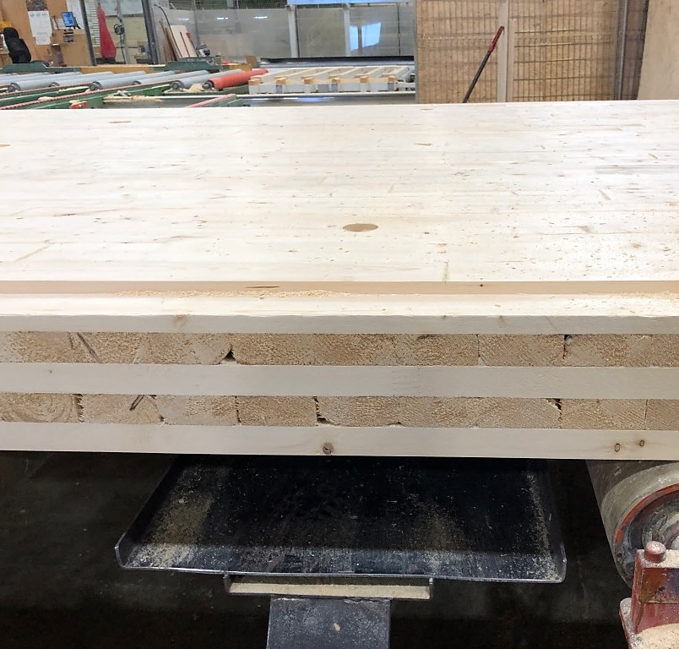
Mass Timber
Engineered products made from dimensional lumber
Laminated together through the elimination process
Forms large structural elements
Lamination occurs through adhesive, nails, screws, or dowels
  Cross Laminated Timber
  Glulam
  Dowel Laminated Timber
  Nail Laminated Timber
  Mass Plywood
Image of a CLT Panel in the fabrication process. Photo by: Veronica Madonna

Slide 5
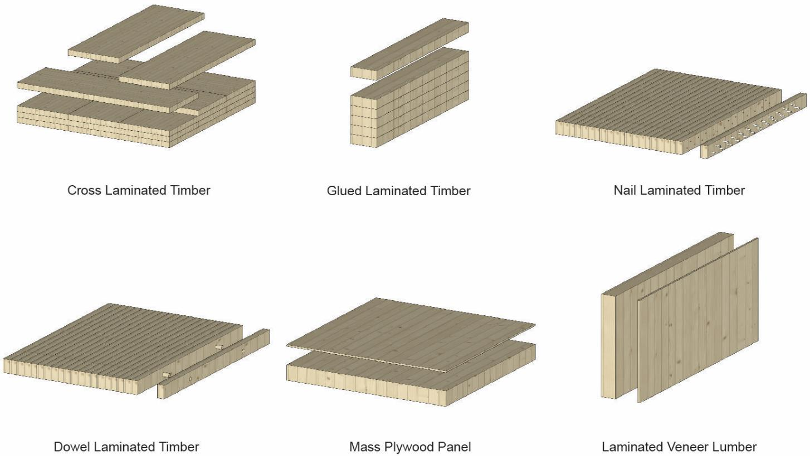
Mass Timber Products

Slide 6
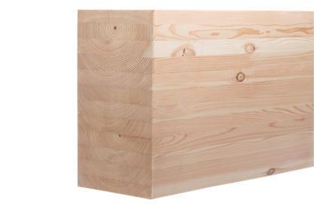
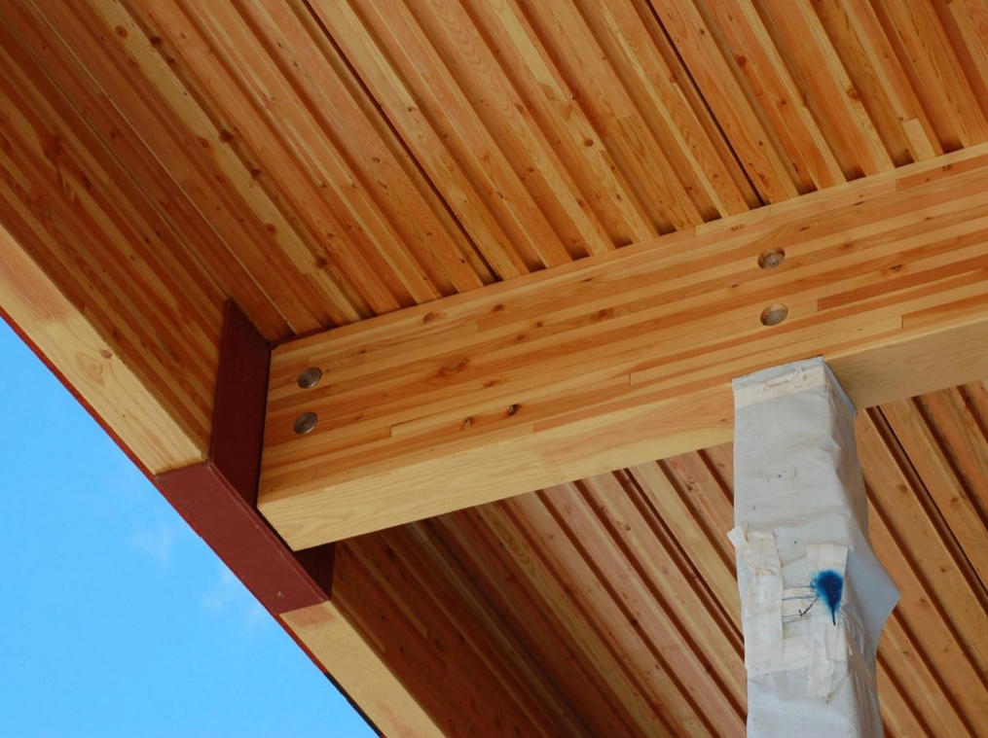
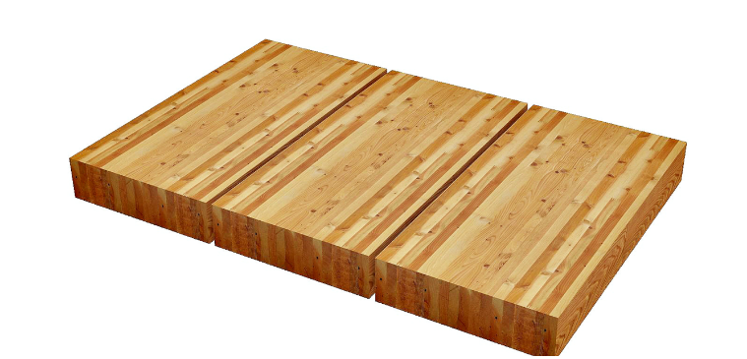
Glulam and Glulam Panels (GLT)
Dimensional Lumber stacked parallel to each other
Long spans and strength
Image of a glulam beam structure and decking. Source: StructureCraft

Slide 7
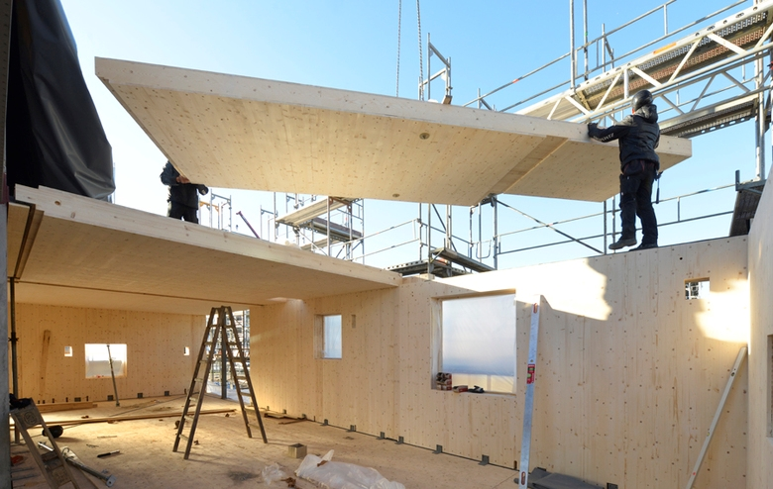
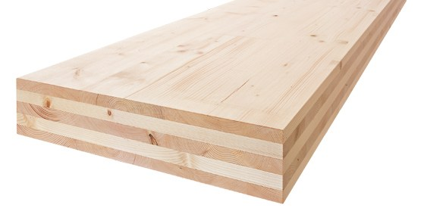
Cross Laminated Timber (CLT)
Dimensional lumber stacked crosswise
Strength, dimensional stability and rigidity
The Cube in Hamburg, Germany, is constructed using CLT panels for floor and wall structure. Photo credit IBA Hamburg, Martin Kunze.

Slide 8
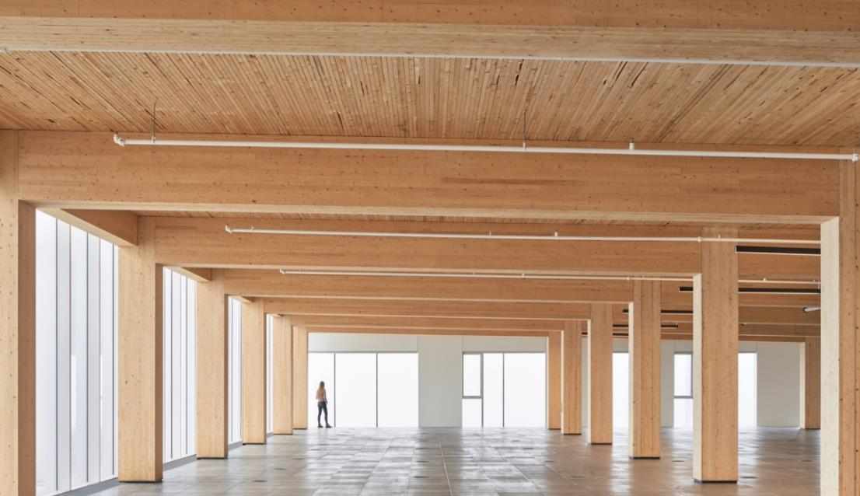
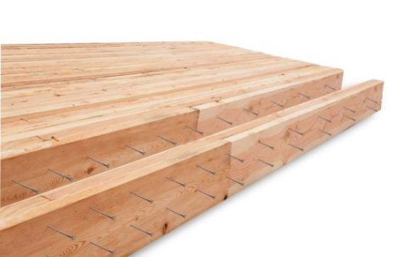
Nail Laminated Timber (NLT)
NLT consists of dimensional lumber placed on edge with individual pieces mechanically fastened together by nails or screws
The interior of 80 Atlantic Avenue in Toronto, Ontario architectural designed by BPN Quadrangle (formerly Quadrangle Architects Ltd.) utilizes a nail-laminated timber floor deck. Photo credit: Doublespace Photography.

Slide 9
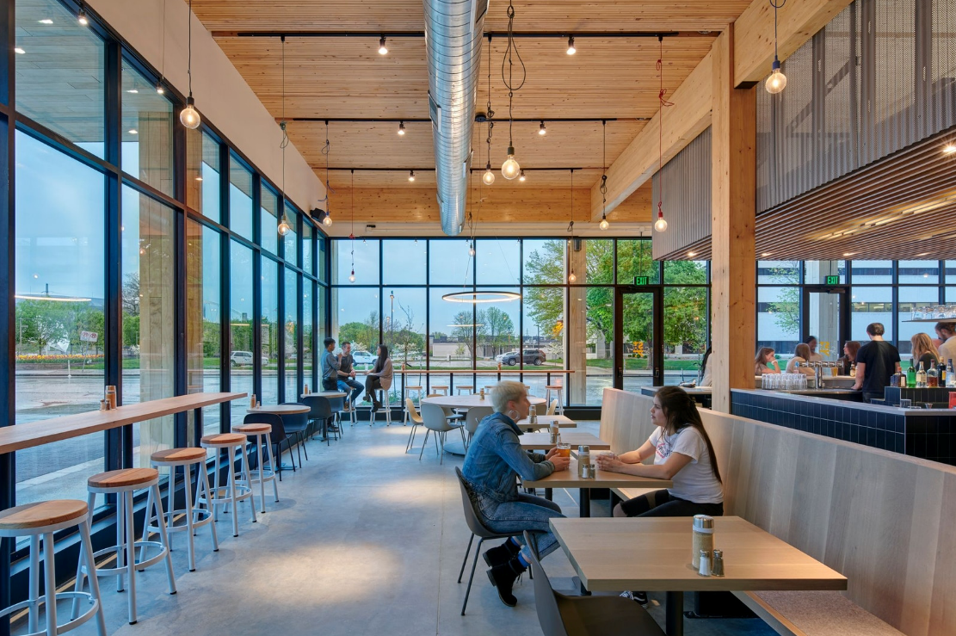
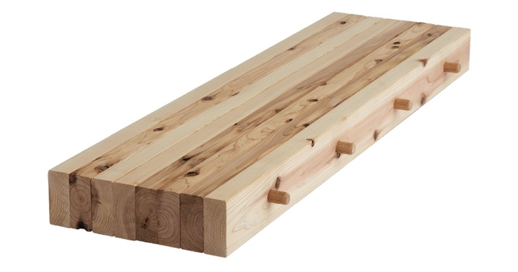
Dowel Laminated Timber (DLT)
Like NLT, except it is fastened together using wood dowels rather than metal screws or nails
Image of the DLT floor structure at 111 East Grand Office. Source: StructureCraft

Slide 10
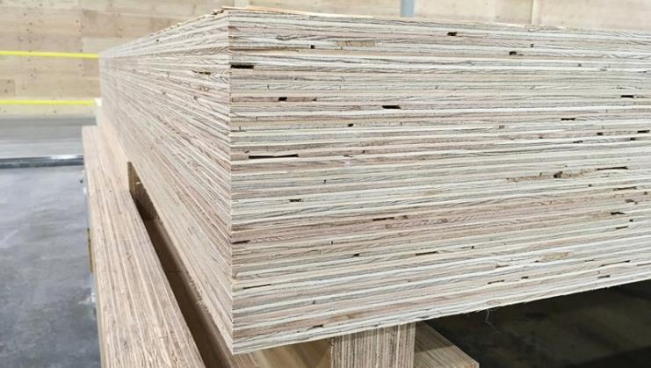
Mass Plywood Panels (MPP)
Veneer-based engineered panel comprised of multiple veneers pressed and adhered together
Image of a mass plywood pavilion. Source: Lever Architecture.

Slide 11
Advantages of Mass Timber
Construction Advantage
Prefabrication on components provide greater precision and quality control.
Reduced on-site construction.
Aesthetic Advantage
Aesthetic and experiential benefits often make mass timber buildings desirable to tenants as well as aiding in biophilic benefits.
Ecological Advantage
Building represent close to 40% of the greenhouse gas emissions.
Wood has the ability to sequester carbon, and is a low embodied carbon building product.
Speed and cost
Human connection
sustainability

Slide 12
Additional Advantages
Proven Performance and Safe
Light-weight and Low Embodied Carbon Material
Efficient, Cost-Saving Construction
Thermal and Health Benefits

Slide 13
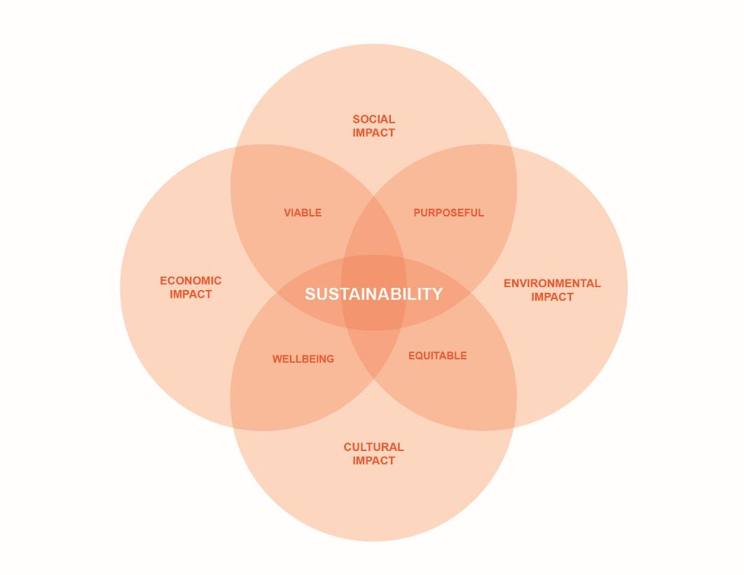
Social, Economic, Environmental and Cultural Benefits

Slide 14
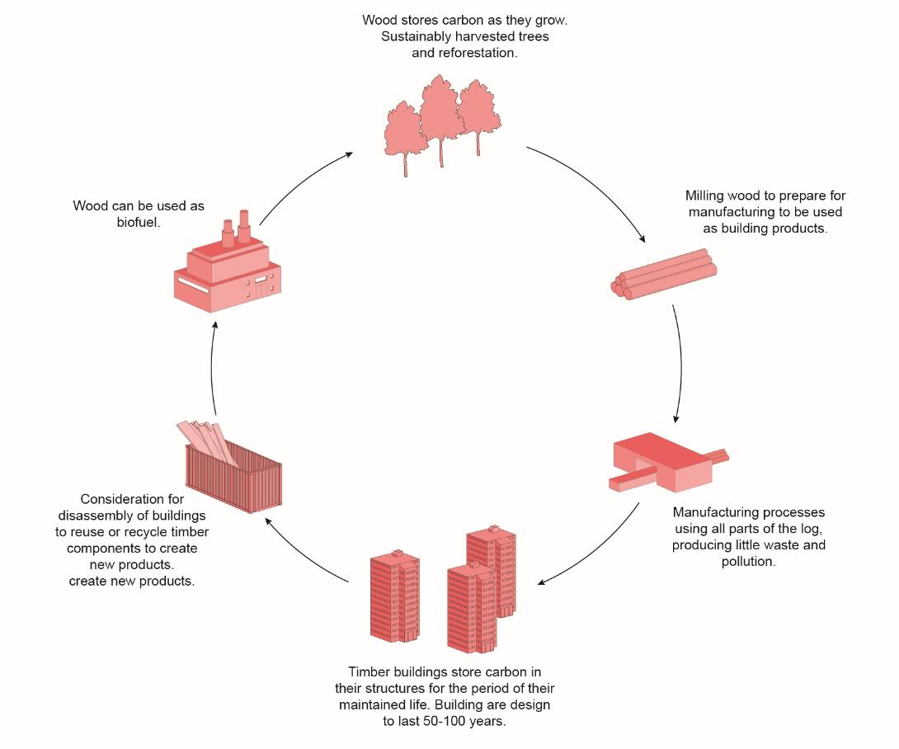
Life Cycle Overview of Mass Timber

Slide 15
Carbon Emissions
Buildings contribute to over 40% of the total green house emissions globally
Annually, embodied carbon is responsible 11% of global GHG emissions and 28% of global building sector emissions.
Source: Architecture 2030

Slide 16
Embodied vs. Operation Carbon
Embodied carbon will be responsible for almost half of total new construction emissions between now and 2050.
  Unlike operational carbon emissions, which can be reduced over time with building energy efficiency renovations and the use of renewable energy, embodied carbon emissions are locked in place as soon as a building is build. It is critical that we get a handle on embodied carbon now if we hope to phase out fossil fuel emissions by the year 2050.
Source: Architecture 2030

Slide 17

Activity – Understanding Mass Timber
Name three mass timber products and how they compare.
What are three advantages of mass timber?
Describe the four benefits to utilizing mass timber.
Notes:
Refer to lecture notes for analysis results.

Slide 18
Advantages of Prefabrication

Slide 19
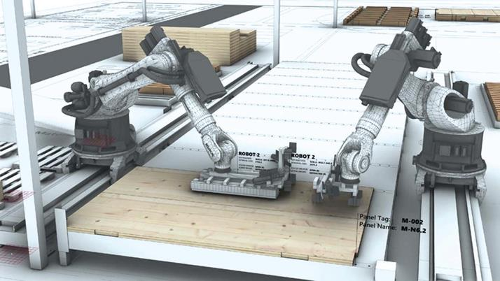
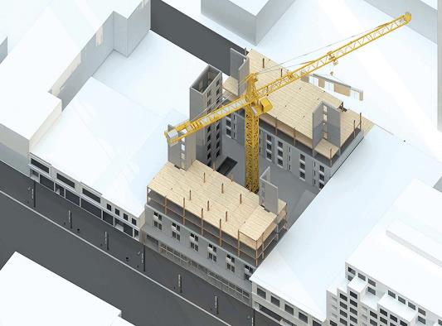
Mass Timber and Prefabrication
https://www.canadianarchitect.com/home-products-r-hauz-toronto-ontario-and-intelligent-city-vancouver-british-columbia/

Slide 20
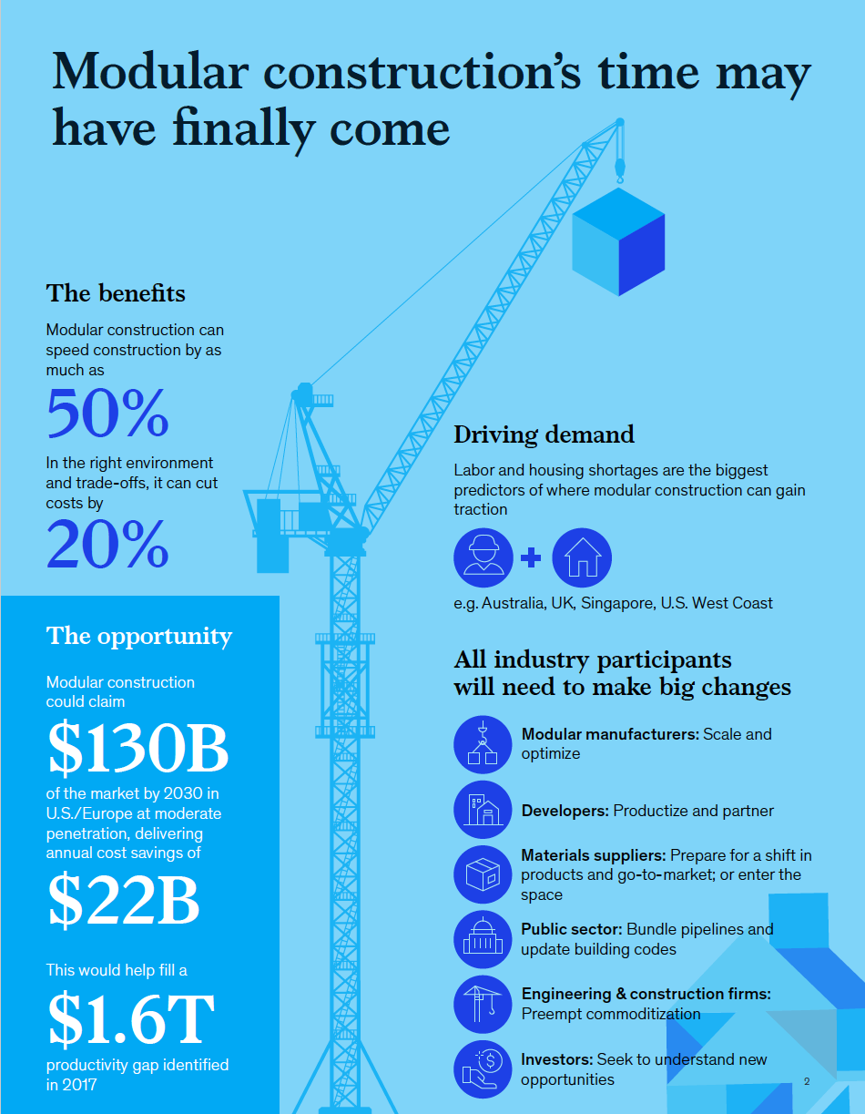
Benefits of Modular Construction
20-50% increase speed of construction
Potential cost savings of 20%
Big changes are required
Modular manufacturers
Developers
Suppliers
Regulations
Design & Engineering
Investments
Source: McKinsey & Company . (2019, June). Modular Construction: From Projects to Products. Retrieved from McKinsey & Company

Slide 21
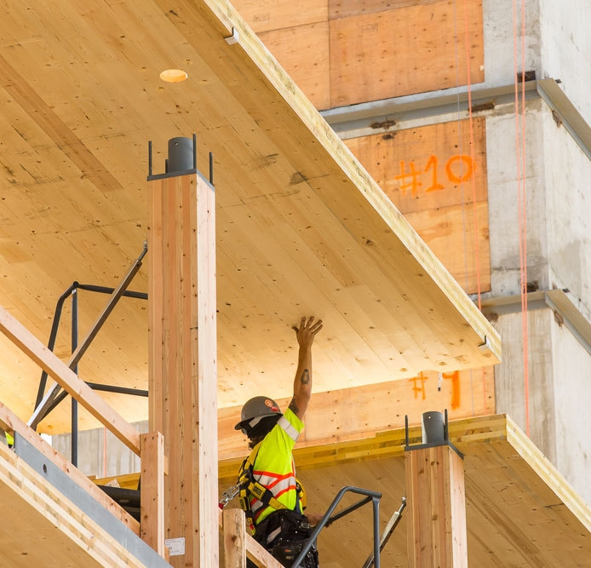
Construction Advantage
Construction speed
Potential 25% quicker than traditional material like concrete
90% reduction in truck deliveries
75% fewer works on active deck
Light Weight Structure
Can reduce foundation sizes
Prefabrication = Less Waste
Precision in fabrication process
Greater quality and quality control
Modular Construction
Brock Commons Tall Wood House during construction. Architect: Acton Ostry, Structural Engineer: Fast+Epp. Photo by: KKLaw

Slide 22
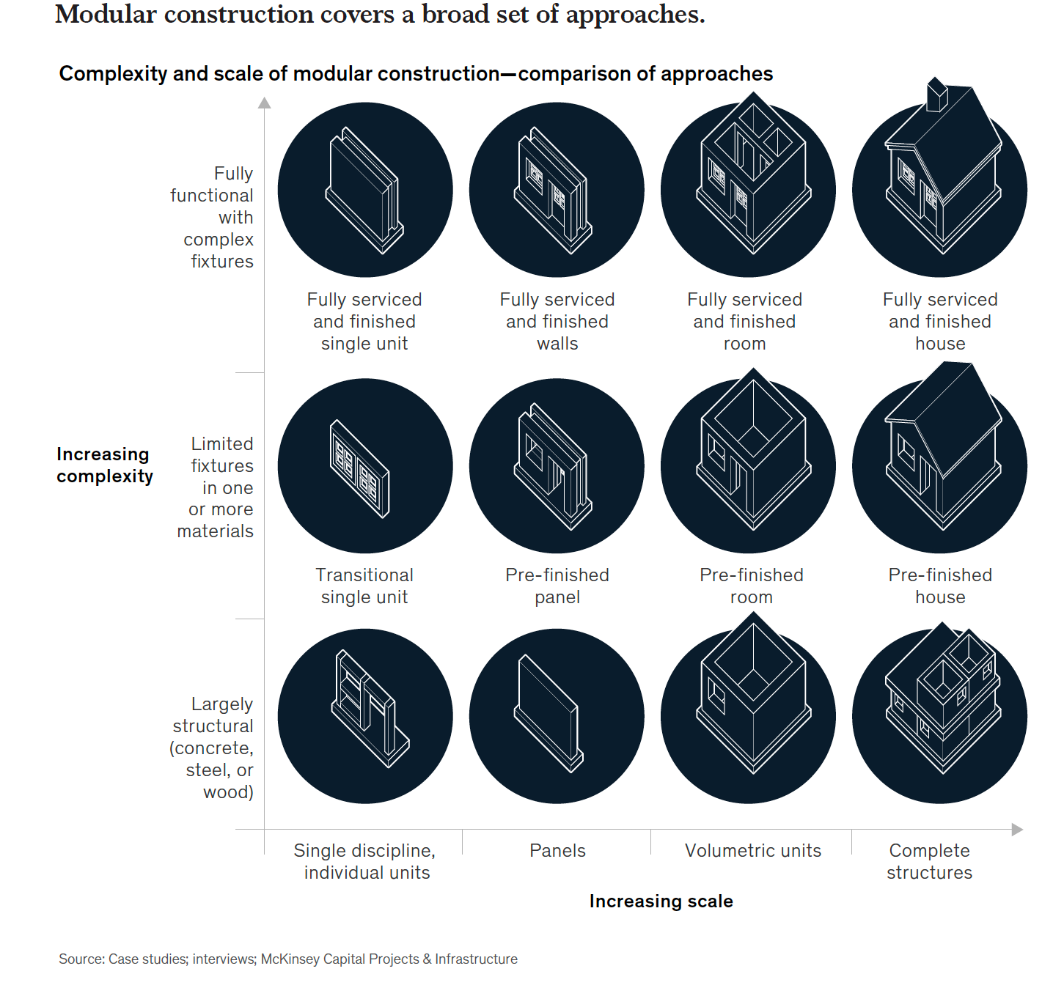
Various Approaches to Prefabrication
Source: McKinsey & Company . (2019, June). Modular Construction: From Projects to Products. Retrieved from McKinsey & Company

Slide 23
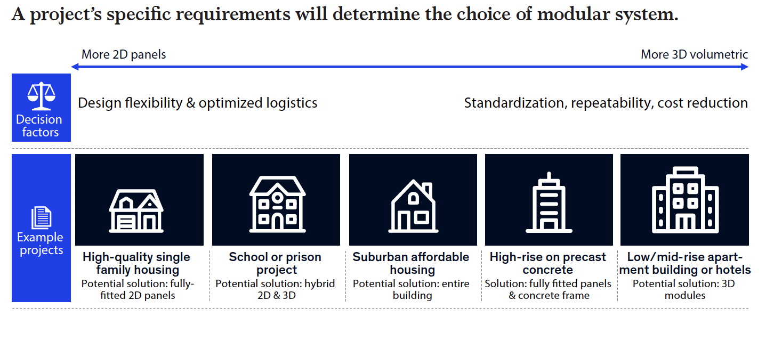
Prefabrication and Potential Scenarios
Source: McKinsey & Company . (2019, June). Modular Construction: From Projects to Products. Retrieved from McKinsey & Company

Slide 24
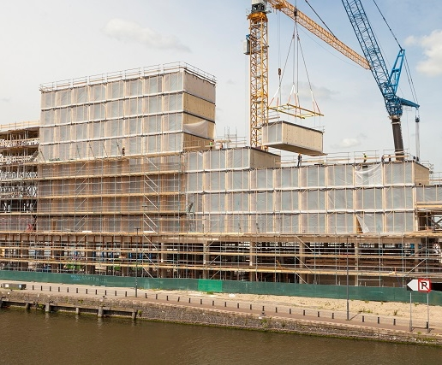
3D Volumetric Prefabrication
Fully Assembled Units
Maximize productivity benefits and efficiencies
However, limitation include transportation
  Typically, 3.5m wide for non-police escort
Compartmentalized plans
  Hotels
  Student Residence
  Affordable Housing
Source: 3D Volumetric Construction of Hotel Jakarta in Amsterdam.
https://www.derix.de/en/referenzen/X-LAM/hoteljakarta

Slide 25
2D Panelized
Panels prefabricated off-site and assembled on site
Flat packed for shipping, more economic shipping costs than 3D Volumetric
However, longer times on site than 3D Volumetric
Permits flexibility for open plan design, ie. Offices
Albina Yard in Portland Oregon by LEVER Architecture. Photo by: Jeremy Bittermann

Slide 26
Early Considerations For Optimizing Design

Slide 27
Project Planning

Slide 28
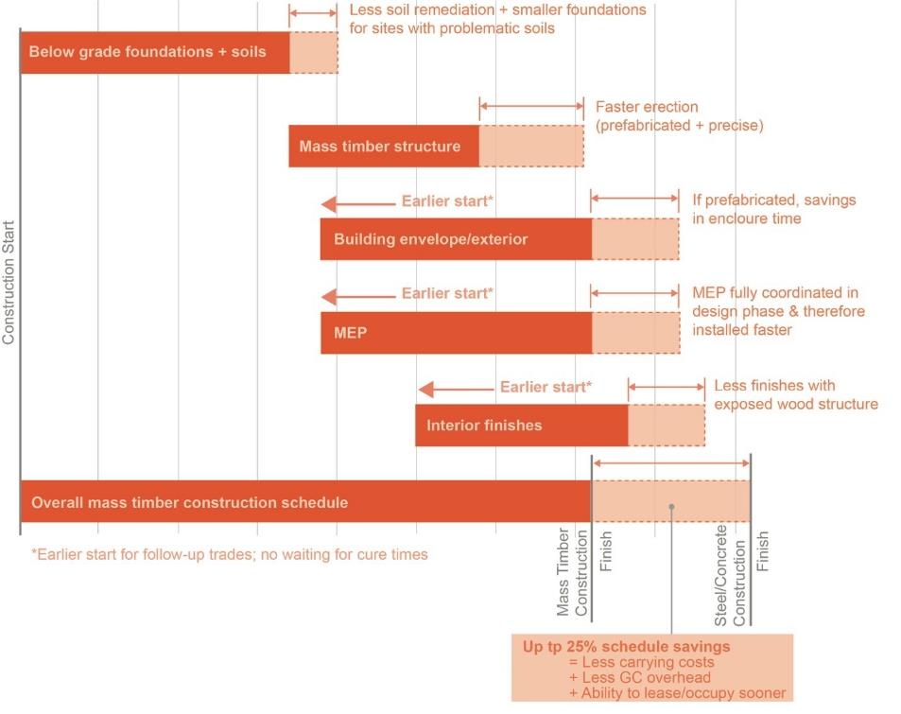
Project Planning and Time Distribution
Figure 9: Compressing the Typical Construction Schedule with Mass Timber. Potential cost savings in comparison to steel and concrete.
(WoodWorks 2019)

Slide 29
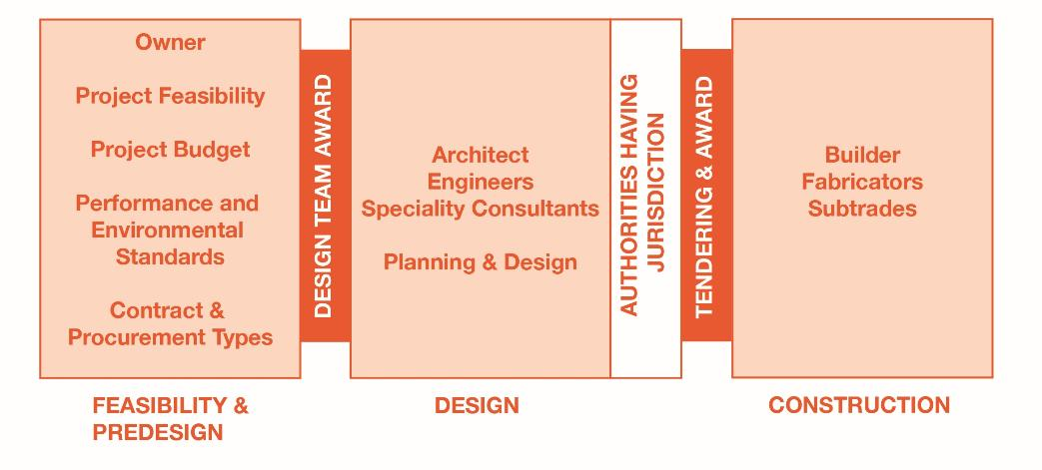
Traditional Project Delivery - Design-bid-build

Slide 30
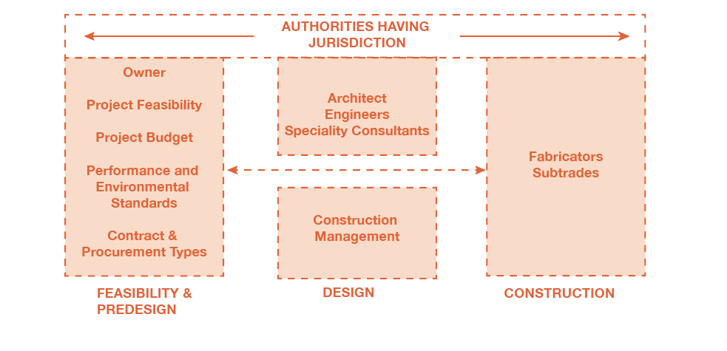
Cooperative Planning

Slide 31
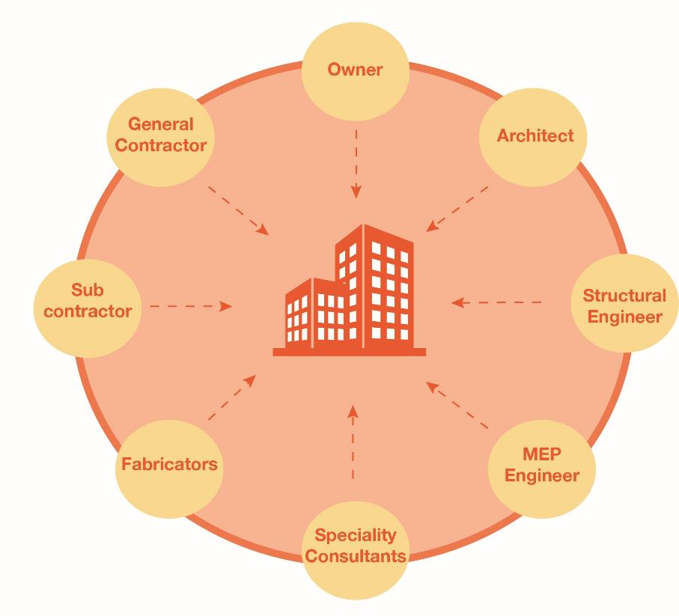
Integrated Design And Project Delivery

Slide 32
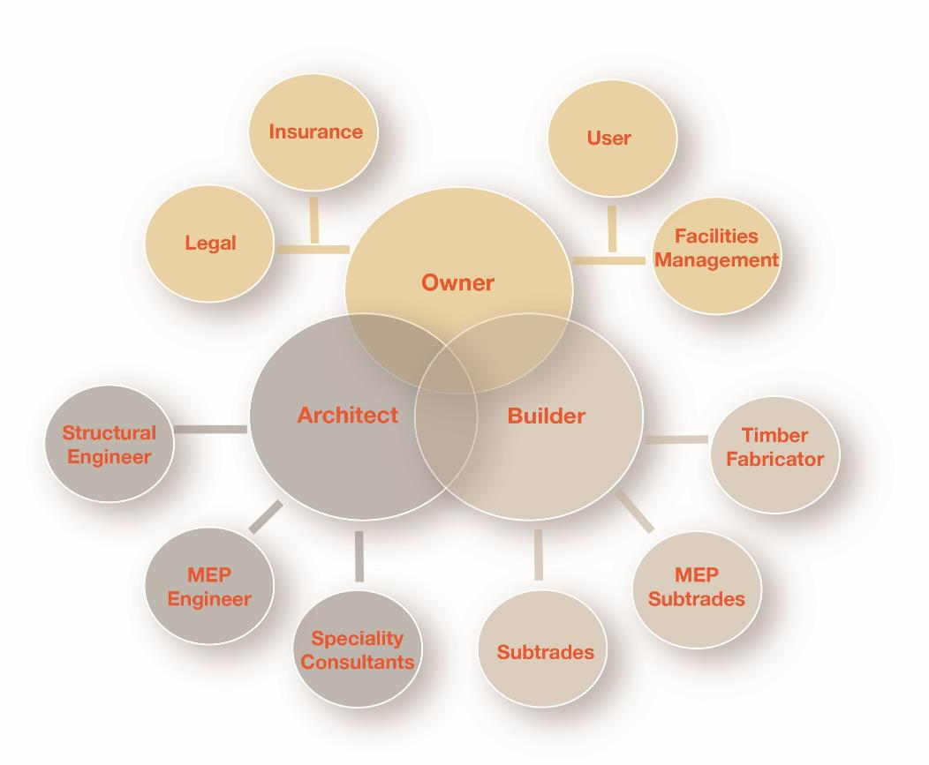
The Integrated Team

Slide 33
Key Planning Considerations
Integrated design process to ensure careful considerations of building use, site considerations, structure, systems integration and construction sequencing.
Sufficient time must be budgeted in the planning stages.
Enhanced coordination of systems during the design process.
Prefabrication and detail planning are critical to resolve before construction.
Significantly reduce time during the construction stage and heightened overall quality control.

Slide 34
Manufacturer Input
Capabilities for product and sizes
Optimize size
Reduce waste
Albina Yard in Portland Oregon by LEVER Architecture. Photo by LEVER Architecture.

Slide 35
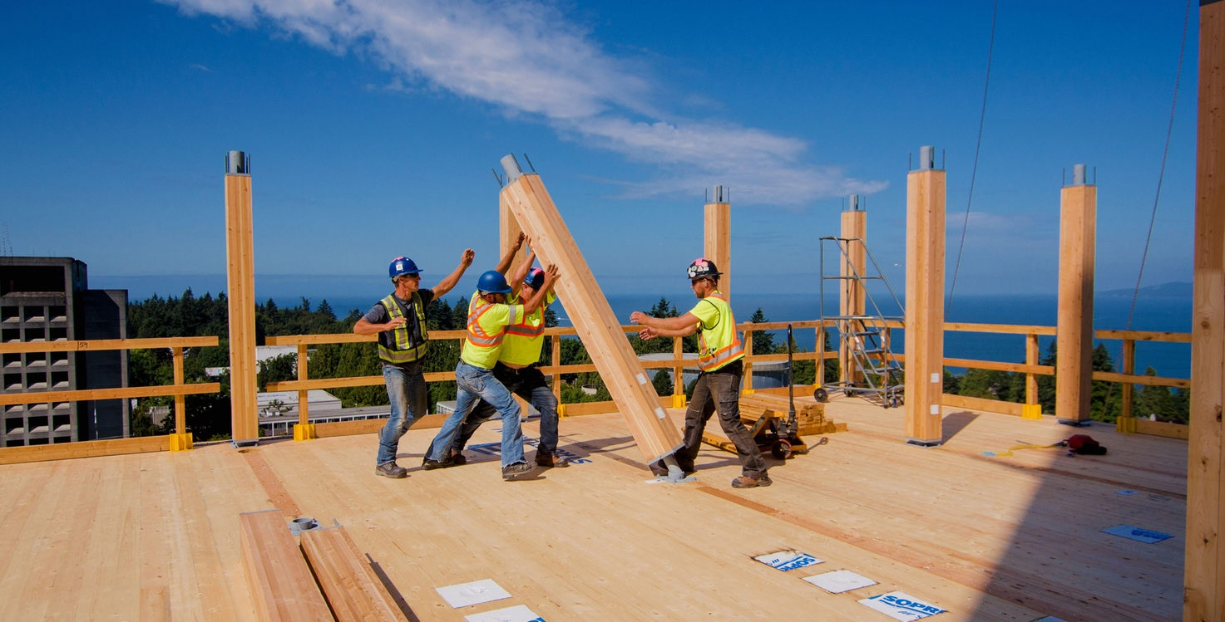
Kit of Parts
Brock Commons Tall Wood House. Architects: Acton Ostry Architects, Structural Engineer: Fast + Epp, Photo By: Pollux Chung

Slide 36
Know Your Product and Supply Chain
March 2021

Slide 37
Activity – Integrated Design Process
Describe the differences between the design-bid-build and the integrated design process (IDP). Provide a diagram of the relationships. Consider:
    What are the key advantages to IDP in mass timber buildings?
    What is the collaboration process critical?
Notes:
Refer to lecture notes for analysis results.

Slide 38
Module 2: Design Considerations for Optimized Design
Objectives:
Understand key design considerations to optimize design for prefabrication of mass timber design.
Structural design considerations
Fire protection design considerations
Acoustic and vibration design considerations
Retrofits and adding storeys to existing building design considerations

Slide 39
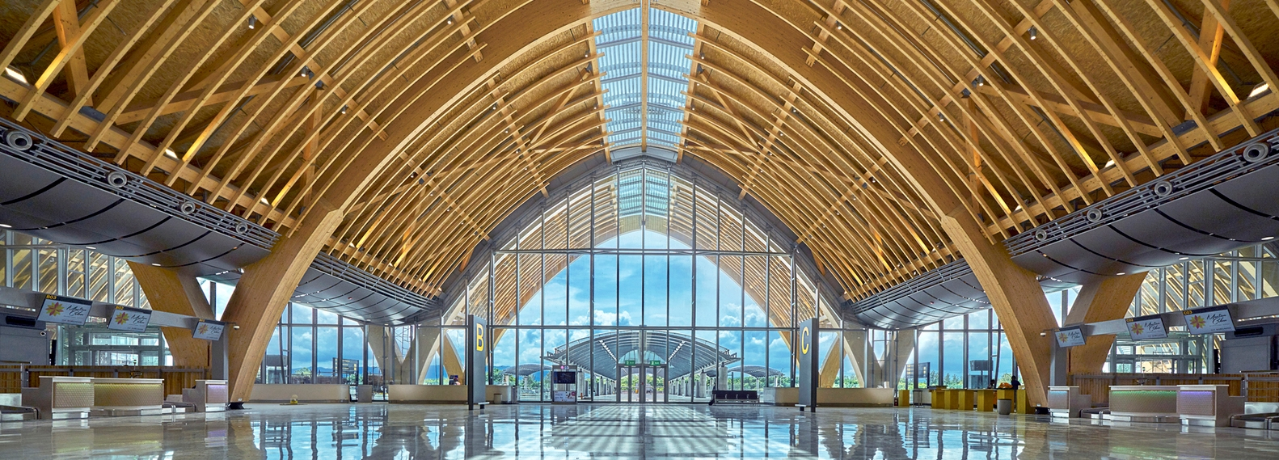
Design Consideration of Mass Timber Design
Mactan Cebu
International Airport Terminal 2,
Cebu City, Philippines.

Slide 40
Structural Design Considerations

Slide 41
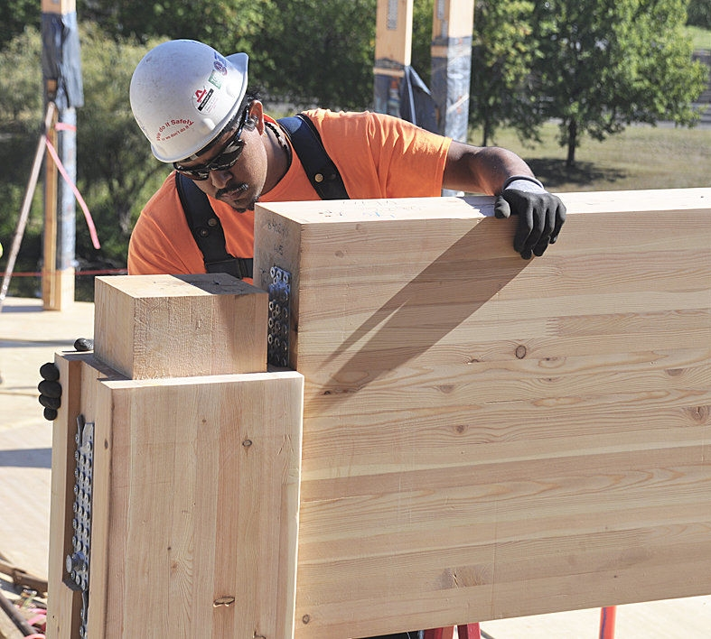
Selecting a Mass Timber System
Strength and stability
Load capacity
Program and use
Long term flexibility
Installation of glulam beam during the construction of the First Tech Credit Union headquarters building in Hillsboro, Oregon.
Source: https://www.capitalpress.com

Slide 42
Common
Timber Systems
Framed Systems
Panelized Systems
Hybrid Systems

Slide 43
Structural System and Program Use

Slide 44
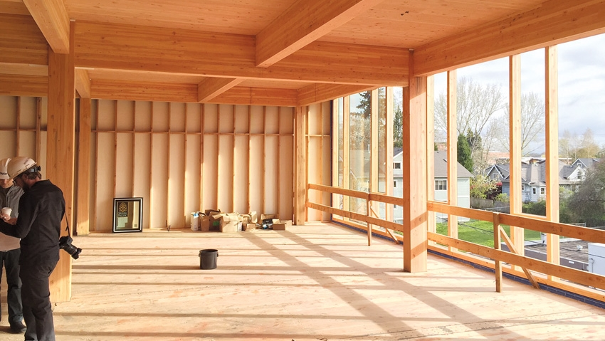
Structural System and Program Use

Slide 45
Key Considerations
Program Use
Cost
Fire Protection
Vibration and Acoustic Control
Authorities and Code Requirements

Slide 46
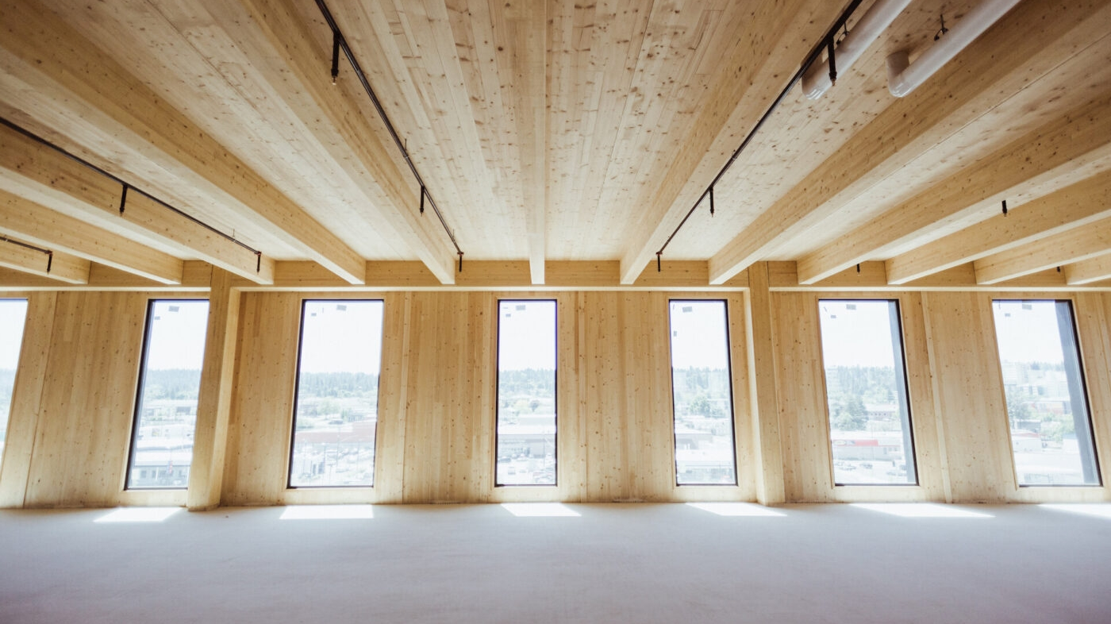
Factors in Selecting a Structural System
Cost
Cost of design
Cost of materials
Cost of transportation
Cost of installation
Cost of protection and maintenance
Schedule
Shop drawings and approvals
Materials acquisition
Construction productivity

Slide 47
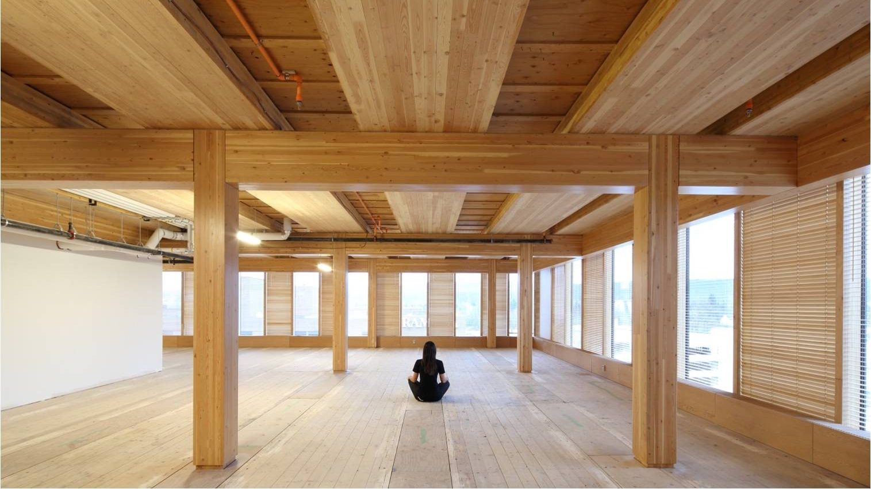
Factors in Selecting a Structural System
Function
Clear span
Program requirements and long-term flexibility
Depth of members and clear height
Location of bearing walls and other supports
Incorporation of mechanical and electrical systems
Thermal insulation
Code Requirements
Fire protection
Sound transmission
Structural capacity
Durability

Slide 48
Factors in Selecting a Structural System
Aesthetics
  Appearance of material
  Appearance of finished system
  Architectural blend of form and function
Environmental
  Environmental impact of harvesting, mining, quarrying, and manufacture
  Energy required to manufacture, transport, and install materials
  Thermal efficiency of building systems
  Disposal, recycle or reuse at end-of-life cycle

Slide 49
Framed Structural System

Slide 50
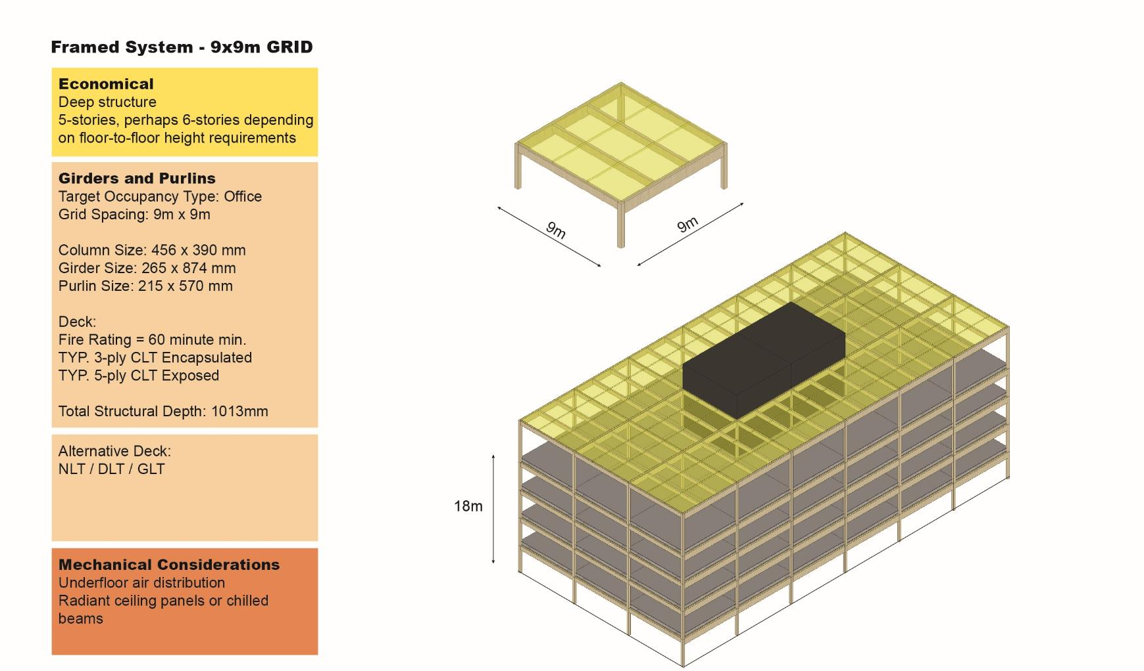

Slide 51
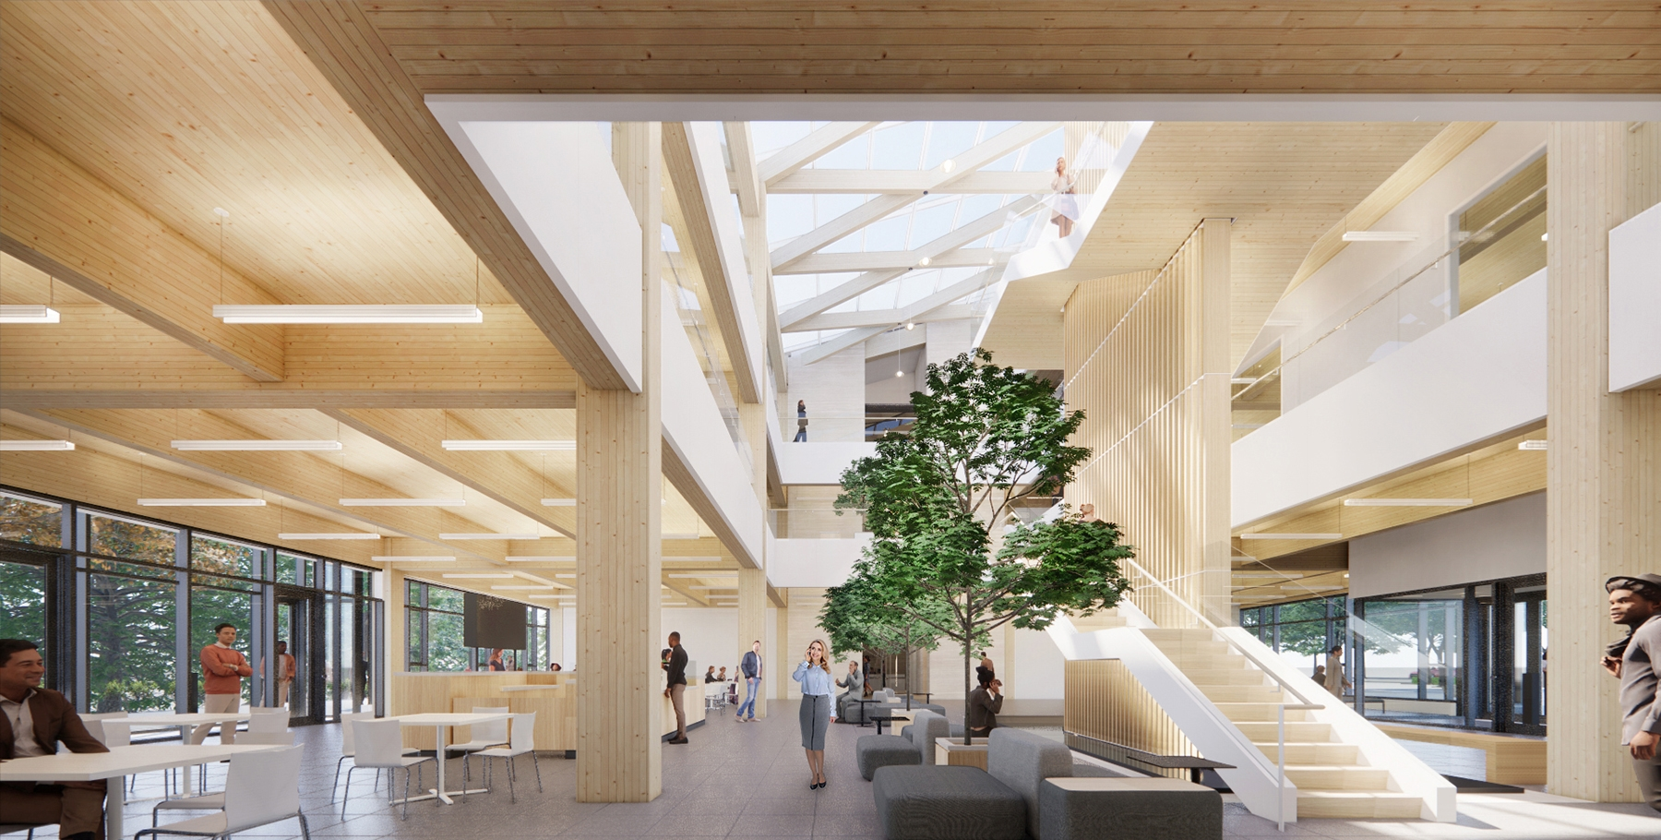
Ontario Secondary School Teachers’ Federation
Moriyama & Teshima Architects, www.mtarch.com

Slide 52
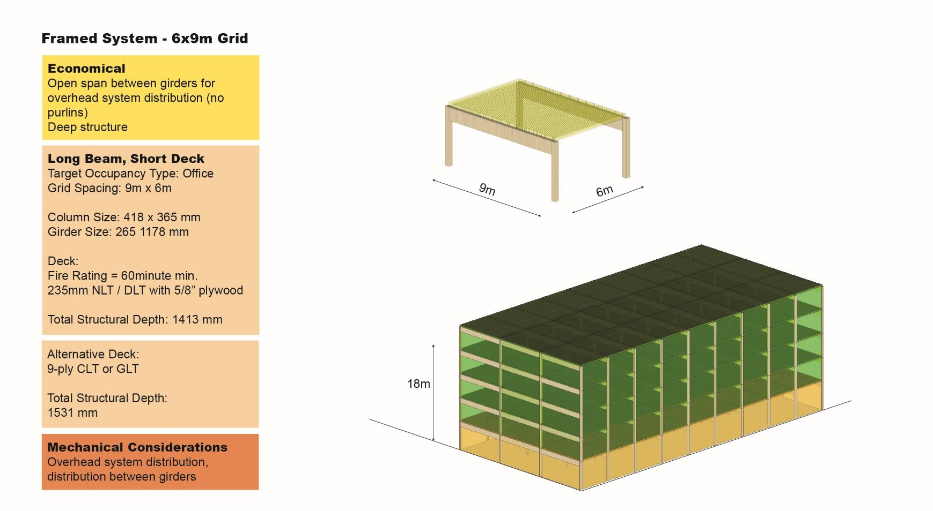

Slide 53
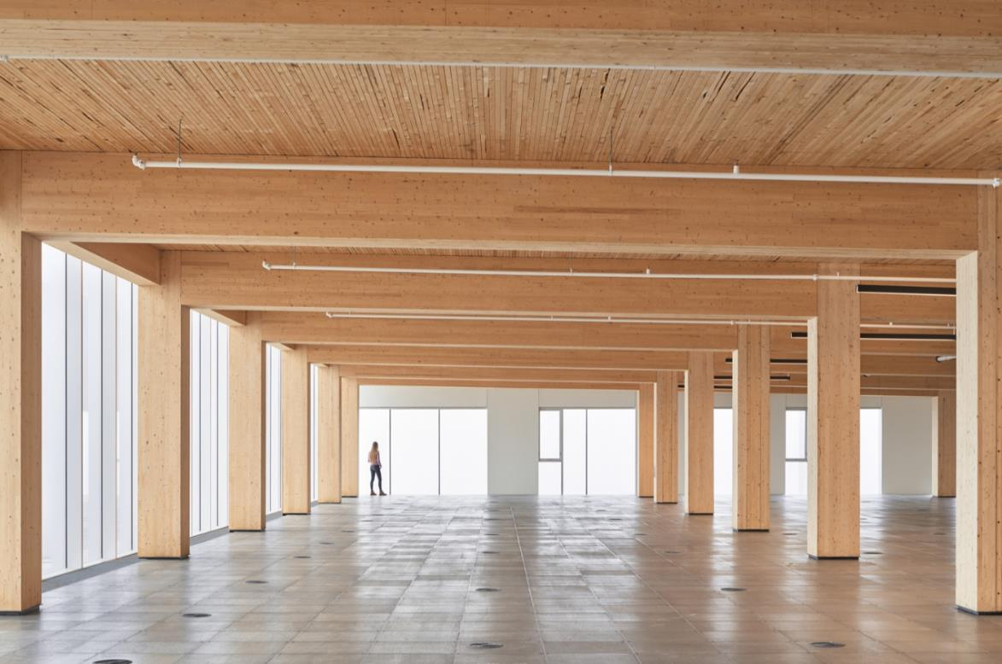
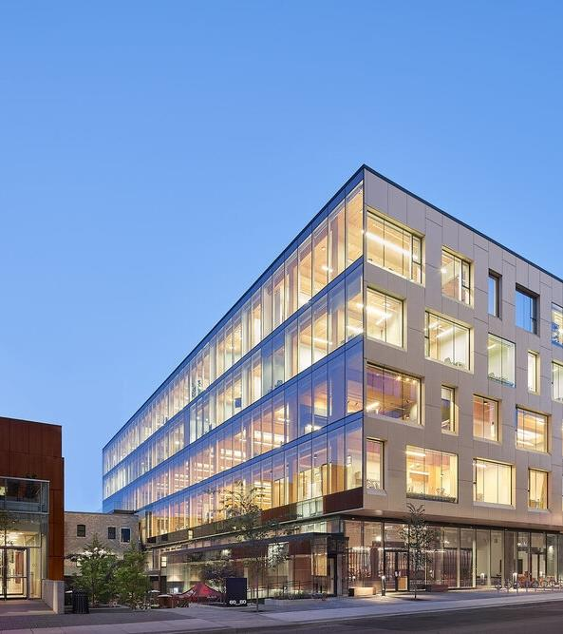
80 Atlantic Avenue – Toronto Ontario
Quadrangle Architects
https://www.archpaper.com/2020/01/80-atlantic-toronto-timber-office-building/

Slide 54
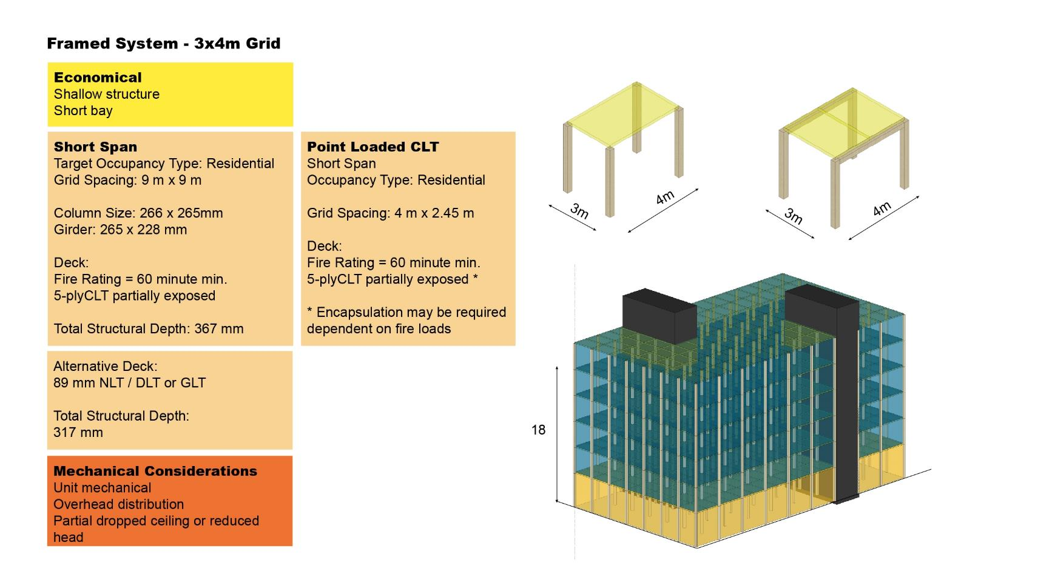

Slide 55
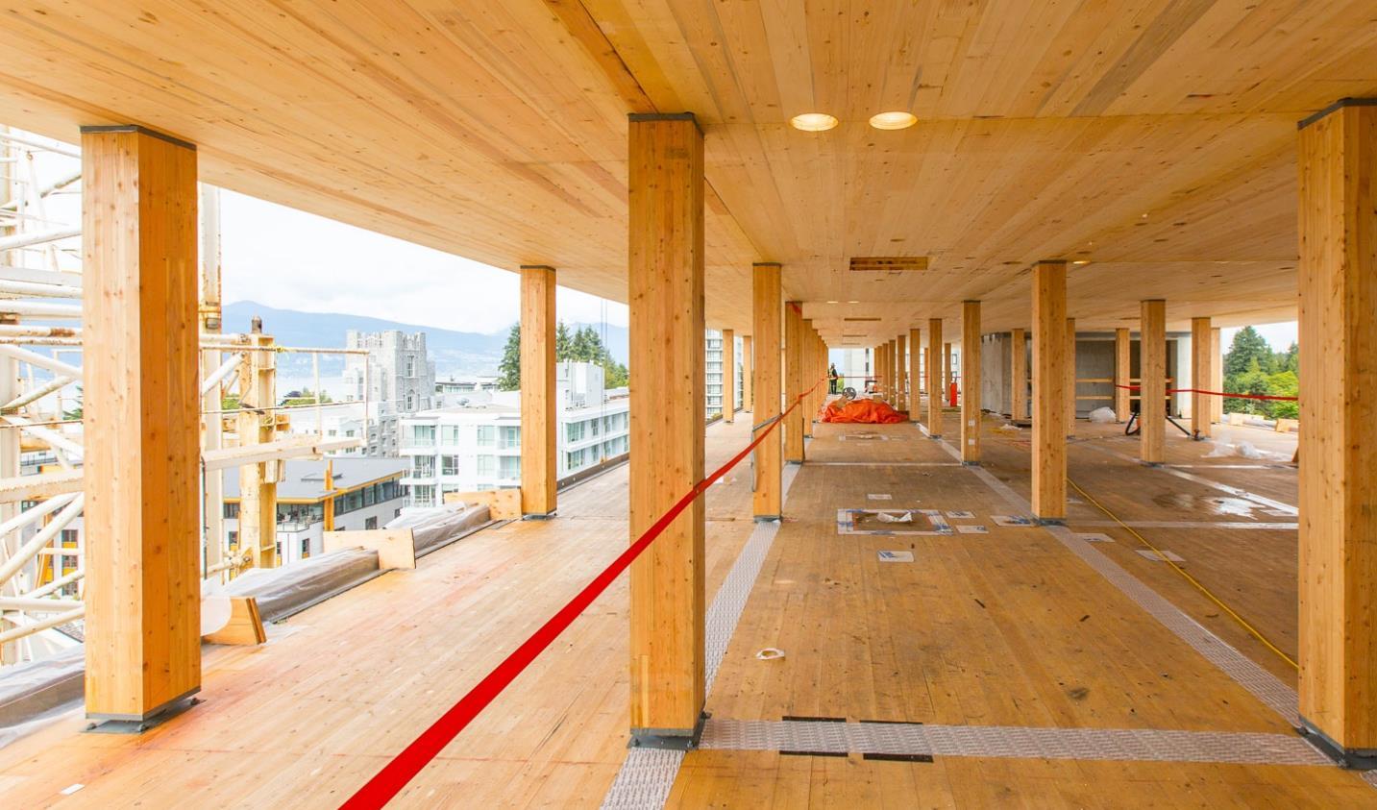
Brock Commons Tall Wood House
Acton Ostry Architects

Slide 56
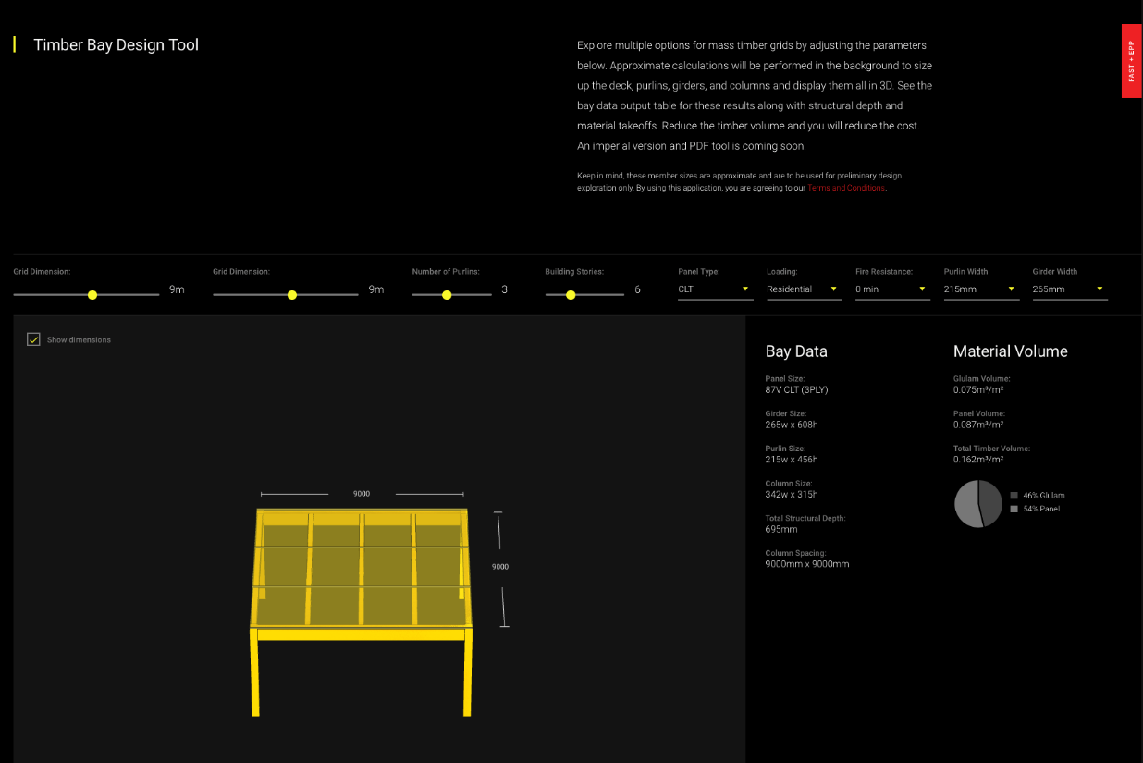
Timber Bay Design Tool – Fast + Epp Concept Lab
https://www.fastepp.com/concept-lab/timber-bay-design-tool/

Slide 57
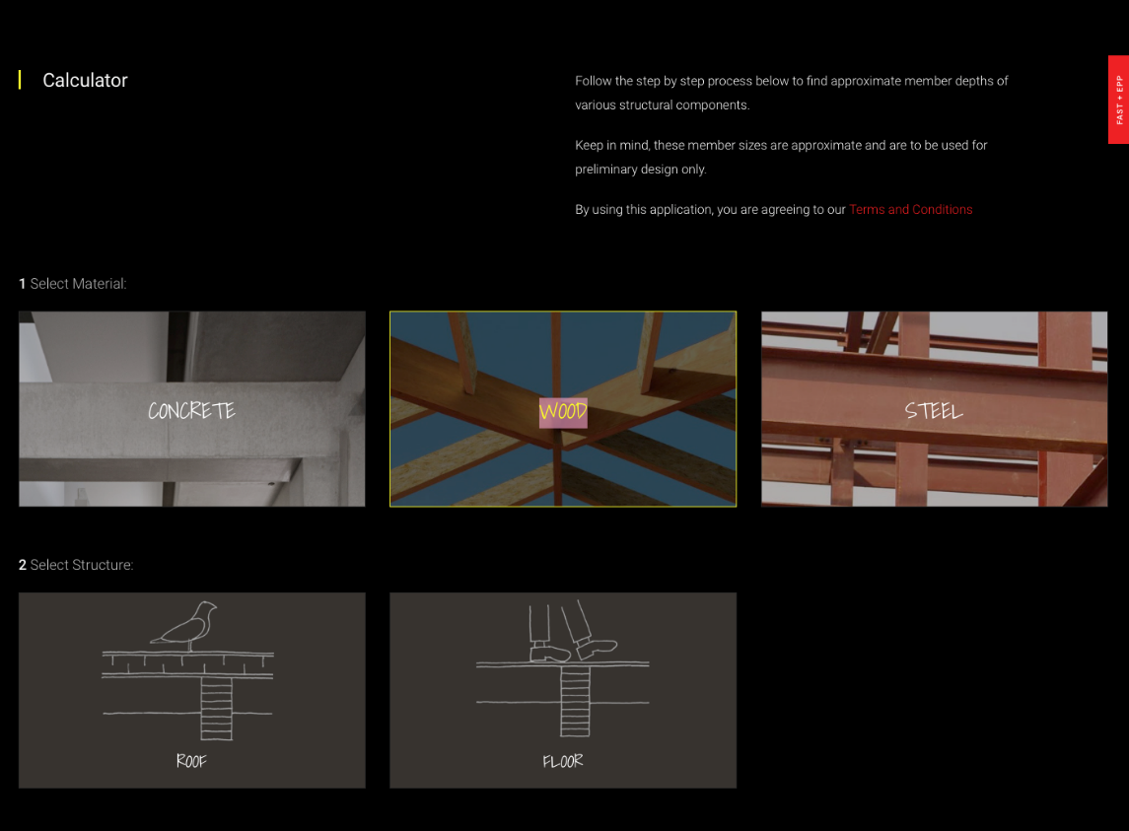
Member Calculator Tool – Fast + Epp Concept Lab
https://www.fastepp.com/concept-lab/calculator/

Slide 58
Activity – Factors in Selecting a Structural System
Name the six factors described in selecting a structural system.
Utilizing the Fast + Epp Concept Lab Timber Bay sizing tool, calculated the size of the structural members of the following structural grid spans.
  8x6m Office Building, 6 stories with a 60 min fire resistance rating.
  Describe the advantages and challenges in design choices available for the scenario.
Notes:
Refer to lecture notes for analysis results.

Slide 59
Hybrid System

Slide 60
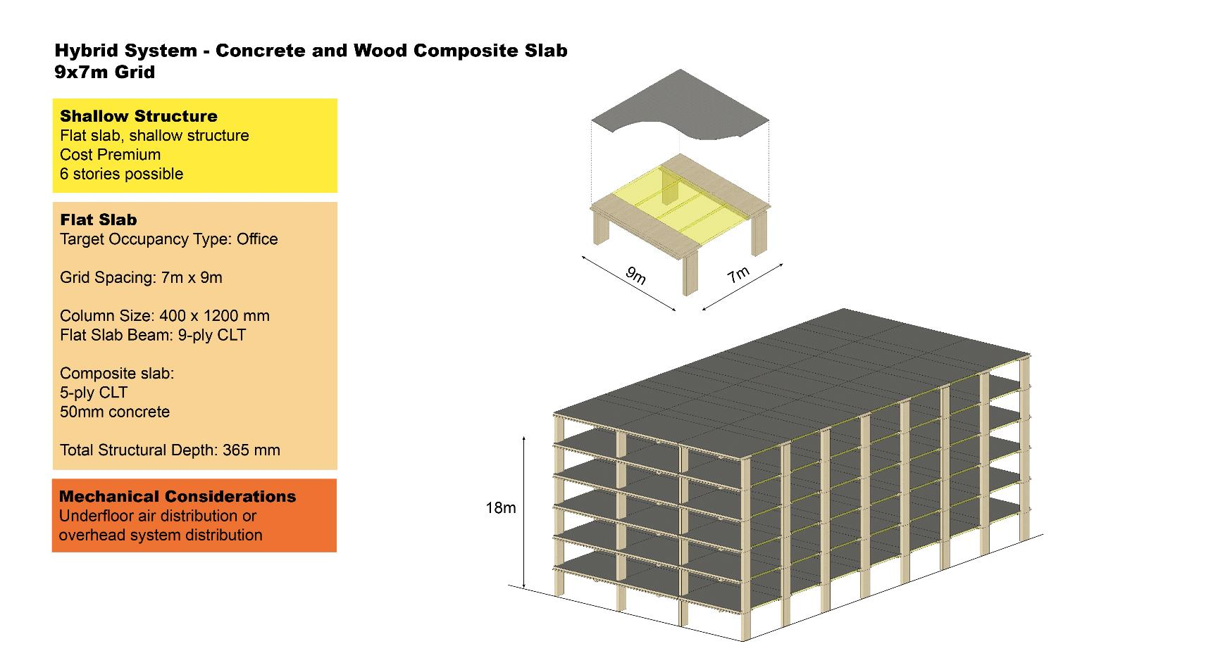

Slide 61
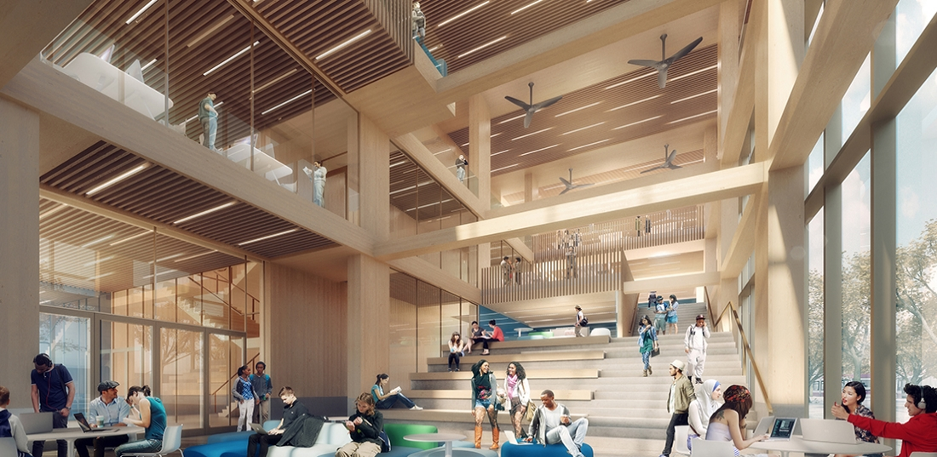
The Arbour at George Brown College
Moriyama & Teshima Architects and Acton Ostry Architects

Slide 62
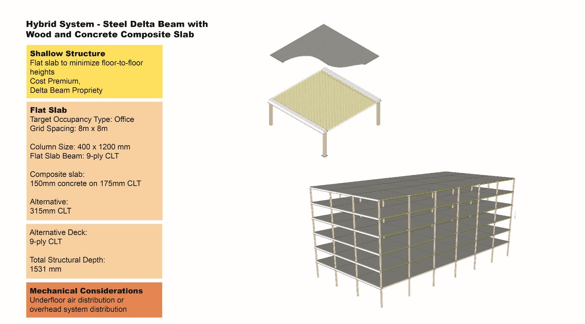

Slide 63
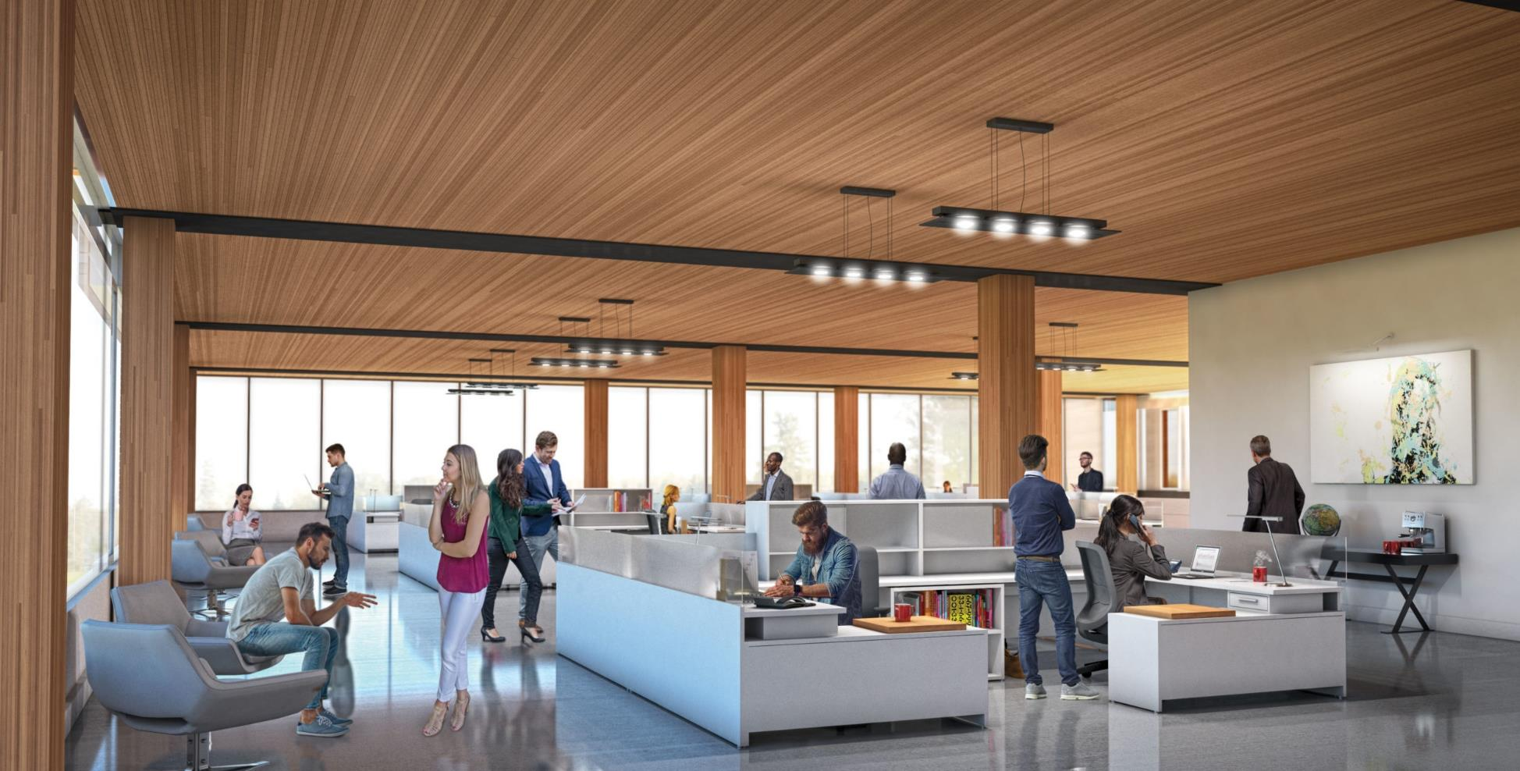
77 Wade Avenue, Toronto Ontario
BNKC Architects

Slide 64
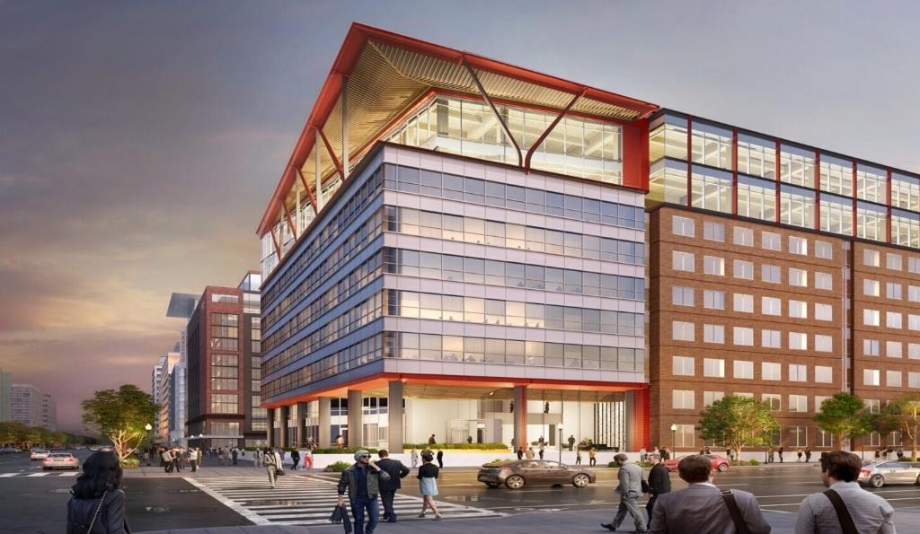
80 M Street, Washington D.C.
Figure 44: 80 M Street in Washington D.C. is a vertical expansion of an existing building. Source: Think Wood.

Slide 65
Panelized System

Slide 66
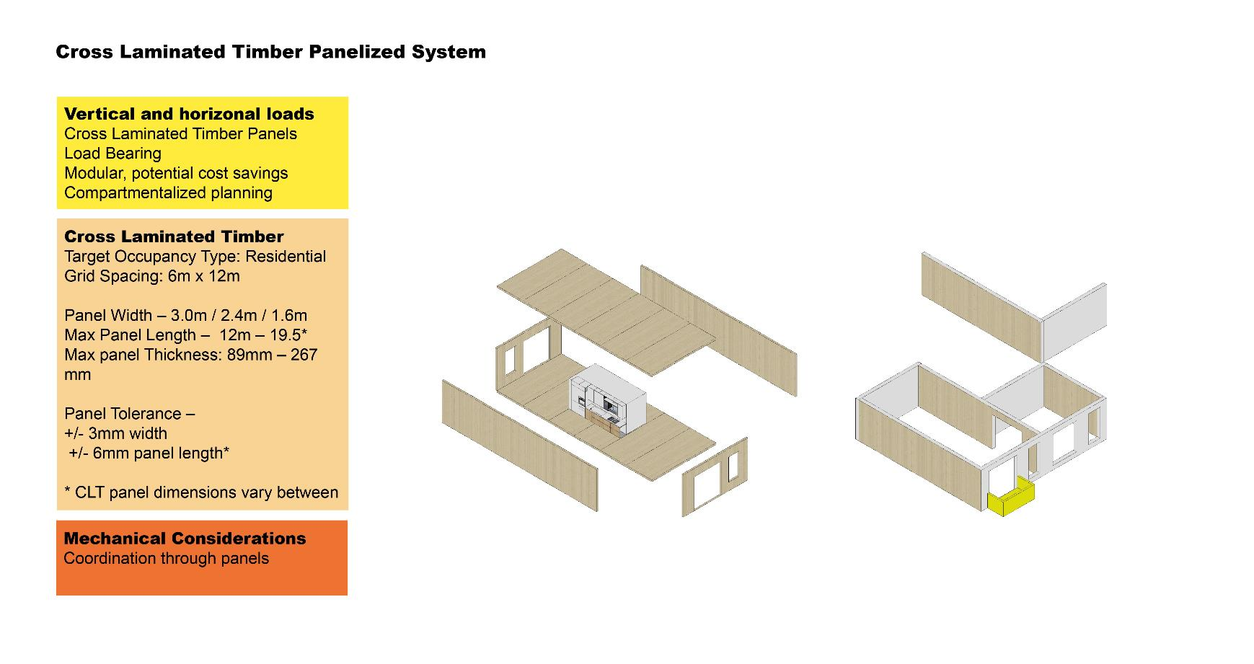

Slide 67
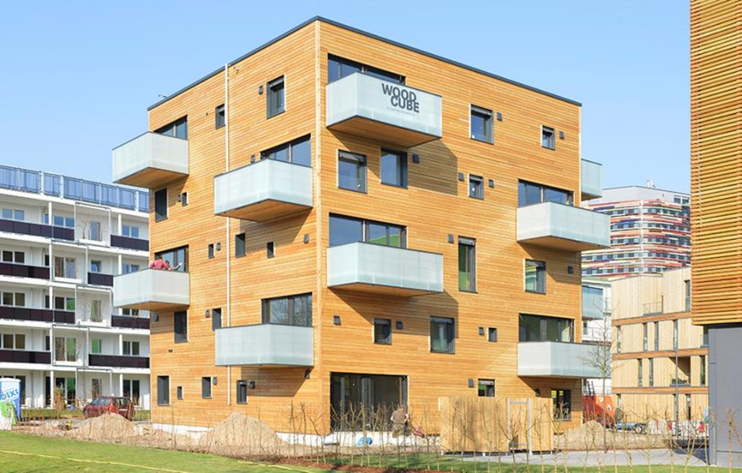
The Cube – Hamburg, Germany
The Cube in Hamburg, Germany, is constructed using CLT panels for floor and wall structure.
Photo credit IBA Hamburg, Martin Kunze.

Slide 68
Case Study:
R-Hauz R-Town, Toronto Ontario
Panelized Cross-Laminated Timber (CLT)

Slide 69
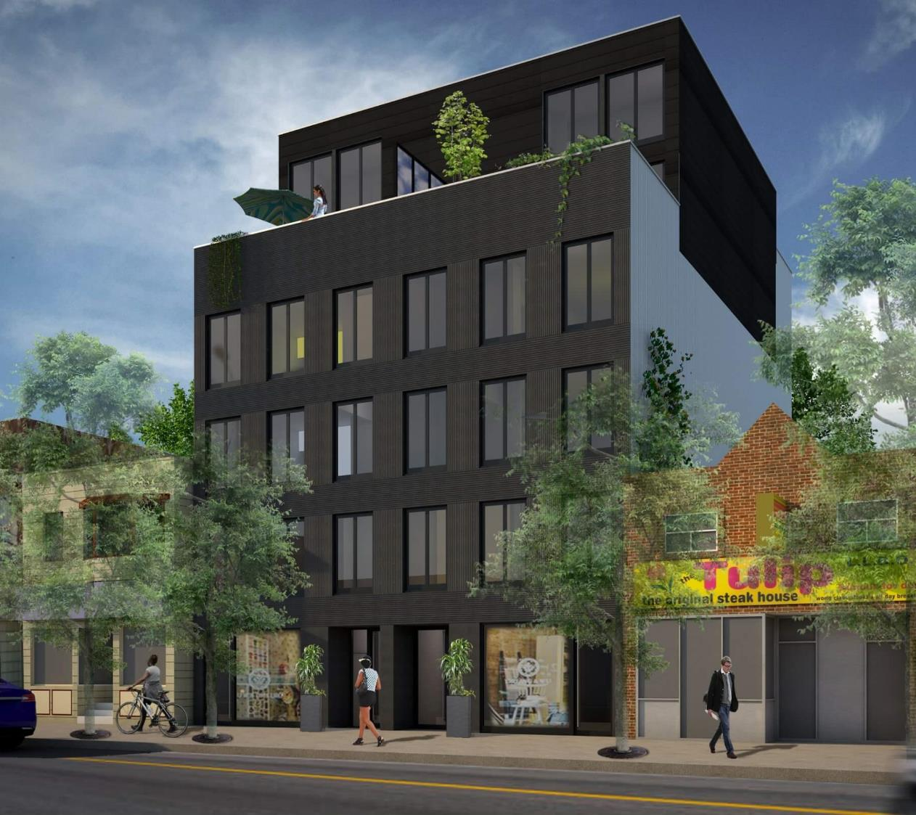
Case Study
R-Hauz, R-Town
Developer: R-Hauz
Architect: CMV Architects
Structural Engineer: Moses Engineering
Cross-Laminated Timber Panels
Concept rendering of the front elevation along Queen Street East in Toronto, Ontario. Image Source: www.r-hauz.ca.

Slide 70
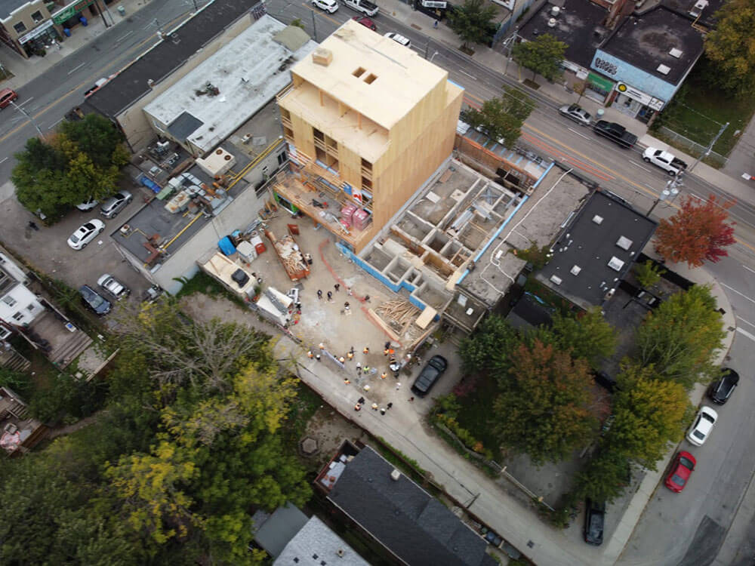

Case Study: R-Hauz, R-Town

Slide 71
Case Study:
YWCA Supportive Housing
Kitchener-Waterloo, Ontario
Panelized Cross-Laminated Timber (CLT)

Slide 72

Case Study: YWCA Supportive Housing
Architect: Edge Architects
Owners: YWKW
Developer: Melloul Blamey Construction
Mass Timber Fabricator: Element5
Cross-Laminated Timber Panels
Concept rendering of the proposed exterior of the YWCA Supportive Housing. Image Source: Edge Architects and Element5.

Slide 73


Case Study: YWCA Supportive Housing
Diagram of cross-laminated timber panel distribution. Image source: Edge Architects and Element5.
Concept rendering of the interior of the ground floor amenity space. The structural grid in this location shifts from a panelized system to a post and panel system. Image Source: Edge Architects and Element5.

Slide 74


Case Study: YWCA Supportive Housing
Left: Diagram of Element5’s CLIP system. Right: Building Diagram illustrating the prefabricated mass timber structural system and exterior envelop components. Image Source: Edge Architects and Element5.

Slide 75

Case Study: YWCA Supportive Housing
Diagram and description of the process and sequencing of construction. Image Source: Edge Architects and Element5.

Slide 76
Designing for Fire Protection

Slide 77
Fire Protection – Key Considerations
Low-rise, Mid-rise, High-rise Code Requirements
Passive Fire Protection Strategies
Active Fire Protection Strategies
Fire Protection During Construction

Slide 78
Passive Fire Protection Strategies
Fire resistant rating of structure in floors
Level of encapsulated material or char consideration
Fire rating of egress routes
Fire separation requirements
Components and systems are intended to contain fire or slow the spread of fires through the use of fire-resistant building elements

Slide 79

Active Fire Protection Strategies
Detection and response systems
  Fire dampers
  Closure of automatic doors
  Fire sprinklers activated
  Fire suppression system activated

Slide 80

Fire Protection – Char Theory

Slide 81

Fire Protection – Encapsulation
Source: Denis Blount, ARUP – “Knock on Wood: Acoustical Design in Mass Timber Structures”.

Slide 82
Fire Protection Case Study – Brock Commons Tall House
Fire Safety During Construction
High-Rise
  Less than four levels of unprotected wood during construction.
  Protection of wood structural elements by installing a layer of Type X gypsum board and concrete topping as structure is built.
  Functional standpipe in concrete cores.
  On-site security and fire watch
Image: Source: Think Wood, https://www.thinkwood.com/projects/brock-commons-tallwood-house
Image: Source: Think Wood, https://www.thinkwood.com/projects/brock-commons-tallwood-house

Slide 83

Carbon 12 – Portland Oregon
Fully Exposed Mass Timber
Maximum height: 9 stories; 85 feet
Maximum area: 405,000 SF total building; 45,000 SF average per floor
Fire-rating requirements: 2-hour primary frame; 2-hour floors
Image Source:
https://www.kaiserpath.com/carbon12
Images: Andrew Pogue, Marcus Kauffman

Slide 84
Designing for Acoustics and Vibration

Slide 85


Acoustics – STC vs IIC
Sound Transmission Class (STC) – Airborne
“Through” partitions
Around partitions (flanking)
Through structural coupling
Impact Sound Isolation (IIC) – Impact
Through floor assemblies
Through structural coupling
Source: Denis Blount, ARUP – “Knock on Wood: Acoustical Design in Mass Timber Structures”.

Slide 86
Improving Acoustics
Add Mass
Mass provides weight to mitigate transfer of low frequency sounds. For example, impact noise.
Add Noise Barriers
Add Decouplers
Resilient layers to “separate” materials provides decoupling to reduce the transfer of vibration.
Add insulation and other acoustic absorptive material

Slide 87

Acoustics – Flanking Control
Decoupling of floor topping at CLT
Decoupling walls from space below
Acoustic sealant at partition joints
Source: Denis Blount, ARUP – “Knock on Wood: Acoustical Design in Mass Timber Structures”.

Slide 88

Acoustic Treatments on CLT Floor Assembly
Reference: Canadian CLT Handbook – 19th Edition, FP Innovations
Source: Denis Blount, ARUP – “Knock on Wood: Acoustical Design in Mass Timber Structures”.
Notes:
Review sources and CLT Handbook for reference

Slide 89

Acoustic Treatments on CLT Wall Assembly
Reference: Canadian CLT Handbook – 19th Edition, FP Innovations
Source: Denis Blount, ARUP – “Knock on Wood: Acoustical Design in Mass Timber Structures”.

Slide 90
Other Design Considerations
Full scale mockups
Fire proofing of connectors
Vibration and Acoustics
Approval Process and AHJ
Insurance Requirements
Temporary fire protection during construction
Onsite Security and Protection
Supply Chain
CLT floor slab is lowered into place and fastened to the glulam columns. Photo: KK Law, Courtesy of Naturally: Wood.
Notes:
To avoid delays on site, may want to consider full scale mock-ups to sort out connection and construction specifics.

Slide 91
Activity – Understanding Fire Protection and Acoustics
Name the various passive and active strategies involved in designing for fire protection of mass timber buildings.
What are the two main acoustic concerns when it comes to mass timber buildings?
What are the three main ways to improve acoustical performance and what are some of the key considerations of each?
Notes:
Refer to lecture notes for analysis results.

Slide 92
Retrofits and Adding Storeys to Existing Buildings

Slide 93

Adding Stories to Existing Buildings and Mass Timber
Illustration representing design opportunities with adding storeys to an existing building. Concept rendering by Studio Veronica Madonna Architect.

Slide 94

Consideration of Mass Timber and Adding Stories

Slide 95

South Boston Rivet Factory
Adding storeys to South Boston Rivet Factory, by Margulies Perruzzi Architects.

Slide 96
South Boston Rivet Factory
Source: https://www.enr.com/articles/51022-former-south-boston-rivet-factory-gets-heavy-timber-upgrade

Slide 97






Resources

Slide 98
Module 3: Early Construction Consideration
Objectives:
Understand the key early construction consideration involved with prefabrication and mass timber design.
Building Information Modelling (BIM) and Design for Manufacturing and Assembly (DfMA)
System Integration
Envelop and Moisture Consideratioins
XXXX
Assignment: Embodied Carbon Comparison

Slide 99
Automation and Industrialization of Mass Timber
Image of an automated fabrication process of mass timber, Katerra.
Source: www.kateria.com.

Slide 100
Benefits of Prefabrication
Less noise, dust and site disruption
Improved health and safety
Continuity of employment
Workforce upskilling
Predictable product performance
Lower product operational costs

Slide 101

Image of Element5’s new factory in Ontario. Source: Element5

Slide 102
Building Information Modeling (BIM)
Design for Manufacturing and Assembly (DfMA)

Slide 104

Importance of BIM and DfMA Integration
Integration of BIM amongst the owner, design and construction team.

Slide 105

Virtual Design and Construction Modelling
Brock Commons Tallwood House utilized various levels of Virtual Design and Construction Modelling throughout the design and construction process. Source: Wood-Works, Brock Commons Tallwood House: Construction Modelling.

Slide 106

Mass Timber Factory
Layout of the new CLT line for Element5’s new state-of-the-art mass timber facility in St. Thomas, Ontario. Source: www.ledinek.com

Slide 107

Digital Twin / Virtual Design and Construction Model

Slide 108

Video – Digital Twin, Virtual Design and Construction Modeling
https://www.youtube.com/watch?v=ATKpFtzCVFU

Slide 109
Next Generation
Mass Timber research at ETH Zurich.
Robot – dimROB
Source: “Mobile Robotic Fabrication on Construction Sites: DimRob”

Slide 110
Activity – Benefits of Prefabrication
1. Which of the following is a benefit of wood prefabrication?
    Process efficiency
    b. Controlled environment
    c. Material efficiency
    d. Sustainability
    e. All of the above
2. Name all six identified benefits of prefabrication.
Notes:
Refer to lecture notes for analysis results.

Slide 111
System Integration

Slide 112


Prefabrication and System Integration
Right: Image by Cadmakers illustrating the level of detail involved in coordinating MEPF systems for fabrication. Left: Image of plumbing shelving and penetrations through CLT slab (Photo source Structurlam).

Slide 113
Wood Innovation Centre, University of Northern British Columbia
Source: Michael Green Architecture

Slide 114

80 Atlantic Avenue, Toronto
Source: Quadrangle Architects

Slide 115
Case Study:
Brock Commons Tallwood House
University of British Columbia

Slide 116


Brock Commons Tallwood House
18 storeys
53 metres high

Slide 117

Brock Commons Overview – Video 1
https://www.youtube.com/watch?v=G22kYhaT-h4

Slide 118
Brock Commons

Slide 119


Virtual Design and Construction Modelling

Slide 120

Brock Commons

Slide 121

BROCK COMMONS TALLWOOD HOUSE: CONSTRUCTION OVERVIEW

Slide 122

Brock Commons Design Process – Video 2
https://www.youtube.com/watch?v=ABQHbNwvU_s

Slide 123

Brock Commons Project Schedule Overview

Slide 124

Full-Scale Mock-Up
Brock Commons

Slide 125
Construction Planning
Photography by KK Law

Slide 126
Kit of Parts
Brock Commons

Slide 127

Brock Commons Construction Process – Video 3
https://www.youtube.com/watch?v=Fmuj4XeHsbo

Slide 128
Activity – Benefits of VDC Modelling
Describe the benefits of VDC modelling. What advantages did it offer on the Brock Common’s Tallwood House and why was it an important aspect of the success of the project?
Notes:
Refer to lecture notes for analysis results.

Slide 129
Envelop & Moisture

Slide 130




Envelop and Enclosure
The Arbour, Moriyama & Teshima Architects / Acton Ostry Architects
Notes:
Moisture control of the mass timber, is critical.
In thinking about construction, the best defence is to close the building up as quickly as possible to prevent moisture saturation and potential staining on the mass timber.
It is ok to get the wood wet, but it is important to allow it to dry out appropiately before any encapsulation occurs.
The mass timber is prefabricated, and will go up quickly. The Arbour utilizes a prefabricated wall system, that will be built off site and be installed in tandum with the mass timber structure.

Slide 131
Temporary Protective Roofing
Temporary protective roofing at the Limnologen Vaxjio construction site, Sweden.

Slide 132
Prefabricated Envelopes
Source: Island Exterior

Slide 133

Managing the Risk of Water Damage During Construction
https://www.surfacesreporter.com/articles/72301/mass-timber-architecture-benefits-and-common-misconceptions

Slide 134

Managing the Risk of Fire During Construction
Fire protection system
Clean site, reduce flammable
Hot work, such as welding, was done ahead of the mass timber structure installation.
All trades were required to take fire-prevention and fire response training.
Temporary fire doors were installed on the two exit stairs and clear exit paths were maintained.

Slide 135
Module 4: Life Cycle Assessment
Objectives:
Describe Life Cycle Assessment and the consideration involved in holistic design.
Holistic considerations of carbon
Why is LCA and Carbon Analysis Important
Life Cycle Assessment Tools
Biophilia, Health and Wellness

Slide 136
Holistic Considerations of Carbon
Looking Towards The Future

Slide 137

Life Cycle Assessment
Life Cycle Assessment (LCA) is a cradle-to-grave analysis technique to assess environmental impacts associated with all the stages of a product’s life.
The five key stages of LCA include:
Manufacturing
Packaging
Distribution
Use
Disposal
Raw Materials

Slide 138

The Process of Whole-Building LCA
Source: Athena Sustainable Materials Institute, “About Whole-Building LCA and Embodied Carbon,” 2019.

Slide 139

Operational Carbon
OPERATIONAL CARBON is defined as the greenhouse gas emissions associated with the operational energy use of a building. This includes all carbon from energy required to heat and power the building, including but not limited to lighting, plug loads, heating and cooling, and cooking.

Slide 140

Embodied Carbon
EMBODIED CARBON is defined as the greenhouse gas emissions associated with the raw material extraction, manufacturing and processing, transportation, and installation of all building materials.

Slide 141

Net-Zero Carbon
NET-ZERO CARBON is defined as the combined operational and embodied carbon being resolved as zero through material selection, renewable energy and approved appropriate offsets.

Slide 142

LCA / LCI / LCIA and LCC
Life Cycle Assessment (LCA)
Calculating the lifetime environmental impact of a product or service.
Life Cycle Inventory (LCI)
Data collection portion of LCA. The accounting of everything involved in the system.
Life Cycle Impact Assessent (LCIA)
What does it mean? The inventory is analyzed for environmental impact.
Life Cycle Costing
Direct monetary cost involved with a product or service on the environmental.

Slide 143

Life Cycle Assessment

Slide 144

Whole-Building LCA Explained
LCA looks at cradle-to-grave lifetime of buildings including as resources are consumed and emissions created during each phase of a building’s life span.
  Manufacturing and transportation of construction materials
  Process of construction
  Long phase of building occupancy and maintenance
  Demolition
  Removal of waste materials

Slide 145

Activity - Life Cycle Assessment
What is the definition of Life Cycle Assessment and what are the five stages of consideration?
What are five phases of a building?
Notes:
Refer to lecture notes for analysis results.

Slide 146
Why is LCA and Carbon Analysis Important?
Working Towards Climate Stability

Slide 147

2060 Global Building Stock
Over the next 35 years,
  2.5 trillion ft²
  of buildings will be constructed or renovated in cities worldwide
Architecture 2030, “Why The Building Sector?,” accessed May 12, 2021, https://architecture2030.org/buildings_problem_why/.

Slide 148
Global CO₂ Emissions by Sector
Buildings contribute to over 40% of the total green house emissions globally
Annually, embodied carbon is responsible 11% of global GHG emissions and 28% of global building sector emissions.
Source: Architecture 2030

Slide 149

Why is Reducing Embodied Carbon Important?

Slide 150
Embodied vs. Operation Carbon
Embodied carbon will be responsible for
  almost half of total new construction
    emissions between now and 2050.
Source: Architecture 2030

Slide 151
Canada Raising Climate Ambitions
Federal Government Announcement - April 21, 2021
Go beyond their 30% by 2030
Reduce 2005 emission levels by 40-45% by 2030
Net zero by 2050
Price on pollution
Decarbonizing materials
concrete, steel and aluminum
Will make it law
Notes:
One of the drivers that we hear a lot of today is that the impact that mass timber can have on climate stability
As you may know, the federal government recently released announced accelerating environmental targets
- Go beyond 30% carbon reduction by 2030 ….

Slide 152
Accelerating to Zero by 2040
Source: Architecture 2030
Notes:
In addition, world organizations such as Architecture 2030, are adopting similar programs to accelerate carbon positivity – to move 2050 to 2040.
For all new buildings and major renovations – zero-net-carbon (ZNC) operations as soon as possible
For embodied carbon – a 40% reduction as soon as possible for all new buildings, infrastructure, and major renovations, and 65% by 2030.
For existing buildings – a 65% reduction by 2030 in operational carbon emissions.
Zero carbon emissions for the entire built environment by 2040.

Slide 153

50% of wood is carbon
Notes:
Wood is a renewable and naturally growing material that can sequester carbon from the earth’s atmosphere. The manufacturing of wood products for construction produces low carbon emissions from fossil sources than other building materials, therefore offering a low embodied carbon solution. Prefabricated processes commonly used for products like mass timber create less waste and use less energy than traditional building materials. In addition, the potential available in reducing on-site construction are all factors that benefit the environment.
Carbon sink: approx. 50% of the weight of wood is solid carbon, absorbed as CO2
Renewable Resource
Less waste in construction through prefabrication, lamination of smaller elements in a controlled environment
Tangible/material commitment to the environment
only building material grow

Slide 154

Sustainable Forests Strategy
https://www.ontario.ca/page/sustainable-growth-ontarios-forest-sector-strategy

Slide 155
Activity – Building and Impact on Climate
Define the following terms:
  Operational Carbon
  Embodied Carbon
  Net-Zero Carbon
Why are each important consideration?
Why is the consideration of embodied carbon critical in achieving climate stability?
Notes:
Refer to lecture notes for analysis results.

Slide 156
Life Cycle Assessment Tools
Gestimat, Athena and Other Tools

Slide 157
Life Cycle Assessment Workflow
Data Gaps: Some important products and processes are missing or incomplete in the Life Cycle Inventory (LCI) databases. Materials and Energy data is fundamental to whole-building LCA.
Data Inconsistency and Lack of Detail: Currently, there could exist variation in the method and quality of the data. Data on materials may be out of date, and may not adequately resemble regional circumstances.
Method and Standards Inconsistency: There may be variation in approach to LCA, which means results may not be comparable across studies.

Slide 158

Gestimat
https://gestimat.ca

Slide 159

Comparative Analysis - Gestimat

Slide 160

Gestimat – Comparing Results

Slide 161

Gestimat – Precalculated Typical Buildings

Slide 162
Tool – Athena Impact Estimator

Slide 163

Activity - Embodied Carbon Analysis using Gestimat
Using the Gestimat program, perform a carbon comparison analysis of the following building using the following systems:
  Steel
  Hybrid – Steel structure and CLT deck
  Mass timber
Building Specifications:
  Begin with the typical commercial building (start with the predefined building in the system)
  6 stories
  Total Floor Area: 5400 m2
  Building Footprint: 900 m2
  Location: Toronto, Ontario
  Include Foundations:
    15mPA Concrete, 1000m3 Volume
    0.5 metric tons of rebar
Notes:
Refer to lecture notes for analysis results.

Slide 164


Tools

